Slide 1
DCE Student Council Election Results
2021 - 2022

Slide 2
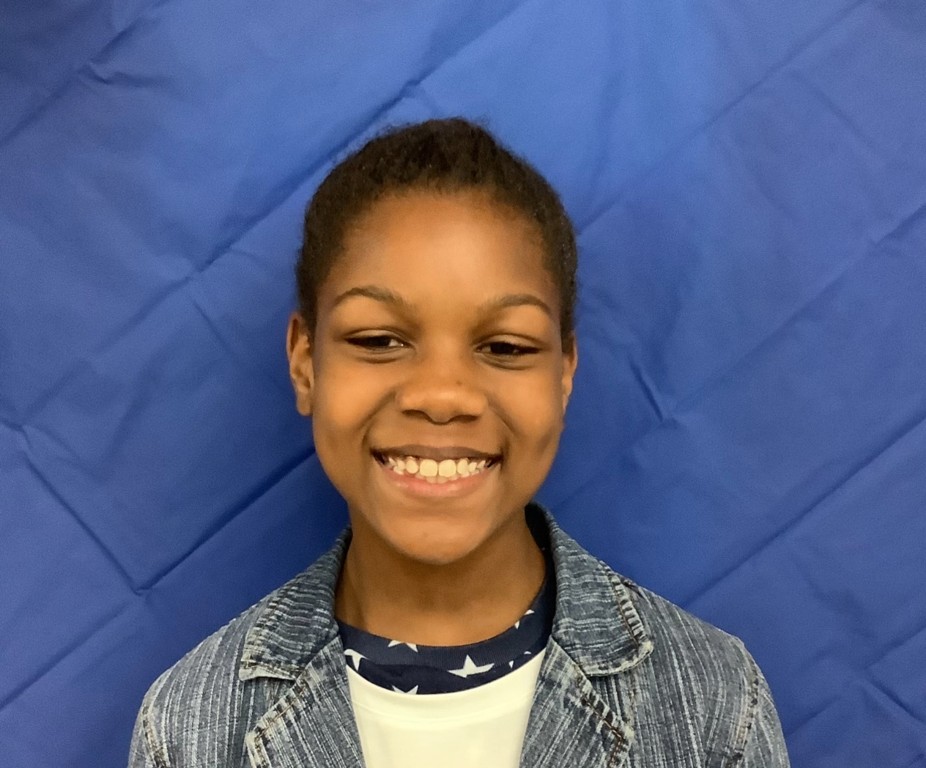
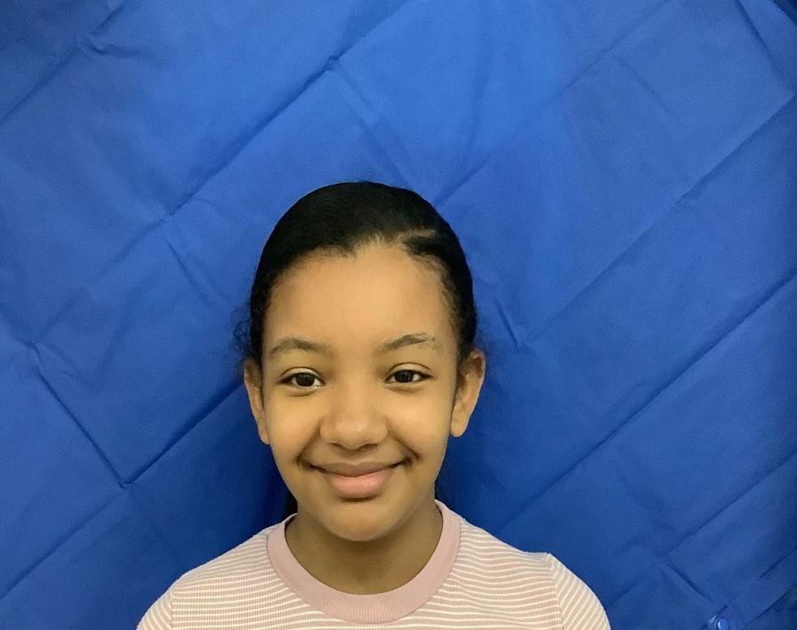
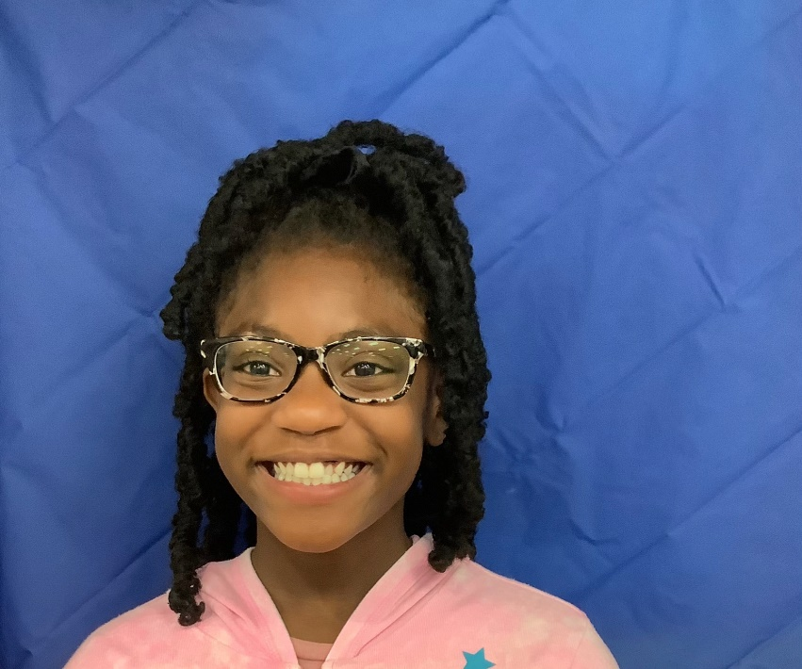


DCE Student Council President
Deramia Moss
106 Votes
Anissa Bido
87 Votes
Khloe Terrell
85 Votes

Slide 3
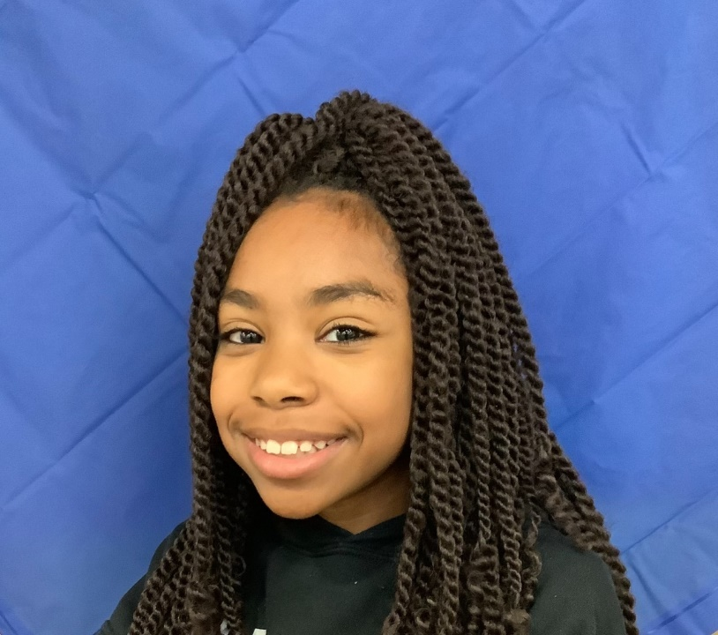
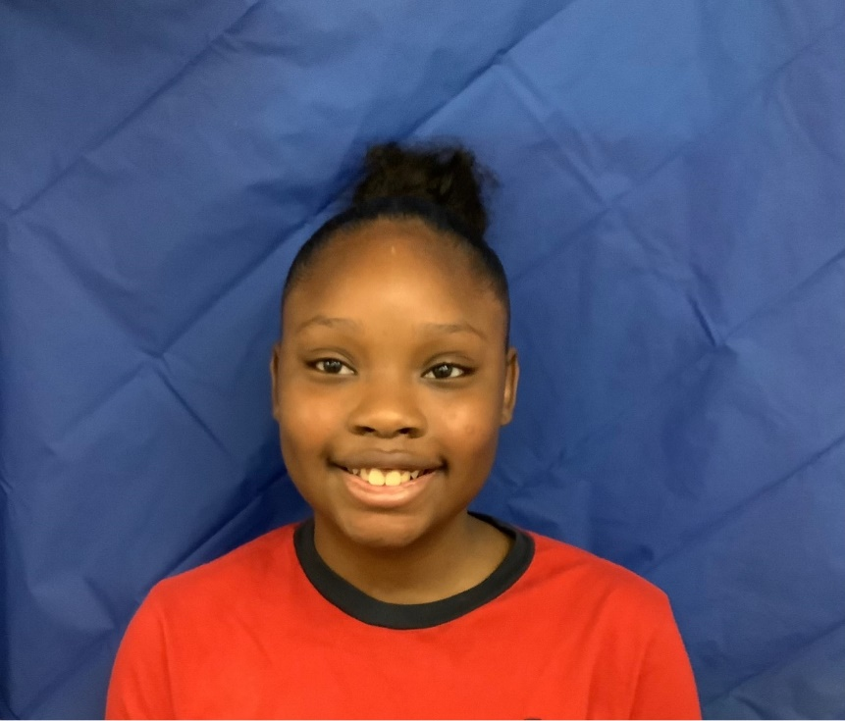
DCE Student Council Vice President
Malia Bowen
149 Votes
Kemoni Alexander
129 Votes

Slide 4
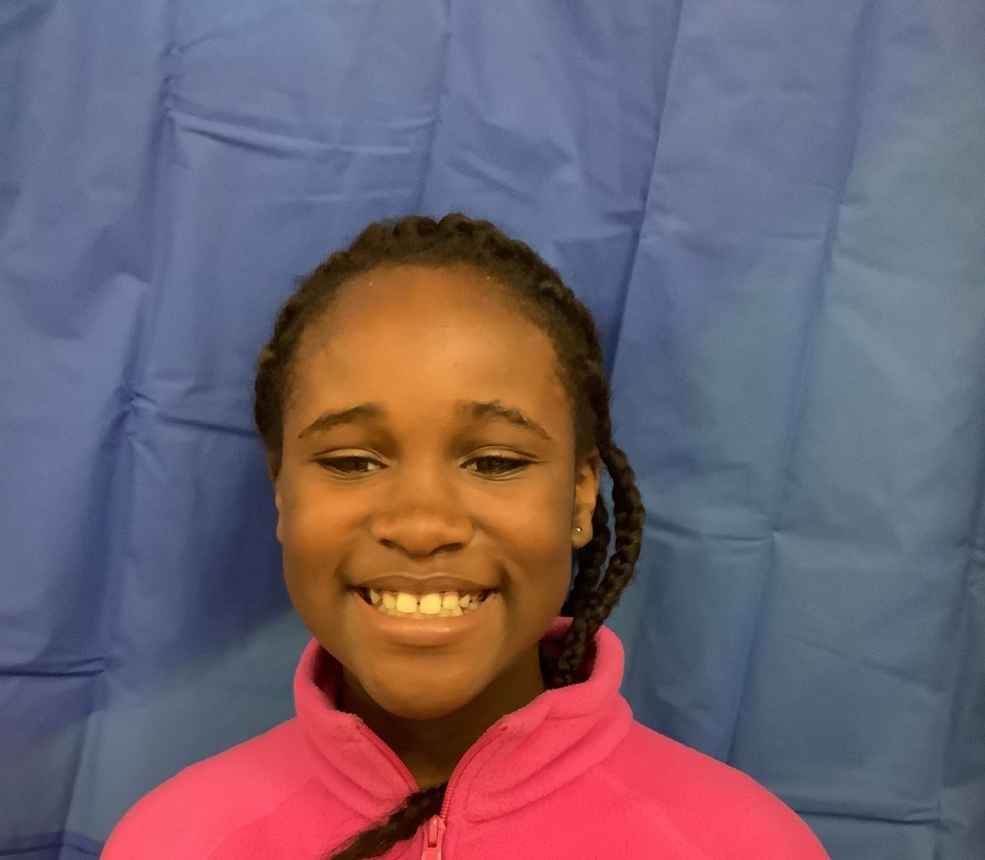
DCE Student Council Votes Secretary
Fayln Dimpson
243 Votes

Slide 5
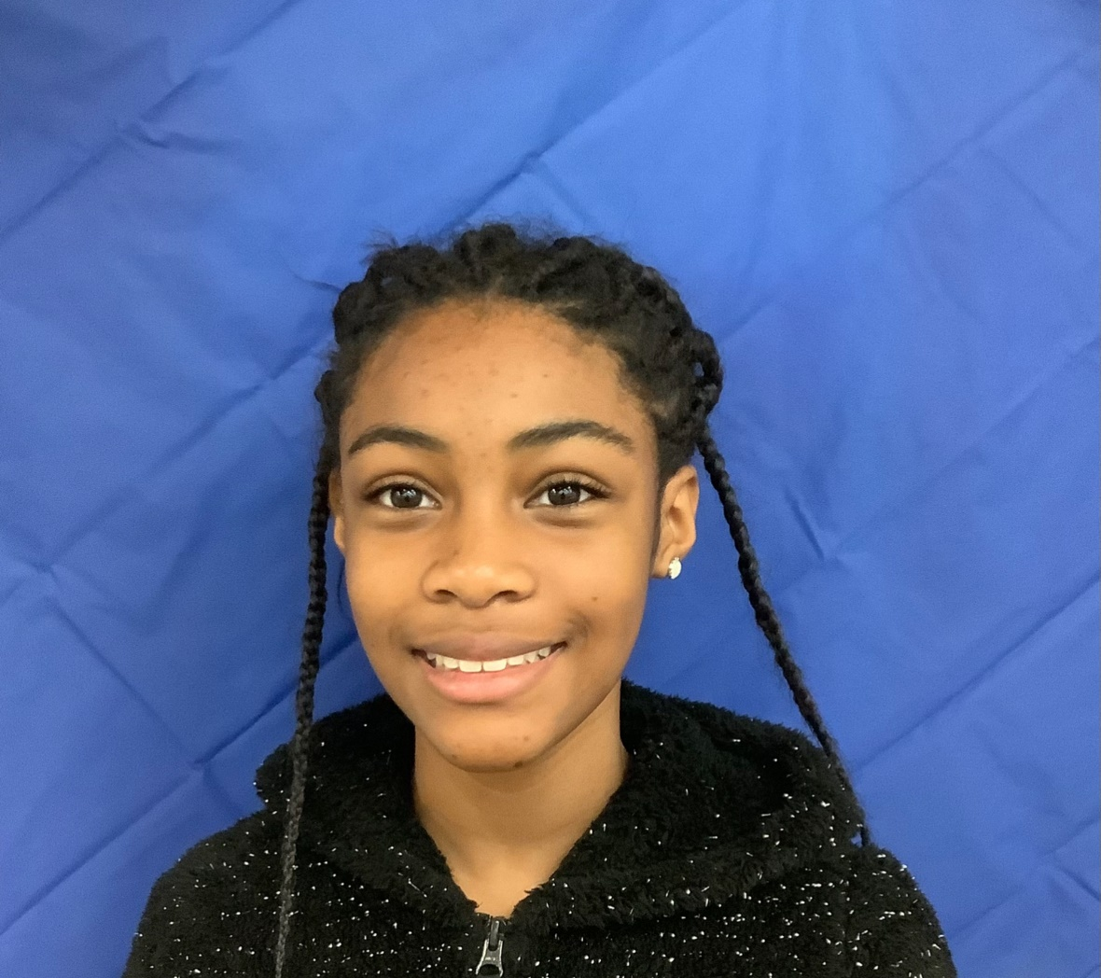
DCE Student Council Treasurer
Naiyana Turner
251 Votes

Slide 6
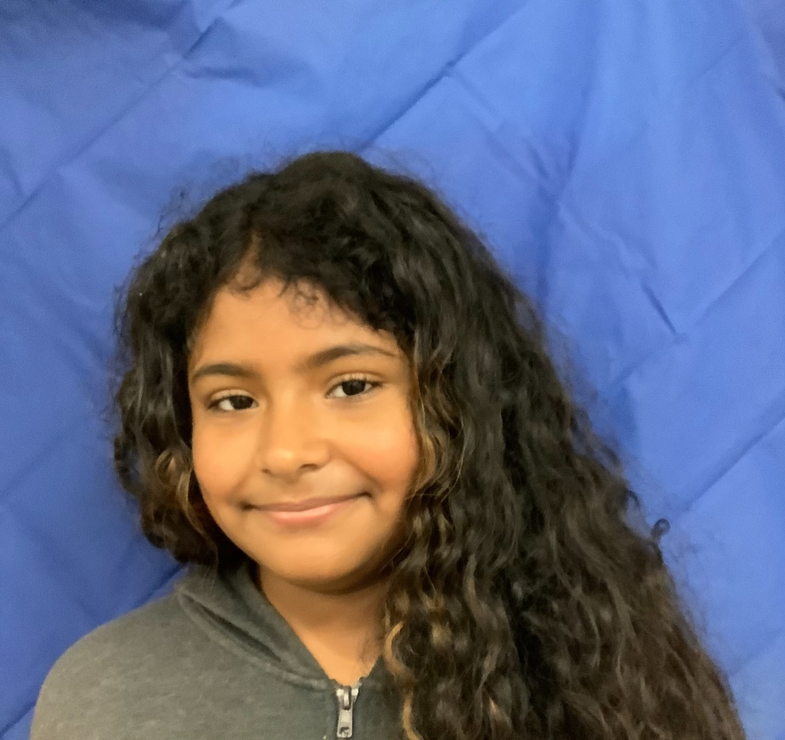
DCE Student Council Historian
Milianys Mendez Montano
233 Votes

Slide 7
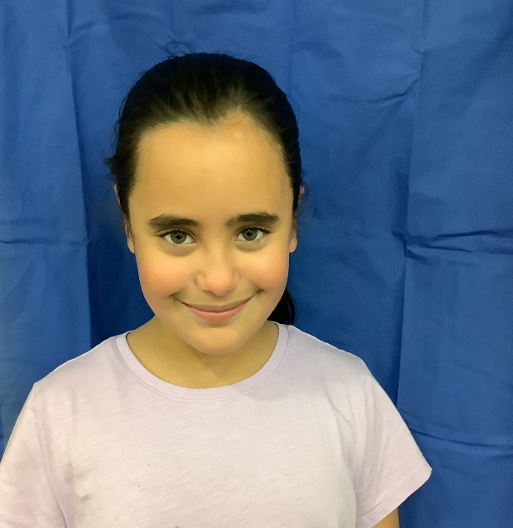
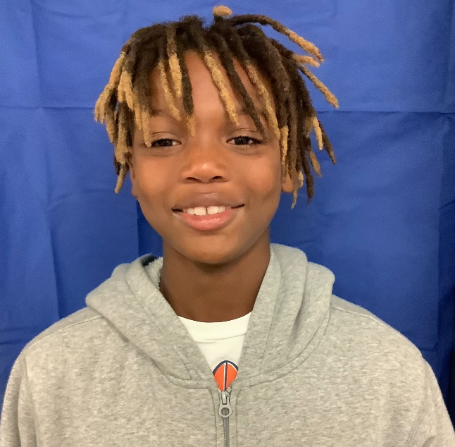
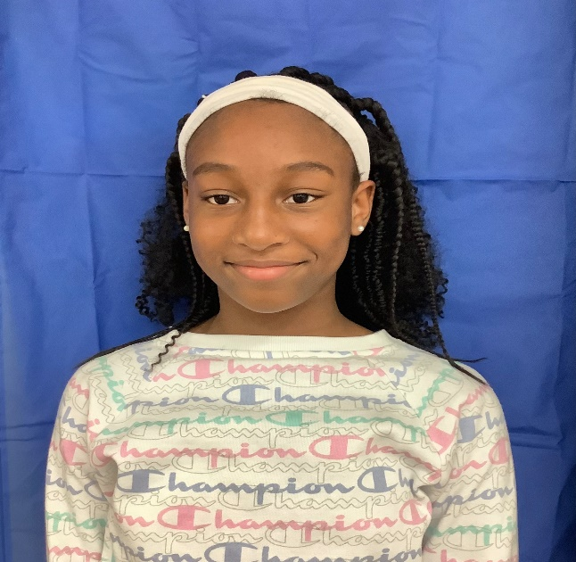
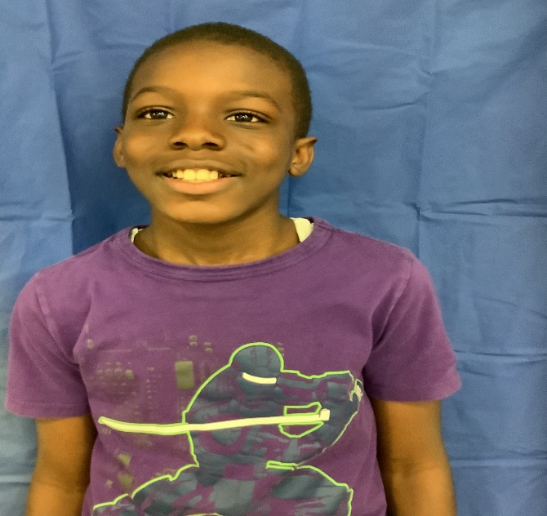
DCE Student Council 4th Grade Representatives
Tia Bolin
Zion Deas
Jaida Salmond
Josiah Hodge

