Slide 1
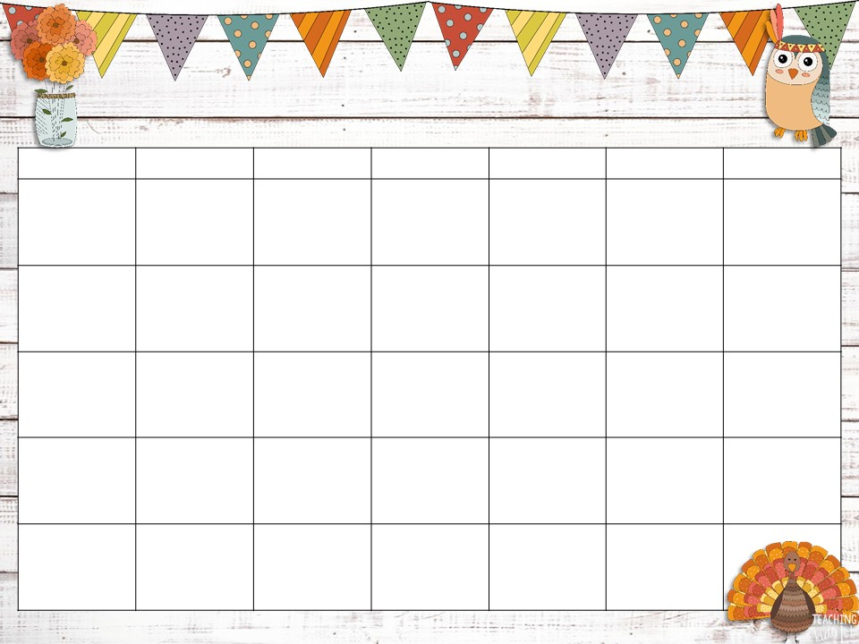



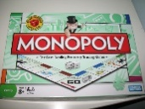


November 2021
Sunday | Monday | Tuesday | Wednesday | Thursday | Friday | Saturday
 | 1 Have your child practice counting by 5’s. | 2 Make up trivia questions about your family. Quiz one another at the dinner table. | 3 Hug your child for no reason other than loving him or her! | 4 Talk about what is happening to the leaves on the trees as they begin to change colors. | 5 Learn a new word each day. Challenge family members to use it three times during the day | 6 Go on a short walk with your child today.
7 Set aside time every day for reading aloud. Sometimes, let your child read to you. | 8 Make a special effort to reinforce manners today. Remind your child to say please and thank you. | 9 Young Readers Day. Reading opens up a lifetime of knowledge, information, success, and happiness. | 10 | 11 Holiday | 12 Holiday | 13 Play board game as a family this evening.
14 Make a habit of using Sunday nights as a time to talk with your child about the week ahead. | 15 Practice naming the months of the year with your child. | 16 National Fast Food Day. These type of American restaurants begin in the early 1950’s. Eat or drink from a Fast Food today | 17 World Peace Day encourages us to be kind to others, and teach others to be peaceful. | 18 Great American Smokeout Day! Let’s finally kick the habit. | 19 Play Monopoly Day. | 20 Make a list before you go to the grocery store. Then have your child help you read the list.
21 | 22 | 23 | 24 | 25 | 26 | 27
28 Make sure you and your child know school rules. Ask for a list of rules and post them on your refrigerator. | 29 Have a 20-minute DEAR time (Drop Everything and Read) | 30 Encourage your child to clean out his or her backpack everyday weekend.
Happy Thanksgiving
This Photo by Unknown Author is licensed under CC BY-NC

