Slide 1
Describing Motions
Kinematics: A branch of physics that study of motion
Position (x) – where you are located
Distance (d ) – how far you have traveled, regardless of direction; it has a scalar quantity description.
Displacement (Δx) – where you are in relation to where you started; it has direction with its scalar quantity.

Slide 2
Two Types of Quantities in Physics
1.Scalar quantities:
2.Vector quantities
Remember: a quantity in the first place is an amount or number of something

Slide 3
SCALAR
A SCALAR quantity
is any quantity in
physics that has
MAGNITUDE ONLY
Scalar Example | Magnitude
Speed | 35 m/s
Distance | 25 meters
Age | 16 years
Number value
with units

Slide 4
Scalar Quantities:
Have a size with a unit called a Magnitude but NO DIRECTION.
Examples: a distance of: (10m)
a time of : (6 s)
a speed of : (12.3 km/h)

Slide 5
Vector Quantities
A vector quantity is any quantity in physics that HAS BOTH MAGNITUDE AND DIRECTION
Vector Example | Magnitude and Direction
Velocity | 35 m/s, North
Acceleration | 10 m/s², South
Force | 20 N, East
AN ARROW above the symbol illustrates a vector quantity. It indicates MAGNITUDE and DIRECTION

Slide 6
Some Physics Quantities
Vector - quantity with both magnitude (size) and direction
Scalar - quantity with magnitude only
Vectors:
Displacement
Velocity
Acceleration
Momentum
Force
Scalars:
Distance
Speed
Time
Mass
Energy

Slide 7
Units
Units are not the same as quantities!
Quantity . . . Unit (symbol)
Distance . . . meter (m)
Displacement…… meter (m)
Time . . . second (s)
Speed . . . (m/s)
Velocity (m/s) with direction
Acceleration . . . (m/s²)
Mass . . . kilogram (kg)
Momentum . . . (kg · m/s)
Force . . .Newton (N)
Energy . . . Joule (J)

Slide 8
Distance. Vs. Displacement.
Distance
  Actual path that an object takes
  Cannot be negative
Displacement
  Straight line from start to finish
  Can be negative or zero
Explain how an object can have a zero or negative displacement.

Slide 9
Distance vs. Displacement
You drive the path, and your odometer goes up by
8 miles (That’s your distance).
Your displacement is the shorter directed distance from start to stop (green arrow).
What if you drove in a circle?
start
stop

Slide 10
Displacement Works Vectors
Vectors are often used to show Displacement
The length of the arrow represents the magnitude (how far, how fast, how strong, etc , depending on the type of vector).
The arrow points in the directions of the displacement, , the motion, forces, etc.
It is often specified by an angle.
You can add Vectors or subtract vectors.
5 m/s
42°

Slide 11
VECTOR APPLICATION
SUBTRACTION: When two (2) vectors point in the OPPOSITE
direction, simply subtract them.
EXAMPLE: A man walks 46.5 m east, then another 20 m west.
Calculate his displacement relative to where he started.
46.5 m, E
-
20 m, W
26.5 m, E

Slide 12
Distance and Displacement
Displacement is also the x or y coordinate of position. Consider a car that travels 4 m, E then 6 m, W.
Net displacement:
D = 4m E- 6 W,
D
4 m,E
D = 2 m, W
What is the distance traveled? 4m +6m =
x = -2
x = +4
6 m,W
10 m !!

Slide 13
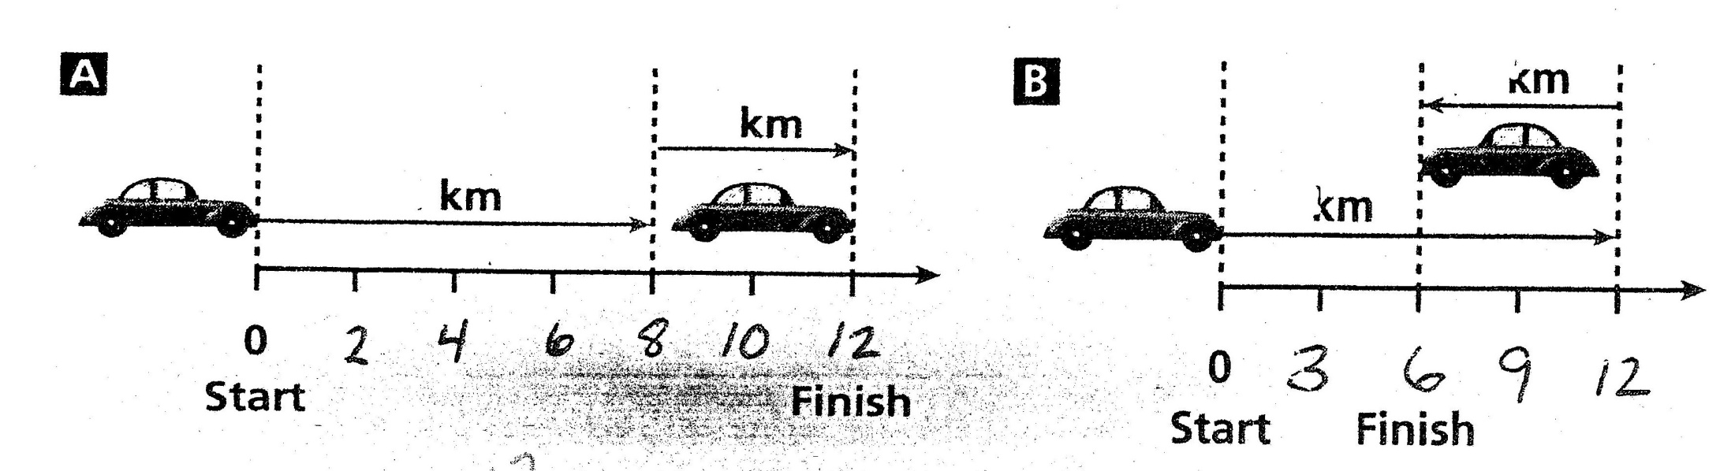
Determine the displacement for A and B below.

Slide 14
Determine the displacement for A and B below.
12 km 6 km

Slide 15
Example
A bear, searching for food wanders 35 meters east then 20 meters north. Frustrated, he wanders another 12 meters west then 6 meters south. Calculate the bear's displacement.
23 m, E
-
=
12 m, W
-
=
14 m, N
6 m, S
20 m, N
35 m, E
R
14 m, N
θ
23 m, E
The Final Answer: 26.93 m, 31.3 degrees NORTH or EAST

Slide 16
Vectors At a Right Angle
When two (2) vectors are PERPENDICULAR to each other,
you must use the PYTHAGOREAN THEOREM
FINISH
Example: A man travels 120 km east
then 160 km north. Calculate his
resultant displacement.
the hypotenuse is
called the RESULTANT
160 km, N
VERTICAL
COMPONENT
Start
120 km, E
HORIZONTAL COMPONENT

Slide 17
WHAT ABOUT DIRECTION?
In the example on the previous slide, is DISPLACEMENT asked for .
Since it is a VECTOR quantity, we need to report its direction.
N
W of N
E of N
N of E
N of W
N of E
W
E
S of W
S of E
NOTE: When drawing a right triangle that conveys some type of motion, you MUST draw your components HEAD TO TOE.
W of S
E of S
S

Slide 18
An ANGLE Is Needed To Be Exact !
Just putting N of E is not good enough (how far north of east ?). We need to find a numeric value for the direction.
To find the value of the angle we use the Trig function called TANGENT.
200 km
160 km, N
θ
N of E
120 km, E
So the COMPLETE final answer is : 200 km, 53.1 degrees North of East

Slide 19
What are your missing components?
Suppose a person walked 65 m, 25 degrees East of North. What were his horizontal and vertical components?
The goal: ALWAYS MAKE A RIGHT TRIANGLE!
To solve for components, we often use the trig functions since and cosine.
H.C. = ?
V.C = ?
25
65 m

Slide 20
Example
A plane moves with a velocity of 63.5 m/s at 32 degrees South of East. Calculate the plane's horizontal and vertical velocity components.
H.C. =?
32
V.C. = ?
63.5 m/s

Slide 21
Example
A storm system moves 5000 km due east, then shifts course at 40 degrees North of East for 1500 km. Calculate the storm's resultant displacement.
1500 km
V.C.
40
5000 km, E
H.C.
5000 km + 1149.1 km = 6149.1 km
R
964.2 km
θ
The Final Answer: 6224.2 km @ 8.92 degrees, North of East
6149.1 km

