Slide 1

Literacy Strategies and Lexiles
to support student learning

Slide 2

Learning Targets
Participants will
locate their school’s Lexile Achievement Score.
analyze the correlation between the school’s Lexile Achievement Score and the CCRPI thresholds.
locate students and text Lexile measures.
match content specific texts to students based on Lexile level.

Slide 3

College and Career Ready Performance Index

Slide 4
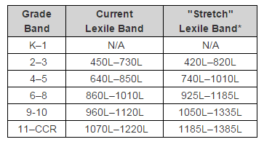

Slide 5
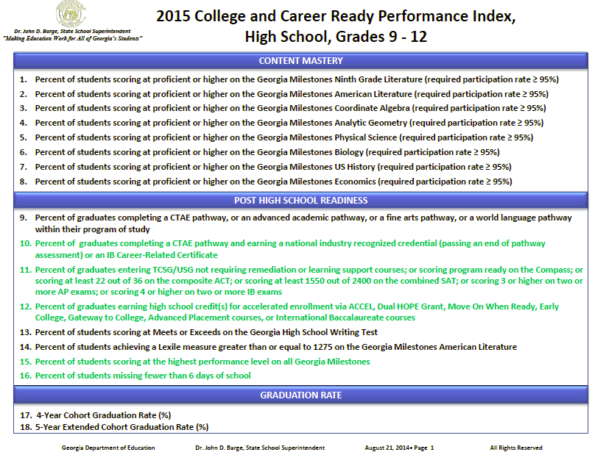

Slide 6
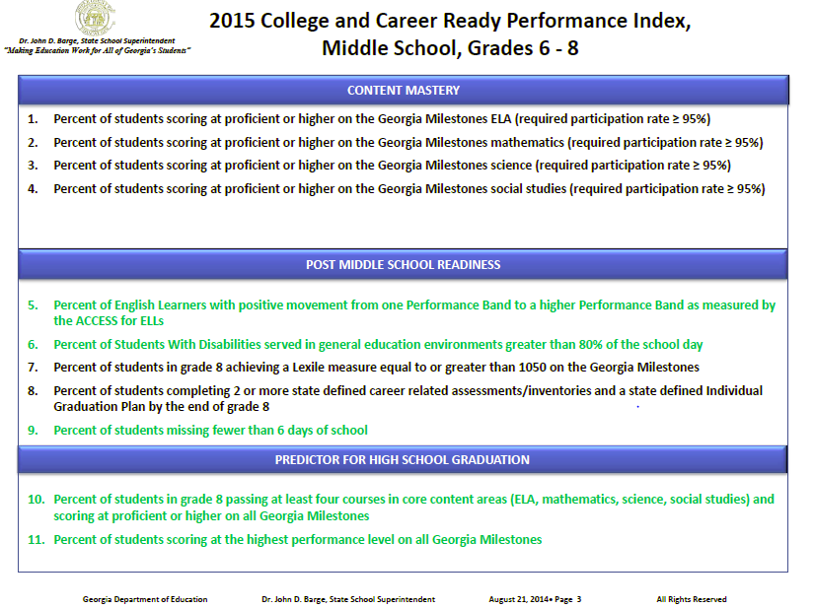

Slide 7
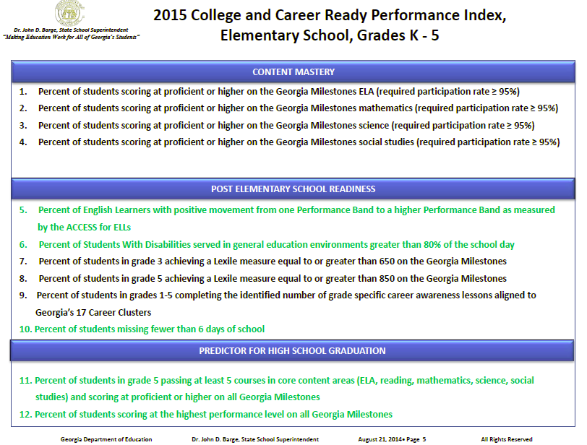

Slide 8
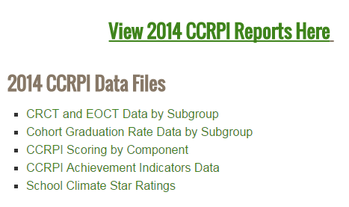
Lexile Data in CCRPI
http://www.gadoe.org/CCRPI/Pages/default.aspx

Slide 9
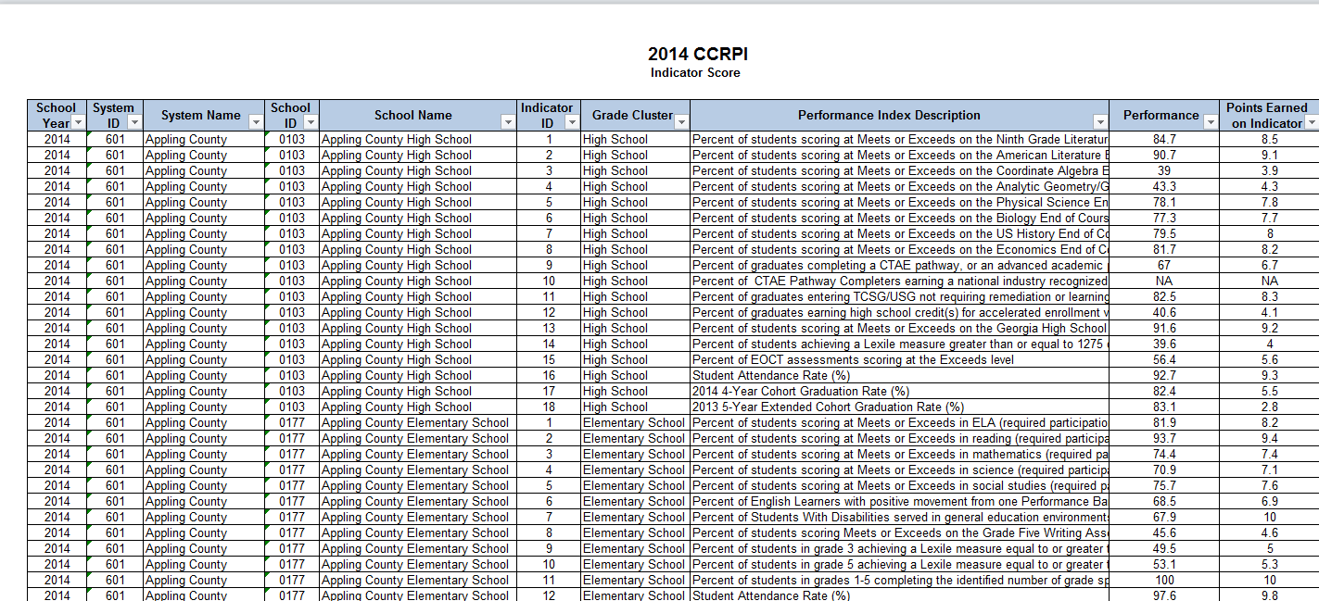

Slide 10
Activity
Padlet- http://padlet.com/livintr/Lexile
CCRPI website
  School Name
  Lexile Achievement Score
    % of students meeting or exceeding the threshold
      3rd grade—650L
      5th grade—850L
      8th grade—1050L
      American Lit (11th grade)—1275L
  Achievement Points Earned

Slide 11
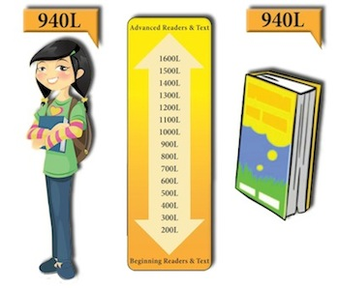
What is the Lexile Framework?
The Lexile Framework is scientific way to match readers with text using the same scale. (www.lexile.com)

Slide 12

The Lexile Framework Scale ranges from below 200L to 1700L.
In addition to this there are other codes for non-conforming texts. The Lexile codes are:
  AD: Adult Directed
  NC: Non-Conforming
  HL: High-Low
  IG: Illustrated Guide
  GN: Graphic Novel
  BR: Beginning Reader
  NP: Non-Prose
The Lexile Framework Map provides sample titles for each Lexile range as well as equivalent grade levels.

Slide 13
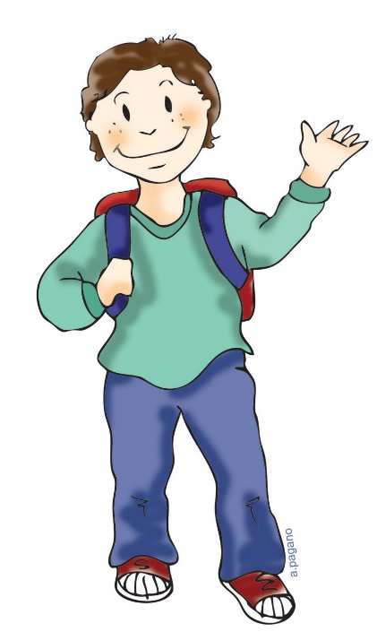


What is a Lexile Measure?
There are two Lexile measures:
Lexile reader measure and the Lexile text measure.
A Lexile reader measure represents a person’s reading ability on the Lexile scale.
A Lexile text measure represents a text’s difficulty level on the Lexile scale.

Slide 14
Student (Reader) Lexile
Georgia Milestones
iReady
Data Director- activity
SLDS

Slide 15
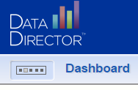
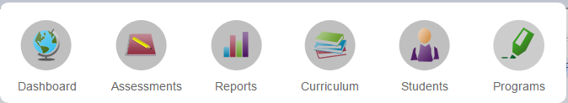
Lexile levels for students using Data Director
Log into www.datadirector.com/richmond

Slide 16
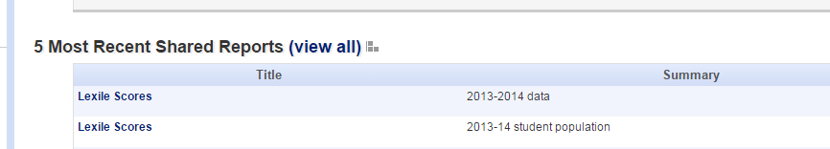

Lexile Reports
Your students will come up in a report with Lexile Data
Click on

Slide 17

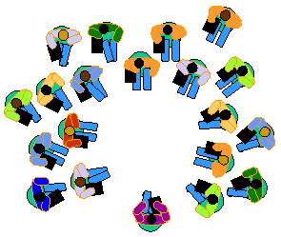
Lexile Data- Activity
Sort the Excel spreadsheet from largest to smallest and your have your groups for differentiation
Sort the spreadsheet from
highest to lowest
Divide the groups into three
equal groups
Highest
Middle
Lowest
Record the Lexile score
of one student
Notes:
Export the Excel spreadsheet and have the participants sort the scores from highest to lowest. Then have the participants divide the groups equally into thirds, the top third will be the top group, the middle third will be the middle group, and the bottom third will be the bottom group.

Slide 18

Text Lexile

Slide 19
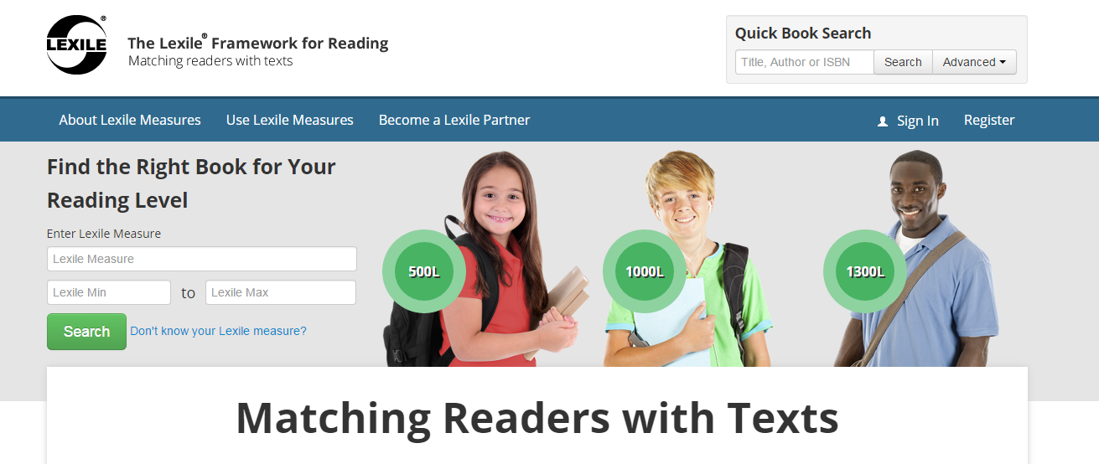
Place a student’s Lexile level in the box
www.lexile.com

Slide 20
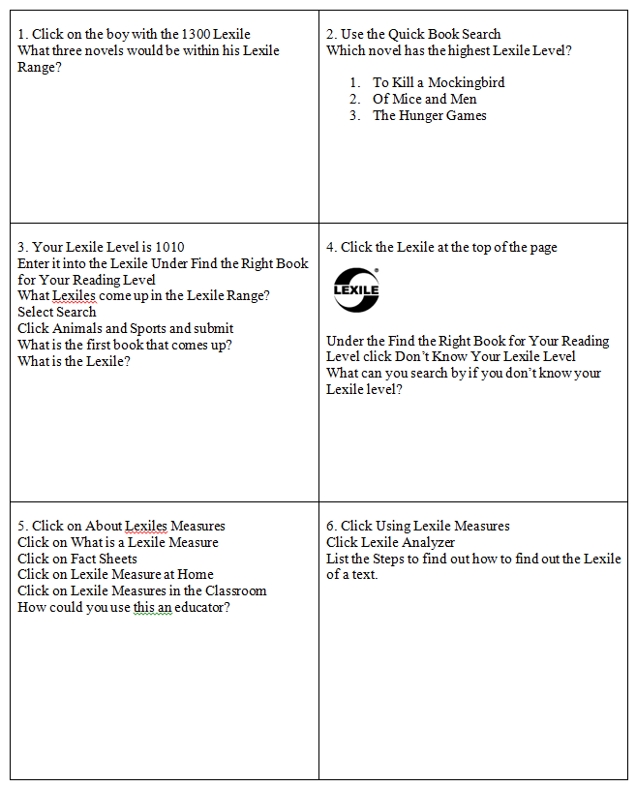
Lexile Scavenger Hunt
Notes:
Answer Key: 1. Chronicle of a Death Foretold 1270L, The Hunchback of Notre Dame 1340L, Walden 1340L 2. The Hunger Games 3. 910 to 1060 The Turtle Watch, 4. By your grade 5. Any answer that makes sense 6. Step 1: What kinds of texts can be measured, Step 2: Prepare your text for measurement, Step 3: Type or scan your text, Step 4: Convert your text into a plain text file, Step 5: Analyze your text and get results

Slide 21
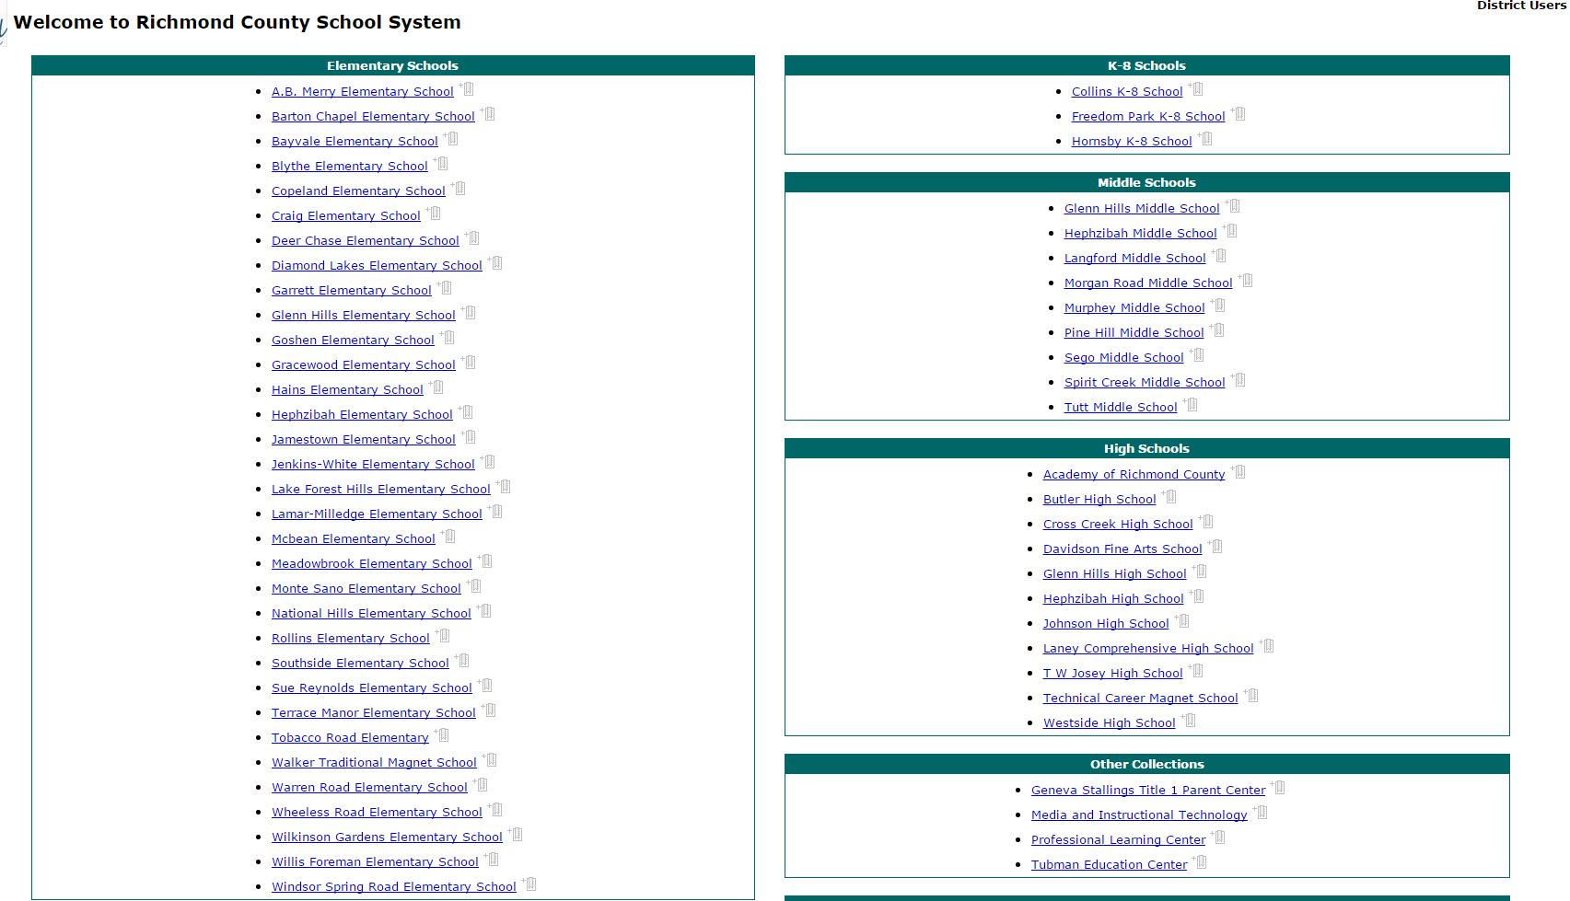
Lexile materials In destiny
Destiny.richmond.k12.ga.us
Notes:
Print slides 24 – 34 to give to participants when they are looking for books or articles on the student’s Lexile level. You can print the slides 3 to a page.

Slide 22
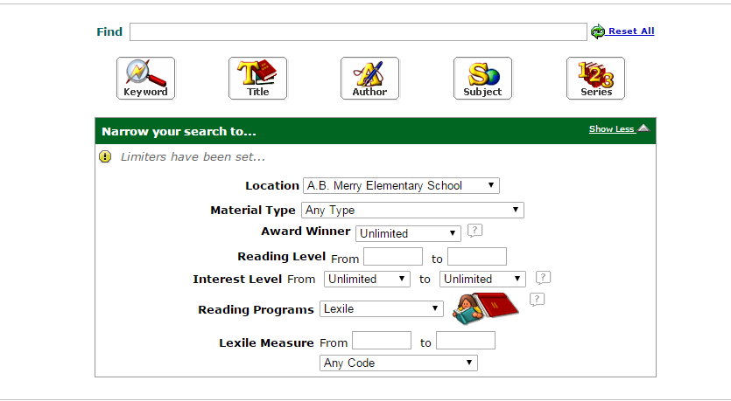
Finding resources in your media center

Slide 23
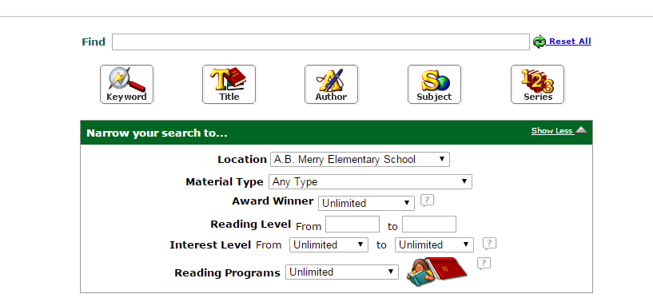
Find a book by subject, key word aligned to Lexile

Slide 24
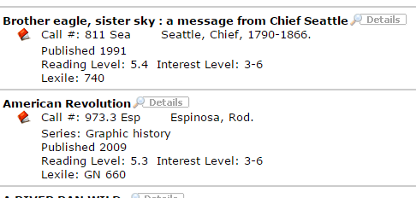
Resources for students by Lexile and keyword

Slide 25

Newsela
www.newsela.com
Select a subject at the top or search by subject!!!

Slide 26


Slide 27


Slide 28
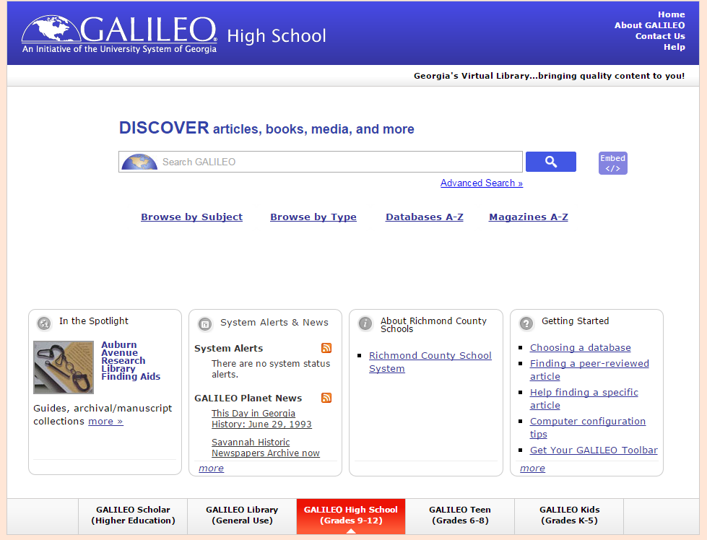
Galileo
http://www.galileo.usg
Galileo is accessible for free within the RCSS network. To access it from home you will need the password (see your Media Specialist).

Slide 29
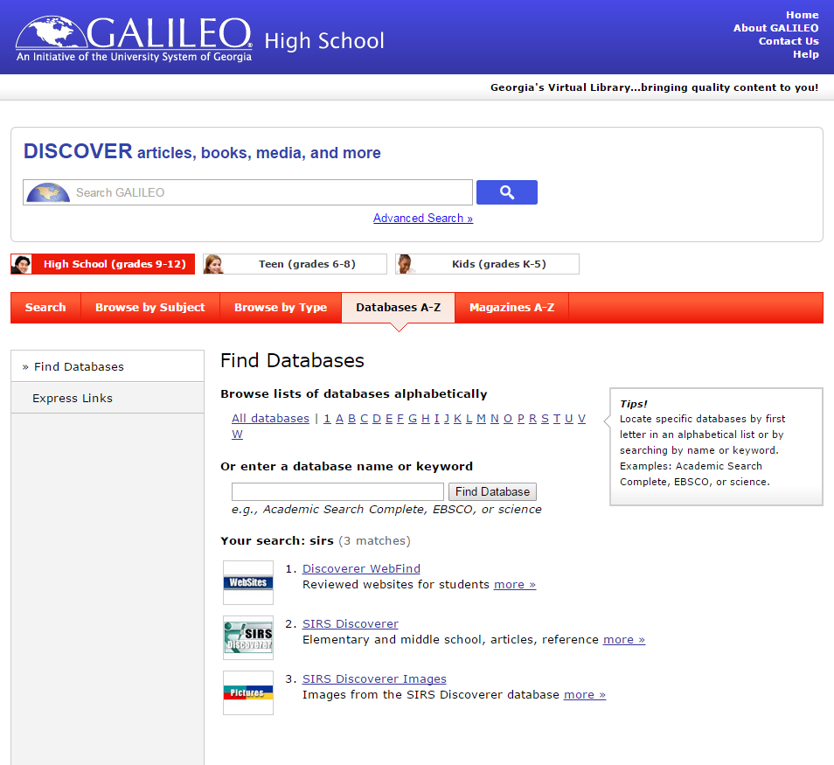

Slide 30
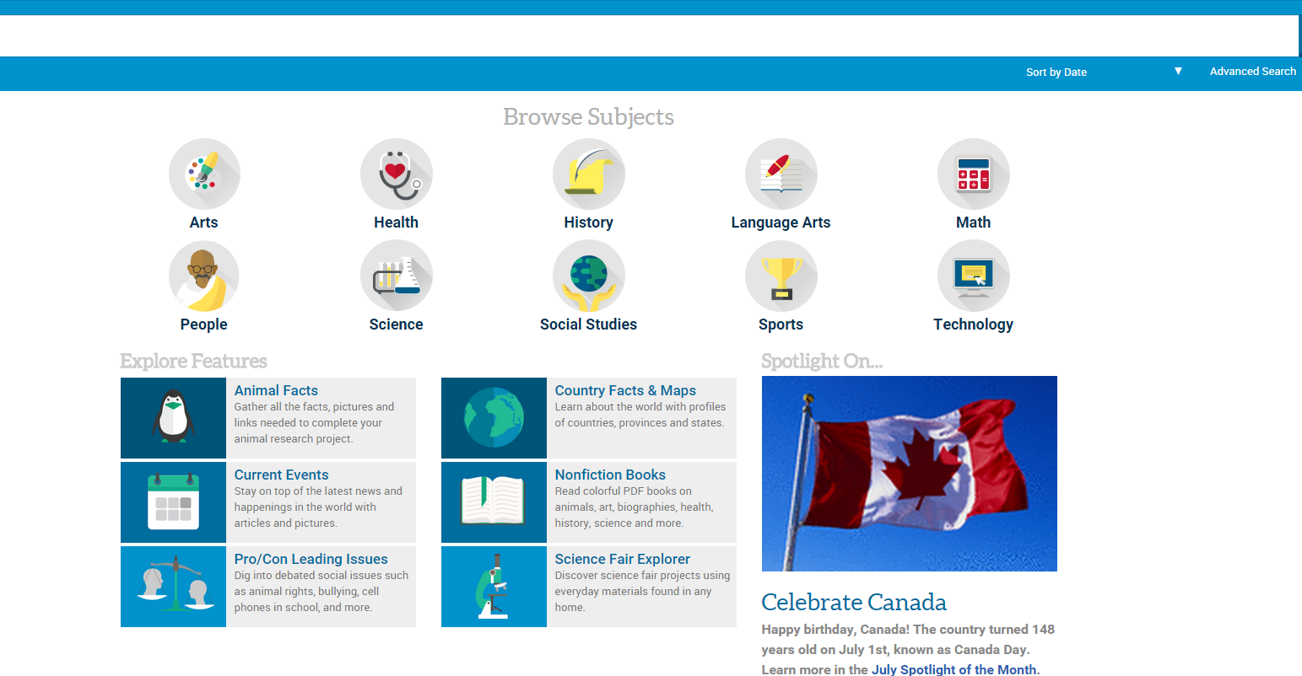
SIRS- Galileo Database

Slide 31
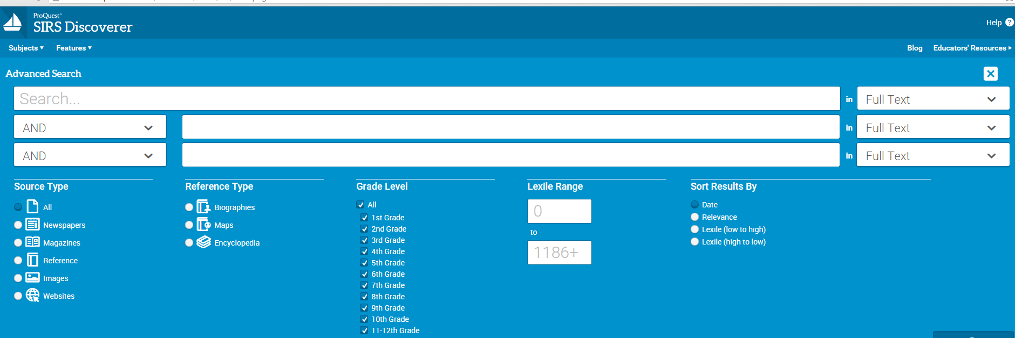

Slide 32



Find the Text for Your Students
Lexile-to-Grade
Click Here

Slide 33



Activity
Use Destiny, NEWSELA, or SIRS and find an article or book that matches the Lexile level of the student you selected from your data earlier in the session.

Slide 34
Learning Targets
Participants have:
locate their school’s Lexile Achievement Score.
analyze the correlation between the school’s Lexile Achievement Score and the CCRPI thresholds.
locate students and text Lexile measures.
match content specific texts to students based on Lexile level.

Slide 35

Feedback
https://www.surveymonkey.com/r/9VNCK7K

