Slide 1

PowerUp Parent Orientation

Slide 2
RCSS Vision and Mission Statements
Vision Statement
The Richmond County School system will provide an equitable education for all students to prepare them for life beyond the classroom.
Mission Statement
Building a globally competitive school system that educates the whole child through teaching, learning, collaboration, and innovation.

Slide 3

PowerUp is the name of our 1:1 campaign – it means that every student will have a device (computer). We want to make sure that we answer your questions and to let you know how to find support.

Slide 4

PowerUp Canvas Course
Administrators and Teachers have taken a course in Canvas called Power Up to help get ready for 1:1.
We are asking our teachers to teach students about Digital Citizenship. Digital Citizenship includes instruction on safety and appropriate behavior when using technology.
We are including some Digital Citizenship information in a course for parents so that you can help your children.

Slide 5

Digital Citizenship
Most of the information on Digital Citizenship comes from a site called Common Sense Media. This includes lessons on protecting your identity, creating strong passwords, how to be a responsible user of technology.

Slide 6

You will need to read the PowerUp Handbook with your student.
After reading the handbook, you will need to fill out the permission form.
The device (computer) will then be issued to the student. Devices will be distributed on Tues., Nov. 30, 2021, between 9:00 a.m. – 2:00 p.m.

Slide 7
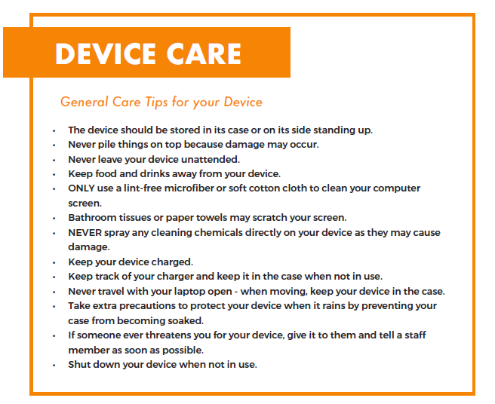

Slide 8
Computer Use at Home
All school rules apply for the home use of your device.
Keep your device and charging cord away from pets, extreme heat or cold, food, drinks and small children.
Designate a safe location (off of the floor) where your device can be stored and charged each evening.

Slide 9
PowerUp Handbook
Each student will receive a printed copy of the PowerUP 1:1 Student Handbook along with a one page instruction sheet on how to log on and use the device for the first time. This handbook provides information about device care, using the device responsibly, and internet safety.
Page 11 of the handbook is the RCSS Student Technology Loan Agreement. This agreement must be signed by the parent/guardian of any 3rd, 4th or 5th Grade student who receives a device (Chromebook) for at-home use.
3rd – 5th Grade students WITHOUT a signed Loan Agreement will NOT be allowed to take a device home. They will be Day Users ONLY.
This form will not be used for students in PreK – 2nd Grade as they will NOT be allowed to take their devices home.

Slide 10
Computer Information
Blythe Elementary School students will receive Chromebooks. With the Chromebook, the student will receive a laptop bag (carrying case) and a charger for the device.
Students in Grades 3 -5 have the options of being Day Users Only or being able to take the devices home each day. Take Home Users must bring their device to school every day fully charged.
Optional annual insurance will be available to help protect families against theft, loss or damage beyond repair.
Insurance cost for a Chromebook is $8.82 per year.
If insurance is not purchased, the replacement cost for the computer will be charged if it is lost or damaged beyond repair.

Slide 11
Blythe Elementary’s Device Distribution Plan
Device Distribution for Blythe Elementary is scheduled for Tuesday, November 30, 2021, from 9:00 a.m. – 2:00 p.m. in the Media Center.
This is the date and time for parents/guardians to come to the school to sign the RCSS Student Technology Loan Agreement for their 3rd, 4th or 5th Grade student to receive a Chromebook that can be taken back and forth between school and home for at home use. Students without a signed Loan Agreement will be Day Users ONLY and will not be allowed to take their devices home.
If you are unable to come to school during this time but wish for your 3rd, 4th or 5th Grade child to receive a device that can be taken home, please complete all parts of the Loan Agreement EXCEPT the Device Information portion. Return the completed form to your child’s homeroom teacher.

Slide 12
If you have any questions or concerns, please contact your child’s homeroom teacher, the Media Specialist, or a school administrator.

