Slide 1
Go for Fruits & Vegetables and Move More!
Improving Learning through Healthy Eating and Physical Activity
September
Notes:
Hello, my name is Mrs. Krista Meadows, I’m the new PE Teacher and I’m glad you are able to join us today. During our time together I will be asking you a few questions. You have the choice not to answer any of them. Your participation is voluntary. All responses are kept confidential and your individual answers and personal information will not be shared with anyone. Thank you for your time!
Welcome to HealthMPowers presentation on go for fruits & vegetables and moving more! How many of you have heard of “Go” foods? “Go” foods are the foods that are good for your body, and give you the energy to move more!
Today, we are going to talk about how foods can fit into three different groups: Go, Slow, and Whoa!
We are hoping that at the end of this presentation, you will be encouraged to:
Serve 2-3 vegetables daily to your child.
Help your child be physically active for at least 1 hour each day.
This school is working with HealthMPowers to improve the nutrition and physical activity behaviors of students and families. HealthMPowers is a non-profit organization.
The Centers for Disease Control and Prevention in Atlanta has identified evidence that helps all to understand that education and health for students must go hand-in-hand for students to succeed. This presentation is based upon those documents.

Slide 2


Ensure Your Children Eat Healthy Diets
Half of their plate for each meal is fruits and vegetables
Serve different colors of fruits & vegetables
Serve fruit instead of sugary drinks
when you can
Serve water or low fat milk
… instead of sugary drinks
Notes:
Families can help their children eat nutritiously by:
Ensuring that half their child’s plate each meal are fruits or vegetables
Making those fruits and vegetables a variety of different colors so that you know that your child is receiving a variety of needed nutrients
Serving whole fruit and limiting all fruit drinks and fruit punch, as they have a lot of sugar and nutritional value
Serve water or low fat milk instead of sugary drinks. Limit serving fruit punch, sweetened tea or sodas – any sugary drinks
You can learn more about choosing healthy foods and physical activity by reading your child’s student agenda, Get Ready! Get Set! G0! for grades 1-2 or Choosing Healthy Habits for 3-5.

Slide 3



Eat More Go Foods and Less Whoa Foods
Eat Often
These foods are lowest in fat, added sugar and calories.
Eat Less Often
These foods are higher in fat added sugar and/or calories and only should be eaten occasionally.
Eat Rarely
These foods are very high in sugar, fat and calories.
Notes:
Think of all food as being in a range from “Go Foods” to “Slow Foods” to “Whoa Foods”. Go Foods are those foods that one can eat anytime. These foods are lowest in fat, added sugar and calories. All food groups have go foods:
Two servings of fresh, frozen or canned (in juice) fruit are smart choices.
Colorful vegetables are smart choices and aim for three servings a day.
When choosing milk products, fat-free and low fat milk, yogurt are smart choices.
Grains particularly, whole grains are recommended for your child to receive critical nutrients.
Smart choices for protein include beans, nuts and lean meat, fish that is baked or broiled.
Slow foods are higher in fat added sugar and/or calories and only should be eaten sometimes. All food groups have “Slow Foods.” Dried fruit and fruit juice have more sugar. Vegetables with added butter, oils and sauces should be eaten less often. Milk products like 2% milk and cheese spreads are “Slow Foods.” In the grains category, “Slow Foods” would include: muffins, baked chips, popcorn. Peanut butter and eggs are “Slow Foods” in the meat and bean category.
Whoa Foods are those foods that we should eat only once in awhile. These foods are very high in sugar, fat and calories. These include cookies, cake, chips, soda, processed meats (like hot dogs, sausage), fried chicken/hamburgers, whole milk and ice cream.

Slide 4
Did you know a healthy diet can…
Improve memory
Increase grades & scores
Improve attendance
Notes:
Students’ success in school is more than just academics. Eating healthy food is important to your child’s success in school. For students to do their best in school, (and for their parents, caretakers and teacher to be healthy and avoid disease) they must eat a healthy diet. A healthy diet includes eating each day two fruits and three vegetables. Particularly important is ensuring that your child learns to like a variety of fruits and vegetables because different colors of fruit and vegetables contain different needed nutrients. Not only does a healthy diet make your child more healthy and less likely to get sick but look at the academic benefits: improved learning: improved memory, improved learning, increased grades, increased scores on state and national tests, and less absenteeism.
Decreasing absenteeism is really a very important factor in the education of your child. While missing one day here and there does not seem like much, it can definitely have an impact.

Slide 5

Encourage Physical Activity
Play games and sports with your child
Encourage your child to be more active
Notes:
Children need to be physically active for at least 60 minutes a day! So it is important to encourage physical activity at home. You can help your child to improve their health as well as academic achievement by becoming an active family. Prolonged sitting is bad for both students and adults!!!! Stand more often; take the stairs instead of an elevator or escalator; park far from the store and walk more.
Encourage your child to actively play after school with and without you joining in the activity.
Encourage your child to take a physical activity breaks every minutes when they are working to complete their homework.
Discourage your child from playing computer games, being on their phone or watching TV for a total of more than 2 hours each day.

Slide 6


For More Information
Grades 1-2
Grades 3-5
Notes:
For more information check out the September section of your child’s student planner and read the information on healthy eating and physically activity!
As a family, complete all of the activities for the month of September. For example, students in grades 1-2, complete the Family Challenge. Students in grades 3-5, complete the weekly Take Home Heathy Habits Challenge.

Slide 7
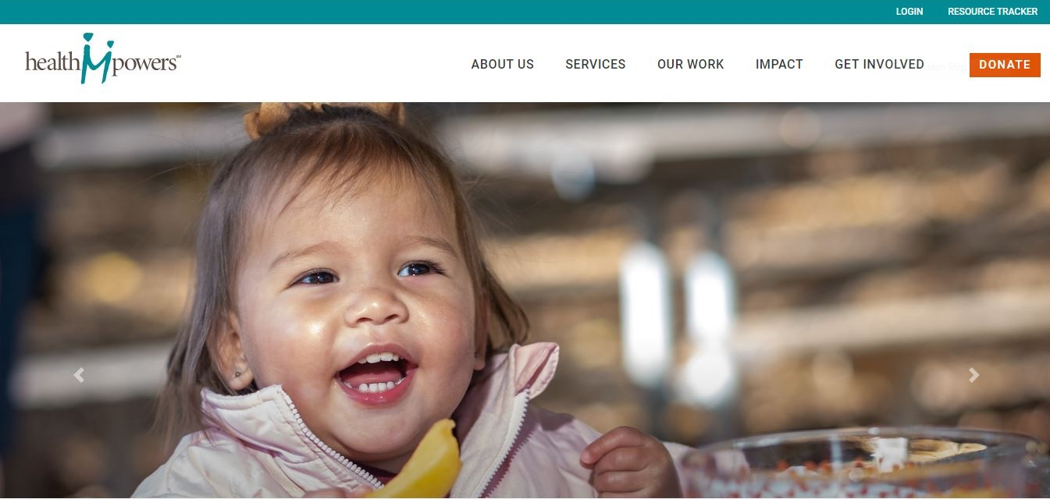
HealthMPowers.org
Notes:
HealthMPowers now has a section on their website that is filled with resources for parents and families. Go to their website at- HealthMPowers.org, then click on Services.

Slide 8
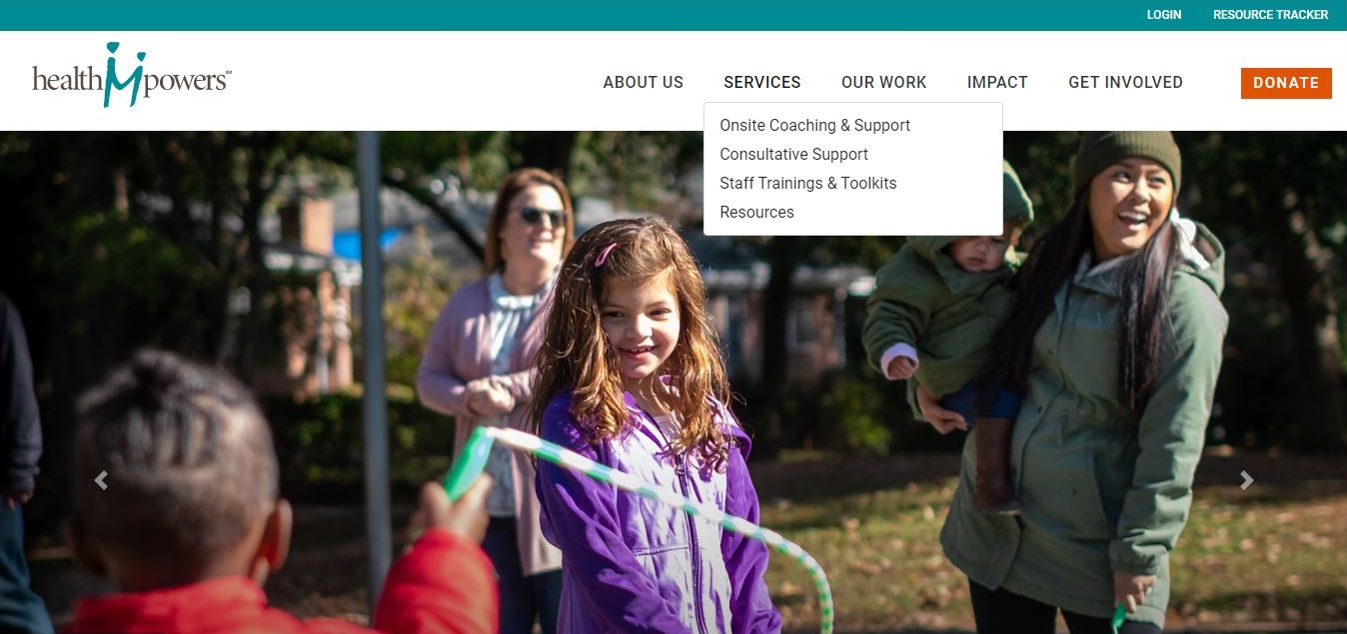
HealthMPowers.org
Notes:
Click on Resources in the drop-down.

Slide 9
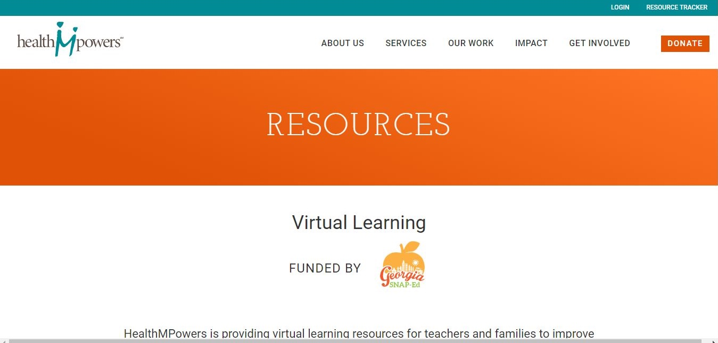
HealthMPowers.org
Notes:
There you will find resources including fun activities, videos, recipes that you can use with your family.

Slide 10

Follow Us
Notes:
Keep receiving information and tips by following HealthMPowers on Facebook, Twitter, and Instagram.

Slide 11
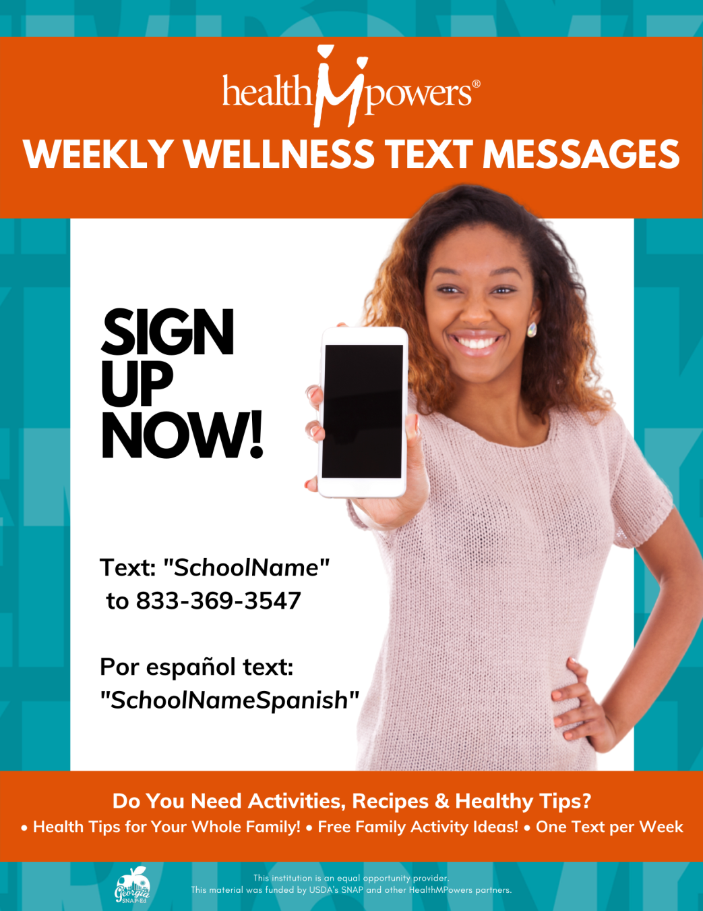
Notes:
Have you heard? HealthMPowers offers health-enhancing weekly text messages. To sign up, text your school’s name to 833-369-3547. You will receive weekly text messages on cooking tips, healthy eating or physical activity ideas that you can do with your family.

Slide 12
Notes:
Thank You for your continued support to improve the health and future of our children! Together you and your child’s school will work in partnership to ensure a healthy and bright academic future for all children!

Slide 13


This institution is an equal opportunity provider.
This material was funded by USDA's SNAP and other HealthMPowers partners.
Notes:
This institution is an equal opportunity provider. This material was funded by USDA's SNAP and other HealthMPowers partners.

Slide 14
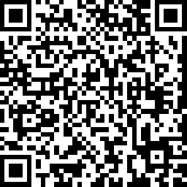
Notes:
NOTE: please have your audience complete the survey that corresponds with this presentation to collect the necessary demographic and behavior data, then submit completed surveys to HealthMPowers. Your audience can complete the survey by completing the survey in the following link:
https://www.surveymonkey.com/r/V669F77
Or by scanning the QR code in the slide. To open the survey with the QR code, instruct your audience to open their smart phone’s camera and hover it the over the QR code. The smart phone’s camera will scan the code and a prompt will appear to open link to the survey.

Slide 15
References
Centers for Disease Control and Prevention. (2014) Healthy Kids. Successful Students. Stronger Communities: Improving Academic Achievement through Healthy Eating and Physical Activity. Retrieved 5/25/16 from http://www.cdc.gov/healthyyouth/health_and_academics/pdf/health-academics-ppt.pdf.
Centers for Disease Control and Prevention. (2014) Health & Academic Achievement. Atlanta, GA: Centers for Disease Control and Prevention. Retrieved from http://www.cdc.gov/healthyyouth/health_and_academics/pdf/health-academic-achievement.pdf

