Slide 1
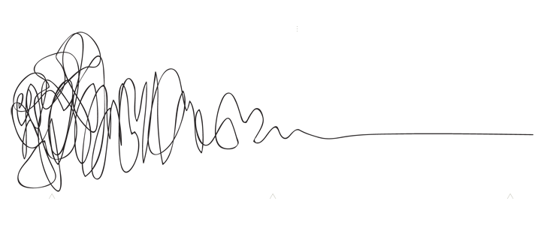
Algebra
with Ms. Lake
Overview
Students will apply their algebraic and geometric reasoning skills to make sense of problems involving algebra, geometry, bivariate data, and statistics. This course focuses on algebraic, quantitative, geometric, graphical, and statistical reasoning. In this course, students will continue to enhance their algebraic reasoning skills when analyzing and applying a deep understanding of linear functions, sums and products of rational and irrational numbers, systems of linear inequalities, distance, midpoint, slope, area, perimeter, nonlinear equations and functions, quadratic expressions, equations and functions, exponential expressions, equations, and functions, and statistical reasoning
Contact
Email:lakees@richmond.k12.ga.us
Remind code: @lakealg23
Materials
Spiral Notebook
Calculator
Pencil
Grades
- Weekly Notebook
- Classwork
- Quizzes & Mini-Assessments
Tests & Unit Projects
Minor Grades- 60%
Major Grades-40%
Responsibilities & Expectations
Be on time and prepared
Keep track of your notebook for this class! Don’t lose it! Show all of your work and do your practice problems in the notebook.
Always be respectful and positive towards others, their work, and their ideas. Listen to others to help LEARN about their point of view, even if you don’t always agree with them.
Become comfortable with taking risks, pushing ourselves, and trying work outside of our comfort zone.
Communication, honesty, and transparency from everybody.
Take responsibility for our own learning (ask for help; participate in discussions; show our work and follow through with trying even when we’re unsure; take our practice work seriously).
If you want to retake an assessment then you must first complete a learning plan
Work needs to be done by the due date. Late work may be turned in up to two weeks after the due date. After two weeks work will not be accepted.
Students may keep their cellphones unless they become a distraction. If a student has to be told more than once to put away their phone, they will be asked to store it in cell jail and parents will be notified.
Student should follow the school behavior and dress code policies. Dress code issues will be sent to Mrs. Crawford, behavior issues will be dealt with in class and with parents depending on the severity.
Units
Modeling linear function
Analyzing Linear Inequalities
Investigating Rational & Irrational Numbers
Modeling & Analyzing Quadratic Functions
Modeling & Analyzing Exponential Expressions & Equations
Analyzing Exponential Functions
Investigating Data
Algebraic Connections to Geometric Concepts
Culminating Capstone Unit
“You are going to be solving problems in your future that haven’t even been thought of yet. You don’t only need to know how to find the answer to already-known problems; you need to learn the skills that will help you tackle the unthinkable problems of the future.”
What if I need help?
After school tutoring will be available on Tuesdays until 4:15. Your ride must be on time or else you will not be allowed to stay again.
Resources for each standard will be made available on Canvas
FEV tutor will be available for extra help

