Slide 1
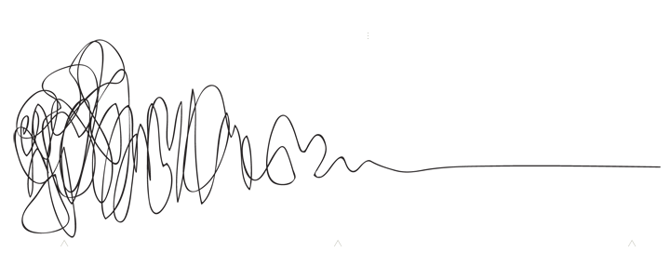
Enhanced Advanced Algebra
with Ms. Lake
Overview
This course enhances students’ geometric, algebraic, graphical, and probabilistic reasoning skills. Students will apply their algebraic and geometric reasoning skills to make sense of problems involving geometry, trigonometry, algebra, probability, and statistics. Students will continue to enhance their analytical geometry and reasoning skills when analyzing and applying a deep understanding of polynomial expressions, proofs, constructions, rigid motions and transformations, similarity, congruence, circles, right triangle trigonometry, geometric measurement, and conditional probability.
This course is combined with AP Precalculus. You will be expected to take the AP Precalculus Exam at the end of the course. Students must have access to College board in order to fully participate in class.
Contact
Email:
lakees@richmond.k12.ga.us
Materials
Spiral Notebook
Calculator
Pencil
Dry Erase Markers
Loose Leaf Paper
Grades
- Classwork
- Quizzes & Mini-Assessments
Tests & Unit Projects
Minor Grades- 60%
Major Grades-40%
Responsibilities & Expectations
Be on time and prepared
Keep track of your notebook for this class! Don’t lose it! Show all of your work and do your practice problems in the notebook.
Always be respectful and positive towards others, their work, and their ideas. Listen to others to help LEARN about their point of view, even if you don’t always agree with them.
Become comfortable with taking risks, pushing ourselves, and trying work outside of our comfort zone.
Communication, honesty, and transparency from everybody.
Take responsibility for our own learning (ask for help; participate in discussions; show our work and follow through with trying even when we’re unsure; take our practice work seriously).
If you want to retake an assessment then you must first complete a learning plan
Work needs to be done by the due date. Late work may be turned in up to two weeks after the due date. After two weeks work will not be accepted.
Students may keep their cellphones unless they become a distraction. If a student has to be told more than once to put away their phone, they will be asked to store it in cell jail and parents will be notified.
Student should follow the school behavior and dress code policies. Dress code issues will be sent to Mrs. Crawford, behavior issues will be dealt with in class and with parents depending on the severity.
Units
Descriptive & Inferential Statistics
Exponential & Logarithmic Functions
Investigating Radical Functions
Modeling Polynomial Functions
Investigating Linear Algebra & Matrices
Trigonometry and the Unit Circle
Exploring Rational Functions
Culminating Capstone Unit
“You are going to be solving problems in your future that haven’t even been thought of yet. You don’t only need to know how to find the answer to already-known problems; you need to learn the skills that will help you tackle the unthinkable problems of the future.”
What if I need help?
After school tutoring will be available on Tuesdays until 4:15. Your ride must be on time or else you will not be allowed to stay again.
Resources for each standard will be made available on Canvas
FEV tutor will be available for extra help

Slide 2
Technology Policy
Laptops and phones will need to put away during class time unless we are working on a digital assignment. Students who do not comply will be disciplined following the current Richmond County School Board policy.
Academic Honesty
Students are expected to complete all of their own work whether it is digital or on paper. Academic dishonesty includes; copying work of another student, allowing another student to do their work for them, and using technology to get the answer without working out the problem. Students who have been found to be academically dishonest will receive a zero if it is a minor grade and will have to retake if it is a major grade.
Ungraded Work Policy
Some of the work that we do in class is meant to be a part of the learning process. While this work is not graded, students are still expected to participate in these learning activities.
Other School Activities
Students are not permitted to miss class if they have less than a 75. If the student requests to be absent from a period to attend another school function, they must have approval from the teacher. A student with less than a 75 must have provided acknowledgment from the parent of their current score and the parent agrees to allow them to miss the class.
What if I need help?
After school tutoring will be available once a week until 4:15. Your ride must be on time or else you will not be allowed to stay again.
Resources for each standard will be made available on Canvas
FEV tutor will be available for extra help
“You are going to be solving problems in your future that haven’t even been thought of yet. You don’t only need to know how to find the answer to already-known problems; you need to learn the skills that will help you tackle the unthinkable problems of the future.”

