Slide 1

Senior Advisement 2015-2016
Congratulations to the first graduating class of Richmond County Technical Career Magnet School!

Slide 2
Guidance Staff
Mrs. Karen H. McCord, Counselor
mccorka@rcboe.org
Ms. Doris James, Data Collection Specialist
706-823-5580
706-796-4889 fax

Slide 3

Topics of interest…
Graduation Requirements
Valedictorian/
Salutatorian
Honor Graduates
STAR Student
HOPE & Rigor Requirements
Scholarships
Applying to college
ACT/SAT
Letters of recommendations
Move On When Ready Opportunities

Slide 4

Graduation Requirements
Areas of Study Units Required
English/Language Arts 4 units
Mathematics 4 units
Science 4 units
Social Studies 3 units
Physical Education 1 unit
(Personal Fitness & Health and Safety)
CTAE/Foreign Language/Fine Arts 3 units
Electives 4 units
TOTAL 23 UNITS

Slide 5

Changes to graduation requirements….
Changes:
23 total credits required to graduate (changed from 25)
Fine Arts elective no longer required
3 credits in CTAE, Fine Arts, and or Foreign Language
  Students may combine courses across areas
  Pathway completion not required (although strongly recommended).

Slide 6

Valedictorian/Salutatorian
2016
Criteria
Student must have taken all junior & senior course work in Richmond County
Students enrolled in the MOWR program are prospective candidates.
The Valedictorian & Salutatorian must be enrolled in the school from which they are chosen first and second semesters of their senior year.

Slide 7
Valedictorian/Salutatorian
All high schools will have a valedictorian and salutatorian
Valedictorian - highest average in the class
Salutatorian - second highest average in the class
These students should be selected at the end of the first semester of their senior year.
Averages may not be rounded to determine qualification.
If they have identical averages, the second semester average shall be considered.
If a tie remains, the student with the highest SAT verbal and math total will be Valedictorian or Salutatorian. (pg 88-89)
http://www.rcboe.org/download.axd?file=a4009e33-7198-44c2-9ec5-680ae794c87b&dnldType=Resource

Slide 8

Honor Graduates
Students with an average of ninety and above will be honor graduates
These students should be selected at the end of the first semester of their senior year.
Averages may not be rounded to determine qualification. (pg88-89)
http://www.rcboe.org/download.axd?file=a4009e33-7198-44c2-9ec5-680ae794c87b&dnldType=Resource

Slide 9

STAR Student
The PAGE STAR (Student Teacher Achievement Recognition)
Program honors Georgia’s highest achieving high school seniors and the teachers most instrumental in their academic development.

Slide 10
STAR Student, continued…
High school seniors must have the highest score on any single test date of the three-part SAT
be in the top 10 percent or top 10 students of their class based on grade point average
SAT scores must be equal to or higher than:
Critical Reading= 495
Math = 511
Writing =484
The last SAT date for STAR 2016 is November 7
STAR Student and STAR Teacher nominations must be submitted by December 18, 2015.
http://www.pagefoundation.org/?STAR6Guidelines

Slide 11

Students must meet one of the following academic requirements:
1. Graduate from a HOPE eligible high school or home study program with a 3.0 grade point average.
2.Be enrolled as a degree-seeking student at an eligible institution.
3.Meet HOPE’s Georgia, U.S. Citizen, or eligible non-citizen requirements: Georgia residency requirements.
4.Be in compliance with Selective Service registration requirements (male students 18-25 years of age must be registered within 30 days of 18th birthday. You can register at any US Post Office).
5.Be in compliance with the Georgia Drug-Free Postsecondary Education Act of 1990. A student may be ineligible for HOPE payment if he or she has been convicted for committing certain felony offenses involving marijuana, controlled substances, or dangerous drugs.
6.Not be in default or owe a refund on a student financial aid program.
7.Maintain satisfactory academic progress as defined by the college.
https://secure.gacollege411.org/Financial_Aid_Planning/HOPE_Program/Georgia_s_HOPE_Scholarship_Program_Overview.aspx

Slide 12
The Georgia Student Finance Commission, a state agency, calculates HOPE averages based on transcript information provided by Richmond County Public Schools. The school system does not calculate HOPE averages and does not have access to the state’s calculations.
How and when do families learn a student’s HOPE eligibility status?
Students will not receive automatic or direct notification of their HOPE eligibility status.
Students and/or their parents may sign on to www.GAcollege411.org and create a “My411 Student Account.”
The state generally makes HOPE eligibility available for graduating seniors through these personal accounts in mid-June.
After the state posts HOPE eligibility information on GAcollege 411, families may contact the financial aid office of the college or postsecondary school the student is registered to attend in the summer or fall.
Financial aid staff will have access to this information directly from the Georgia Student Finance Commission.
https://secure.gacollege411.org/Financial_Aid_Planning/HOPE_Program/Graduate_from_a_HOPE-eligible_high_school_.aspx

Slide 13
HOPE continued…..
 | Hope Scholarship | Zell Miller Scholarship
GPA Graduating High School | 3.0 | 3.7
SAT/ACT Requirement | None | 1200(reading/math) SAT26 Composite ACT
Other | None | A Valedictorian or Salutatorian is eligible independent of GPA or SAT/ACT Score
GPA in College | Maintain 3.0 | Maintain 3.3If between 3.0 and 3.3, then coverts to regular HOPE
Award Amounts | based upon a per hour rate at the institution | 100% tuition
Book fee Allowance | None | None
Regain Eligibility after loss due to GPA | One Chance to regain | One Chance to regain
Maximum number of semester hours to receive scholarship | 127 | 127
High School requirements starting 2015 Mandatory Fees | Must have certain number of hours of rigorous courses (math, science, language) None | Must have certain number of hours of rigorous courses (math, science, language) None
http://hope-scholarship.net/tips/hope-scholarship-changes/

Slide 14
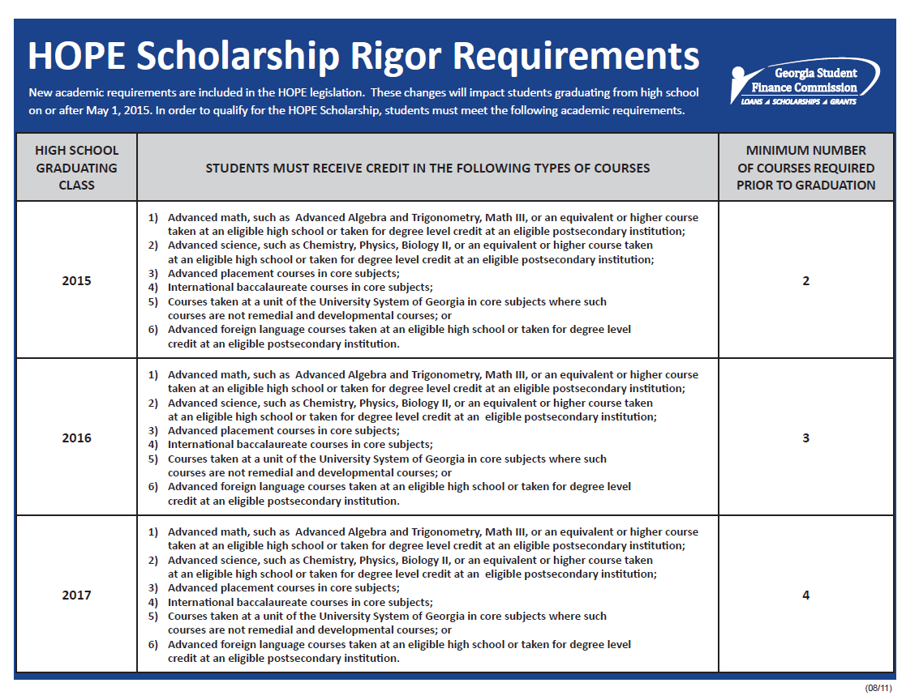
http://www.gsfc.org/main/publishing/pdf/2012/Rigor_Explanation.pdf

Slide 15
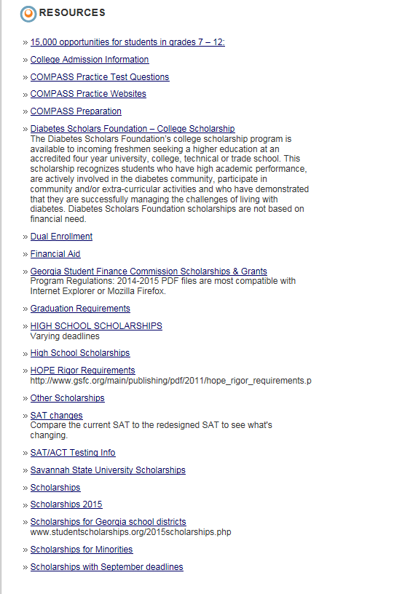


Check the site weekly!
Look on the school’s website , click the guidance tab, then scroll down until you see Resources!
The Career Center is open!
You may come to the guidance office with a pass to search for scholarships and apply to colleges! Be sure to sign in!
Beware of deadlines!

Slide 16


Applying to college
There are many considerations:
Type of college- 4 year, 2 year, or technical
In state or out-of-state
Housing options
on campus
at home
apartment
Public or private
Majors offered
Campus size
Extracurricular opportunities
Distance from home
Admissions requirements
Cost
  Financial aid
  Scholarships
  Loans
  grants

Slide 17


Narrow down your choices
Which college meets your needs?
Research college websites
Talk to admissions counselors
Attend college fairs or make a campus visit
Look for your major
You should apply to 4 or more colleges

Slide 18


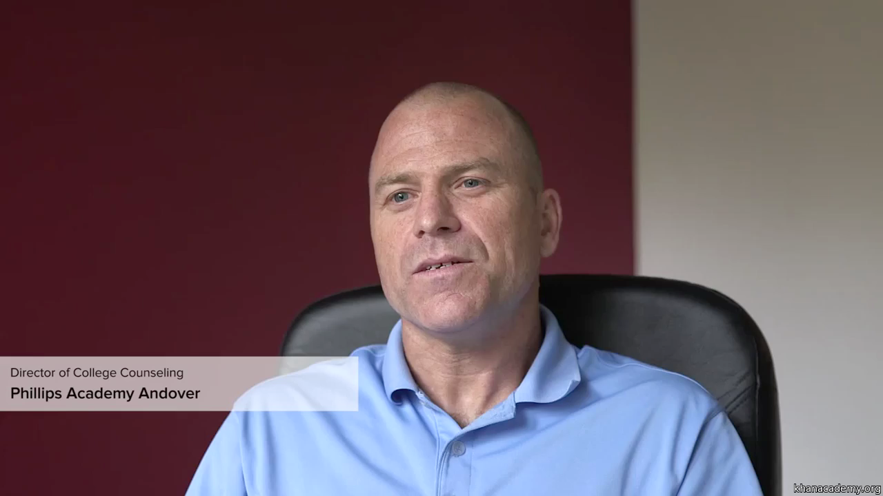

How to apply…
Visit the college’s website!
Most applications are on-line
Look for application fees
  Some colleges accept college fee waivers!
Apply early!
Don’t wait until the deadline!
Check the college’s website for application deadlines
Early admissions deadlines
If you used a fee waiver for the SAT last year, you have 4 college application fee waivers to use.
If you use a fee waiver for the first time this year, your fee waivers will be available once your scores return.
https://www.khanacademy.org/video/overview-applying-to-college

Slide 19
College Application Deadlines
Early admission to GA Tech – Oct. 15, 2015
Early admission to UGA- October 15, 2015
Augusta University – February 15, 2016
Georgia Southern - April 1, 2016

Slide 20


The two main college entrance exams
You are encouraged to take the same test more than once
The current SAT will be offered through the January 2016 administration
You can have your scores sent directly to the colleges you want to attend

Slide 21
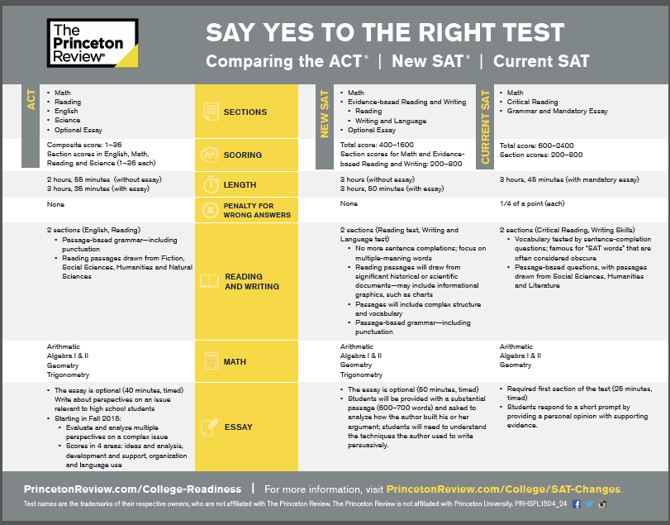

Slide 22
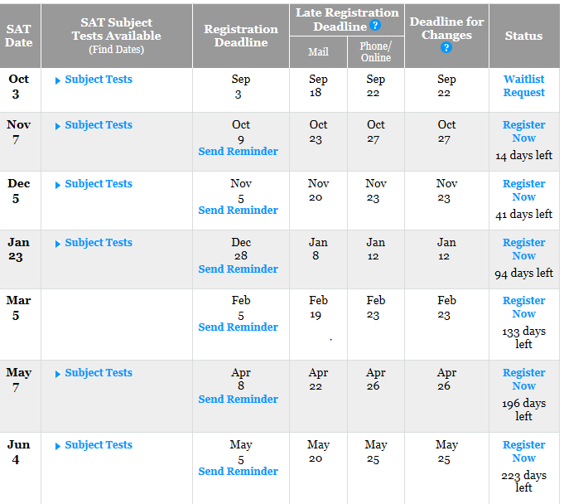
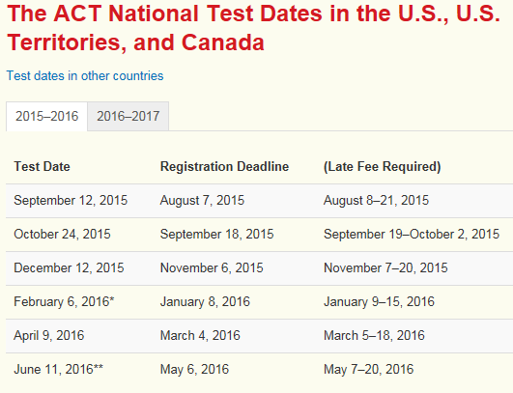
SAT/ACT test dates
https://sat.collegeboard.org/register/sat-us-dates
http://www.actstudent.org/regist/dates.html

Slide 23
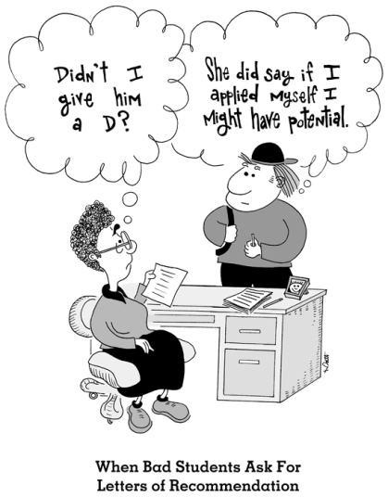

Letters of Recommendations
https://www.khanacademy.org/video/sal-khans-story-applying-to-college
Teachers
Employers
Professors
Club advisors
Counselors
    Give them adequate time to write the letters!

Slide 24
Move On When Ready
GRU/Augusta University
http://www.gru.edu/admissions/documents/2015mowrapplchecklist.pdf
Augusta Technical College
https://www.augustatech.edu/high_school.html
Georgia Military College
http://www.gmc.edu/admissions/join-dual-enrollment.cms
Paine College
http://www.paine.edu/admissions/learn/HighSchoolDualEnrollmentProgram.aspx
Move on When Ready Program REGULATIONS
http://www.gsfc.org/main/publishing/pdf/2016/2016-Move%20On%20When%20Ready.pdf
Move on When Ready Program - GaCollege 411
https://secure.gacollege411.org/Financial_Aid_Planning/Scholarships/Grants_and_Scholarships/MOWR.aspx

Slide 25
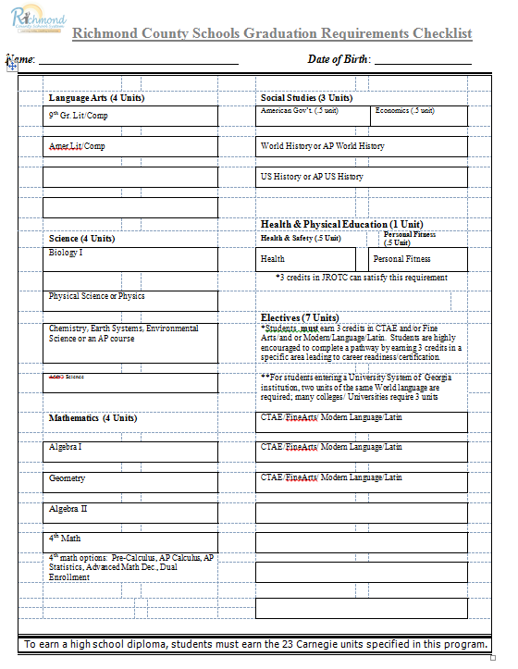
Get your transcript
Fill in the boxes with the grade you received in each course
Highlight/circle the boxes for the classes you are taking this school year

Slide 26

Questions……

