Slide 1
STEERING COMMITTEE PRESENTATION
NORTHEAST LAKEVIEW COLLEGE &
Fredericksburg Early College High School
Fredericksburg ISD
Spring 2025
Notes:
Speaker- Sara
Welcome to the Spring 2025 Steering Committee Presentation
The Spring presentation will cover the Spring 25 highlights/Fall enrollment data
An opportunity to provide an overview of the Fredericksburg ECHS model, collaborative work, program highlights, student support services, strategic partnership goals.
This presentation will be conducted by Dr. Carrie Turner-Gray, Sophia Solano, and Fredericksburg ECHS and myself.

Slide 2
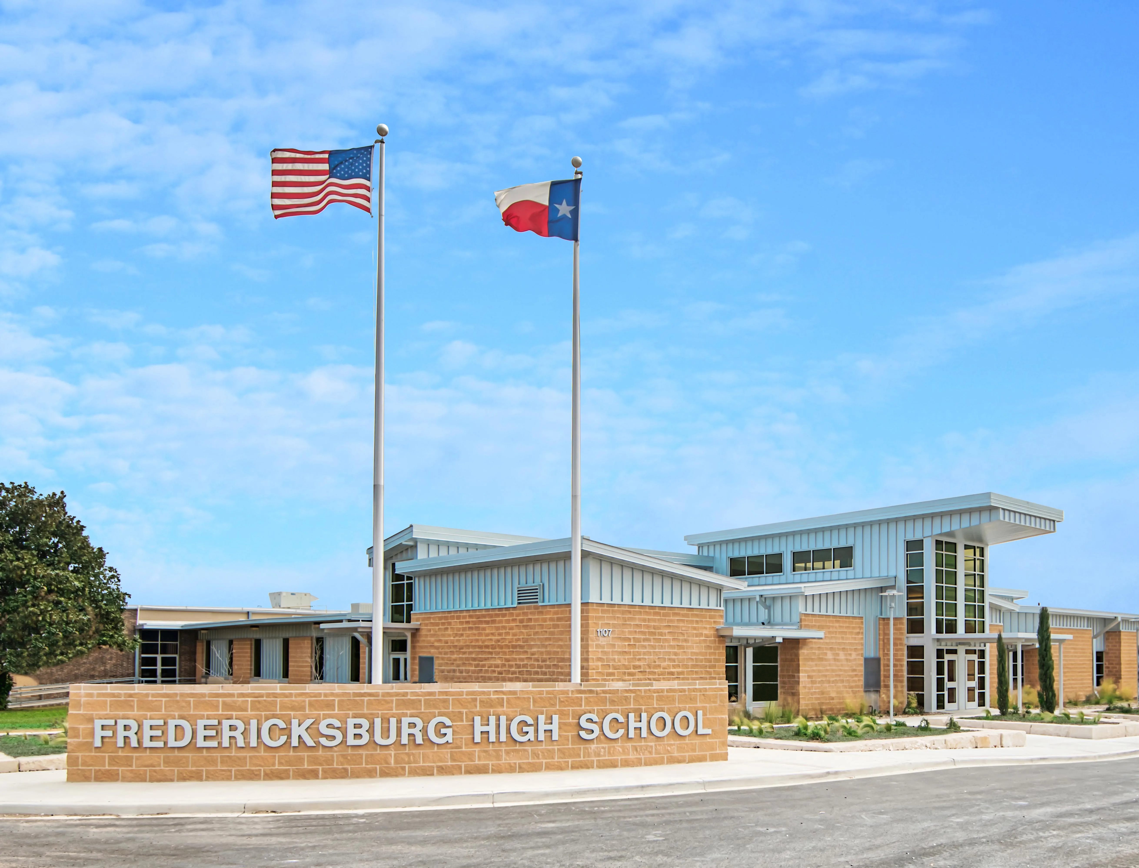




Benchmark 1: School Design
No Cost to Students
School within a
School Model
Organized Cohorts
Flexible Scheduling
TSIA Test Site
Leadership Team
Strategic Priorities
Programmatic Goals
Collective Agreements:
MOU & SSA
District, High School,
& College Team Roles
Partnership Meetings
Shared Artifacts
Professional Development
Notes:
Speaker - Sara
School Location-School within a School Model at
Fredericksburg High School
State Hwy 16
Fredericksburg, Texas 78624
1.3 Students are placed in organized cohorts by grade level/graduation year.
1.4 Students are provided Flexible, individualized scheduling that ensures students graduate with their high school diploma AND AA in Liberal Arts
1.5 Memorial ECHS is a TSIA Testing Site which allows the HS to provides students with multiple opportunities per year to take the TSI assessment.
Speaker - Carrie
Leadership:
Superintendent Dr. Joe Rodriguez
Assistant Superintendent for Teaching and Learning Lori Maxcey
Coordinator for Secondary Teaching and Learning Sheryl Jacks
Fredericksburg High School/ECHS Principal Chris Weirich
Fredericksburg ISD Counselors Cayle Koennecke- ECHS Co-Counselor (ECHS Lead)
Joel Bush- FHS
Kathie Hardison- FHS
Jenny Immel- FHS
Summer Vann- FHS
John Hext- CTE Coordinator
Sandra McQuinn- FMS Counselor
CCRSMCoach Nelda Howton
FISD Meetings - every 1st Monday of the month Meeting Minutes

Slide 3


Professional Development
Notes:
Speaker: Carrie
August 9, 2024 – NLC High School Program Professional Development

Slide 4

Benchmark 2: Partnership
MOU
Staffing Plan
Funding:
DC Cost & Books
Academic Plan
Course Delivery & Scheduling
Collaborative Outreach
Student Participation & Access
2024-2027
Memorandum of Understanding (MOU)
In Progress – 2024-2027 Shared Services Agreement (SSA)
Notes:
Speaker: Carrie
MOU – Done
SSA – In Progress – Working Copy - Fredericksburg ECHS_SSA_Fall 2024.docx

Slide 5
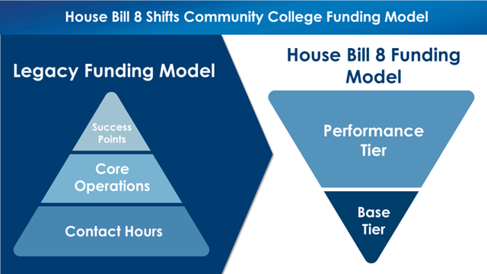
House Bill 8: New Formula Model
Building a Talent Strong Texas - Texas Higher Education Coordinating Board
Performance tier funding will be calculated based on:
No. of credentials of value awarded;
No. of credentials of value awarded in high-demand occupations;
No. of students who earn at least 15credit hours and transfer to a 4-year University; and
No. of HS students who earn at least 15credit hours through academic and workforce dual credit programs.
Economically disadvantaged students, defined as Pell recipients, receive an additional weight of 25%.
Academically disadvantaged students, defined as students who are not Texas Success Initiative (TSI) ready in any subject area, receive an additional weight of 25%.
Adult learners, defined as 25 years or older, receive an additional weight of 50%.
Notes:
Speaker: Sara

Slide 6
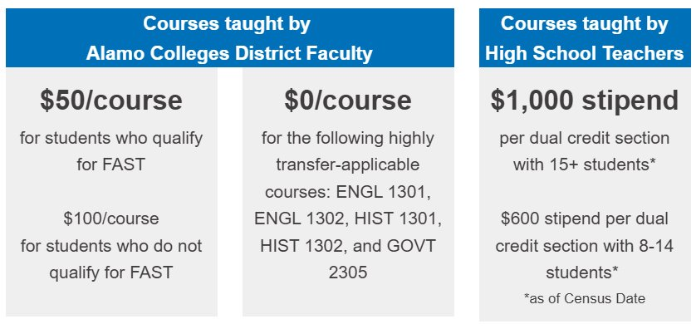


Cost Share Model
The Alamo Colleges District is committed to providing greater dual credit attainment to students in our community by waiving tuition and fees for high school students through cost-share agreements with K-12 partners.
Beginning in Fall 2024, we are reducing the cost of dual credit opportunities for our public and charter school partners. We will capitalize on House Bill 8 (HB 8) funds to reduce the cost for public and charter school partners to enroll students in dual credit courses.
Notes:
Speaker: Sara
Effective Fall 2024 changes have been made to the cost share model.
The cost share adjustment capitalizes on House Bill 8 (HB8) funds to reduce the cost for public and charter partners to support dual credit enrollment. Communication regarding this update was shared during the summer to all partners as well as our PD in August.

Slide 7

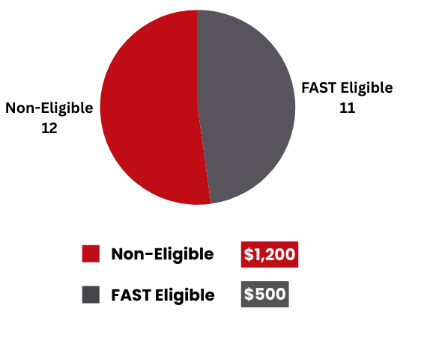
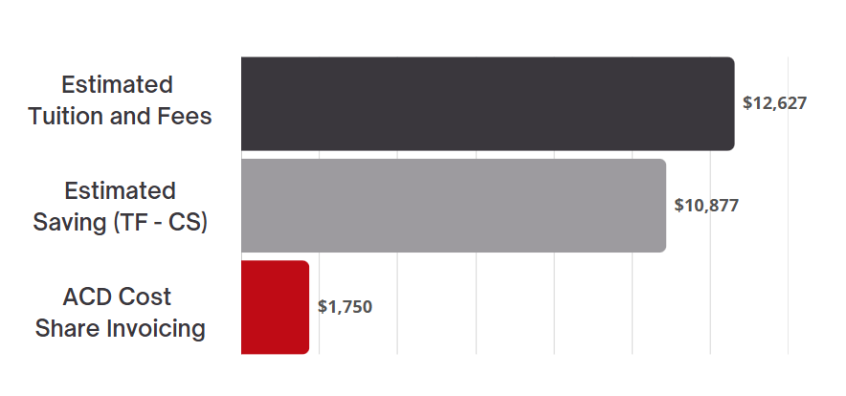
Cost Share Fall 2024 Summary
Data Source: STU0190B_202510 - **Residency is a true pull from the student account, errors may exist which impact the estimates. **​
Notes:
Speaker: Sara
Invoicing – 100% Fully Online Instruction (NLC Instructors)
Stipend is paid out to the district for the courses taught by a certified dual credit instructor.
Effective Fall 2024 changes have been made to the cost share model.
The cost share adjustment capitalizes on House Bill 8 (HB8) funds to reduce the cost for public and charter partners to support dual credit enrollment. Communication regarding this update was shared during the summer to all partners as well as our PD in August.
If questions arise:
Snapshot of adjustments: Invoicing fee amount incorporates FAST qualifiers and $0 fee for five core classes taught by ACD faculty. The stipend adjustment has expanded to add an additional tier of enrollment. Free books through AlamoBooks+.

Slide 8

Benchmark 3: Target Population
December Recruitment Begins
December 9th Student Presentations
December 11th Student Presentations
January 21rd Application Closes
January 7th Application Opens
January 7th & 8th Parent Information Session
January 27th ECHS Committee Review for Lottery
February 3rd to 5th Individual Student Interviews
February 20th Student Acceptances
25 Accepted
Class of 2029
Data Source: ECHS Recruitment Plan 24_25
Notes:
Speaker: Fredericksburg ECHS

Slide 9
Fredericksburg ECHS Demographics-Fall 2024
Gender | ECHS | Campus | District
Female | 11 | 493 | 1627
Male | 12 | 531 | 1757
Special Population | ECHS % | Campus % | District %
At-risk | 13% | 45.9% | 55.5%
Economically disadvantaged | 39.1% | 52.2% | 60.2%
Special Education | 4.3% | 12.4% | 15.5%
504 | 13% | 11% | 6.9%
English Learners | 4% | 13% | 18.5%
Data Source: FECHS Provided Data, FISD TAPR District Report
Notes:
Speaker: FECHS
Information provided by FECHS

Slide 10
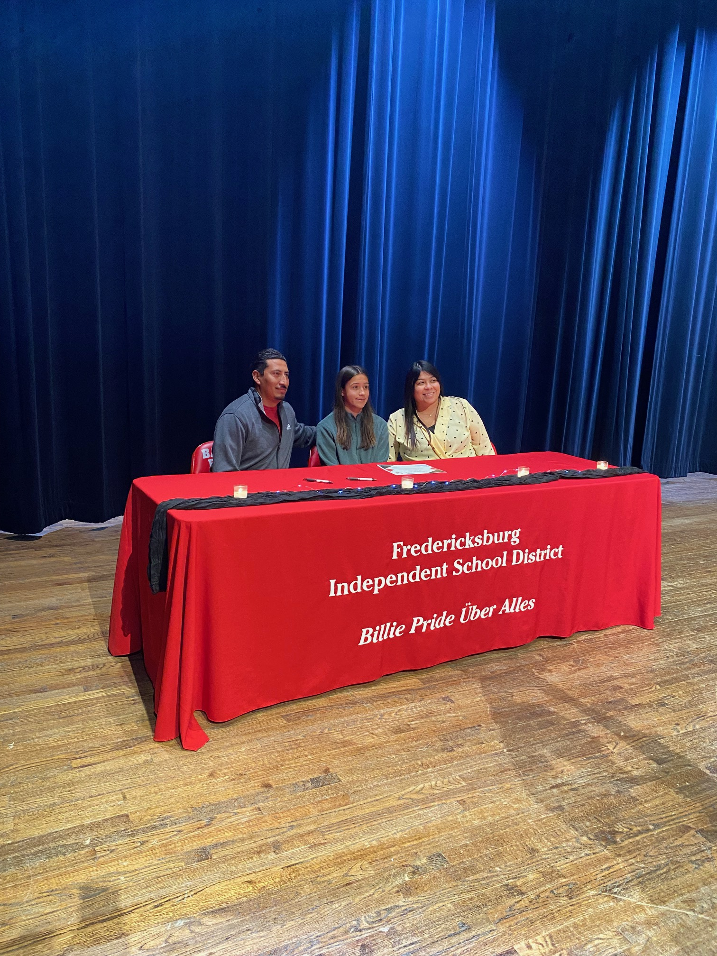
Growth Mindset
Good Work Ethic
Overcome barriers to college.
Cohort Information
GRADE LEVEL | CLASS YEAR | NO. OF STUDENTS
8th | 2029 | 25
9th | 2028 | 23
Data Source: FECHS Provided Data
Notes:
Speaker: FECHS

Slide 11
Benchmark 4: 4-Year Crosswalk
11th Grade
Fall | Spring
Algebra 2 or Pre-Calculus | Algebra 2 or Pre-Calculus
Phys A&P, or Other Adv Science | Phys A&P, or Other Adv Science
College Prep 3 | College Prep 3
Elective | Elective
Elective | Elective
ENGL 1301 – Composition 1 | ENGL 1302 – Composition 2
HIST 1301 – US History 1 | HIST 1302 – US History 2
PSYC 2301 – Gen. Psychology | GOVT 2305 – Fed. Government
9th Grade
Fall | Spring
English 1 | English 1
Algebra 1 or Geometry | Algebra 1 or Geometry
Biology | Biology
Foreign Language | Foreign Language
Physical Education | Physical Education
Fine Arts or Elective | Fine Arts or Elective
College Prep 1 | College Prep 1
EDUC 1300 Learning Framework | BCIS 1305 Business Computer App.
12th Grade
Fall | Spring
College Prep 4 | College Prep 4
Elective | Elective
Elective | Elective
Elective | Elective
ENGL 2322 | ENGL 2323
MATH 1314 College Algebra | PHIL 1301 Intro to Philosophy
BIOL 1308 Biology | BIOL 1323 Consumer Nutrition
GOVT 2306 TX Government | ECON 2301 Economics
10th Grade
Fall | Spring
English 2 | English 2
Geometry or Algebra 2 | Geometry or Algebra 2
Chemistry | Chemistry
Foreign Language or Elective | Foreign Language or Elective
Elective | Elective
College Prep 2 | College Prep 2
ARTS 1301 or MUSI 1306 | GEOG 1303 W. Reg. Geography
COMM 1307 Intro to Mass Comm | SPCH 1318 Interpersonal Comm.
Data Source: FECHS Provided Data
Notes:
Speaker: Sara
2.5 Transcription of Credit
Crosswalk of College to High School Credit – To the left you have the college courses by grade level. To the right you have the high school subject equivalency.
2.4 Academic Plan – Associate of Arts Degree Plan – General outline for the AA degree for Liberal Arts
We have a total of 14 core courses and 6 courses available for electives. The electives are determined by the partnership to help fulfill both high school and college curriculum requirements.

Slide 12
Benchmark 4: Master Course Schedule
Data Source: FECHS Provided Data
1st Period | 2nd Period | 3rd Period | 4th Period | 5th Period | 6th Period | 7th Period | 8th Period
Pre-AP Biology | English 1 | Spanish I | Principles of Health | Algebra 1 | EDUC 1300/MAPS | PATH 1 | Athletics
Athletics | Spanish 2 | Pre-AP Biology | Principles of Health | Pre-AP English 1 | BCIS 1305/Bus Inf Mgmt 2 |  | Pre-AP Geometry
Pre-AP English 1 | Spanish 1 | Band | Pre-AP Geometry | Athletics |  |  | Introduction Trades
Spanish 1 | Principles of Agriculture | Spanish 2 | English 1 | Principles of Health |  |  | Biology
Cheer | Pre-AP English 1 | Algebra 1 | Principles of Engineering | English 1 |  |  | Spanish 2
Biology | Algebra 1 | Principles of Agriculture | Pre-AP Biology | Introduction Trades |  |  | German 2
 | PE | Introduction Culinary | German 2 | Pre-AP Geometry |  |  | Introduction Culinary
 | Theatre 1 |  | Introduction Trades | Spanish 1 |  |  | English 1
 | Band |  | Biology | Law Enforcement 1 |  |  | Floral Design
Notes:
Speaker: Carrie

Slide 13
Student Persistence
Cohort | Fall 2024 Admission | Withdraws | Total Cohort
2028 | 25 | 2 | 23
Notes:
Speaker: FECHS

Slide 14

Texas Success Initiative (TSI)
Grade Level | Reading | Writing | Diagnostic Reading | Math | Diagnostic Math
9th | 13 | 10 | 0 | 7 | 0
TSI Interventions
IXL TSIA2.0 Prep for College Readiness
Data Source: FECHS Provided Data
Notes:
Speaker: FISD ECHS

Slide 15


Performance Information
STAAR Test | Taken/Passed
8th Grade – Algebra I | 14/14
9th Grade – Algebra I | 9/Will take Spring 2025
English I | 23/Will take Spring 2025
Biology | 23/Will take Spring 2025
This Photo by Unknown Author is licensed under CC BY-SA-NC
Data Source: FECHS Provided Data
Notes:
Speaker: Fred ECHS

Slide 16




Benchmark 5: Academic Success Services
Library Resources & Access
Academic Support Center
Access to Faculty
Instructional Innovation (IIC) - OLRN
Faculty-Student Mentoring
Notes:
Speaker: Carrie
Library Resources & Access
Hours of Operation
Monday - Thursday, 7:30 am to 9:00 pm
Friday, 7:30 am to 5:00 pm
Saturday, 9:00 am to 1:00 pm
Electronic Databases using Academic Search Complete
Noodle Tools
Citation Workshops – in person or via zoom
Academic Support Center
In-person tutoring
Online tutoring
Via zoom for Math, Programming, Writing, Chemistry
Brainfuse – contact me if you need any additional hours
Access to Faculty
Faculty-Student Mentoring

Slide 17
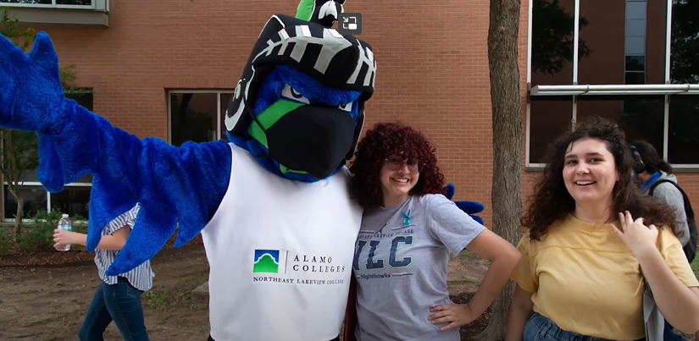
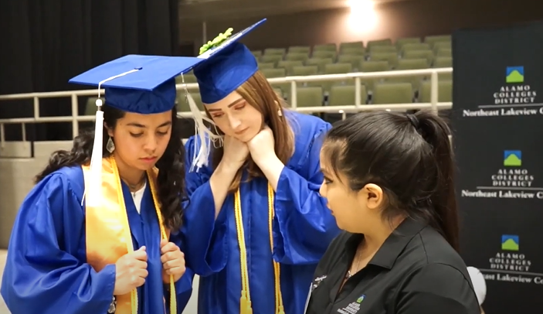
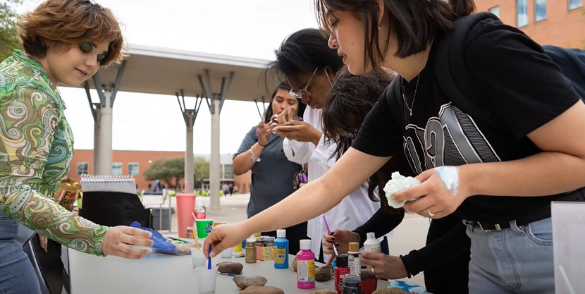
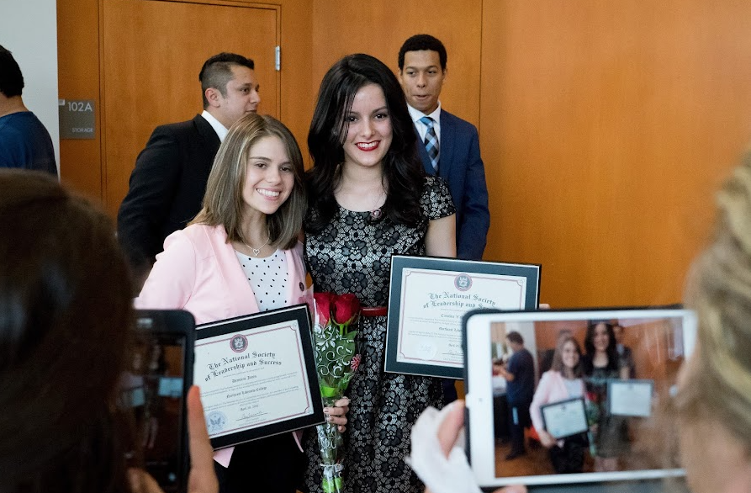
Benchmark 5: Student Success Services
Advocacy Services
Disability Support Services
Clubs & Organizations
Direct Access to College Events
Access to campus spaces
Academic Advising
Communal Graduation Ceremony
Notes:
Speaker Sara
5.4 Classroom Supports
5.5 Wrap Around Services and Strategies – In addition to Academic Success Services, our students have access to the student success support services. We understand our Fredericksburg ECHS students are off-site and may not be able to fully utilize all services, but we encourage students to seek virtual opportunities and visit campus outside of school hours.

Slide 18
Advising: Touchpoints
TOUCH POINT | SEMESTER | TYPE | TOPICS
9th Grade | FALL | New Student Orientation August | New Student Orientation Get to know your assigned Certified Advisor and maintain consistent contact. Receive and understand your High School Programs Advising Syllabus. Identify your intended educational and career pathway choice. Understand college and community resources available to students.
 | FALL/ SPRING | Group Advising September-February | Program Overview and Expectations 4 Year Plan Review. Academic Integrity/Student Code of Conduct. College/Classroom Expectations. Campus Resources. TSI requirements and placement scores.
Notes:
Speaker: Sophia

Slide 19
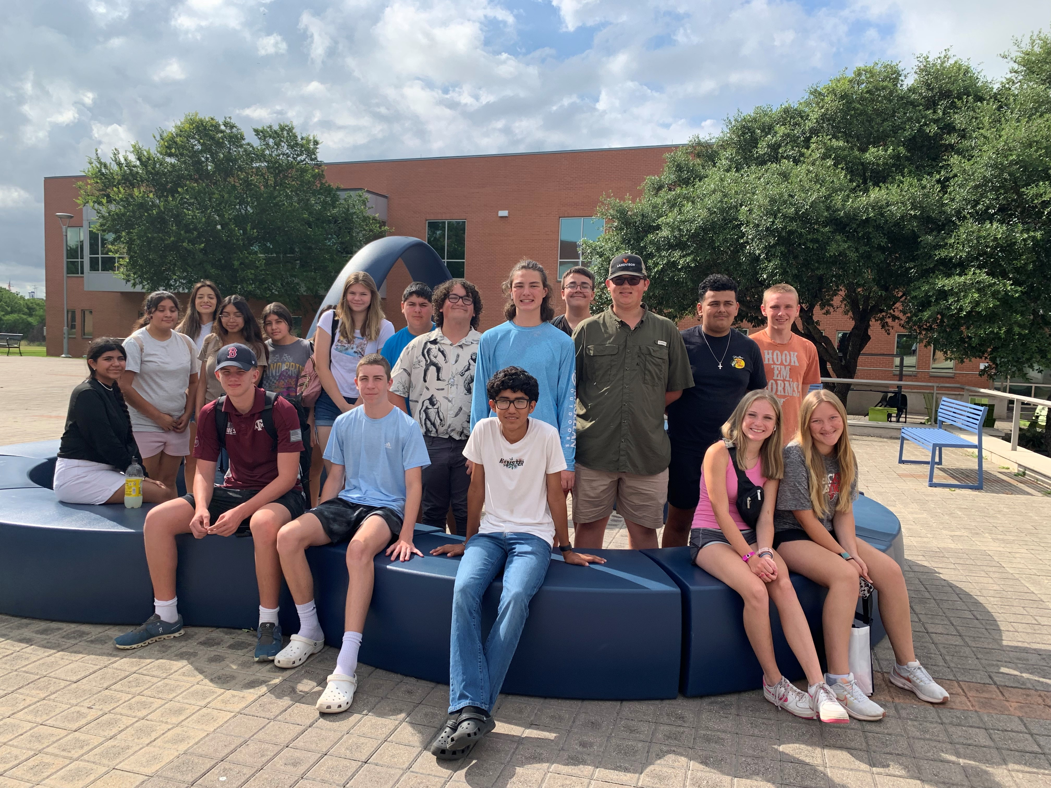
Intervention and Enrichment Opportunities
ECHS Summer Bridge and Fish Camp
College Fairs, FAFSA Nights
Tutoring before and after school, lunch periods
Pre-AP, AP, UT OnRamps and Dual Credit Courses
SAT, TSIA2, and ASVAB Testing Days
NLC College Field Trip
PATH 1 Daily for Dedicated Tutoring
Notes:
Speaker: Fred ECHS

Slide 20
FECHS Summer Bridge 2025
June 2 | June 3 | June 4 | June 5
Location: Fredericksburg ECHS Team Building Activities TSIA 2 Prep TSIA 2 Exam |  |  | Location: Northeast Lakeview College
Notes:
Speaker: FECHS/Sara

Slide 21


FECHS Enrichment and Outreach
June | ECHS Summer Bridge ECHS TSIA2 Testing for Incoming 9th Graders Northeast Lakeview College Field Trip for ECHS
July | Registration / Schedule Pick Up
August | Fish Camp @ FHS
October | SAT Day Skyward Night ASVAB Testing ECHS TSIA2 Testing Drug Awareness Parent and Student Presentation
November | College Fair Veteran’s Day Program
December | ECHS Recruitment Visit for Students at FMS
January | FAFSA Night ECHS Parent Informational Meeting
February | Parent Night - Topics to be reviewed; pathways, course selection, dual credit course offerings ECHS TSIA2 Testing
March | ECHS Signing Night SAT Day Skyward Night
May | Scholarship Night Academic Awards 8th Grade Visits FHS Career Fair
Notes:
Speaker: FECHS

Slide 22

FHS Campus Activities
Campus Activity | ECHS Students Involved
Interact | 1
Eye Opener | 1
National Society of Leadership Success | 3
FFA | 3
4H | 2
FCA | 5
Notes:
Speaker: FECHS

Slide 23

Academic Honors/Recognition
Students receive academic awards in the 3rd Quarter 2025
9th Grade Fall 2024 – 2 Students on A-Honor Roll
2 students are participating in at least one Pre-AP course outside of their DC course
18 students are participating in more than one Pre-AP course outside of their DC course.
Notes:
Speaker: FECHS

Slide 24

Questions &
Partnership Shares
Notes:
Speaker: Sara
We will have another Steering Committee presentation in the Spring 2025. We’ll follow up with calendar invite once details are confirmed.

