Slide 1

Today’s Schedule
10:00-11:00 - How Much Money Could My District Save w/ MSFBG?
11:00-11:45 -The MSFBG Award Process From A-Z
11:45 – 12:00 General Parts “Hello”
12:00-2:00 – Tasting Event
2:01 – Happy Friday, GO HOME ☺

Slide 2
How Much Money Could My District Save w/ MSFBG?
April 27, 2018 10:00 – 11:00

Slide 3
WELCOME
Laura Metzger, MSFBG Consultant

Slide 4
Agenda
Review of History of MSFBG
Current Status of MSFBG
How to Start Participating
Cost Savings

Slide 5


What is MSFBG?
What is the MSFBG?
  MSFBG = Minnesota School Food Buying Group
  A food/non-food buying group with joint purchasing agreement with Anoka Hennepin School District

Slide 6
What are the main goals of MSFBG?
To lower food and supply costs through volume purchasing to save time and money.
Provide current nutrition information in one place.
Bid items where 80% of school district’s food dollars are spent

Slide 7
How Did It All Get Started?
Started in the 2006-07 school year with 15 districts
Looking for savings that would be the same for all districts
1 bid process for an entire school year
Notes:
looking for ways to reduce their food costs. The group believed that they could attain savings through volume buying and worked to reach consensus to purchase one item in its category type. A bid was developed that asked for delivered price to the distributor without any bill backs or rebates that would be the same for all MSFBG districts, and that would be guaranteed for the entire school year. By the second year the districts projected close to $1,000,000 in combined savings.

Slide 8
How Did It Work Out?
By the 2nd year, the districts projected a combined savings close to
$1,000,000
Notes:
looking for ways to reduce their food costs. The group believed that they could attain savings through volume buying and worked to reach consensus to purchase one item in its category type. A bid was developed that asked for delivered price to the distributor without any bill backs or rebates that would be the same for all MSFBG districts, and that would be guaranteed for the entire school year. By the second year the districts projected close to $1,000,000 in combined savings.

Slide 9
Fast Forward 11 Years…

Slide 10
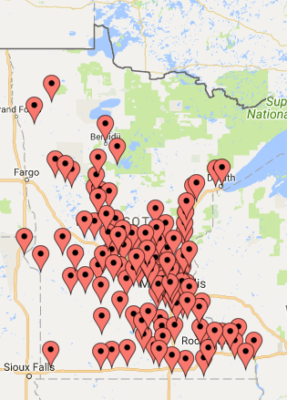
130 Participating Districts

Slide 11
Current Distributors
Food Services of America – Fargo/Moorhead
Indianhead – Eau Claire, WI
Martin Brothers – Cedar Falls, IA
Reinhart – La Crosse, WI
Reinhart - Marshall
Reinhart - Rogers
Sysco – Fargo, ND
Sysco MN
Sysco Western MN - St. Cloud
Upper Lakes Foods – Cloquet
US Foods – Grand Forks, ND
US Foods – Plymouth
US Foods - Sioux Falls, SD

Slide 12
How Does The Process Work?
Each district signs a joint purchasing agreement with Anoka Hennepin Schools
  Anoka Hennepin manages the bid process for the group, in compliance with MN Statute
  Anoka Hennepin currently has 1 voting team member
  Anoka Hennepin purchasing department handles all legal bid requirements and contracts
  Anoka Hennepin hires the MSFBG consultant
  Anoka Hennepin hosts the MSFBG website

Slide 13
Participation Fee
$450 for districts with 3,000 students or less
$800 for districts with more than 3,000 students
Annual Fee

Slide 14
So My District Participates, What’s Next?
Check out your menu to see if there are any items you could switch to an awarded MSFBG item and save money.
Make sure your distributor is matching MSFBG pricing plus your contracted case delivery fee on MSFBG awarded items.
Alert your distributor of expected usage for any MSFGB items you plan to use.
Look out for the email in late October/early November for the commitment process

Slide 15
What’s the Commitment Process?
Participating districts estimate usage for specified items for the following school year.
The estimated number of cases is entered into an online system currently called Interflex (similar to cLiCs).
Each specified item needs a community commitment of 2000 cases in order for it to be put on a bid.
Districts are expected to purchase items they have committed to during the following school year.

Slide 16
When Do We Find Out The Awarded Items?
MSFBG announces the awards early March.
  In time for commodity commitments
There could be items announced as late as April if a 2nd bid needs to be released.

Slide 17
So…How Much Could My District Save?

Slide 18
MSFBG Cost Savings
District with < 2000 students saved on avg: $20,000/year on annual food purchases.
Districts with < 10,000 students saved on avg: $50,000/year on annual food purchases.
Single Line item savings:
  Ketchup > $1,000 on district < 2,000 students
  Orange Juice w/calcium >$2,000 on district <2,000 students
  Apple Juice w/calcium > $3,000 on district <2,000 students
  Garlic Cheese Bread
    > $8750 on district > 30,000 students
    > $1250 on district < 5,000 students
    > $2100 on district < 15,000 students
  Pizzas
    >$500 on district < 5,000 students
    >$500 on district < 10,000 students
    >$1500 on district <15,000 students
  Hard Boiled Eggs
    $404 annual savings on district < 40,000 students
    $202 annual savings on district < 5,000 students

Slide 19
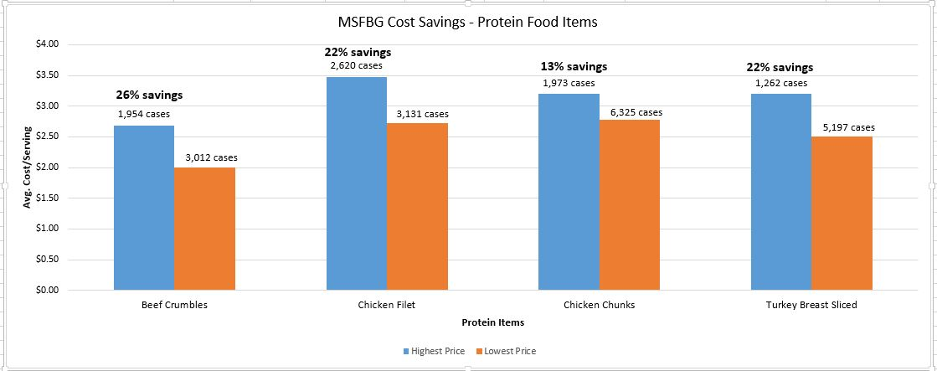
MSFBG Cost Savings – Protein Food Items

Slide 20
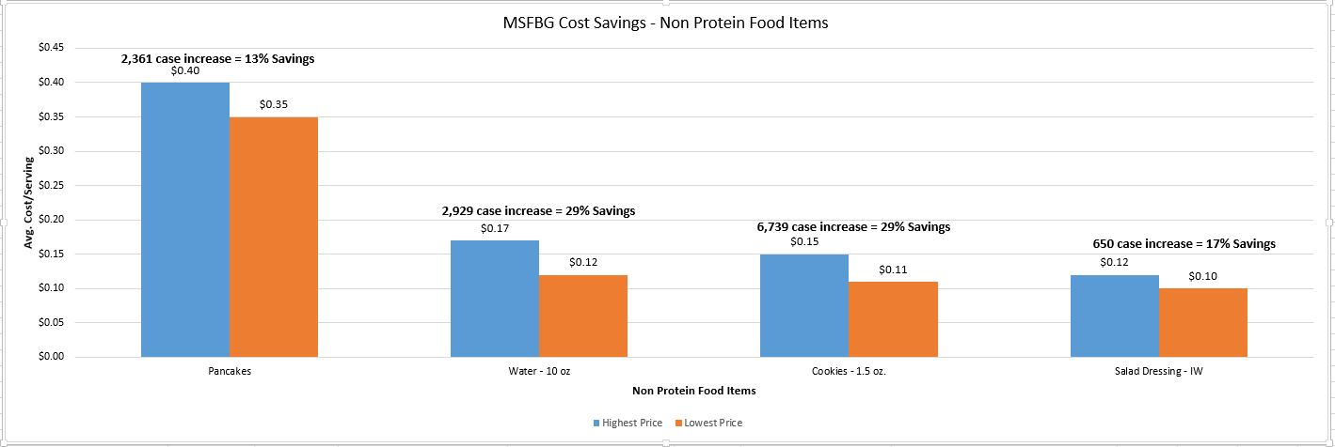
MSFBG Cost Savings – Non Protein Food Items

Slide 21
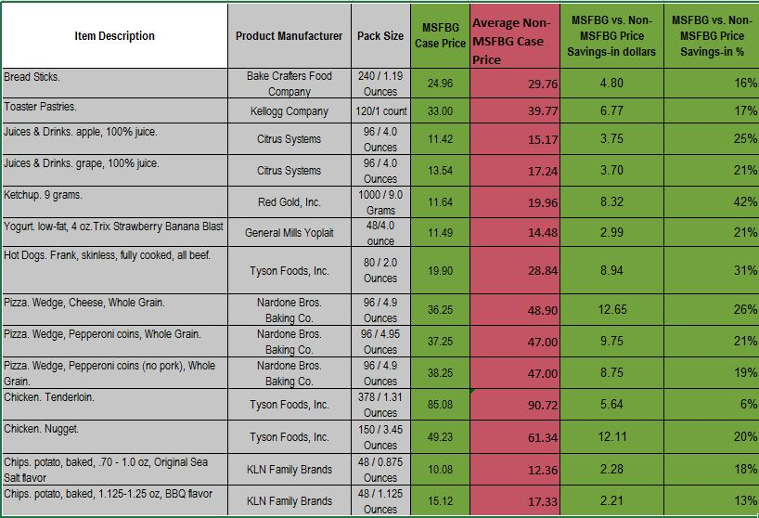
MSFBG Price Savings vs. Non-MSFBG Price Savings 2014-2015

Slide 22

Quotes from Manufacturers and Participants
“MSFBG provides the best bid allowances in the 5 state area.” MSFBG Participating Manufacturer
“MSFBG has helped me be more creative with my menu. We would never had offered the kids’ favorite of Peanut Butter and Jelly Sandwiches as a menu item, but they are affordable on the MSFBG bid. We now have a vegetarian option for our elementary students and boy do they love them!” MSFBG Participant

Slide 23
FAQ?
How do I get started?
  Email msfbg@ahschools.us with noted interest
How are items ultimately selected?
  Via the voting team
What is the Voting Team?
  The voting team consists of 12 districts across the metro area that writes the specifications and evaluates products that are bid and ultimately decides which products are awarded
How is the Voting Team Chosen?
  Currently voting team members are asked to participate as needed

Slide 24

Questions

Slide 25
Thanks for Coming!
Laura Metzger, MSFBG Consultant
msfbg@ahschools.us

