Slide 1

Yearly Written Notification
September 5, 2025
Tex Acosta, Secondary Director
Multilingual Programs Department

Slide 2
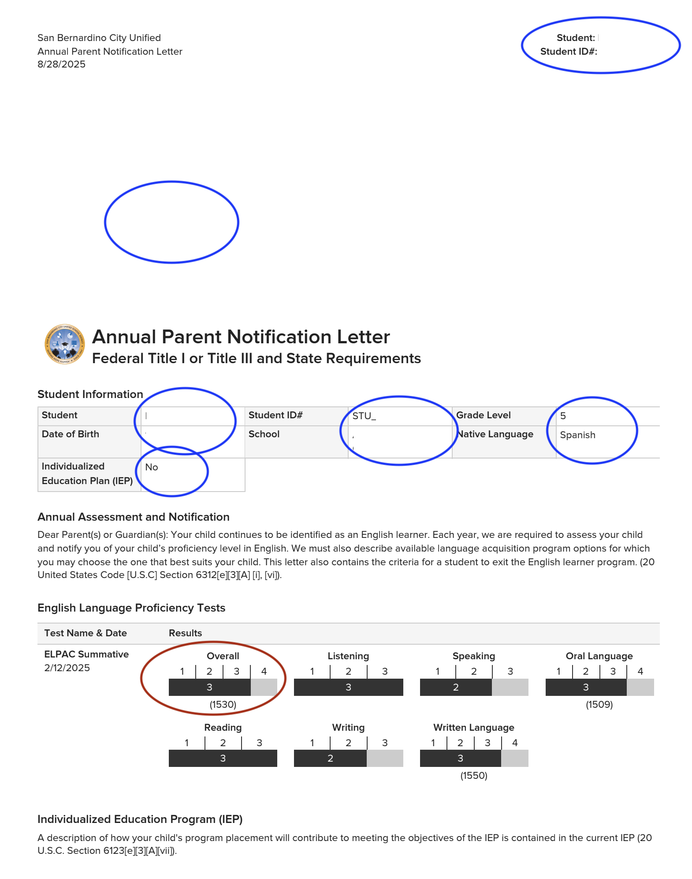
Page #1…Info and ELPAC

Slide 3
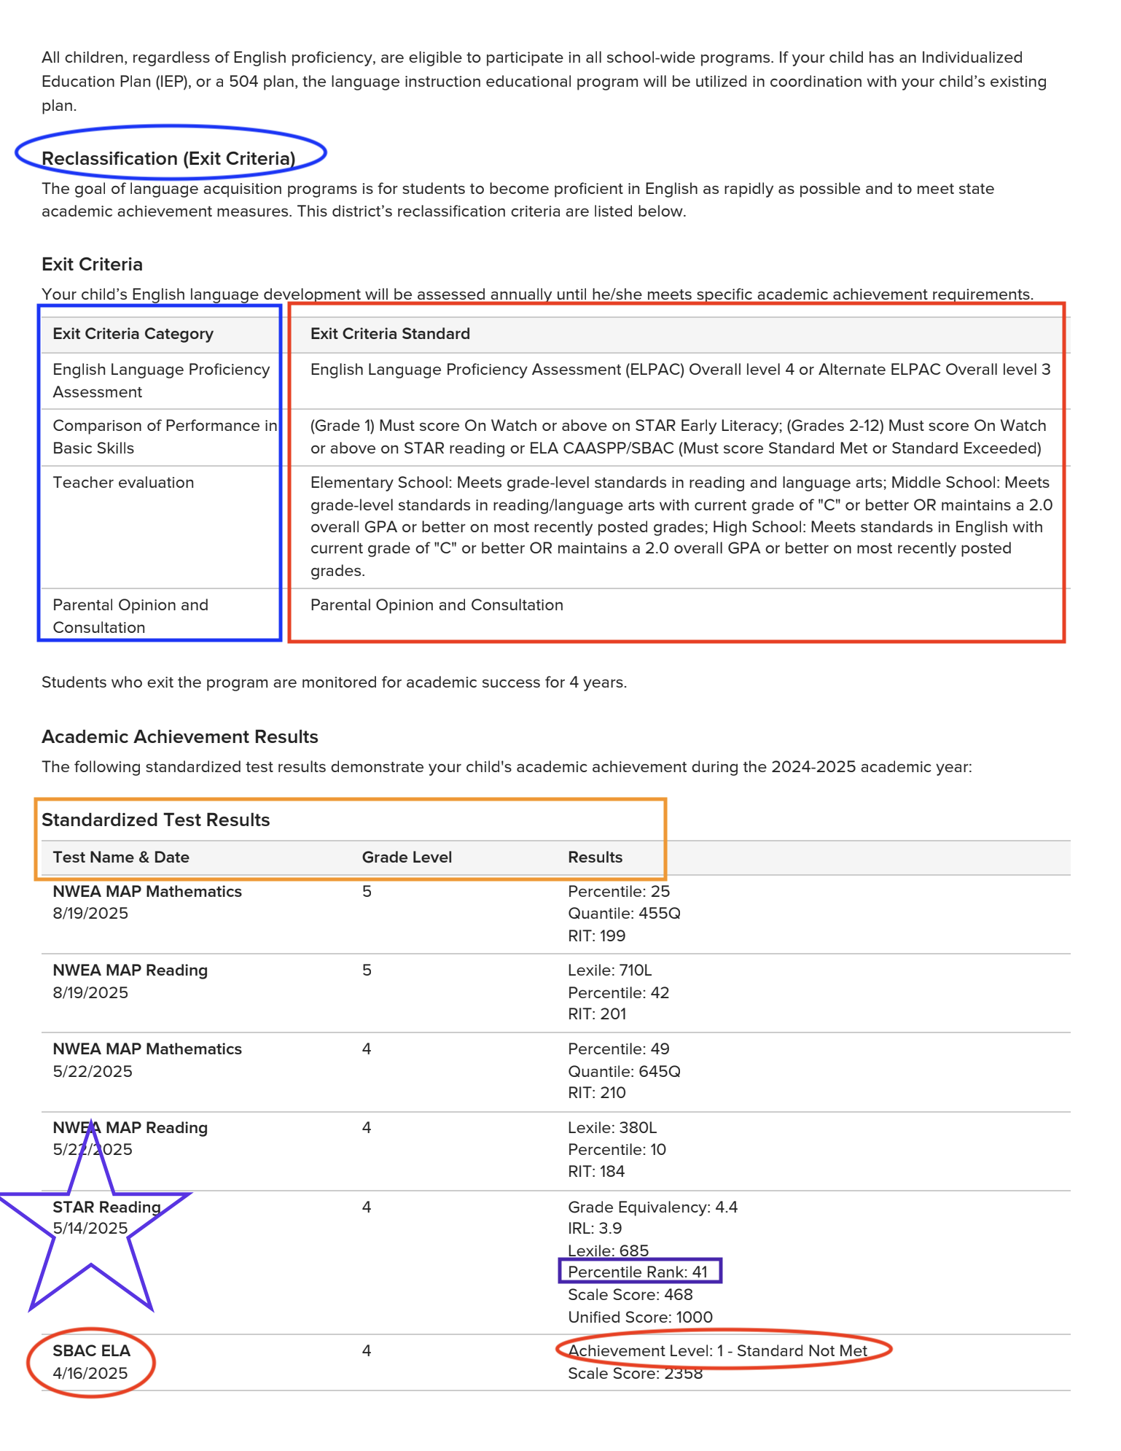
Page #2…Exit Criteria and Results

Slide 4
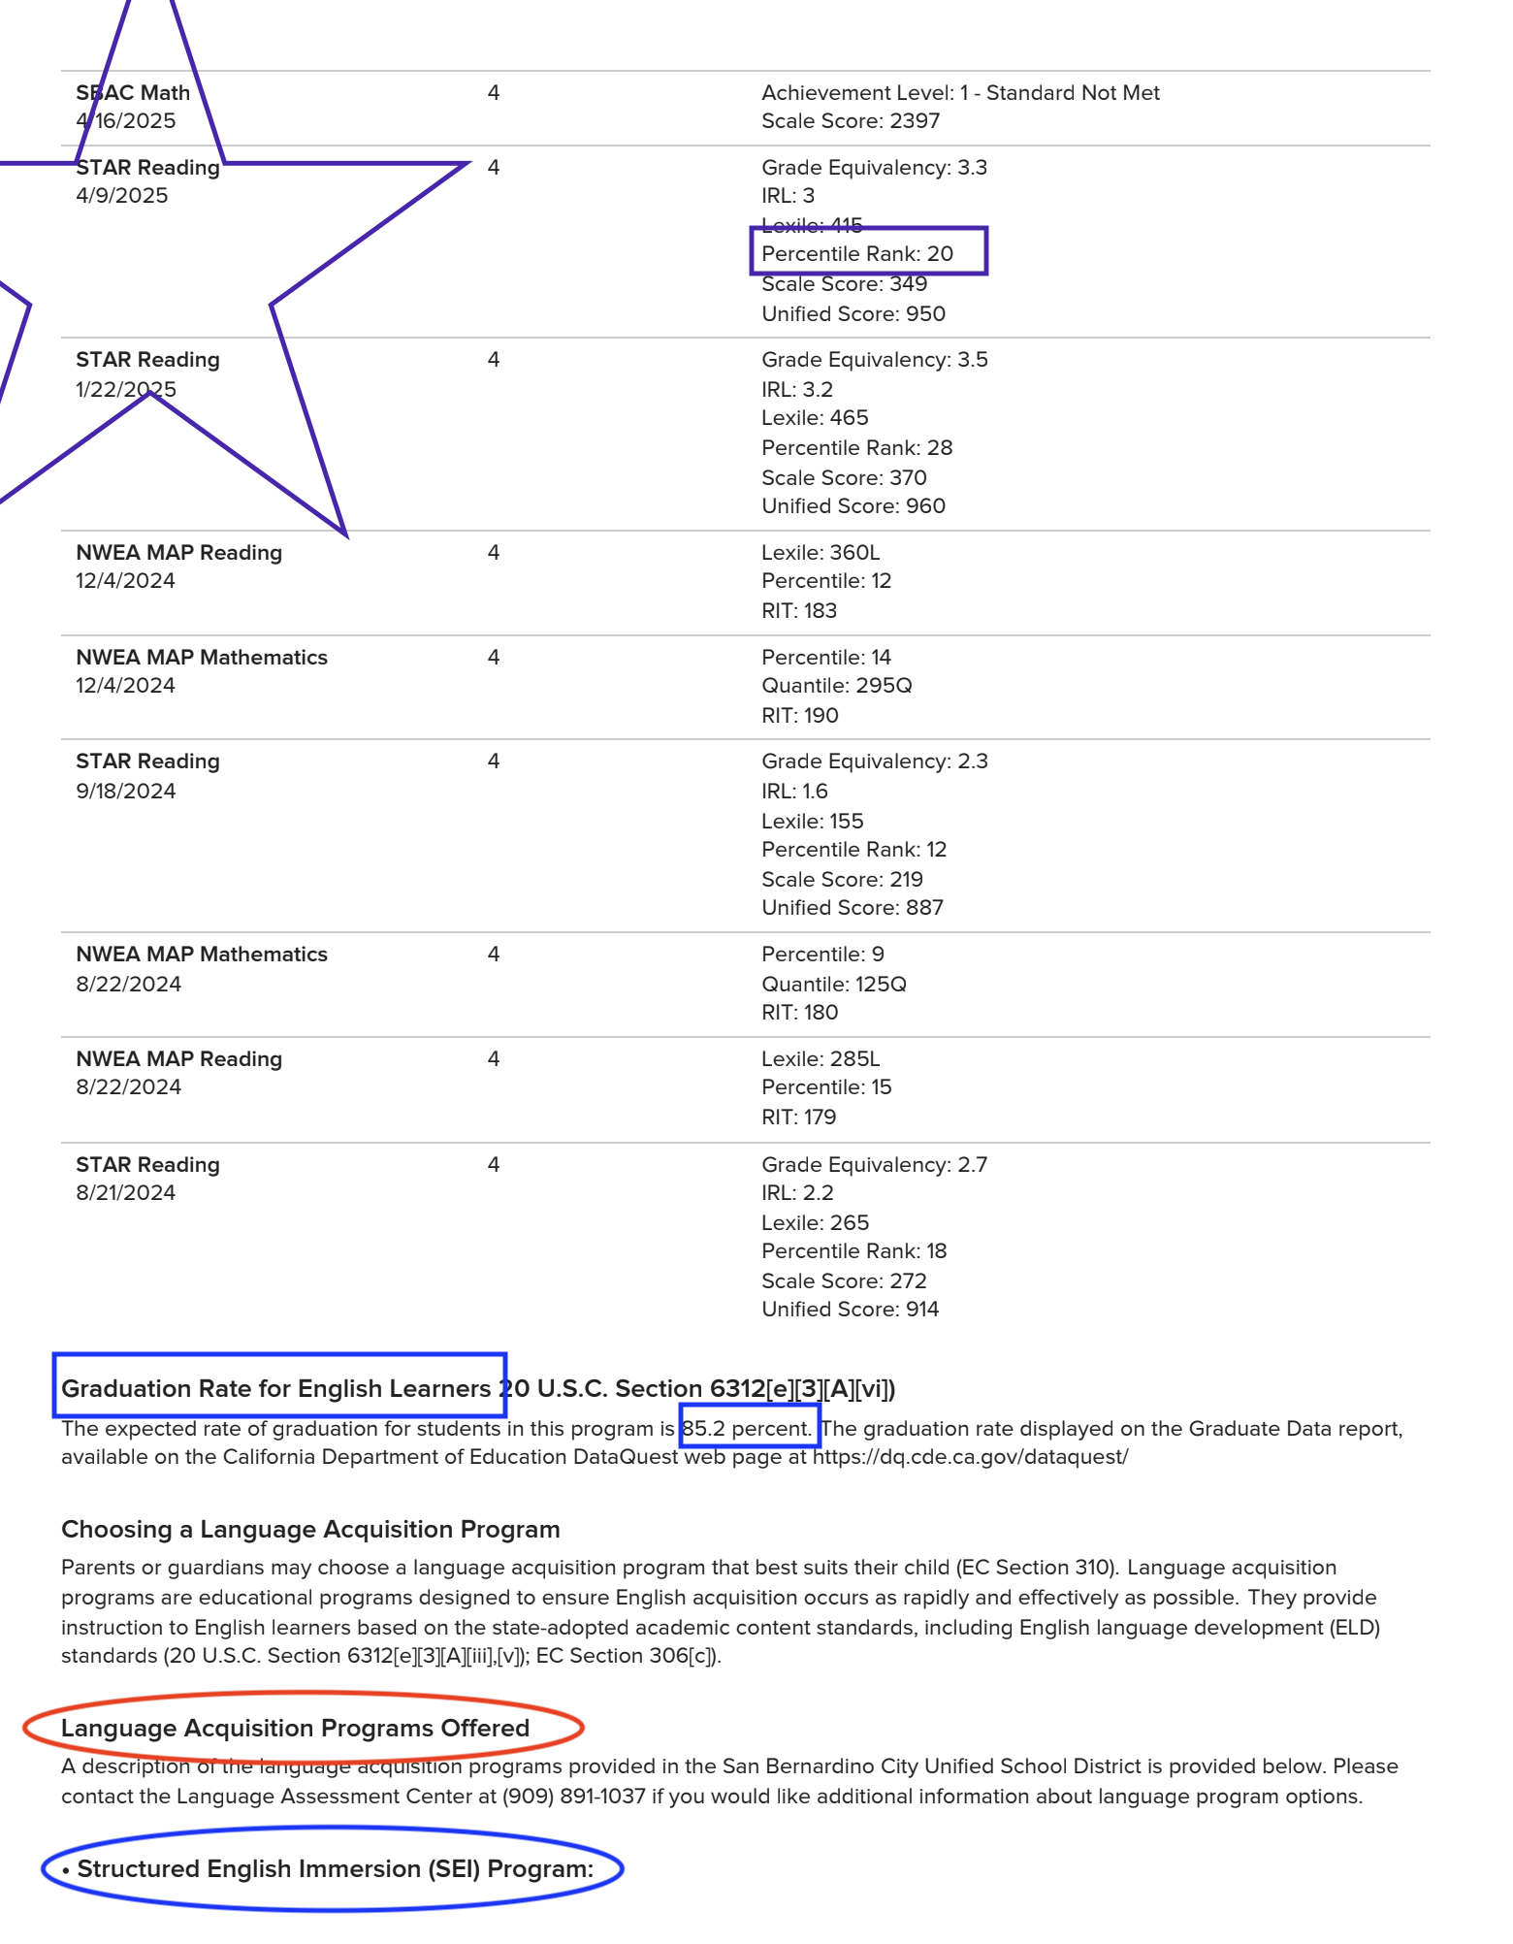
Page #3… Test Results

Slide 5
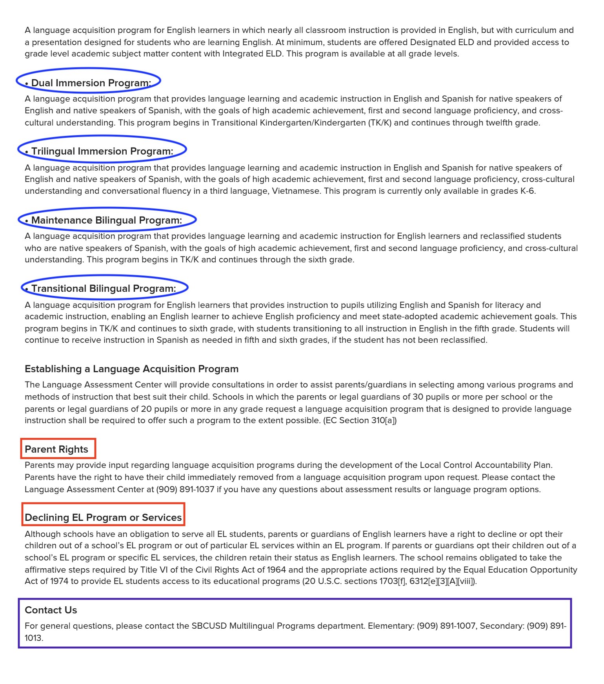
Page #4… Program and Parent Rights

Slide 6

Thank You
Questions?

