Slide 1



This Week’s Specials
9/8/25 -9/12/25
Monday, September 8th, 2025
Philly Steak Sandwich served with Roasted Peppers & Mozzarella Cheese with Curly Fries- $ 5.00
Tuesday, September 9th, 2025
Italian Herb Chicken With White Rice - $4.00
Wednesday , September 10th, 2025
Tex-Mex Sloppy Joes on a Brioche Bun with Fried Curly Fries- $4.50
Thursday, September 11th, 2025
Breaded Chicken Sandwich Dipped in Your Favorite Sauce with Fries With Your Choice Of Toppings Lettuce, Tomatoes, Onions, Pickles & Caesar Salad- $6.50
Friday, September 12th, 2025
Taco Bar- Seasoned Beef with Your Choice of Salsas, Roasted Vegetables, Sour Cream, Cheese Lettuce, Onions and Rice- $5.00
Caesar Salad- $4.00
Romaine Lettuce, Parmesan cheese, Crispy Chicken & Caesar Dressing
Mixed Berry Parfait- $3.50
Fresh Strawberries and Blueberries with Vanilla Yogurt and Crunchy Granola
Grilled Chicken Deluxe Wrap -$5.00
Grilled Chicken with Cheese, Lettuce & Tomato in a Tortilla
S’mores Cup - $4.00
Milk Chocolate Pudding, Graham Crackers, Mini Marshmallows, Chocolate chips.
$6 Meal Deal
Dash Specials
Any Dash Sub Sandwich with Baked Chips & Whole Fruit
Quest Food prioritizes the health and wellness of our guests through chef-crafted recipes and scratch made cooking techniques using fresh, high-quality ingredients that are flavorful, wholesome, and responsibly sourced.

Slide 2
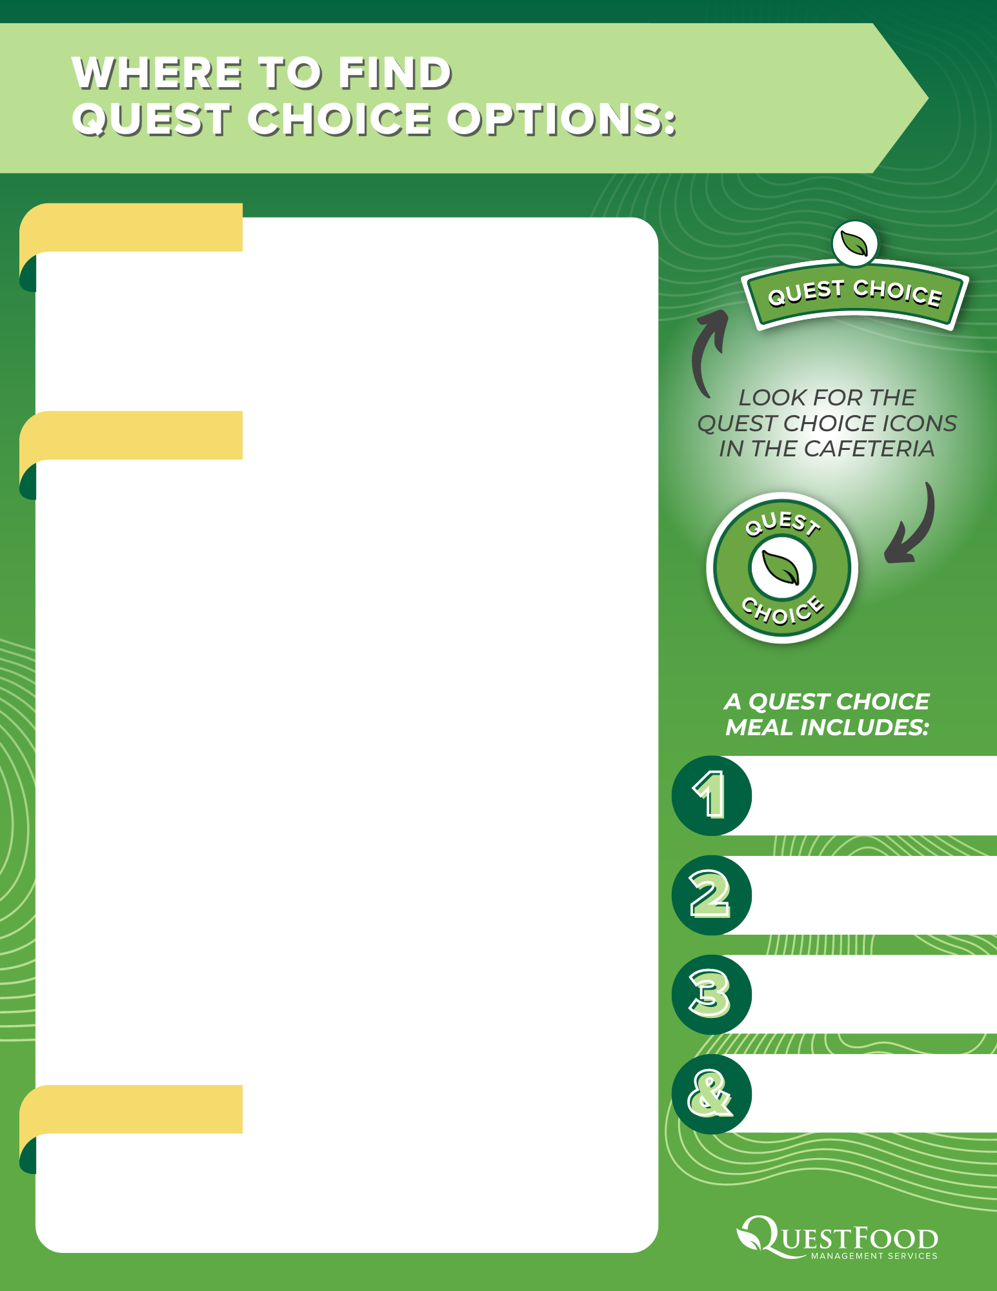
DASH
DASH- DAILY
Simple Ham & Cheese Sandwich with Choice of Toppings, Whole Fruit or Veggie Cup, Milk or Water
Entrée Salad with Whole Fruit or Veggie Cup, Milk or Water
LUNCH
DASH-- MONDAY
Beef & Cheese Sandwich with Whole Fruit or Veggie Cup, Milk or Water
HOMEGROWN- TUESDAY
Italian Herb Chicken With White Rice. Whole Fruit or Veggie Cup, Milk or Water
PICANTE - WEDNESDAY
Tex-Mex Sloppy Joe with Whole Fruit or Veggie Cup, Milk or Water
HOMEGROWN –THURSDAY
Build Your Own Chicken Sandwich, Whole Fruit or Veggie Cup, Milk or Water
GRILL-FRIDAY
Turkey, Bacon & Cheddar Panini , Whole Fruit or Veggie Cup, Milk or Water
CRUST- DAILY
Cheese Pizza, Small Salad, Whole Fruit or Veggie Cup, Milk or Water
Pasta With Your Choice of Sauce, Whole Fruit or Veggie Cup, Milk or Water
Choice of Entrée
and a Side Dish
Fresh
Vegetable
Fresh
Fruit
BEVERAGES
½ Pint Milk or
16.9oz Bottled Water
2% Milk ½ Pint
Chocolate Milk ½ Pint
Bottled Nestle Water

Slide 3
This Week’s Specials
9/15/25 – 9/19/25
Monday, September 15th, 2025
Chicken Garlic Broccoli Stir Fry with Vegetables served over Ramen Noodles -$5.50
Tuesday, September 16th, 2025
Buffalo Chicken Tacos with Ranch Cole Slaw & Pickled Red Onions- $6.50
Wednesday, September 17th, 2025
Burger Bar with Fries- Build Your Own Burger with 3 different types of Cheese, Lettuce, Tomatoes, Onions, Pickles, Ketchup Mustard & Mayo -$5.00
Thursday, September 18th, 2025
Breaded Chicken Sandwich Dipped in Your Favorite Sauce with Fries With Your Choice Of Toppings Lettuce, Tomatoes, Onions, Pickles& Caesar Salad- $6.50
Friday, September 19th, 2025
Pasta Bar- Your Choice between Spaghetti and Penne Pasta With Alfredo Sauce, Marinara Sauce, Parmesan Cheese, Broccoli, Roasted Peppers, And Garlic Bread.- $5.00
$5 Meal Deal
Dash Features
Pizza Slice, Side Salad, Fruit Cup & Bottled Water or Milk
Turkey Bacon Wrap- $4.50
Turkey, Bacon, Cheddar Cheese On a Tortilla with Mayo
Oreo Cheesecake Cup $4.00
Crushed Oreos, Whipped Cream, Cream Cheese, & Chocolate syrup
Quest Food prioritizes the health and wellness of our guests through chef-crafted recipes and scratch made cooking techniques using fresh, high-quality ingredients that are flavorful, wholesome, and responsibly sourced.

Slide 4
DASH
DASH- DAILY
Simple Turkey & Cheese Sandwich with Choice of Toppings, Whole Fruit or Veggie Cup, Milk or Water
Entrée Salad with Whole Fruit or Veggie Cup, Milk or Water
LUNCH
DASH-- MONDAY
Ham & Cheese Sandwich with Whole Fruit or Veggie Cup, Milk or Water
DASH- TUESDAY
Deluxe Turkey Deli Sub with Whole Fruit or Veggie Cup, Milk or Water
DASH - WEDNESDAY
Ham Deli Sub Whole Fruit or Veggie Cup, Milk or Water
HOMEGROWN –THURSDAY
Build Your Own Chicken Sandwich, Whole Fruit or Veggie Cup, Milk or Water
HOMEGROWN-FRIDAY
Pasta Bar with Whole Fruit or Veggie Cup, Milk or Water
CRUST- DAILY
Cheese Pizza, Small Salad, Whole Fruit or Veggie Cup, Milk or Water
Pasta with Your Choice of Sauce, Whole Fruit or Veggie Cup, Milk or Water
Choice of Entrée
and a Side Dish
Fresh
Vegetable
Fresh
Fruit
BEVERAGES
½ Pint Milk or
16.9oz Bottled Water
2% Milk ½ Pint
Chocolate Milk ½ Pint
Bottled Nestle Water

Slide 5
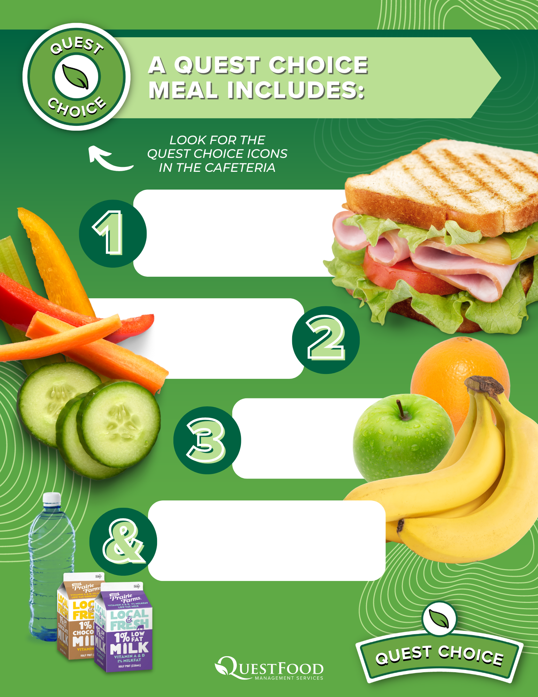
Choice of Entrée and a Side Dish
Fresh
Vegetable
Fresh
Fruit
½ Pint Milk or
16.9oz Bottled Water

Slide 6
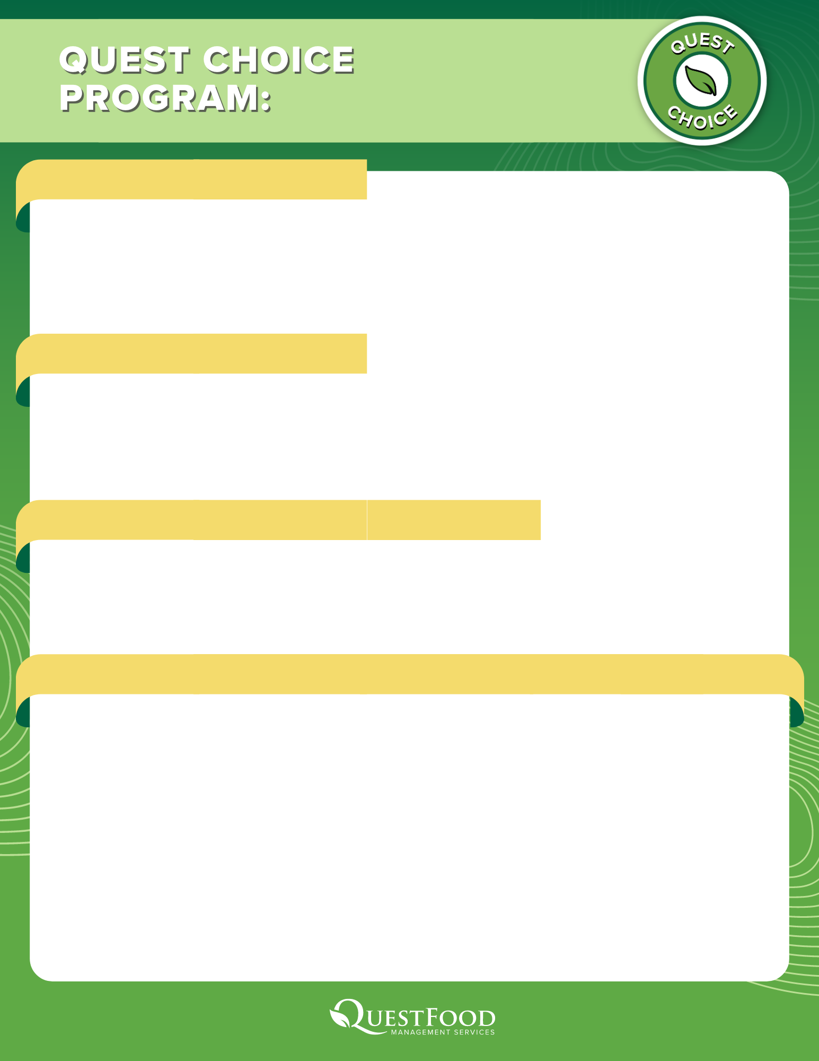
ADDITIONAL PURCHASES
If a student wants to purchase any item outside of the Quest Choice program, they are permitted to do so through the school’s dining account or with cash payment at check-out. When funds are added to the dining account, students will be able to access those funds by showing their student ID at check-out, and the cost of the additional item(s) will be automatically deducted from their account.
QUEST CHOICE SYMBOL
The Quest Choice symbol is used throughout serving areas so that students can easily identify the items included in the program, allowing them easy and discreet access to their meals. The Quest Choice symbol is featured next to qualifying items on menu signage at each station, and oftentimes next to the item itself on the serving line or pick-up location.
ABOUT QUEST FOOD MANAGEMENT SERVICES
Quest Food Management Services is a premier food service provider for schools throughout the Midwest. Quest is committed to using scratch made cooking techniques and fresh, high-quality ingredients to offer students nutritious meals that fuel their development and learning.
FOR MORE INFORMATION
If a student or caregiver is having difficulty understanding what is included in the Quest Choice program at their school, our dining team is available to provide further details. Students and caregivers can contact Megan Gacek, Chef Manager by email at megan.gacek@questfms.com or phone at 773-965-0142, or email QuestChoice@QuestFMS.com to request more information.

