Slide 1
Navigating SORA

Slide 2
How to use link: https://fast.wistia.net/embed/iframe/x1crca6t1n?videoFoam=true

Slide 3
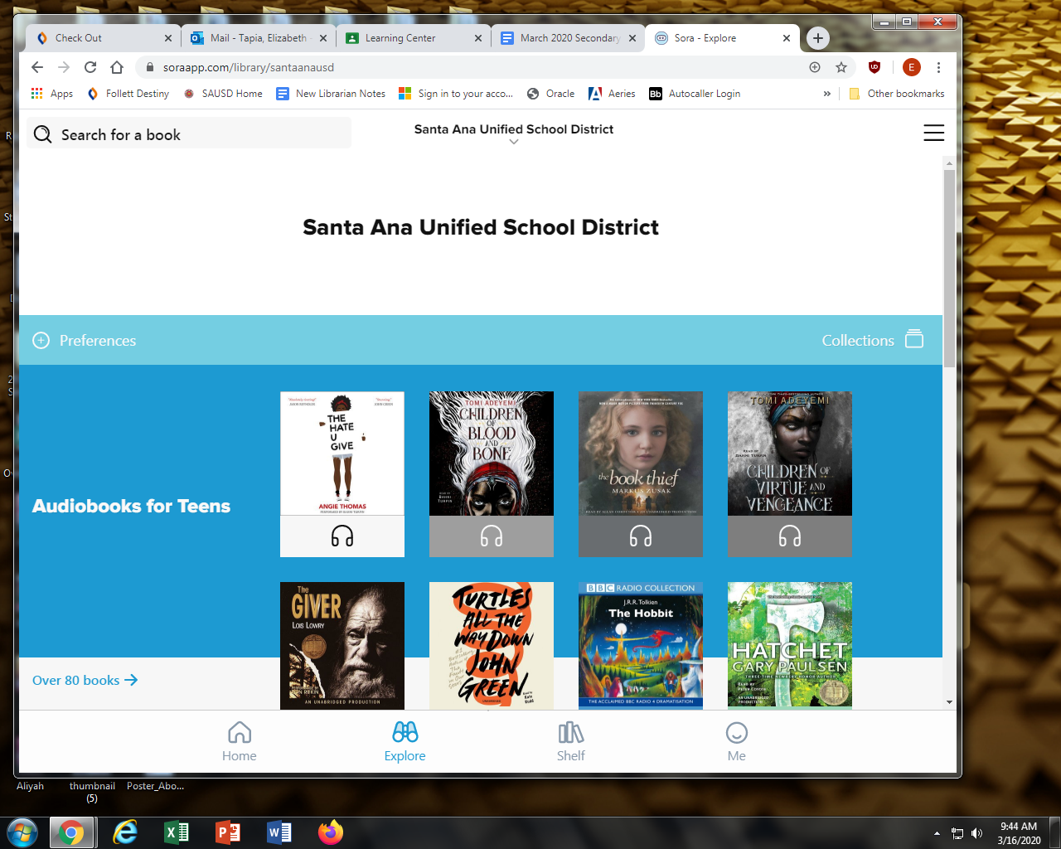
Step 1
Go to
soraapp.com/library/santaanausd
and then login in with your SAUSD google account
Place your screenshot here

Slide 4
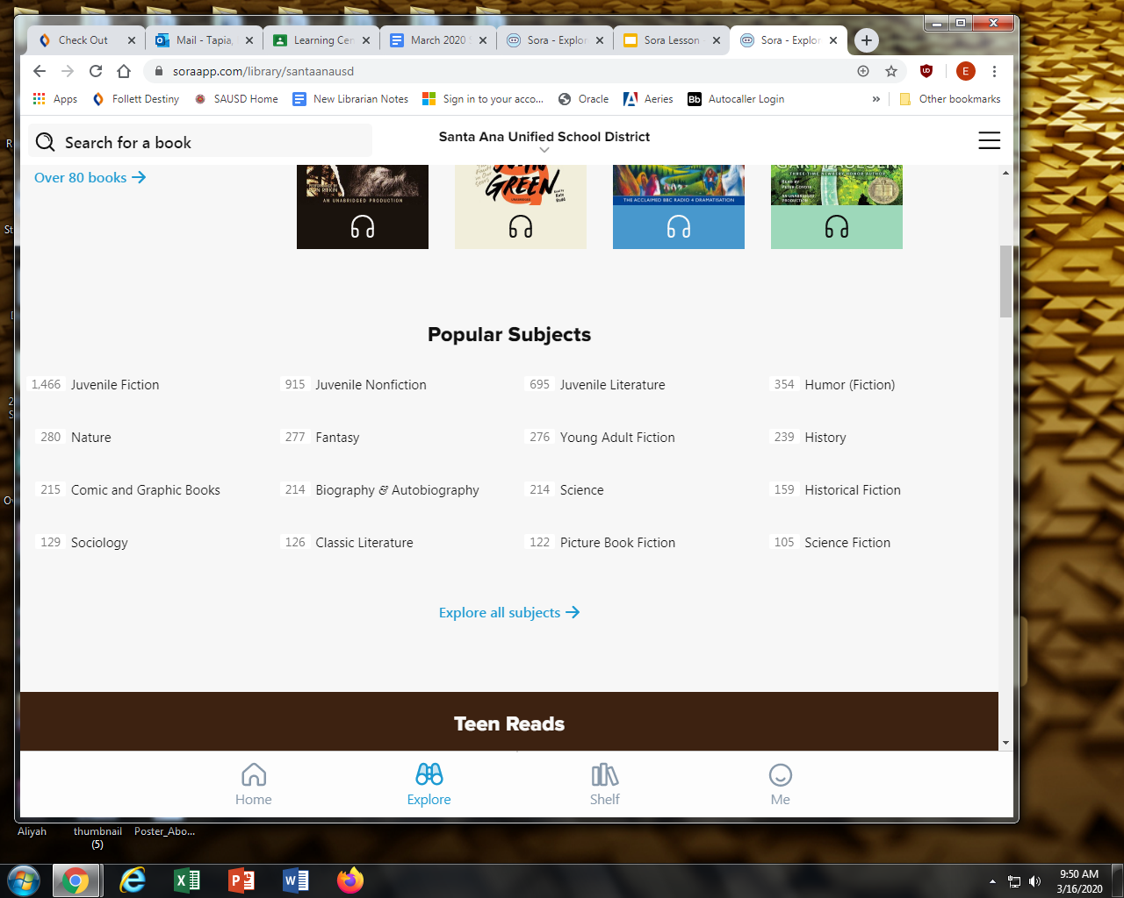
Step 2
Explore the popular subjects or browse and see what you like.

Slide 5
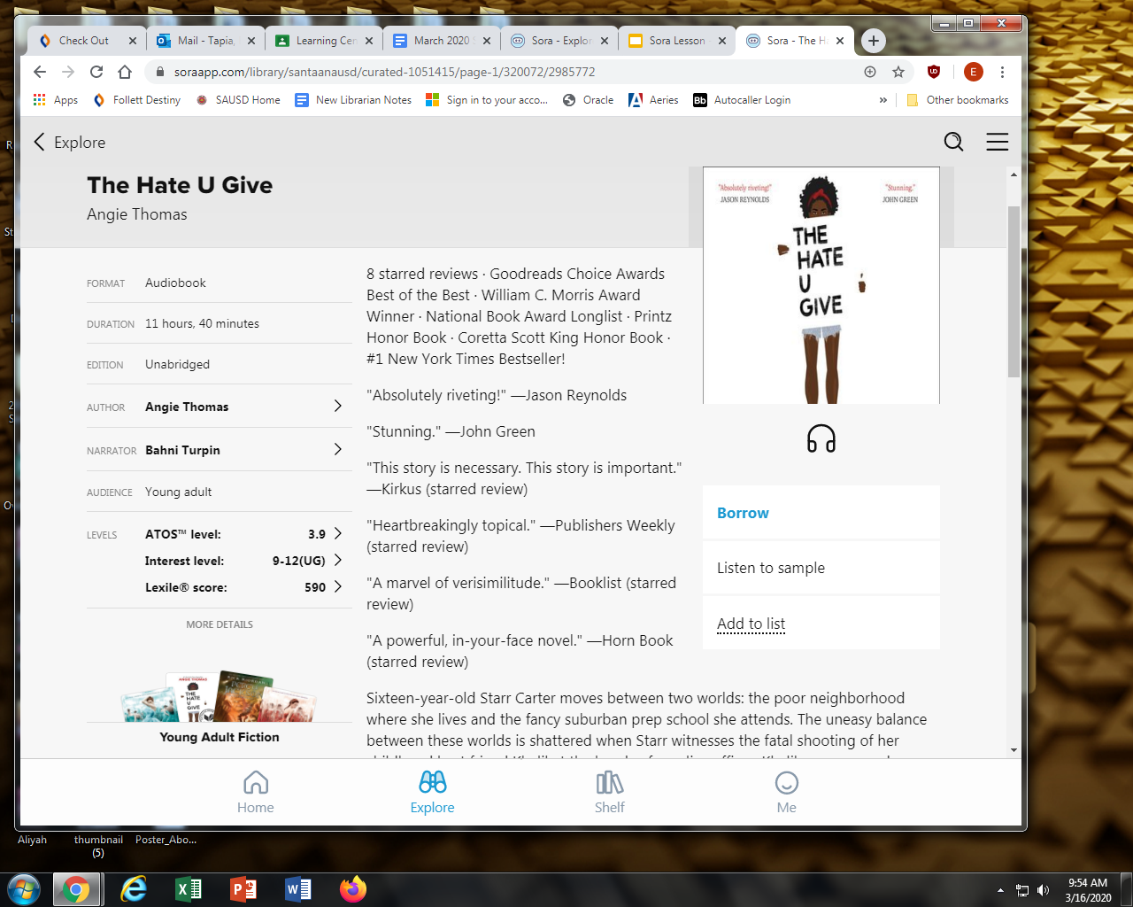
Step 3
Click on the book that you are interested in and click borrow.
If you are allowed to borrow the book, you will have 2 weeks before its due date.
If you are not allowed to borrow the books, then place it on Hold or add it to your list

Slide 6
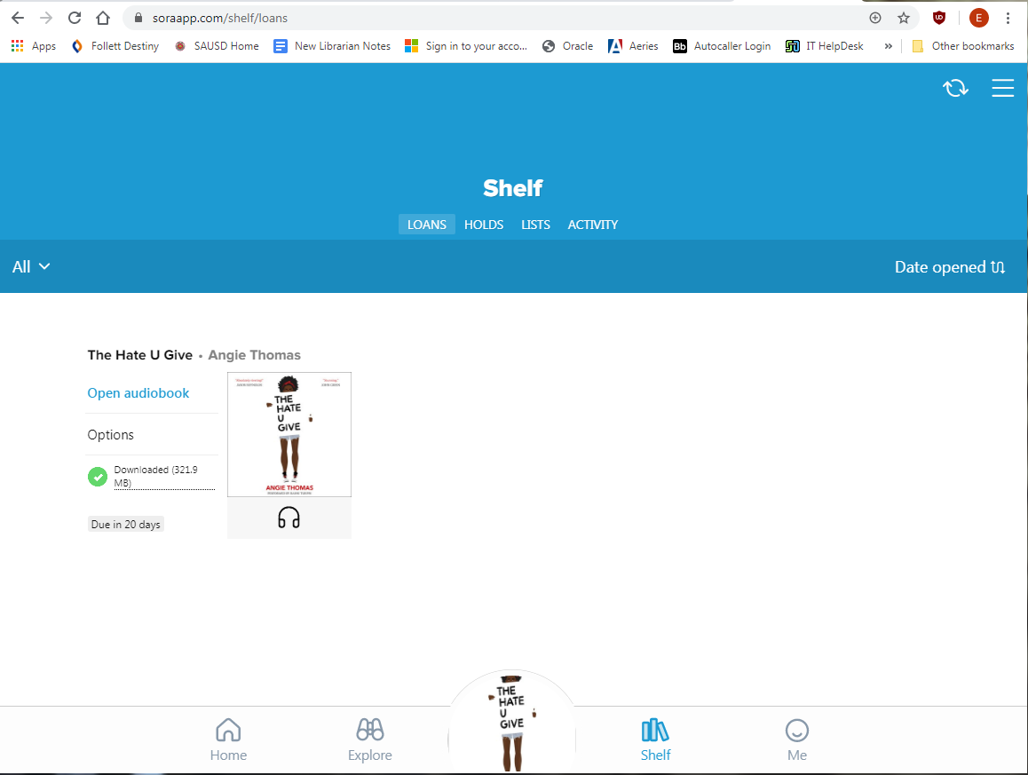
Step 4
Click on Shelf to see your books out on loan or your books on hold.
Or
click on Me to look at your reading achievements.

Slide 7
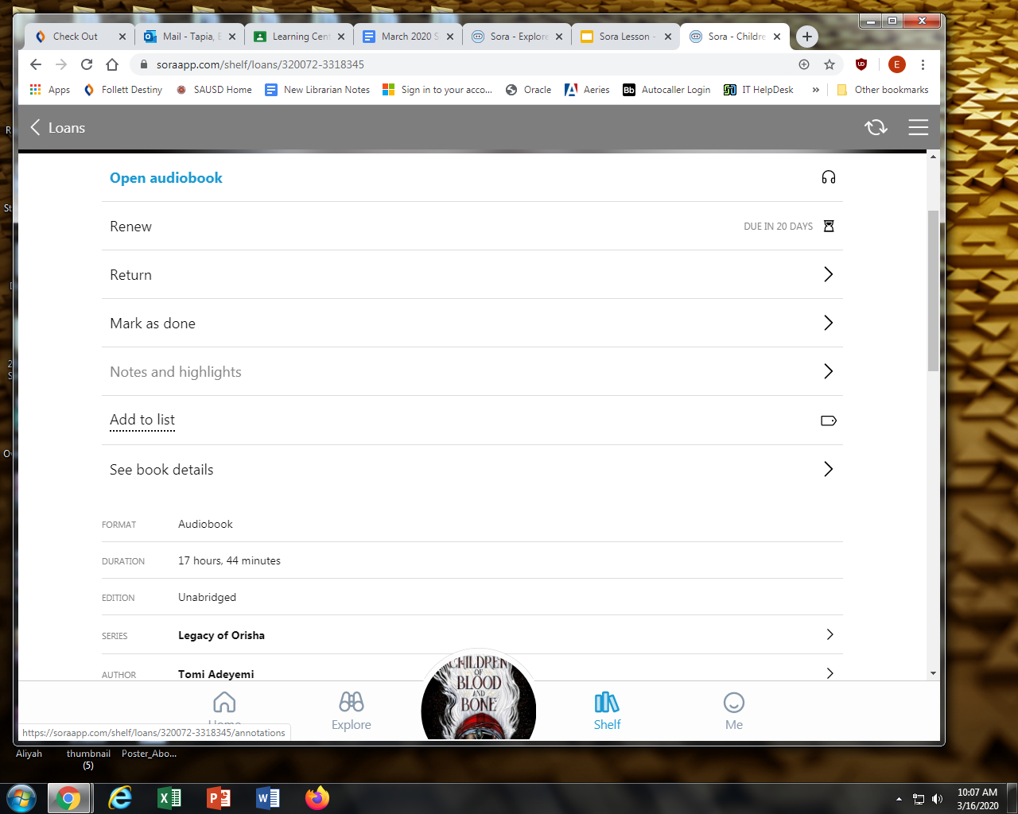
How to Return or Renew
Under Loans click the Options button Next to the book
You may click renew, return, or add to List

Slide 8
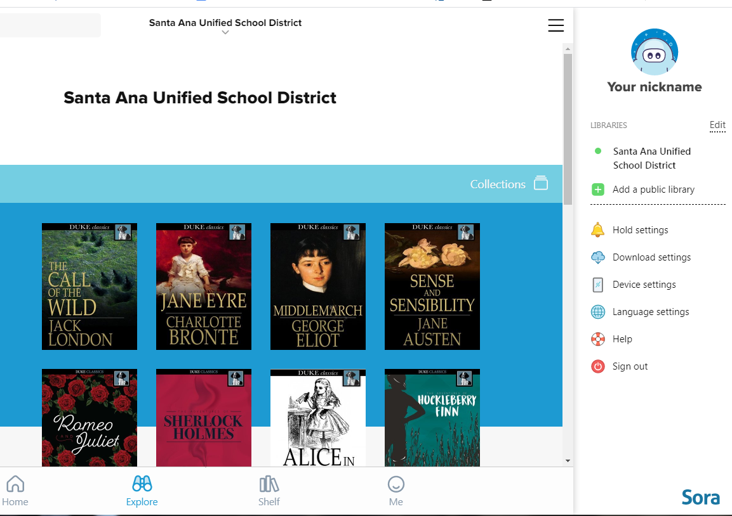
Students may add a public library account by:
Clicking on the sidebar to the right and click on Add a public library.

Slide 9
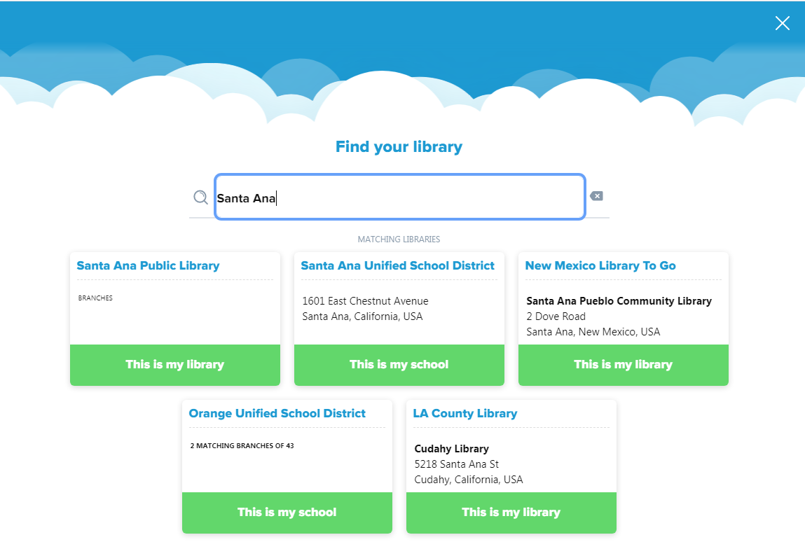
Students may add a public library account by:
You may borrow a book from that library using your library card information.

Slide 10
You are Ready To Explore!!!

