Slide 1

6th Grade
Language Arts
Mrs. Kempe

Slide 2
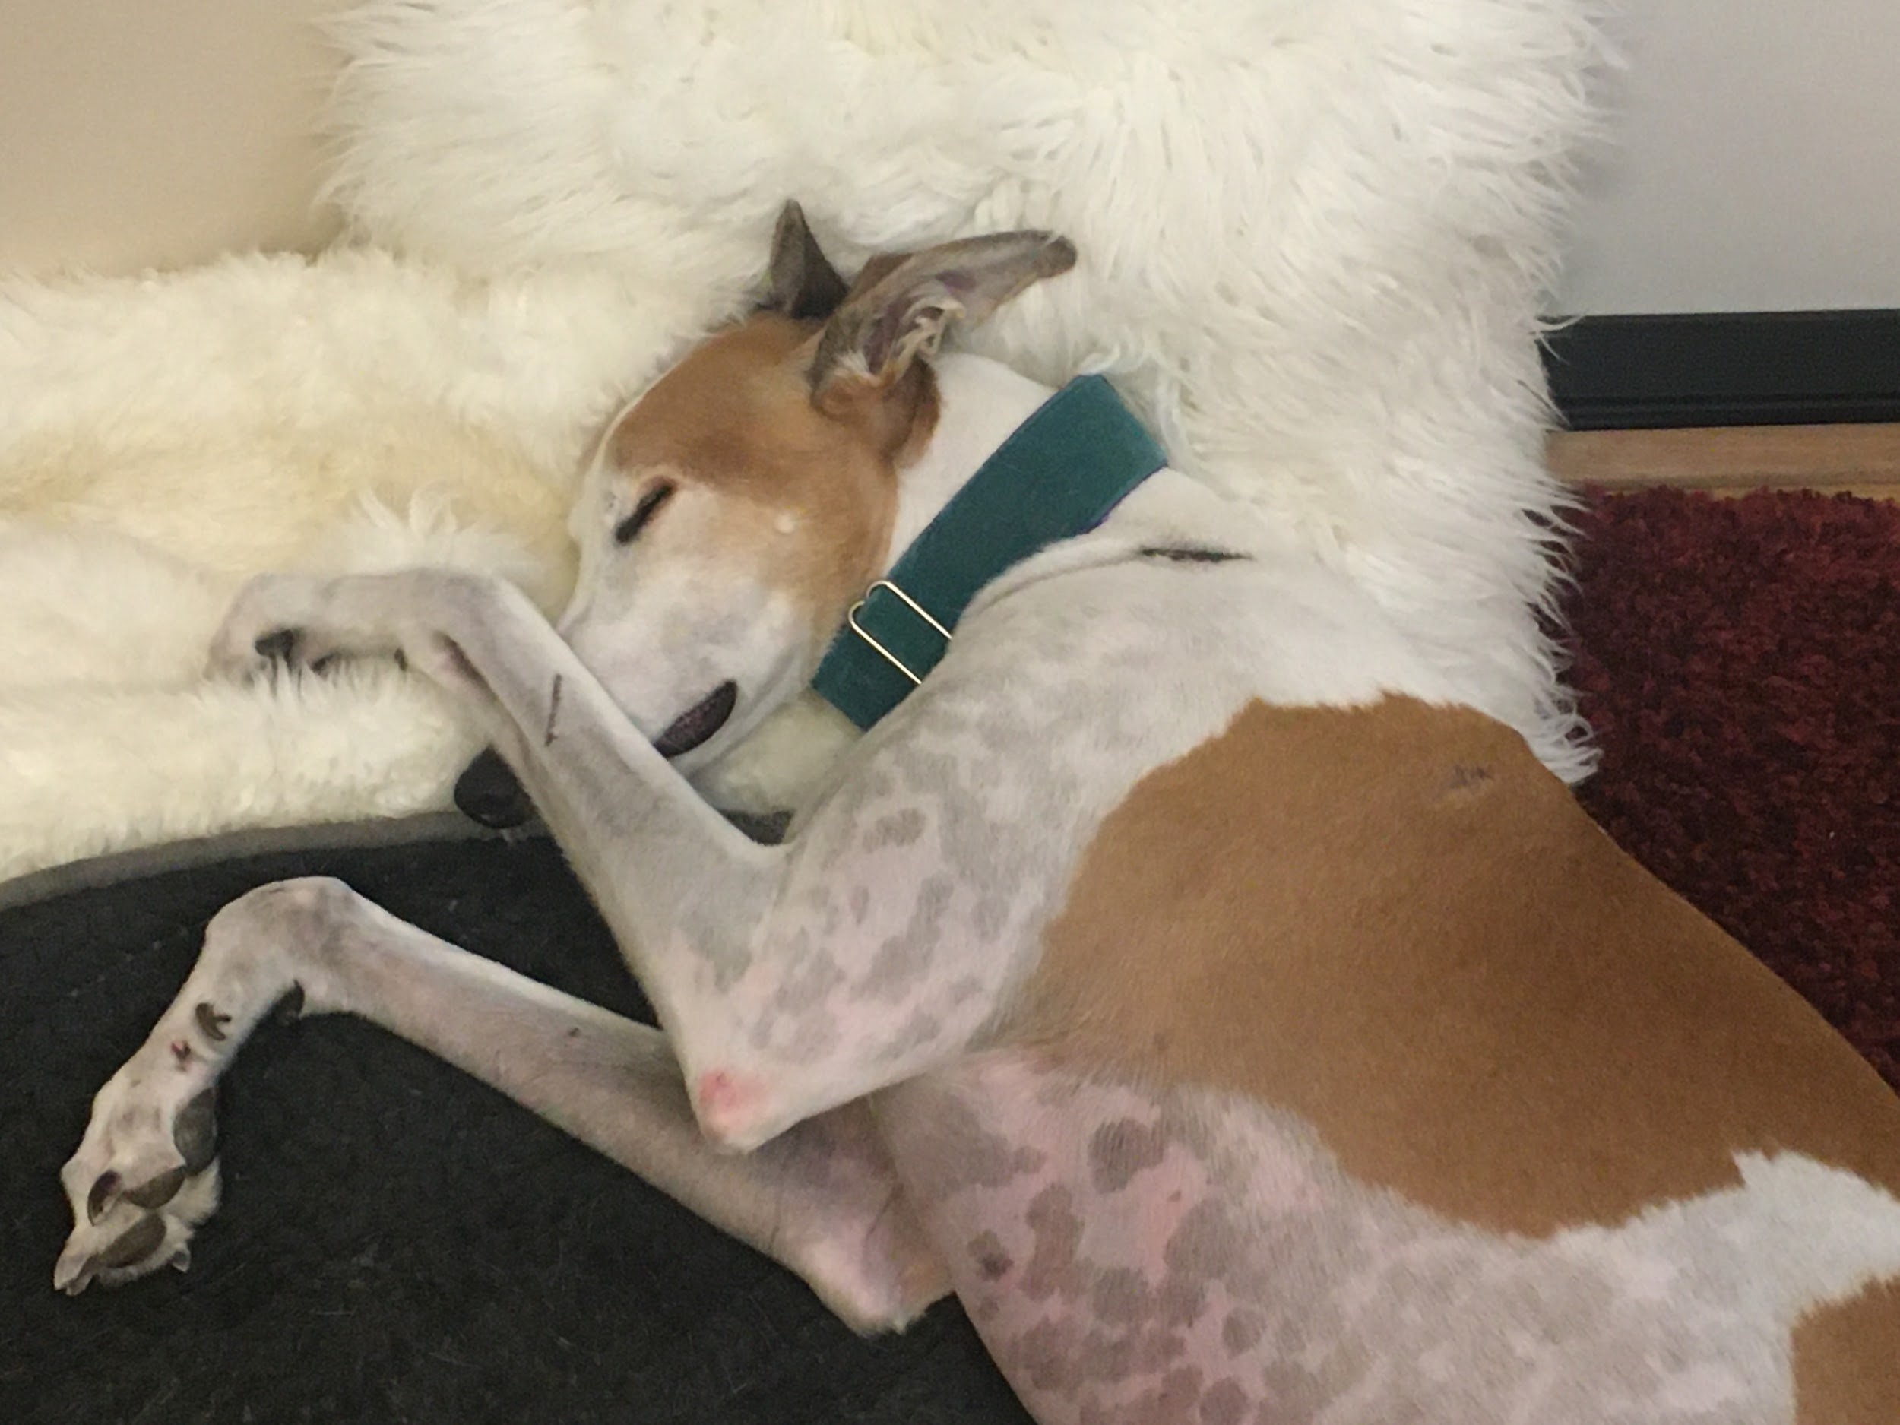
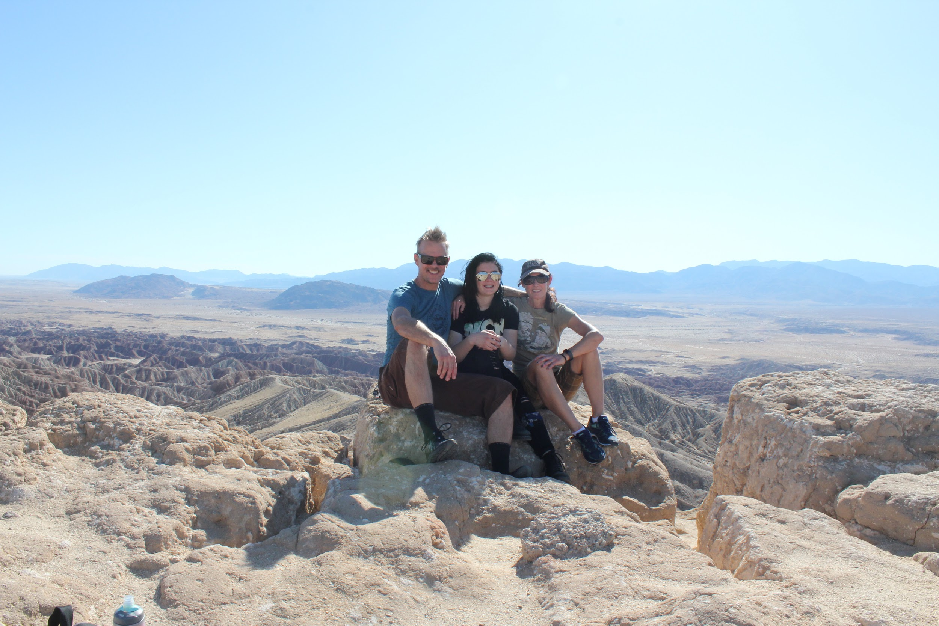
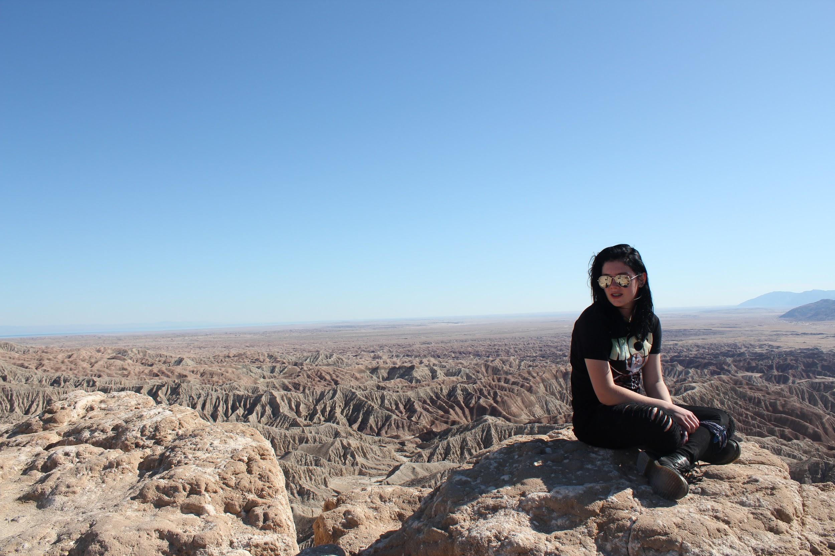
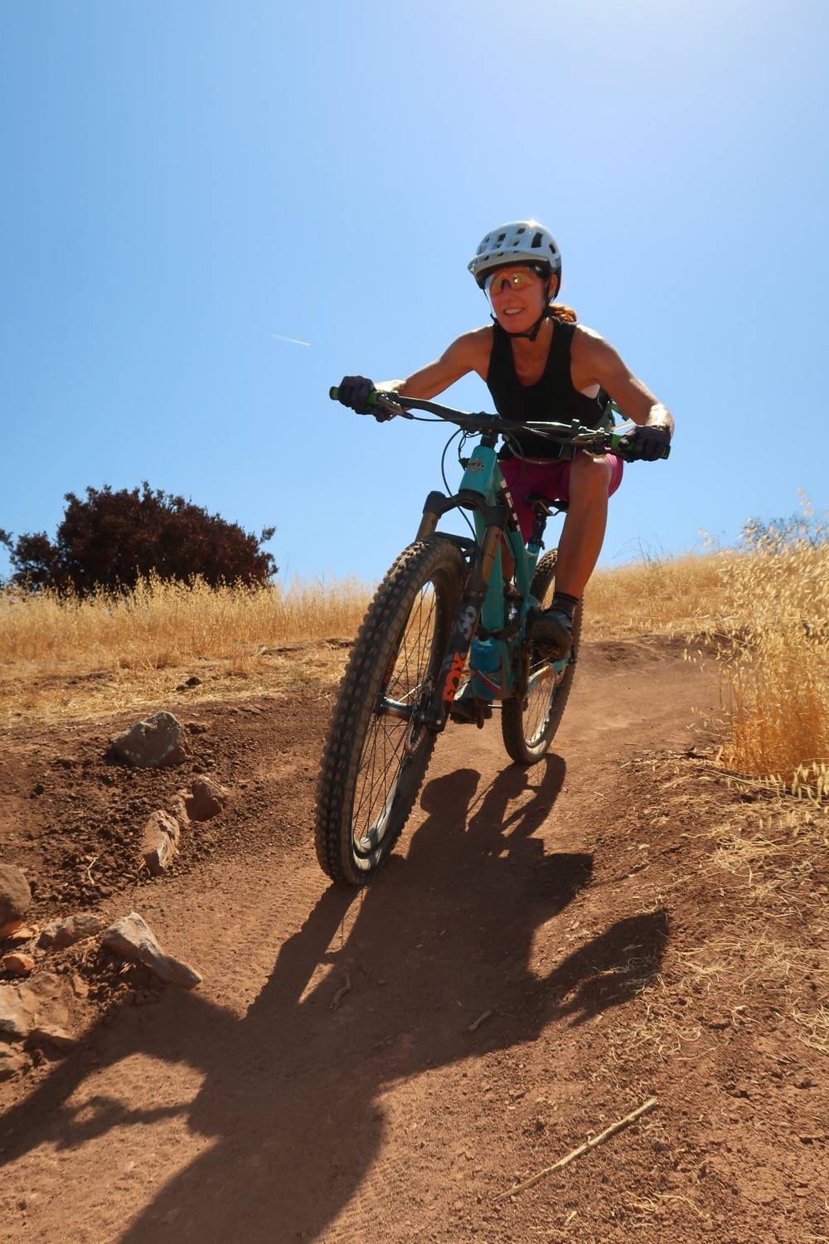
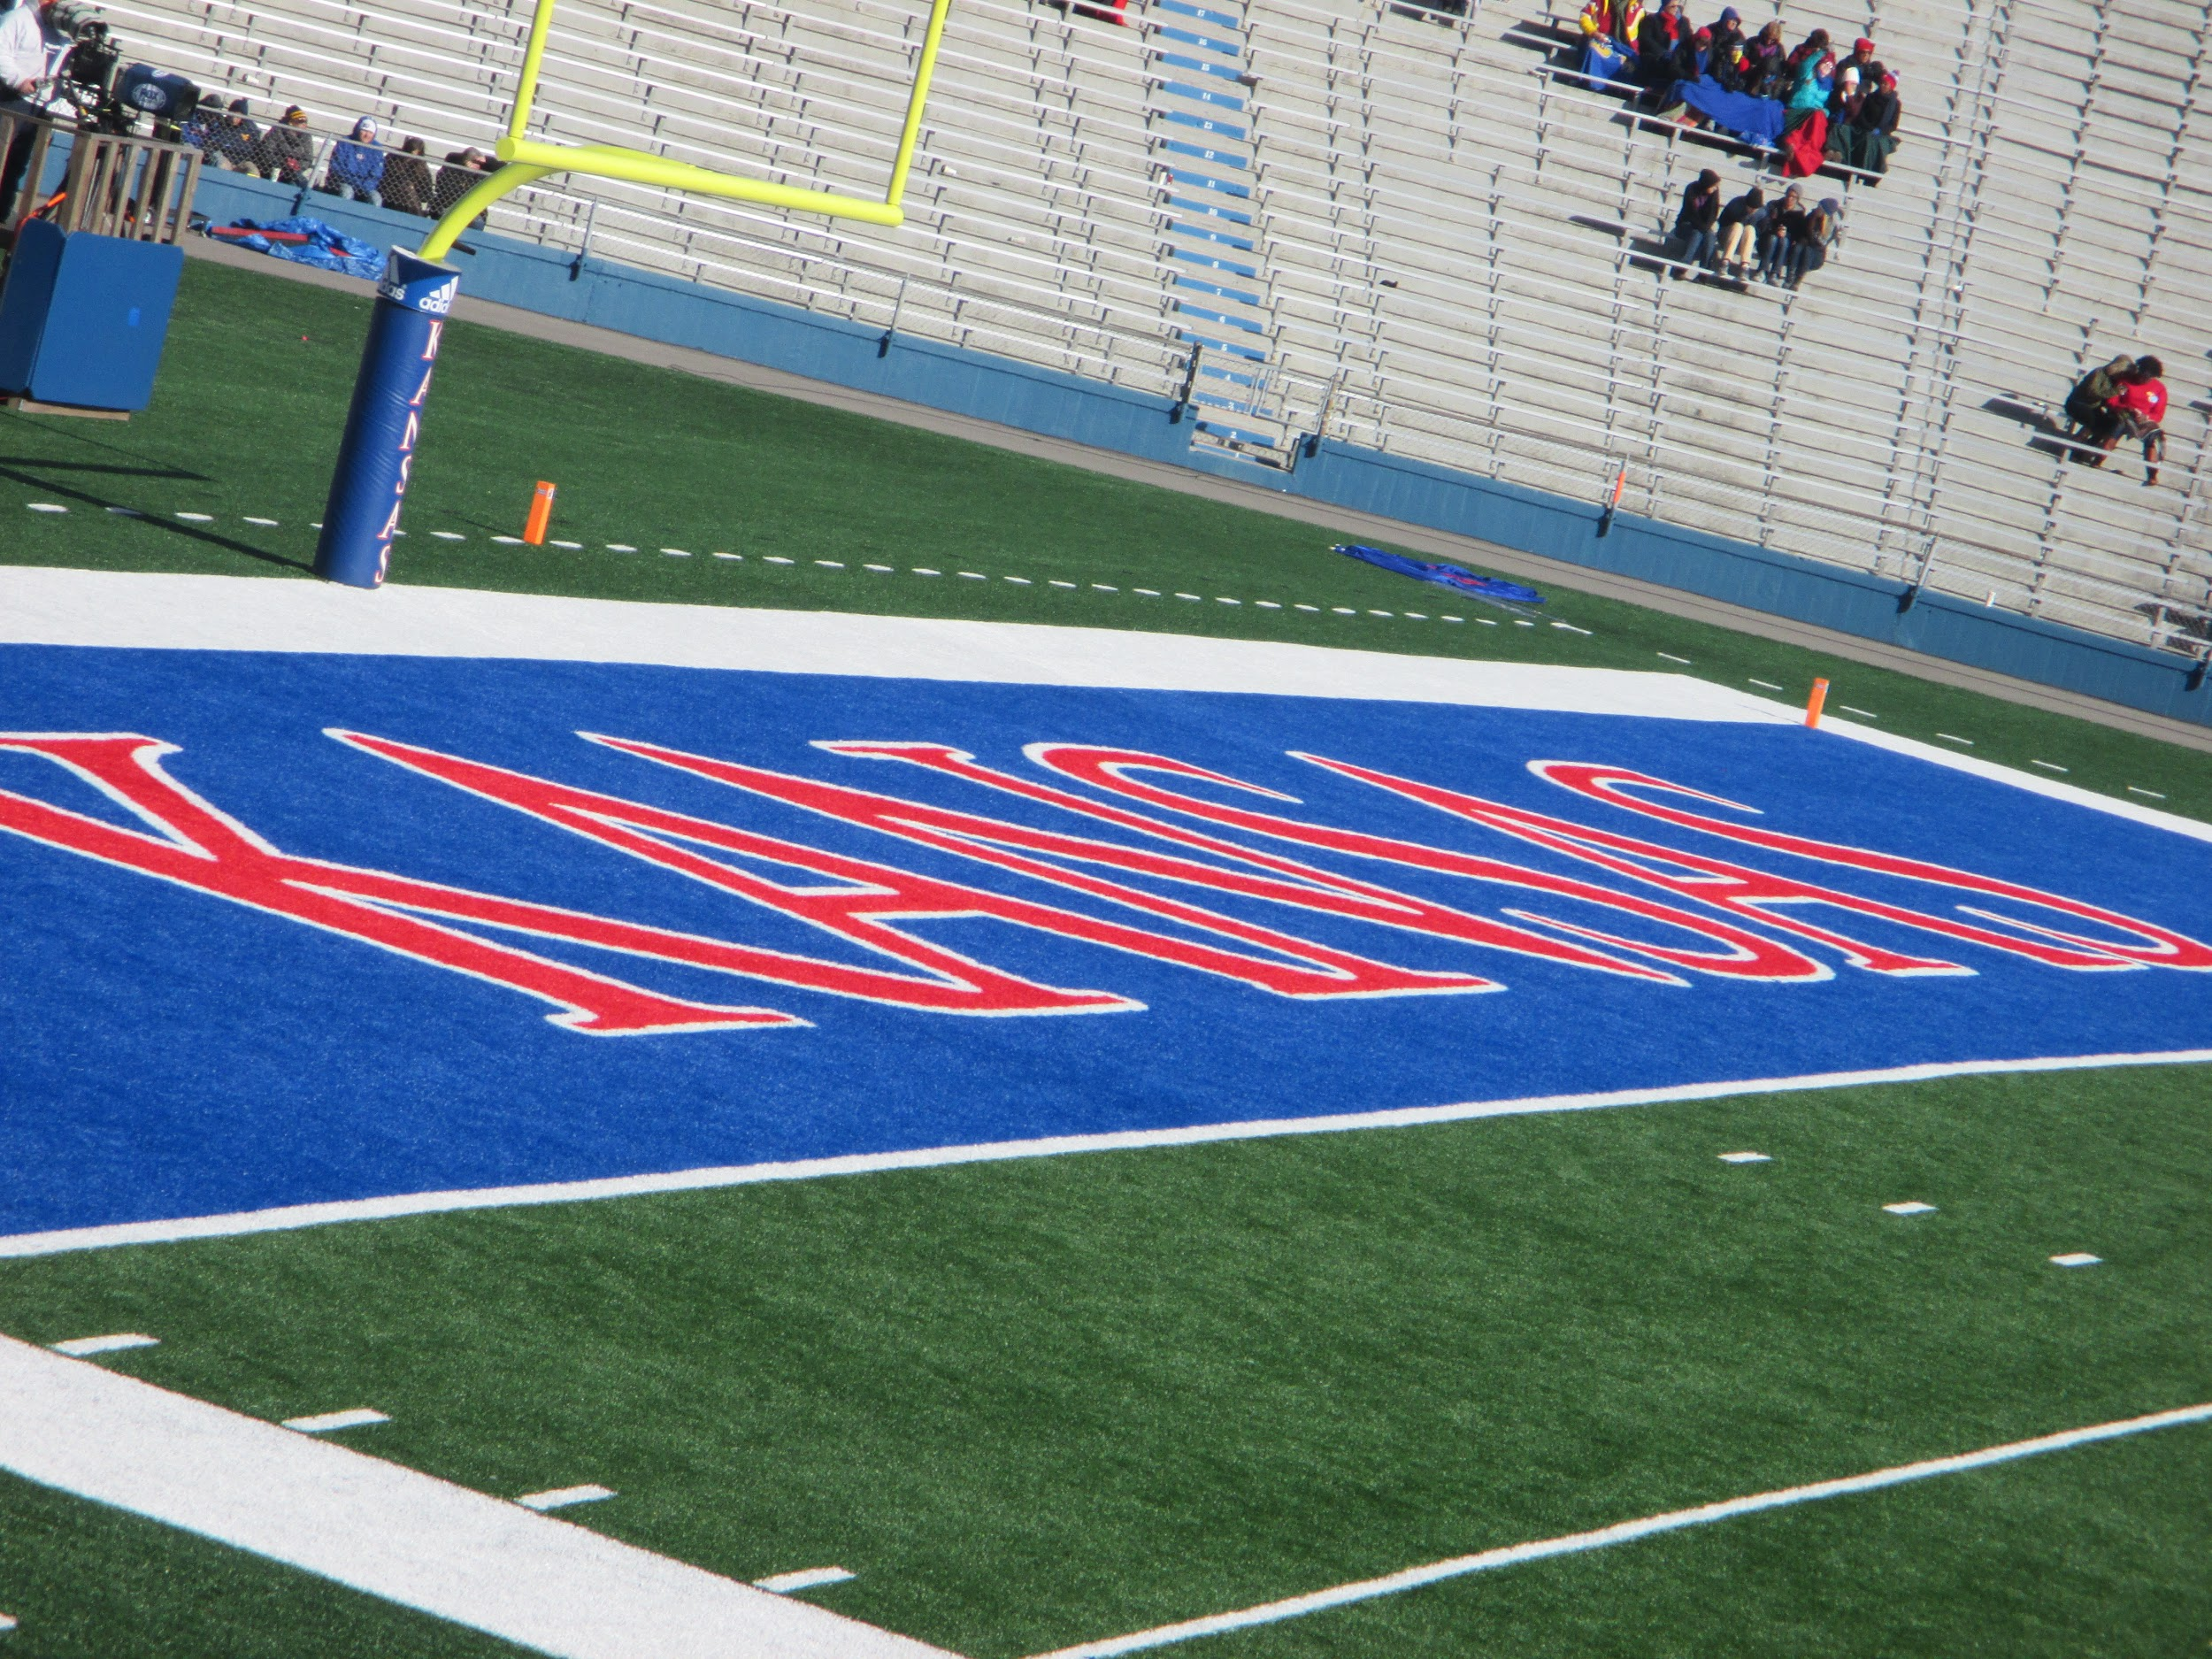
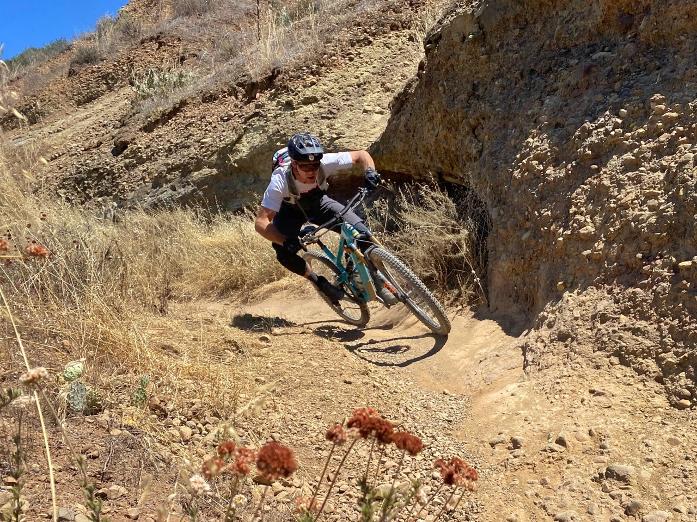
Mrs. Kempe

Slide 3
My Background
Masters of Education & Teaching Credential - National University
BA in Philosophy; BA in Communication Studies - University of Kansas
Began teaching at Mendez in 2005
I have taught sixth, seventh, and eighth grade Language Arts, AVID, and Leadership
My husband and I have a 14 year old daughter, Lily. We live in Tustin.

Slide 4

Parents
Parents are an
important
piece of the
learning
puzzle
Let your kids know that education is important and value your child’s learning process
Monitor progress - check Aeries & Google Classroom
Support independent problem solving
Monitor screen time

Slide 5
Distance Learning
Please join the Zoom meeting on time
Notify teacher or office if you have Internet problems
Please do not distract others during class
Remain in class at all times with video on and face showing when possible
Please keep microphone muted until asked to turn it on
Take food and bathroom breaks during the break

Slide 6
Resources
Aeries
  Please check grades at least twice a week
  Link to Zoom meeting can be found in Aeries
Google Classrooms
  Daily agenda, assignments, and announcements
  Check daily to see daily agenda & assignments
  Students are responsible for making up missed work due to absences and/or technical problems
Please call office for help with technical problems.

Slide 7
Grades
ALL work must be completed on time
  Assignments and assessments must be 70% completed in order to be accepted
  Late work will be accepted, but points will be deducted
Grades are in Aeries
Grades are updated weekly

Slide 8
Language Arts
Independent Reading - 30 minutes each weekday
Fiction & non fiction
Literary elements
Theme
Main idea & summary
Structure & Organization
Narrative
Poetry
Grammar

Slide 9
Distance Learning Resources and Websites
Google Classroom - Learning Management System
StudySync - Literature, Grammar, Writing
Quill - Grammar
BrainPOP
Nearpod
CNN10
Sora - free online library
Newsela - current events and reader response

Slide 10
Attributes of a Successful Student:
Is prepared and PRESENT at all times
Is organized
Utilizes Aeries and Google Classroom daily
Completes all work on time
Asks for help when needed

Slide 11
Questions?
Please email me at:
patricia.kempe@sausdlearns.net
Office hours M, T, Th, F
8-8:40; 1:45-2:30

