Slide 1



September Character Trait
School
Pride

Slide 2
Campus Matrix
SCHOOL PRIDE

Slide 3

Objectives
Understand what school pride means and why it matters
Commit to one personal action that shows personal pride in your school
Reflect on how school pride contributes to a positive school culture
Identify ways you can show pride in your school
1
4
3
2
SCHOOL PRIDE

Slide 4





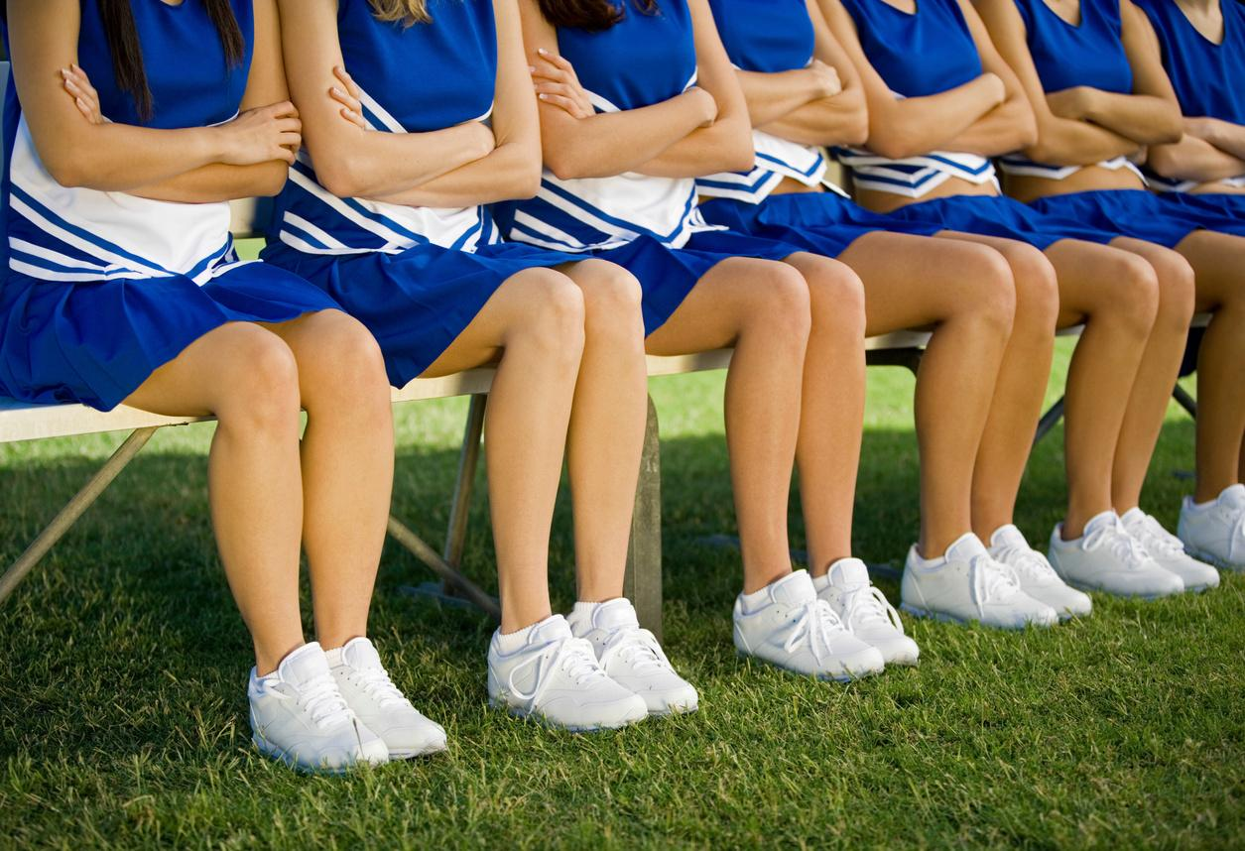
"Team Up"
Turn and talk:
What does it mean to be proud of something?
What are some strengths that your school has that makes you proud?
SCHOOL PRIDE
Notes:
Teacher: have students share some of the things they discussed and write responses on the board. Some responses could include: clean environment, friendly people, good sports teams, respectful students, safe space, strong academics, fun activities, etc.
Teacher Tie-In:
“School pride isn’t just about colors or mascots—it’s about how we treat each other, represent our school, and take care of it.”

Slide 5



What is School Pride?
Let’s Chat:
What do you think School Pride Means?
Have you ever seen someone show pride in our school? What did that person do?
SCHOOL PRIDE
Notes:
Teacher: have students share some of the things they discussed and write responses on the board. Some responses could include: clean environment, friendly people, good sports teams, respectful students, safe space, strong academics, fun activities, etc.
Teacher Tie-In:
“School pride isn’t just about colors or mascots—it’s about how we treat each other, represent our school, and take care of it.”

Slide 6

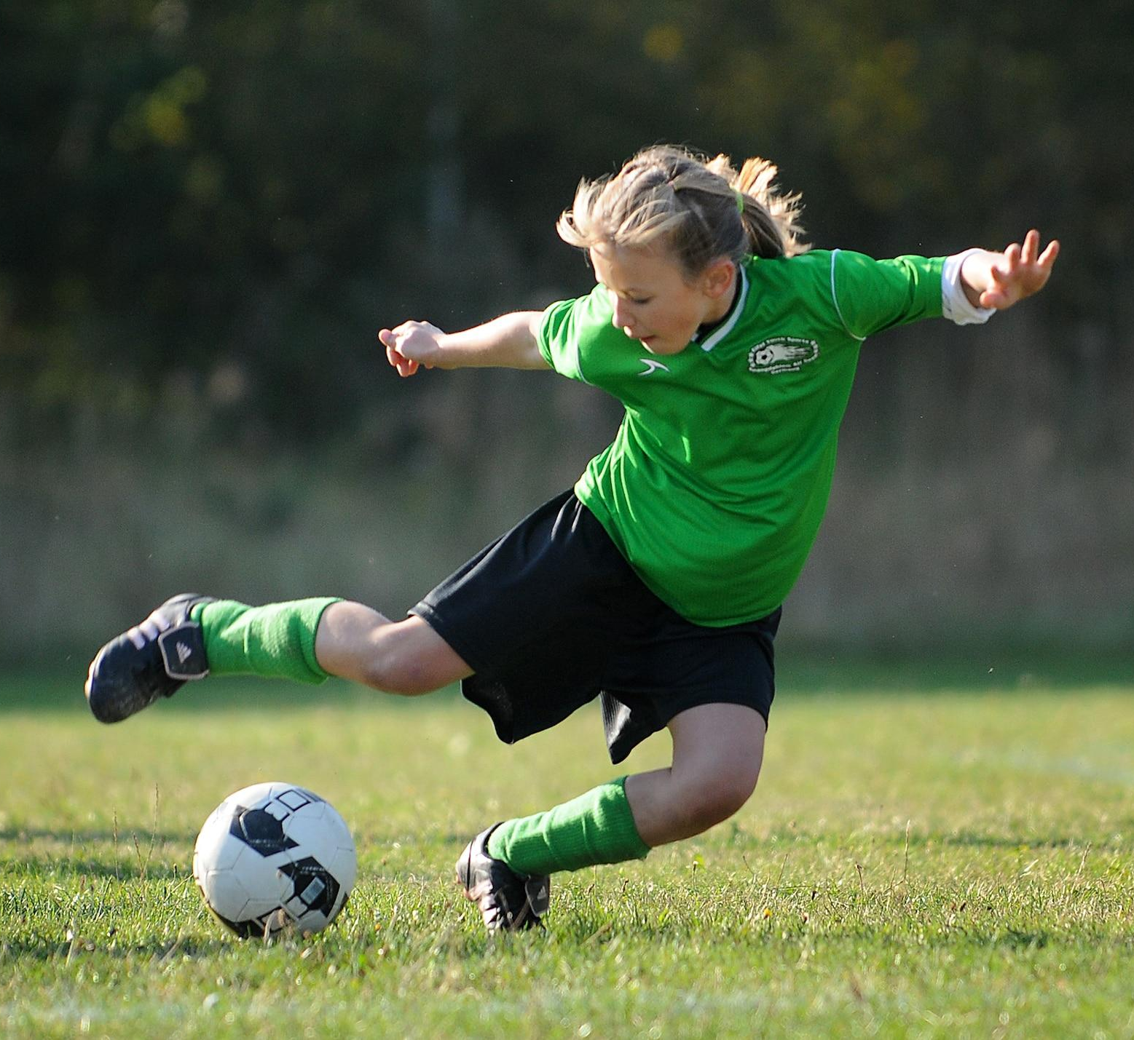
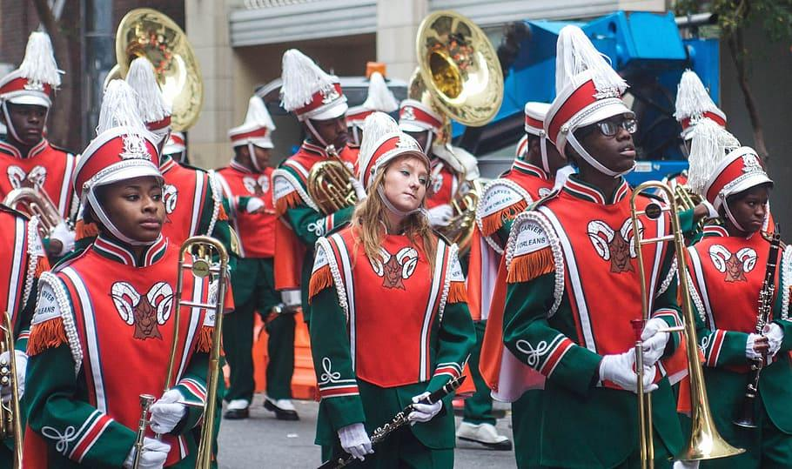
Definition
Supporting One’s School
SCHOOL PRIDE

Slide 7
Brainstorm
What is….
Take Care of Building
Attend
Performances
School
Wear School Colors
Pride
Attend Games
Get involved in School Clubs
SCHOOL PRIDE
Notes:
TEACHER NOTE: Only click ONCE and clouds will fly in.
Brainstorm a list of ways that students can demonstrate school pride. Students might mention attending games or performing arts, participating in spirit weeks, getting involved in school events, or simply supporting classmates. Some ideas will appear on the screen. Teacher should ask students to mention other ways that school pride is demonstrated. Explain: School pride is shown through actions like participating in events, keeping the school clean, helping others, cheering on teams, and respecting staff and classmates.

Slide 8

SCHOOL PRIDE
Notes:
Reflection: Why is SCHOOL PRIDE important? Students could mention the following: (1) Improved Student Outcomes (2) Positive School Environment (3) Sense of Belonging (4) Motivation and Success (5) Stronger Relationships (6) Positive School Culture

Slide 9
Scenario Challenge!
Read each scenario on the following slides. Then, decide
what would someone with school pride do in the following situations?
SCHOOL PRIDE

Slide 10

Scenario #1
You see trash on the floor in the hallway. How would a person with SCHOOL PRIDE React?
SCHOOL PRIDE

Slide 11

Scenario #2
A classmate is being disrespectful to a substitute teacher. How would a student with SCHOOL PRIDE respond?
SCHOOL PRIDE

Slide 12

Scenario #3
A friend is making fun of a new student’s clothes. How would a student with SCHOOL PRIDE respond?
SCHOOL PRIDE

Slide 13

Scenario #4
You see another student vandalizing a desk? How would a student with SCHOOL PRIDE React?
SCHOOL PRIDE

Slide 14

Scenario #5
C
You see a friend vandalizing a wall in the bathroom. How would a student Demonstrate SCHOOL PRIDE in this scenario?
SCHOOL PRIDE

Slide 15
Team Up!
C
“What are 5 ways students can show SCHOOL PRIDE—today, this week, or all year?”
C
SCHOOL PRIDE
Notes:
Divide class into small groups of 3 to 5 students. Give each group markers with a large piece of paper or chart paper. Ask students to list 5 ways students can show school pride—today, this week, or all year? Share Out: Each group presents their favorite 1–2 ideas.

Slide 16
Huddle Up!
C
Reflect with a partner on how SCHOOL PRIDE contributes to a positive school culture.
C
SCHOOL PRIDE
Notes:
Have students turn and talk with a partner, (or share in a small group), and reflect how school pride contributes to a positive school culture. Have students share responses.

Slide 17
PBIS Rewards
Teachers: Please pass out PBIS awards to students who are showing School Pride. Examples are:
Example 1: A student takes pride in completing an assignment and follows classroom procedures to turn it in.
Example 2: A student helps the teacher prepare the classroom prior to a lesson, such as passing out materials.
SCHOOL PRIDE
Notes:
Have students turn and talk with a partner, (or share in a small group), and reflect how school pride contributes to a positive school culture. Have students share responses.

Slide 18
Extension Activity
Work in a small group to create a School Spirit Week. The Spirit Week will be presented in a 1 slide presentation in Google Slides. The Spirit Week should focus on the school’s PBIS matrix and should have “5 Ways to Show School Pride” (one way to show school pride for each day of the week). Be creative and use illustrations.
SCHOOL PRIDE
Notes:
Teacher should provide students with examples such as “Teamwork Tuesday” and students can wear t-shirts or jerseys that represent their different extracurricular activities such as choir, band, football, cross country, volleyball, etc.

Slide 19



Home Connection
SUPPORT SCHOOL INITIATIVES AND EVENTS:
EMBRACE SCHOOL COLORS AND MERCHANDISE
DEMONSTRATE RESPECT FOR THE SCHOOL AND ITS LEADERSHIP
HIGHLIGHT SCHOOL ACHIEVEMENTS
Attending school events, volunteering when possible, and staying informed about school activities shows your child that school is a priority and you value its community.
Talk about the school's accomplishments in areas like academics, sports, or arts, helping your child recognize the value of their school.
Encourage your child to wear school colors or apparel, helping them visually represent their school pride.
Positive attitudes toward school staff and administration can foster a sense of trust and support for the entire school community.
SCHOOL PRIDE
Notes:
Ask students to talk with a parent or guardian: (1) “What was your school like when you were my age?” (2) “What made you proud—or not proud—of your school?” Then discuss ways in which students and adults can demonstrate school pride.

Slide 20
Go School Pride!
SCHOOL PRIDE
Notes:
School Laison can replace the words “School Pride” with the school mascot name or name of school by going to ‘Insert’ and selecting ‘Word Art’

