Slide 1









Bringing Out the Best
with
SCHOOL PRIDE
GRADES 3rd -5th

Slide 2









SCHOOL PRIDE
DEFINE:
school pride
APPLY:
demonstrate school pride
IDENTIFY:
what school pride looks like, sounds like, and feels like

Slide 3

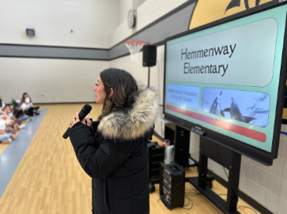

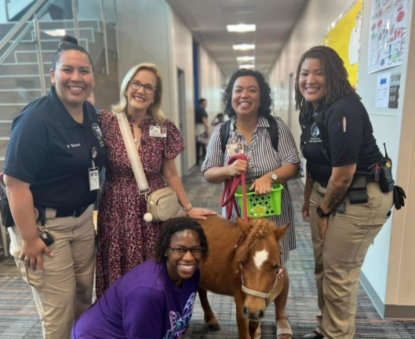

WHAT IS SCHOOL PRIDE?
SUPPORTING
ONE’S SCHOOL

Slide 4




Slide 5

TRIVIA CHALLENGE
It is time for a class challenge!!
Choose a student who will earn points for the class if the following trivia questions are answered correctly.

Slide 6

TRIVIA CHALLENGE
What are our school colors?
CORRECT RESPONSE
INCORRECT RESPONSE
+2 points
+0 points

Slide 7

TRIVIA CHALLENGE
What is our school PBIS matrix?
CORRECT RESPONSE
INCORRECT RESPONSE
+2 points
+0 points

Slide 8

TRIVIA CHALLENGE
What does each letter represent in our PBIS matrix?
CORRECT RESPONSE
INCORRECT RESPONSE
+2 points
+0 points

Slide 9

TRIVIA CHALLENGE
What is our school mascot?
CORRECT RESPONSE
INCORRECT RESPONSE
+3 points
+0 points

Slide 10

TRIVIA CHALLENGE
What are the names of our Principals?
CORRECT RESPONSE
INCORRECT RESPONSE
+3 points
+0 points

Slide 11

TRIVIA CHALLENGE
What year was our school built?
CORRECT RESPONSE
INCORRECT RESPONSE
+7 points
+0 points

Slide 12

TRIVIA CHALLENGE
What time does school start?
CORRECT RESPONSE
INCORRECT RESPONSE
+10 points
+0 points

Slide 13
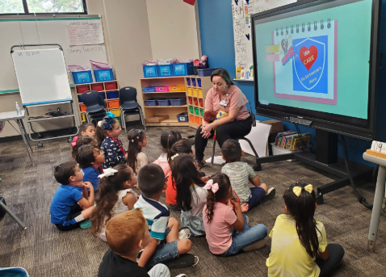
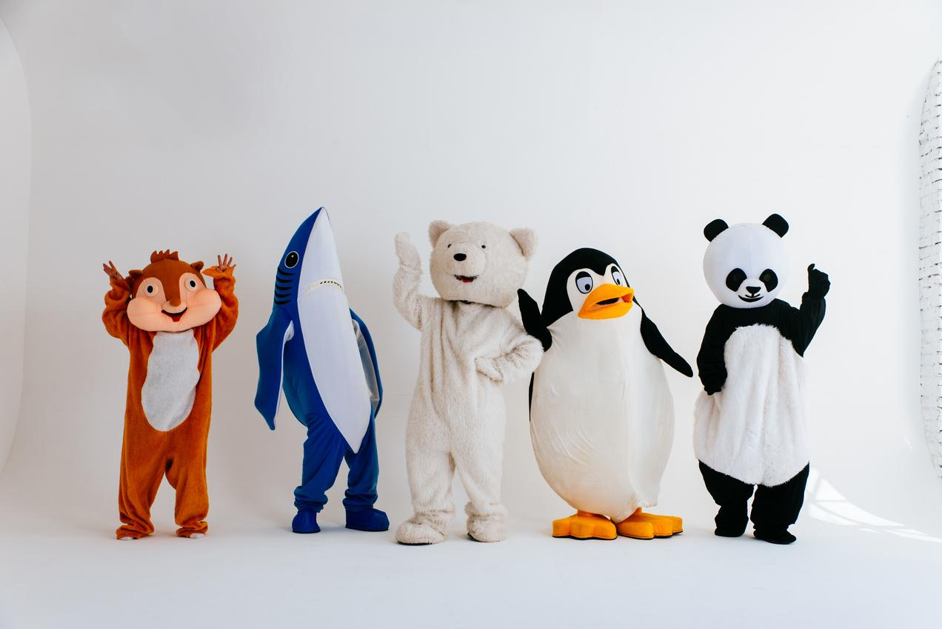

SCHOOL PRIDE
TAKE HOME ACTIVITY
When you get home this afternoon, have a discussion with a parent or guardian about their school years. What was the name of their school? Mascot? Etc.

