Slide 1
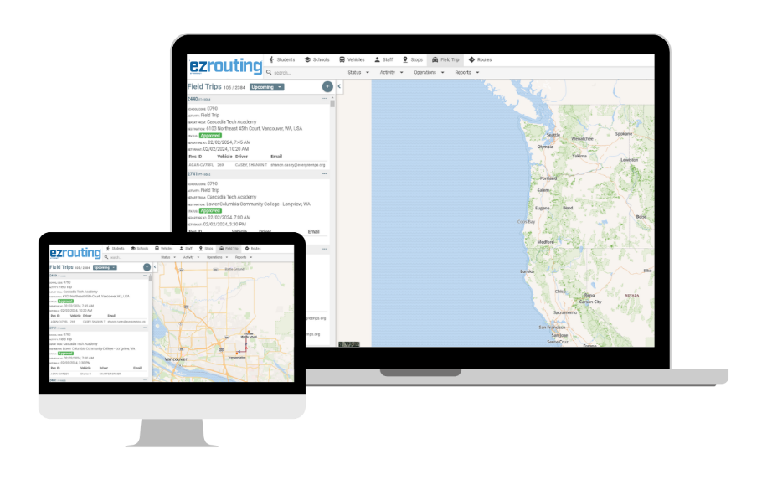
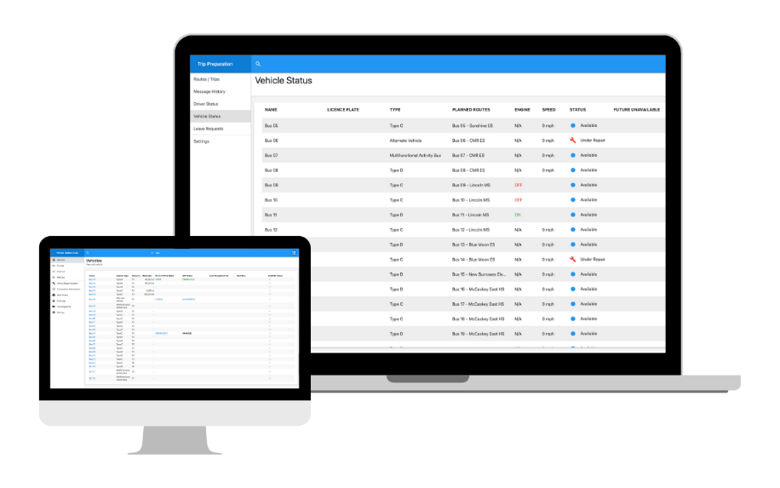
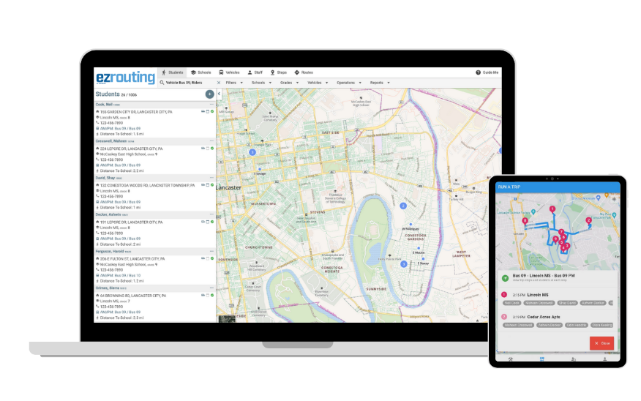


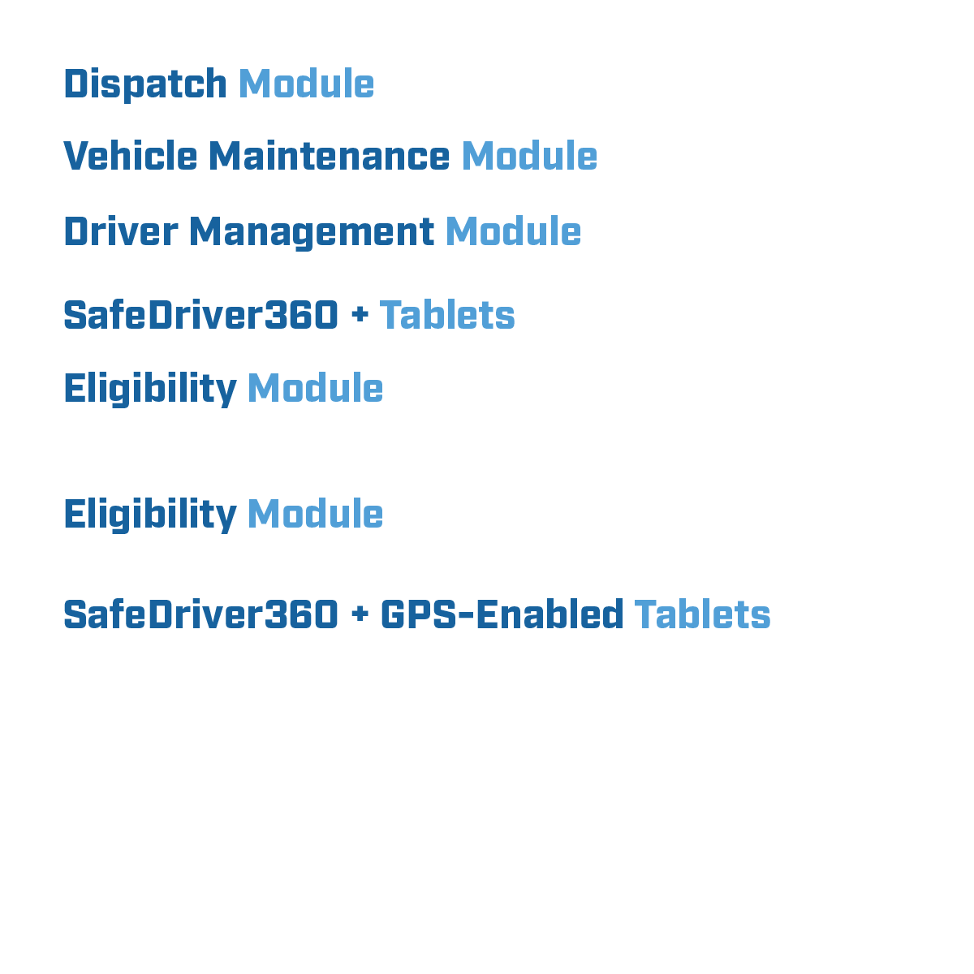
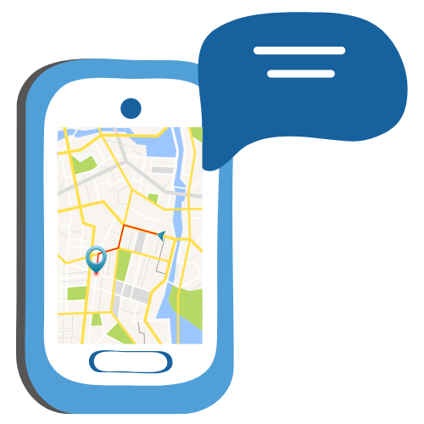
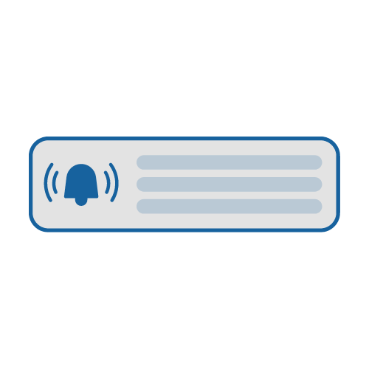
EZTransportation
Planning & Assignments
Daily Operations
Navigation/Ridership/GPS
Efficiency Bundle
Efficiently manage student transportation logistics.
Easily address daily challenges.
Expand your visibility and enhance driver satisfaction and student safety.
Parent Communications
EZ A2B Parent App (formerly Bus Quest) & Parent Portal
Proactively communicate with parents and provide self-service access to ridership information related to their child.

Slide 2


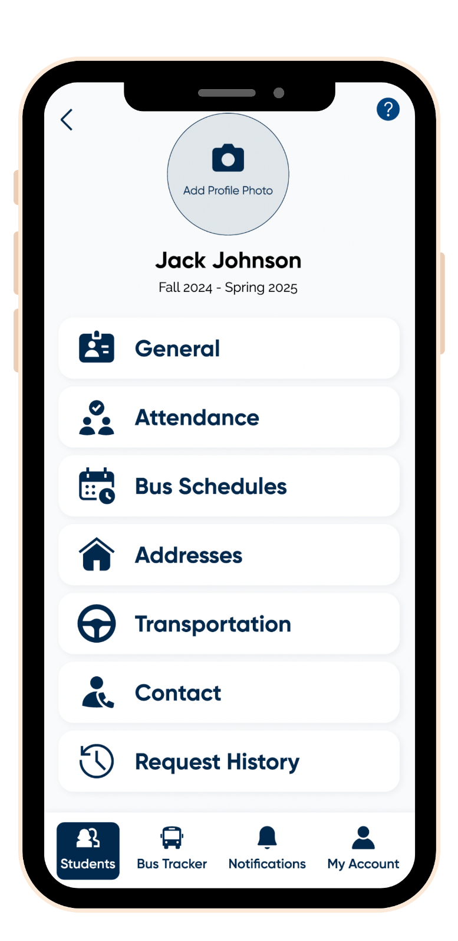




EZ A2B Parent App (formerly Bus Quest)
Easy, intuitive, and immediate access to student transportation
information for your parents and guardians.
A modern, intuitive interface.
Easy access to relevant data for their student.
Ability to track the bus as it approaches their student’s stop.
One set of login credentials for both EZ A2B and the Parent Portal.
Ability to receive real-time notifications about delays and changes impacting their student.
Trouble-free, secure account creation.
An in-app FAQ to help answer questions.

Slide 3
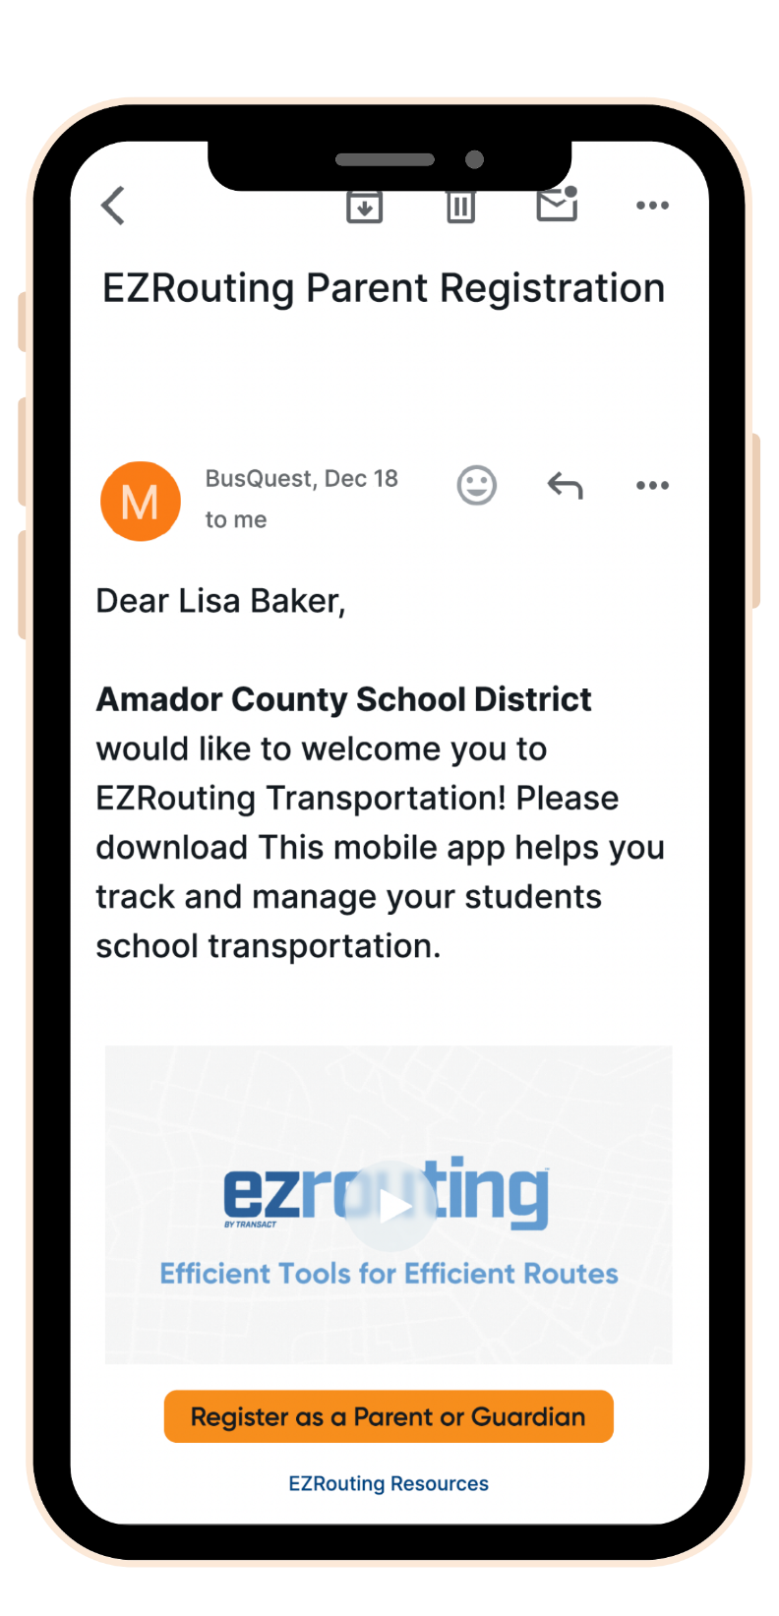
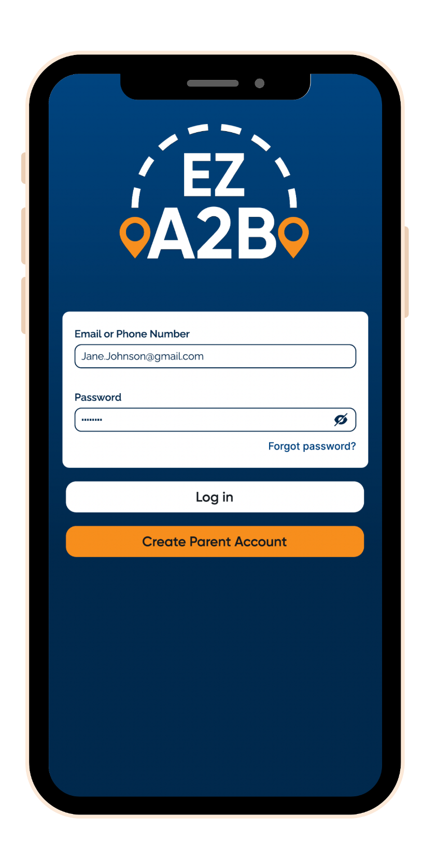
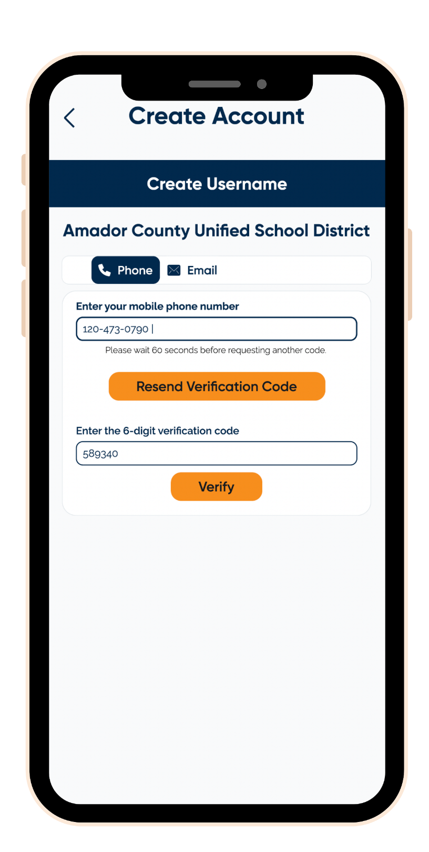
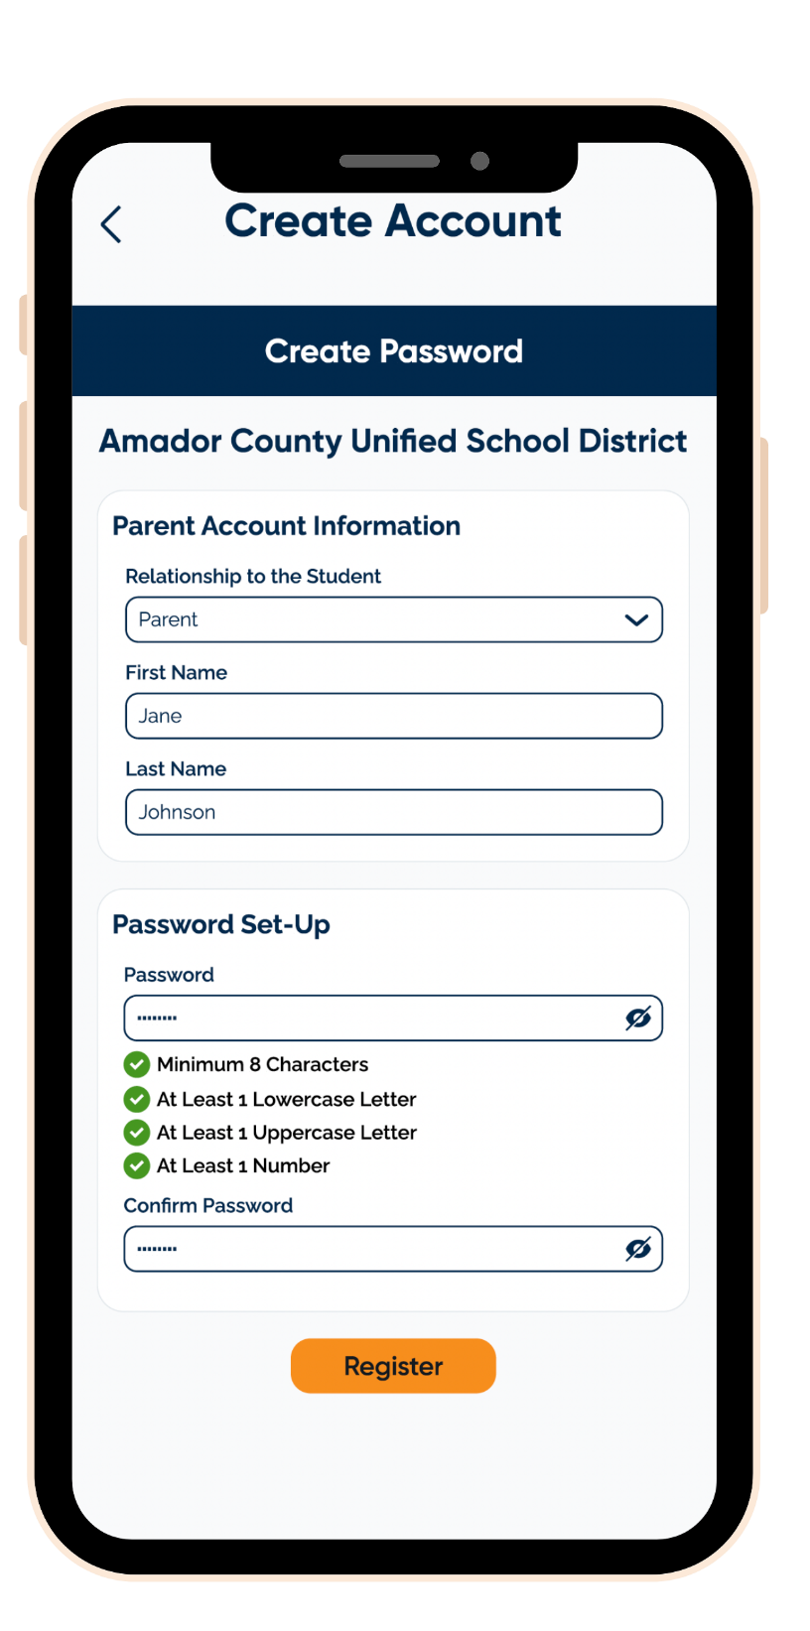
Onboarding Made EZ
And they’re in!
1. Parents receive a notification.
2. They create their account.
3. They register with a phone number or email.
4. They create their password.

Slide 4
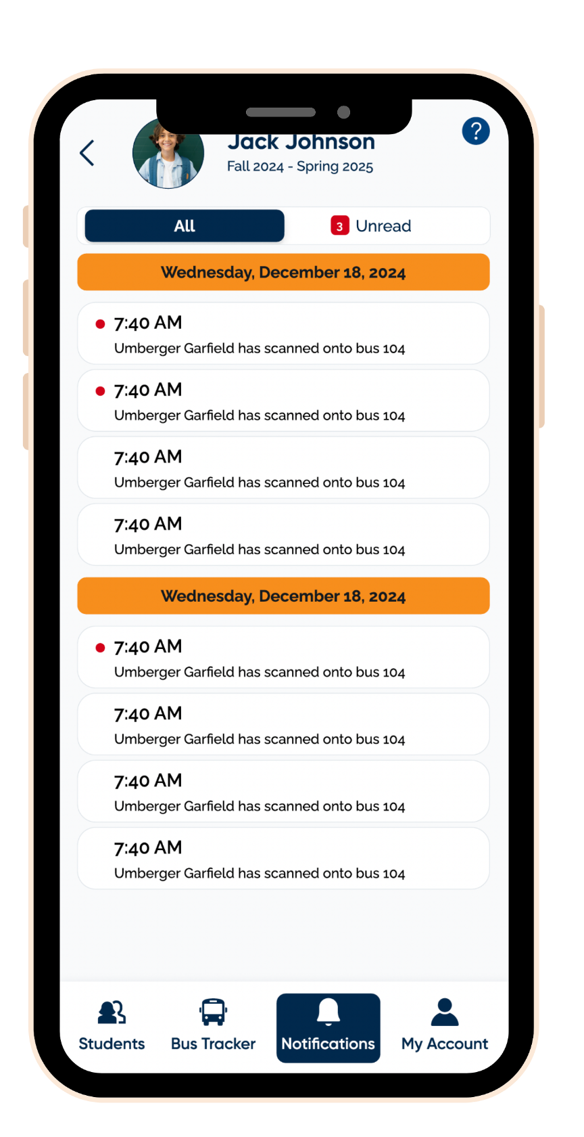
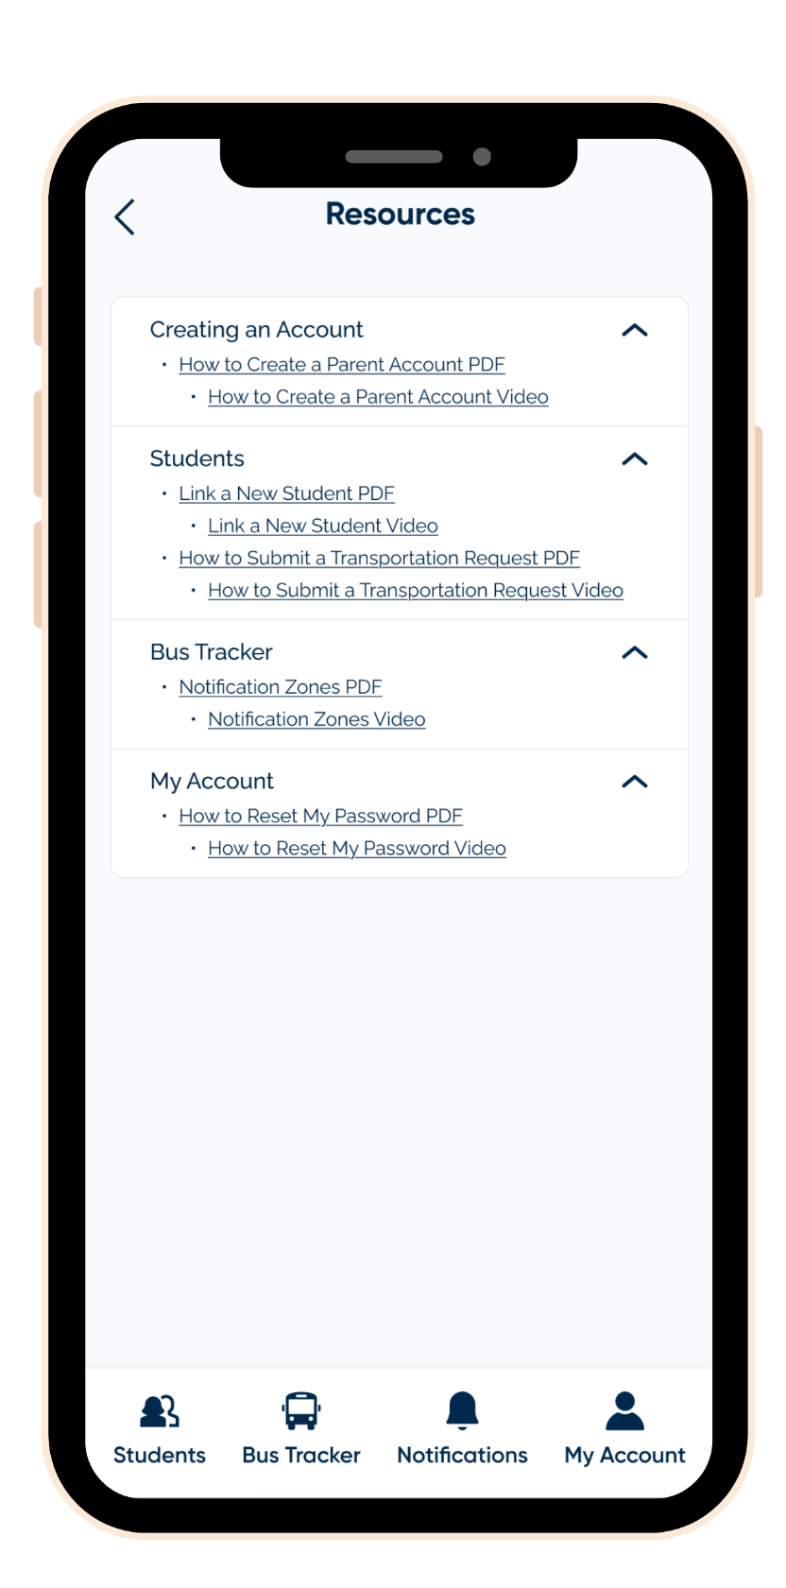
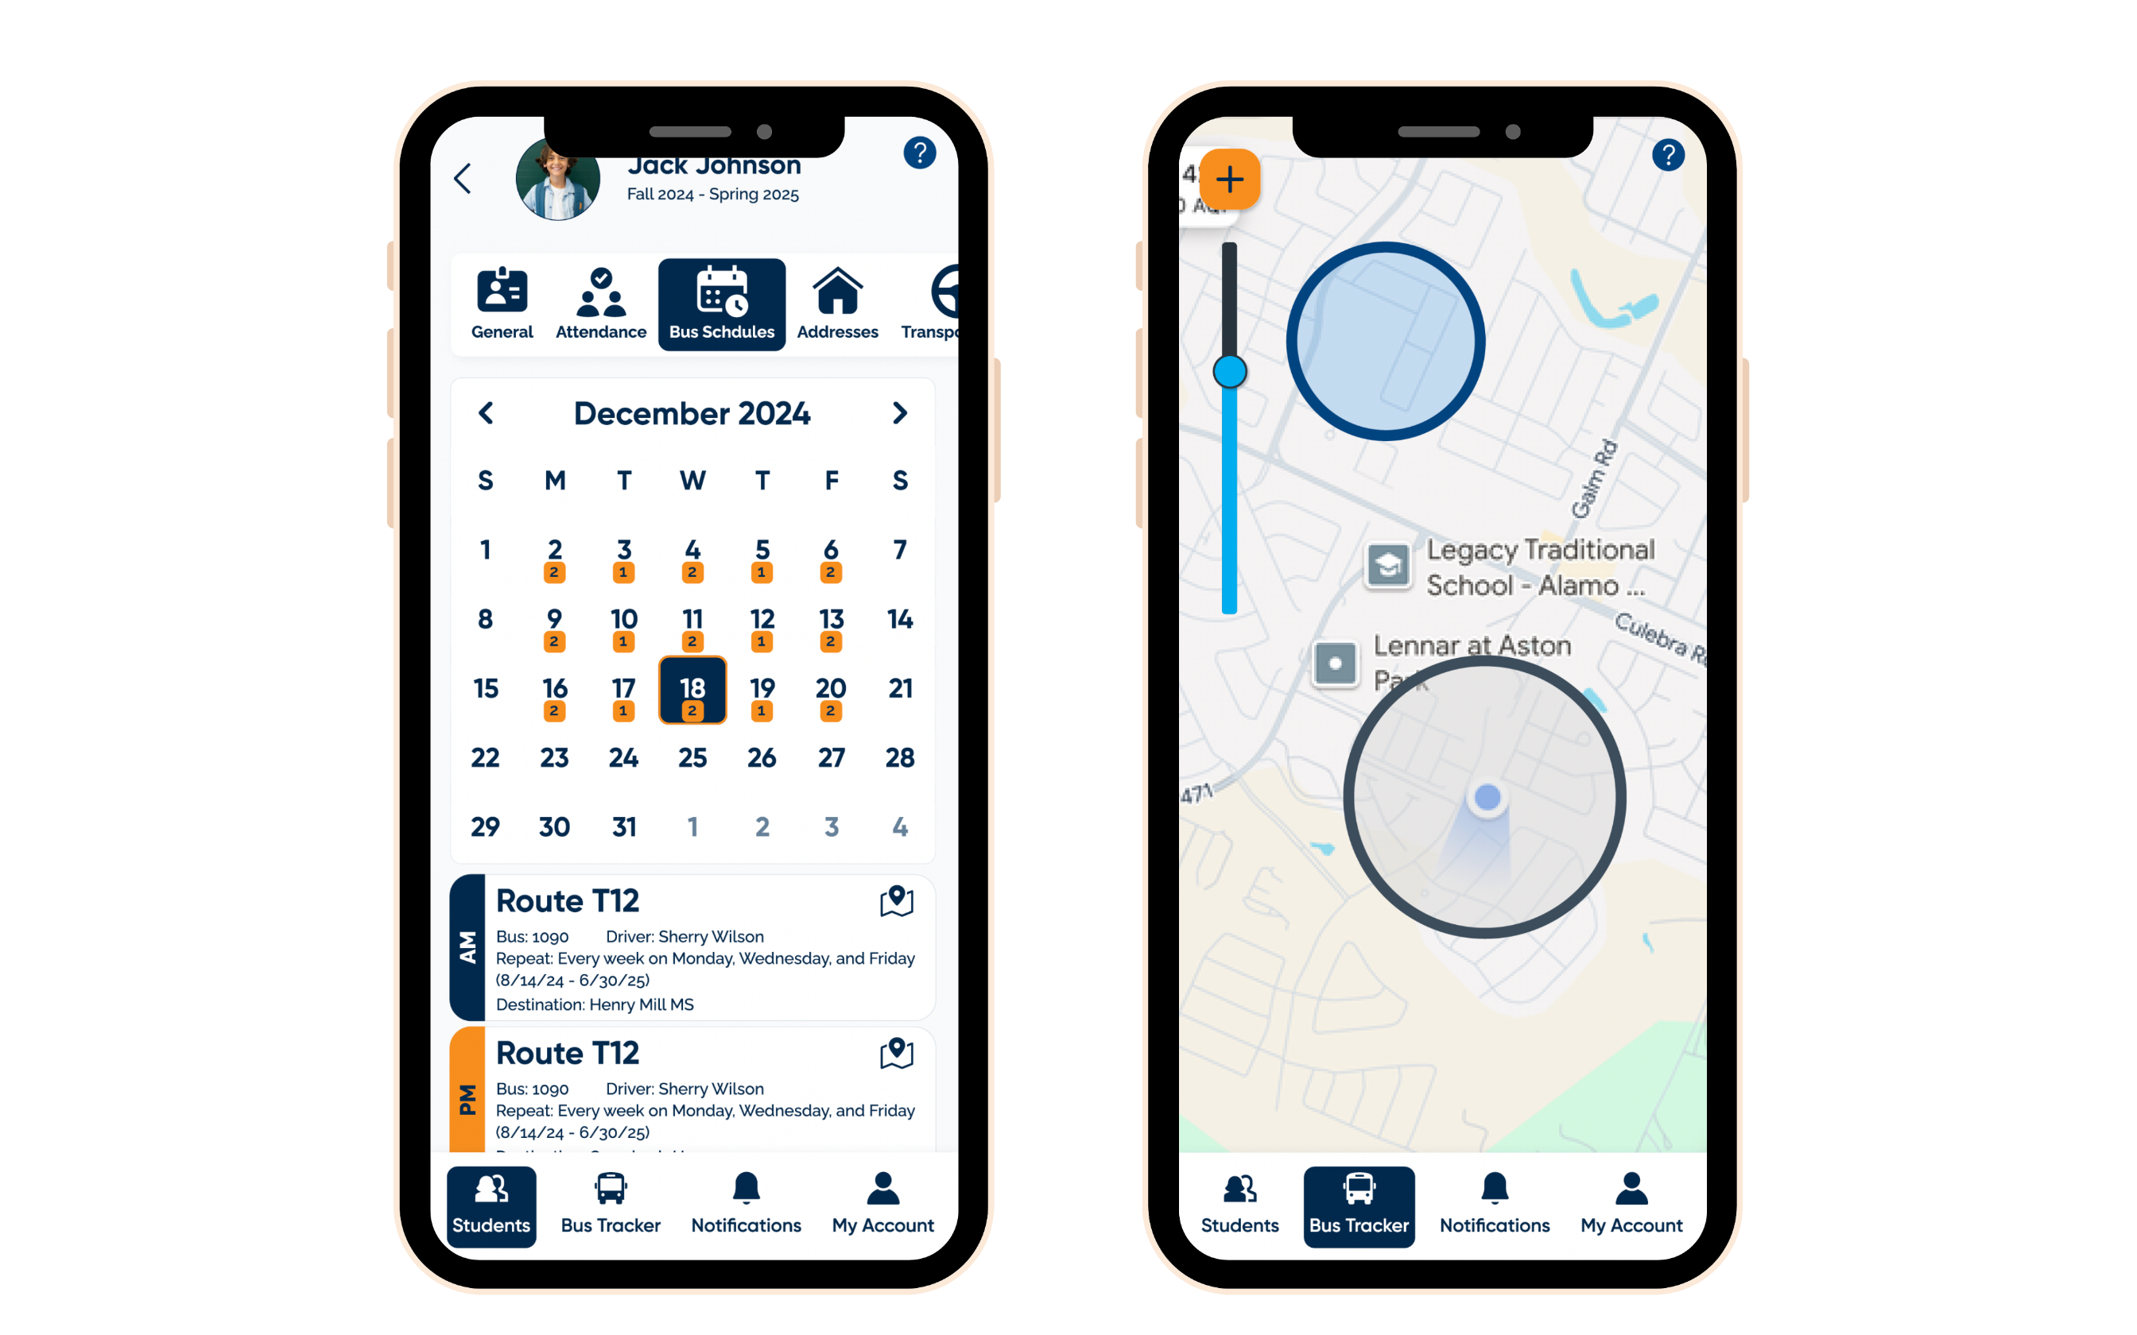
An Unparalleled Parent Experience
Real-time notifications with an “unread” category.
Helpful resources, including videos and docs, are easily accessible.
Parents can view route information.
Customizable geofencing makes it easy to monitor the bus's approach.

