Slide 1
Focus 203
January 2025
Notes:
Welcome to Focus 203, we are so grateful to each of you for giving up some of your own time to join us for tonight’s session. I am Dan Bridges, Superintendent of Schools, and I, along with my teammates are excited to spend time with you tonight sharing our plans and engaging in conversations about the future for our students. I want to acknowledge that we have scripted this presentation to ensure that each session receives the same information and we are currently live streaming this presentation and will be placing a copy of this recording on our website after Friday’s session.

Slide 2
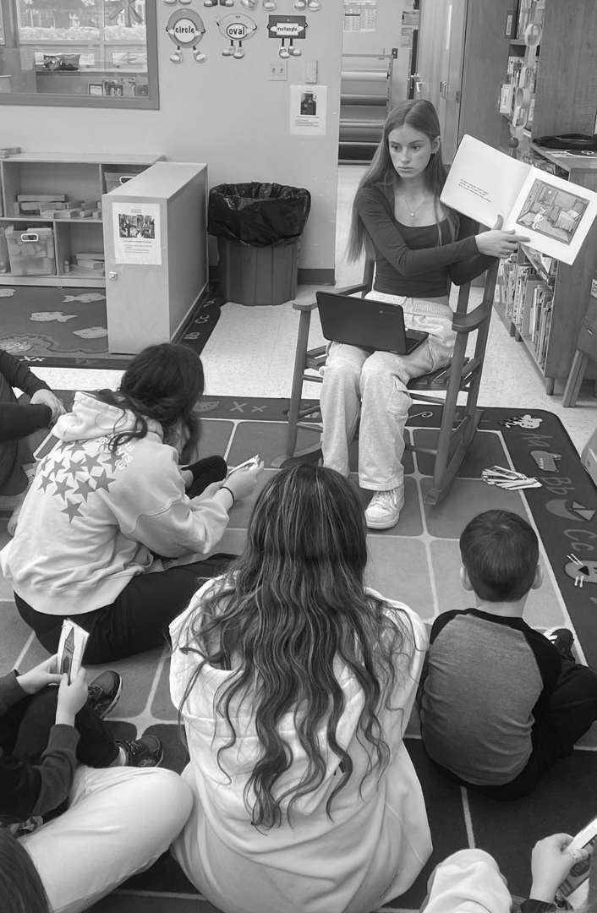



01
Welcome
02
Data / Informational Presentation
03
Instructions for Small Group Work Activity
04
Small Group Work and Online Participation
Session Schedule
05
Small Group Reporting to Large Group
06
Closing
Notes:
Here’s a quick overview of our session schedule for tonight. We’ll begin with a data and informational presentation, followed by instructions for our small group activity. Then, you’ll have time to engage in small group work and online participation before reporting your discussions back to the larger group. We’ll wrap up with a closing to summarize and reflect on the evening.

Slide 3




Questions/Comments
•Submit a
• Call: (630) 420-6475
• Ask questions during Small Group time
naperville203.org
Notes:
We know your time is very valuable and we want to honor our 90 minute time commitment. We recognize that we are sharing a lot of information in a very short period of time. And, we know you will have questions and we want to capture those in a way that is most effective. Therefore we request your patience with our plan and procedure for questions and comments tonight. Questions related to the content presented can be asked during our small group time as district personnel are seated at each table.
There may also be questions or comments that may or may not be directly related to tonight’s topic. We have added a QR code to Let’s Talk so you can submit your questions. You can also call or send us an email and we will have the appropriate person respond in a timely manner.

Slide 4


What is
school for?
Notes:
As we begin tonight, let’s take a moment to reflect on a foundational question: What is school for?
At your tables, we invite you to discuss this question for the next few minutes. Consider not only what school means to you and your family but also what is the purpose of school.
We’ll only take about two minutes for this conversation, so please share your thoughts, respect air time and listen to others at your table.

Slide 5
We need to prepare our students for success in their future, not our past.
Students of today will be in the workforce into the 2080s
Notes:
Thank you for those thoughtful conversations. As we reflect on what school is for, it’s important to remember that school is not just about helping students succeed in school or preparing them for the world we grew up in. Instead, it’s about equipping them for a future we can’t fully predict. During our last focus 203 event, we shared that our students will likely hold 12 to 15 different jobs before they’re 40, and many of the careers they’ll pursue haven’t even been invented yet. It’s not enough for us to have a system that prepares students to do well IN school. Our true vision is for our school district to help build a passion for LIFELONG learning - that means we need to prepare students for success AFTER they leave school.
Today’s students will be in the workforce well into the 2080s, navigating industries and challenges we can only imagine. With 80% of high school students expressing a desire for on-the-job learning opportunities, it’s clear that education must evolve to meet these changing needs and empower our students to thrive in their future.

Slide 6





Ongoing Blueprint Commitments
Implement a multi-tiered system of support to promote all students’ academic, social-emotional, and behavioral development for college, career, and life readiness.
Implement a comprehensive social emotional learning plan that will support students’ ability to demonstrate the skills needed to be competent in their families, with their peers, in school, at their work settings, and in their community.
Implement a Comprehensive Equity Plan that focuses on educational equity to ensure that every student has access to exemplary learning opportunities with the support they need to develop a learner’s mindset, demonstrate adaptability, communicate effectively, think critically and become global citizens.
Notes:
As we move forward towards the future, it’s important to ground our work in the commitments we’ve made to our community through our Strategic Blueprint.
Our previous Blueprint, which guided us to 2020, included several transformative commitments that supported our work in building inclusive, supportive school communities. These commitments laid a strong foundation for ensuring all students feel a sense of belonging and have the tools needed to succeed.
When we began writing our 2027 commitments, we knew our work had to continue and deepen. Our current Blueprint includes multiple commitments that guide all we do. A few of those ongoing commitments are highlighted in this slide. We are committed to implementing a multi-tiered system of support, a comprehensive social-emotional learning plan, and a comprehensive equity plan to ensure every student has the skills, opportunities, and support needed to thrive academically, socially, and emotionally while preparing for college, career, and life readiness.
These commitments remain at the heart of our work, and they are foundational to the changes we’re discussing tonight.

Slide 7
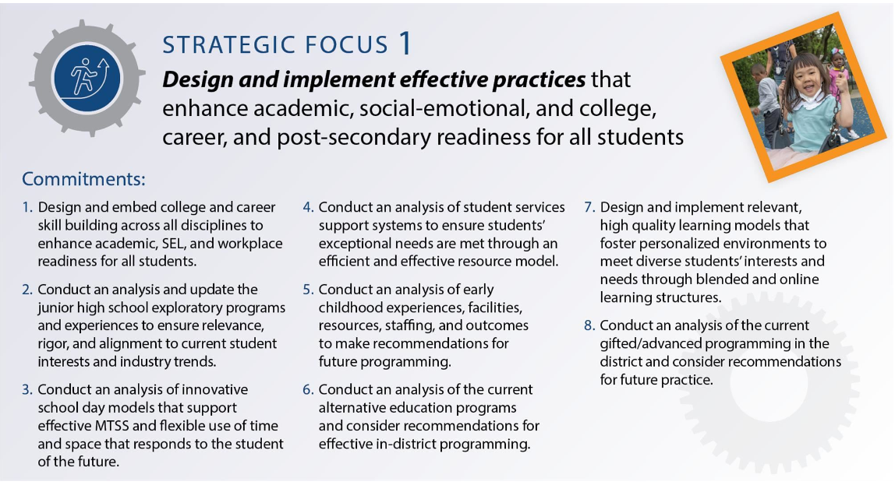
Strategic Focus 1
Notes:
The work we are sharing today is not new—it’s been a key focus of our district for years. Commitment 1.3, which calls for an analysis of innovative school day models, has been part of our focus since before 2018 and was added to our blueprint in 2021.
This commitment is the backbone of the work we’re sharing tonight, guiding our efforts to create flexible, student-centered learning environments that support effective individualized interventions and prepare every student for the future. It’s the lens through which we’ve examined time, space, and the needs of today’s learners.

Slide 8
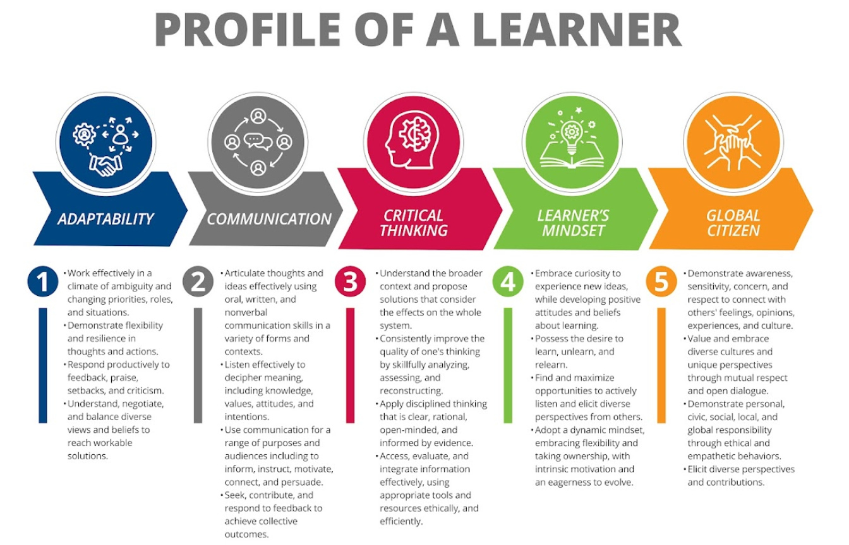
Notes:
Last session, we shared more about Our Profile of a Learner as it represents the skills and attributes our students need to thrive in their future. Developed by a design team of 70 plus community members, students, staff, and local business owners, this profile was informed by a deep analysis of the skills businesses are seeking in future employees and the evolving demands of our society.
The five competencies—adaptability, a learner’s mindset, communication, critical thinking, and global citizenship—must guide our decisions on the learning experiences we provide. These skills will best prepare our students for life beyond our schools.
We are deeply grateful to our Board of Education for adopting a new mission statement aligned with these essential competencies, further strengthening our commitment to empowering every learner. The new mission of Naperville Community Unit School District is to empower students to develop a learner’s mindset, demonstrate adaptability, communicate effectively, think critically, and become global citizens.

Slide 9


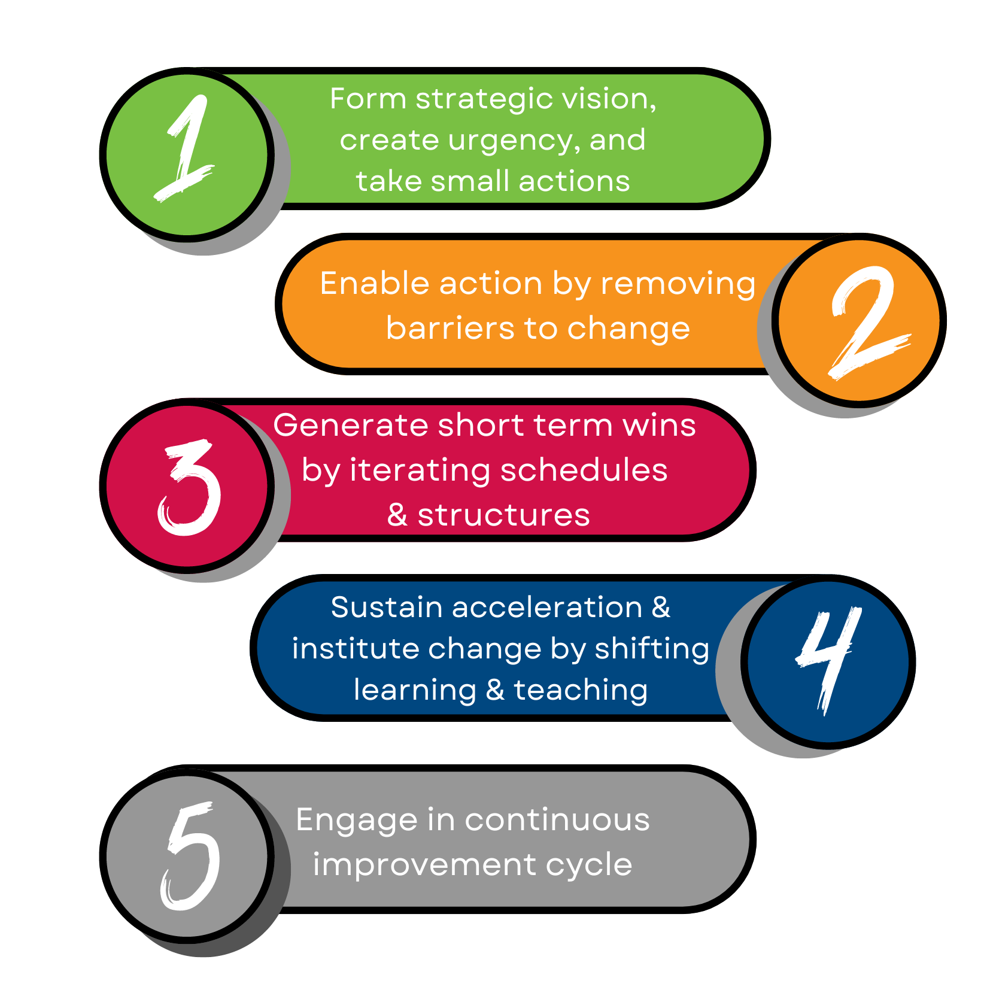
Developed Strategic Blueprint
Modified HS Schedules
Innovated Course Offerings
Developed Profile of a Learner
Instructional time
Collaboration opportunities
Transportation Challenges
Contractual limitations
Test Conditions
Innovate experiences
Iterate schedules
Align grading practices
Personalized learning
Experiences beyond school walls
Cross-curricular designs
#Naperville203
Measure effectiveness
Analyze results
Innovate & reiterate
Notes:
As we continue this journey of innovation, it’s essential to understand the process that has guided our work. This framework, based on John Kotter’s change process, reflects how we are moving forward with intentionality and focus.
We’ve already set a clear vision, taken small but meaningful steps, and made changes within our current structures to innovate where possible. However, we’ve reached a point where we must address the conditions that limit our ability to fully realize change—such as instructional time, collaboration opportunities, and logistical challenges.
Our next steps involve iterating and reiterating to meet the evolving needs of the students of the future. This requires us to continuously evaluate, innovate, and adapt, ensuring we stay responsive to the demands of the world our students will enter. Change is not a one-time event but a constant cycle of improvement to prepare our learners for success.

Slide 10

Celebrations
Across all academic accountability assessments, relative to all Illinois unit districts, Naperville’s overall proficiency equals the 99th percentile rank in English Language Arts (ELA) and Mathematics, and 98th percentile rank in Science
Post-pandemic elementary and middle school proficiency recovery achieved in ELA and within ~3% in Mathematics
Over 95% graduation rate at 4, 5, and 6 years
Post-secondary education enrollment exceeds 85% after graduation
New career focused courses at our high school level have the highest rate of growth over any course of study
Notes:
Before we dive deeper into the changes ahead, it’s important to take a moment to celebrate the incredible success we’ve experienced as a district. As you can see on the slide, we continue to perform at the highest levels across all academic accountability assessments, ranking in the 99th percentile in English Language Arts and Mathematics and the 98th percentile in Science among Illinois unit districts.
We’ve also seen strong post-pandemic recovery, our graduation rates exceed 95%, and more than 85% of our graduates enroll in post-secondary education.
It’s also exciting to note the rapid growth of new career-focused courses at the high school level, which have become some of the most in-demand offerings for our students.
These accomplishments reflect the strength of our schools and the dedication of our community to preparing students for the future.

Slide 11
District Data:
Growth Opportunities
Middle School math growth data:
  Average level of achievement: 74th percentile rank; however, student growth percentile: 42nd percentile
Approximately 30% of incidents resulting in exclusionary discipline occur during unstructured time
Chronic absenteeism is at 15%
First period tardies: HS 50% of tardies; JH 45% of tardies
Student Sense of Belonging - perceptions of understanding, support, respect, and feelings of belonging at school
67% of third through fifth graders
55% of sixth through twelfth graders
Approximately 50% of our graduates obtain a post-secondary degree within four years
Notes:
While we have many reasons to celebrate, it’s equally important to acknowledge the opportunities we have to better serve our students and prepare them for their future.
As you can see on this slide, our data highlights key areas for improvement. For example, while on average, our middle school students achieve at the 74th percentile in math, their average growth ranks at the 42nd percentile, signaling a need for greater support in accelerating their progress.
We also see challenges in student behavior and attendance. Approximately 30% of exclusionary discipline incidents occur during unstructured time, and our chronic absenteeism is at 15%. First-period tardies account for nearly half of all tardies at both the high school and middle school levels.
Additionally, student surveys reveal that a sense of belonging declines as students progress through school—only 67% of third through fifth graders and 55% of sixth through twelfth graders feel a strong sense of belonging.
Finally, while 85% of our graduates enroll in post-secondary education, only about 50% of them complete a degree within four years.
These data points drive home the importance of the work we’re doing to remove barriers, create meaningful learning opportunities, and foster a supportive environment where all students can thrive.

Slide 12
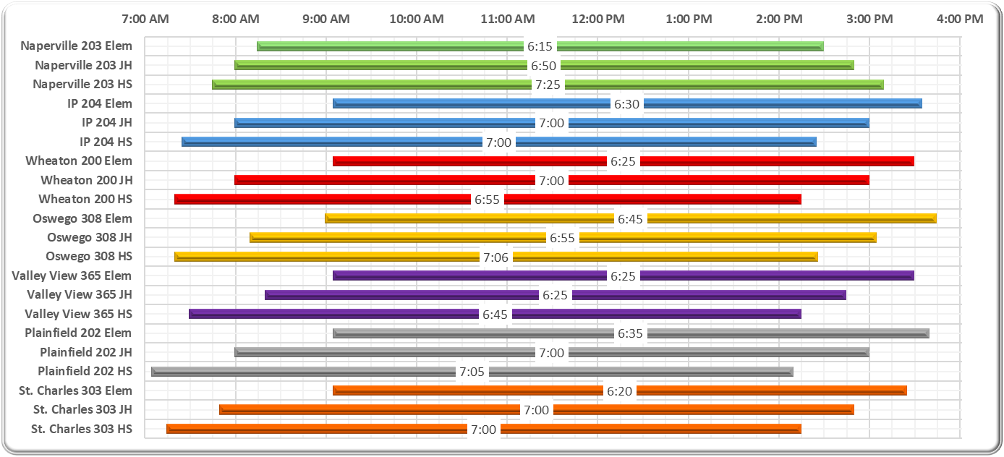
School Day Comparison
Notes:
Let’s take a look at how our school day lengths and schedules compare to other unit districts in the area. This slide shows Elementary, Middle, and High School school day length comparisons with start and end times. For example, the first green bar, shows that our current Elementary school day is 6 hours and 15 minutes in length, beginning at 8:15 and ending at 2:30.
For our elementary schools, our school day is 15 minutes shorter than the average in the area. On the other hand, we have one of the longest high school days, which is 27 minutes longer than the average nearby.
Another key difference is how we structure our start and end times. Most unit districts in the area stagger their school day so that each level finishes in the order in which it starts—AND they average nearly 40 minutes between start times for different levels, while we average just 15 minutes between levels.
Additionally, we are the only unit district in the Chicagoland area using “nested” school days, where schedules for each level overlap rather than stagger.

Slide 13
Our high school students who take the bus arrive at school over an hour before school begins, getting on the bus as early as 6:15 am.
Our elementary school day is one of the shortest in the state, shorter than all of our comparison districts.
Our middle school schedules have fewer minutes for mathematics instruction than what is recommended by research and the state average.
Instructional time is currently blocked at 82 minutes at the middle school and up to 150 minutes for literacy at the elementary level.
We have continuous enrollment throughout the year for 3-year-olds at our Early Childhood program, welcoming new students every week.
Did You Know?
Notes:
This slide shares some critical facts about our current structures—facts that raise important questions about how we can better serve our students.
Did you know that many of our high school students who take the bus arrive at school more than an hour before classes begin, with some boarding as early as 6:15 a.m., 90 minutes prior to the start of the day?
Did you know that our elementary school day is one of the shortest in the state, even compared to similar districts in our area?
Did you know that our middle school schedules provide fewer minutes for mathematics instruction than what is recommended by research and the state average?
Did you know that instructional time for literacy is currently blocked at 82 minutes for middle school and up to 150 minutes at the elementary level?
Did you know that we have continuous enrollment at our early childhood center, welcoming new students every week when our littlest learners turn 3?
These facts highlight challenges in how we allocate time and structure our school days, which directly impact our students' learning experiences and outcomes.
Now, take a moment to reflect on these 'Did You Know' statements with your table. What stands out to you the most, and why? What connections do you see between these facts and the opportunities we’ve discussed earlier?
We’ll give you only about two minutes to discuss, then we’ll come back together to continue the conversation

Slide 14







Current Challenges
Engagement: Attendance & Tardiness
Instructional Minutes and Mandates
Professional Collaboration
Individualized Supports
Post-Secondary Readiness
Schedule
Nested Transportation
& School Days
Notes:
Thank you for your conversations. As we bring together all of the data, challenges, and opportunities we’ve discussed thus far, this slide highlights key areas that represent the structural barriers we face in creating the innovative school experience our students and staff deserve. These are the challenges we are working to address with our proposed solutions.
Engagement: Our students are telling us they want something different, not just through their words but through their behaviors and performance. Purposeful, relevant learning experiences are key to improving attendance, reducing tardiness, and fostering deeper engagement.
Instructional Minutes and Mandates: Compared to other districts, we are not aligned in critical areas, such as math instructional time. Research and best practices recommend more minutes for math at the middle school level, and we must also consider how to better use our existing time, including transitions. State mandates continue to grow, requiring us to do more within the same amount of time.
Supports and Schedules: Our school day structure has remained largely unchanged for decades. Many of you see your children following schedules similar to what you experienced. How many of us can say our careers haven’t evolved in how we do business? Unstructured time, limited individualized supports, and nested school days are all barriers to progress.
Post-Secondary Readiness: We need to ensure students leave us with the skills they need to succeed, whether that’s in college, career, or life. This includes skills-based instruction, exposure to careers, mentorship opportunities, exploratory options at the middle school level, and college course options at the high school level.
Professional Collaboration: Our teachers are being asked to do more than ever—supporting academic, social-emotional, and wellness needs, all while delivering deeper, interdisciplinary learning experiences. Collaboration is foundational to this work, yet our current structures do not allow for the meaningful planning and teamwork that is critical for success.
Finally, there’s another factor—our nested transportation and school day schedules. This means our school days fit within one another and are not staggered. These schedules create inefficiencies that ripple through all levels, limiting how we can innovate time and space to meet the needs of students and staff.
These categories summarize the structural challenges we are working to overcome. Addressing these barriers is essential to creating the kinds of learning environments that will prepare our students for their futures.

Slide 15
Problem of Practice
Transform learning experiences and create flexible scheduling to meet the needs of all students for the future:
Increase opportunities for interdisciplinary learning experiences focused on skills
  Promote the Profile of a Learner skills
Allow for individualized supports and learning paths
Increase opportunities for students to access work-based learning or career pathways
Address the social emotional wellbeing of students
  Increase teacher collaboration and connection with students
Increase professional collaboration to support the ability to iterate and innovate
Notes:
These structural barriers lead us to the heart of our work—our identified problem of practice. At its core, Innovating the School Experience is about transforming learning experiences and creating flexible scheduling to meet the needs of all students as they prepare for the future.
This means:
Increasing opportunities for interdisciplinary learning experiences that focus on developing real-world skills and promoting the skills in our Profile of a Learner.
Allowing for individualized supports and learning paths so every student has the chance to thrive.
Expanding work-based learning and career pathway opportunities to better prepare students for life after graduation.
Addressing the social-emotional wellbeing of students, ensuring they feel supported and ready to learn.
Increasing teacher collaboration and connection with students to foster meaningful relationships and deeper learning.
Enhancing professional collaboration so our educators have the time and tools to iterate, innovate, and build dynamic, authentic learning experiences.
This is the driving force behind our work: to create schools that truly prepare students for the world they will enter, not just the one we know today. It’s a bold vision, but one we are fully committed to achieving together.

Slide 16
Timeline of Innovative School Day Work
2018
2019-2022
Summer 2023
Winter 2023
Spring & Fall 2024
Review of School Day
Shift in Learning
Administrator Learning
Profile of a Learner Developed
Leveled Design Teams
Teams analyzed surveys & school day structures to determine proposals for structural changes. Changes were not implemented due to a variety of constraints.
The district expanded blended learning opportunities, changed high school schedules, developed the strategic plan and reviewed and revised JH exploratory offerings.
Administrators across the district engaged in learning & participated in an Innovation Summit regarding the impact of emerging technology and innovation on the future workforce.
A team of parents, students, staff, administrators, community members and business leaders developed our Profile of a Learner.
Leveled Design Teams reviewed research, analyzed neighboring school structures, developed core beliefs and designed innovative structures.
Notes:
Our commitment to innovating the school experience has been years in the making. This work has been guided by intentional efforts to analyze, learn, and design solutions that meet the needs of our students for the future. As you can see from this timeline, our process over that past six years has engaged many members of our staff, administration, parents, community partners, and students.
In 2018, teams analyzed surveys and existing school day structures to propose structural changes. While these proposals provided valuable insights, they were not implemented at the time due to various constraints.
From 2019 to 2022, the district made progress by expanding blended learning opportunities, revising high school schedules, developing a comprehensive strategic plan, and reviewing and updating junior high exploratory course offerings to better align with student interests and workforce needs.
In the summer of 2023, administrators across the district engaged in learning about emerging technologies & generative Artificial Intelligence, the transition from content to skills and the need for innovative school experiences during an Innovation Summit.
In the winter of 2023, as we shared earlier, a team of parents, students, staff, administrators, community members, and business leaders developed our Profile of a Learner, establishing the skills that would guide our work moving forward.
Then, in the spring of 2024, leveled Design Teams, consisting of certified staff, administrators, and educational support professionals at each level began a deeper dive. They reviewed research, analyzed neighboring school structures, developed core beliefs, and designed innovative structures tailored to the needs of their students.

Slide 17
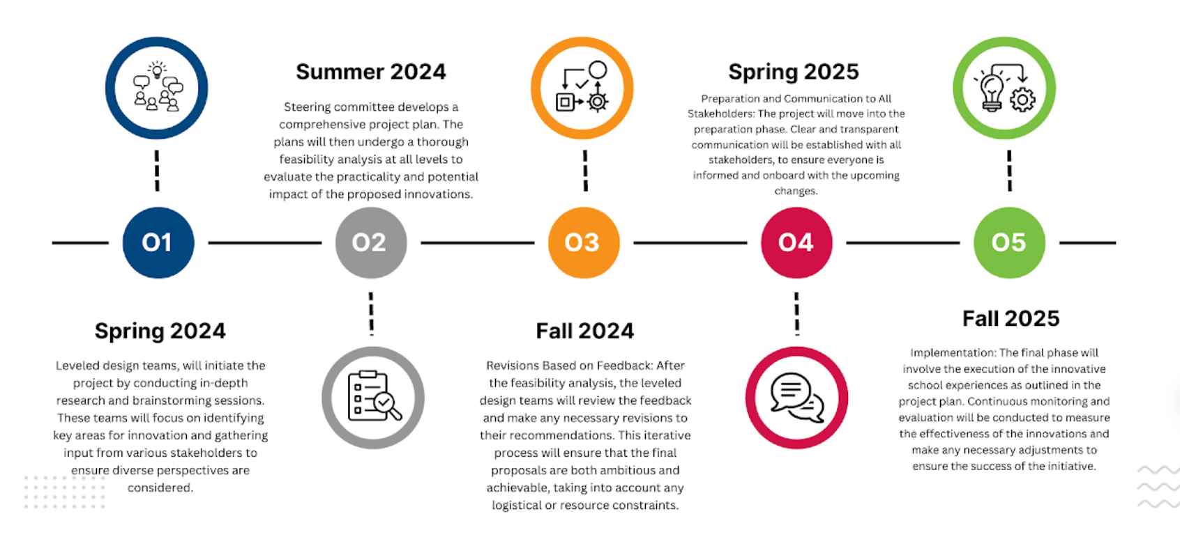
Innovative School Experience Timeline
Notes:
This timeline brings us to where we are today. Last summer, the leveled design teams shared their proposals with a cross-district steering committee, which conducted a thorough feasibility analysis and provided feedback. This fall, the design teams refined their proposals based on that feedback, with the ultimate goal of implementing these innovative changes in August of 2025.

Slide 18
Design Team Considerations
2018 School Day Work
Research & Best Practices
Profile of a Learner Skills & Attributes
Current Challenges
Staff & Student Surveys / Morale
Societal Changes
Notes:
Before we review the specific challenges and proposals for each level, it is important to know that when completing their work on our problem of practice, the design teams considered a wide range of factors to ensure their proposals were comprehensive and aligned with our goals. They reviewed the work of the 2018 school day teams, analyzed staff morale data and surveys from both students and staff, examined our data and current challenges, and studied research and best practices.
They also reflected on societal and landscape shifts and intentionally incorporated the skills and attributes from our Profile of a Learner. All of this informed a cohesive plan designed to meet the evolving needs of our students, staff, and community.

Slide 19
Early Childhood - Transition
Notes:
Our district is proud to be a comprehensive system that serves students from early childhood through transition programs. Next, we will share the proposals developed by each of our leveled design teams.
It’s important to note that we are not proposing changes to our transition program. This program is already extraordinarily innovative, offering a schedule similar to a collegiate model that effectively prepares students for their next steps. Innovation for Connections has come through creating additional space and more flexibility within that space to allow them to effectively serve their growing student population.
I will now invite Katie Matthews, Assistant Superintendent for Elementary, to speak on behalf of the Early Childhood and Elementary Design Teams.

Slide 20
Early Childhood - Current State
The program serves students with disabilities, students who are at risk for academic challenges and community paid tuition based students
All students attend for 2.5 hours in an a.m. or p.m. session in 3-5 year old multi-age classrooms
Early childhood teachers serve as
    General education teacher
    Learning behavior specialists for students with IEPs, and
    Multilingual specialist for english learners
Only 25 min. between sessions daily and 60 minutes of special time weekly for educators to plan for students’ unique needs and innovative learning experiences
Only 5 non-student attendance days to allow for home visits, community events, and collaboration
Notes:
Our early childhood program currently serves students in 2.5-hour sessions, either in the morning or afternoon, in multi-age classrooms for 3- to 5-year-olds. Teachers in these classrooms fulfill multiple roles, serving as general education teachers, learning behavior specialists for students with IEPs, and multilingual specialists for English learners.
Despite these complex responsibilities, teachers have only 25 minutes of planning time each day between the morning and afternoon sessions, and two 30 minute specials weekly to address students’ unique needs and design innovative learning experiences. Additionally, there are only five non-student attendance days per year to support home visits, community events, and collaboration;

Slide 21
Early Childhood - Proposal
Increased planning and collaboration time to innovate and design instruction to meet students’ unique needs and align to EC standards
More tailored instruction to students’ developmental stages by differentiating the time students attend by age level.
Play based preparation for kindergarten for children transitioning from early childhood to kindergarten
Notes:
The early childhood design team has proposed several key changes to enhance learning and better meet the needs of our youngest students.
First, they recommend increasing planning and collaboration time to allow teachers to innovate and design instruction that aligns with early childhood standards and addresses each student’s unique needs.
Second, the team proposes tailoring instruction to students’ developmental stages by differentiating attendance times based on age level, ensuring that each child receives the appropriate support and opportunities for growth.
Finally, they emphasize the importance of play-based preparation for kindergarten to help children transitioning from early childhood programs develop the skills and confidence they need for success in kindergarten.

Slide 22
Proposed Early Childhood Plan
Early Childhood Proposed Model
Model | Monday | Tuesday | Wednesday | Thursday | Friday
8:15-10:15 Morning Session ONLY 3 year olds | Targeted Attendance | All | All | All | Out Fridays for Home Visits, Community Events
10:30-11:25 - Planning & Collaboration
11:25-12:05 -Staff Lunch
12:05-2:35 Afternoon Session ONLY 4&5 year olds | Targeted Attendance | All | All | All | All
Notes:
The proposed schedule for early childhood introduces significant improvements to better meet the developmental needs of our students while supporting our educators' ability to plan and collaborate.
Under this proposal, 3-year-olds would attend only in the morning for a slightly shorter session of 2 hours, and 4- to 5-year-olds would attend in the afternoon for the same 2.5-hour session as before. This change allows for tailored instruction aligned with each age groups’ developmental needs.
Similar to our current structure, on Mondays, only students requiring additional supports would attend for targeted interventions, ensuring they receive the focused help they need. Additionally, on Friday mornings, 3-year-olds would not attend, giving educators the time to conduct home visits, provide community events, and collaborate with colleagues.
This schedule also allows educators to have 55 minutes of daily planning time—a significant increase—enabling them to design innovative and individualized instruction for every student.

Slide 23
Elementary - Current State
Students attend for 6 hours and 15 minutes
Inconsistencies in structures used to provide interventions and extension for students
Schedules do not reflect time for non-instructional tasks
Time for morning meetings or class meetings is inconsistent across classrooms and schools
Time dedicated for collaboration & planning differs across schools
Notes:
Our elementary students currently attend school for 6 hours and 15 minutes each day.
However, there are inconsistencies in the structures used to provide interventions and extensions for students, which impacts how support is delivered. Additionally, schedules do not always account for non-instructional tasks, making it challenging to balance academic and operational needs.
The time allocated for morning or class meetings, which foster community and social-emotional learning, also varies across classrooms and schools. Lastly, planning and collaboration time for teachers differs from school to school, creating inequities in how teams can work together to design and deliver effective instruction.

Slide 24
Elementary - Proposal
Built in time for individualized interventions and extensions for students
Ensure a daily morning meeting routine and explicit social and emotional learning
Maximize use of instructional time by accounting for non-instructional tasks (i.e. snacks, transitions)
Add opportunities for collaboration within schools and across the district
Add 15 minutes to the school day to address all of the identified needs
Notes:
The elementary design team has identified several key proposals to address the current challenges and create a more consistent and effective school experience for our students and they propose adding 15 minutes of time to the length of the student day in order to adequately address the first three components of their proposal.
First, they propose built-in time for individualized interventions and extensions to ensure that all students receive the support or enrichment they need.
Second, the team emphasizes the importance of establishing a daily morning meeting routine with explicit social and emotional learning opportunities to foster a sense of belonging and build essential life skills.
Third, they proposes maximizing instructional time while accounting for non-instructional tasks like snacks and transitions.
Finally, the team recommends increasing opportunities for collaboration, both within schools and across the district, to ensure consistency and to empower teachers to work together to enhance student learning.

Slide 25
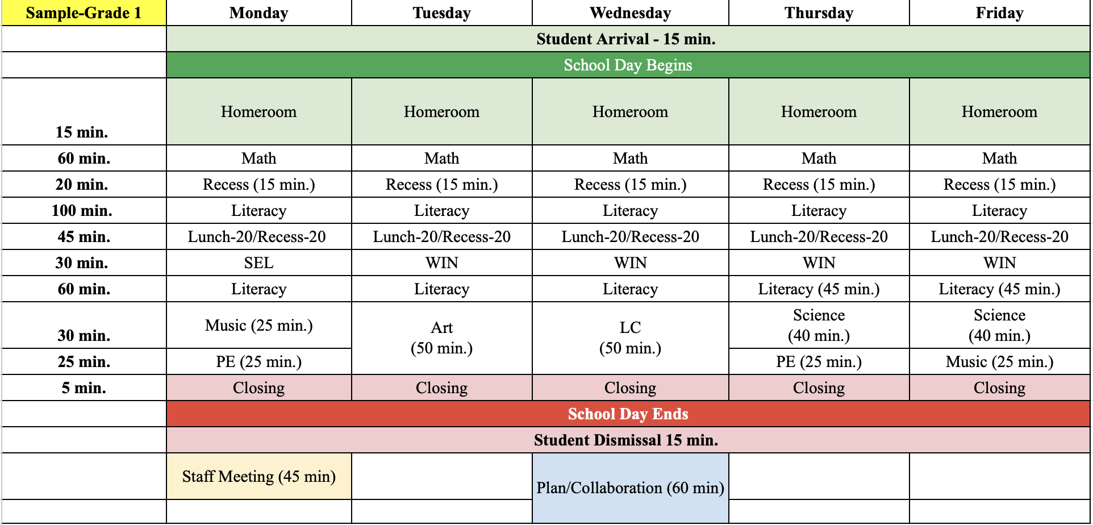
Sample Elementary Schedule
Notes:
This sample first grade schedule reflects the proposed changes, highlighting how we can create a more consistent and intentional structure for our elementary schools.
The schedule includes a dedicated 15-minute homeroom period each day, ensuring time for morning meetings and explicit social and emotional learning. This routine fosters a sense of community while setting a positive tone for the day.
Additionally, the schedule accounts for necessary transitions and non-instructional tasks without taking time away from core content areas. For example, you will see 20 minutes allotted during the morning recess time even though recess is 15 minutes, and there is 45 min. allotted at the midday lunch recess time even though they together lunch and recess are 40 min. This approach helps us maximize instructional time while addressing the logistical needs of the school day.
At this time, Allison Boutet, Assistant Superintendent for Middle School, will share the recommendations of the Middle School Design Team.

Slide 26
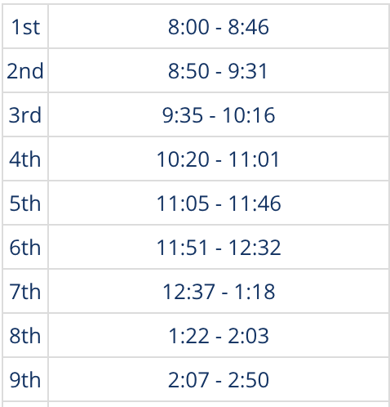
Middle School - Current State
Students experience 9 periods per day at 41 minutes per period, with 10 transitions of unstructured time
Currently no weekly advisory period
Students only have 1 exploratory and some must give up that time to receive interventions
There are 82 minutes for ELA instruction and only 41 for math each day
Students in Band & Orchestra miss core classes for instruction
Current Middle School Schedule
Notes:
Currently, middle school students experience a 9-period day with 41-minute classes and 10 transitions, resulting in significant unstructured time throughout the day.
There is no dedicated weekly advisory, which limits opportunities for building connections and addressing students’ social-emotional needs. Additionally, students only have access to one exploratory course, and some must give up that time to receive academic interventions.
Instructional time is uneven, with 82 minutes allocated to English Language Arts daily, but only 41 minutes for math, which does not align with best practices for middle school math instruction. Finally, students in Band and Orchestra miss core classes to participate, creating scheduling conflicts that impact their academic experience.

Slide 27
Middle School - Proposal
Increase math instructional minutes
Incorporated time for individualized interventions while maintaining access to exploratory offerings
Add weekly anchor day with advisory and all classes to support content and connection and build community, SEL, and Profile of a Learner skills
Allow opportunities for deeper learning in math, science, and social studies
Ensure flexible time for hands-on projects, interdisciplinary connections, and collaboration
Add innovative exploratory choices
Notes:
The middle school design team has proposed several impactful changes to address current challenges and create a more balanced and enriching school experience for our students.
First, they recommend increasing math instructional minutes to align with best practices and provide deeper support for student learning.
Second, the team proposes incorporating time for individualized interventions while ensuring students maintain access to exploratory offerings, so no one has to sacrifice opportunities for support or enrichment.
They also suggest adding a weekly anchor day that includes advisory and all classes. This day would focus on building community, strengthening SEL and Profile of a Learner skills, and supporting connections across content areas.
Additionally, the team emphasizes the need for deeper learning opportunities in math, science, and social studies, with flexible time built in for hands-on projects, interdisciplinary connections, and collaboration.
Finally, they propose adding innovative exploratory choices to expand opportunities for students to explore their interests and develop new skills.

Slide 28
Sample MS Student Schedules
Period Length | Student 1 | Student 2 | Student 3
(41 min) | English Language Arts | Physical Education | Math/WIN
(38 min) |  | Art
(38 min) | Math/WIN | Supervised Study | Social Studies/Science
(38 min) |  | Math/WIN | Physical Education
(38 min) | Lunch/Recess |  | Art
(38 min) | Social Studies/Science | Lunch/Recess | PLTW
(38 min) |  | English Language Arts | Lunch/Recess
(38 min) | Band |  | Social Studies/Science
(38 min) | Spanish | Social Studies/Science | English Language Arts
(38 min) | Physical Education
Notes:
The proposed middle school schedule introduces several enhancements designed to better meet student needs, provide personalized learning opportunities, and address key structural challenges. Students have many options in the exploratory paths that they choose. Here are 3 different students and what their schedules could look like.
This schedule includes a FLEXIBLE MODIFIED BLOCK which maintains a 2-period ELA instructional block. This slide increases mathematics instructional time to 53-60 minutes daily, with a 20-minute WIN (What I Need) period attached to math, aligning with best practices to ensure students have adequate time to deepen their understanding AND offering individualized support for any content area tailored to student needs.
Social studies and science are organized into flexible time blocks that can be combined or separated depending on the instructional needs of the day. This structure supports deeper learning and hands-on projects in these critical subjects.
Students will have access to two daily exploratory classes, plus Physical Education, ensuring opportunities for enrichment and personal growth. Band and Orchestra are now embedded in the schedule, eliminating the need for students to miss core classes to participate. Additionally, students receiving interventions will still be able to take an exploratory class, ensuring equity and access for all.
Daily PE and/or health and lunch/recess remain part of the schedule, meeting students’ physical and social-emotional needs. The schedule also reduces 1-2 transitions per day, decreasing hallway traffic and improving overall flow.
Finally, this structure supports the expansion of exploratory wheel classes, giving students more choices and opportunities to explore diverse interests, while fostering an engaging and supportive learning environment.
The proposal is to have a weekly anchor day which would be on Wednesday. There will be an advisory to start the day and then students will progress through all of their classes.
Lastly, on all days students will have recess daily embedded within their lunch period. We are looking at offering a variety of options for students to participate in during the recess period as many students have voiced they want recess time, but do not all want the traditional outdoor recess as it is now.
Deputy Superintendent for High Schools, Dr. Mark Cohen, will now share the recommendations from the high school design team.

Slide 29
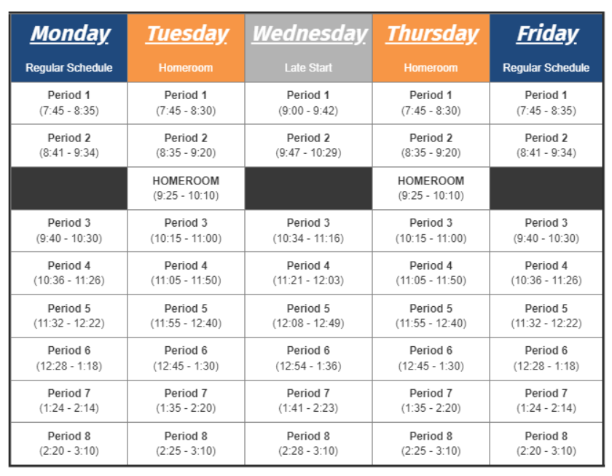
High School - Current State
Students experience 3 different schedules with 2 different start times
Students experience 8/9 periods per day with between 42-50 minutes
There are 7/8 passing periods equaling between 35-42 min each day
Wednesday late starts allows for formal teacher collaboration only once per week
Transportation logistics add another 60-90 minutes onto the day
Example High School Schedule
Notes:
Currently, our high school students navigate a complex and inconsistent schedule. They experience 8 or 9 periods per day with 7 to 8 passing periods, which add between 35 and 42 minutes of transitions daily. Class periods range from 42 to 50 minutes, depending on the day, and opening and closing activities in each class reduce the amount of usable instructional time in each class.
Students and staff follow three different schedules with two different start times each week, which makes it challenging to establish routines. While Wednesday late starts provide time for formal teacher collaboration, this happens only once per week. Scheduling constraints require that most collaboration occurs outside of the school day.
Our high school day is about 30 minutes longer than many other local suburban high schools, and transportation logistics add 60-90 minutes to students’ days, requiring early wake-ups and long days that contribute to challenges with sleep and mental health. These factors emphasize the need to reimagine the school day to make better use of our students’ and staff’s time.

Slide 30
High School - Proposal
Maximize instructional time
Built in time for individualized interventions for students
Decrease unstructured time and increase engagement & attendance
Increase opportunities for teacher collaboration
Allow opportunities for deeper learning in all content areas
Notes:
One of the key shifts recommend by the design team is a focus toward deep learning—moving beyond traditional, surface-level teaching practices to meaningful, student-centered learning experiences. This approach emphasizes inquiry-based, project-oriented, and collaborative work that allows students to apply their knowledge in real-world scenarios. Longer periods of time are essential for engaging in these types of complex and impactful learning activities.
Currently, students have large amounts of unstructured time during the school day due to transitions and transportation constraints. The design team seeks to reduce unstructured time by creating a more compact, efficient, and engaging school day, which we believe will also improve attendance and connection with school.
As interventions and social-emotional learning time have been added, class periods have grown shorter, making it harder to meet our instructional goals. Our goal is to maximize the impact of instructional time by organizing it into larger chunks for deeper learning, while provide more time for individualized interventions and social-emotional support.
Finally, we recognize the importance of teacher collaboration. Currently limited to Wednesday morning late starts, this time is insufficient to meet the growing demands of interdisciplinary and collaborative teaching. The proposed schedule seeks to increase opportunities for teacher collaboration to support the high-quality learning experiences our students deserve.

Slide 31
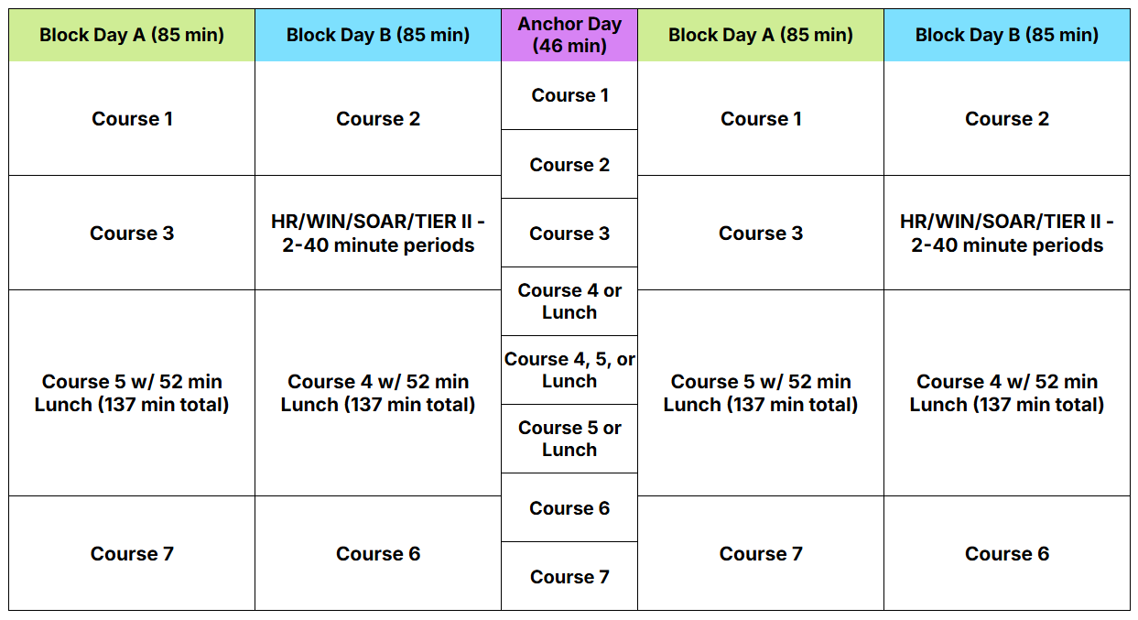
Proposed High School Schedule
Notes:
To meet the goals of our desired state, the high school design team recommends a block schedule model. This framework includes four block days and one anchor day in a typical five-day week.
On block days each course is scheduled for 85 minutes of instruction, with the third block extended by 52 minutes to allow for lunch. Lunch periods can occur at the beginning, middle, or end of this block, and upperclassmen will retain their off-campus lunch privileges. Block days are organized into two clusters (A and B), maintaining the current number of courses while adding an additional two 40-minute periods for interventions or homeroom compared to the current schedule.
The anchor day, shown in the middle of the week, follows a traditional high school schedule with 46-minute periods, ensuring each course meets three times in a five-day week. In shortened weeks, the anchor day would be eliminated to balance the schedule.
It’s important to note that this is not the same block schedule used during pandemic learning.
This model doubles the time available for interventions, reduces time spent in unstructured passing periods, and compacts the school day by 35 minutes, going from 7 hours and 25 minutes to 6 hours and 50 minutes. This adjustment allows students to get more sleep while giving faculty time to meet before school without needing a special schedule—truly a win-win for both students and staff.
While the student day is shorter, instructional minutes remain maximized. Teachers spend just as much time in instruction as they do now but benefit from longer blocks that reduce the need for frequent transitions and administrative tasks, such as taking attendance seven times a day. These longer blocks also enable deeper learning activities, allowing teachers and students to fully engage without interruptions or delays.

Slide 32
77%
of courses at the University of Illinois, Urbana-Champaign are longer than 50 minutes
Most are 80-180 minutes.
Notes:
Finally, let’s take a moment to reflect on the structure of the typical middle or high school day. Imagine if your workday were organized like a traditional American high school:
You arrive at the office, sit at your desk, take a few minutes to settle in, and begin working. After 45 minutes, a bell rings, and you’re required to leave that task, whether it is finished or not, and move to another part of the building. There, a new supervisor gives you a completely different set of tasks. Forty-five minutes later, the bell rings again, and you repeat this process seven or eight times throughout the day.
Under these circumstances, how productive do you think you would be?
This is the assembly line, factory model of education—and it’s unique to secondary schools. In contrast, elementary schools structure time in extended blocks for literacy and math, and at the university level, 77% of courses at the University of Illinois are longer than 50 minutes, with most ranging from 80 to 180 minutes.
When students enter the workforce, they’ll need the ability to focus on tasks for extended periods of time. With the prevalence of technology and digital distractions, it’s more important than ever to build mental stamina and focus. A block schedule provides students with opportunities to develop these critical skills, preparing them for the demands of college, careers, and life beyond high school.
I would like to invite Lisa Xagas, the Assistant Superintendent for Strategy and Engagement, to conclude our presentation and to introduce your work activities.

Slide 33
Proposed Structural Changes
Structures alone aren’t innovative, but they allow us to innovate and iterate.
Shift to a staggered school day
Add 15 minutes to the Elementary day
Shift MS and HS to later start times to address physiological needs of teens
Shift Elementary to start first and MS to start last
  Ensure students arrive to school as close to the start as possible
Shift to have no school day start before 7:30 a.m. or end later than 4:00 p.m
Change schedules to
  Embed individualized support time within the day
  Extend time for MS mathematics
  Ensure opportunities for deeper learning
  Ensure non-instructional time is appropriate to the level
Notes:
This slide outlines the key structural changes we are proposing across all levels to address the challenges and opportunities we’ve discussed tonight. While structures themselves aren’t inherently innovative, they are essential in creating the conditions for innovation to thrive. These changes are designed to ensure that our students’ time in school is purposeful, engaging, and aligned with their developmental and academic needs.
We propose a staggered school day to make better use of time and resources. By also ensuring that students arrive at school as close to the start of the day as possible, we reduce unstructured time and maximize instructional opportunities.
At the elementary level, we plan to add 15 minutes to the school day to account for time for an intervention and extension block, daily morning meetings, and non-instructional tasks, without stealing time from core instruction. At the same time, at the secondary level, we aim to reduce non-instructional time, like excessive passing periods or lengthy time before school even begins, to ensure that time is reallocated to meaningful learning opportunities.
For middle school, we propose extending mathematics instructional time and creating opportunities for deeper learning in all subjects, including flexible blocks for interdisciplinary projects and collaboration.
We also propose shifting the elementary start time earlier, while delaying start times for middle and high school to better align with the physiological needs of adolescents. Research tells us that later start times improve sleep, alertness, and overall well-being for teens.
Finally, no school day will start before 7:30 a.m. or end later than 4:00 p.m., ensuring that our schedules are both developmentally appropriate and efficient for students, families, and staff.
While we believe these proposed schedule shifts and structural changes will benefit all students, we are particularly excited about the positive impacts for students requiring additional supports or special education services. These changes provide greater opportunities for individualized learning without compromising instructional time or students’ access to career exploration experiences.
These structural changes lay the groundwork for a more innovative school experience, one that prepares students for the challenges and opportunities of the future while supporting their growth and success today.

Slide 34
Next Steps
Collect, analyze, & consider feedback
Continue ongoing professional learning for staff
Plan for implementation
  Systems
  Transportation
Presentations to the Board of Education
  January 21st: Why Innovate
  February 3rd: Recommendations for Innovating the School Experience
Collective Bargaining
Notes:
As we move beyond today, we want to share the next steps in this process and emphasize how critical your feedback is to shaping the final proposal.
We are working to collect, analyze, and consider feedback from all stakeholders to refine and strengthen the recommendations. Alongside this, we will continue ongoing professional learning for staff to ensure they are fully prepared to implement these changes effectively.
Additionally, we are continuing our collaboration with a transportation consultant specializing in school district logistics to design school start and end times and transportation routes that minimize travel time, ensure students arrive at school close to the start of the day, and ensure buses are waiting and ready for dismissal. This will help us maximize efficiency and meet the needs of our students and families.
We have two key presentations to the Board of Education:
On January 21st, we will present the rationale behind this work—Why Innovate?
On February 3rd, we will share our final recommendations, for innovating the school experience, including school start and end times and schedules. The Board of Education will then vote on the proposal at a following meeting.
In parallel, we will engage in collective bargaining to ensure alignment with our staff contracts and begin planning for implementation.
These steps are all part of ensuring that we create a thoughtful, effective plan for implementing these changes by August 2025.

Slide 35





Small Group Work Activities
Notes:
Thanks for your patience during the presentation portion of the evening. At this time, we will shift to our small group work activities.

Slide 36
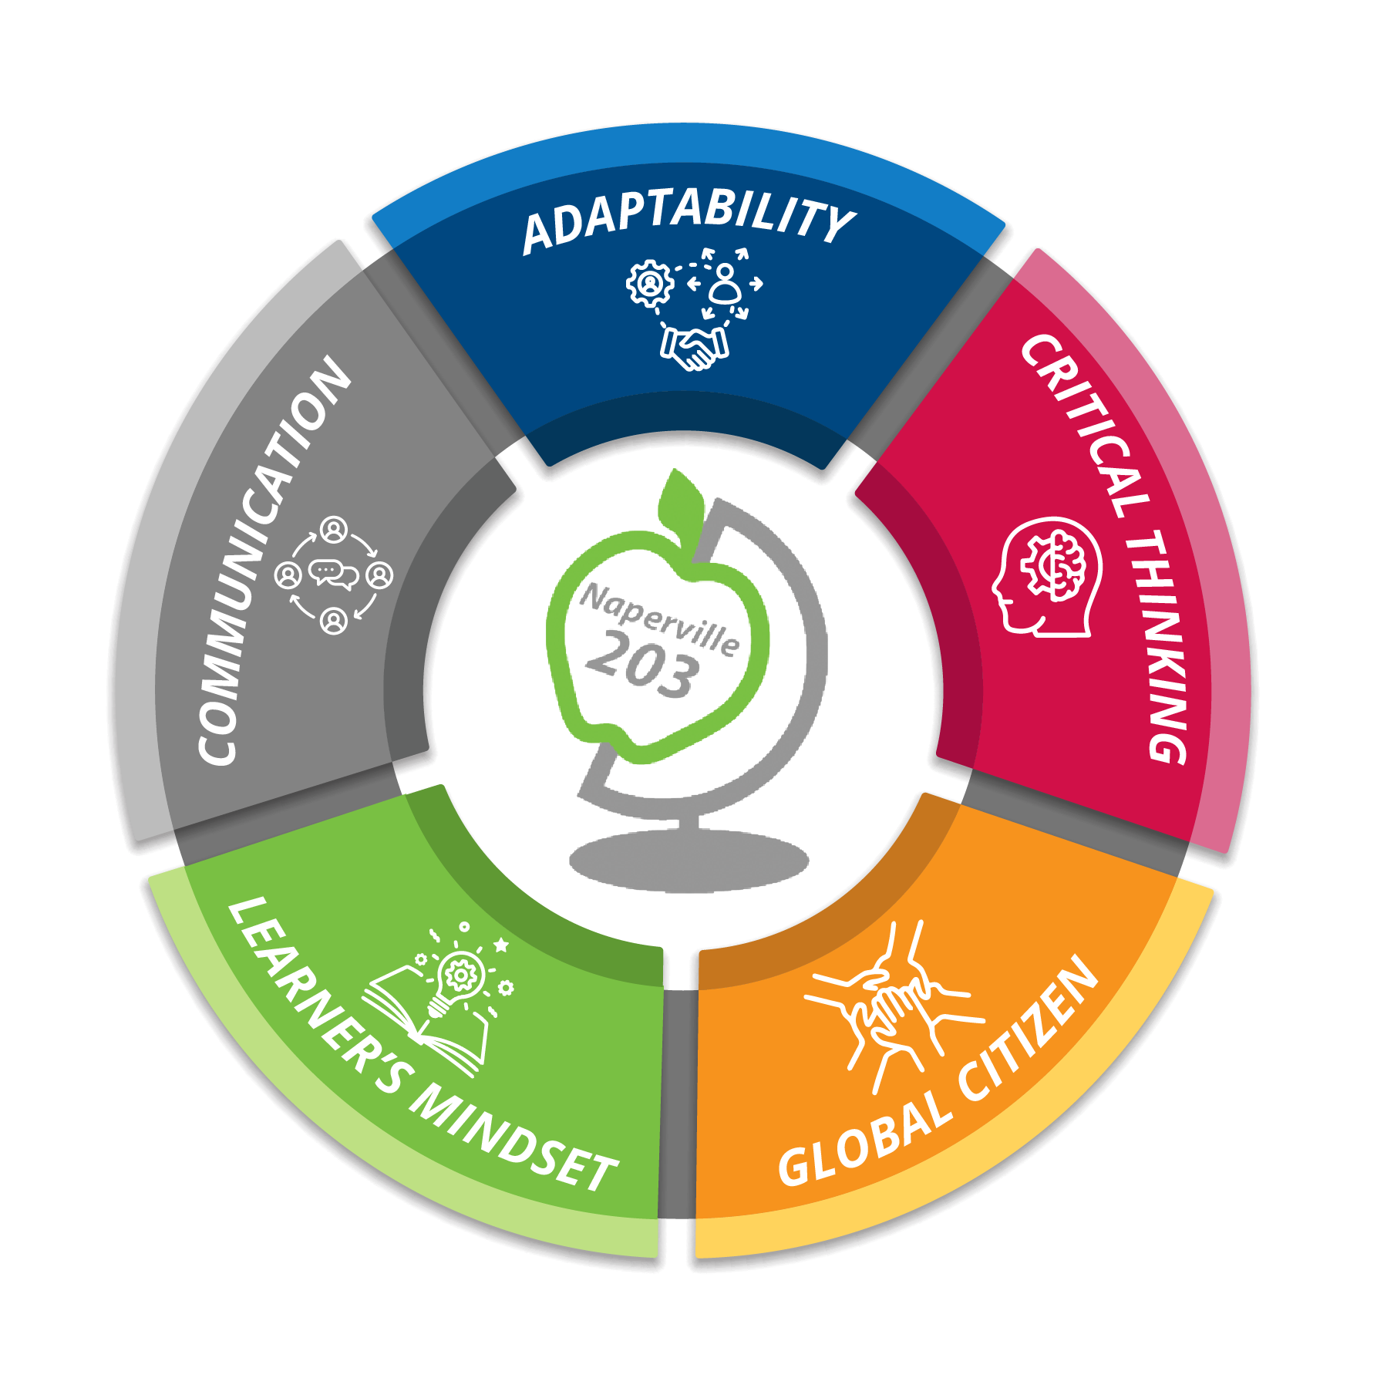
Select a Recorder and Facilitator
Recorder Responsibilities –
Complete the information on the group’s worksheet (PINK)
Facilitator Responsibilities—
Facilitate Discussion
Keep Group Focused/On Task
Report Group’s Information
Small Group Work Activity Roles
Notes:
On your tables, you have a Small Group Activity Worksheet on white paper. You will use this document to capture your individual thoughts and reactions. Please select a recorder and facilitator at your table.
The facilitator should facilitate discussions, keep the group focused and on task so the work is completed in the allotted time, and report the group’s information if time permits.
Once group work begins, the recorder is responsible for completing the information requested on the official pink worksheet in the center of the table. This worksheet will be collected at the conclusion of the session, used for the verbatim transcription of your input to district administration and compiled to post the results on the website.

Slide 37
Recorded information should reflect consensus/general agreement of group members
Monitor progress to complete the tasks in allotted time
Only the group’s pink worksheet will be collected
Small Group Work Activity Instructions
Notes:
The recorder, should capture information that is consensus or the general agreement of the table. Facilitators will need to make sure you are monitoring the conversation within the allotted time. As a reminder, only the pink worksheets will be collected.

Slide 38
Shared airtime
Listen generously
Respect perspectives
Adhere to topic
Working Agreements
Notes:
As you engage in table conversations, we ask that each participant agrees to the following working agreements. The first is shared airtime, it is important to ensure that each person has the opportunity to share their thoughts as we move through our conversations. Next we are asking each participant to listen generously, this means to listen to understand. We are asking to respect the perspectives of others as we all have different life experiences and opinions. Finally, we are asking that we keep the discussion on topic for each of the small group activities. As a reminder, to honor the time of all participants, should you have questions or topics that are not related to tonight’s content, please utilize Let’s Talk or connect with someone at the conclusion of our event.

Slide 39

TASK 1
Considerations
Based on the information provided in the presentation, what additional factors do we need to consider to ensure students are best prepared for life after high school?
Notes:
Online ThoughtExchange: Task #1: Considerations - Based on the information provided in the presentation, what additional factors do we need to consider to ensure students are best prepared for life after high school?

Slide 40
TASK 2
Student Supports
Based on the information provided in the presentation, what are the types of support our students may need to be successful within these new structures?
Notes:
Online ThoughtExchange: Task #2: Student Supports - Based on the information provided in the presentation, what are the types of supports our students may need to be successful within these new structures?

Slide 41
TASK 3
Family Partnerships
Based on the information shared in the presentation, how can we partner to ensure families are prepared for the change?
Notes:
Online ThoughtExchange: Task #3: Family Partnerships - Based on the information shared in this presentation, how can we partner to ensure families are prepared for the change?

Slide 42

Small Group Share to Large Group
Task 1
Task 2
Task 3
Notes:
Differentiate based upon timing left

Slide 43
Next Steps
Collect, analyze, & consider feedback
Continue ongoing professional learning for staff
Presentations to the Board of Education
  January 21st: Why Innovate?
  February 3rd: Recommendations for Innovating the School Experience
Collective Bargaining
Plan for implementation
  Systems
  Transportation
Notes:
As a reminder, these are our next steps following the Focus 203 event on Friday.

Slide 44

THANK YOU
What additional information do you need to support these plans?
https://tejoin.com/scroll/441653357
Notes:
Thank you for sharing a portion of your evening with us, we are grateful for your dedication and partnership and for trusting us with your littlest humans. Together, we will create opportunities that set them up for success in their futures.
As we conclude, let’s return to the question we began with: What is school for? It is our responsibility to empower students to develop a learner’s mindset, demonstrate adaptability, communicate effectively, think critically, and become global citizens, fully prepared to thrive in a world of constant change and opportunity when they leave us, not just while they are here.
We also invite each of you to reflect and share what additional information you would need to support our plans for ensuring an innovative school experience for our students and staff. Utilize the QR code or web address to submit your thoughts.

Slide 46
References
Benner, M., & Partelow, L. (2025, January 10). Reimagining the School Day. Center for American Progress. https://www.americanprogress.org/article/reimagining-the-school-day/
Kirk, M., N. H., et. al (2020, January 21). Brave before perfect at Northern Cass School District. NGLC. https://www.nextgenlearning.org/articles/brave-before-perfect-transforming-learning-in-rural-north-dakota
Mathewson, T. G. (2020, March 30). Does lunch have to be 45 minutes? Rethinking School schedules to support innovation. The Hechinger Report. https://hechingerreport.org/does-lunch-have-to-be-45-minutes-rethinking-school-schedules-to-support-innovation/
Redesigning high school. Redesigning High School. (n.d.). https://www.redesigninghighschool.org/
Unlocking time. Reimagine time in K-12 schools. (n.d.). https://unlockingtime.org/
Whitman, G. (2019, March 12). Using neuroscience to launch a research-informed school schedule - edsurge news. EdSurge. https://www.edsurge.com/news/2019-02-20-using-neuroscience-to-launch-a-research-informed-school-schedule

