Slide 1
Understanding Erin’s Law
A Parent’s Guide

Slide 2
What is Erin’s Law?
Erin’s Law is named after childhood sexual assault survivor, author, speaker and activist Erin Merryn, who is the founder and President of Erin’s Law, which is registered with the State of Illinois and the IRS as a 501 (c)(4) non-profit social welfare organization.
Erin’s Law requires public schools to teach child sexual abuse and exploitation prevention classes to students in kindergarten through eighth grade.
Source: Erinslaw.org

Slide 3
What are the district’s requirements under the new legislation?
“Erin’s Law” requires that all public schools in each state implement a prevention-oriented child
sexual abuse program which teaches:
● 1 Students in grades K – 8th grade, age-appropriate techniques to recognize child sexual abuse and tell a trusted adult
● 2 School personnel all about child sexual abuse
● 3 Parents & guardians the warning signs of child sexual abuse, plus needed assistance, referral or resource information to support sexually abused children and their families
Source: Erinslaw.org

Slide 4
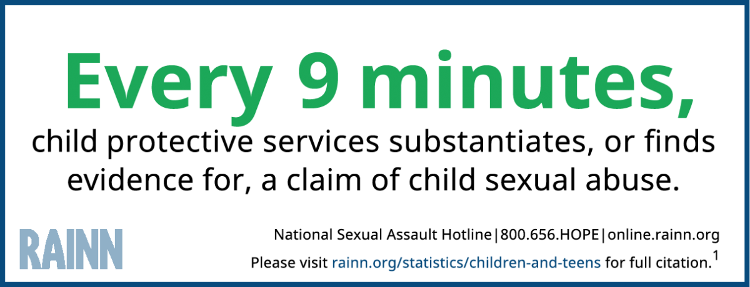

Slide 5
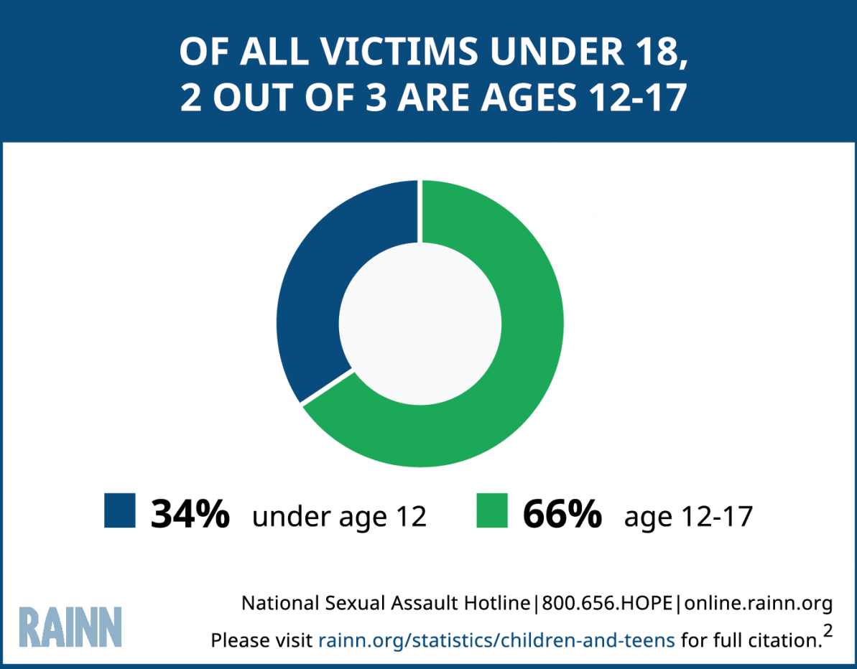

Slide 6
What can parents do?
Talk to your child regularly about body safety:
● Start the conversation early: as soon as language starts and can be understood, it is a great time to begin.
● Talk to your child about trusting their intuition. That feeling in your tummy that something doesn’t seem right likely isn’t. Even if nothing has happened empower your child that they can leave a situation and find another safe adult. That might mean calling someone if they are alone with only one adult making them feel uneasy.
Abusers almost always tell a child to keep it a secret. They may tell them they will be in trouble if they tell anyone. Get across to your child they will not be in trouble. That this is not their fault. Abusers can threaten children to stay silent by saying they will hurt them or someone in their family. Let your child know no matter what they have been told you don’t keep this is a secret. You will be protected once you report it. Teach them the differences between safe and unsafe secrets.
Use simple language

Slide 7
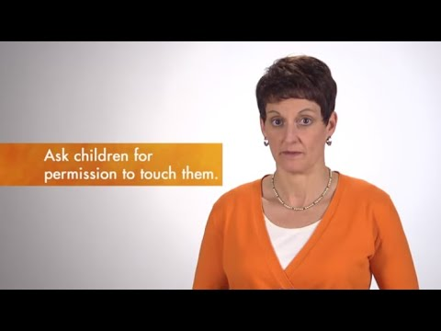
Healthy Touches
Talk to your kids about safe and unsafe touches.
Examples of safe touches:
● Giving a hug.
● Giving a high five.
Examples of unsafe touches.
● Touching your private parts.
● Getting kicked.
● Hair pulling.
Never force children to give hugs and kisses. Let them make that decision. Empower them to know they are the boss of their bodies and decisions about their body.
Make the conversation an ongoing one.

Slide 8
Recognizing the signs and symptoms of child sexual abuse
May include but not limited to:
● Nightmares
● Trouble sleeping
● Bed wetting
● Change in appetite
● Fear of certain people, places, activites
● Mood swings: rage, anger, fear, anxiety, insecure or withdrawn
● Depression
● Suicidal thoughts
● Acting out sexually
● Exhibits adult sexual behaviors, knowledge, and language

Slide 9
Signs more common in adolescents:
May include but not limited to:
● Eating disorders
● Self-injurious behavior
● Drug and alcohol abuse
● Promiscuous activity
● Running away
● Suicidal (ideation/thoughts)
● Depression and anxiety
● Fear (unrealistic/abnormal)
● Change in academic performance

Slide 10
Warning signs of a child being abused:
A child receiving special attention; from one human consistently
● An adult creating opportunities to spend alone time with child
● Buying a child expensive gifts or giving them money
● Favoritism towards that child
● Physical affection towards that child: Kissing, hugging, holding hands, or wanting to be very close to a child

Slide 11
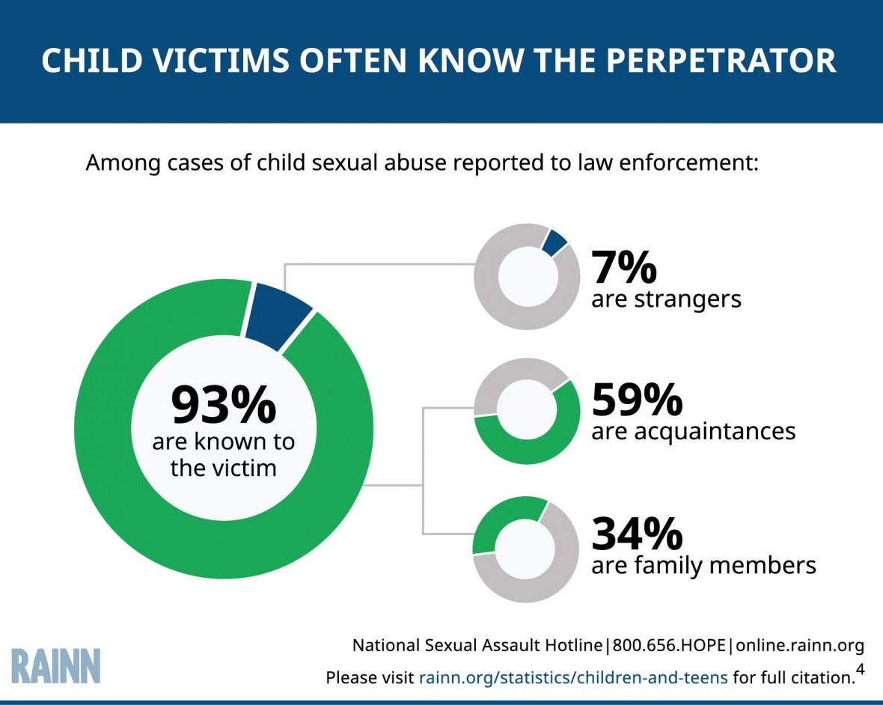
Who are the abusers?
Abusers can be in any relationship to the child including an older sibling or playmate, family member, a teacher, a coach or instructor, a caretaker, or the parent of another child
Perpetrators can be any gender identity, race, sexual orientation, or age

Slide 12


Talk with your kids about explicit content online
Wouldn’t you rather them ask you the questions instead of Google?

Slide 13

Talking to your child about sexual predators:

Slide 14
What to do if your child discloses abuse:
1. Listen to the child
2. Thank them for sharing with you
3. Reassure them it is not their fault
4. Explain that you will work to develop a plan to keep them safe
5. Review confidentiality
6. Report abuse immediately

Slide 15
How can you help if you suspect Child Sexual Abuse?
Pick your time and place carefully, be aware of your tone. Talk to the child directly, listen and follow up. Avoid judgment and blame, reassure the child, be patient. Tell them you are so proud of them for telling you and that you are not mad at them. Let the child know it is not their fault and they are not in any trouble. Tell the child that you’re going to talk to someone who can help. The child may not want you to report and may be frightened, especially if the perpetrator has threatened them or their loved ones.
**If you suspect child sexual abuse has occurred, or your child or another party reports/states that child sexual abuse has occurred:
Do not attempt to do your own investigation. Leave that for the professionals.
Go to the nearest emergency room, or your child’s pediatric doctor
24 Hour Confidential Hotline: (888) 802-8890
Call your local Child Advocacy Center [CAC] for support, information, and a forensic interview
Call or go to your nearest police station

Slide 16
Why they don’t tell
They may care about the abuser and be afraid of what will happen to the abuser if they tell.
They may also be concerned about other family members' reactions, fearing they won’t be believed or will be accused of doing something wrong.
They may have already tried to tell someone what happened, but the abuse was ignored or minimized.
They have been told by the perpetrator that what is happening is normal or happens in every family, and they don’t realize that it is a form of abuse. [grooming]
They may not know that help is available, or they don’t know who to trust.
They may be afraid of getting in trouble for telling, or that the abuser will follow through with threats.

Slide 17
What is the Ravens plan?
Our social worker along with our health teacher will be co-teaching lessons in grades 6-8 during the months of September and October. Lessons will be age appropriate and will focus on age-appropriate techniques to recognize:
child sexual abuse
sexual harassment
personal safety and telling a trusted adult
Awareness of body safety and personal boundaries
Safe vs. Unsafe Touches
Online Safety
3 step rule to getting help (No, Go, Tell)
Identifying trusted adults at school & at home
what healthy vs. unhealthy relationships look like
Students will make further connections to these techniques in our SEL and Health lessons.
Our students should always feel safe and comfortable going to their trusted adult in the school building.

Slide 18
Who can I call if I need support?
Our staff is here to help and always ready to support our families.
Please reach out to any of the following if you would like more information about talking to your children about safe and unsafe touching.
Mr. Molby, Principal nmolby@sd12.org
Ms. Petelle, Assistant Principal kpetelle@sd12.org
Mrs. Meyer, Social Worker gmeyer@sd12.org
Ms. Lawson, PE/Health Teacher tlawson@sd12.org
24 Hour Confidential Hotline: (888) 802-8890
www.nwcasa.org or www.erinslaw.org

