Slide 1


I thought I’d awaken to a world in mourning. Heavy clouds crowding, a society storming. But there’s something different on this golden morning. Something magical in the sunlight, wide and warming. I see a dad with a stroller taking a jog. Across the street, a bright-eyed girl chases her dog. A grandma on a porch fingers her rosaries. She grins as her young neighbor brings her groceries. While we might feel small, separate, and all alone, Our people have never been more closely tethered. The question isn’t if we can weather this unknown, But how we will weather this unknown together. So on this meaningful morn, we mourn and we mend. Like light, we can’t be broken, even when we bend. As one, we will defeat both despair and disease. We stand with healthcare heroes and all employees; With families, libraries, waiters, schools, artists; Businesses, restaurants, and hospitals hit hardest. We ignite not in the light, but in lack thereof, For it is in loss that we truly learn to lovIn this chaos, we will discover clarity. In suffering, we must find solidarity. For it’s our grief that gives us our gratitude, Shows us how to find hope, if we ever lose it. So ensure that this ache wasn’t endured in vain: Do not ignore the pain. Give it purpose. Use it. Read children’s books, dance alone to DJ music. Know that this distance will make our hearts grow fonder. From these waves of woes our world will emerge stronger. We’ll observe how the burdens braved by humankind. Are also the moments that make us humans kind; Let each morning find us couraWhen this ends, we’ll smile sweetly, In testing times, we became the best of beings.
Alanood Alzendani
822

Slide 2
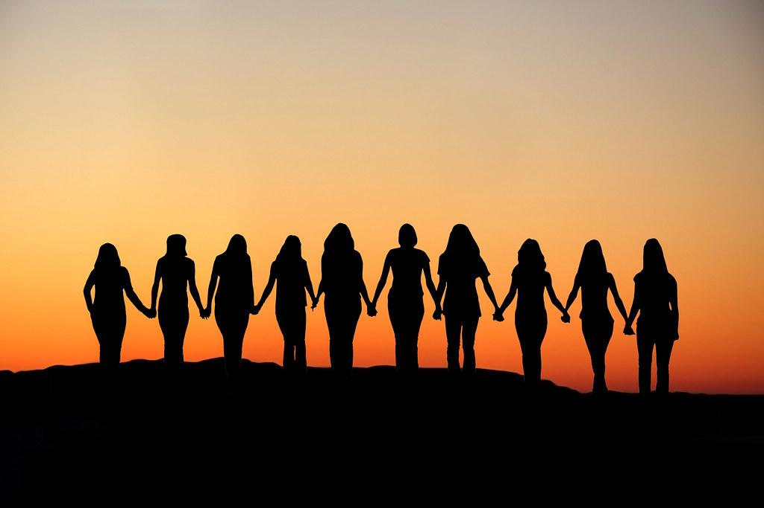
The Miracle of Morning
I thought I’d awaken to a world in mourning. Heavy clouds crowding, a society storming. But there’s something different on this golden morning. Something magical in the sunlight, wide and warming. I see a dad with a stroller taking a jog. Across the street, a bright-eyed girl chases her dog. A grandma on a porch fingers her rosaries.
She grins as her young neighbor brings her groceries. While we might feel small, separate, and all alone, Our people have never been more closely tethered. The question isn’t if we can weather this unknown, But how we will weather this unknown together. So on this meaningful morn, we mourn and we mend.
Like light, we can’t be broken, even when we bend. As one, we will defeat both despair and disease.
We stand with healthcare heroes and all employees; With families, libraries, waiters, schools, artists; Businesses, restaurants, and hospitals hit hardest. We ignite not in the light, but in lack thereof,
For it is in loss that we truly learn to love. In this chaos, we will discover clarity. In suffering, we must find solidarity. For it’s our grief that gives us our gratitude, Shows us how to find hope, if we ever lose it. So ensure that this ache wasn’t endured in vain: Do not ignore the pain. Give it purpose. Use it. Read children’s books, dance alone to DJ music. Know that this distance will make our hearts grow fonder.
From these waves of woes our world will emerge stronger. We’ll observe how the burdens braved by humankind. Are also the moments that make us humans kind; Let each morning find us courageous, brought closer; Heeding the light before the fight is over. When this ends, we’ll smile sweetly, finally seeing In testing times, we became the best of beings.
April 2020
Ashley Tovar 822

Slide 3

The Miracle of Morning
I thought I’d awaken to a world in mourning.
Heavy clouds crowding, a society storming.
But there’s something different on this golden morning.
Something magical in the sunlight, wide and warming.
I see a dad with a stroller taking a jog.
Across the street, a bright-eyed girl chases her dog.
A grandma on a porch fingers her rosaries.
She grins as her young neighbor brings her groceries.
While we might feel small, separate, and all alone,
Our people have never been more closely tethered.
The question isn’t if we can weather this unknown,
But how we will weather this unknown together.
So on this meaningful morn, we mourn and we mend.
Like light, we can’t be broken, even when we bend.
As one, we will defeat both despair and disease.
We stand with healthcare heroes and all employees;
With families, libraries, waiters, schools, artists;
Businesses, restaurants, and hospitals hit hardest.
We ignite not in the light, but in lack thereof,
For it is in loss that we truly learn to love.
In this chaos, we will discover clarity.
In suffering, we must find solidarity.
For it’s our grief that gives us our gratitude,
Shows us how to find hope, if we ever lose it.
So ensure that this ache wasn’t endured in vain:
Do not ignore the pain. Give it purpose. Use it.
Read children’s books, dance alone to DJ music.
Know that this distance will make our hearts grow fonder.
From these waves of woes our world will emerge stronger.
We’ll observe how the burdens braved by humankind
Are also the moments that make us humans kind;
Let each morning find us courageous, brought closer;
Heeding the light before the fight is over.
When this ends, we’ll smile sweetly, finally seeing
In testing times, we became the best of beings.
April 2020
Malak Alawdi
822

Slide 4

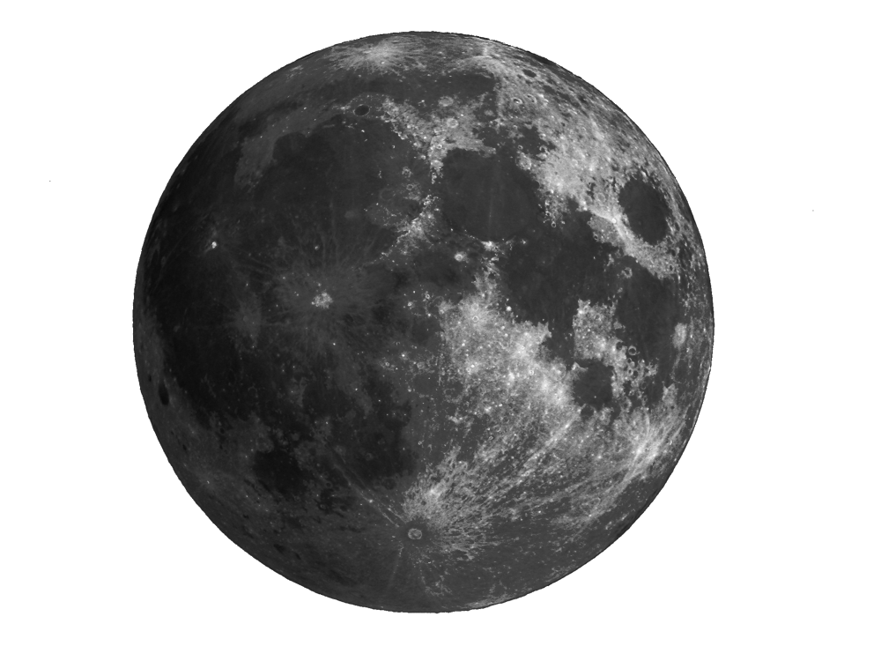

The Miracle of Morning
I thought I’d awaken to a world in mourning. Heavy clouds crowding, a society storming.But there’s something different on this golden morning. Something magical in the sunlight, wide and warming. I see a dad with a stroller taking a jog. Across the street, a bright-eyed girl chases her dog. A grandma on a porch fingers her rosaries.
She grins as her young neighbor brings her groceries. While we might feel small, separate, and all alone, Our people have never been more closely tethered. The question isn’t if we can weather this unknown, But how we will weather this unknown together. So on this meaningful morn, we mourn and we mend.
Like light, we can’t be broken, even when we bend. As one, we will defeat both despair and disease.
We stand with healthcare heroes and all employees; With families, libraries, waiters, schools, artists;Businesses, restaurants, and hospitals hit hardest. We ignite not in the light, but in lack thereof,
For it is in loss that we truly learn to love. In this chaos, we will discover clarity. In suffering, we must find solidarity. For it’s our grief that gives us our gratitude, Shows us how to find hope, if we ever lose it. So ensure that this ache wasn’t endured in vain: Do not ignore the pain. Give it purpose. Use it. Read children’s books, dance alone to DJ music. Know that this distance will make our hearts grow fonder.
From these waves of woes our world will emerge stronger. We’ll observe how the burdens braved by humankind. Are also the moments that make us humans kind; Let each morning find us courageous, brought closer; Heeding the light before the fight is over. When this ends, we’ll smile sweetly, finally seeing In testing times, we became the best of beings.
April 2020
Matthew Castro
822

Slide 5
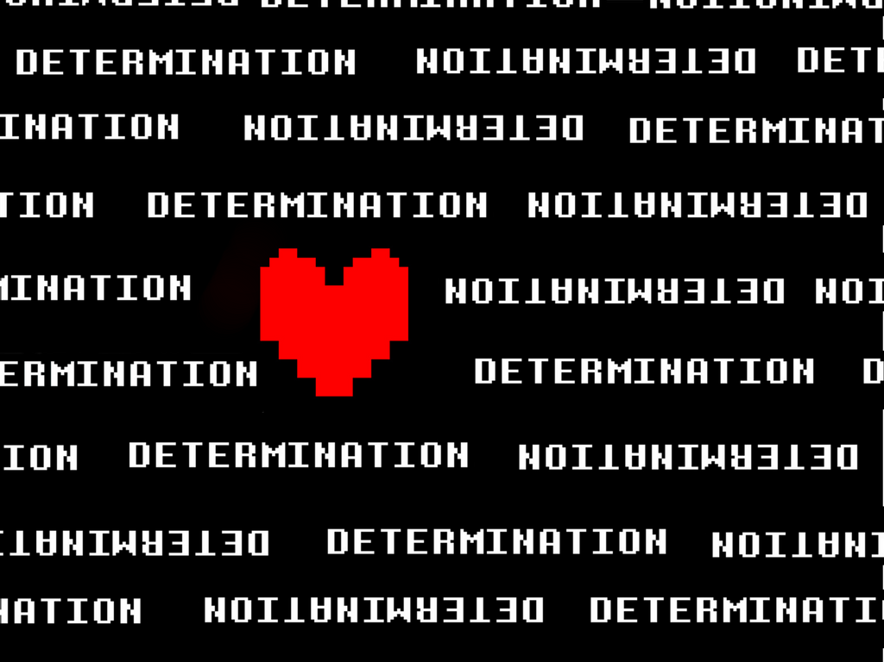


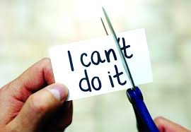
The Miracle of Morning
I thought I’d awaken to a world in mourning.
Heavy clouds crowding, a society storming.
But there’s something different on this golden morning.
Something magical in the sunlight, wide and warming.
I see a dad with a stroller taking a jog.
Across the street, a bright-eyed girl chases her dog.
A grandma on a porch fingers her rosaries.
She grins as her young neighbor brings her groceries.
While we might feel small, separate, and all alone,
Our people have never been more closely tethered.
The question isn’t if we can weather this unknown,
But how we will weather this unknown together.
So on this meaningful morn, we mourn and we mend.
Like light, we can’t be broken, even when we bend.
For it’s our grief that gives us our gratitude,
Shows us how to find hope, if we ever lose it.
So ensure that this ache wasn’t endured in vain:
Do not ignore the pain. Give it purpose. Use it.
Read children’s books, dance alone to DJ music.
Know that this distance will make our hearts grow fonder.
From these waves of woes our world will emerge stronger.
We’ll observe how the burdens braved by humankind
Are also the moments that make us humans kind;
Let each morning find us courageous, brought closer;
Heeding the light before the fight is over.
When this ends, we’ll smile sweetly, finally seeing
In testing times, we became the best of beings.
April 2020
Mariana Gomez-hernandez
822

Slide 6
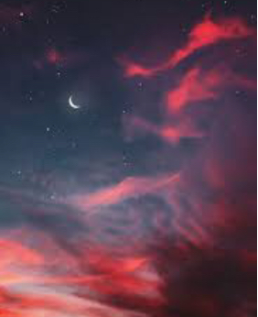
thought I’d awaken to a world in mourning.
Heavy clouds crowding, a society storming.
But there’s something different on this golden morning.
Something magical in the sunlight, wide and warming.
I see a dad with a stroller taking a jog.
Across the street, a bright-eyed girl chases her dog.
A grandma on a porch fingers her rosaries.
She grin as her young neighbor brings her groceries.
While we might feel small, separate, and all alone,
Our people have never been more closely tethered.
The question isn’t if we can weather this unknown,
But how we will weather this unknown together.
So on this meaningful morn, we mourn and we mend.
Like light, we can’t be broken, even when we bend.
As one, we will defeat both despair and disease.
We stand with healthcare heroes and all employees;
With families, libraries, waiters, schools, artists;
Businesses, restaurants, and hospitals hit hardest.
We ignite not in the light, but in lack thereof,
For it is in loss that we truly learn to love.
In this chaos, we will discover clarity.
In suffering, we must find solidarity.
For it’s our grief that gives us our gratitude,
Shows us how to find hope, if we ever lose it.
So ensure that this ache wasn’t endured in vain:
Do not ignore the pain. Give it purpose. Use it.
Read children’s books, dance alone to DJ music.
Know that this distance will make our hearts grow fonder.
From these waves of woes our world will emerge stronger.
We’ll observe how the burdens braved by humankind
Are also the moments that make us humans kind;
Let each morning find us courageous, brought closer;
Heeding the light before the fight is over.
When this ends, we’ll smile sweetly, finally seeing
In testing times, we became the best of beings.
This is what I have realized after reading her poem and how I see things now. Thank you for showing this poem to me
Shayli Guerrero
822

Slide 7
The Miracle of Morning
I thought I’d awaken to a world in mourning. Heavy clouds crowding, a society storming.But there’s something different on this golden morning. Something magical in the sunlight, wide and warming. I see a dad with a stroller taking a jog. Across the street, a bright-eyed girl chases her dog. A grandma on a porch fingers her rosaries.
She grins as her young neighbor brings her groceries. While we might feel small, separate, and all alone, Our people have never been more closely tethered. The question isn’t if we can weather this unknown, But how we will weather this unknown together. So on this meaningful morn, we mourn and we mend.
Like light, we can’t be broken, even when we bend. As one, we will defeat both despair and disease.
We stand with healthcare heroes and all employees; With families, libraries, waiters, schools, artists;Businesses, restaurants, and hospitals hit hardest. We ignite not in the light, but in lack thereof,
For it is in loss that we truly learn to love. In this chaos, we will discover clarity. In suffering, we must find solidarity. For it’s our grief that gives us our gratitude, Shows us how to find hope, if we ever lose it. So ensure that this ache wasn’t endured in vain: Do not ignore the pain. Give it purpose. Use it. Read children’s books, dance alone to DJ music. Know that this distance will make our hearts grow fonder.
From these waves of woes our world will emerge stronger. We’ll observe how the burdens braved by humankind. Are also the moments that make us humans kind; Let each morning find us courageous, brought closer; Heeding the light before the fight is over. When this ends, we’ll smile sweetly, finally seeing In testing times, we became the best of beings.
April 2020
Nemar Monrobert
822

Slide 8
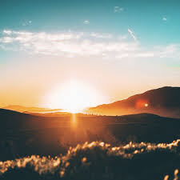
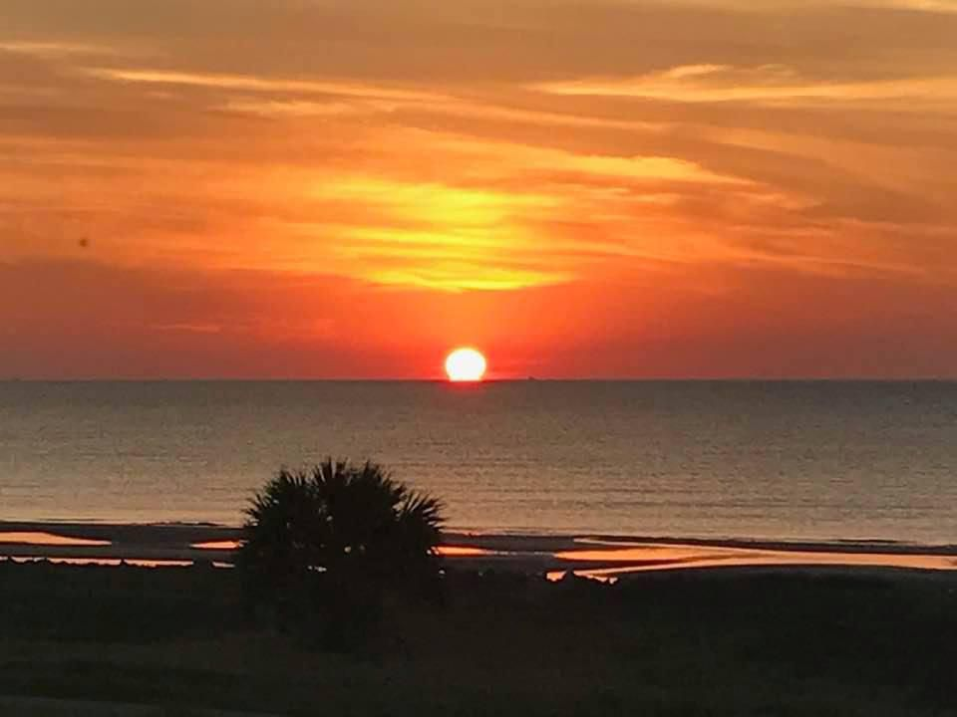
The Miracle of Morning
I thought I’d awaken to a world in mourning.
Heavy clouds crowding, a society storming.
But there’s something different on this golden morning.
Something magical in the sunlight, wide and warming.
I see a dad with a stroller taking a jog.
Across the street, a bright-eyed girl chases her dog.
A grandma on a porch fingers her rosaries.
She grins as her young neighbor brings her groceries.
While we might feel small, separate, and all alone,
Our people have never been more closely tethered.
The question isn’t if we can weather this unknown,
But how we will weather this unknown together.
So on this meaningful morn, we mourn and we mend.
Like light, we can’t be broken, even when we bend.
As one, we will defeat both despair and disease.
We stand with healthcare heroes and all employees;
With families, libraries, waiters, schools, artists;
Businesses, restaurants, and hospitals hit hardest.
We ignite not in the light, but in lack thereof,
For it is in loss that we truly learn to love.
In this chaos, we will discover clarity.
In suffering, we must find solidarity.
For it’s our grief that gives us our gratitude,
Shows us how to find hope, if we ever lose it.
So ensure that this ache wasn’t endured in vain:
Do not ignore the pain. Give it purpose. Use it.
Read children’s books, dance alone to DJ music.
Know that this distance will make our hearts grow fonder.
From these waves of woes our world will emerge stronger.
We’ll observe how the burdens braved by humankind
Are also the moments that make us humans kind;
Let each morning find us courageous, brought closer;
Heeding the light before the fight is over.
When this ends, we’ll smile sweetly, finally seeing
In testing times, we became the best of beings.
April 2020
Morning blessing
Frank Naranjo
822

Slide 9
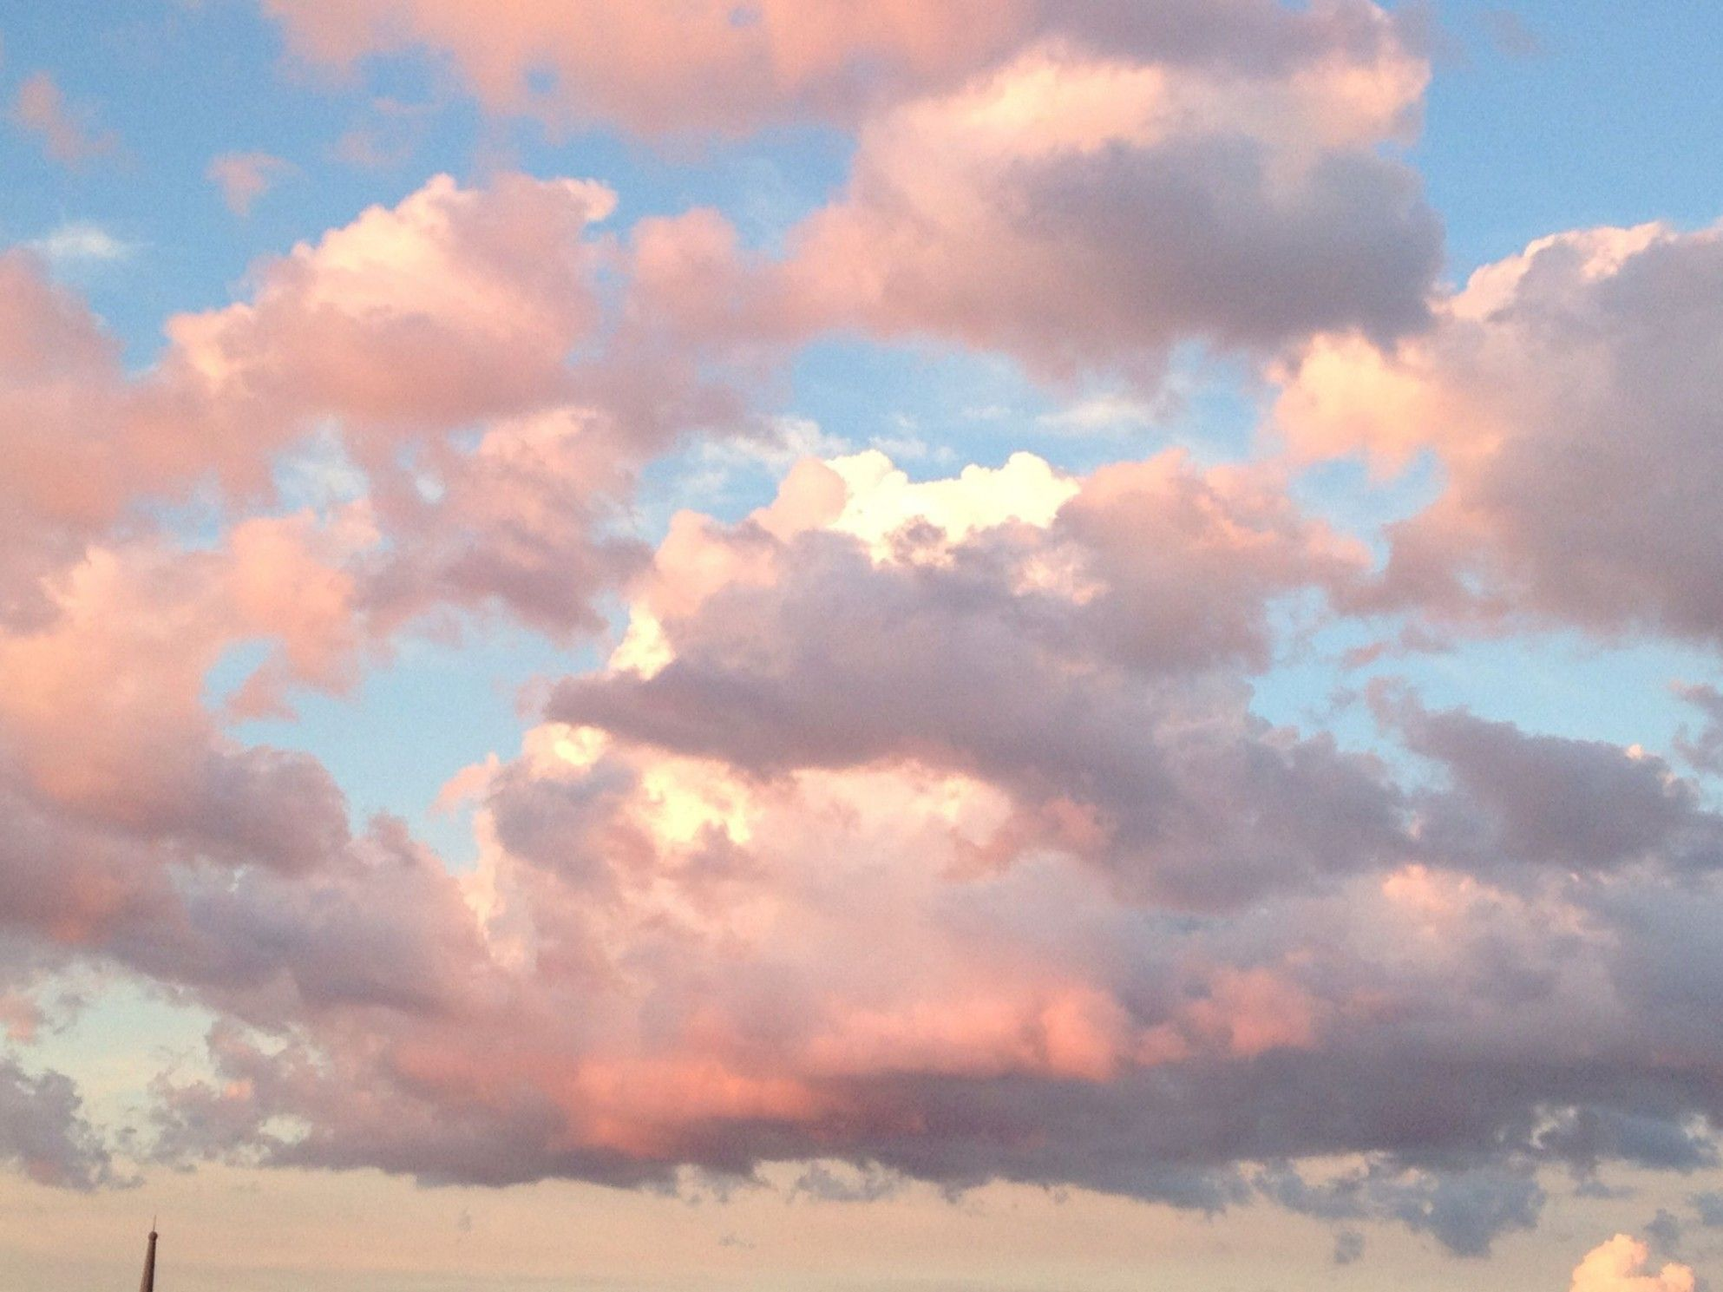
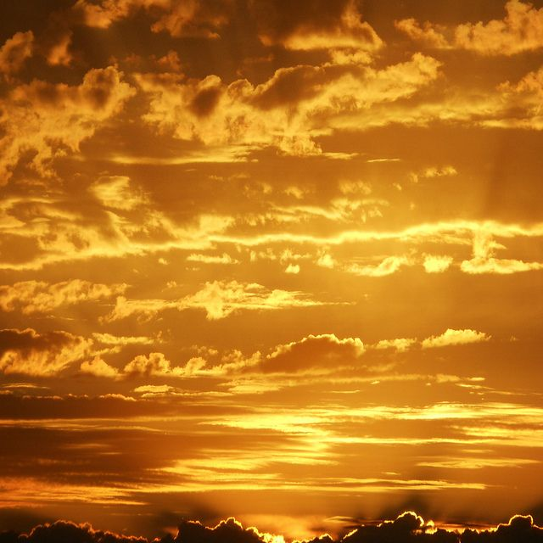
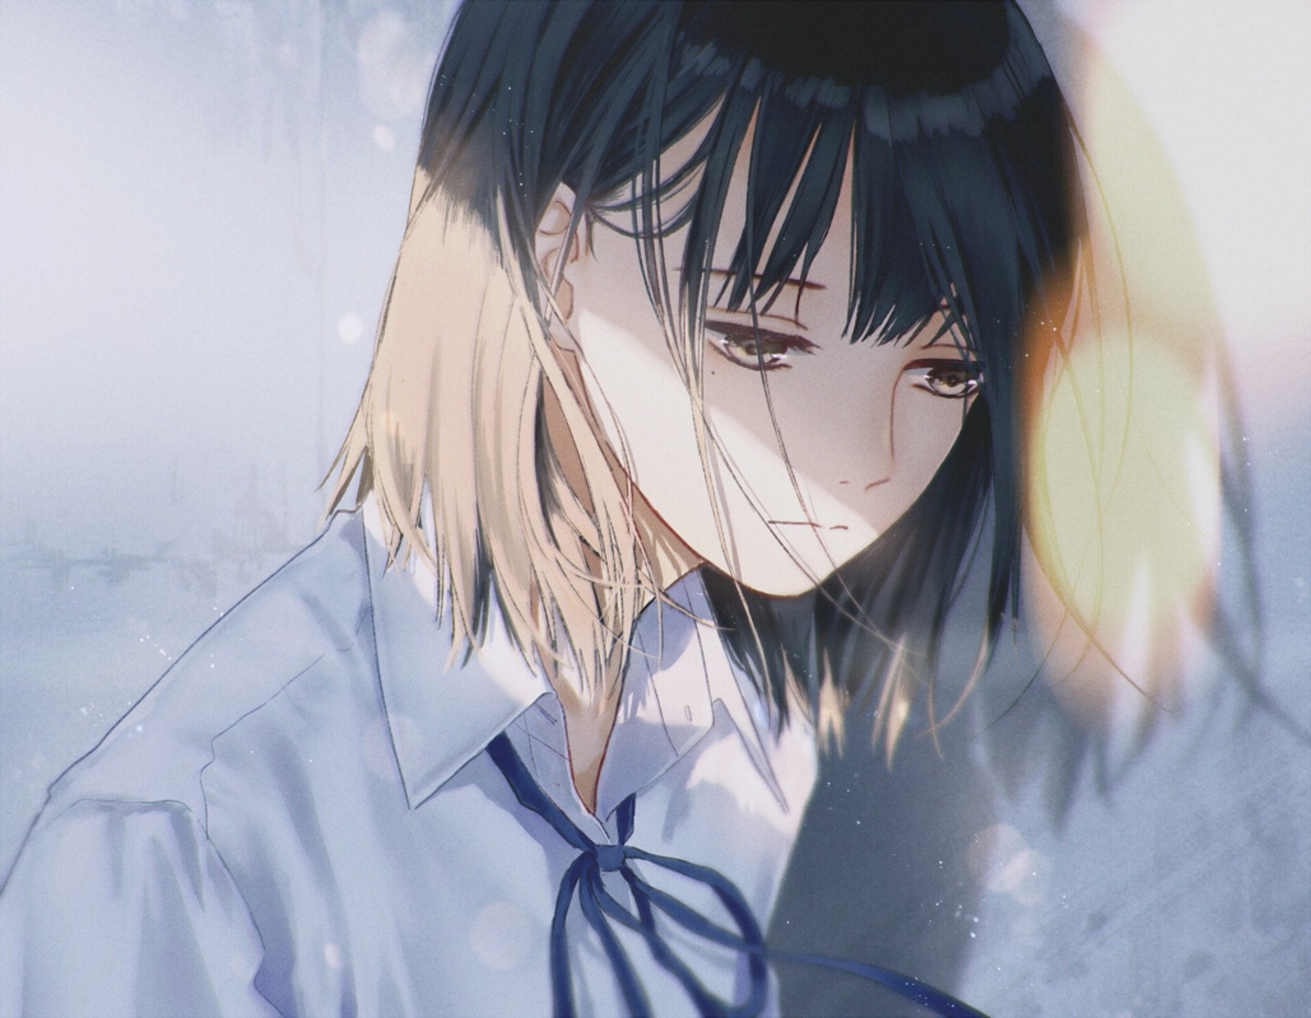
The Miracle of Morning
I thought I’d awaken to a world in mourning.
Heavy clouds crowding, a society storming.
But there’s something different on this golden morning.
Something magical in the sunlight, wide and warming.
I see a dad with a stroller taking a jog.
Across the street, a bright-eyed girl chases her dog.
A grandma on a porch fingers her rosaries.
She grins as her young neighbor brings her groceries.
While we might feel small, separate, and all alone,
Our people have never been more closely tethered.
The question isn’t if we can weather this unknown,
But how we will weather this unknown together.
So on this meaningful morn, we mourn and we mend.
Like light, we can’t be broken, even when we bend.
As one, we will defeat both despair and disease.
We stand with healthcare heroes and all employees;
With families, libraries, waiters, schools, artists;
Businesses, restaurants, and hospitals hit hardest.
We ignite not in the light, but in lack thereof,
For it is in loss that we truly learn to love.
In this chaos, we will discover clarity.
In suffering, we must find solidarity.
For it’s our grief that gives us our gratitude,
Shows us how to find hope, if we ever lose it.
So ensure that this ache wasn’t endured in vain:
Do not ignore the pain. Give it purpose. Use it.
Read children’s books, dance alone to DJ music.
Know that this distance will make our hearts grow fonder.
From these waves of woes our world will emerge stronger.
We’ll observe how the burdens braved by humankind
Are also the moments that make us humans kind;
Let each morning find us courageous, brought closer;
Heeding the light before the fight is over.
When this ends, we’ll smile sweetly, finally seeing
In testing times, we became the best of beings.
April 2020
Liza Nawab
822

Slide 10
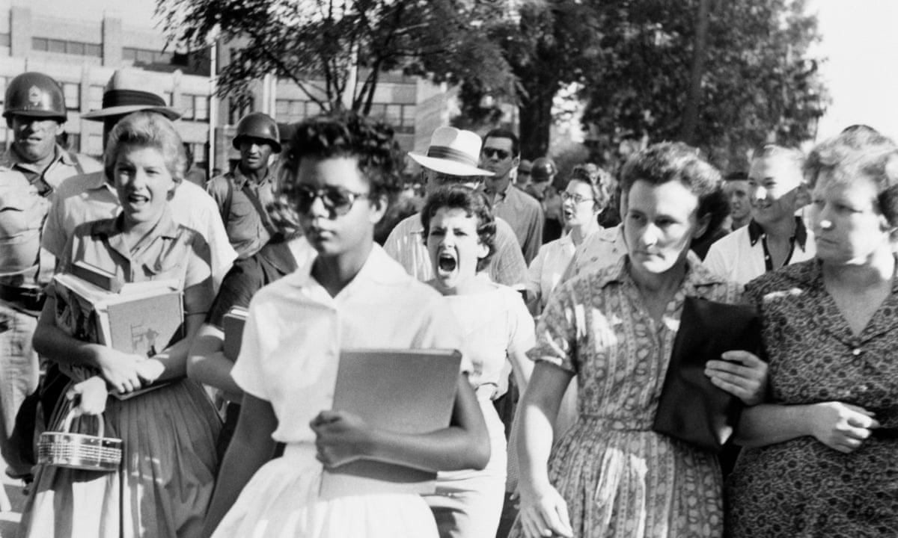
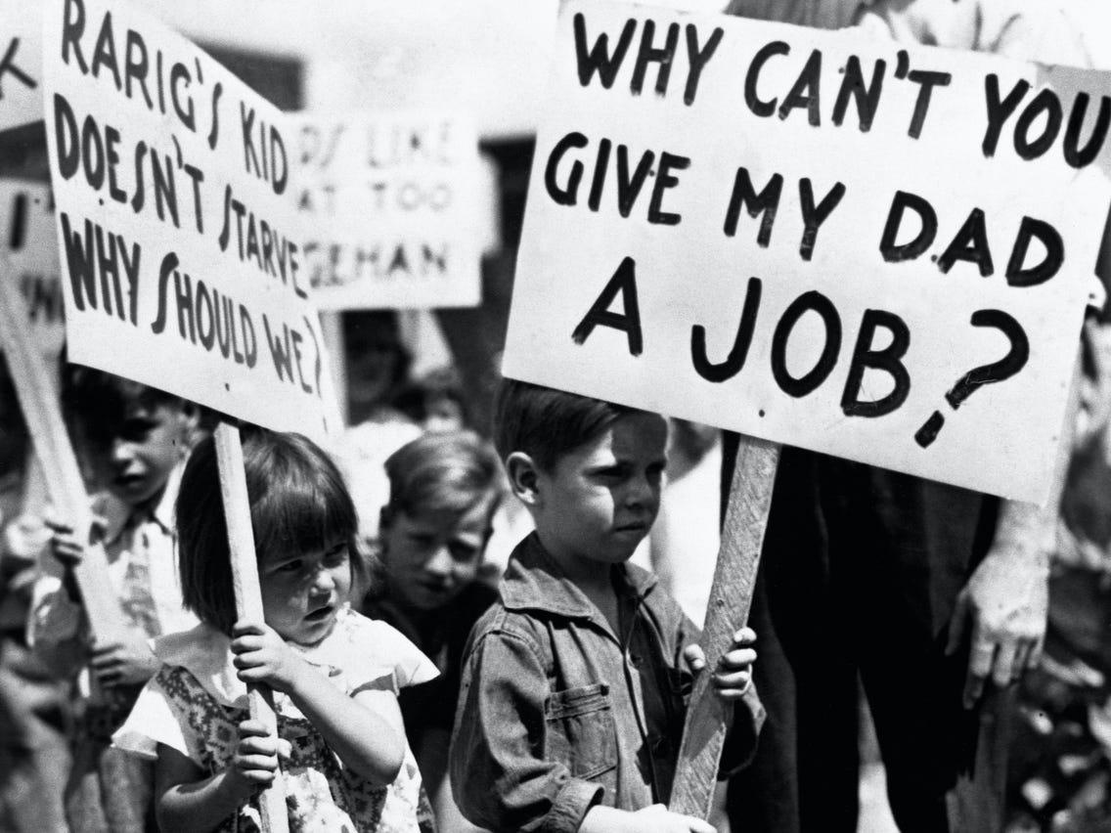
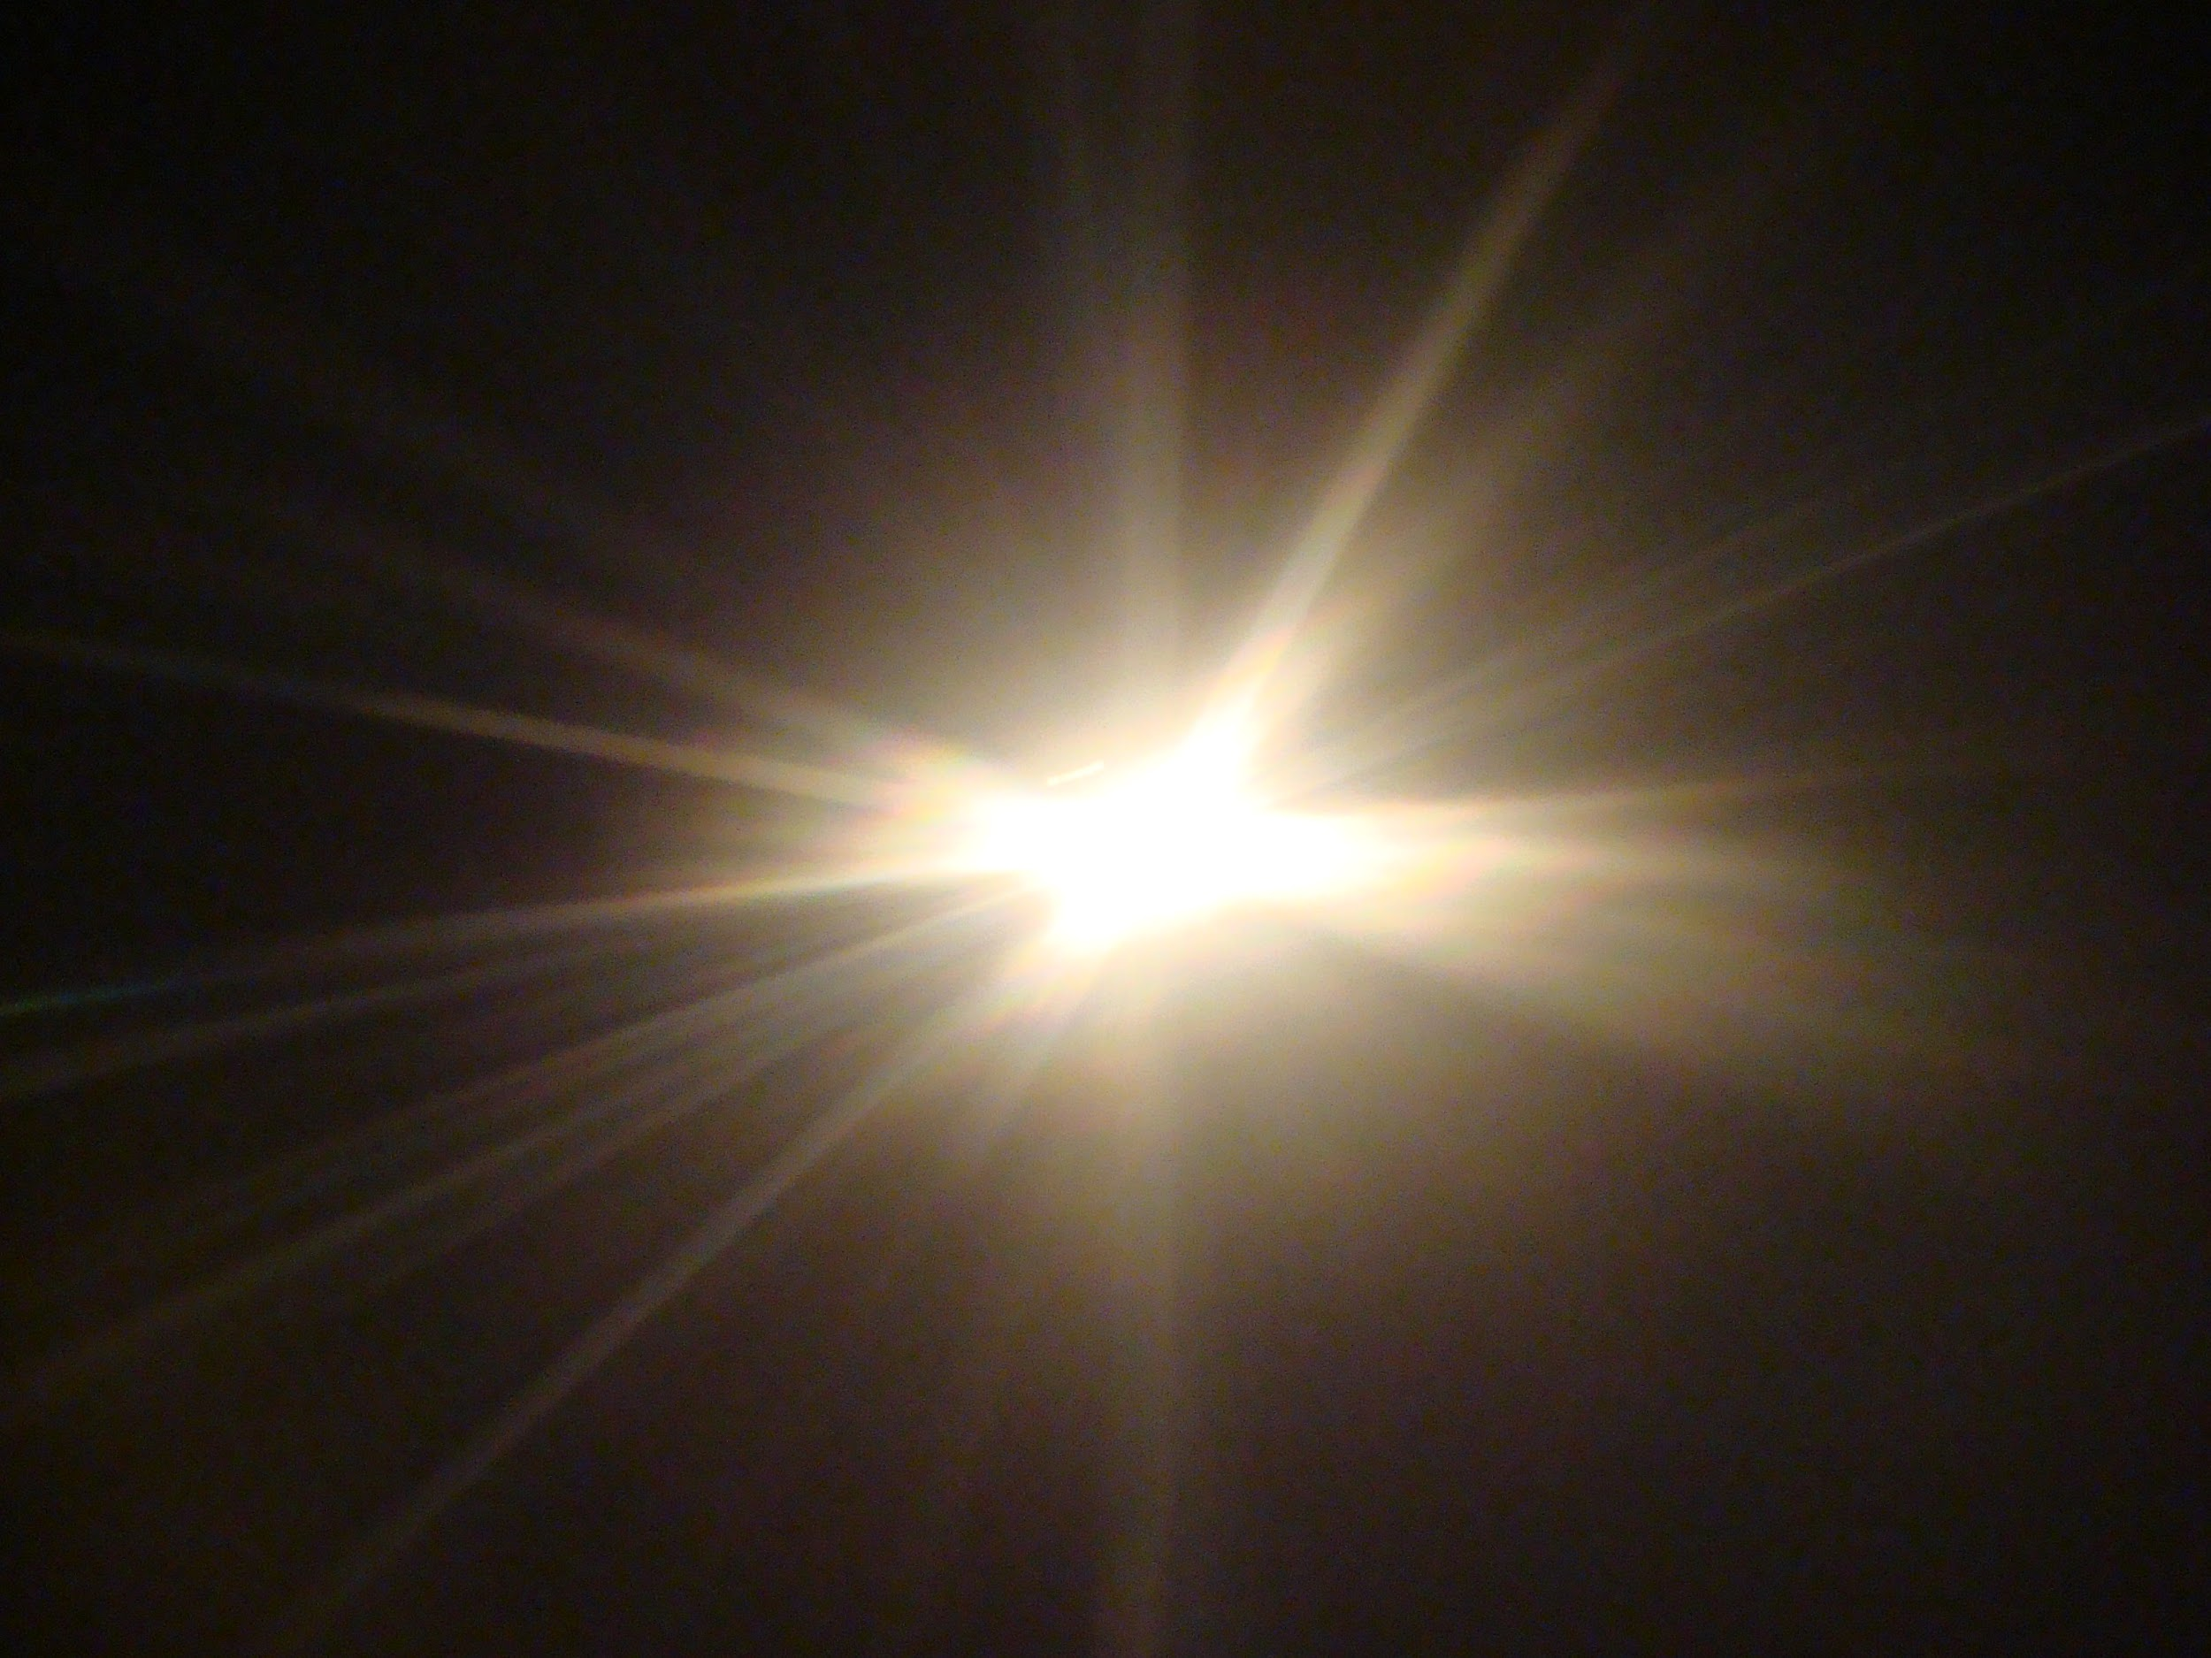
The Miracle of Morning
I thought I’d awaken to a world in mourning.
Heavy clouds crowding, a society storming.
But there’s something different on this golden morning.
Something magical in the sunlight, wide and warming.
I see a dad with a stroller taking a jog.
Across the street, a bright-eyed girl chases her dog.
A grandma on a porch fingers her rosaries.
She grins as her young neighbor brings her groceries.
While we might feel small, separate, and all alone,
Our people have never been more closely tethered.
The question isn’t if we can weather this unknown,
But how we will weather this unknown together.
So on this meaningful morn, we mourn and we mend.
Like light, we can’t be broken, even when we bend.
As one, we will defeat both despair and disease.
We stand with healthcare heroes and all employees;
With families, libraries, waiters, schools, artists;
Businesses, restaurants, and hospitals hit hardest.
We ignite not in the light, but in lack thereof,
For it is in loss that we truly learn to love.
In this chaos, we will discover clarity.
In suffering, we must find solidarity.
For it’s our grief that gives us our gratitude,
Shows us how to find hope, if we ever lose it.
So ensure that this ache wasn’t endured in vain:
Do not ignore the pain. Give it purpose. Use it.
Read children’s books, dance alone to DJ music.
Know that this distance will make our hearts grow fonder.
From these waves of woes our world will emerge stronger.
We’ll observe how the burdens braved by humankind
Are also the moments that make us humans kind;
Let each morning find us courageous, brought closer;
Heeding the light before the fight is over.
When this ends, we’ll smile sweetly, finally seeing
In testing times, we became the best of beings.
April 2020
To Kill A Mockingbird
Kevin Perez
822

Slide 11

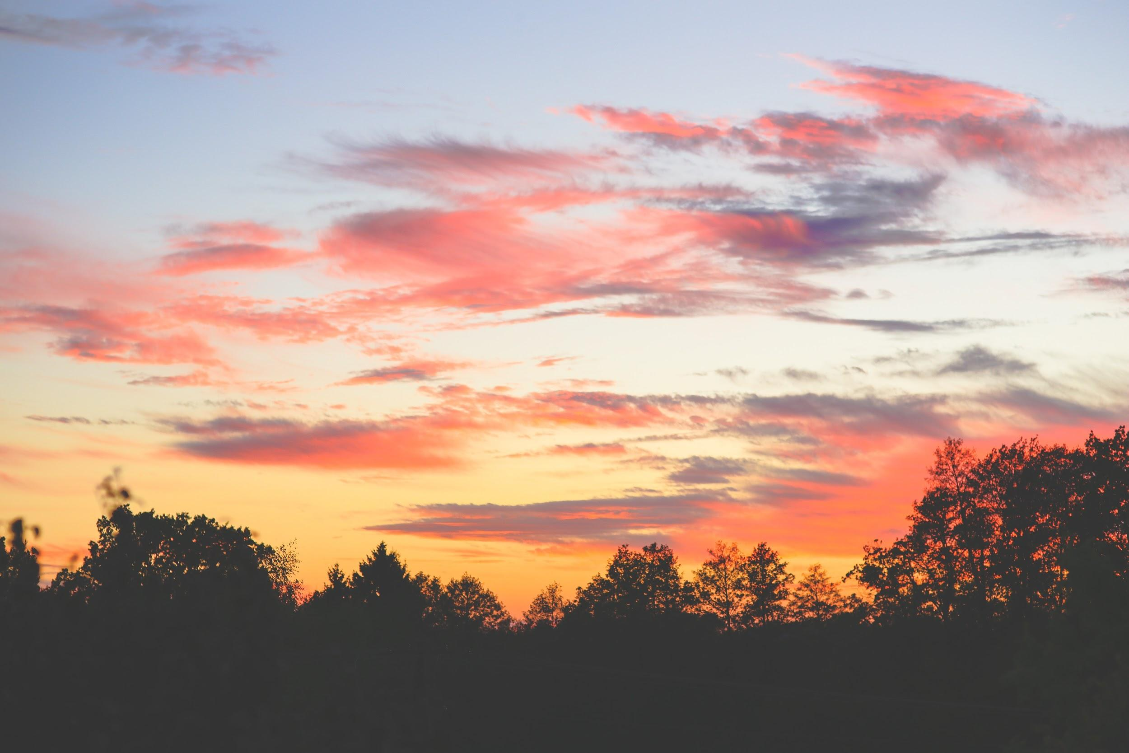
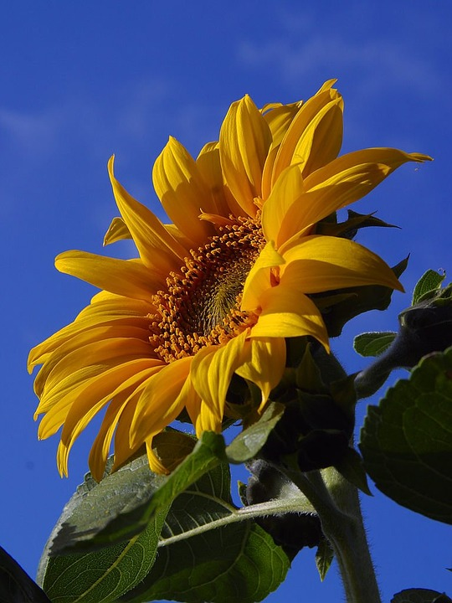

The Miracle of Morning
I thought I’d awaken to a world in mourning. Heavy clouds crowding, a society storming. But there’s something different on this golden morning. Something magical in the sunlight, wide and warming. I see a dad with a stroller taking a jog. Across the street, a bright-eyed girl chases her dog. A grandma on a porch fingers her rosaries.
She grins as her young neighbor brings her groceries. While we might feel small, separate, and all alone, Our people have never been more closely tethered. The question isn’t if we can weather this unknown, But how we will weather this unknown together. So on this meaningful morn, we mourn and we mend.
Like light, we can’t be broken, even when we bend. As one, we will defeat both despair and disease.
We stand with healthcare heroes and all pemployees; With families, libraries, waiters, schools, artists;Businesses, restaurants, and hospitals hit hardest. We ignite not in the light, but in lack thereof,
For it is in loss that we truly learn to love. In this chaos, we will discover clarity. In suffering, we must find solidarity. For it’s our grief that gives us our gratitude, Shows us how to find hope, if we ever lose it. So ensure that this ache wasn’t endured in vain: Do not ignore the pain. Give it purpose. Use it. Read children’s books, dance alone to DJ music. Know that this distance will make our hearts grow fonder.
From these waves of woes our world will emerge stronger. We’ll observe how the burdens braved by humankind. Are also the moments that make us humans kind; Let each morning find us courageous, brought closer; Heeding the light before the fight is over. When this ends, we’ll smile sweetly, finally seeing In testing times, we became the best of beings.
April 2020
Jaslene Pena
822

Slide 12
The Miracle of Morning
I thought I’d awaken to a world in mourning. Heavy clouds crowding, a society storming.But there’s something different on this golden morning. Something magical in the sunlight, wide and warming. I see a dad with a stroller taking a jog. Across the street, a bright-eyed girl chases her dog. A grandma on a porch fingers her rosaries.
She grins as her young neighbor brings her groceries. While we might feel small, separate, and all alone, Our people have never been more closely tethered. The question isn’t if we can weather this unknown, But how we will weather this unknown together. So on this meaningful morn, we mourn and we mend.
Like light, we can’t be broken, even when we bend. As one, we will defeat both despair and disease.
We stand with healthcare heroes and all employees; With families, libraries, waiters, schools, artists;Businesses, restaurants, and hospitals hit hardest. We ignite not in the light, but in lack thereof,
For it is in loss that we truly learn to love. In this chaos, we will discover clarity. In suffering, we must find solidarity. For it’s our grief that gives us our gratitude, Shows us how to find hope, if we ever lose it. So ensure that this ache wasn’t endured in vain: Do not ignore the pain. Give it purpose. Use it. Read children’s books, dance alone to DJ music. Know that this distance will make our hearts grow fonder.
From these waves of woes our world will emerge stronger. We’ll observe how the burdens braved by humankind. Are also the moments that make us humans kind; Let each morning find us courageous, brought closer; Heeding the light before the fight is over. When this ends, we’ll smile sweetly, finally seeing In testing times, we became the best of beings.
April 2020
Everly santana
822

Slide 13
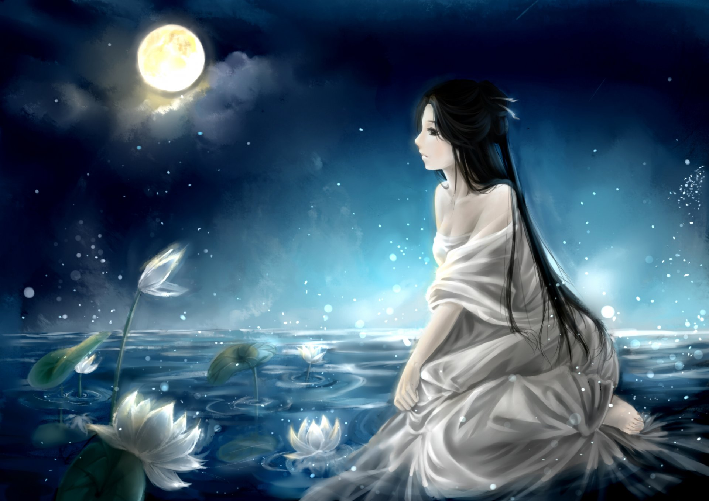
The Miracle of Morning
I thought I’d awaken to a world in mourning.
Heavy clouds crowding, a society storming.
But there’s something different on this golden morning.
Something magical in the sunlight, wide and warming.
I see a dad with a stroller taking a jog.
Across the street, a bright-eyed girl chases her dog.
A grandma on a porch fingers her rosaries.
She grins as her young neighbor brings her groceries.
While we might feel small, separate, and all alone,
Our people have never been more closely tethered.
The question isn’t if we can weather this unknown,
But how we will weather this unknown together.
So on this meaningful morn, we mourn and we mend.
Like light, we can’t be broken, even when we bend.
As one, we will defeat both despair and disease.
We stand with healthcare heroes and all employees;
With families, libraries, waiters, schools, artists;
Businesses, restaurants, and hospitals hit hardest.
We ignite not in the light, but in lack thereof,
For it is in loss that we truly learn to love.
In this chaos, we will discover clarity.
In suffering, we must find solidarity.
For it’s our grief that gives us our gratitude,
Shows us how to find hope, if we ever lose it.
So ensure that this ache wasn’t endured in vain:
Do not ignore the pain. Give it purpose. Use it.
Read children’s books, dance alone to DJ music.
Know that this distance will make our hearts grow fonder.
From these waves of woes our world will emerge stronger.
We’ll observe how the burdens braved by humankind
Are also the moments that make us humans kind;
Let each morning find us courageous, brought closer;
Heeding the light before the fight is over.
When this ends, we’ll smile sweetly, finally seeing
In testing times, we became the best of beings.
April 2020. Gisselle Serrano 822

Slide 14

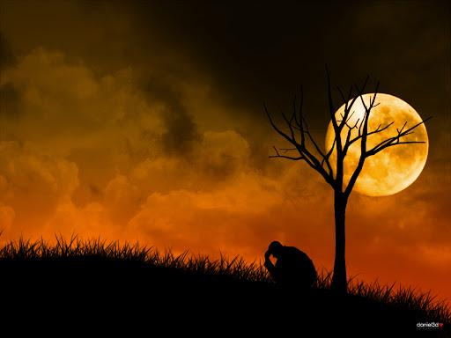

The Miracle of Morning
I thought I’d awaken to a world in mourning
Heavy clouds crowding, a society storming.
But there’s something different on this golden morning.
Something magical in the sunlight, wide and warming.
I see a dad with a stroller taking a jog.
Across the street, a bright-eyed girl chases her dog.
A grandma on a porch fingers her rosaries.
She grins as her young neighbor brings her groceries.
While we might feel small, separate, and all alone,
Our people have never been more closely tethered.
The question isn’t if we can weather this unknown,
But how we will weather this unknown together.
So on this meaningful morn, we mourn and we mend.
Like light, we can’t be broken, even when we bend.
As one, we will defeat both despair and disease.
We stand with healthcare heroes and all employees;
With families, libraries, waiters, schools, artists;
Businesses, restaurants, and hospitals hit hardest.
We ignite not in the light, but in lack thereof,
For it is in loss that we truly learn to love.
n this chaos, we will discover clarity.
In suffering, we must find solidarity.
For it’s our grief that gives us our gratitude,
Shows us how to find hope, if we ever lose it.
So ensure that this ache wasn’t endured in vain:
Do not ignore the pain. Give it purpose. Use it.
Read children’s books, dance alone to DJ music.
Know that this distance will make our hearts grow fonder.From these waves of woes our world will emerge stronger. We’ll observe how the burdens braved by humankind
Are also the moments that make us humans kind
Let each morning find us courageous, brought closer;
Heeding the light before the fight is over.
When this ends, we’ll smile sweetly, finally seeing
In testing times, we became the best of beings.
April 2020
Jade Ramos
801

Slide 15
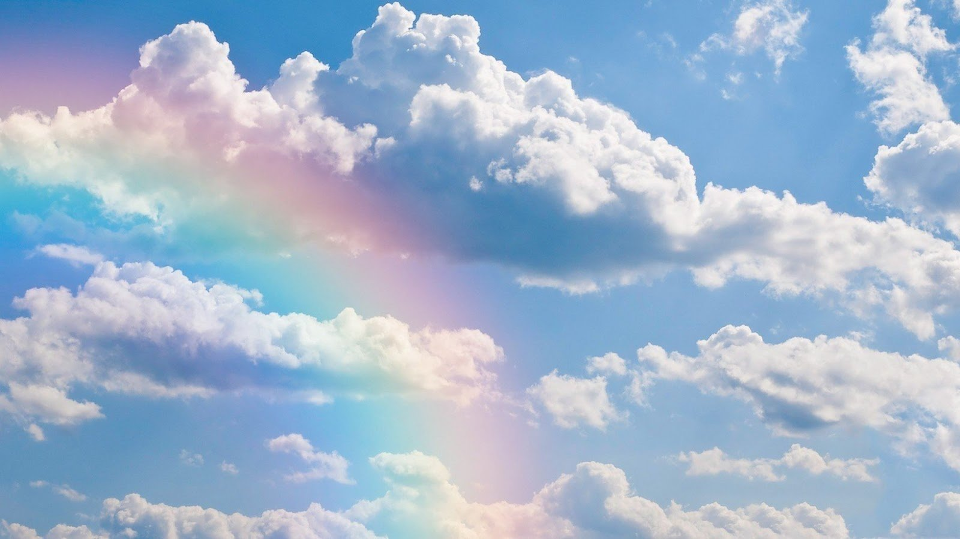
The Miracle of Morning
I thought I’d awaken to a world in mourning. Heavy clouds crowding, a society storming.But there’s something different on this golden morning. Something magical in the sunlight, wide and warming. I see a dad with a stroller taking a jog. Across the street, a bright-eyed girl chases her dog. A grandma on a porch fingers her rosaries.
She grins as her young neighbor brings her groceries. While we might feel small, separate, and all alone, Our people have never been more closely tethered. The question isn’t if we can weather this unknown, But how we will weather this unknown together. So on this meaningful morn, we mourn and we mend.
Like light, we can’t be broken, even when we bend. As one, we will defeat both despair and disease.
We stand with healthcare heroes and all employees; With families, libraries, waiters, schools, artists;Businesses, restaurants, and hospitals hit hardest. We ignite not in the light, but in lack thereof,
For it is in loss that we truly learn to love. In this chaos, we will discover clarity. In suffering, we must find solidarity. For it’s our grief that gives us our gratitude, Shows us how to find hope, if we ever lose it. So ensure that this ache wasn’t endured in vain: Do not ignore the pain. Give it purpose. Use it. Read children’s books, dance alone to DJ music. Know that this distance will make our hearts grow fonder.
From these waves of woes our world will emerge stronger. We’ll observe how the burdens braved by humankind. Are also the moments that make us humans kind; Let each morning find us courageous, brought closer; Heeding the light before the fight is over. When this ends, we’ll smile sweetly, finally seeing In testing times, we became the best of beings.
April 2020
Sophia Acevedo 822

