Slide 1

CYPRESS-FAIRBANKS ISD
Benefit Plan Year:
September 1, 2025 – August 31, 2026
BENEFITS PRESENTATION
OPEN ENROLLMENT:
August 1– August 15, 2025

Slide 2

Discussion Points
The Insurance Department web page
Benefit Enrollment
What is TRS-ActiveCare?
What’s new with TRS-ActiveCare?
Medical Plan Options and Benefits
Employee Premium Rates
Plans Maximum Cost Comparisons
Express Scripts Drug Plan
TRS-ActiveCare BCBS Support
CFISD’s Optional Plans
  New Carriers effective 9/1/25

Slide 3
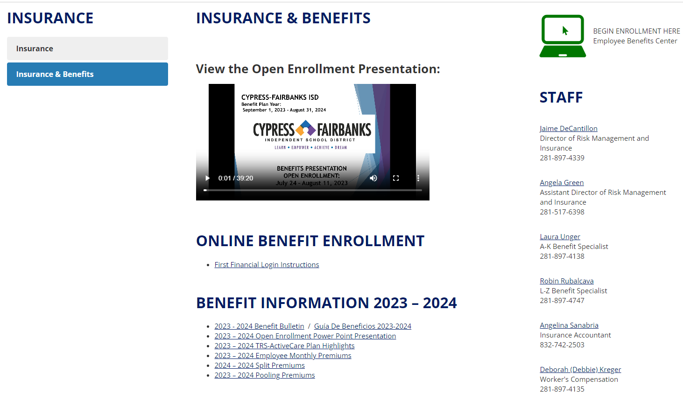
Insurance Department Website

Slide 4
Insurance Department
Website
District Website: www.cfisd.net
Staff → Insurance
Employee Benefit Center (EBC)
TRS-ActiveCare Plan Designs and Summaries
Monthly Premium Rates
Employee Assistance Program (EAP)
Retirement Plan Information
Agent Contact Information
Insurance Company Links

Slide 5
Benefit Enrollment Information
Enroll through Benefit Solver during the Open Enrollment Period from August 1st – August 15th.
https://my.cfisd.net
  Employee Resource Folder
  Click Benefit Solver Icon
All eligible employees must either enroll in TRS-ActiveCare or
decline(waive).
Mid-Year Plan Changes are made by submitting the change in
the benefit system and submitting the required documentation of
your “qualifying event” NO LATER THAN 31 DAYS from the
event date.
Instructions are on the Insurance Department web page under “Mid-Year Plan Changes”
You should choose your plan carefully – You may not change plans during a plan year unless you experience a “qualified change of status” that results in a Special Enrollment Event.
Notes:
Employees must submit an Enrollment Application and Change Form if they change employment during the plan year and enroll for TRS-ActiveCare coverage with another participating district/entity.

Slide 6
The Importance of Enrolling or Waiving
This will be the eleventh year the Affordable Care Act is requiring Providers and Employers to submit form 1094-C to the IRS and form 1095-C to employees for the 2025 tax year.
Employers must offer health insurance to eligible employees and collect declination forms from employees that choose not to enroll in order to satisfy reporting requirements and avoid penalties.
Employees failing to “decline” may not be allowed to enroll later should they experience a Special Enrollment Event.
It is imperative that you log into Benefit Solver and either enroll or waive a medical plan.

Slide 7
NEW CFISD EMPLOYEES
Enroll through Benefit Solver during your first 31 days of employment.
Example: Date of Hire: Monday, 8/4/2025
Enrollment Eligibility Ends: Wednesday, 9/3/2025
Example: Date of Hire: Friday, 1/2/2026
Enrollment Eligibility Ends: Sunday, 2/1/2026
Access through my.cfisd.net / Employee Resource Folder / Benefit Solver

Slide 8
Mid-year plan changes
Enrollees may make plan changes during the plan year due to a “Special Enrollment Event”
Individuals who voluntarily drop coverage because of a Special Enrollment Event during the plan year may re-enroll during the plan year due to experiencing another Special Enrollment Event
Changes must be made within 31 days of the event date
All changes must be made on the benefit system and your documentation must also be uploaded within 31 days for us to approve the change.
Special enrollment event/family status change: Marriage, divorce (resulting in a loss of coverage), birth, adoption or placement for adoption, or if an individual with other health insurance coverage involuntarily loses that coverage
Common law marriage: Not considered a special enrollment event unless there is a Declaration of Common Law Marriage filed with an authorized government agency
Notes:
An employee can enroll for coverage, change plan options, or change the dependents he or she covers during a plan year if the employee has a special enrollment event such as a marriage, divorce (resulting in a loss of coverage), birth, adoption or placement for adoption, or if an individual with other health insurance coverage involuntarily loses that coverage. Changes must be made within 31 days after the event date (special rules apply to newborns). A new application must be submitted for any change.
Note: A common law marriage is not considered a special enrollment event unless there is a Declaration of Common Law Marriage filed with an authorized government agency.
When the employee or dependent of an employee loses other health coverage, the employee or dependent must have had other health coverage when coverage under TRS-ActiveCare was previously declined in writing. (COCC no longer accepted in lieu of a declination form.) If the other coverage was COBRA continuation coverage, special enrollment can be requested only after the COBRA continuation coverage is exhausted. If the other coverage was not COBRA continuation coverage, special enrollment can be requested when the individual loses eligibility for the other coverage. Refer to page 19 for additional information on loss of other coverage.
Changes in employee and/or dependent coverage must be made within 31 days after the special enrollment event. (Special rules apply to newborns; see Enrollment Guide for more information.) If the employee does not request the appropriate changes during the applicable special enrollment period, the changes cannot be made until the next plan enrollment period or, if applicable, until another special enrollment event occurs.

Slide 9
What is TRS-ActiveCare?
A statewide health care benefits program for employees
of school districts, charter schools, regional educational service centers and other educational districts
Established and signed into law in 2001 by Texas Legislature. Today over 90% of Texas school districts participate.
Law authorizes minimum funding levels to help employees pay for coverage ($150 from districts; $75 from state).
CFISD joined
TRS-ActiveCare September 1, 2011.
1,120 districts/entities participate in TRS-ActiveCare

Slide 10


WHAT’S NEW WITH TRS-ACTIVECARE Effective September 1, 2025 ?
Individual and family deductible increase for HD medical plan.
Individual and family maximum out of pocket increase for Primary and HD plans.
Enhanced Member Rewards Program and Well on Target.
Fitness Program

Slide 11






Who is Eligible to Enroll?
To be eligible for TRS-ActiveCare coverage, you must:
  Be employed by a participating district/entity and
  Be an active, contributing TRS member or
  Be expected to work 10 or more hours each week. This includes substitutes and temporary workers.
Health care coverage for public school employees and their families
Notes:
Who can enroll in TRS-ActiveCare?
To be eligible for TRS-ActiveCare, you must be employed by a participating entity. Then, ask yourself these questions:
(1) Are you an active, contributing TRS member?
(2) Are you employed for 10 or more regularly scheduled hours each week?
If the answer is yes to either question, then you are eligible for TRS-ActiveCare coverage.

Slide 12
Employees NOT Eligible to Enroll in TRS-ActiveCare
State of Texas employees or retirees
Higher education employees or retirees
TRS retirees, either receiving or who have declined coverage under TRS-Care
These individuals are not eligible to enroll for TRS-ActiveCare coverage as employees, but they can be covered as a dependent of an eligible employee.
Notes:
Employees that are not eligible to enroll in TRS-ActiveCare include individuals:
Receiving health care coverage as an employee or retiree under the Texas State College and University Employees Uniform Insurance Benefits Act, for example, a school employee that has UT SELECT coverage as an employee with The University of Texas System.
Receiving health care coverage as an employee or retiree under the Texas Employee Uniform Group Insurance Benefits Act, for example, a school employee that has HealthSelect coverage as an employee with ERS
A TRS retiree receiving, or who waived coverage, under TRS-Care, including a retiree who has returned to work. Note: If a retiree has returned to work and has never been eligible for TRS-Care, he or she would be eligible for TRS-ActiveCare coverage, as long as the retiree meets all the TRS-ActiveCare eligibility requirements.
Basically, employee coverage is not available from two state sources.
However, these individuals–retirees, higher education and state of Texas employees–while they are not eligible to enroll for TRS-ActiveCare coverage as employees, they can be covered as a dependent of an eligible employee.

Slide 13

Eligible Dependents
Spouse (including a common law spouse and same sex marriage)
Children (married or unmarried) under age 26
  Natural child
  Adopted child
  Stepchild
  Foster child
  Child under the employee’s legal guardianship
Other eligible dependents
  Other child under age 26 (unmarried)
  in parent-child relationship
  Grandchildren (under age 26)
  Disabled children (of any age)
13
Notes:
You may also cover your eligible dependents at the same time you enroll for coverage. Eligible dependents of a covered employee include a spouse (including a common law spouse) and child (married or unmarried) under the age of 26 described by any of the following: a natural or adopted child, a stepchild, foster child or a child under the employee’s legal guardianship.
More examples of eligible dependent children under age 26 include:
Any other child (unmarried) in a regular parent-child relationship with the employee. See Enrollment Guide for the eligibility criteria; all four eligibility criteria must be met.
An grandchild under age 26 (married or unmarried) whose primary residence is the household of the employee and who is a dependent of the employee for federal income tax purposes.
A child of a covered employee, regardless of age, may be eligible for dependent coverage provided that the child is either mentally or physically incapacitated to such an extent as to be dependent on the employee on a regular basis as determined by TRS and the child meets other requirements as determined by TRS.
Note: Siblings over age 26 of the covered employee, as well as parents and grandparents of the covered employee, do not meet the definition of an eligible dependent.
When enrolling dependent children, you will be asked on the TRS-ActiveCare Enrollment Application and Change Form to indicate your child’s relationship to you, the employee. Check natural/adopted, stepchild, foster child, legal guardianship, grandchild or other child, as appropriate. You’ll also want to read the coverage conditions on the back of the Enrollment Application and Change Form that you understand the eligibility criteria for TRS-ActiveCare.

Slide 14
Special Eligibility Situations
If an employee and spouse both work for a participating district/entity:
  A spouse may be covered as an employee or as a dependent of an employee
  Only one parent can cover dependent children
A child (under age 26) employed by a district/entity and is a contributing TRS member can be covered as a dependent on his or her parent’s TRS-ActiveCare coverage.
  Current law only allows pooling of state and district funds for married couples.
  An employee who is covered as a dependent child will not be entitled to state or district funding.
Notes:
If an employee and spouse both work for a participating district/entity:
Each employee can apply
Each employee can choose employee-only coverage and select the same or different plans
One employee can select employee and spouse coverage, and the spouse must decline coverage
One employee can choose employee-only coverage, and the spouse can choose the same or different plan for employee and child(ren) coverage.
One employee can select employee and family coverage, and the spouse must decline coverage.
Only one parent may enroll dependent children for coverage.
What if a child works for a participating entity?
A child (under age 26) who is employed by a district/entity and is a contributing TRS member cannot be covered as a dependent on his or her parent's TRS-ActiveCare coverage. This child must be covered as an employee. If the child is not a contributing TRS member, the child may be covered as a dependent.

Slide 15
COINSURANCE & COPAYMENTS
WHAT IS A DEDUCTIBLE?
It is the fixed dollar amount(i.e., HD Plan Employee Only: $3,300) of the eligible expenses you are required to pay before your insurance either reimburses you or pays your medical provider directly for a covered service.
WHAT IS COINSURANCE?
Coinsurance is your share of the costs (i.e., 20%) of a covered health care service – usually a percentage of an eligible expense due AFTER you have met your annual deductible.
WHAT IS A COPAYMENT?
A copayment is a fixed dollar amount (i.e., $30.00 Copay for an office visit) that you are required to pay for a covered service at the time you receive care. Can also be charged in addition to the deductible and coinsurance

Slide 16
Plan Overview (Network Level of Benefits)
Services | ActiveCare Primary | ActiveCare HD | ActiveCare Primary+ | ActiveCare 2
Deductible In-Network Out-of-Network | $2,500 / $5,000 This plan does not cover out of network services | $3,300 / $6,600 $6,600 / $13,200 | $1,200 / $2,400 This plan does not cover out of network services | $1,000 / $3,000 $2,000 / $6,000
Out-of-Pocket Maximum In-Network Out-of-Network (includes medical & pharmacy deductibles, co-pays and co-insurance) | $8,050 / $16,100 Not applicable. This plan does not cover out-of-network services except for emergencies | $8,300 / $16,600 $20,500 / $41,000 | $6,900 / $13,800 Not applicable. This plan does not cover out-of-network services except for emergencies | $7,900 / $15,800 $23,700 / $47,400
Coinsurance In- Network Out-of-Network participant pays (after deductible) | 30% Not applicable to this plan | 30% 50% of allowed amount | 20% Not applicable to this plan | 20% 40% of allowed amount
Office Visit Copay | $30 for primary $70 for specialist | 30% after deductible | $15 for primary $70 for specialist | $30 for primary $70 for specialist
Preventive Care | Plan pays 100% when using network providers
Notes:
Plan overview. Let’s take a look at all four PPO plans. This chart illustrates benefits when network providers are used. As mentioned previously, non-network benefits are also available; see the Enrollment Guide for information.
Deductibles: The set amount of out-of-pocket expense, if applicable, that must be paid for health care services by the covered person before the plan begins to share costs. For example, ActiveCare 1 has a $1,200 deductible, which must be met before the plan pays any benefits.
Out-of-Pocket Maximum: If you reach your plan’s out-of-pocket maximum, the plan then pays 100% of any eligible expenses for the remainder of the plan year. Office visit copays continue after the out-of-pocket maximum is reached. As stated here, deductibles do not apply to the out-of-pocket maximums.
Coinsurance: The percentage of medical expenses that you and the plan share. For example, the coinsurance amount when using network providers for all plans is “80/20.” This means that the plan pays 80% and the plan participant pays 20% after any applicable deductible.
Copayments: The set amount you pay for certain medical services and prescription drugs at the time of service. Note: For ActiveCare 2 and 3, the copay depends on whether the doctor is “primary” or a specialist. Primary means care provided by family practitioners, internists, OB/GYNs, and pediatricians. All other physicians are specialists.

Slide 17
Plan Overview
(Network Level of Benefits)
Services | ActiveCare Primary | ActiveCare HD | ActiveCare Primary+ | ActiveCare 2
High-tech Radiology (CT scan, MRI, nuclear medicine) | 30% after deductible | 30% after deductible | 20% after deductible | 20% after deductible + $100 copay per procedure
Inpatient Hospital | 30% after deductible | 30% after deductible | 20% after deductible | 20% after deductible ($150 facility copay per day)
Freestanding Emergency Room | $500 copay + 30% after deductible | $500 copay +30% after deductible | $500 copay + 20% after deductible | $500 copay + 20% after deductible
Outpatient Costs | 30% after deductible | 30% after deductible | 20% after deductible | 20% after deductible ($150 facility copay per incident)
17
Notes:
A new high-tech radiology copay has been added for the ActiveCare 2 and 3 plans. The $100 copay is per service and applies to CT scans, MRIs and nuclear medicine when using network providers for these services. So, if a patient has a CT scan and an MRI on the same day, he/she will pay $200, plus deductible and coinsurance.
The inpatient hospital copays for ActiveCare 2 and 3 are $150 copay per day, plus deductible and coinsurance. The maximum copay per admission for each plan is $750 and the maximum per plan year is $2,250.
The emergency room and outpatient surgery copays for ActiveCare 2 and 3 are $150. The ER copays will be waived if you admitted to the hospital.

Slide 18
2025-2026 CFISD FULL-TIME
EMPLOYEE MONTHLY PREMIUMS
 | Full –Time Employee Premium Rates
Plans | Primary | HD | Primary+ | AC2
Coverage Category | Emp Cost | Emp Cost | Emp Cost | Emp Cost
Employee Only | $257 | $271 | $346 | $775
Employee + Child(ren) | $573 | $597 | $714 | $1,197
Employee + Spouse | $933 | $971 | $1,101 | $1,941
Employee + Family | $1,244 | $1,292 | $1,480 | $2,347
18
Notes:
Cost of Coverage
As mentioned earlier in the session, it is not a typo—the cost of employee and family coverage for ActiveCare 1-HD is, indeed, more expensive than employee and family coverage for ActiveCare 1. Employee and family coverage is more expensive for ActiveCare 1-HD than ActiveCare 1 because the deductible and out-of-pocket maximum amounts for family are less and the plan may begin paying 100 percent benefits sooner. So for ActiveCare 1, employee and family coverage is less expensive than ActiveCare 1-HD because the deductible and out-of-pocket maximum amounts for family are greater and it will take longer to accumulate the medical expenses to satisfy these amounts.

Slide 19
Cypress-Fairbanks Enrollment Summary
CFISD – March 2025
AC HD 3,113 = 38%
AC Primary 3,228 = 39%
AC Primary+ 1,868 = 22%
AC 2 112 = 1%
Total 8,321
Total Eligible Employees 16,874
Enrolled Employees 49%

Slide 20
CFISD Employee Only
Premium & Plan Comparison
Type of Service | ActiveCare Primary | ActiveCare HD | ActiveCare Primary+ | ActiveCare 2
Annual Premiums | $3,084 | $3,252 | $4,152 | $9,300
Monthly Premiums | $257 | $271 | $346 | $775
Deductible | $2,500 | $3,300 | $1,200 | $1,000
Coinsurance | 30% | 30% | 20% | 20%
Out of Pocket Maximum | $8,050 | $8,300 | $6,900 | $7,900

Slide 21
CFISD Employee & Family
Premium &
Plan Comparison
Type of Service | ActiveCare Primary | ActiveCare HD | ActiveCare Primary+ | ActiveCare 2
Annual Premiums | $14,928 | $15,504 | $17,760 | $28,164
Monthly Premiums | $1,244 | $1,292 | $1,480 | $2,347
Deductible | $5,000 | $6,600 | $2,400 | $3,000
Coinsurance | 30% | 30% | 20% | 20%
Out of Pocket Maximum | $16,100 | $16,600 | $13,800 | $15,800

Slide 22
Split Premium Process
  Must be employed by different districts/entities participating in TRS-ActiveCare
  One Employee chooses employee/spouse or employee/family
  One Employee must decline coverage
  Please contact the Insurance Department if you choose to split. This must be renewed yearly going forward.
22
Notes:
If a husband and wife work for different participating entities and which to “pool” funds, an Application to Split Premium must be completed. For the husband and wife who choose this option, the cost of coverage will be split between and billed to the two employers. Each employer will be billed 50% of the total cost of coverage. The entity employing the spouse who declined coverage will consider the employee as covered under a group health plan for funding purposes.
Each employee and their Benefits Administrator must complete their portion of the Application to Split Premium form which is available on the TRS-ActiveCare website, www.trs.state.tx.us/trs-activecare. This form should be submitted to Blue Cross and Blue Shield of Texas with the Enrollment Application and Change Form.
This form should not be used by employees working for the same entity.

Slide 23
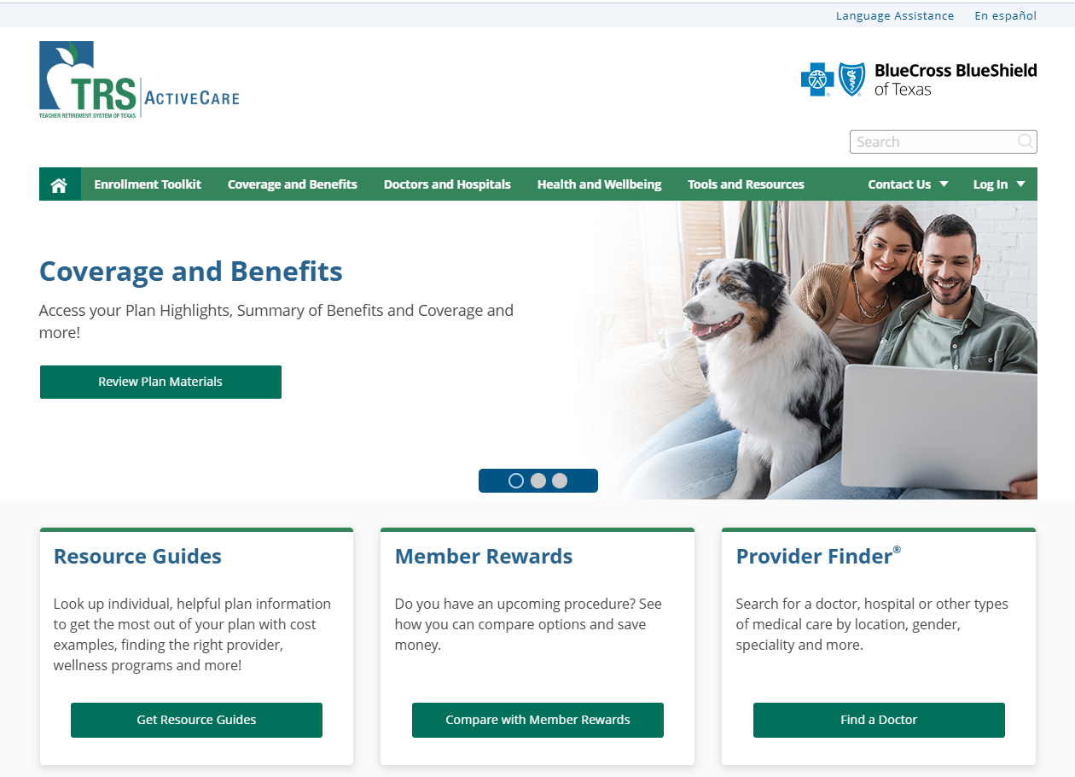
TRS-ACTIVECARE Enrollment Support
Plan Overview
Plan Highlights
Provider Locator for Doctors & Hospitals
Prescription Drug Benefits
www.bcbstx.com/trsactivecare

Slide 24

What if I Have Questions on TRS-ActiveCare medical or prescription drug plans?
Call TRS-ActiveCare BCBS / Express Scripts customer support for:
  Claim questions/status
  Network provider information
  Membership and eligibility
  Medical coverage questions
  Inquiries (telephone and e-mail)
  ID card requests
  Transition of care information
  Help with online tools!
Customer Service
1-866-355-5999
Notes:
Questions? The ActiveCare 1-HD, 1, 2 and 3 customer service team can help answer your questions about your claims, medical coverage, and eligibility. They can also assist you with ID card requests, transition of care information and help with online tools such as Blue Access for Members and the Personal Health Manager.

Slide 25
ID Cards
TRS-ActiveCare HD, Primary, Primary+ and AC 2
  Medical cards will only be mailed to HD enrollees and newly elected plans
  HD & AC2 are family ID cards and will only have the subscriber’s
  name on them. You will receive two per household.
  Primary & Primary+ ID cards will be issued to each member of the
  family with the PCP on the card.
  For additional or temporary cards, please call customer service at
  1-866-355-5999.
Notes:
ID Cards
If an employee submits an Enrollment Application and Change Form by May 20, 2011, he or she will receive a new ID card by September 1, 2011. If an employee submits an application or change after May 20, he or she may not receive an ID card until October 1.
All HMO enrollees will receive new identification cards for the 2011-2012 plan year.
ActiveCare 1-HD, 1, 2 and 3: For the medical benefits, administered by Blue Cross and Blue Shield of Texas, employees with “employee-only” coverage will receive one card; employees with “employee and spouse” or “employee and children” or “family” coverage will receive two cards. Additional cards may be ordered from Customer Service at no charge.
The cards should begin mailing in early August and be received before the effective date of coverage (September 1, 2011).
All ID cards include a unique identification number instead of a Social Security Number (SSN). New cards will be mailed to employees by September 1, 2011. You may receive multiple cards. For example: If you receive a new ID card and subsequently make a change during the summer (August) enrollment period, an updated card will be sent after the change is processed.

Slide 26
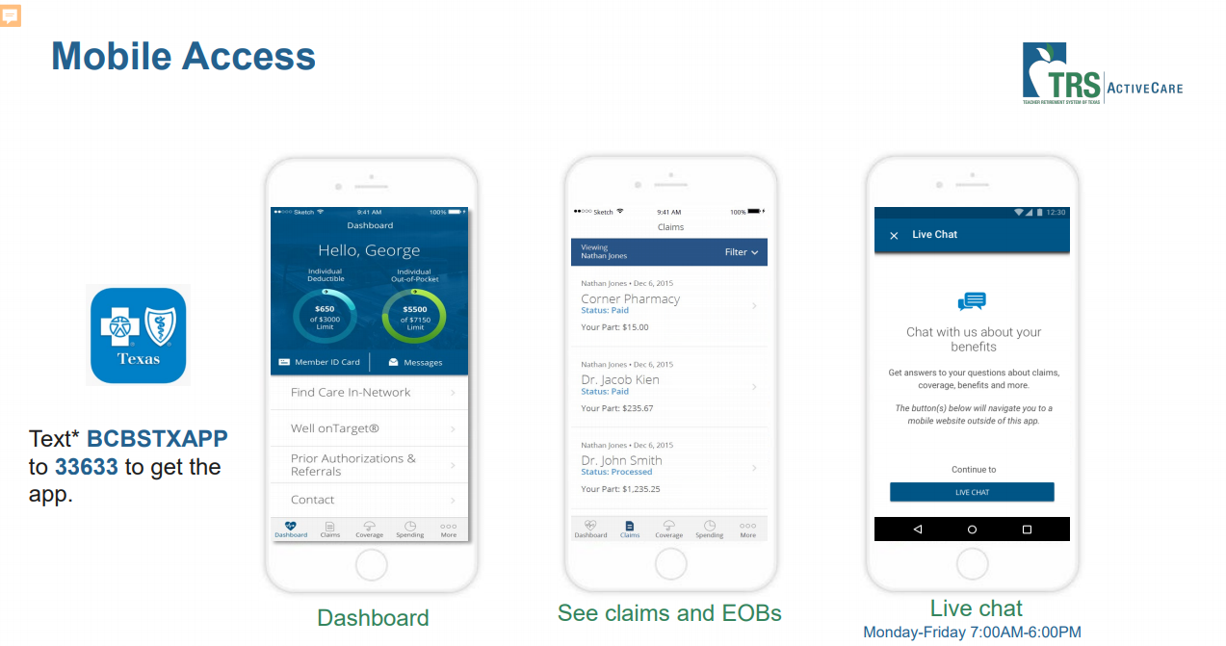
Mobile Access
Notes:
The BCBSTX App allows you to find the most important information quickly and easily. You can use the app to check claims status, track deductibles and out-of-pocket maximums, view prior authorizations and referrals, and out-of-pocket spending. If you have an iPhone, you can view your ID card and add it to Apple Wallet. You can even email your ID card to providers.
The BCBSTX app also is available in Spanish for both iPhone and Android users.
TRS Health App will be sunset and the BCBSTX app will be available starting 9/1/2020.
With Blue Access for Members and the BCBSTX App, your benefits are at your fingertips, wherever you are. Our online tools help you stay informed and better manage your health, wellness, and benefits.

Slide 27




TRS Virtual Health
Your BCBSTX coverage includes TRS Virtual Health choices powered
by Teladoc® and RediMD.
Medical
Cold and flu symptoms
Allergies
Bronchitis
Respiratory infections
Stomach upset
Sinus problems
Skin problems
Mental Health
Depressive and anxiety disorders
Bipolar, schizophrenia and psychotic disorders
Attention disorders
Alcoholism and addiction and substance-related disorders
Medical
Back Strains
Ankle Injuries
Shoulder Strains
Pulled Muscles
Contusions/Bruises
Asthma
Shortness of Breath
Infections
Allergies
Chemical Exposure
Notes:
Your coverage includes TRS Virtual Health choices powered by Teladoc® and RediMD. These services allow you access to convenient, quality health care from home or on the go, without having to travel to a doctor’s office.
To the left here you recognize your existing virtual health option through Teladoc. The offer services for general medicine, including a variety of acute, non-urgent conditions. Confidential mental health services for adults 18 and older from a licensed therapist, psychologist, psychiatrist or certified drug and alcohol abuse counselor are also available. You can even have prescription medication sent right to your home, when medically necessary.
Now lets shift our focus to the right side of the screen. Starting 9/1/2020 you will have as to RediMD! They provide quality primary care medical service with live, face-to-face diagnosis and treatment via the internet by computer or smartphone as well as services over the telephone. You can see and speak with a board-certified physician 24/7 who can diagnose and recommend conservative treatment.
FAQ:
TRS Virtual Medical
ActiveCare HD: $30 copay
ActiveCare 2/Primary/Primary+: Covered at 100%
TRS Mental Health:
ActiveCare HD: $185 for initial with psychiatrist, $95 for on-going appointments with psychiatrist and $85 for therapy appointments
ActiveCare 2/Primary/Primary+: $70 Copay

Slide 28

TRS Virtual Health
As a TRS-ActiveCare plan participant you and your eligible dependents have 24/7/365 access to U.S. board-certified doctors via telemedicine.
Copay waived for ActiveCare Primary, ActiveCare Primary+, and ActiveCare 2 plans for RediMD; $30 consultation fee for ActiveCare HD plan. Teladoc is $12 for Primary, Primary+, and AC2; $42 for HD.
$0 mental health copay for TRS-ActiveCare Primary and Primary+ Plans.
Common diagnosis includes upper respiratory infection, bronchitis, ear infection, influenza, and the common cold.
Consults available where the patient is – at home, work, or traveling within the United States.
The average call back time is 20-30 minutes or schedule a specific call back time.
Diagnosis, recommended treatment and prescriptions ordered when appropriate
Contact Information: Teladoc (855) 835-2362 & RediMD (866) 989-2873.

Slide 29

Medical Tips and Reminders
Remember to get your annual well-visit checkup. Preventative care is covered at 100% on all plans.
Always stay in network, as this can save you hundreds, if not thousands, of dollars in medical care.
Stand alone Emergency Rooms (ERs) are typically out of network, so be cautious.
It is best to go to an Urgent Care or Ready Clinic unless it is truly a life-threatening emergency.
CAT Scans and MRIs are cheaper at imaging centers than in hospitals.
Always research the cost of your medical needs!

Slide 30

Prescription Benefits
Express Scripts
https://www.express-scripts.com/trsactivecare
Website Features Include:
  See Plan Option Details
  Price a Medication
  Request a Temporary ID
  Locate a participating pharmacy
  Check order status with tracking
  Enroll in automatic refills
  Member Services (844) 367-6108
30

Slide 31
Prescription Drug Benefits Summary
 | ActiveCare Primary | ActiveCare HD | ActiveCare Primary+ | ActiveCare 2
Drug Deductible | Integrated with medical | Integrated with medical | $200 Brand Deductible | $200 Brand Deductible
Generics (31-Day Supply/90-Day Supply) | $15/$45 copay; $0 copay for certain generics | You pay 20% after deductible; $0 coinsurance for certain generics | $15/$45 copay | $20/$45 copay
Preferred Brand | You pay 30% after deductible | You pay 25% after deductible | You pay 25% after deductible | You pay 25% after deductible
Non-Preferred Brand | You pay 50% after deductible | You pay 50% after deductible | You pay 50% after deductible | You pay 50% after deductible
Specialty (31-Day Max) | $0 if SaveonSP eligible; You pay 30% after deductible | You pay 20% after deductible | $0 if SaveOnSP eligible; You pay 30% after deductible | $0 if SaveONSP eligible; You pay 30% after deductible
Insulin Out-of-Pocket Costs | $25 copay for 31-day supply; $75 copay for 61–90-day supply | You pay 25% after deductible | $25 copay for 31-day supply; $75 copay for 61–90-day supply | $25 copay for 31-day supply; $75 copay for 61–90-day supply
Notes:
Plan overview. Let’s take a look at all four PPO plans. This chart illustrates benefits when network providers are used. As mentioned previously, non-network benefits are also available; see the Enrollment Guide for information.
Deductibles: The set amount of out-of-pocket expense, if applicable, that must be paid for health care services by the covered person before the plan begins to share costs. For example, ActiveCare 1 has a $1,200 deductible, which must be met before the plan pays any benefits.
Out-of-Pocket Maximum: If you reach your plan’s out-of-pocket maximum, the plan then pays 100% of any eligible expenses for the remainder of the plan year. Office visit copays continue after the out-of-pocket maximum is reached. As stated here, deductibles do not apply to the out-of-pocket maximums.
Coinsurance: The percentage of medical expenses that you and the plan share. For example, the coinsurance amount when using network providers for all plans is “80/20.” This means that the plan pays 80% and the plan participant pays 20% after any applicable deductible.
Copayments: The set amount you pay for certain medical services and prescription drugs at the time of service. Note: For ActiveCare 2 and 3, the copay depends on whether the doctor is “primary” or a specialist. Primary means care provided by family practitioners, internists, OB/GYNs, and pediatricians. All other physicians are specialists.

Slide 32

Ways to Lower your Prescription Drugs
Use generic drugs when they are available.
SaveOnSP is a drug benefit where participants pay $0 for eligible specialty drugs on Primary, Primary+, and AC2.
Participants on AC HD and Primary can receive certain preventive generic drugs at no cost. TRS waives the deductible and coinsurance under these two plans for these drugs.
When you’re on a maintenance drug, it saves you money to fill a 90-day supply, rather than filling a 31-day supply three times. Use Express Scripts Home Delivery or one of the Smart90 participating retail pharmacies.

Slide 33
Additional TRS-ActiveCare
Programs
Airrosti Recovery Program
Women’s & Family Health
Designed to relieve pain from the following areas:
  Back
  Knee
  Arm
  Foot
  Wrist
Provides support for pregnancy, parenting, and menopause.
Maternity Coverages:
  Ovia Health Apps
  Electric Breast Pump
  Hospital-Grade Breast Pump rental
  Lactation Specialists

Slide 34
Wellness Benefits
Well on Target
  Manage stress
  Improve fitness level
  Lose/Maintain weight
  Improve cholesterol
  Improve blood pressure
The Fitness Program offers affordable, no-contract memberships at gyms nationwide.
Be Rewarded for Wellness
  Blue Points: earn rewards for participation in healthy activities.
  Blue 365: save money on health and wellness products and services.
  Member Rewards allows you to earn up to $599.

Slide 35
Optional Benefit Plans
Employee Assistance Program
The Standard*
Health Saving Account
HSA Bank
Term Life Insurance
The Standard*
Disability
The Standard*
Dental
Cigna Dental PPO & DHMO Dental Plan (Insurance)
MSofA Dent-All Discount Plan (Discount plan)
Cancer
APL
Vision
MetLife*
Cancer & Specified Disease APL*
Critical Illness
MetLife
Permanent Life
Texas Life
Legal
ARAG
Hospital Indemnity
MetLife*
Accident
MetLife*
Identity Protection
iLock
* New Carrier for 2025-2026

Slide 36

Employee Assistance Program
District-Paid benefit for all employees.
Confidential solution to life’s challenges. 24/7 Support
Confidential Emotional Support
  Anxiety, depression, stress, grief, relationship/marital conflicts
Work-Life Solutions
  Assistance fining child/elder care, hiring movers, home repairs
Legal Guidance
  Divorce, adoption, family law, wills, trusts
Financial Support
  Retirement planning, taxes, mortgages, budgeting, debt, bankruptcy
  The Plan is Administered by
  The Standard
  (877) 851-1631

Slide 37
Health Savings Account (HSA)
What is an HSA? (See IRS Publication 969)
Special account owned by an individual and used to pay out-of-pocket expenses
(such as deductibles) or to grow as savings for future qualifying expenses
Funded by the employee
Pre-tax payroll deduction, maximum contribution per year of $4,300 for individual or $8,550 per family; 55 years of age and over = $1,000 additional catch-up per year.
Portable - meaning the HSA funds always belong to the individual
Who is eligible?
Per IRS rules, any adult can contribute to an HSA if he/she:
Has coverage under an HSA-qualified high deductible health plan (TRS-ActiveCare HD)
Has no other first-dollar medical coverage
Is NOT enrolled in Medicare
Cannot be claimed as a dependent on someone else’s income tax return
Who administers the HSA?
HSA Bank
Maintenance fee of $2.50 per month WAIVED effective 9/1/2024
Employee receives two debit cards and views statement online
37
Notes:
What is a Health Savings Account (HSA)?
An HSA is a special account owned by an individual used to pay for current and future medical expenses. It combines a high deductible health plan with a tax-free Health Savings Account that the participant and covered family members can use to pay out-of-pocket expenses such as copays and deductibles, or leave unspent to grow as savings. Each year, the HSA can be funded up to the IRS maximum by the employee, the employer or both. The participant controls the HSA, providing the flexibility to decide how, when and where to spend health care dollars. And the HSA is “portable,” which means the participant keeps the funds even if he/she changes health plans, takes a new job or retires.*
Who is eligible for an HSA? Per IRS rules, any adult can contribute to an HSA if he/she:
Has coverage under an HSA-qualified high deductible health plan
Has no other first-dollar medical coverage (other types of insurance such as specific injury or accident, disability, dental, vision or long-term care are permitted)
Is not enrolled in Medicare
Cannot be claimed as a dependent on someone else’s tax return
Does TRS-ActiveCare offer an HSA?
No, but ActiveCare 1-HD meets the IRS definition of a high deductible health plan for all coverage categories, and ActiveCare 1 meets the IRS definition of a high deductible health plan for employee-only coverage. Employees are not required to have an HSA to enroll in these plans, but if desired, employees can seek an HSA administrator on their own to establish an account.
How to learn more about HSAs
Visit the U. S. Treasury’s website at www.ustreas.gov and click on “Health Savings Accounts.”
*Important Note: Health Savings Accounts (HSAs) have tax and legal ramifications. Neither The Teacher Retirement System of Texas or Blue Cross and Blue Shield of Texas provide legal nor tax advice, and nothing herein should be construed as legal or tax advice. These materials, and any tax-related statements in them, are not intended or written to be used, and cannot be used or relied on, for the purpose of avoiding tax penalties. Tax-related statements, if any, may have been written in connection with the matter(s) addressed by these materials. You should seek advice based on your particular circumstances from an independent tax advisor regarding the tax consequences of specific health insurance plans or products.

Slide 38

Optional Term Life/AD&D Insurance
District-Paid Basic Life Insurance / AD & D - $30,000
Optional Life Insurance up to $500,000
  (Guaranteed Issue up to $300,000)
Optional Spouse Life Insurance up to $125,000
  (Guaranteed Issue up to $50,000)
Optional Child Life Insurance - $10,000 for each of your children
  (Guaranteed with a minimum of $10,000 coverage for employee)
  Plan Administered by
  The Standard
  (800) 628-8600

Slide 39
Disability Insurance
Plan provides a maximum benefit of 66% of your monthly earnings up to $7,500 if you are disabled or unable to work.
Elimination periods apply but are waived on the first day of hospital confinement.
Option 1: pays for disability injury or illness to the age of 65
Option 2: pays for disability illness up to 5 years; injury to age 65
Guaranteed Issue – No health questionnaire
A 3 month/12-month pre-existing condition exclusion limitation exists for the first 12 months after the effective date of coverage
Plan Administered by The Standard
(800) 368-1135

Slide 40

Dental Insurance
Provides a range of procedures that may be covered such as comprehensive exams, cleanings, X-Rays, fillings, tooth extractions, general anesthesia, crowns, and root canals.
Cigna Dental PPO : allows employee to choose provider
  Type I Preventative
  Type II Basic Restorative
  Type III Major
  Type IV Orthodontia
Cigna Dental DHMO: offers copayment schedule
  Members MUST indicate their selected provider’s network ID number at the time of enrollment
  No deductibles, waiting periods, or annual maximums
Plan Administered by Cigna Dental
(800) 244-6224

Slide 41

Vision Insurance
Provides vision coverage for regular eye exams, lenses, and frames. Includes coverage for single vision, bifocal, trifocal, lenticular, and medically necessary contact lenses.
Low Plan: frame allowance every other year
High Plan: frame allowance every year
Plan Administered by MetLife
(800) 438-6388

Slide 42
Cancer & Specified Disease
This plan pays cash benefits to the covered member when services are received for the treatment of cancer or other disease specifically named in the policy.
Includes an annual wellness benefit up to $100 for cancer screening
The Plan is Administrated by APL
(800) 256-8606

Slide 43

Critical Illness
Critical illness plan can help with the treatment of costs such has heart attacks, strokes, organ transplants.
Benefits are paid directly to you.
Plan pays a lump-sum initial benefit upon the first verified diagnosis of a covered condition.
Covered conditions include but are not limited to: brain tumors, cancer, coronary artery bypass graft, certain childhood disease, certain infectious disease, heart attacks, or major organ transplants.
$50 Wellness Benefit
Plan Administered
by Met Life
(800) 438-6388

Slide 44

Hospital Indemnity
The Hospital Indemnity plan assist with extra expenses from the result of a hospital stay.
The plan pays a lump benefit that can be used for medical costs, insurance deductibles, groceries, transportation, or childcare. The choice is yours!
Plan Administered by MetLife (800) 438-6388

Slide 45

Accident Insurance
Pays benefits directly to you so you can determine where to spend the money.
May assist with costs associated with concussions, lacerations, broken teeth, ER visits, ICU.
Plan Administered by MetLife (800) 438-6388

Slide 46

Permanent Life
Companion to term life insurance plan
Provides life insurance that you can keep for a lifetime.
You will own this policy, even if you change jobs or retire.
Policy remains in force until you die or up to age 121.
Plan Administered by
Texas Life (800) 283-9233

Slide 47

Legal
Provide access to professional lawyers.
You can consult with a lawyer about having your will prepared, reviewing documents, contesting a traffic ticket, lawsuits, divorce.
Expert legal advice at your fingertips!
Plan Administered by ARAG (800) 247-4184

Slide 48

Identity Protection
District-Paid Benefit for the basic employee only plan. Employee must opt-in to enroll in this plan.
Comprehensive Identity Protection at your fingertips
  Complete Cyber Alert protection
  Credit Bureau monitoring
  Lost wallet protection
  $1M insurance
  Plan Administered by iLock 360
  (855) 287-8888

Slide 49

Tax-Deferred Retirement Investment Plans
Tax Defer Savings for Your Retirement
403(b) Plan:
  Administered by TCG
  Start an Account any time of year
457 Plan:
  Administered by TCG
  Easier to open than a 403(B) account – just fill out the forms
  15 Investment Choices
  Start an Account any time of year (minimum $5.00 per paycheck)
TCG Customer Service:
(800) 943-9179

Slide 50

Insurance Department Contacts
If your last name is A – K, please contact Laura Unger
  (281) 897-4138
  Laura.Unger@cfisd.net
If your last name is L-Z, please contact Robin Rubalcava
  (281) 897-4747
  Robin.Rubalcava@cfisd.net
  If you have technical Issues with the benefit system, please contact First Financial Benefits Online Enrollment System Customer Service.
  (855) 523-8422
  Monday – Friday 8:00 am – 5:00 pm

Slide 51

Have a healthy year!

