Slide 1

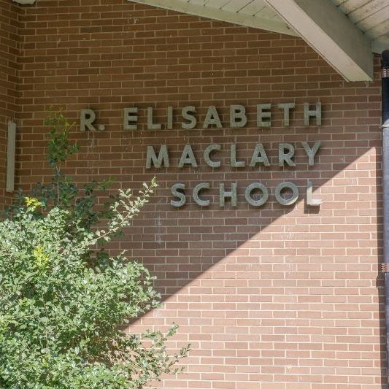
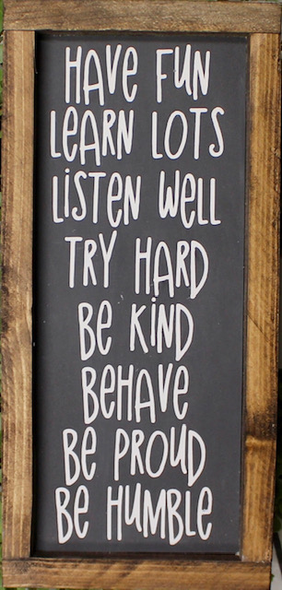







Mrs. Simmers, School Counselor
Meet the Counselor
Contacts
Articles
Websites

Slide 2


Meet Mrs. Simmers
Welcome to Maclary!
You are just going to LOVE IT! I am so excited to meet everyone and start an amazing year!
My Family
My Favorite Things
Husband: Jay
Son: Ryan
Dog: Sundae
Cat: Buddy
Spending Time with My Family
The Beach
Nature walks
Reading
Zumba
Time with Friends
Learning
Experience
10 Years Mental Health Counseling
10 Years in School Counseling

Slide 3
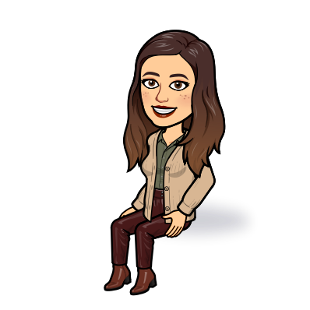
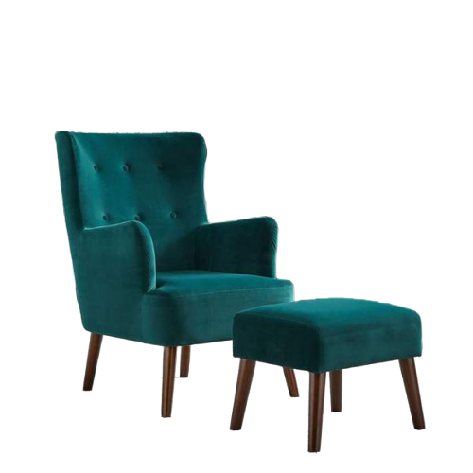


Contact Information
Mrs. Simmers
K-5 School Counselor
M.S., M.Ed.
I’m looking forward to getting to know you and your child this year.
suzanne.simmers@
christina.k12.de.us
454-2142 x. 44241
Office Hours:
8:30 a.m. to 3:30pm
I am not always available
to meet you so please
call to make an appointment before you stop by.

Slide 4
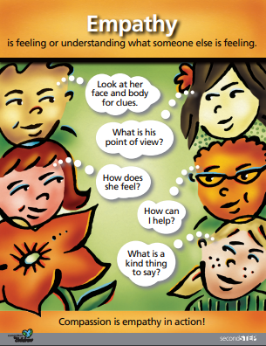
Mrs. Simmers’ Counselor’s Corner
Individual Counseling
As referred or requested. A consent form is needed after one session.
Counseling updates
Upcoming Lessons
Kindness, Bucketfilling
Empathy and Respect
Transition coping and Mindfulness
Small Groups
(based on needs)
Social Lunch Bunches
Structured Groups
friendships, coping skills, self-regulation, self esteem, assertiveness
Parent Resources
Be on the lookout for counseling calm room and SEL library that will be linked in schoology

Slide 5
Interesting Articles in the News
The Catch 22 of Perfectionism and Procrastination
https://www.psychologytoday.com/us/blog/perfectly-hidden-depression/202007/the-catch-22-perfectionism-and-procrastination
Anxiety and Coping with the Coronavirus
https://childmind.org/article/anxiety-and-coping-with-coronavirus/
Screen Time for Kids Recommendations: How Much is Too Much?
https://childdevelopmentinfo.com/screen-time/screen-time-recommendations-for-parents-how-much-is-too-much-for-kids/#gs.ay7kei
30 Books to Help you Talk to Your Kids About Racism.
https://www.todaysparent.com/family/books/kids-books-that-talk-about-racism/
How to get your Kids to Listen: 5 Tricks to Try.
https://www.todaysparent.com/family/discipline/how-to-get-your-kids-to-listen/

Slide 6
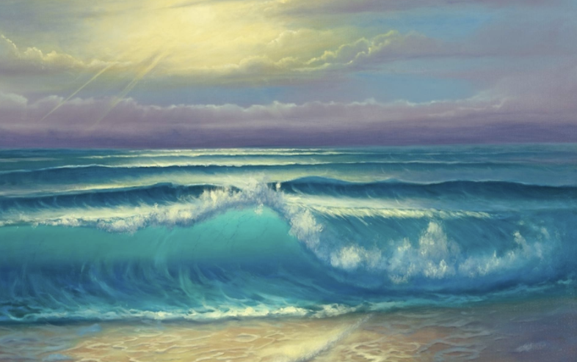

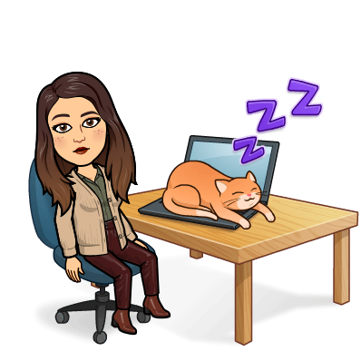
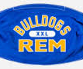


Mrs.Simmers’ Favorite Websites
Coming Soon
Coming Soon
Coming Soon

Slide 7

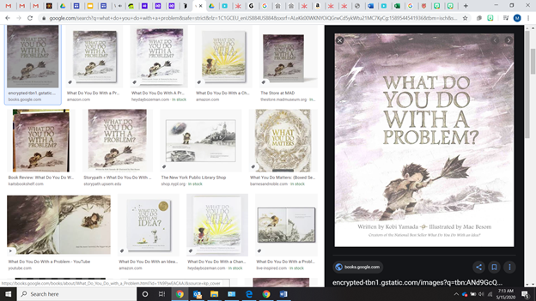


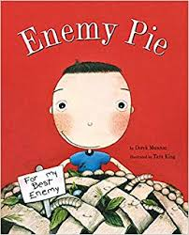


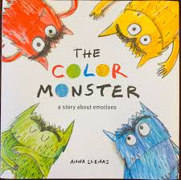

Some of Mrs. Simmers’ SEL Books used in lessons

