Slide 1
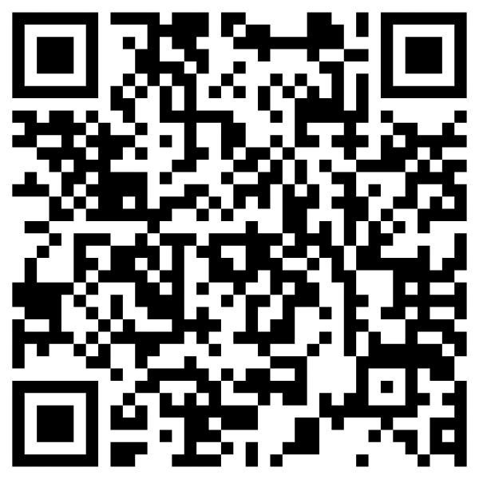
Newman Smith
Trojan Band Boosters
Volunteer Opportunities
Sign Up Today!

Slide 2
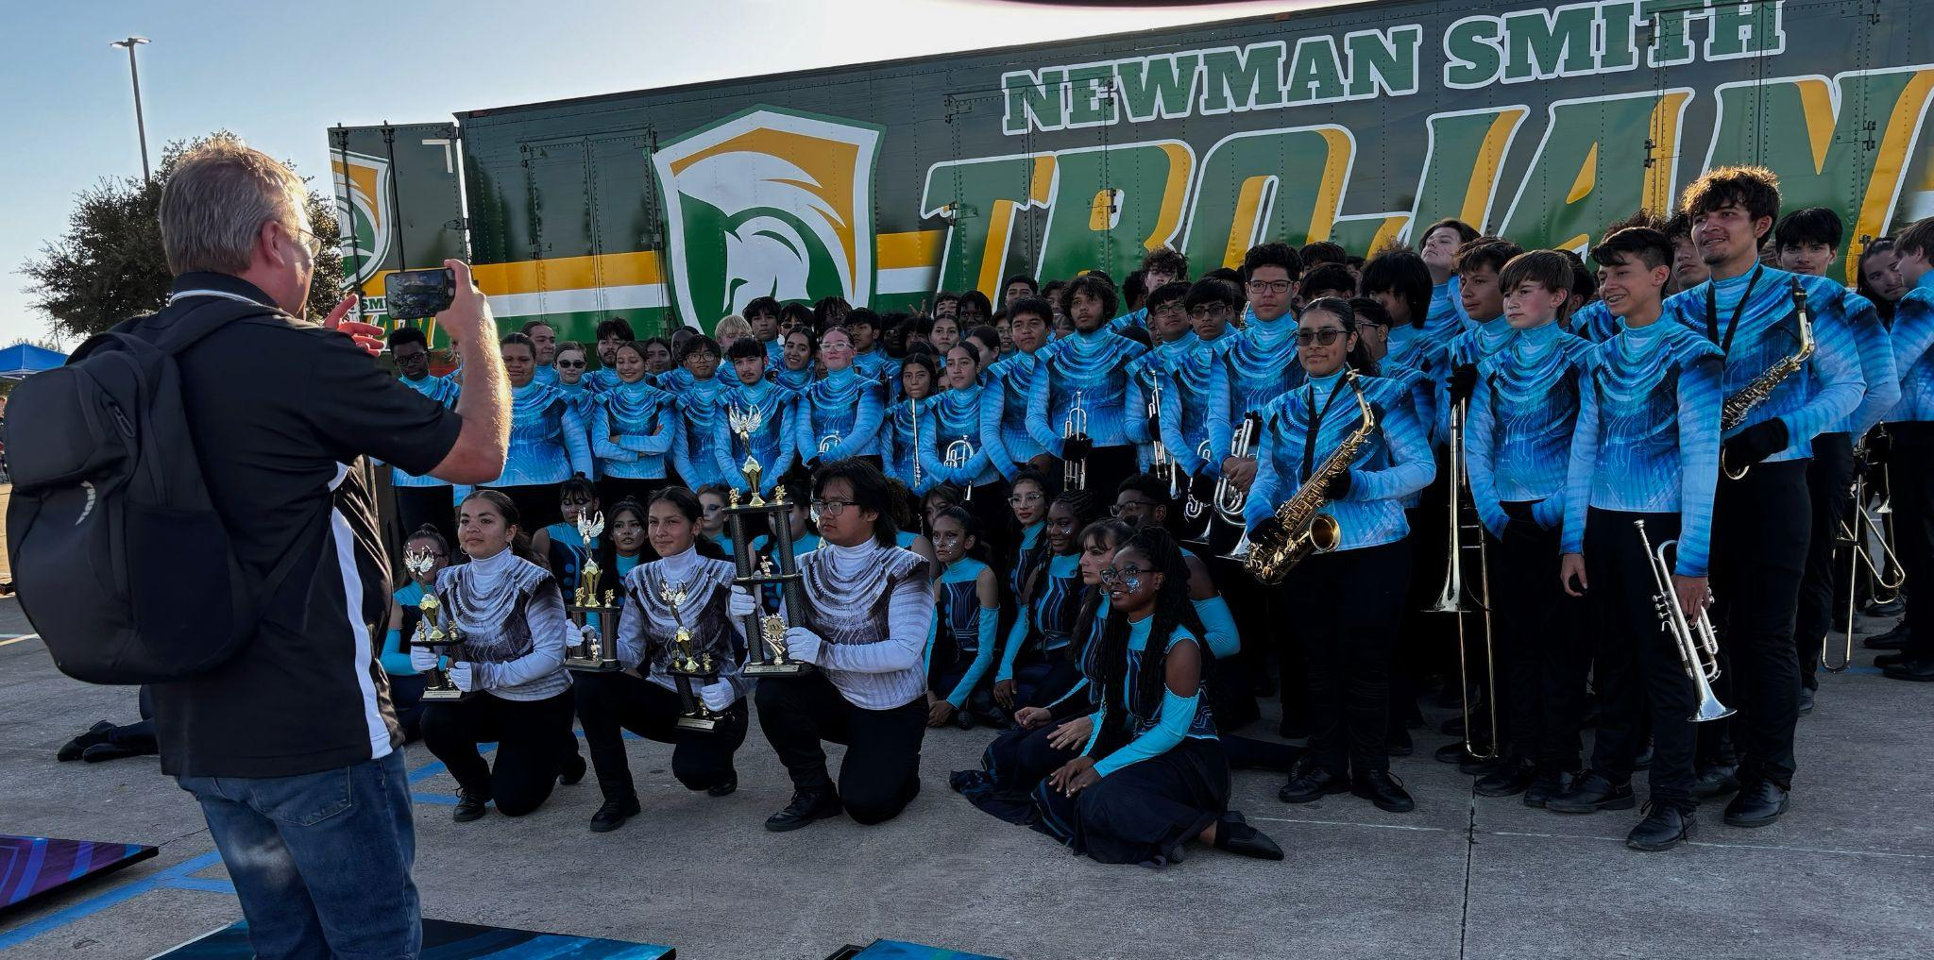
Marching Season Volunteer Opportunities

Slide 3
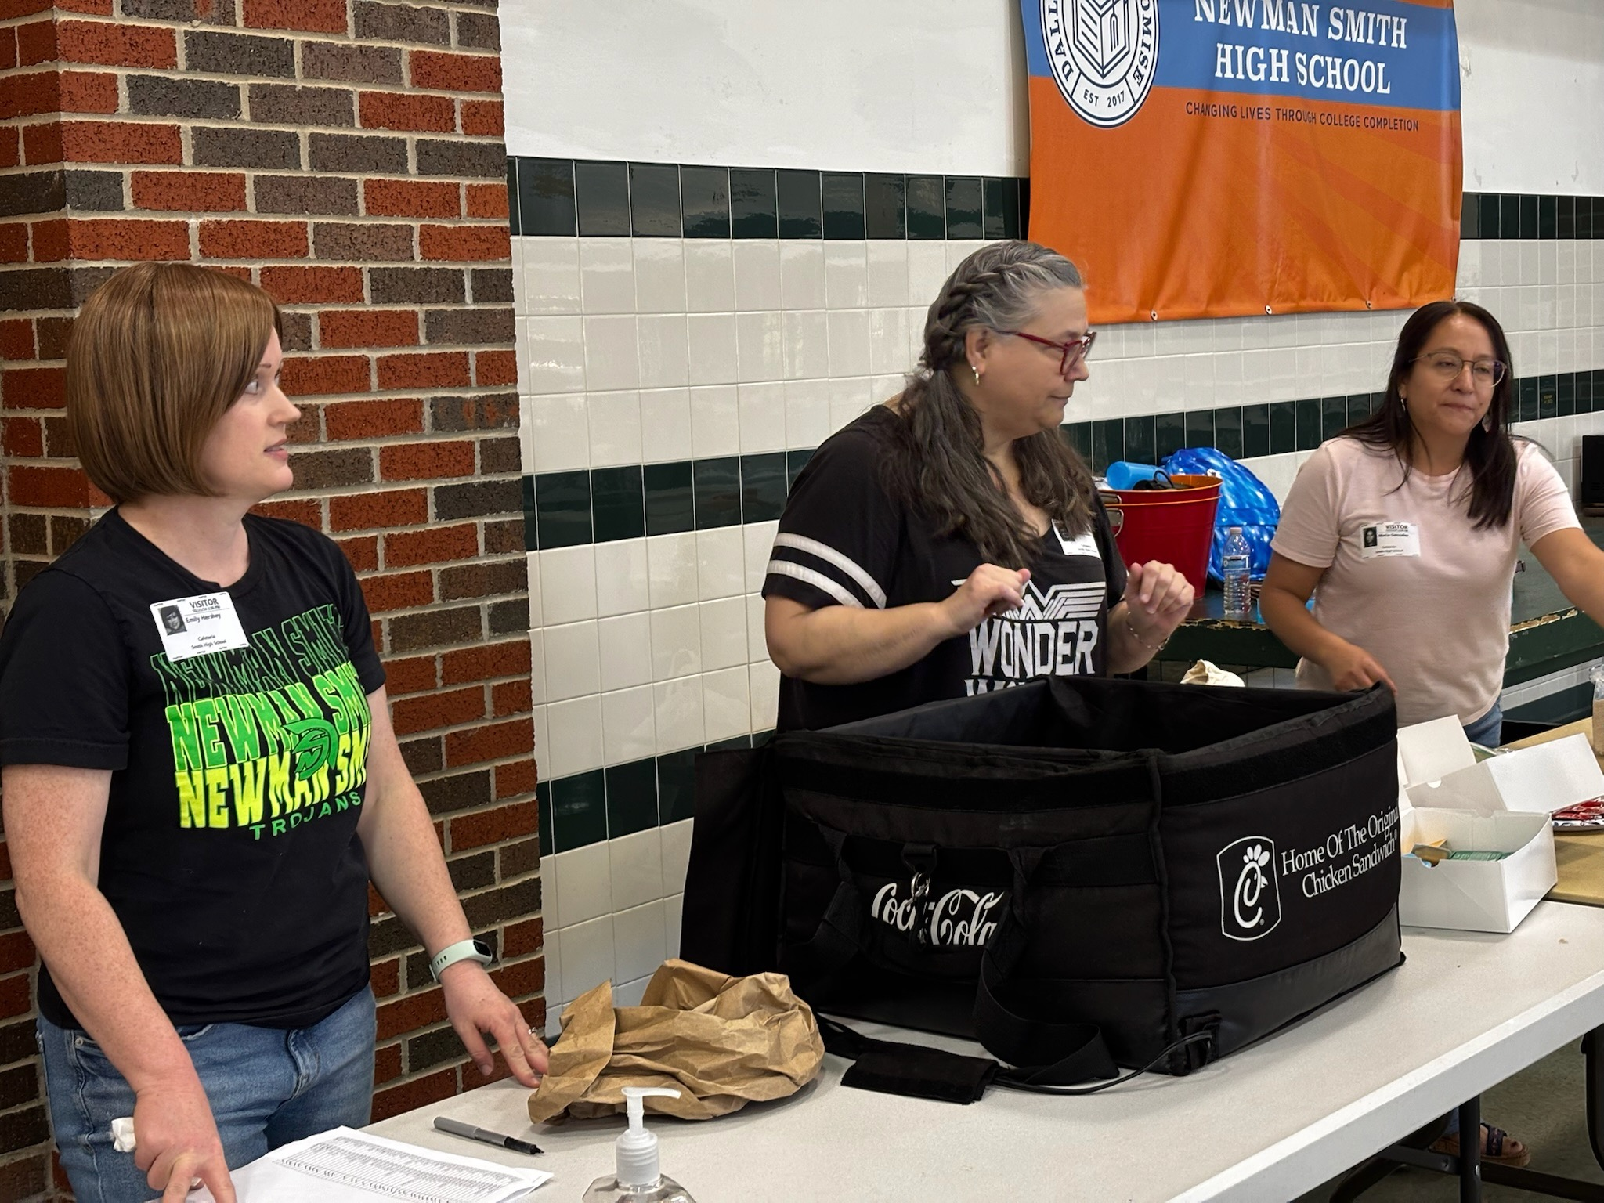
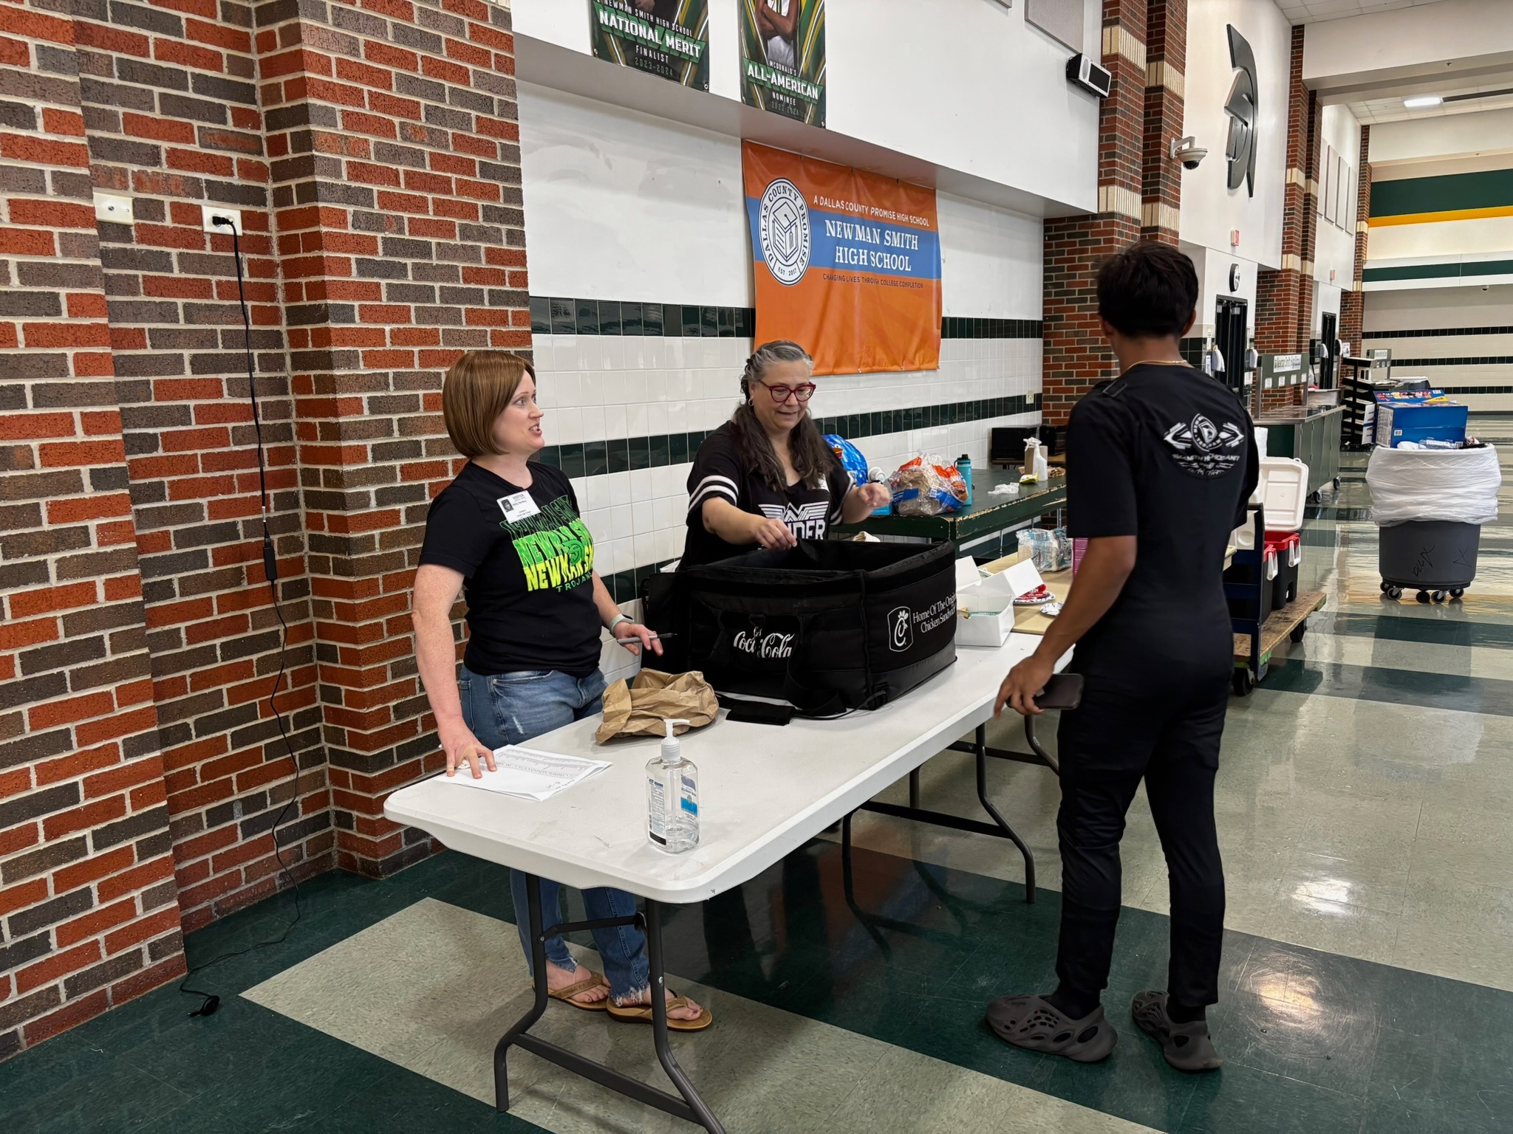
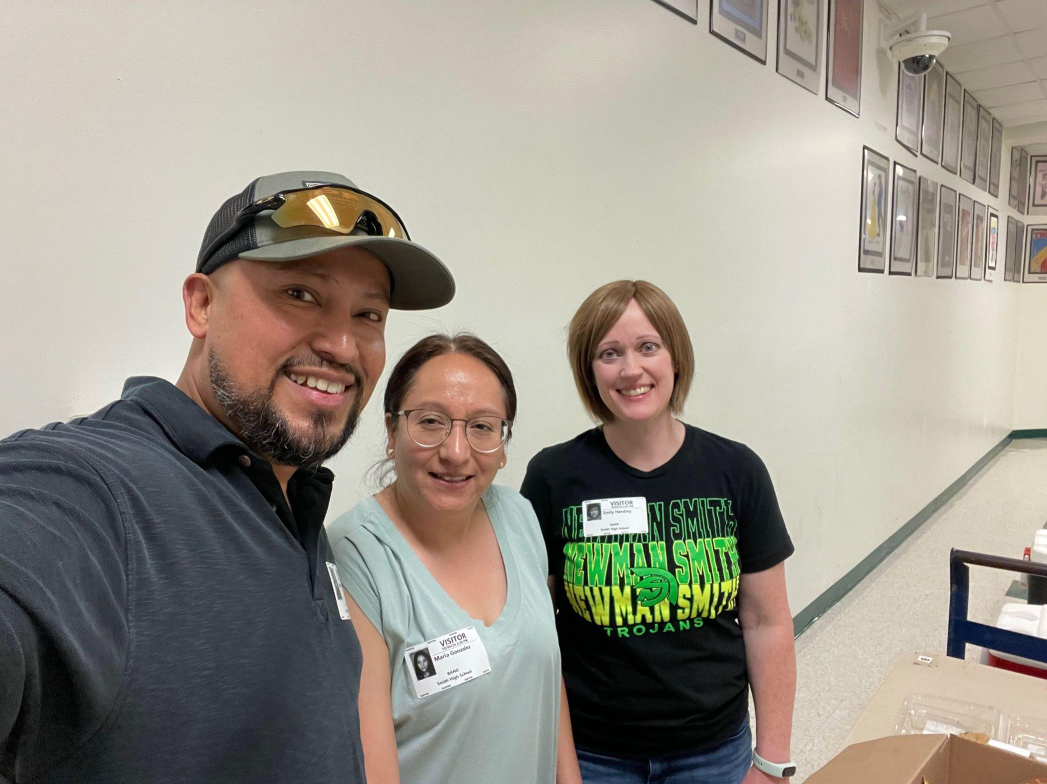
Serve Game Day Meals During Football Season
Game day meals are typically served in the school cafeteria before the game (Quick meals from Chick-Fil-A, Jason’s Deli, Raising Canes, etc.)

Slide 4
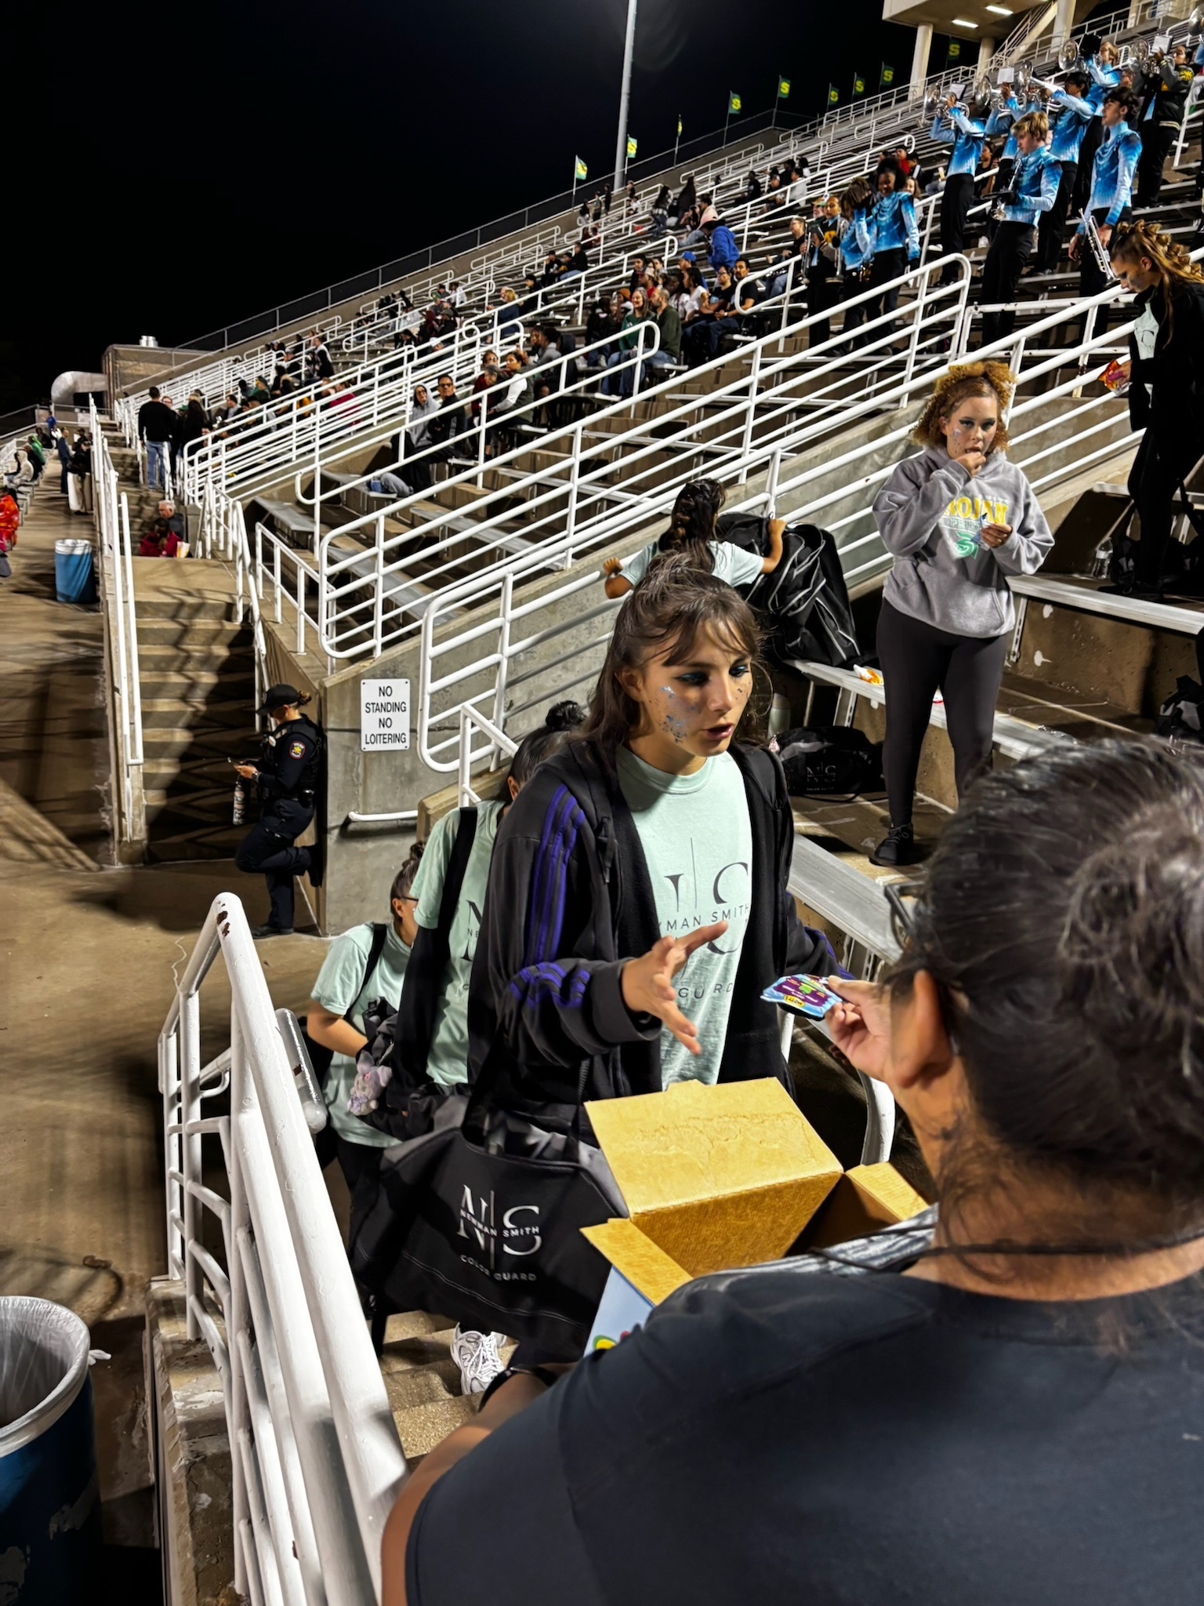
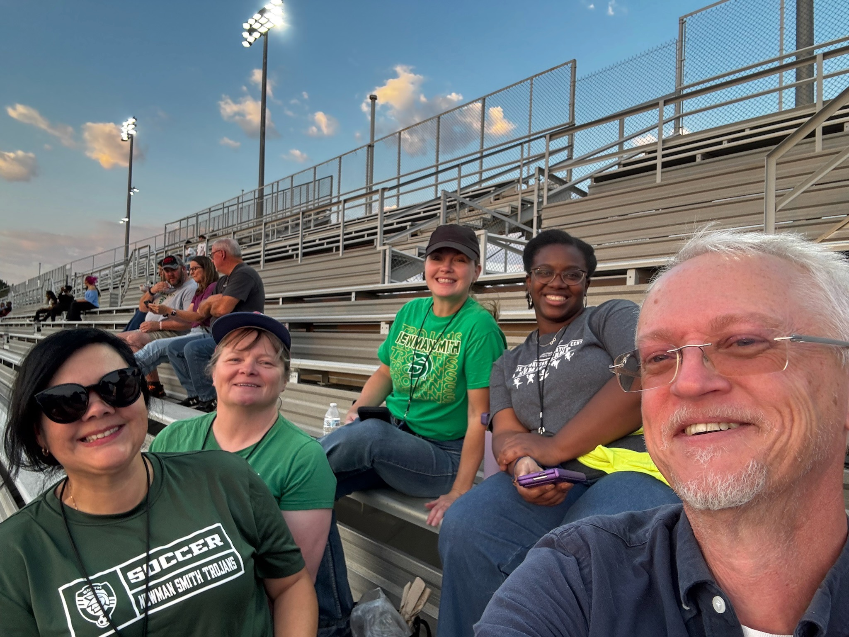
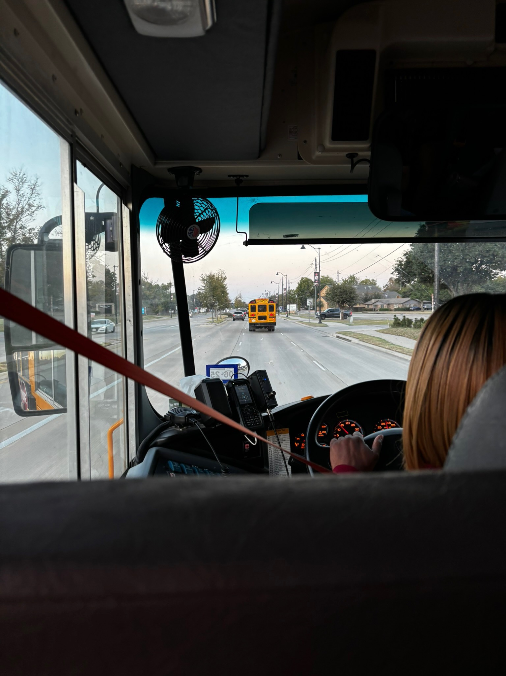
Be a Chaperone for Football Games
Hand out snacks to students after halftime show
Ride the bus
with students
Sit next to the band during football games

Slide 5
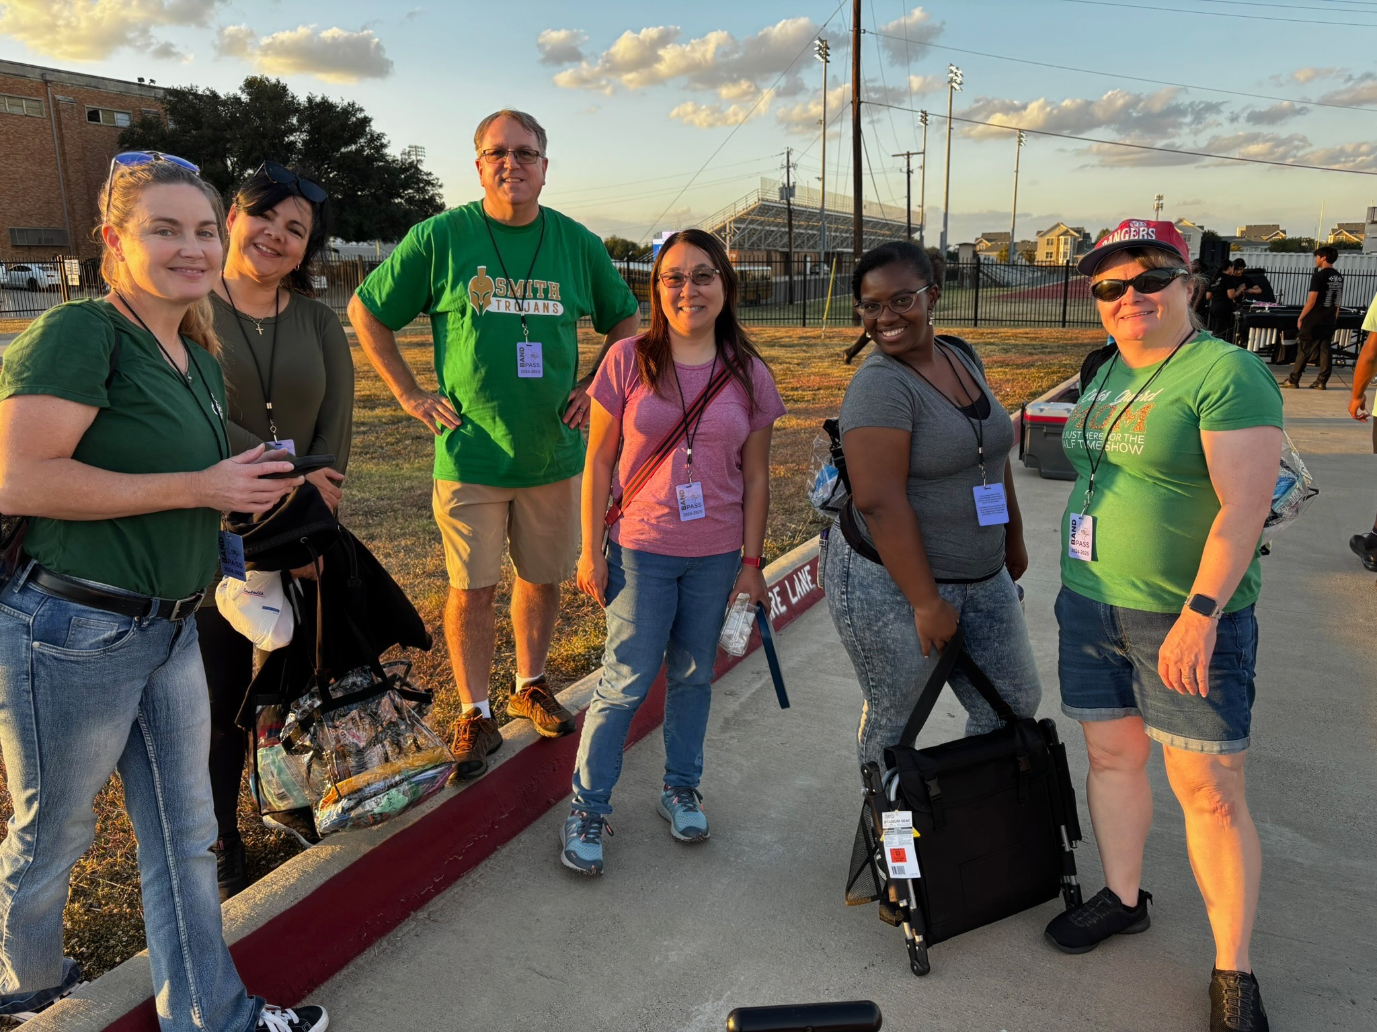
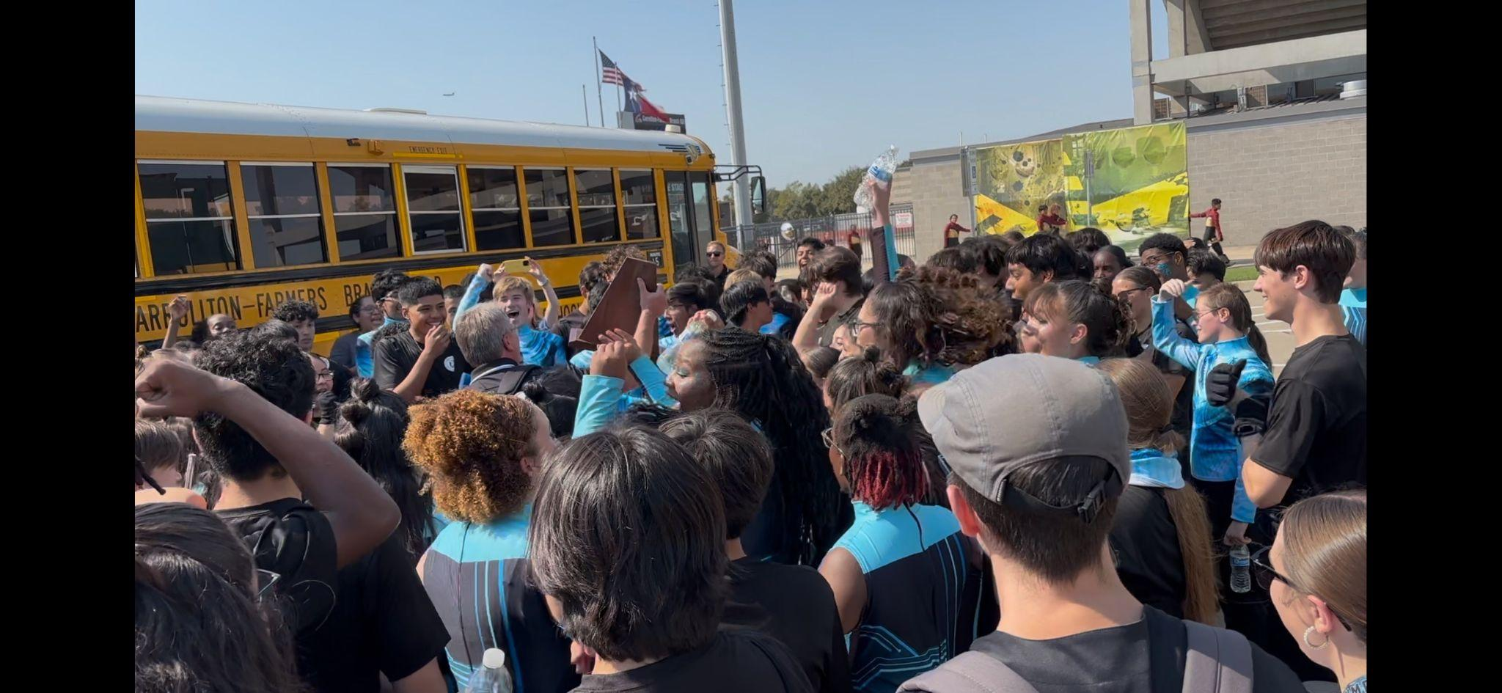
Be a Chaperone for Marching Contests
Ride the bus to and from the contest, and assist band staff in supervising and supporting students while at the contest

Slide 6
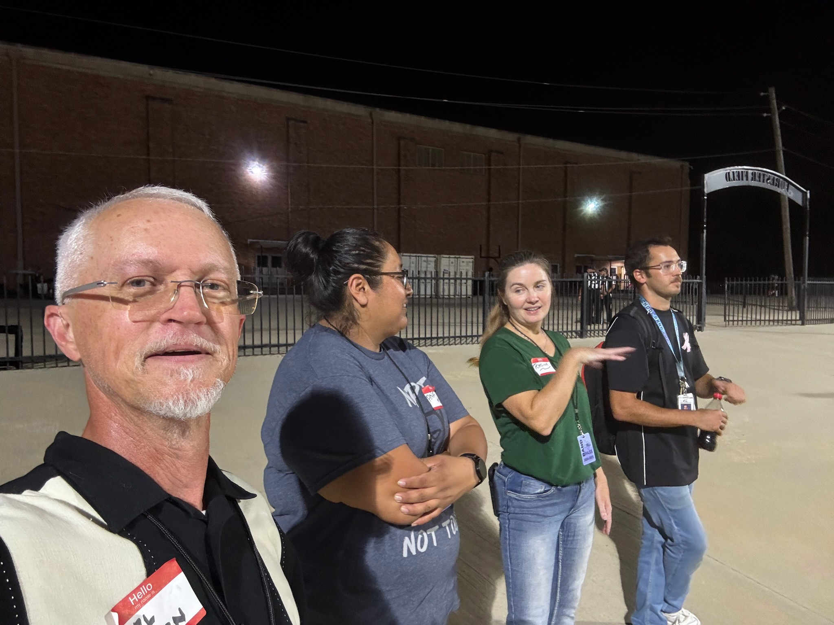
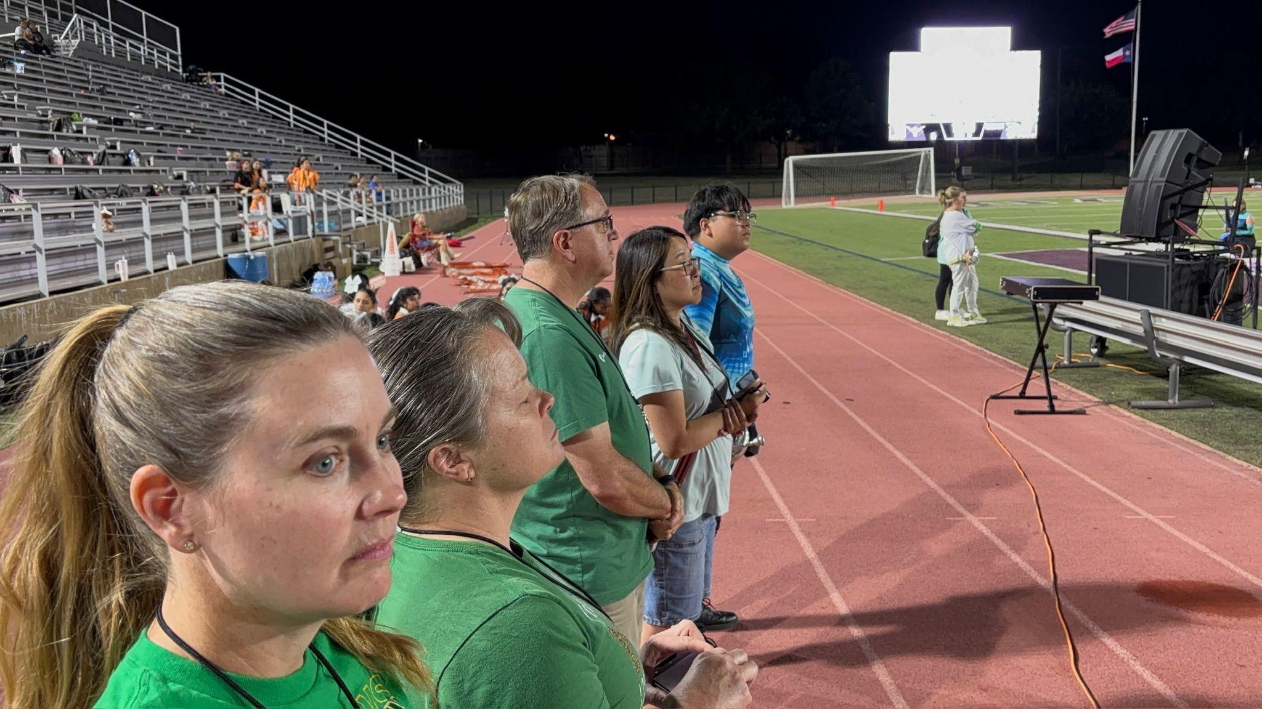
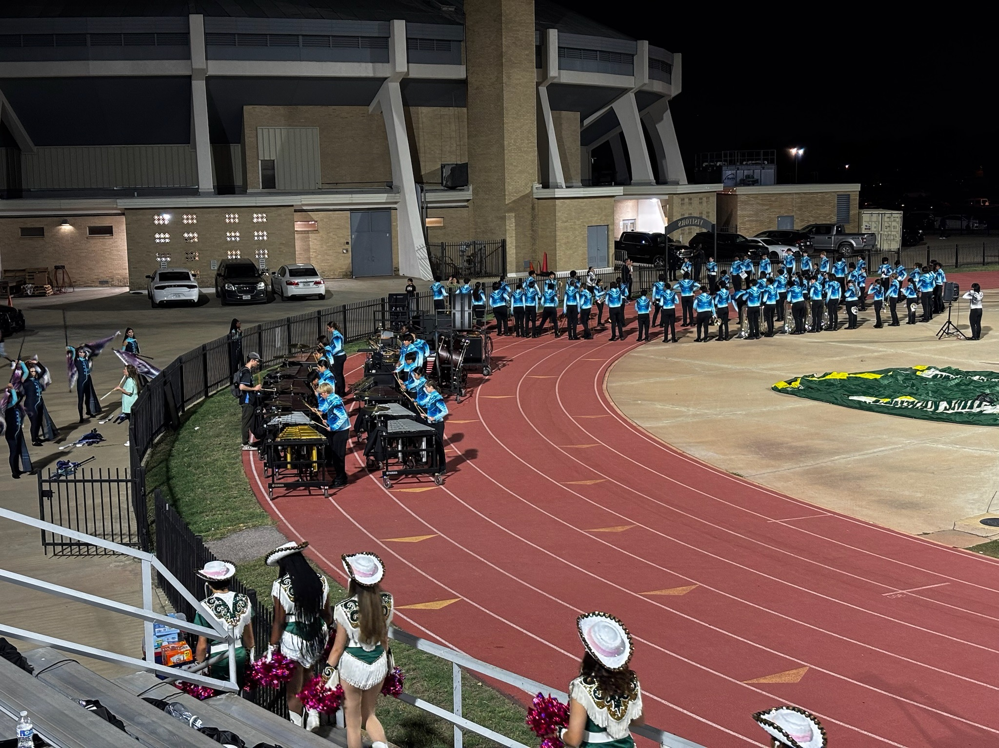
Join the Game Day Pit/Prop Crew
Help move equipment onto the field for halftime performances, then enjoy the show from the sideline

Slide 7
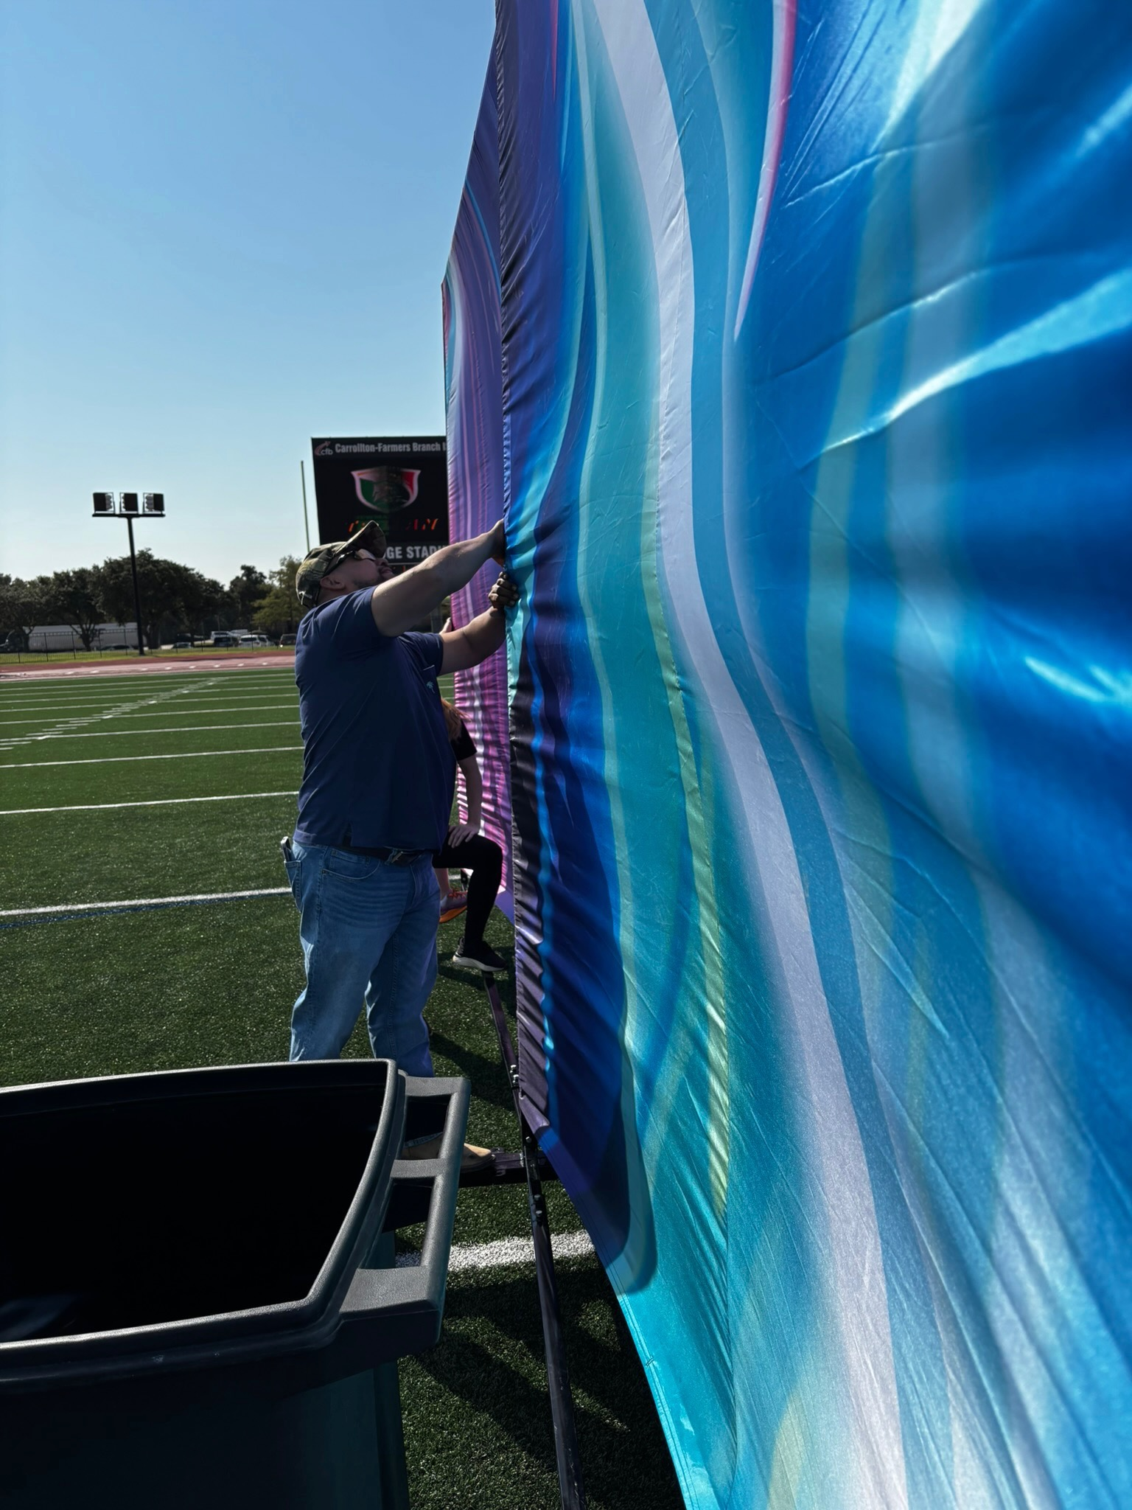
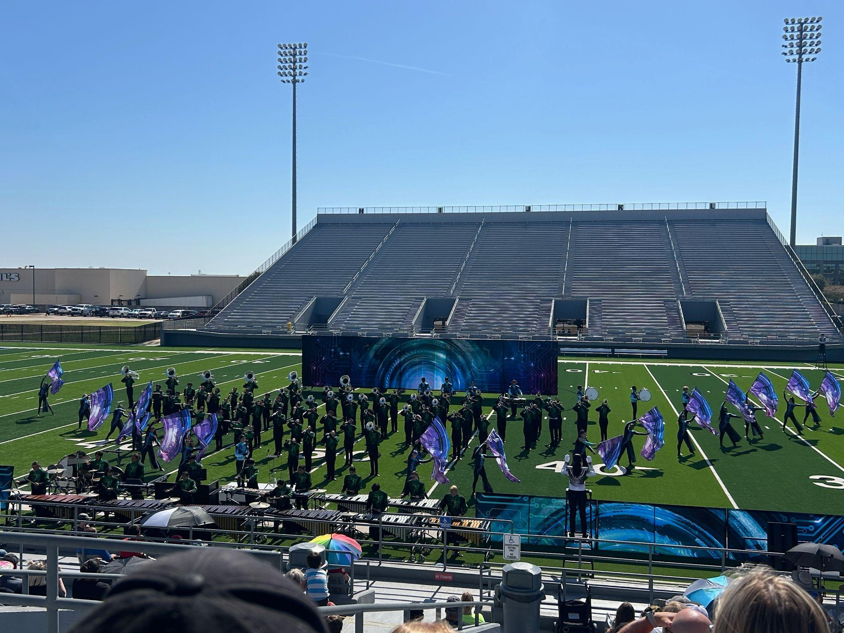
Join the Marching Contest Pit/Prop Crew
Help move equipment onto the field, set up, and hold props during contest performances

Slide 8
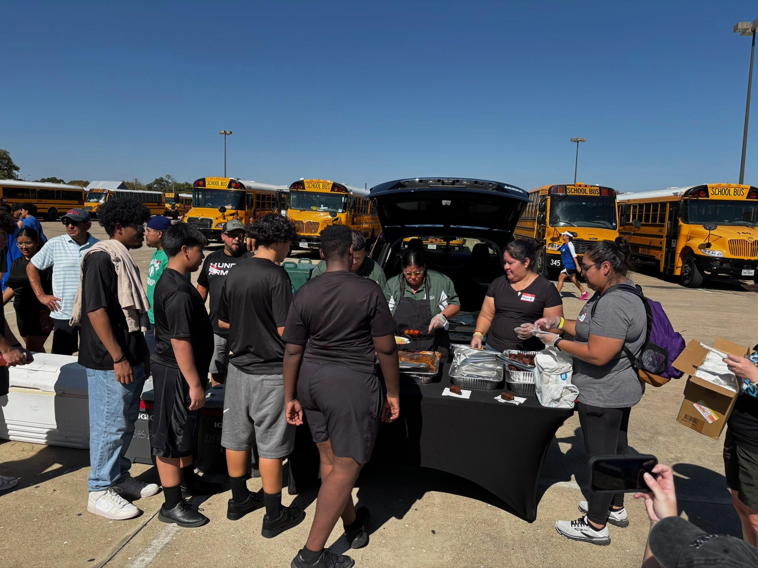
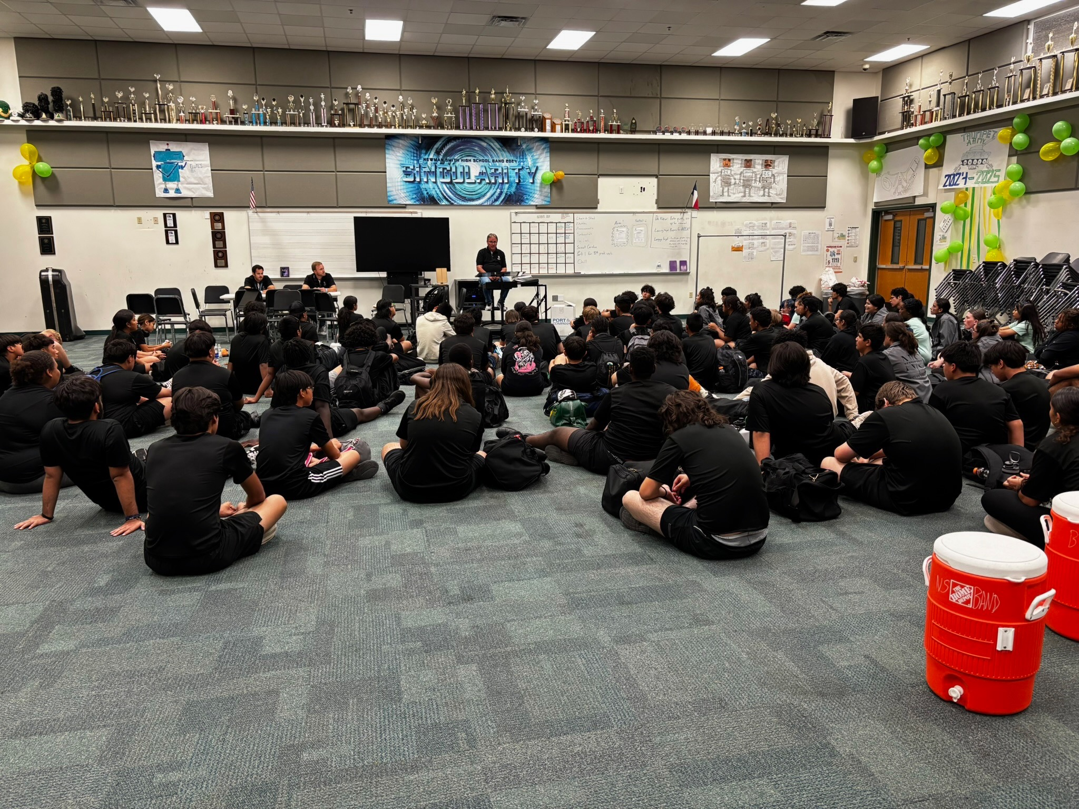
Serve Meals at Marching Contests
Serve meals/snacks/drinks
during marching contests

Slide 9
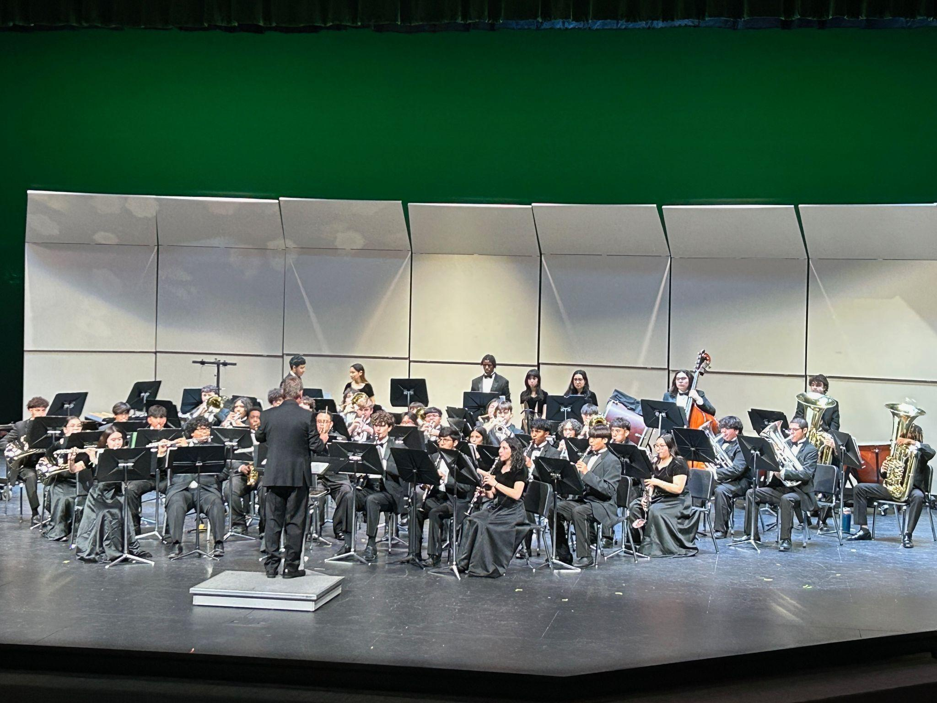
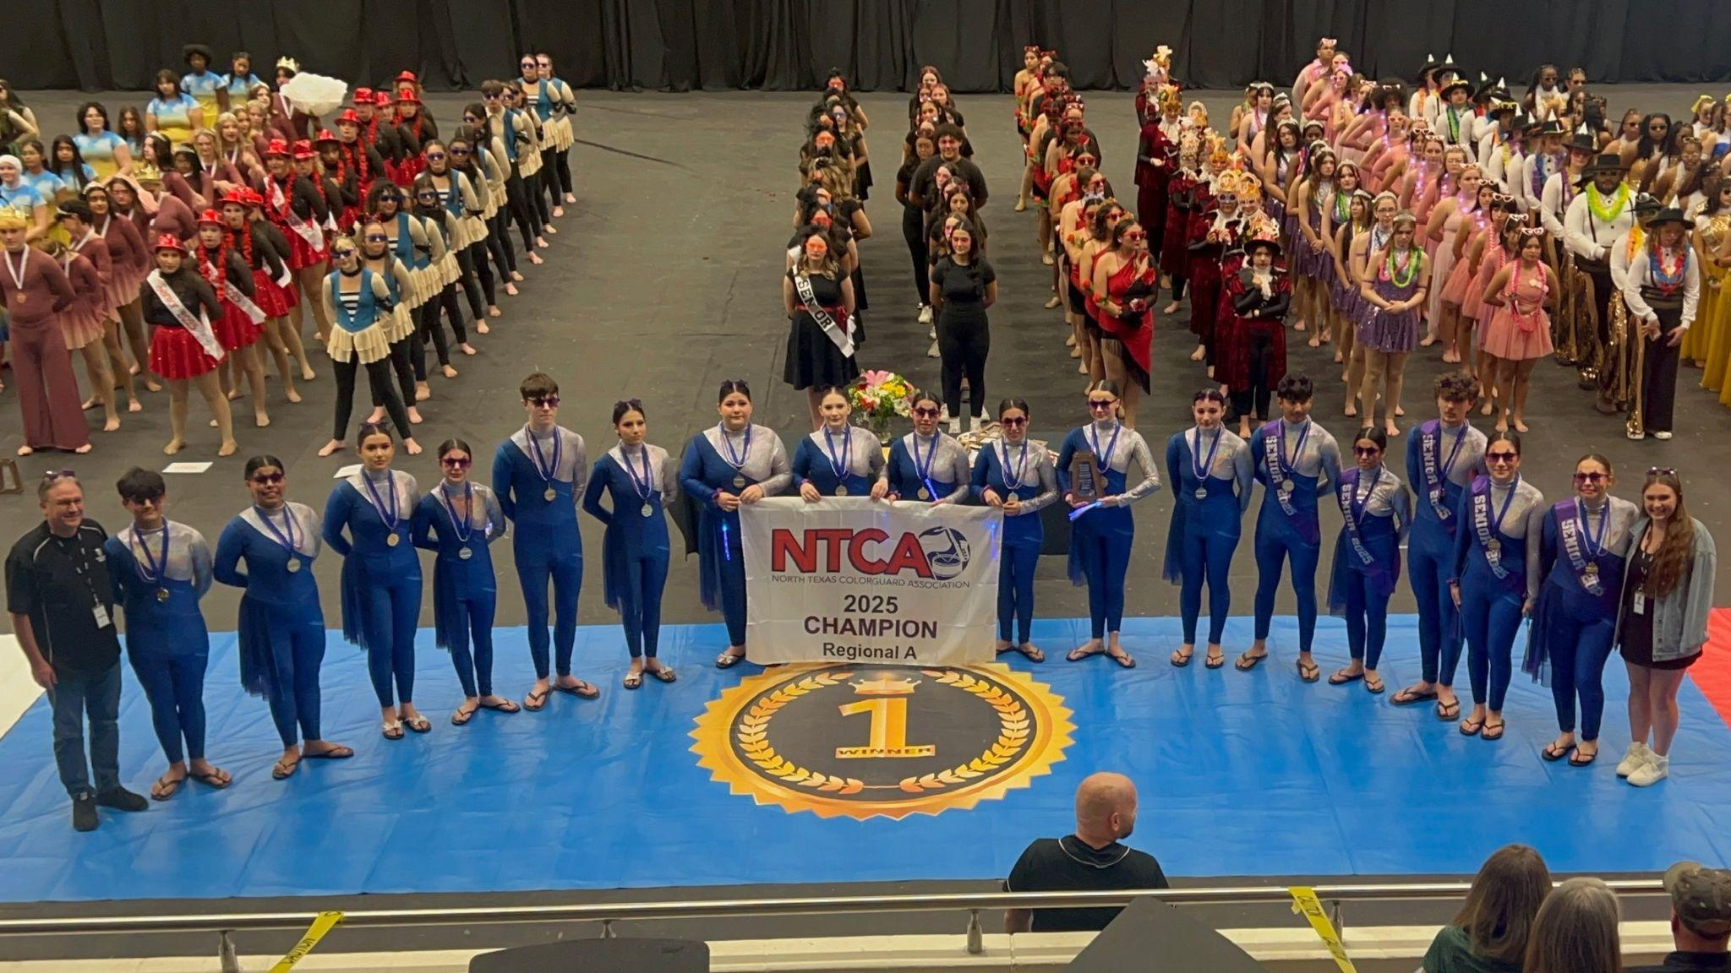
Concert/Winterguard Season Volunteer Opportunities

Slide 10
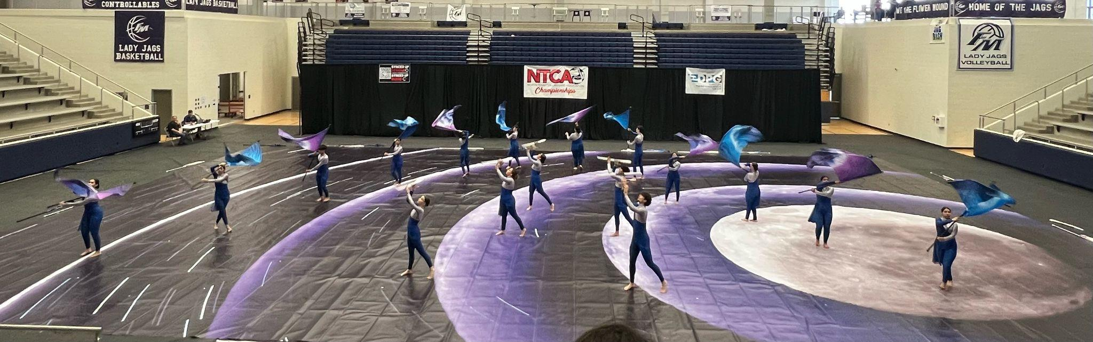
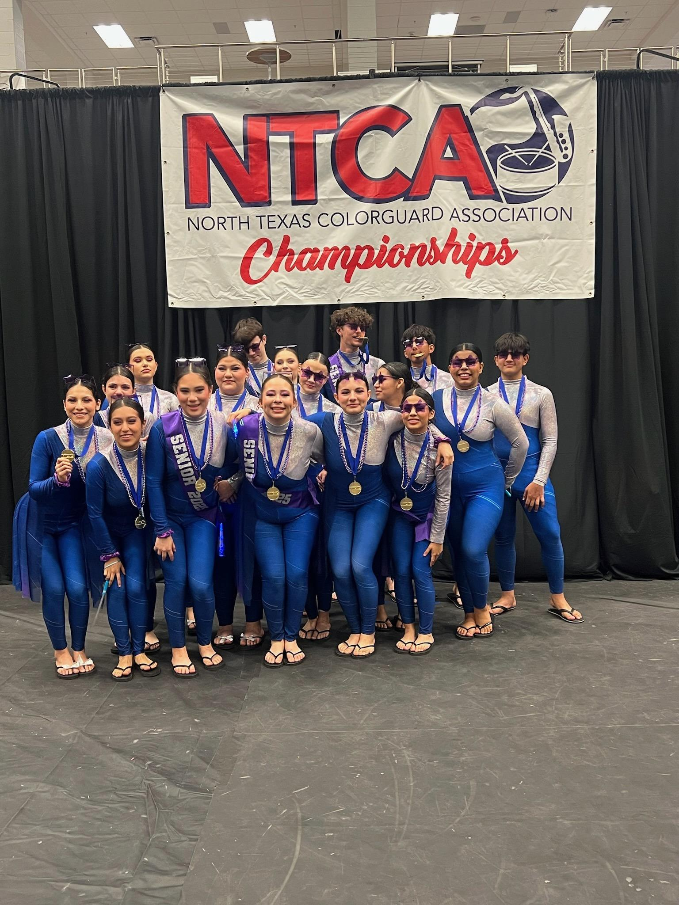
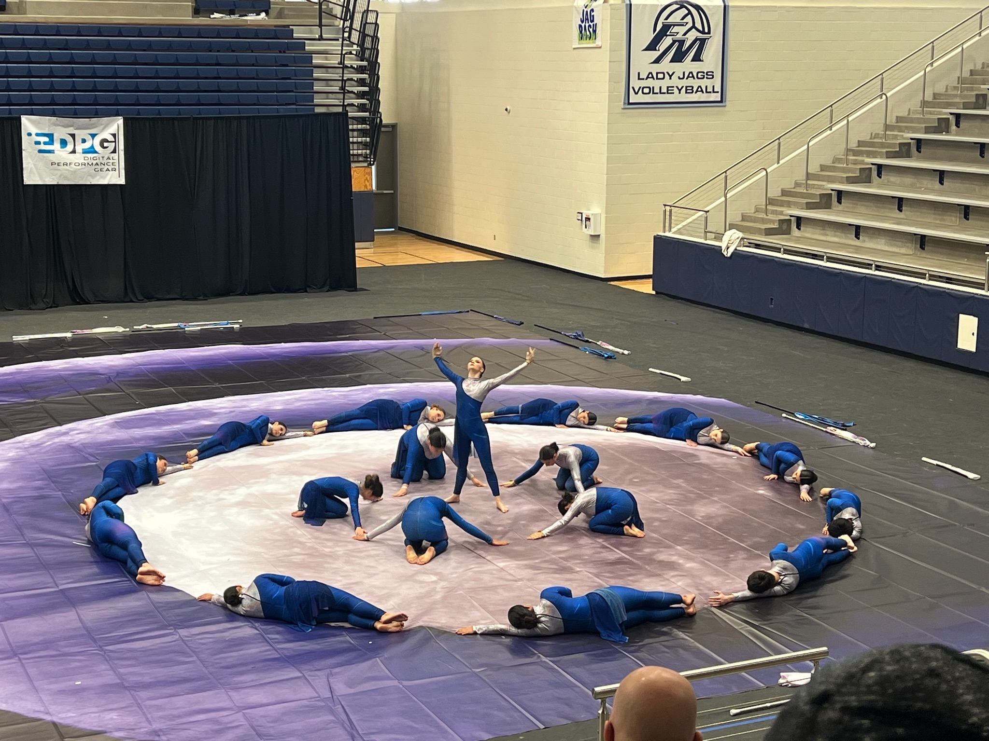
Chaperone for Winterguard Competitions
Ride the bus, supervise and support students during the competition, serve a meal

Slide 11
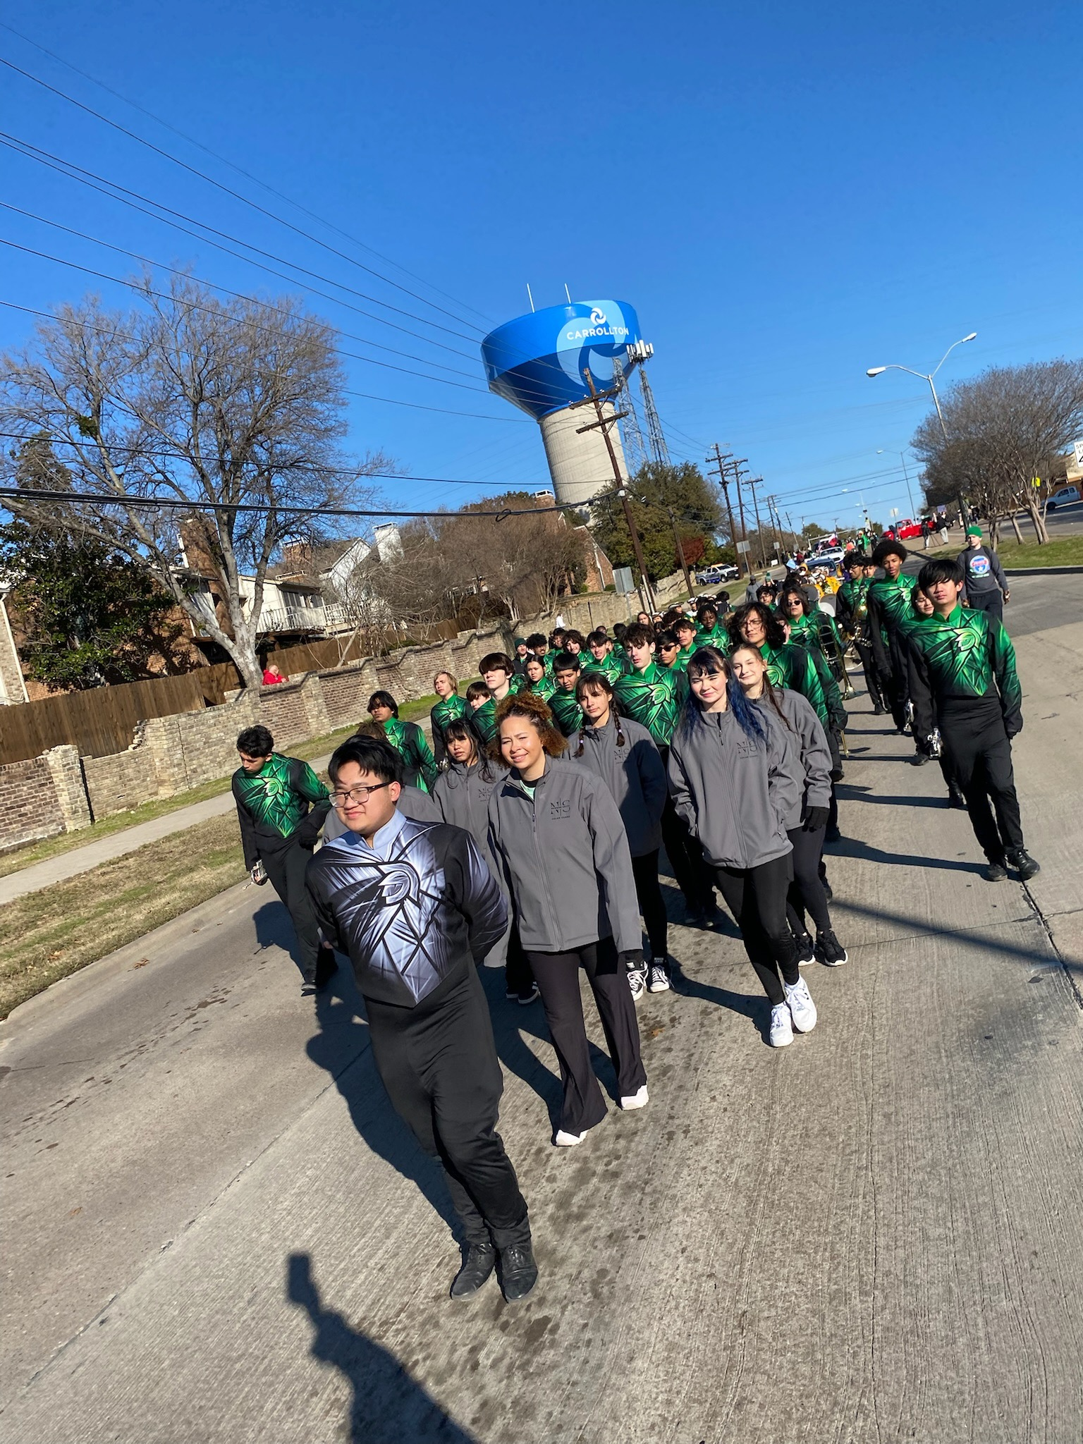
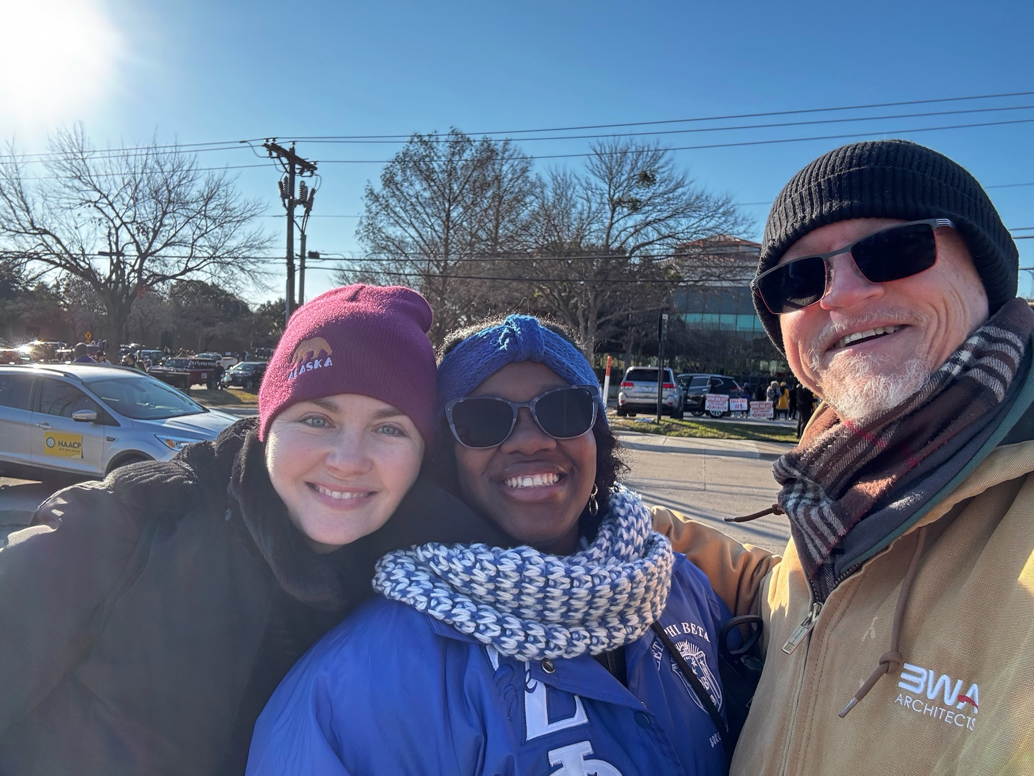
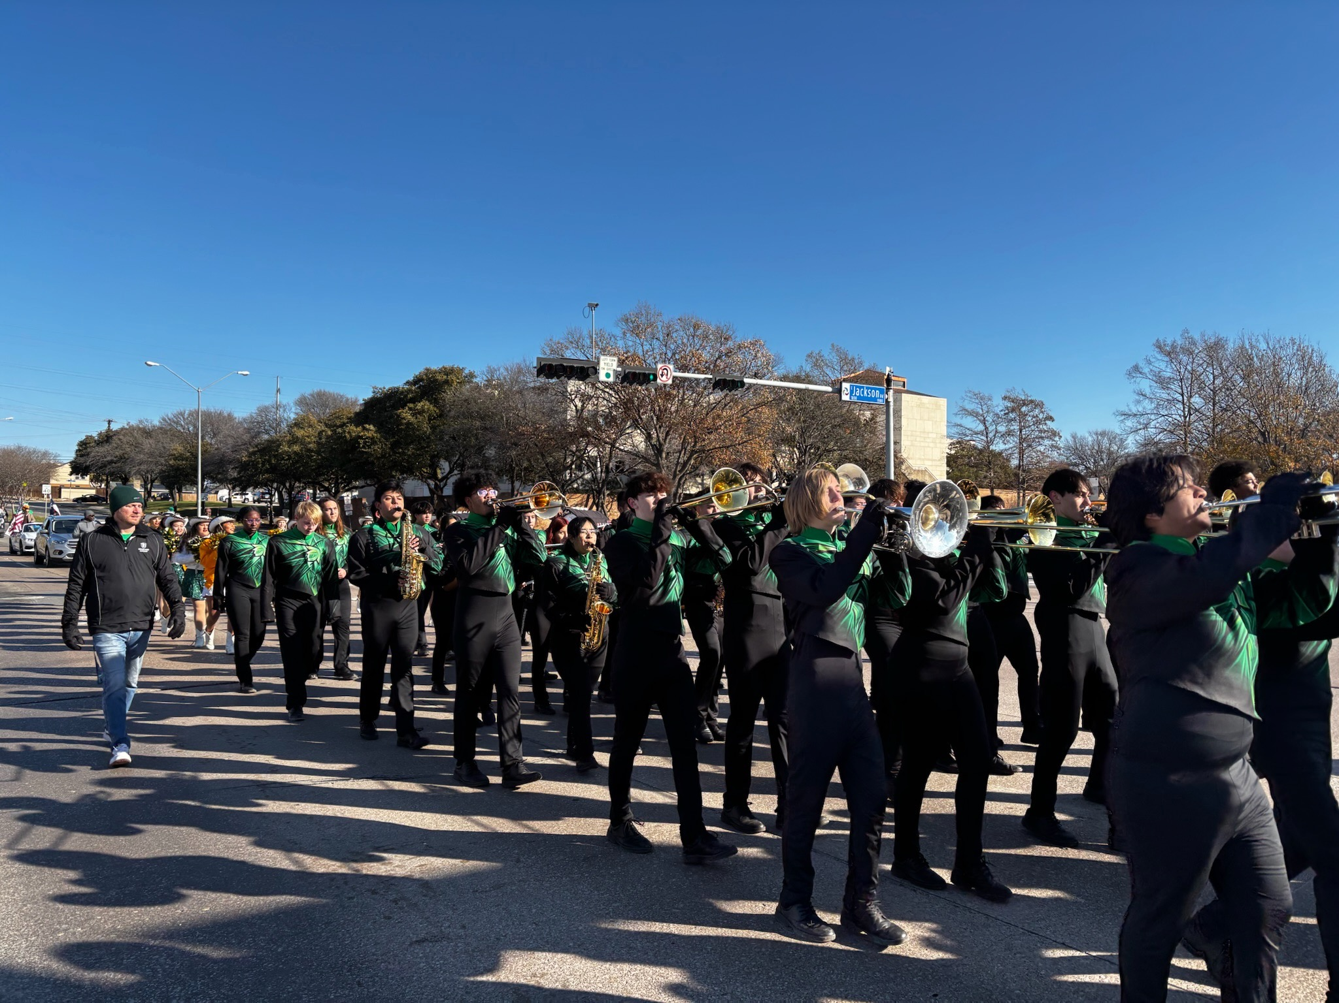
Chaperone During Community Events
Chaperones joined the Trojan Band at Carrollton’s 2025 MLK Day Parade

Slide 12
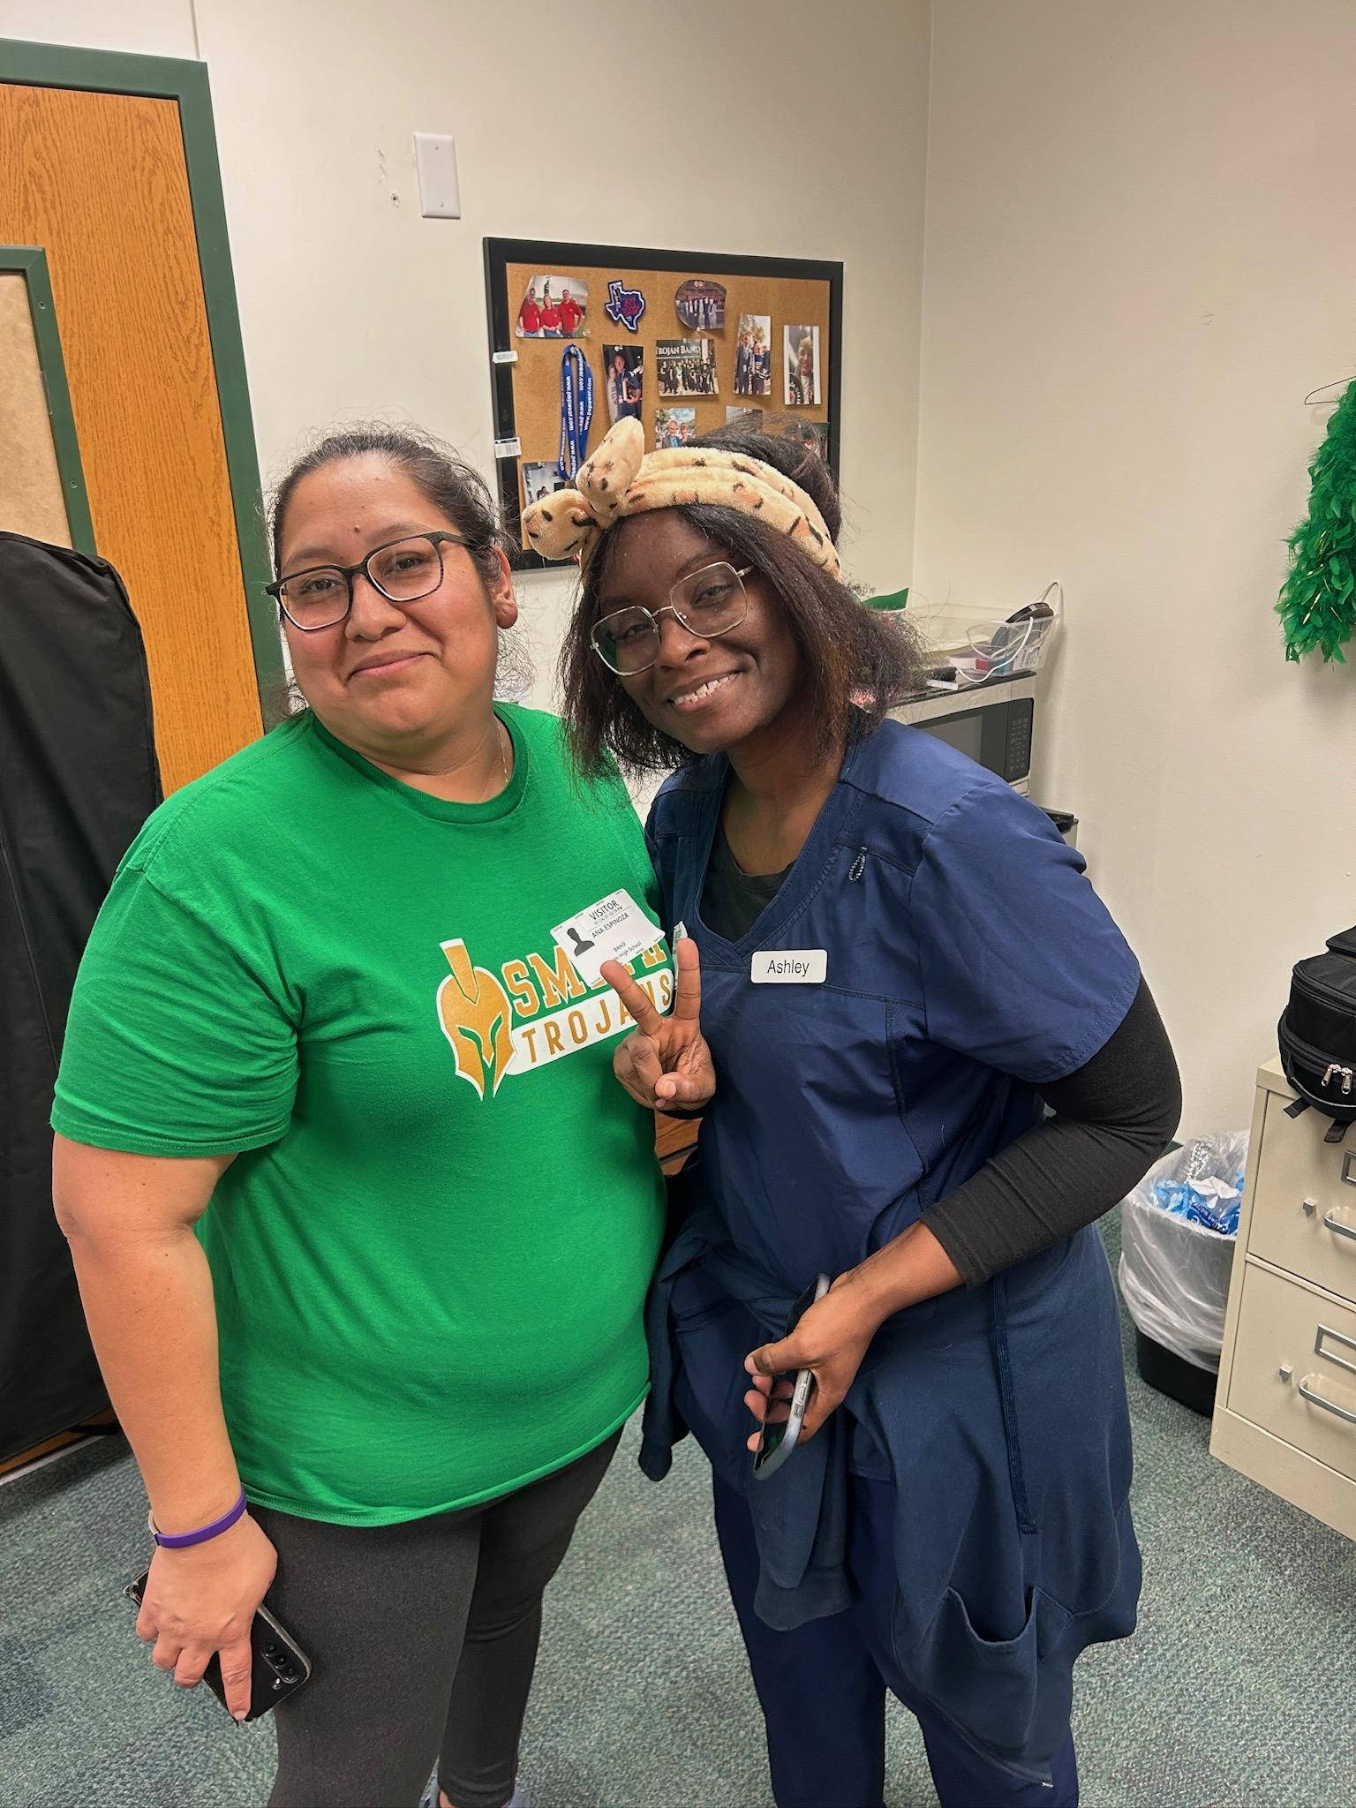
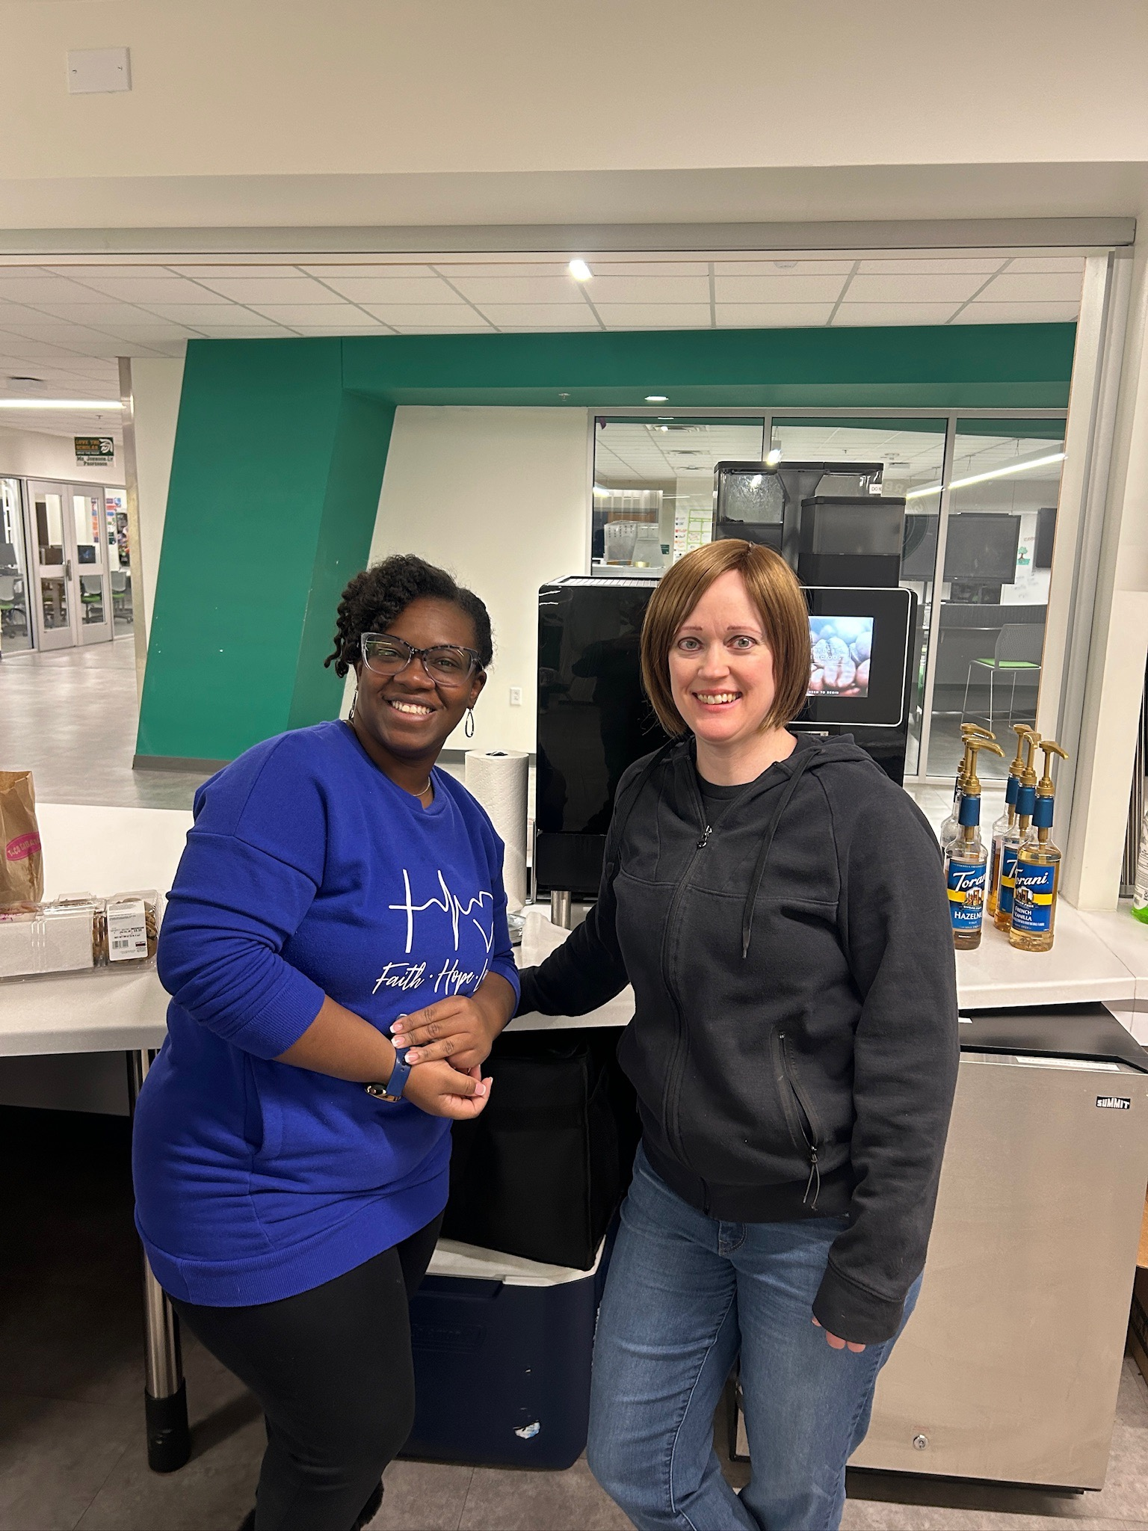
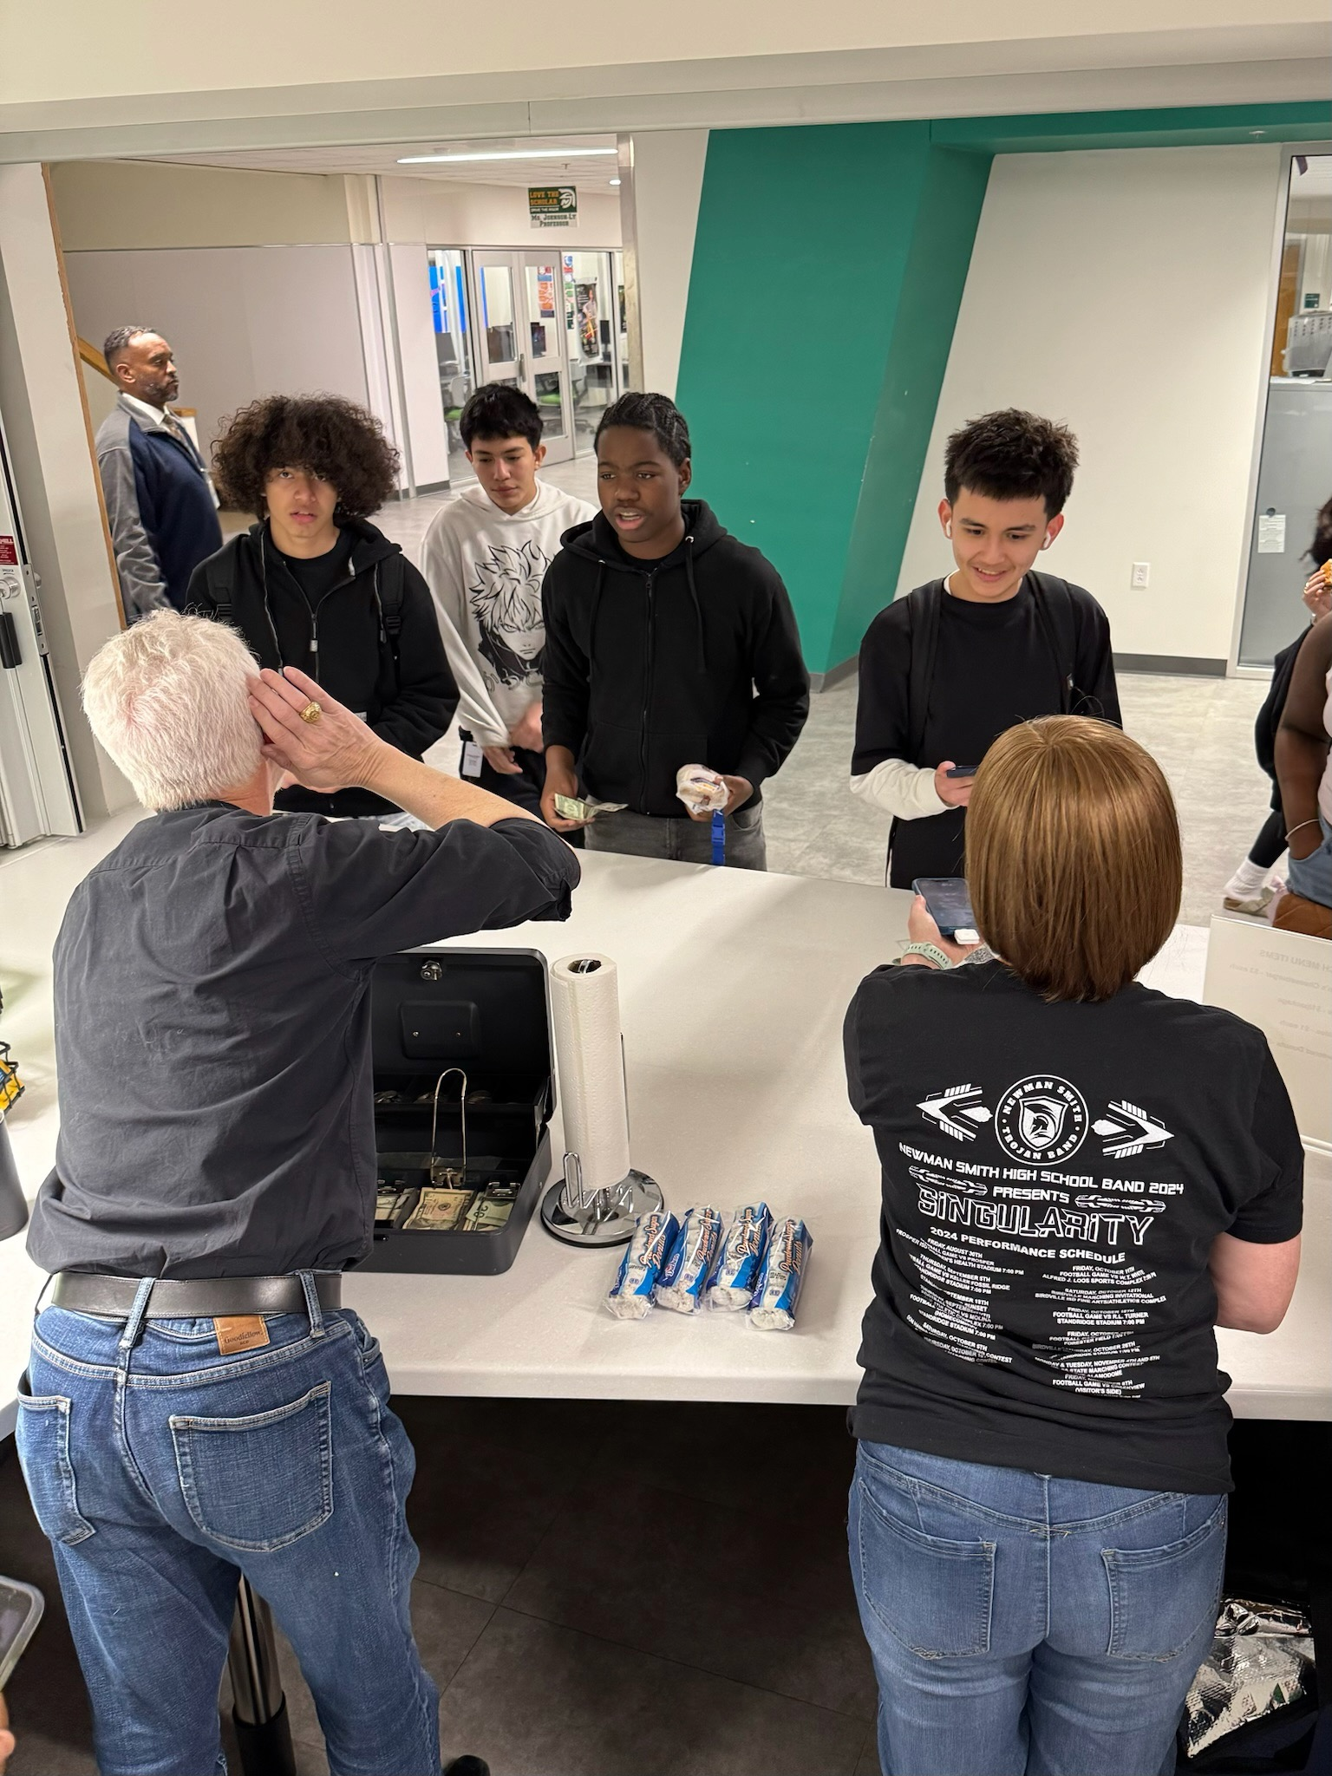
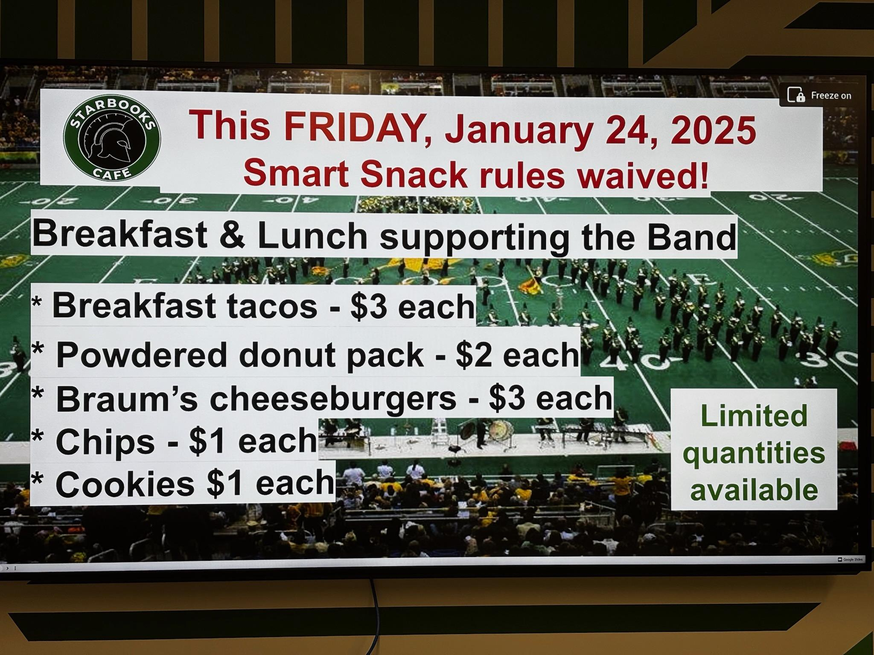
Sign Up for School Concession Fundraisers
Sell concessions at Starbooks Cafe waiver days fundraisers to raise money for the band

Slide 13
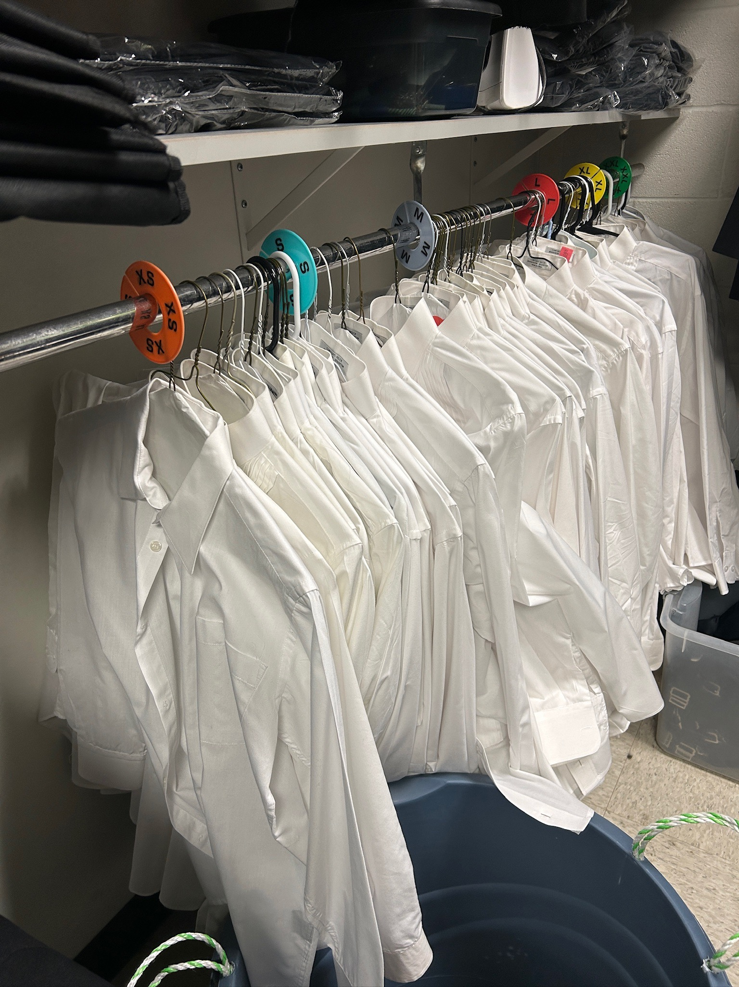
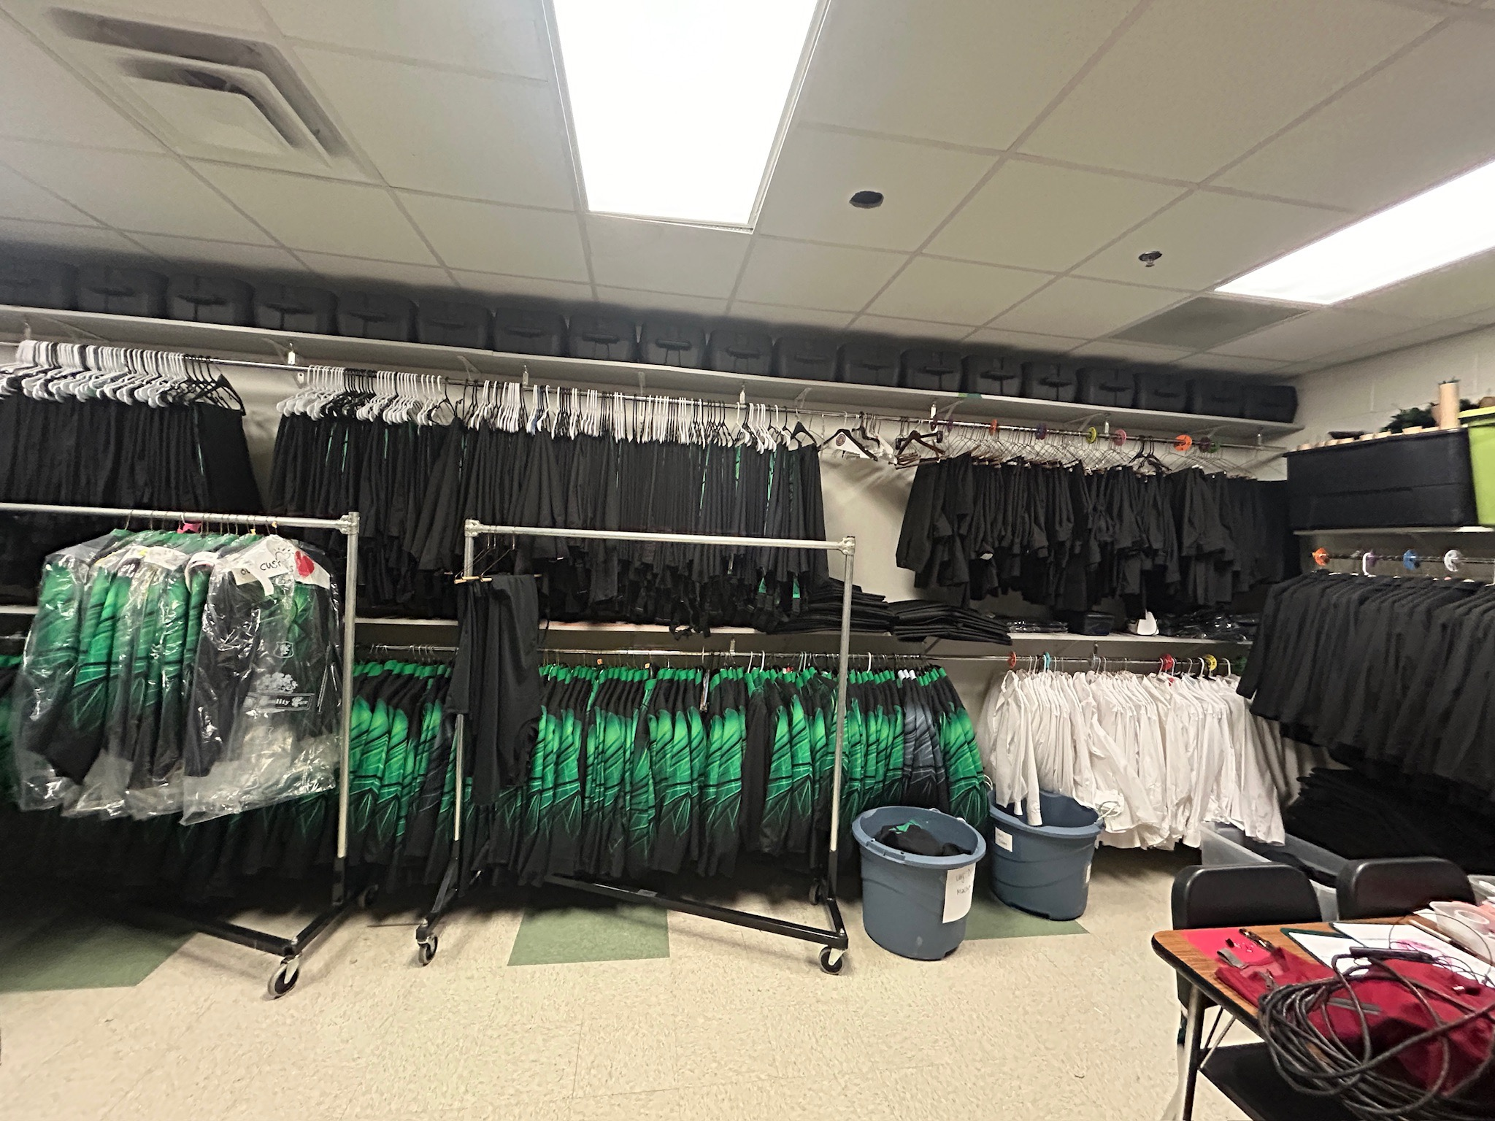
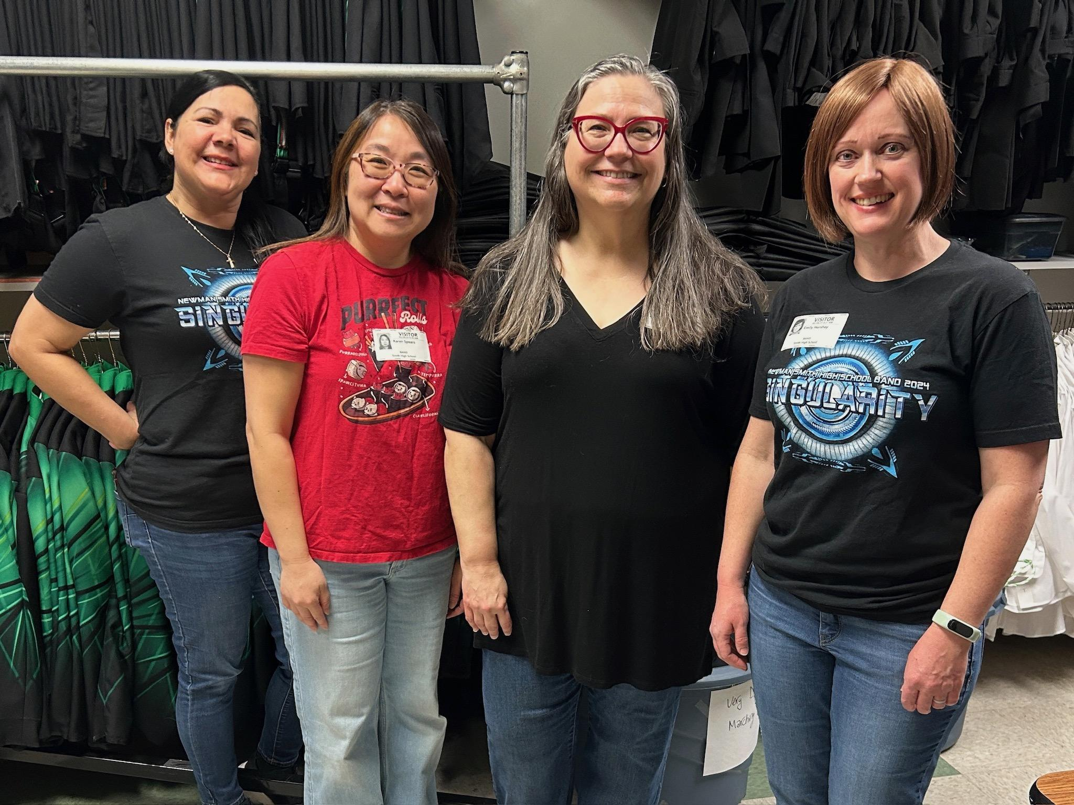
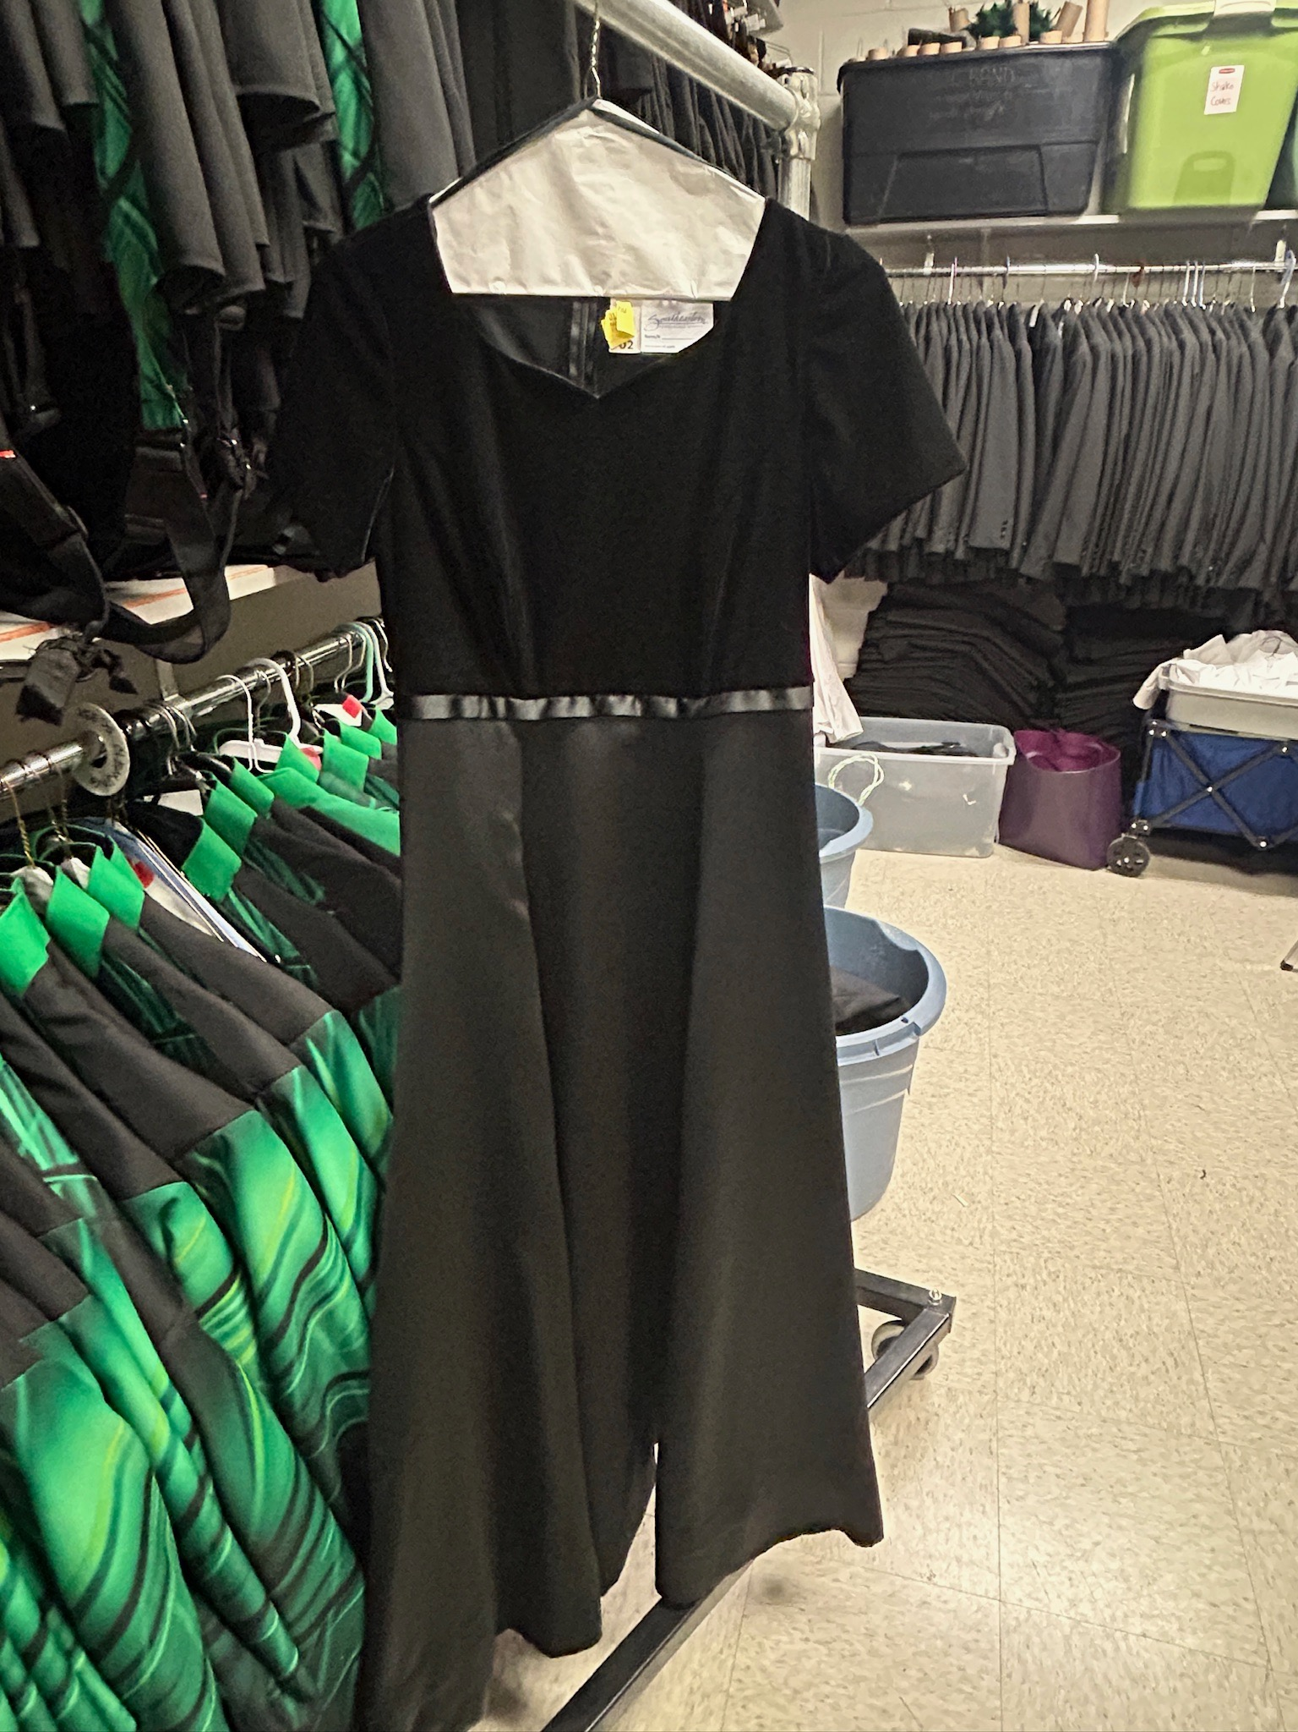
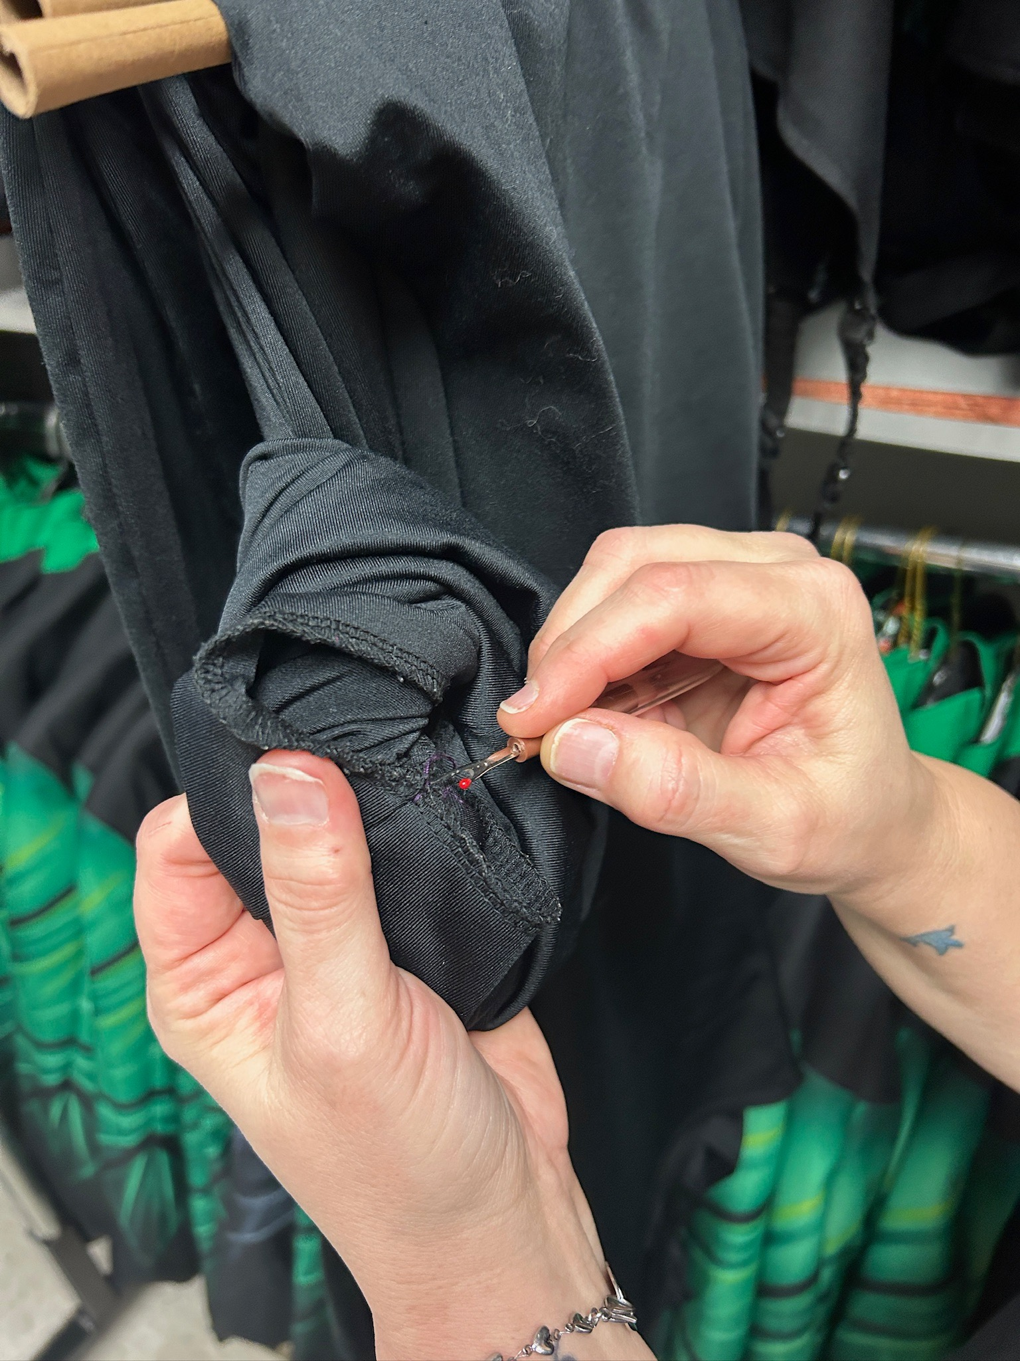
Join the Uniforms Volunteer Team
Assist with marching and/or concert uniform fitting, hemming, distribution, and check-in

Slide 14
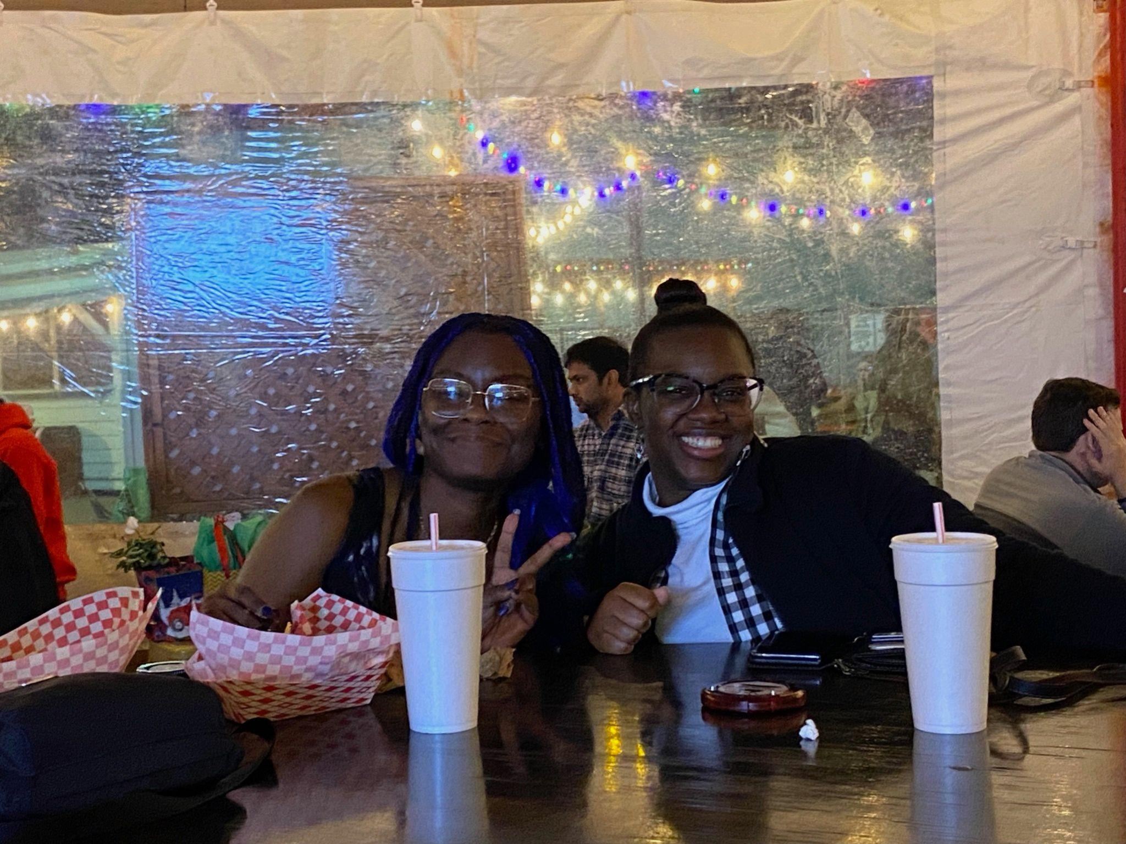
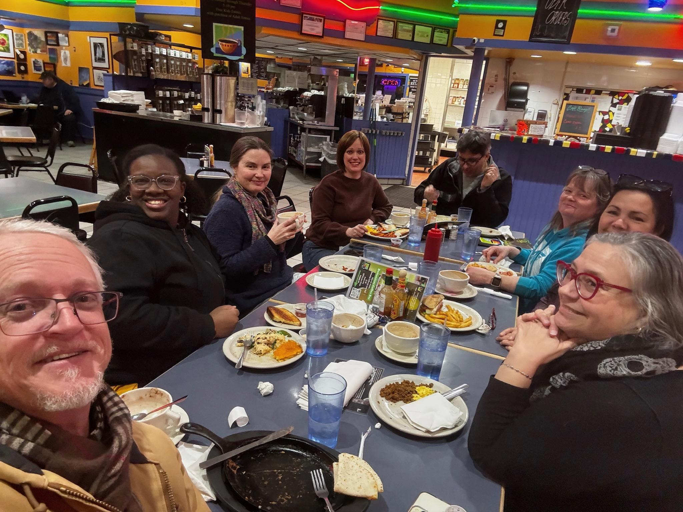
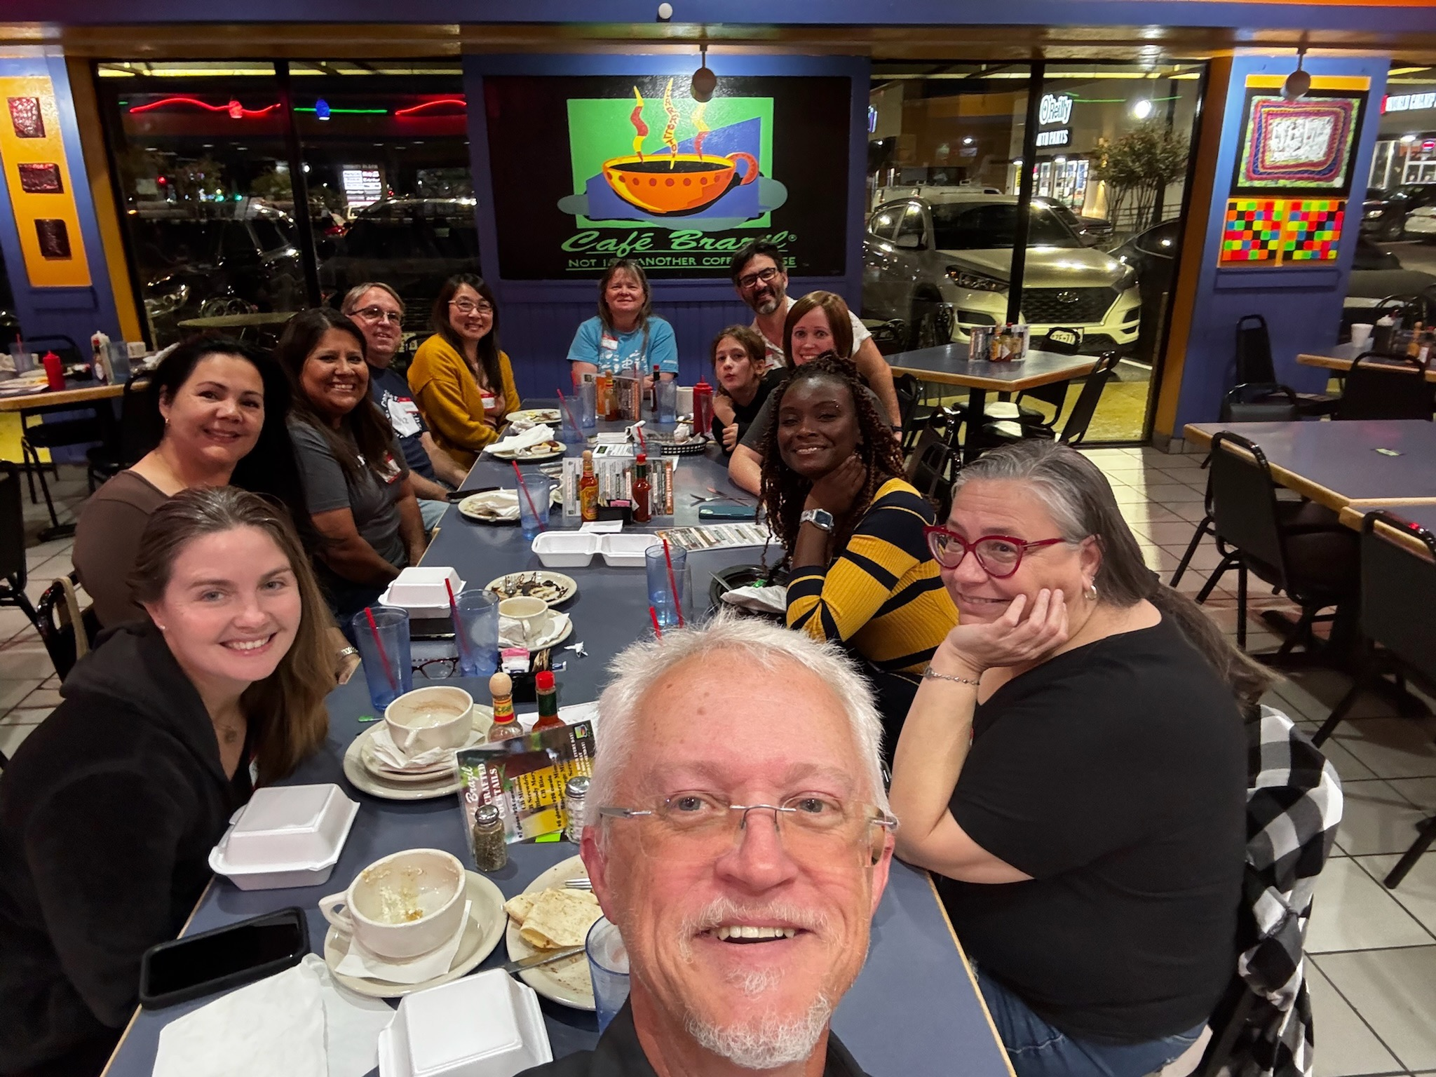
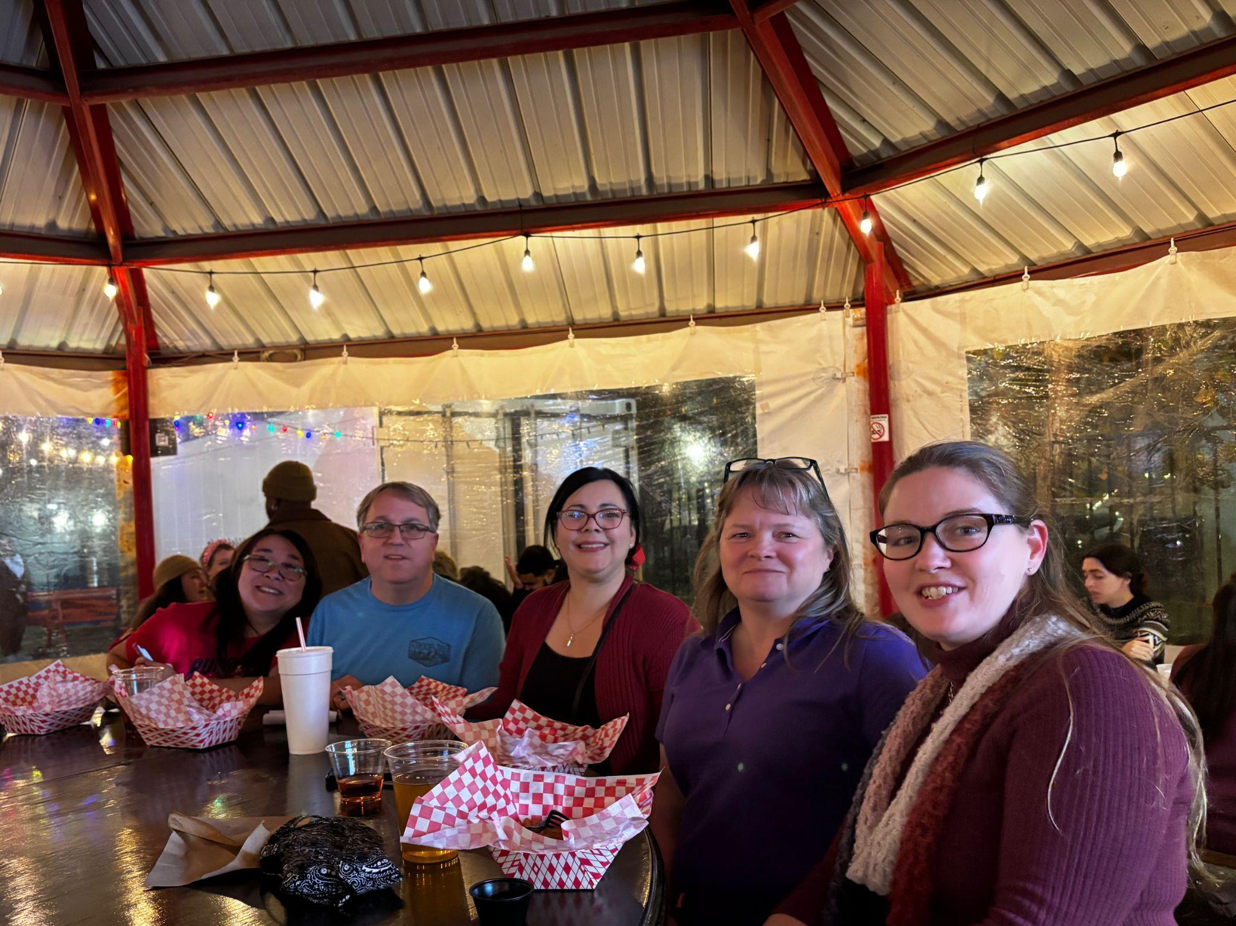
Attend Band Volunteer Socials

Slide 15
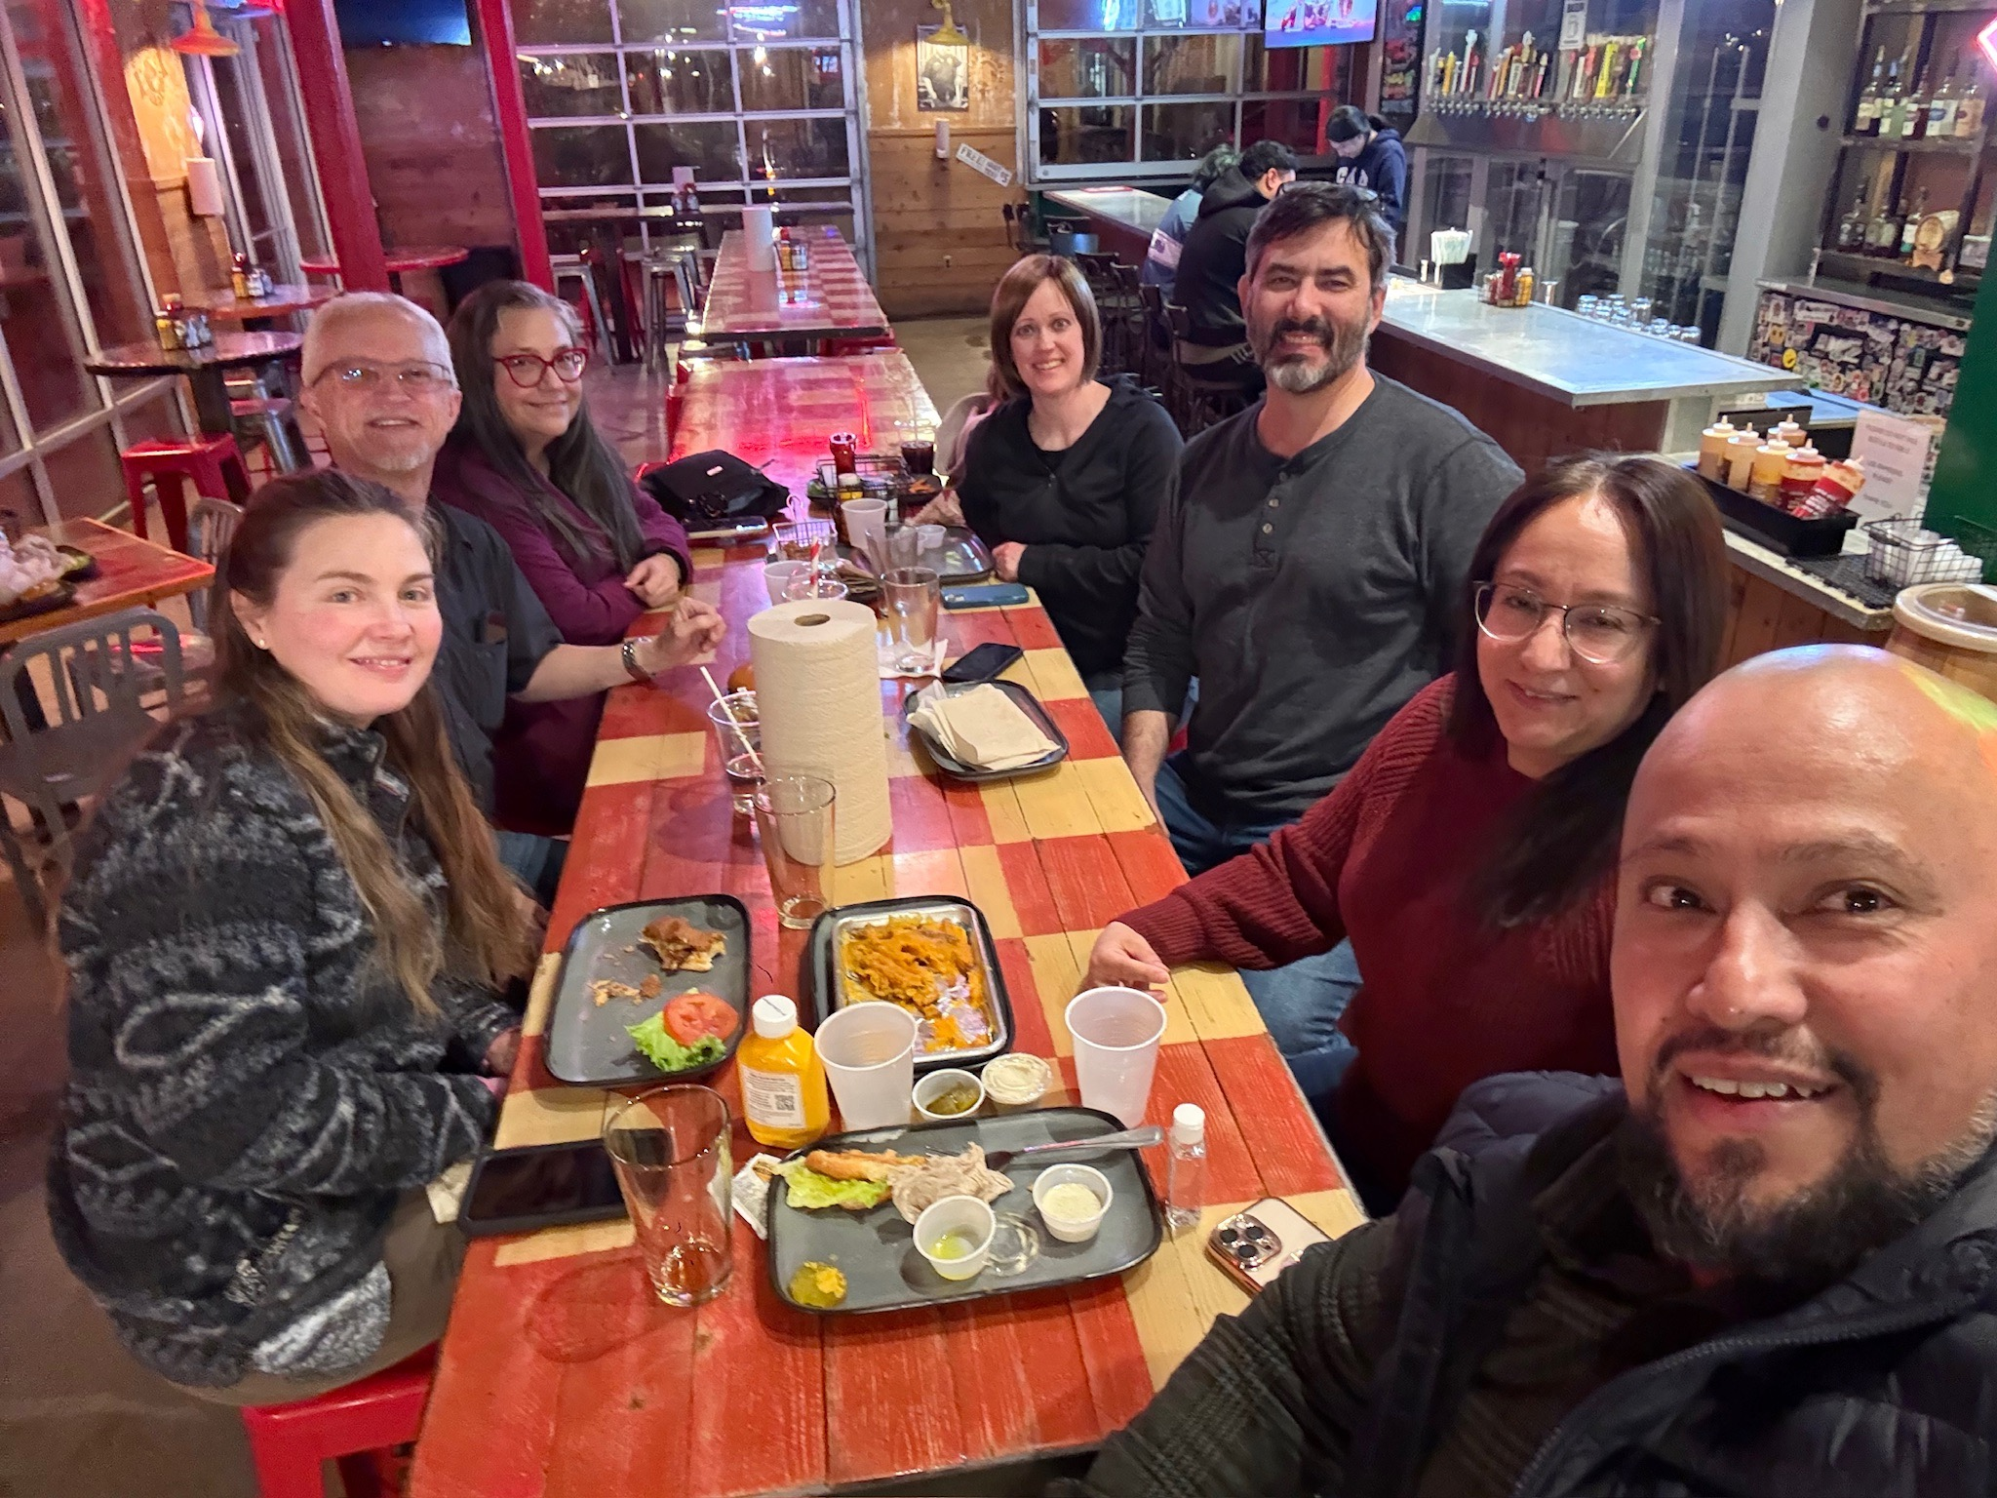
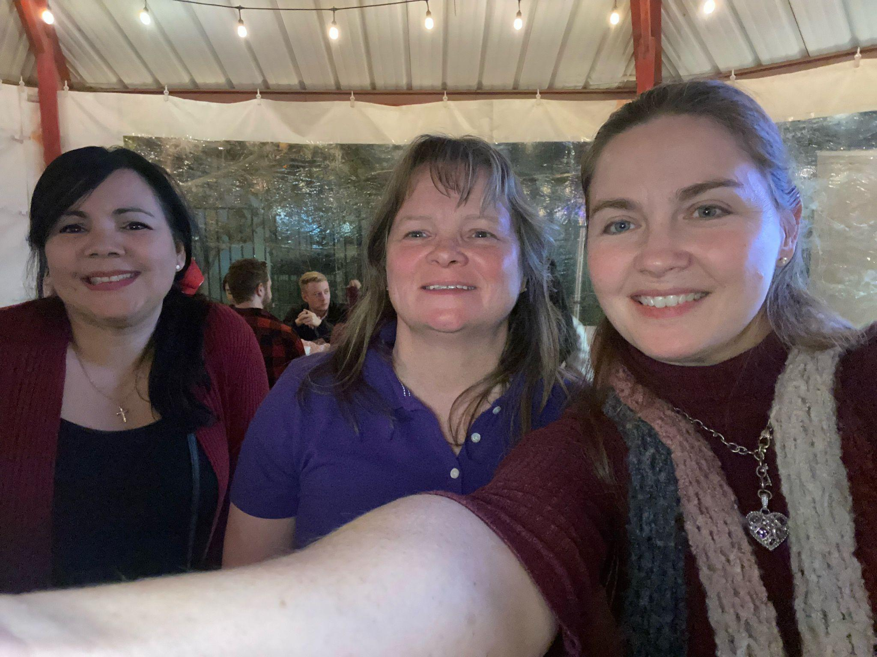
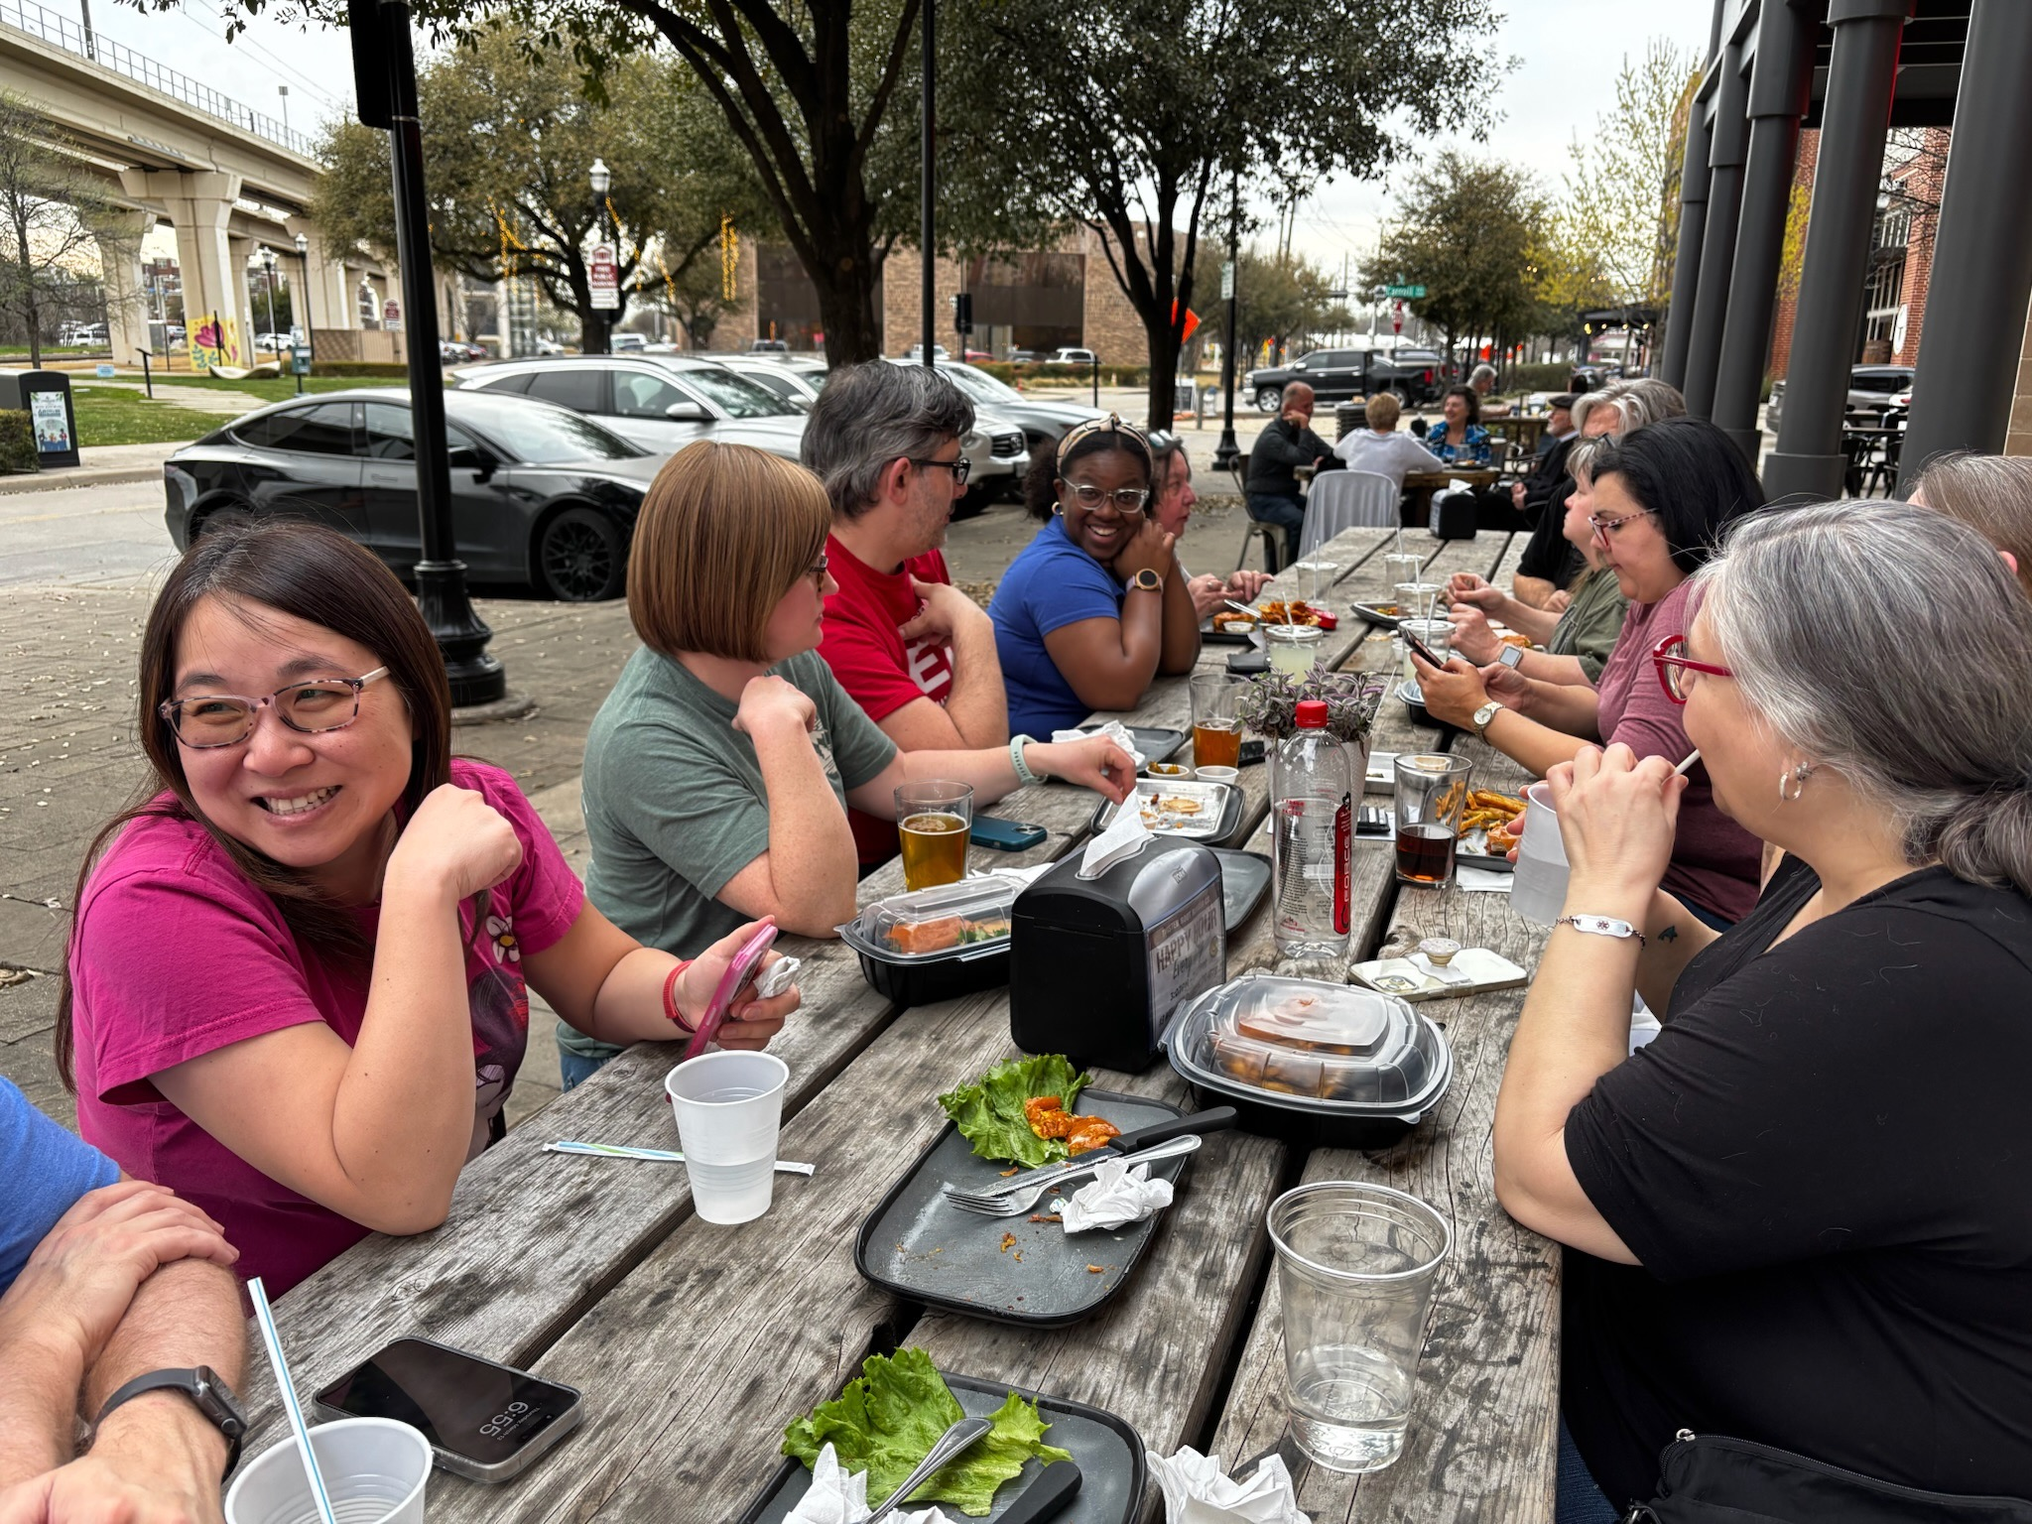
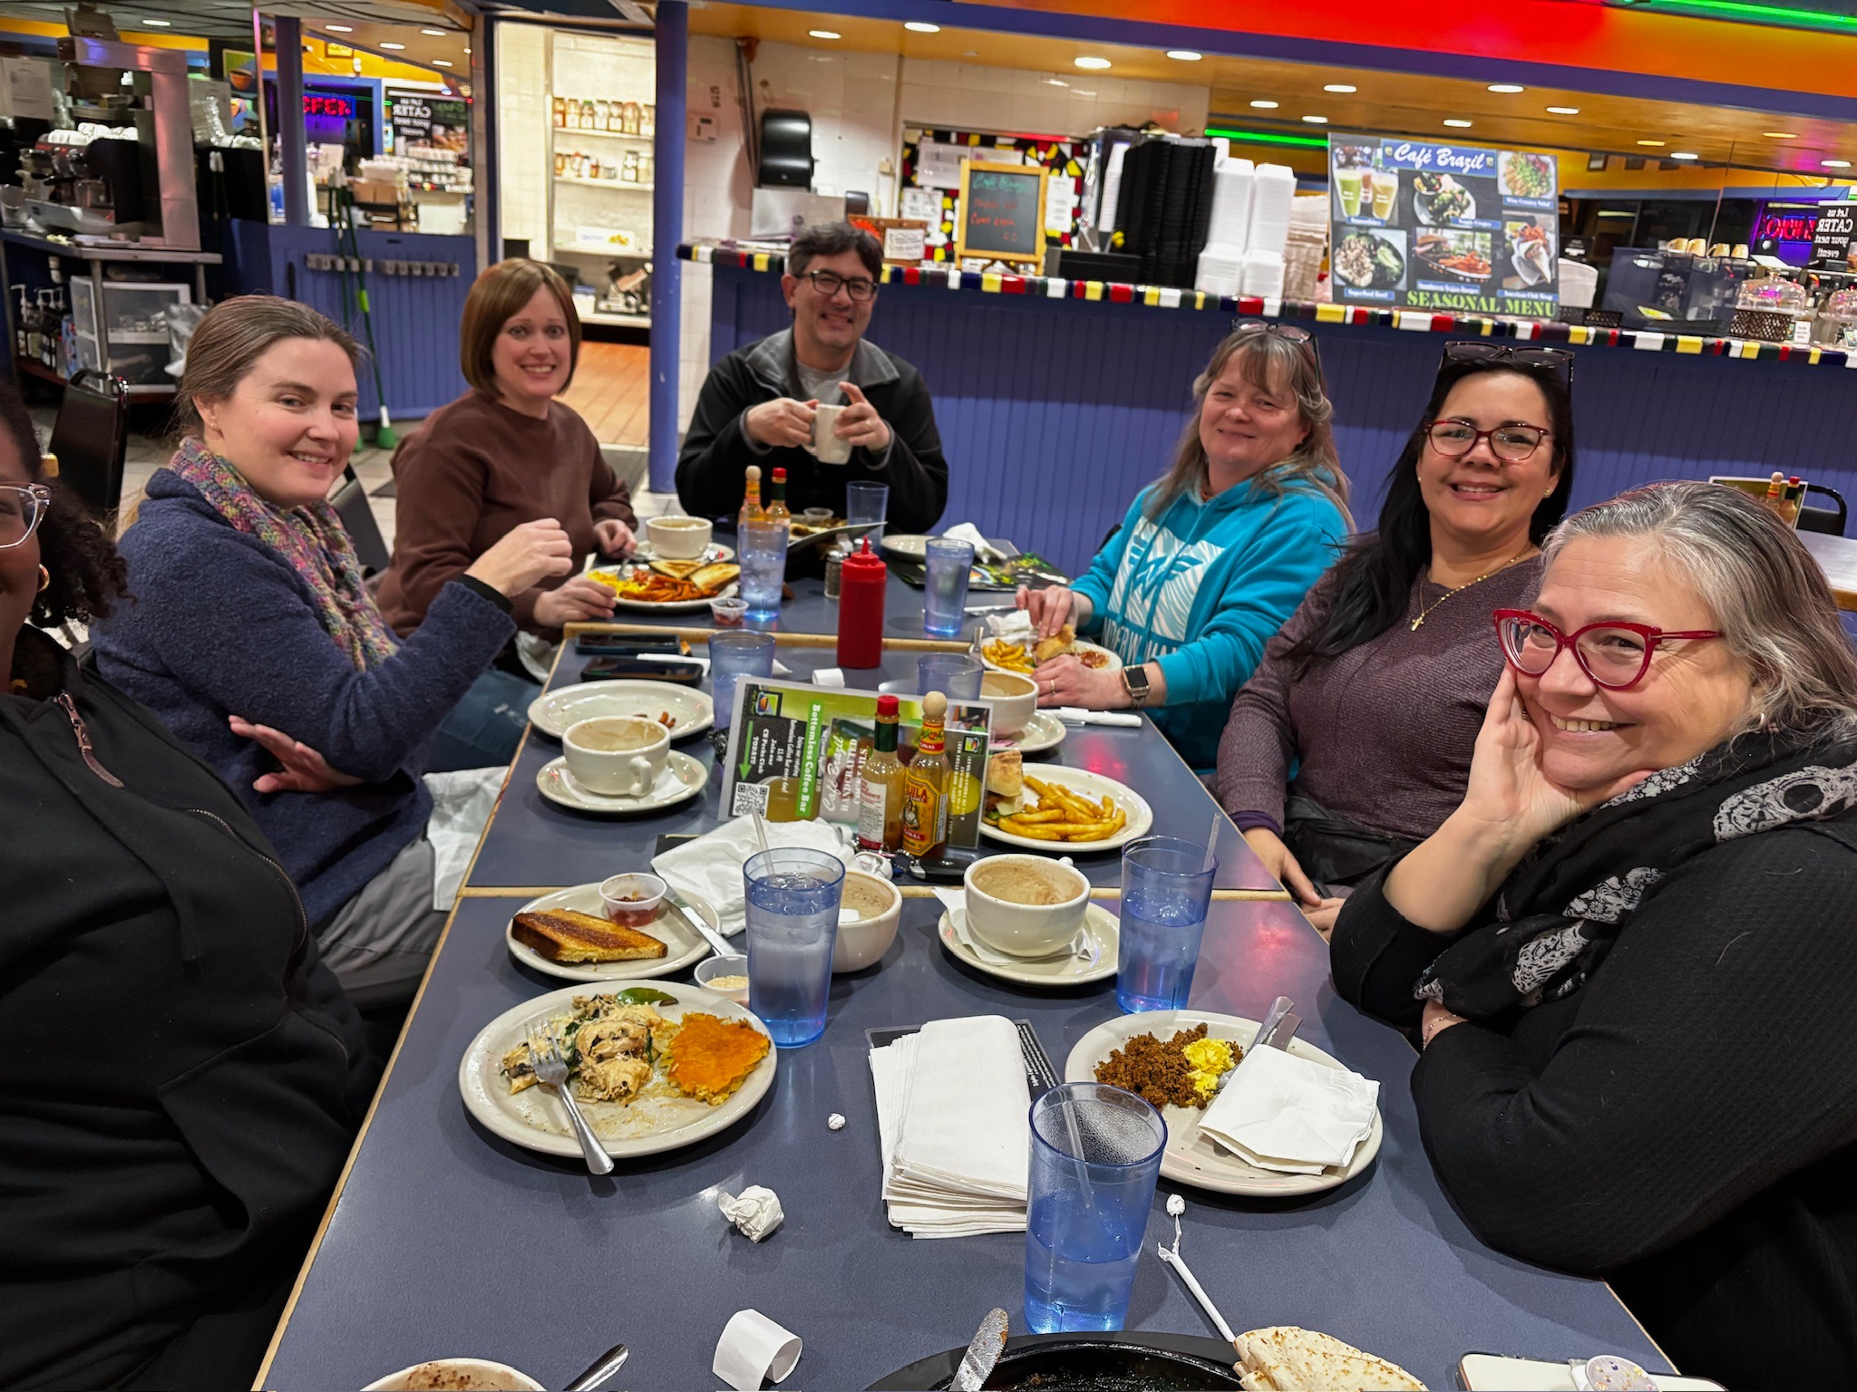
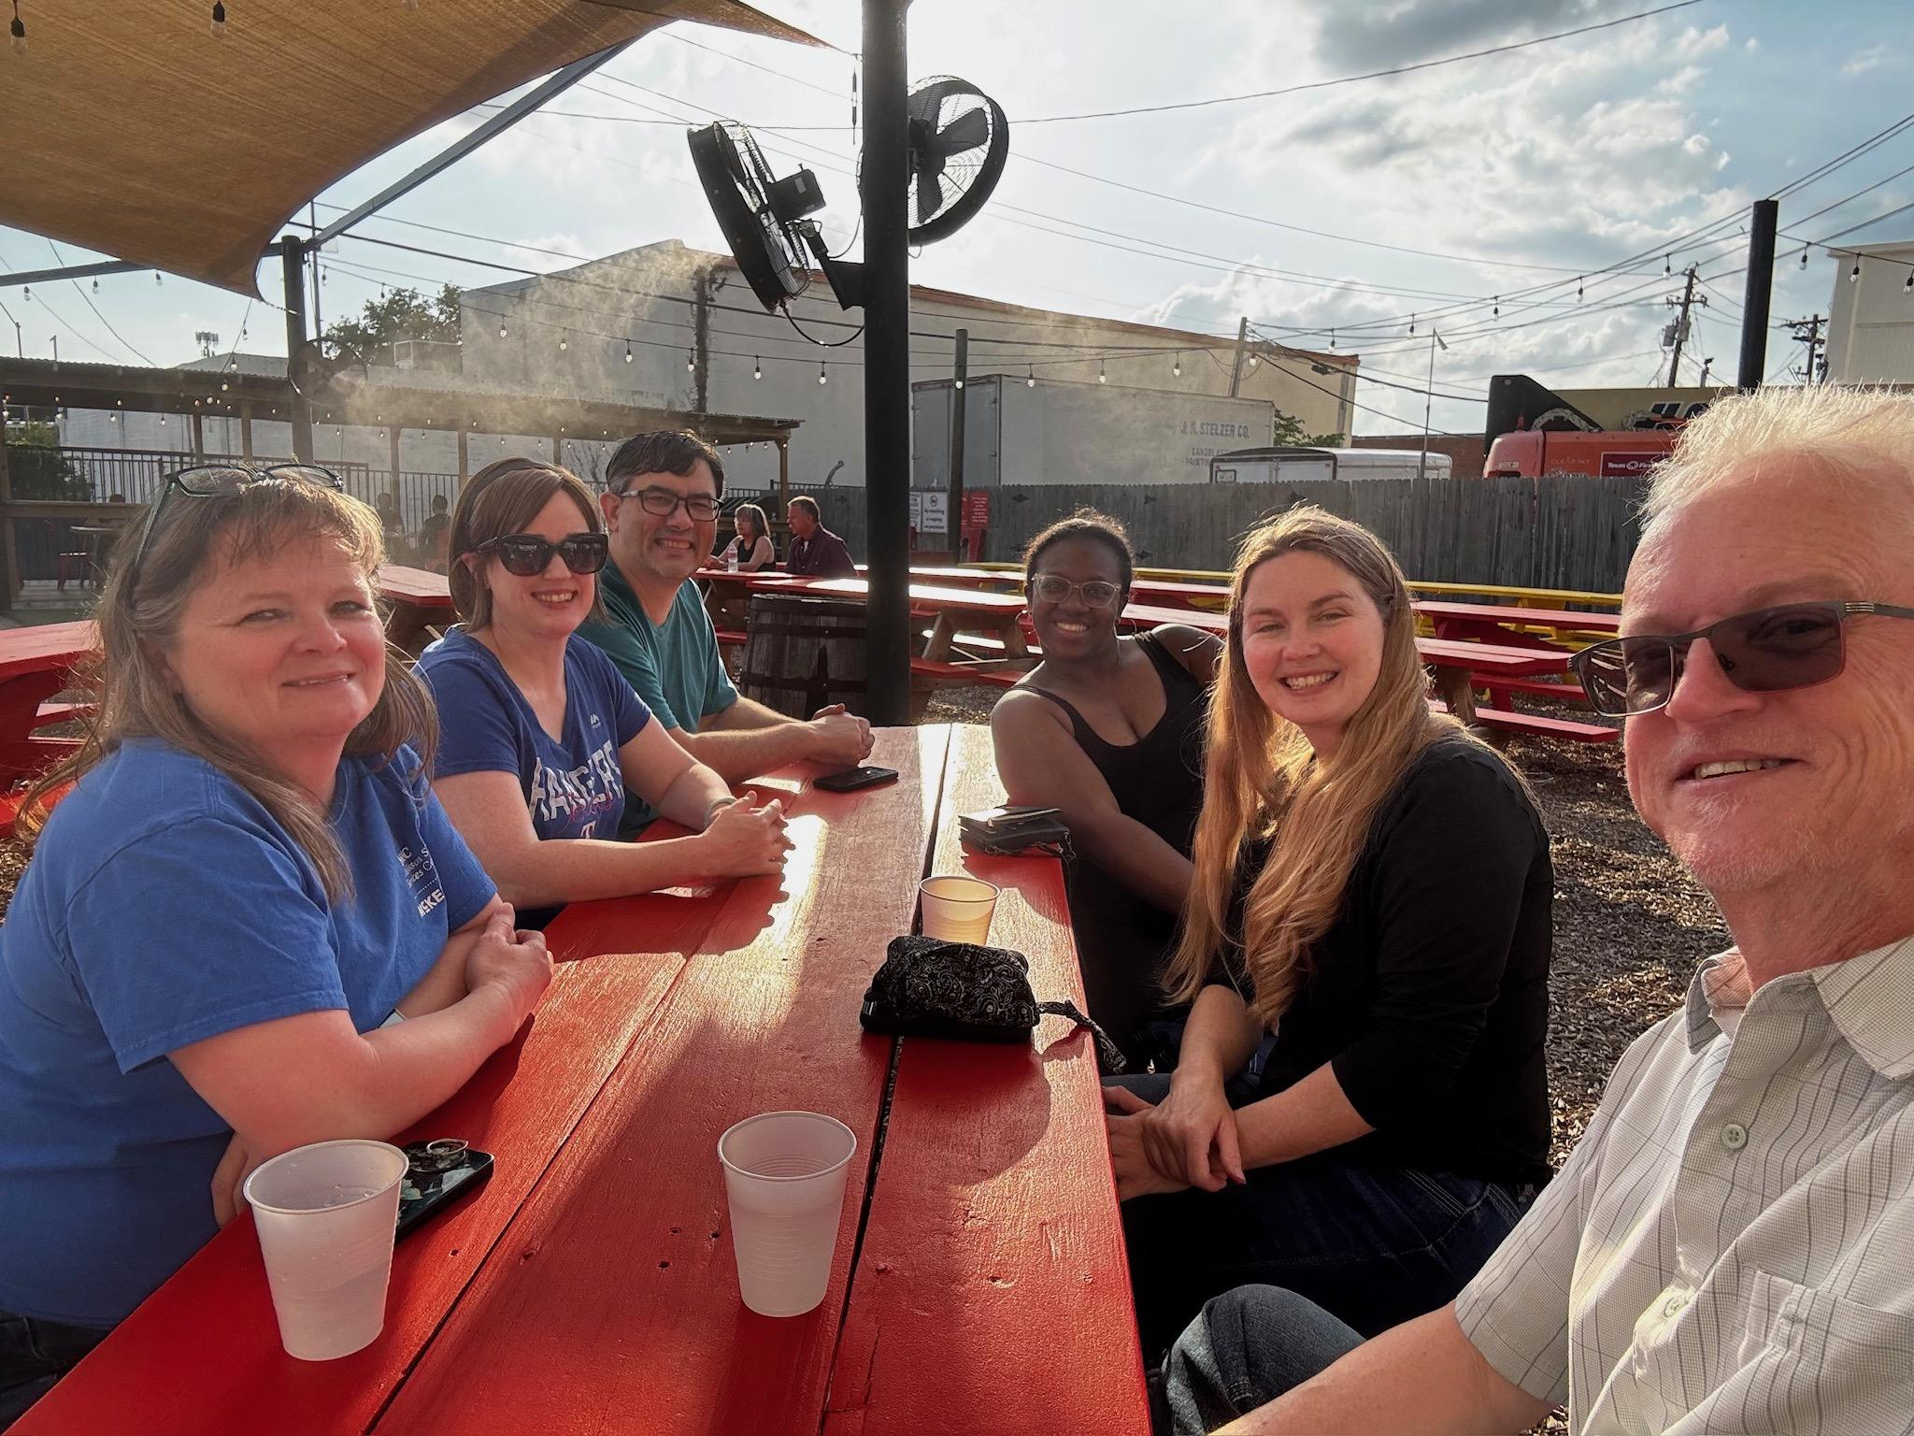
Attend Band Volunteer Socials

Slide 16

Getting involved with the Trojan Band is a fun and rewarding experience. Please fill out our volunteer interest form today, and someone will contact you with more information. Thank you!
Volunteer Opportunities
Sign Up Today!

