Slide 1

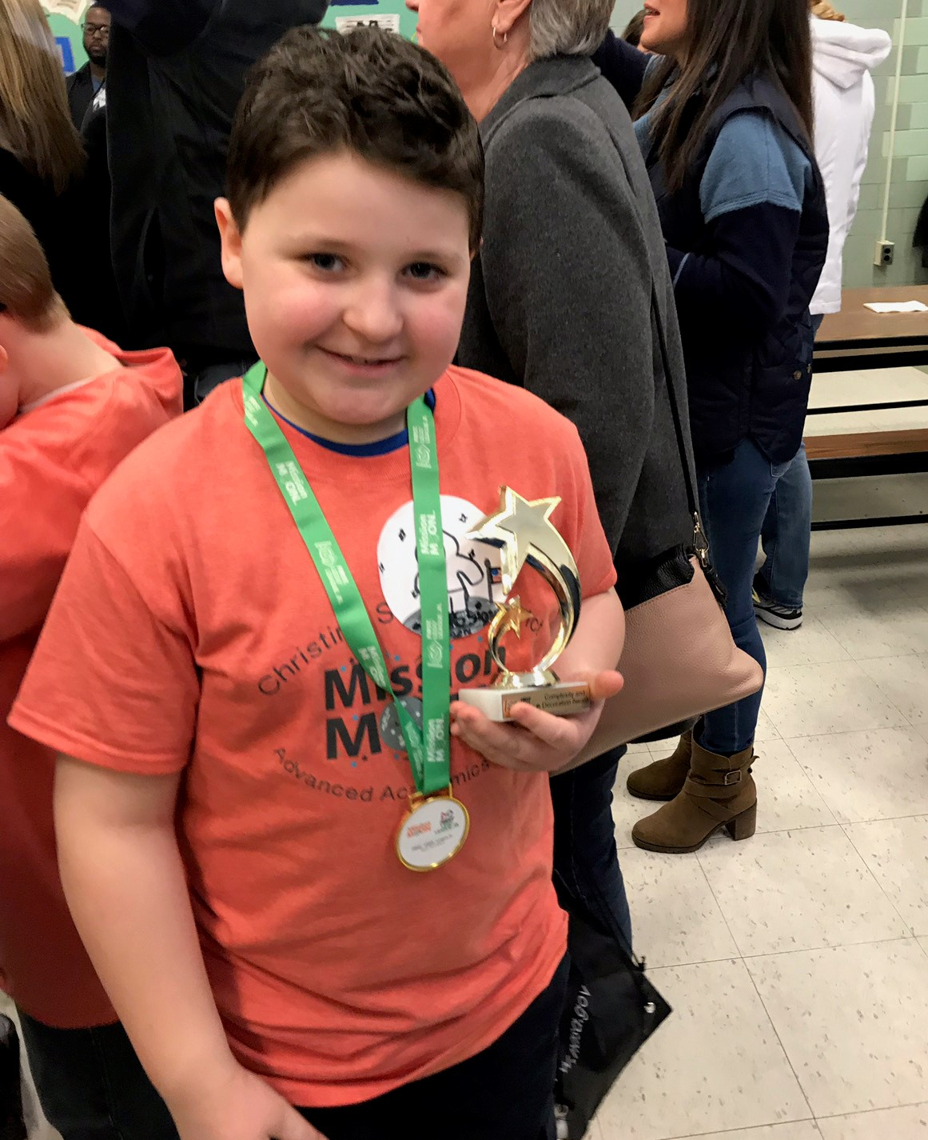
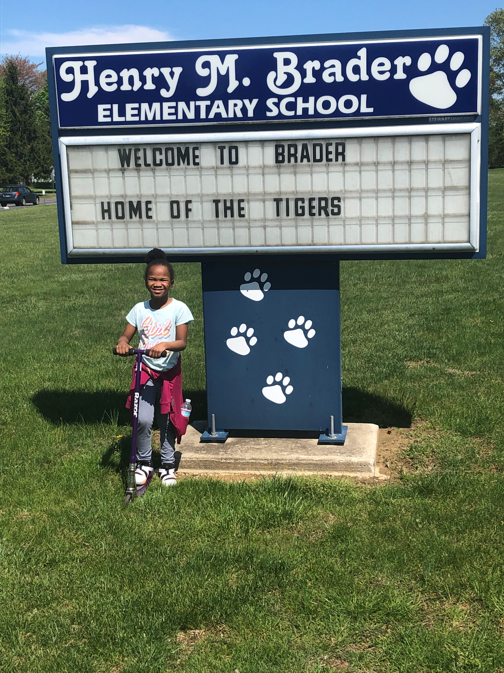

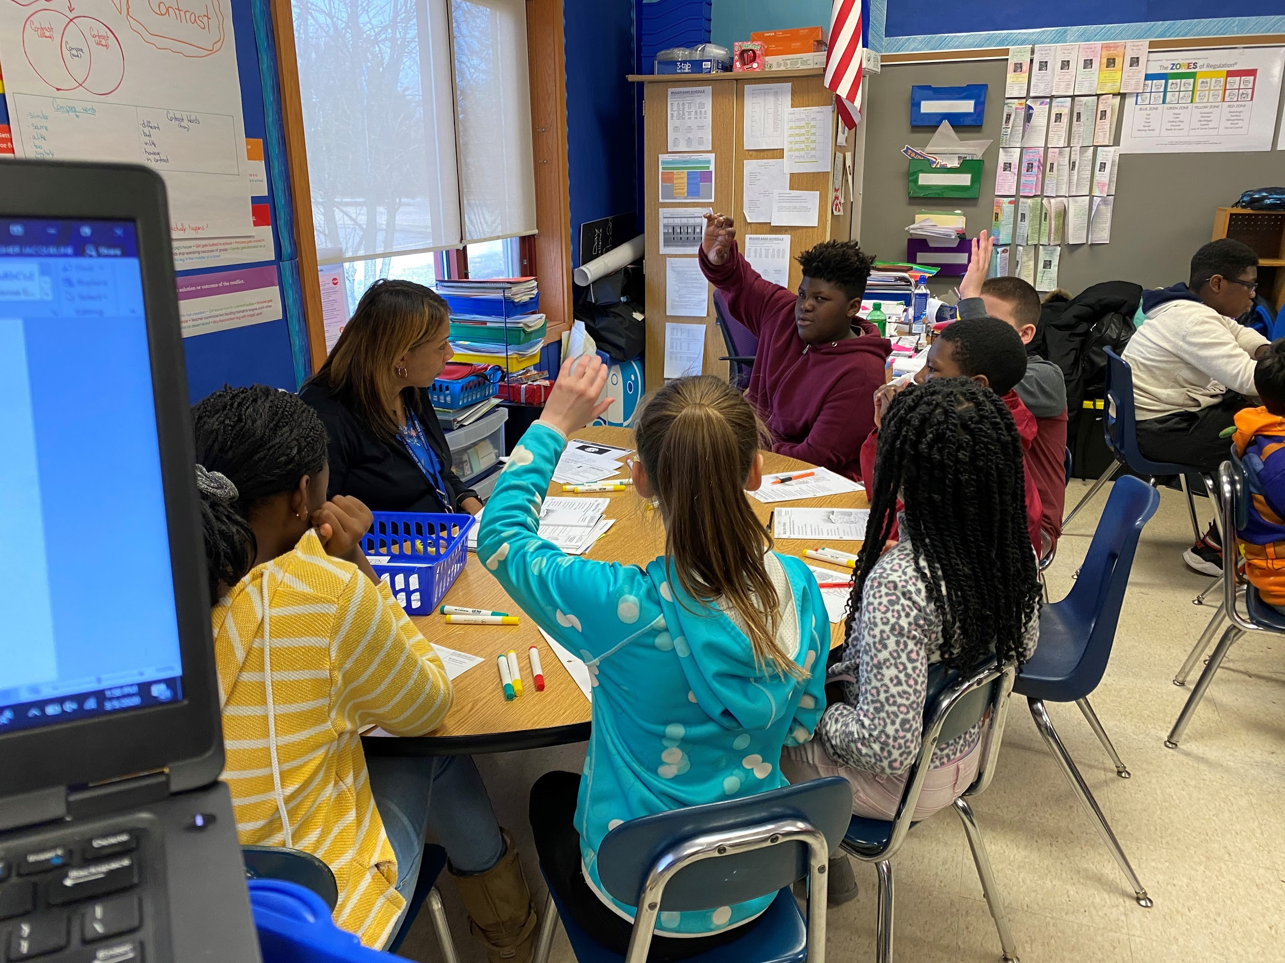
WE ARE
Brader Elementary School
Home of the Brader Tigers

Slide 2
Title I
Parent Information Meeting
Henry M. Brader Elementary School
September, 2021

Slide 3
Definition
Title I is short for the Title I, Part A of the Elementary and Secondary Education Act of 1965, Reauthorized by the No Child Left Behind Act of 2001and the Every Student Succeeds Act of 2015.
Federal Program to help students in our nation’s schools.
Provides funding for schoolwide programs to help ALL children.
Promotes family and community engagement and support.

Slide 4
ESSA Highlights
Advances equity for disadvantaged and high-need students
Requires that ALL students be taught to high academic standards that will prepare them to succeed in college and careers
Ensures that information is provided to educators, families, and students through statewide assessments that measure progress towards the standards
Helps support and grow local innovations and interventions
Sustains and expands investment in high-quality preschool
Maintains an expectation that there will be accountability for our lowest performing schools and where graduation rates are low over extended period of time

Slide 5
Title I Components
School Strategic Plan – Checklist
  School-wide Reform Strategies
  Instruction by Highly Qualified Teachers
  Family and Community Engagement
  Additional Support (interventions)
  School-Specific Transition Plans i.e. assisting preschool students with the transition from early childhood education programs to the elementary school.

Slide 6
Family and Community Engagement Policy
FACE is defined as the participation of the family and the community in regular, two-way and meaningful communication involving student academic learning and other activities. This includes ensuring that:
  Family and Community play an integral role in assisting their child’s learning
  Family and Community are encouraged to be actively involved in their child’s education at school
  Family and Community are full partners in their child’s education and are included, as appropriate in decision making

Slide 7
Family and Community Engagement (cont.)
….and on advisory committees to assist in the education of their child.
  School Improvement Process
  PBS Committee
  Monthly Newsletters
  Parent Link
  Invitations to Events
  PTA Meetings/PAC Meetings
  School/Community Functions
  Parent/Teacher Conferences

Slide 8
Family and Community Engagement (cont.)
  Surveys
  Open House
  Back to School Nights
  Parent Newsletter
  Holding Annual Title I Meeting
  Parent Nights/Workshops
  Progress Reports
  Report Cards
  Bilingual Assistance and Communications

Slide 9
Do You Know Your Rights?
As a parent of a student attending a Title I school, you have the following rights:
  You can schedule regular meetings with your children’s teachers or school administrators.
  You can obtain information on the level of achievement of your child on each state academic assessment.
  You can obtain certain information on the professional qualifications of your child’s classroom teacher and paraprofessional providing services to your child.

Slide 10
Your Rights (cont.)
You can file a complaint to the State of Delaware Department of Education (DDOE) if you believe we are violating Federal law or regulations.

Slide 11
School/District Responsibilities
Inform you about the rating of the school as determined each year by DDOE and why it received that rating
Inform you about programs occurring in the school that may benefit your child
Tell you if you have the opportunity to choice your child to a different school
Inform you if free after-school tutoring is available for your child

Slide 12
School/District Responsibilities (cont.)
Provide you with opportunities to be involved in school and district improvement efforts, including improvement planning
Provide timely notices to you if your child has been assigned to or taught for four or more consecutive weeks by a teacher who is not highly qualified
Provide you with the school’s parental involvement policy and school/parent compact and post them on the school’s website*

Slide 13
School/District Responsibilities (cont.)
Make notifications in other languages for the parents of limited English proficient students, including how these parents can be involved and how they can help their children achieve at high levels
Have monthly meetings where you can learn more about your rights and ask questions about Federal law and our programs

Slide 14
For more information …..
District Parent Advisory Committee (PAC)
PAC (Parent Advisory Council)
The District Parent Advisory Council (CSD-PAC) is comprised of parents from all district schools and programs, and is established to provide parental input on district activities. The Council meets to discuss and review family involvement initiatives and to ensure that the District and schools are in compliance of the law.
Contact: Ledonnis Hernandez
Phone: 302-552-2683
Email: ledonnis.hernandez@christina.k12.de.us

Slide 15
Questions?
Thank You for attending!

