Slide 1



Delaware Valley
School District
Information Session
Welcome!
Dr. Jayson Pope, Supervisor of Academic Services

Slide 2

Agenda
About Delaware Valley School District
Personalized Instruction, Quality Teaching
Outstanding Curriculum
Seamless Technology, Superior Learning
Questions and Answers

Slide 3
About
Delaware Valley
School District

Slide 4

Delaware Valley School District Cyber Academy
Image by Photographer's Name (Credit in black type) or
Image by Photographer's Name (Credit in white type)
All DVCA students are considered Delaware Valley School District students- please refer to all student handbooks, district policies, etc.
Enrollment is handled on a semester-by-semester basis. Failure to meet satisfactory academic/attendance expectations may lead to a re-evaluation/removal from the program.
Your school counselor is your number one point of contact for questions or concerns. Students with IEP’s will also be assigned a case manager.
DVCA students are eligible to participate in all extra-curricular activities but are not permitted to split their academic day between cyber/brick and mortar schooling.
You are entitled to use DVSD hardware/software but are permitted to use your own devices.
Presentation Title Arial Bold 7 pt
4

Slide 5
About
Pearson Connexus
Notes:
[SCHOOL NAME] introduces Pearson

Slide 6

We Offer
Image by Photographer's Name (Credit in black type) or
Image by Photographer's Name (Credit in white type)
An easy-to-use online learning system
Hundreds of courses designed for college and career readiness
Individual attention
A safe and secure learning environment
Observer Resources portal
Presentation Title Arial Bold 7 pt
6
Notes:
Pearson
We offer a world-class educational experience for you and your student through an easy-to-use online learning system called Pearson Connexus. Our robust curriculum includes hundreds of core, advanced, CTE, and elective courses.
Pearson Connexus is designed for your child to receive individualized attention in a safe and secure learning environment through flexible course offerings and an exceptional curriculum.
We know its important to have resources and support to facilitate confidence and comfortability while navigating our platform. So, we have a parent support resource center to help facilitate an individualized learning approach for your child.

Slide 7


Students We Serve
Medically fragile
Homeschooled students
Prefer home-based learning
Need more flexible scheduling
Notes:
Pearson [Exclude for orientations/Include for info sessions]
Over the last couple of years, many of us have seen the shift from a traditional learning model to one that consists of online learning from home.
We are dedicated to serving students from diverse backgrounds, learning styles, and lifestyles, including medically fragile, homeschooled students, and those that simply enjoy learning from home.
With Pearson Connexus, we have seen students thrive while learning online and maintaining active extracurricular schedules, travel, and everything in between.

Slide 8
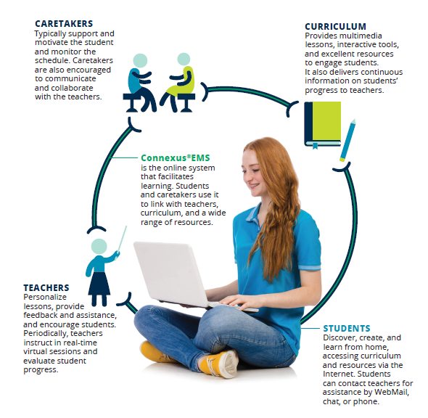
Our Learning Model: Student-Centered
Notes:
Pearson
Our learning model at Pearson is student-centered and consists of caretakers, or parents, as learning coaches, our curriculum, our platform, and our teachers.
Parents or caretakers will serve as the Learning Coach for your student and has an important role in the learning process through student guidance, support, motivation, and regular communication with teachers within the learning environment.

Slide 9
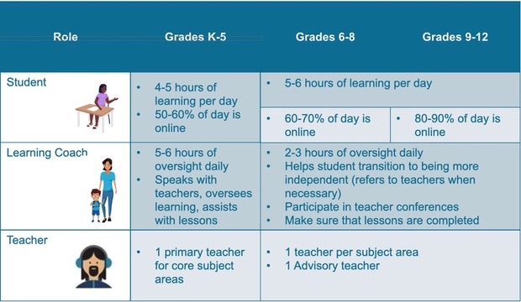
Daily Schedule
Notes:
Pearson
As we think about best practices in supporting your students as parents and caretakers in a learning coach capacity, we wanted to break out those roles a bit more. For k-5, your student can expect 3-5 hours of learning per day, with 50-60% of that day being virtual.
Our learning coaches can expect anywhere from 5-6 hours of oversight per day. This can look like a variety of things, including getting students ready for the day, clearing the student workspace to facilitate learning, and helping with opening and navigating lessons or activities. K-5 students are assigned 1 primary teacher that covers all of their core areas, including science, social studies, language arts, and math.
Our students in 6-8th grade can expect to complete at least 5-6 hours of learning within the platform, with 60-70% of their day being virtual.
The learning coach can expect at least 2-3 hours of oversight and will touch base with their student at the end of the day to ensure that they are prepared for the next day's work. Our students in 6-8 have one advisory teacher and 1 teacher per subject area.
Our students in 9-12 grade can expect 5-6 hours of learning with 80-90% of their day being virtual. The learning coach is more hands off but are there to ensure that the student is staying on pace with their performance.
They encourage their student to work independently and participate in synchronous activities that are provided by their teachers.
The learning coach can also ensure that lessons are completed through evaluating if key concepts and objectives of their courses are being understood. Grades 9-12 have one advisory teacher with one teacher per subject. The support from the learning coach will depend on each particular student and their comfortability within the platform.

Slide 10
Synchronous Support
    Live Synchronous Classes/Live Lessons (K-12)
  Offered weekly for core courses; elective meeting frequency varies according to course
Live Literacy Sessions (K-2)
  Offered daily for students in grades kindergarten through second grade
Homeroom Huddle and DISH (Drop In and Say Hi) (K-5)
  Offered Mondays and Fridays as an opportunity to build community in the virtual classroom
Targeted Small Group Intervention Sessions (K-12)
  Offered weekly for small group intervention sessions focused on mastery of broader concepts
Teacher Time Sessions (K-12)
  Offered a minimum of three hours per week for students to drop in individually or work in small groups with their teacher
Student/Teacher 1:1 (K-12)
  Available by appointment
Advisory Teacher (Full Time Students 6-12)
  Available Monday – Friday on demand and by appointment instructional support in the core content areas
Live Tutor (*Add-on Service)
  Available Monday – Friday on demand and by appointment instructional support in the core content areas
  9am-5pm ET Monday-Thursday: Science, English, Social Studies (Elementary)
  9am-9pm Monday-Thursday: Math /9am-5pm ET Friday
Notes:
Pearson
There are a variety of synchronous support opportunities available for your student. Go through each bullet. Core meetings 1x per week per subject, electives meet 1-2x per month depending on the course.
Live literacy can be thought of as daily language arts support for k-2.
Huddle and DISH are great ways to build community and comradery amongst students as they can connect with their classmates and teachers.

Slide 11
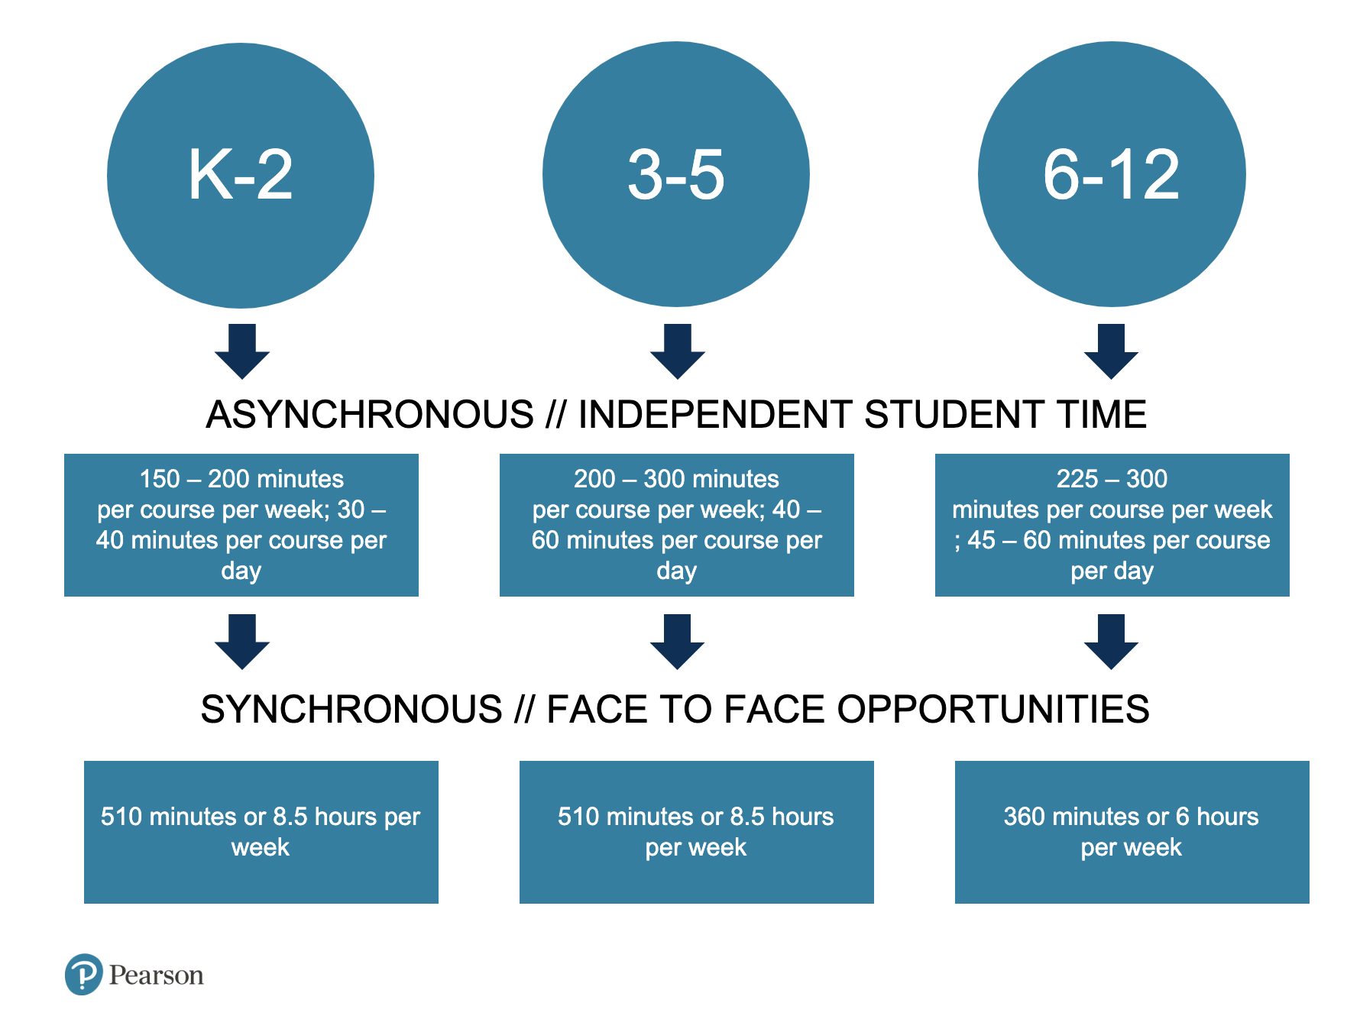
Synchronous and Asynchronous Learning
Notes:
Pearson
To breakdown the difference between those asynchronous and synchronous opportunities mentioned in the last slide, asynchronous or independent time rolls up for K-2 as 40 minutes, 60 minutes for 3-5, and 45-60 minutes for 6-12.
Face to face opportunities for K-5 is about 8.5 hours per week or 510 minutes and 6-12 is 6 hours or 360 minutes.

Slide 12
Outstanding
Curriculum
Notes:
Pearson
Our program offers an exceptionally comprehensive and flexible curriculum that is aligned with state standards.

Slide 13


Learning that Empowers
Students for Life
We foster:
Critical thinking and problem-solving skills
Communications skills
Creativity and innovation
Collaboration
Notes:
Pearson
Pearson Connexus's online learning environment is designed for anywhere, anytime learning. Our online curriculum is a highly effective alternative to a traditional public or homeschool curriculum. It's designed to help students gain the knowledge and thinking skills they'll need for life, work, and higher education. At each grade level, structured lessons are blended with self-paced learning to ensure that each student reaches his or her full potential.
These courses also develop skills in the important "four Cs" of Learning:
Critical thinking and problem solving
Communication
Creativity and innovation and
Collaboration

Slide 14


Variety of Core, World Language, CTE and Elective courses
Notes:
Pearson
Our core courses meet and exceed national and state standards.
These core courses include Language Arts for every grade level and a wide variety of Social Studies courses. There are traditional and advanced Mathematics courses plus a diverse range of Science and Technology courses.
Students will also have the opportunity to participate in CTE and elective courses.

Slide 15


Accessible for All
Students
WCAG 2.0 Compliant
  Technology can provide equal opportunity to all students, including students with disabilities.
Notes:
Pearson
We believe in providing an educational environment that removes barriers to a student’s opportunity to learn and the ability to demonstrate that learning. Web Content Accessibility Guidelines (WCAG) 2.0 covers a wide range of recommendations for making Web content more accessible.
By making content more accessible we are able to support a wider range of student populations that may have learning disabilities, cognitive limitations, limited movement, speech disabilities, photosensitivity, including blindness and low vision, deafness and hearing loss and combinations of these.

Slide 16
Seamless Technology,
Superior Learning
Notes:
Pearson
To provide a superior learning experience for students, seamless and intuitive technology is required.

Slide 17


CONNEXUS ®EMS
Online Learning Platform
Notes:
Pearson
I will now show a demonstration of the Pearson Connexus Platform. Start Demo here.

Slide 18

Support
Get Help When You Need It!
Orientation course for families
Tech support
Support from
teachers and staff
Observer Resources portal
Pearson Parent Power Hour (P3H)
18
Notes:
Many families choose online education to create an environment that’s not only safe, but also nurtures their values.
Our Orientation course is available within the student view of the platform for continuous support for questions that may arise throughout the school year.
Parents and caretakers can always reach out to their district point of contact for questions regarding program specifics.
Students and parents can also contact the teacher for their courses for questions or comments about the coursework that your student is working through.
Throughout the year, Pearson facilitates virtual events called Pearson Parent Power Hours that talk through additional information that is pertinent to the life of an online student using Pearson Connexus.
We make it easy for you to stay connected.
The Customer and Tech Support teams are available to assist with technical difficulties, login help, course navigation or anything regarding Connexus.
As a parent or caretaker, you have unlimited options for being involved in your student’s education.

Slide 19



Join Us:
Pearson Parent Power Hour (P3H) Series!
Pearson Teachers
9/20/2022- 3pm EST
9/22/2022- 11am EST
9/27/2022- 11am EST
9/29/2022- 3pm EST
October 2022
10/4/2022- 3pm EST
10/11/2022- 3pm EST
10/20/2022- 3pm EST
10/27/2022- 3pm EST
November 2022
11/1/2022- 3pm EST
11/10/2022- 3pm EST
11/15/2022- 3pm EST
Dates:
August 2022
8/2/2022- 3pm EST
8/11/2022- 3pm EST
8/16/2022- 3pm EST
8/25/2022- 3pm EST
8/30/2022- 12pm EST
September 2022
9/1/2022- 3pm EST
9/6/2022- 3pm EST
9/8/2022- 3pm EST
9/13/2022- 12pm EST
9/15/2022- 3pm EST
Our P3H series for partners utilizing Pearson teachers offers a deeper dive into topics that are designed for increasing student success. Stop by our live sessions to learn more about Pearson Connexus, tips and tricks for online student efficiency, support opportunities for students, and more!
Click here to join or scan below!

Slide 20

Unlock Your Child’s Potential!
For further information on enrollment please visit:
https://www.dvsd.org/Page/1
Notes:
Thank you for attending our family information session/orientation. I hope you are excited about the [SCHOOL NAME] and all that it offers your students.

Slide 21
Thank you!
Questions?
Notes:
We will now begin a q&a session to answer some of the questions that have been posed in the chat!

