Slide 1
The WellNest
Room E-119
Freedom’s Wellness Center

Slide 2
What is a Wellness Center?
A place for a short break
A place to destress and relax in a calming environment
A place to learn a new healthy coping skill
A place that allows students to be able to reset and return to their class/day

Slide 3
What a Wellness Center is not...
A place for class avoidance
A place for students to come in and socialize with friends
A place to make others feel uncomfortable or excluded
A place to do homework or assignments in an alternative setting
A place to eat or drink
A place for any disruptive behaviors

Slide 4
Purpose Statement
The Wellnest is a safe, calming space dedicated to students that need a moment to destress, refocus and self-regulate their mental well-being before returning to class.

Slide 5

No Phone Zone
Students will place their phone into a pocket chart and after their 15 minutes are up, they will be able to check out and grab their phone.

Slide 6
Policies and Procedures
The center is student driven- students should be the ones asking to go, but they must get approval from their teachers first
Students should be using good judgment when asking to visit, and should try to avoid missing important instruction, presentations or assessments
Students are responsible for anything missed in class while they are in the center
There will be a distinct and unique physical pass to allow students to, and from the wellness center, they will not be allowed to enter or leave without it.
There are a maximum of 8 students at a time in the Wellness center.
Students cannot come from the same period more than once a week.
Students will have exactly 15 minutes at the center to relax and de-stress.
Students will not be allowed to visit the center during the first and last 15 minutes of class.
Students can visit no more than twice a week.
If students want to see a counselor for a longer period of time, they should not come to the center but to their building.

Slide 7
What will students be able to do in the Wellness Center?
Speak to a Counselor (Ms. Zu- brief check in if she is available)
Participate in learning a new coping skill through an available activity
Take a break

Slide 8
Entering and Exiting the Wellness Center
Entering | Exiting
Sign in (ID#, Class Period, Teacher, Grade, Time In) | Clean up area
Turn in phone | Turn in timer
Grab timer (Set for 15 minutes) | Receive phone
Choose one option: Speak to Counselor, Coping Activity, Rest\Break | Take check-out survey
Students can lose privileges if they are not using the center correctly.

Slide 9


Coping Activities in the Wellnest
Mindful Coloring
Aromatherapy
Art Therapy
Water coloring
Puzzle
Chess
Fidgets
Practicing Gratitude
Journaling
"Love the Skin You're In"
Mini Chalk Boards
Relaxing on bean bags, chair or couch
Zen Gardens
Yoga

Slide 10

What the Physical Pass will look like:

Slide 11
On the Freedom Website under Counseling:
Freedom Wellnest Website

Slide 12
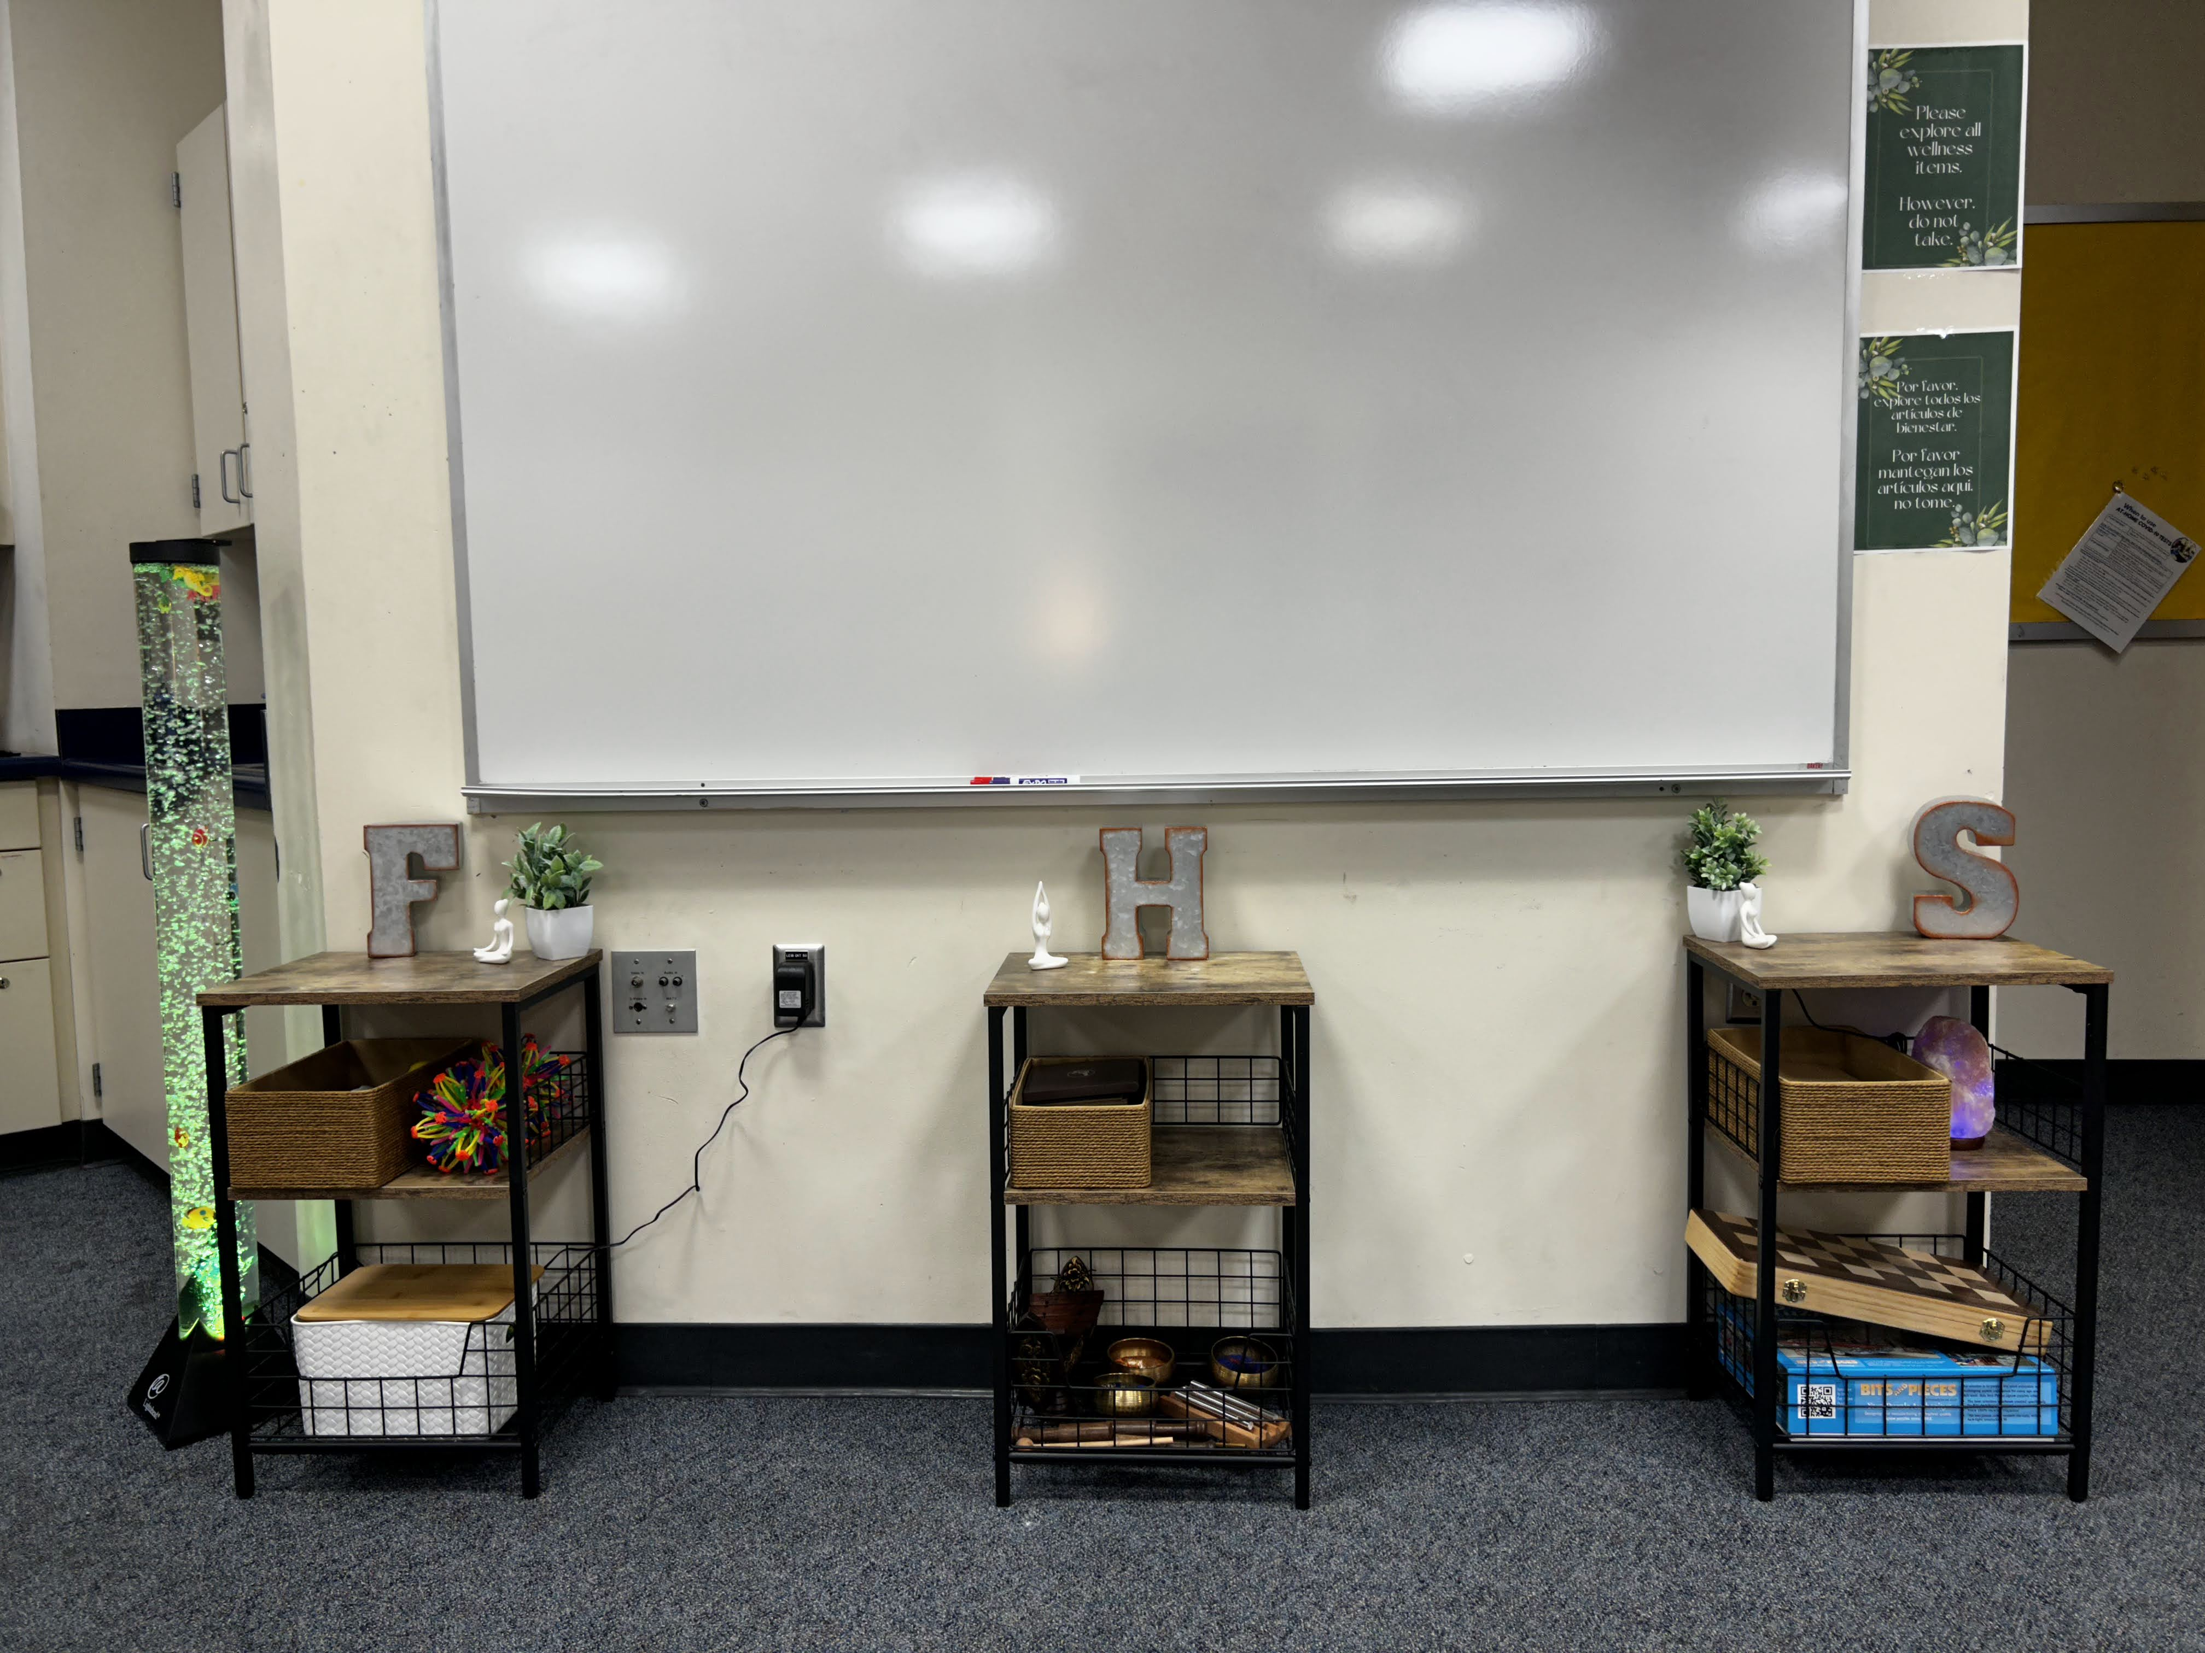
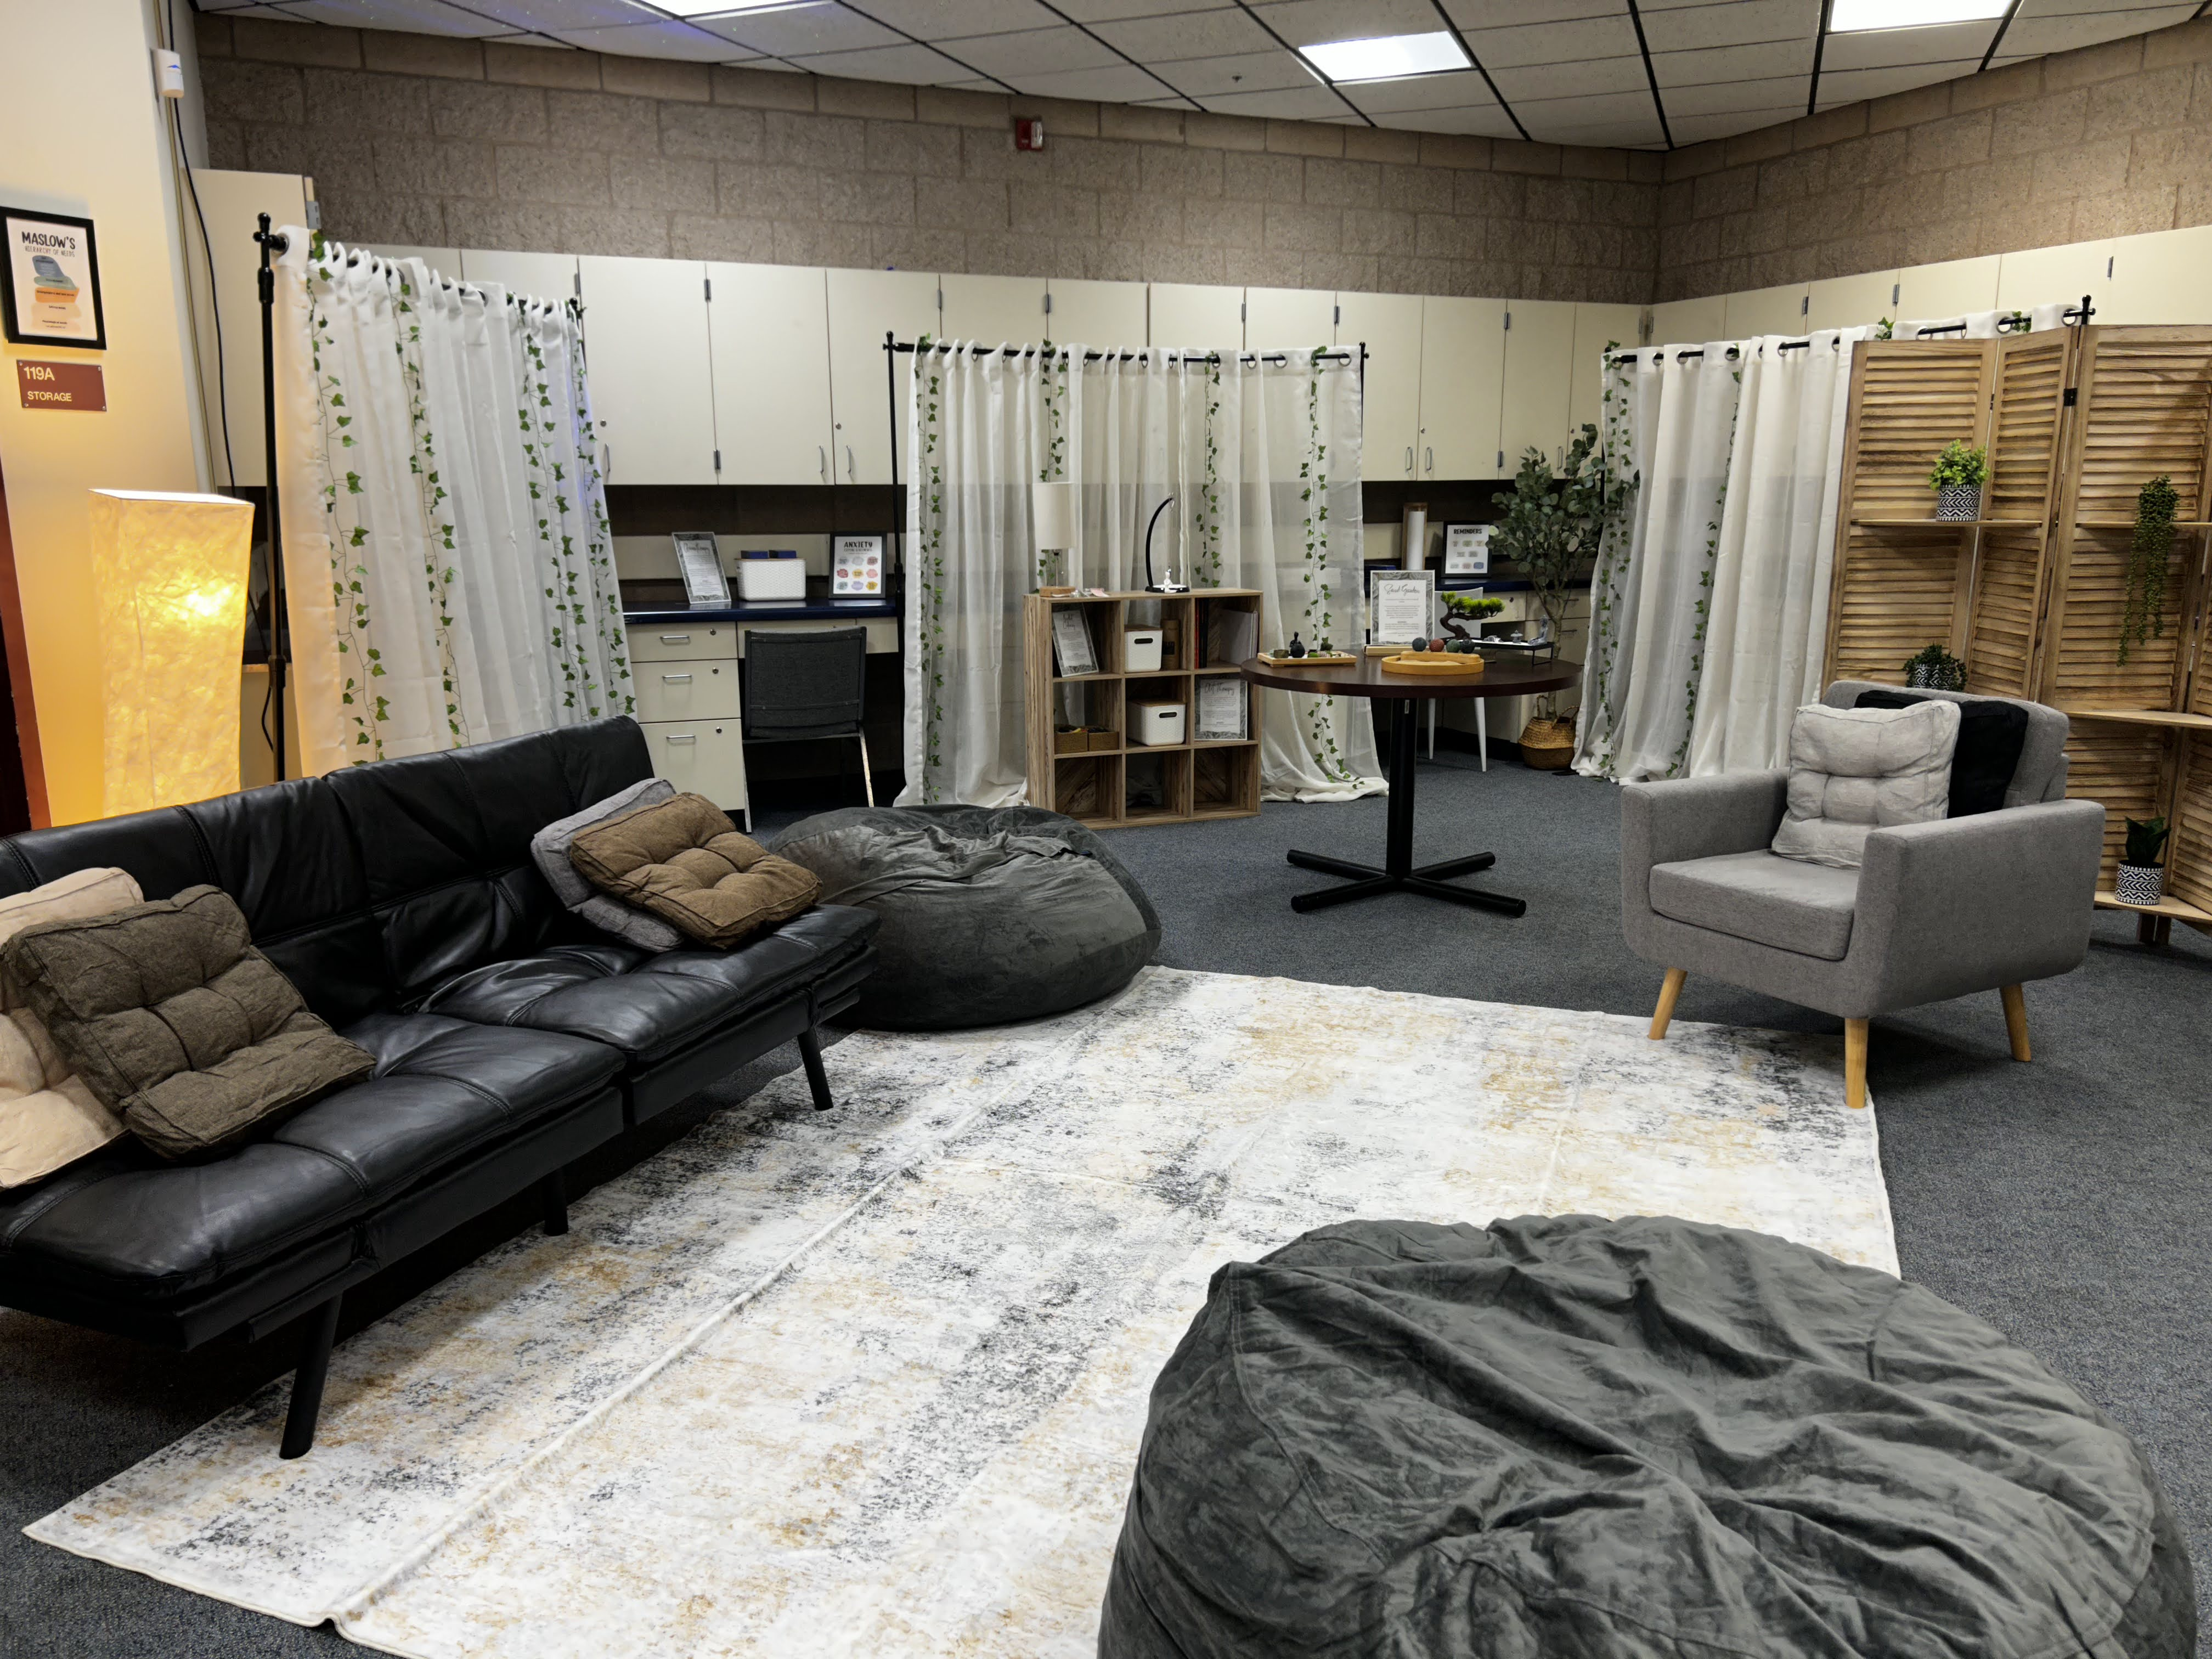
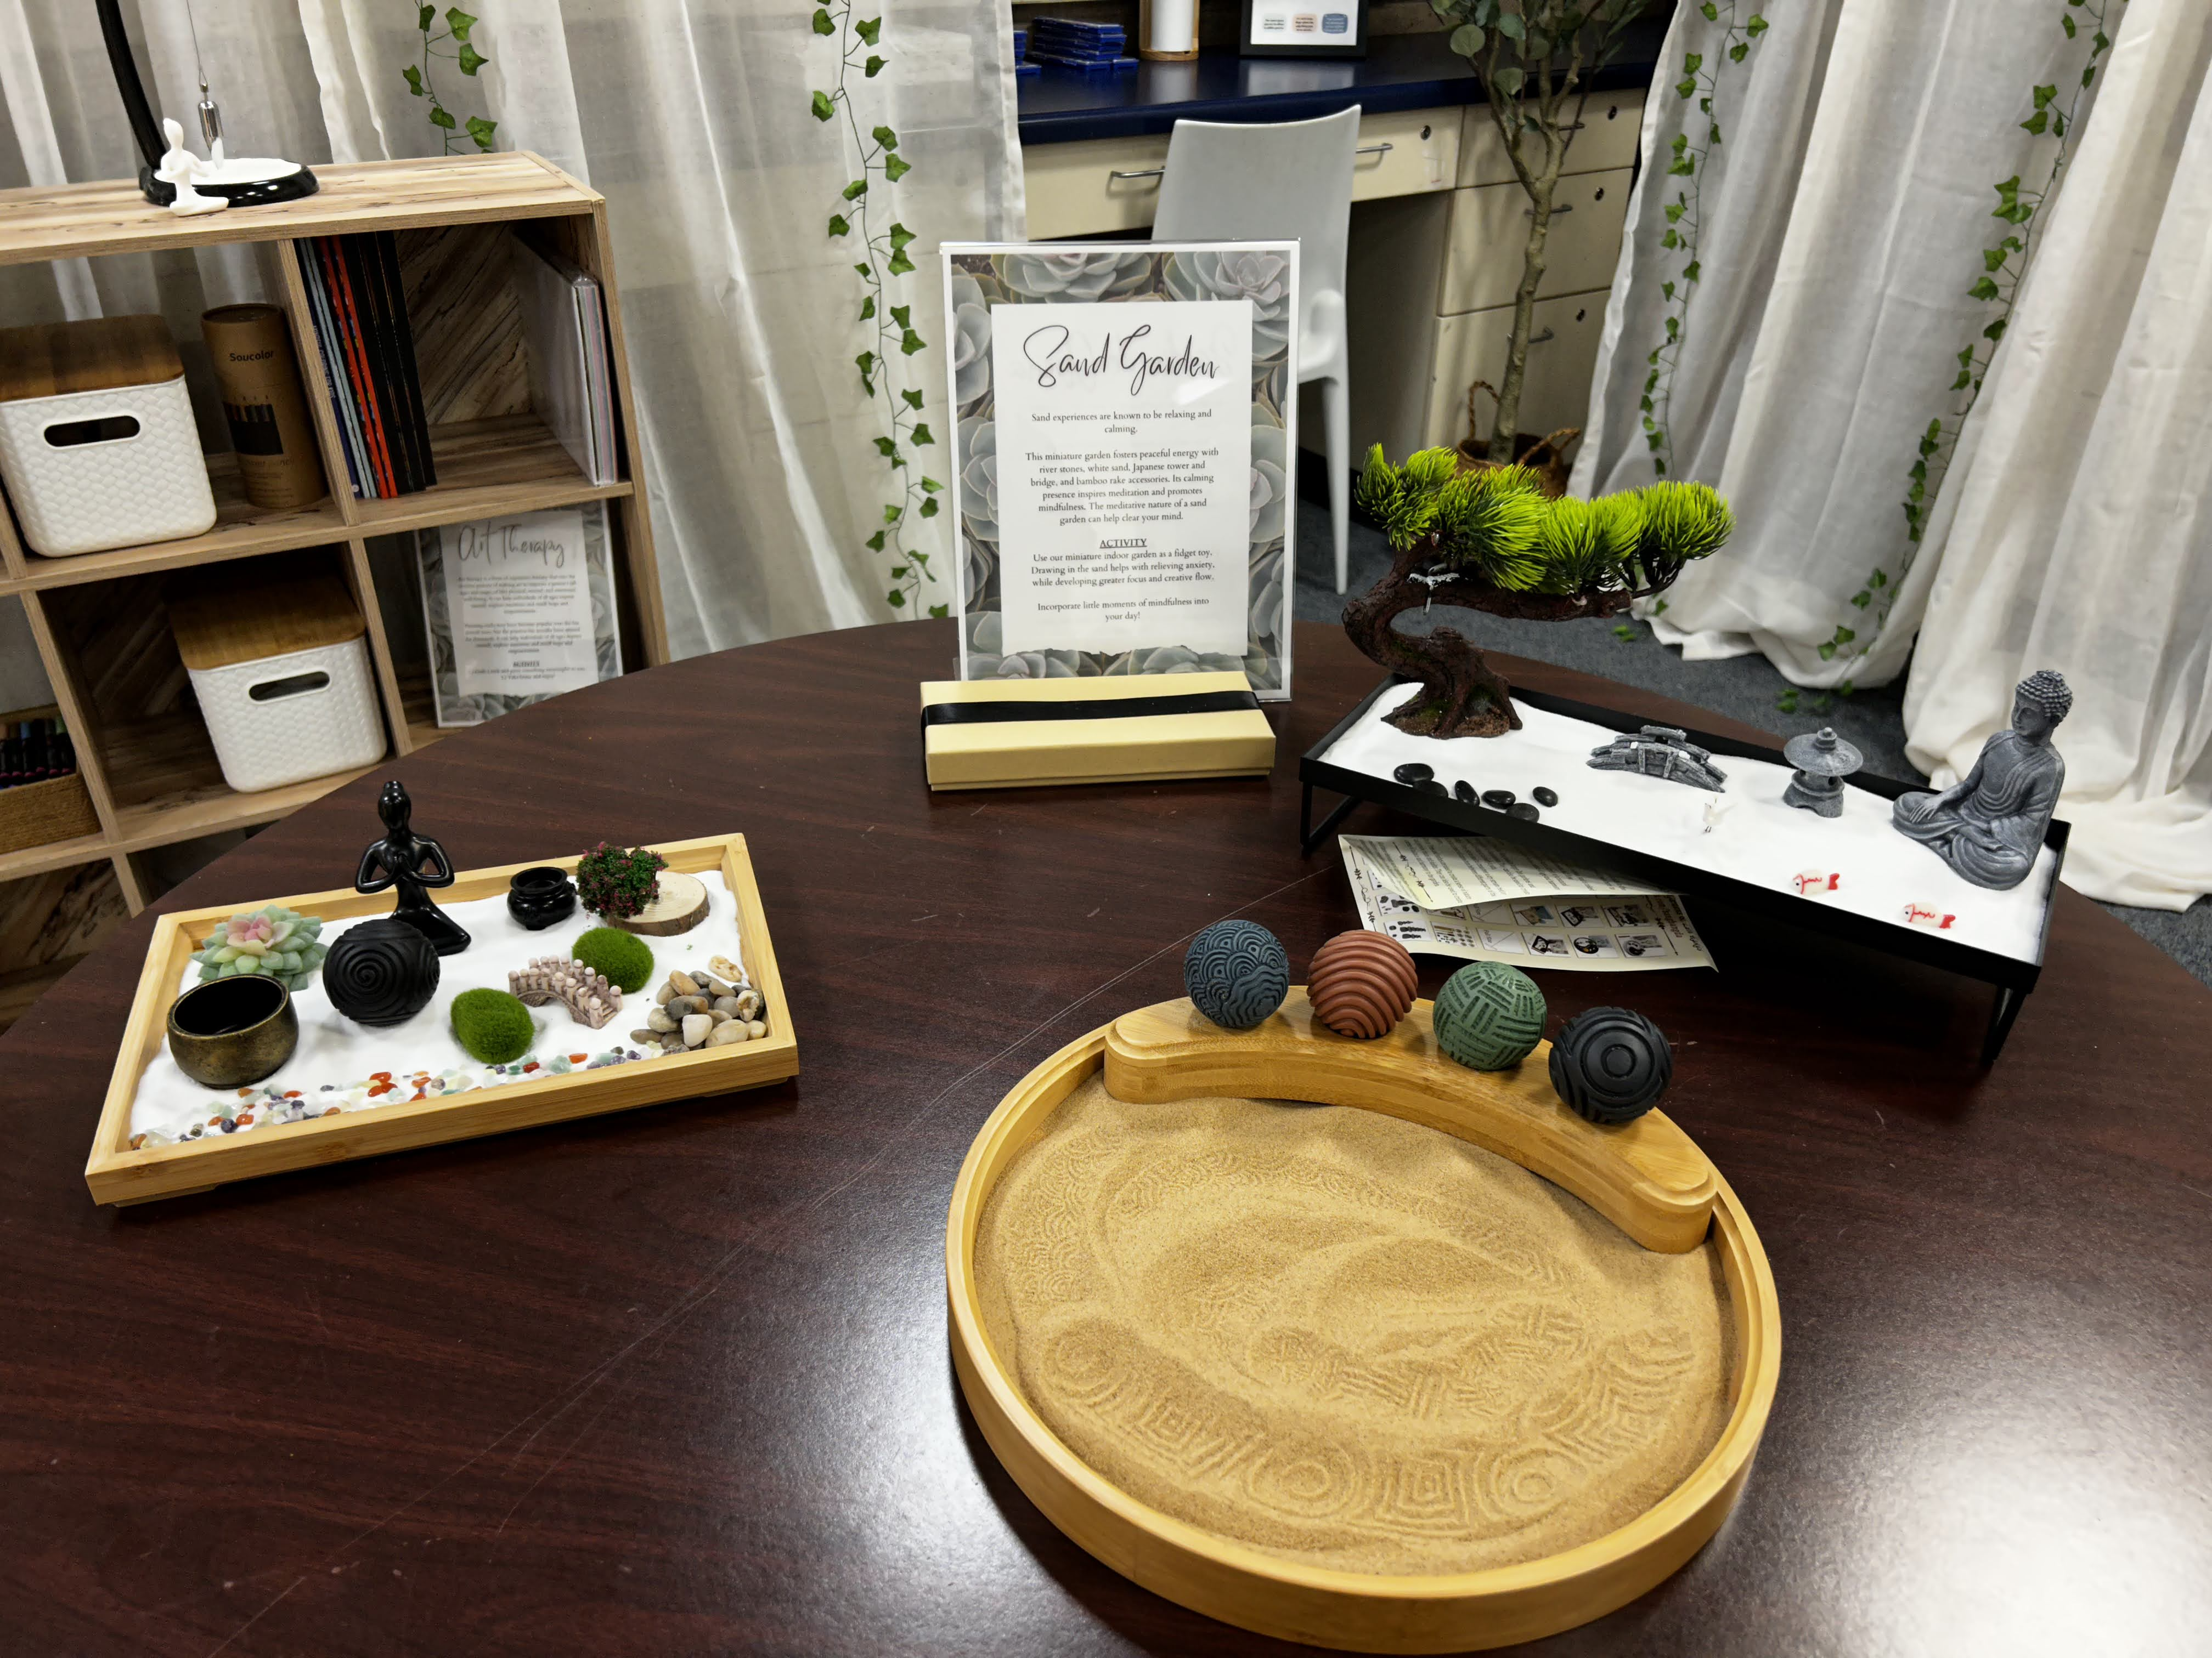
Inside the Wellnest:

Slide 13
Thanks!
This is something new and we will adjust as needed!
, Ms. Zu

