Slide 1

Lenape Links
Be recognized for the actions you take that make Lenape a stronger community.

Slide 2
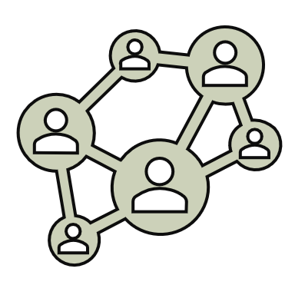
What are they? What’s their purpose?
CONNECTING OUR
COMMUNITY TOGETHER!
Lenape Links are a part of our new acknowledgement system here at Lenape.
Their purpose is to help make Lenape a safe and kind place for everyone: students, teachers, and staff! By committing to be your personal best, you in turn help others be their best.
You can receive one for displaying any of the Core Four Values:
Respect
Responsibility
Kindness
Safety

Slide 3

Steps to Take When you earn a Lenape Link
1. The next day, bring your Lenape Link to outside auditorium principal’s board during loop.
2. Pick a popsicle stick. Whatever number shows on the popsicle stick will be where your name is placed on the Principal’s Board.
3. As your name is being placed on the board, an adult will be emailing home with the good news!
4. Pick a small Thank You!!

Slide 4
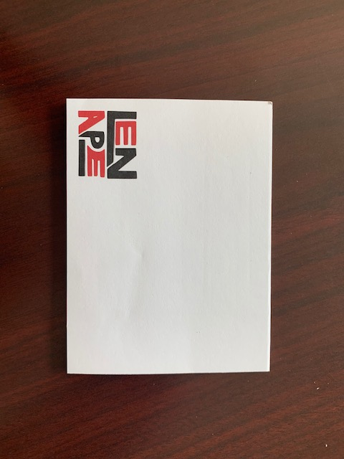
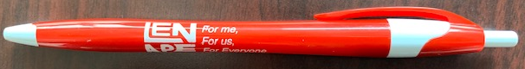
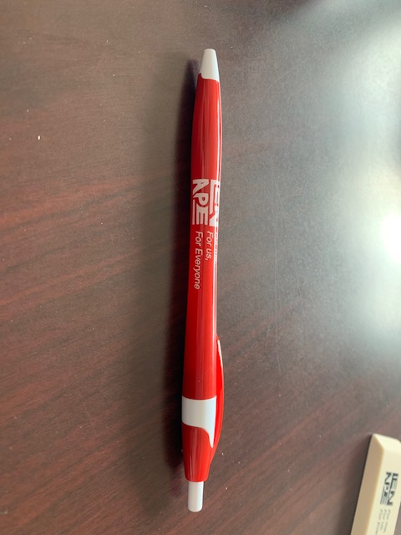
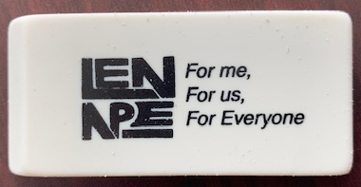
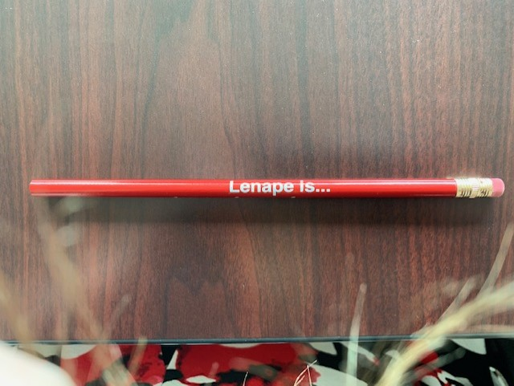
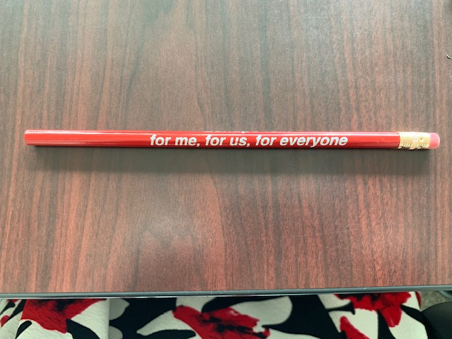
Lenape Links’ Thank Yous
Pens
Post-its
Erasers
Pencils

Slide 5

Principal’s Board
PRINCIPAL’S BOARD!
When you select a popsicle stick with a number, your Lenape Link will be placed into the correlating pocket with the same number on the Principal’s Board.
Once an entire row or column is filled (like the dark red, filled-in squares pictured!) everyone in that row or column will be treated to another “Thank You!”

Slide 6
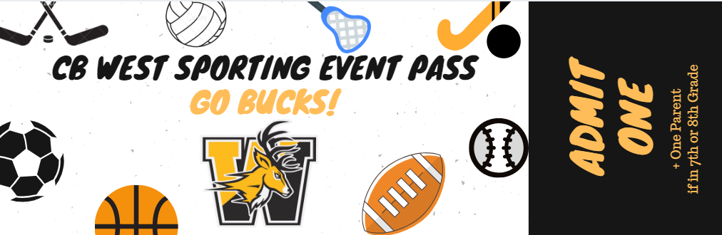
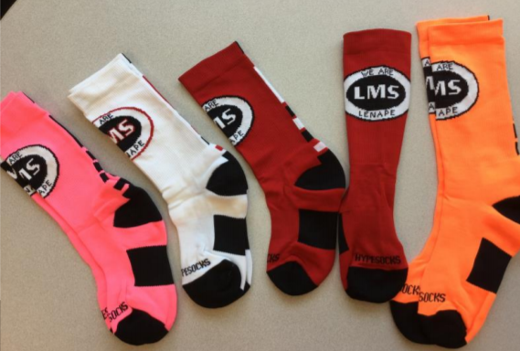

Principal’s Board “thank yous”
Be on the lookout for a survey that we will be sending out soon, asking for more “Thank You” ideas!
Notes:
Sporting Event Pass to West
Lenape Socks
Free ice cream at lunch
And more!

