Slide 1


Nicotine, Vaping & Smoking
Understanding Health Risks For Adolescents
Presented by:
David Fialko, BS, NCTTS, ICPS
Nationally Certified Tobacco Treatment Specialist

Slide 2
Big Tobacco
  106 Billion Dollars expected profit for 2023
  Big Marijuana - 90 Billion expected profits for 2023
Notes:
80 per cent of smokers do it primarily to self-medicate emotional problems. They are using cigarettes as a form of antidepressant or tranquillizer, a drug of solace for negative emotions.
Three-quarters of people with a history of depression become depressed after quitting, compared with 30 per cent of people with no such history.
Months or years after giving up, we still crave nicotine because, as with Prozac or Valium, it improves our mood.
Nicotine has a profound beneficial effect on the emotional state of people who need that kind of help. Nicotine also improves concentration and performance on tasks that demand these.

Slide 3
Nicotine
  80 percent of smokers do it primarily to self-medicate emotional problems
    They are using cigarettes as a form of antidepressant or tranquillizer, a drug of solace for negative emotions.
  Nicotine has a profound beneficial effect on the emotional state of people who could benefit from psychotropic medication.
  Nicotine also improves concentration and performance on tasks that demand these.
    Counterproductive for individuals taking ADHD medication
  Nicotine is a highly addictive substance, distributed quickly through the blood stream
  Provides an increase in dopamine (Bodies “natural happy drug”)
Notes:
80 per cent of smokers do it primarily to self-medicate emotional problems. They are using cigarettes as a form of antidepressant or tranquillizer, a drug of solace for negative emotions.
Three-quarters of people with a history of depression become depressed after quitting, compared with 30 per cent of people with no such history.
Months or years after giving up, we still crave nicotine because, as with Prozac or Valium, it improves our mood.
Nicotine has a profound beneficial effect on the emotional state of people who need that kind of help. Nicotine also improves concentration and performance on tasks that demand these.

Slide 4



Dopamine Production
Euphoric “High”
Sports, Physical Activities
Art, Music, Good Grades
Happy
Conversation
Neutral
Time
Stressed / Unhappy

Slide 5
Dopamine Levels
Natural
Conversation 5%
Art, Culture, Theatre 15%
Sports, Physical Exercise 25%
Unnatural
Nicotine 15 %
Alcohol 15% to 60%
Cannabis 100% to 150%
Cocaine 300%
Crack Cocaine 600%
Methamphetamines 1000%
Opioids 1400%

Slide 6
Effect of Nicotine on Body
Increased risk of cardiovascular, respiratory, gastrointestinal disorders.
Decreased immune response and it also poses ill impacts on the reproductive health.
  Epigenetics!
Nicotine affects the cell proliferation, oxidative stress, apoptosis, DNA mutation by various mechanisms which leads to cancer.
  Affects the tumor proliferation and metastasis and causes resistance to chemo and radio therapeutic agents.
Indian J Med Paediatr Oncol. 2015 Jan-Mar; 36(1): 24–31.
doi: 10.4103/0971-5851.151771

Slide 7
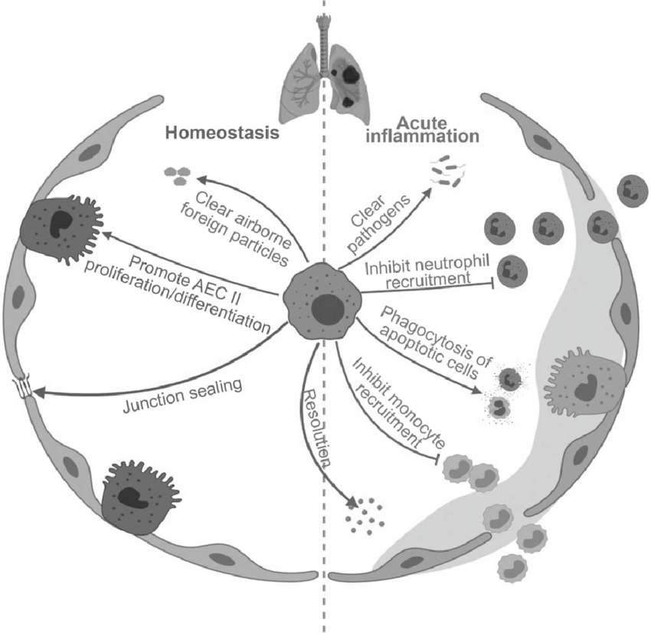
Effect of “Vaping” on The Lungs
Macrophages
  Alveolar macrophages are the cleaner of the lungs
  Clearing air space of infectious, toxic and or allergic particles that have evaded the mechanical defenses of the respiratory tract
Two macrophages found in your lungs
  One that fights viruses
  One that prevents tissue damage
These are what protect the lungs and body from viruses overtaking the lungs
https://www.news-medical.net/news/20190924/Vaping-destroys-lining-and-immune-cells-in-the-lung-says-study.aspx
Notes:
alveolar epithelial cells (AEC II) – Laymens function is to repair damaged lungs (lung injury)
Junction sealing repairs lining of lungs

Slide 8
Nicotine Vs. Caffeine
Caffeine: A stimulant that works by blocking the receptor for adenosine, a neurotransmitter that causes relaxation!
  Does Not increase dopamine, does not increase risks of heart disease or cancer, does not effect epigenetics
  Is Not: A tumor enhancer a cardio-toxic chemical,
Nicotine: A stimulant which increases the release of multiple different neurotransmitters.
  Increases the release of Dopamine, Norepinephrine, Acetylcholine
  Nicotine (Acetylcholine) receptors change into a state that is more easily activated, thereby providing a memory for nicotine exposure.
J Neurosci. 2005 Jun 8; 25(23): 5563–5572.
doi: 10.1523/JNEUROSCI.5240-04.2005
Caffeine increases striatal dopamine D2/D3 receptor availability in the human brainN D Volkow,1,* G-J Wang,1 J Logan,2 D Alexoff,2 J S Fowler,2 P K Thanos,2 C Wong,1 V Casado,3 S Ferre,4 and D Tomasi1
Notes:
Nicotine withdrawal, such as strong cravings for a cigarette, anxiety, irritability, restlessness, difficulty concentrating, depressed mood, frustration, anger, increased hunger and difficulty sleeping. The fastest way to alleviate the withdrawal symptoms is to smoke a cigarette, which releases dopamine and activates the pleasure response.

Slide 9
Effect of Nicotine on Learning
Nicotine raises pulse & heart rate. Brain EEG becomes same as when people are agitated.
Nicotine has a half life of 2 hours. Students who smoke may have more challenges learning and trouble concentrating due to withdrawal symptoms.
Youth report withdrawal symptoms with lower amount of consumption than adults, even as low as 5 cigarettes per week.
Smoking actually contributes to problems; withdrawal causes stress, anxiety.

Slide 10
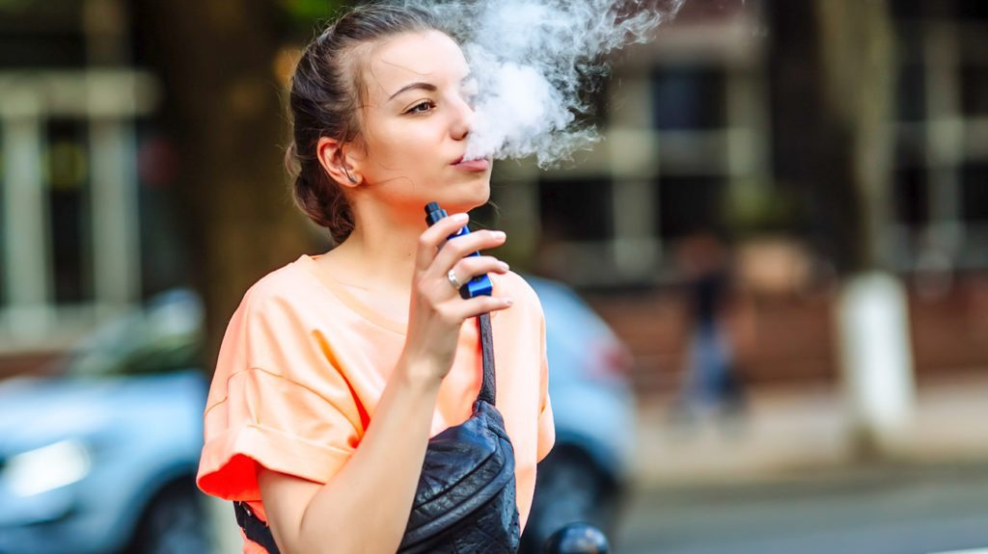

Transition From E-cigs (ENDS) to Tobacco Products
A study by the University of Pittsburgh Schools of the Health Sciences found that young adults who use e-cigarettes are more than four times as likely to begin smoking tobacco cigarettes within 18 months as their peers who do not vape.

Slide 11
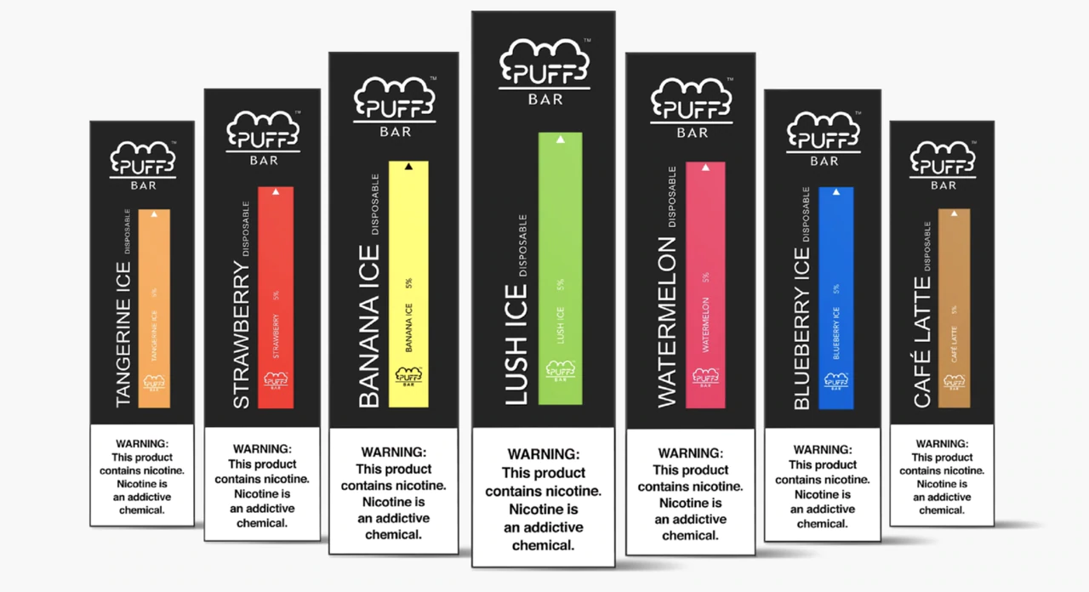
“Puff” Bars
Were banned for flavoring
They came back using synthetic Nicotine to skirt FDA deeming/regulations.
= 300 Puffs

Slide 12
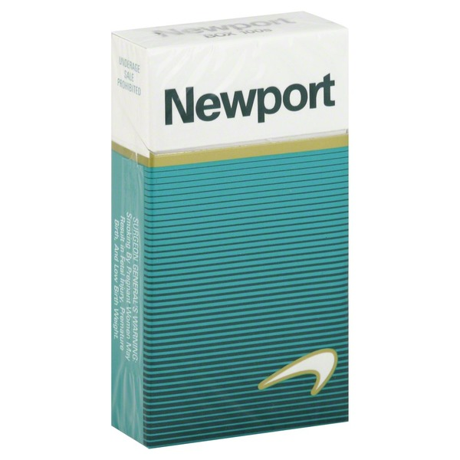
Understanding “Puffs”
The number of puffs in a cigarette varies depending on the smoker and the cigarette, but studies show that the average number of puffs is 12.5 per cigarette12. This means that a pack of 20 cigarettes is equivalent to about 250 puffs.
Smokers usually take 8-12 puffs per cigarette, each lasting 2-3 seconds, and let the cigarette burn idly between puffs.
$11.00
250 puffs

Slide 13

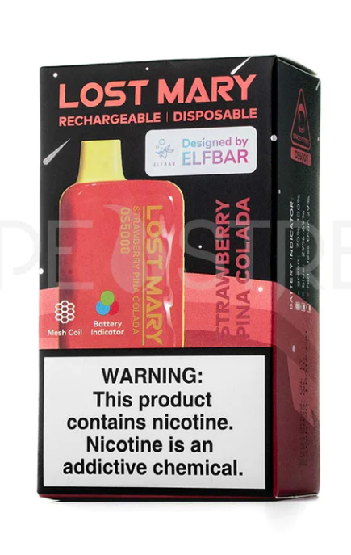
Hottest Sellers Amongst HS Age
8000 puffs ! - $17.00
5000 puffs ! - $17.00

Slide 14
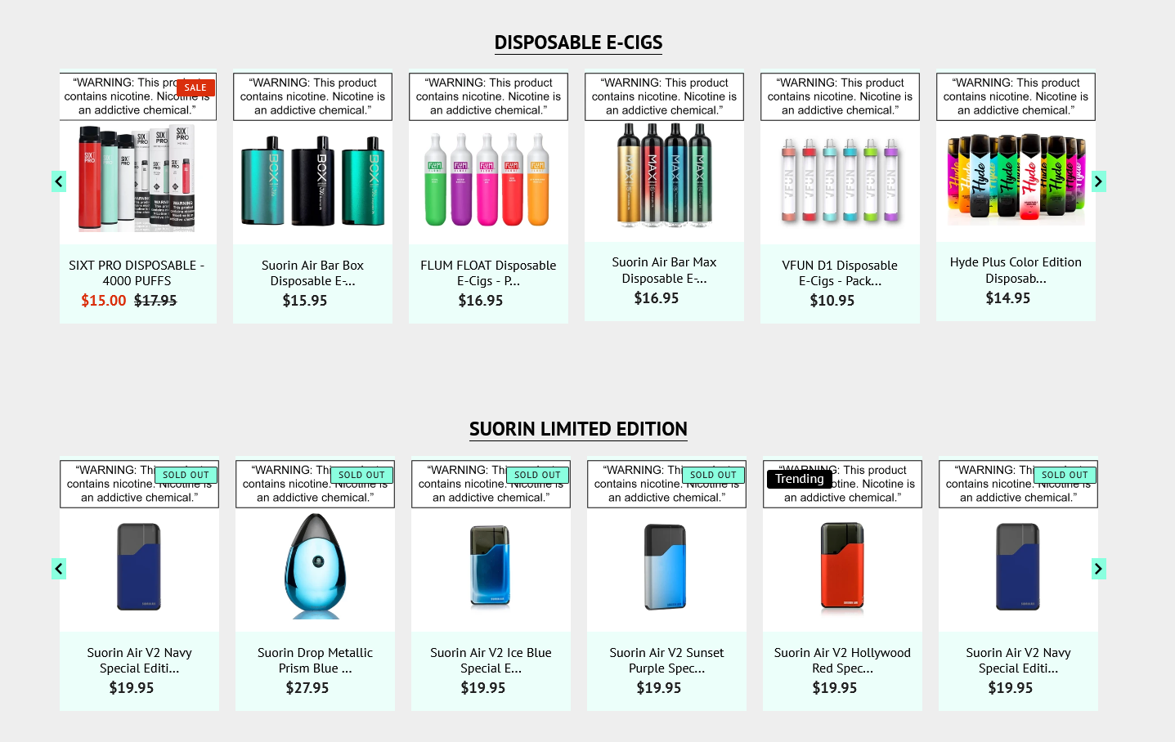
Vaporesso GTX One “Best For Beginners”

Slide 15
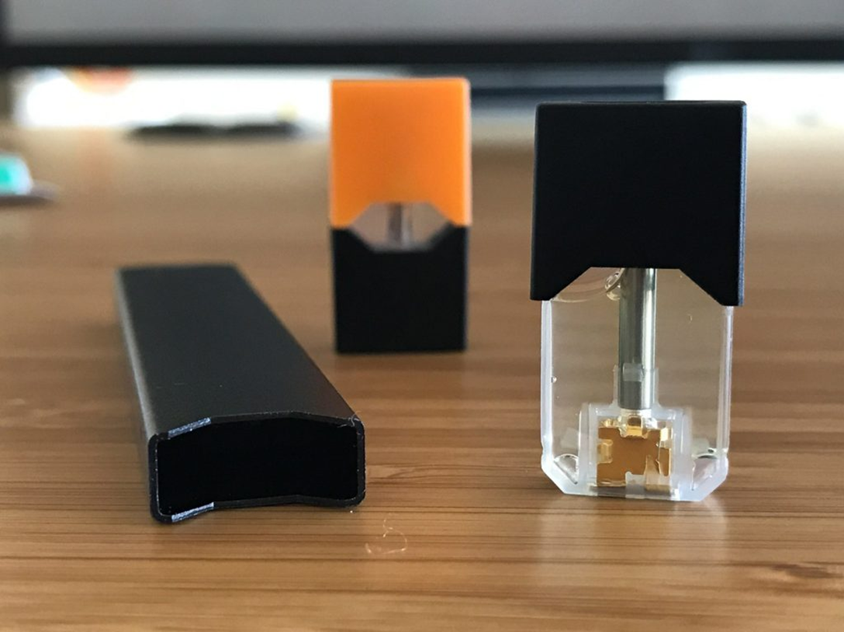
JUUL

Slide 16
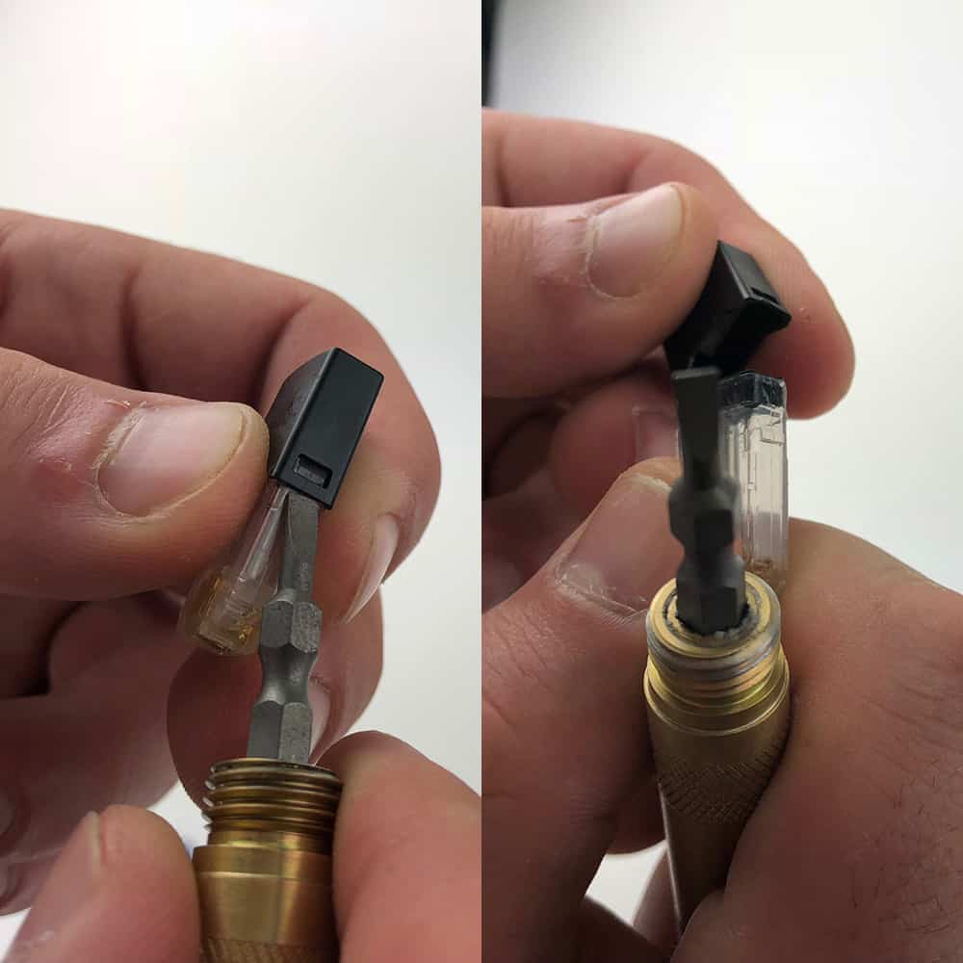
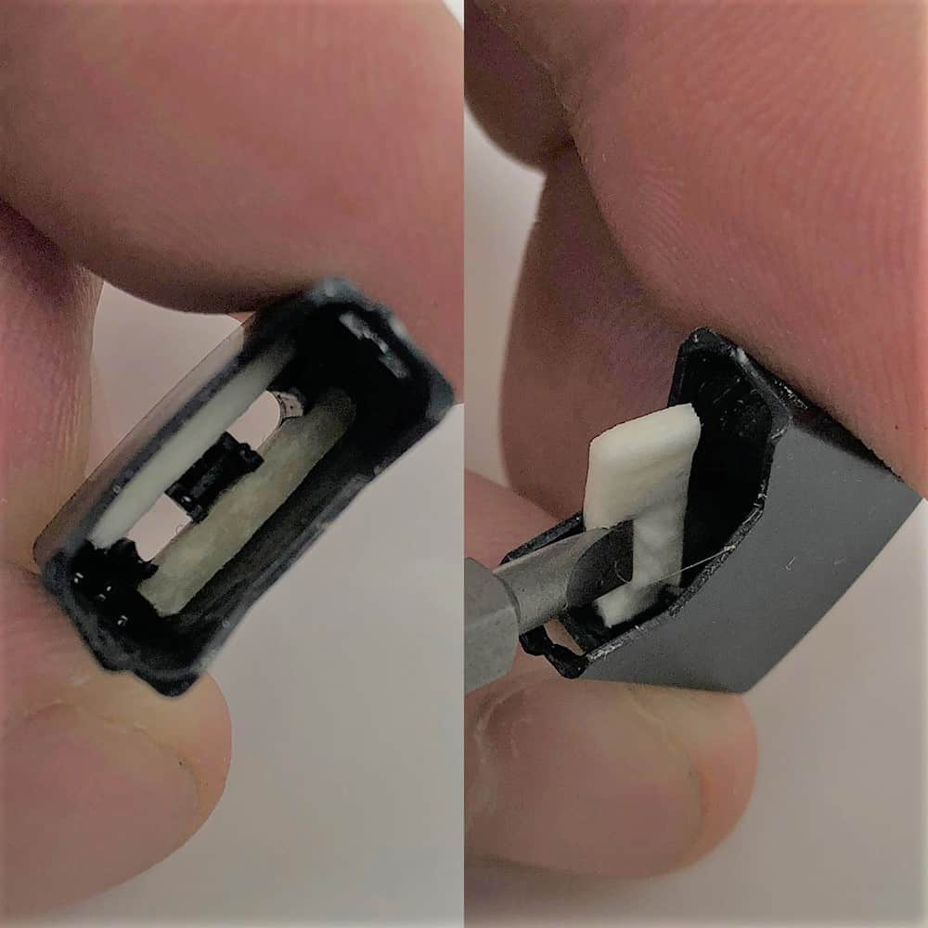
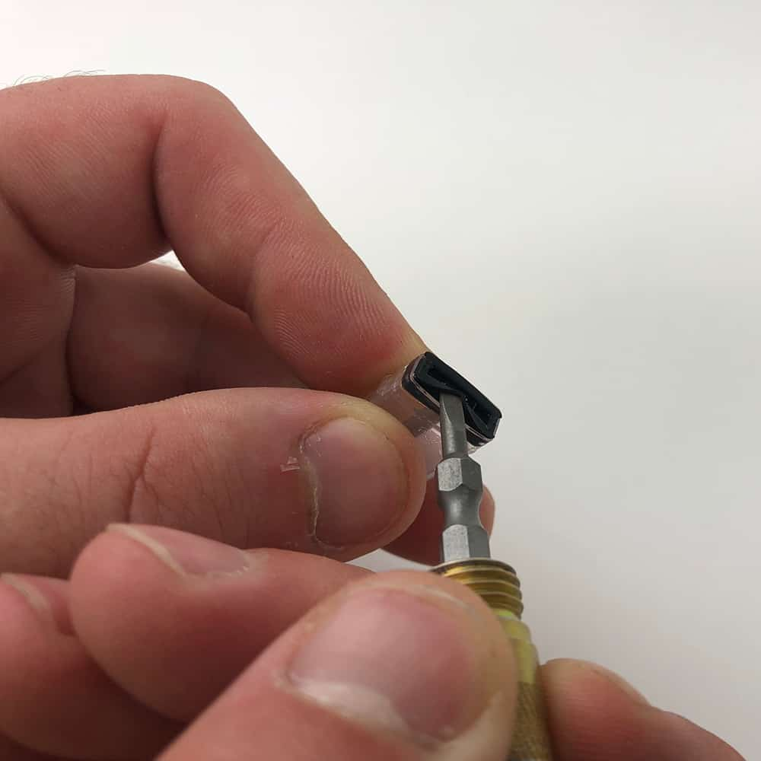
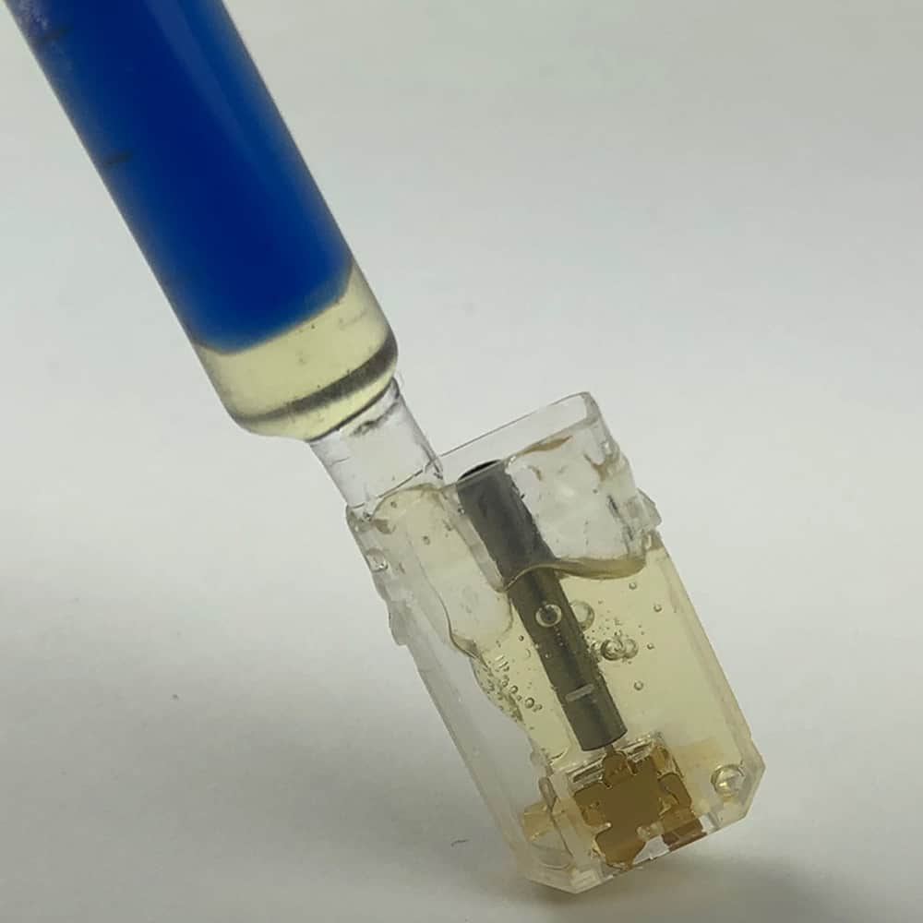
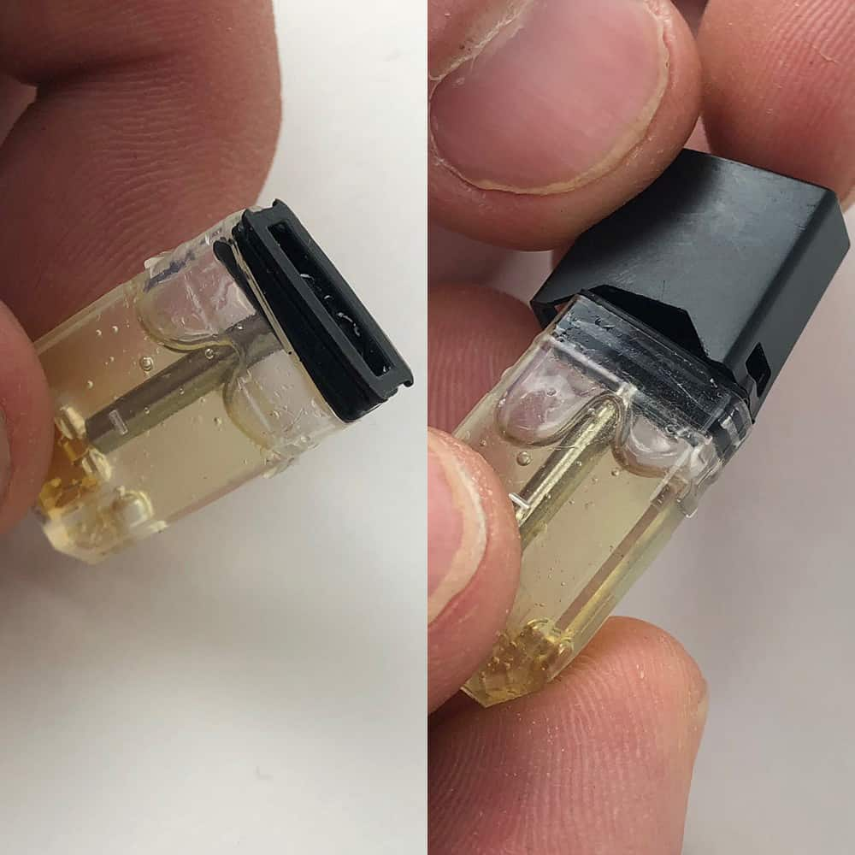
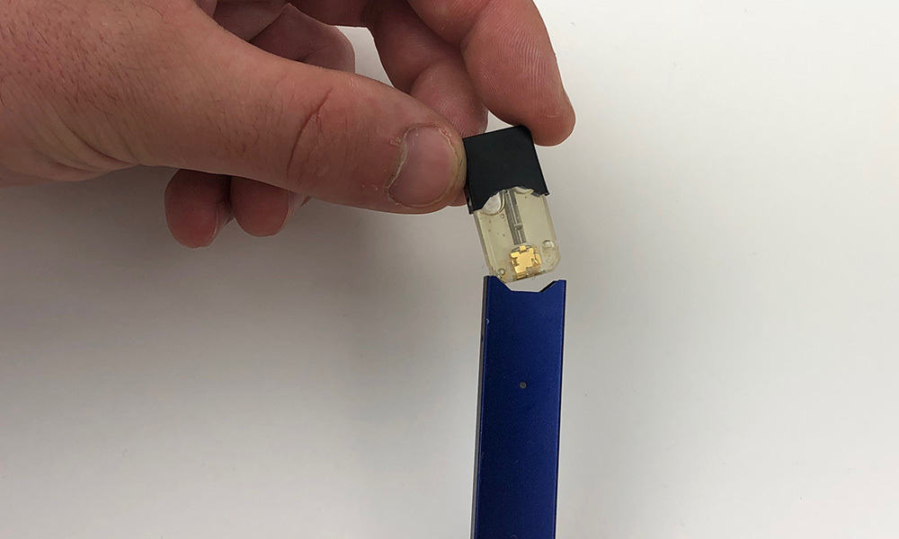

Slide 17
Resources
PA Free Quitline
1-800-QUIT-NOW (784-8669)
1-855-DEJELO-YA (335-3569)
Text2Quit.com
Nicotine Anonymous
1-877-879-6422
DeterminedToQuit.com

Slide 18

Questions & Answers

Slide 19
David Fialko BS, ICPS, NCTTS
Nationally Certified Tobacco Treatment Specialist
The Council of Southeast Pennsylvania, Inc.
4459 W. Swamp Road
Doylestown, Pennsylvania 18902
Phone: (267) 817-7026
Dfialko@councilsepa.org www.councilsepa.org

