Slide 1
In-Text Documentation a.k.a: Parenthetical References
The guts of the paper…
How to use your notecards and works cited Page to write an organized and well researched paper that
gives proper credit to the sources you used.

Slide 2
Student Objectives
I will….
use Noodletools to help organize my research to prepare to write my paper.
understand what in-text documentation is.
understand when I need to use in-text documentation in my paper.
understand how to do in-text documentation in my paper.

Slide 3


Getting Ready to Write
Step 1: Organize your notecards
Complete the graphic organizer so that you know which information needs to be in each body paragraph.
In Noodletools, go to the Notecards page.
Move your notecards onto your table top
  Select “move >>”
  Group your notecards by the body paragraphs you planned on the graphic organizer
    Select a notecard and place it over an other one that goes over a similar topic
    Give the pile of notecards a name (1st paragraph, etc….)
By doing this you will be able to organize your cards so you only will have to look at particular pile while writing each paragraph.

Slide 4
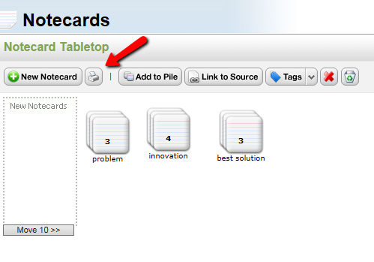
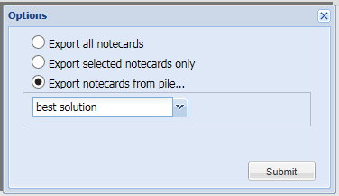
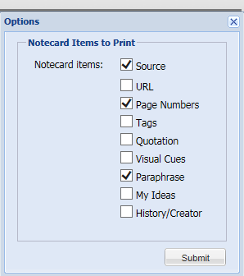
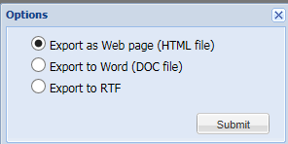
Getting Ready to Write
Step 2: Print your Notecards by Piles with only your notes & source information
Now that you have your cards organized into piles, print each pile of Notecards

Slide 5
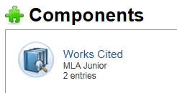

Getting Ready to Write
Step 3: Print Out a Completed Works Cited
Go to Noodle tools
Select your project
Components
  Work Cited
Print out your work cited paper
into a word document.

Slide 6
Getting Ready to Write
Step 4: On your Works Cited page, highlight the first word in each citation. Make sure the first word is unique. If not, keep highlighting until it is.
Works Cited
Goldsmith, Connie. Battling Malaria: On the Front Lines against a Global Killer. Minneapolis: Twenty-First Century, 2011. Print.
"Malaria." Teen Health and Wellness. Rosen Publishing Group, Inc., 2012. Web. 15 Nov. 2012 <http://www.teenhealthandwellness.com/article/221/malaria>
"Malaria." The Gale Encyclopedia of Science. Ed. K. Lee Lerner and Brenda Wilmoth Lerner. 4th ed. Detroit: Gale, 2012. Student Resources In Context. Web. 25 Mar. 2013.
"New Hope in Malaria War As Vaccine Yields Fruit." Africa News Service 23 Nov. 2012. Student Resources In Context. Web. 25 Mar. 2013.
Svoboda, Elizabeth. "#28: Hepatitis Bu2029 Boosts Malaria Vaccine." Discover Jan.-Feb. 2012: n. pag. Discover Magazine. Web. 8 Nov. 2012. <http://discovermagazine.com/2012/jan-feb/28>.
The highlighted words = your CODE for In-Text Documentation

Slide 7
What is in-text documentation?
When you are writing a research paper and you present information that needs to be cited, you must stop immediately and tell the reader exactly from what source this information was obtained. Basically, in-text documentation gives the reader a trail to follow to the exact source.

Slide 8
How In-Text Creates a Trail for the Reader to Follow to the Source
In the body of the paper, in-text gives you a CODE in parenthesis.
Follow the CODE to….
your Works Cited Page.
On the Works Cited page, identify which source the Code matches and follow this to
Your exact location
for the information.

Slide 9
What does In-text Documentation look like in a paper?
Body of the Paper:
Scoliosis is a disorder that is defined by a curvature of the spine. About 6 to 9 million people are affected with scoliosis every year ("Scoliosis.” World). People that have scoliosis can have uneven shoulders or hips, lower back pain, or curvature of the spine. Although some forms of scoliosis seems to run in families, geneticists have not identified a particular gene linked to the disorder (Roggenbuck). Most people that have scoliosis live a normal life. But some people that have a really bad curve can have collapsed lungs and decrease the lung capacity so you are unable to breathe . Scoliosis can affect anyone at any age all around the world. However, it is five times more likely to affect girls than boys ("Scoliosis” Sick!). Scoliosis has a lot of symptoms, diagnosis, and treatment.
Works Cited:
Roggenbuck, Jennifer. "Scoliosis." The Gale Encyclopedia of Genetic Disorders. Ed. Brigham Narins. 2nd ed. Vol. 2. Detroit: Gale, 2005. 1164-1167. Opposing Viewpoints in Context. Web. 7 Nov. 2014.
"Scoliosis." Sick! Gale, 2007. Student Resources in Context. Web. 7 Nov. 2014.
Scoliosis." World of Health. Gale, 2007. Student Resources in Context. Web. 7 Nov. 2014.

Slide 10
Writing your Paper:
When do you need to use in-text documentation?
All Statistics
All Direct Quotes- When you are using someone else’s words without changing them
Any information that is Not Common Knowledge
Common knowledge is defined as information you found in more than 3 sources.
Any information that is controversial or questionable.
Opinions from scholars and other individuals you consulted.

Slide 11
How much of your paper should be cited?
Basic rule-
cited information accounts for 50% to 75% of a research paper.

Slide 12
Reminder of What You Did to Get Ready to Write
On your Works Cited page, highlight the first word in each citation. Make sure the first word is unique. If not, keep highlighting until it is.
Works Cited
Goldsmith, Connie. Battling Malaria: On the Front Lines against a Global Killer. Minneapolis: Twenty-First Century, 2011. Print.
"Malaria." Teen Health and Wellness. Rosen Publishing Group, Inc., 2012. Web. 15 Nov. 2012 <http://www.teenhealthandwellness.com/article/221/malaria>
"Malaria." The Gale Encyclopedia of Science. Ed. K. Lee Lerner and Brenda Wilmoth Lerner. 4th ed. Detroit: Gale, 2012. Student Resources In Context. Web. 25 Mar. 2013.
"New Hope in Malaria War As Vaccine Yields Fruit." Africa News Service 23 Nov. 2012. Student Resources In Context. Web. 25 Mar. 2013.
Svoboda, Elizabeth. "#28: Hepatitis Bu2029 Boosts Malaria Vaccine." Discover Jan.-Feb. 2012: n. pag. Discover Magazine. Web. 8 Nov. 2012. <http://discovermagazine.com/2012/jan-feb/28>.
The highlighted words = your CODE for In-Text Documentation

Slide 13
How to do Properly Cite your Information?
Use Parenthetical or In-text Documentation
To put it simply, after you write information that qualifies as needing to be cited, you tell the reader right away where you found the information.
Whatever you highlighted on your Works Cited page (your CODE) goes into parenthesis at the end of the sentence in which the information was found.
The period goes on the outside of the parenthesis.
If it is a print source, you must also include the page number where the information was found.

Slide 14
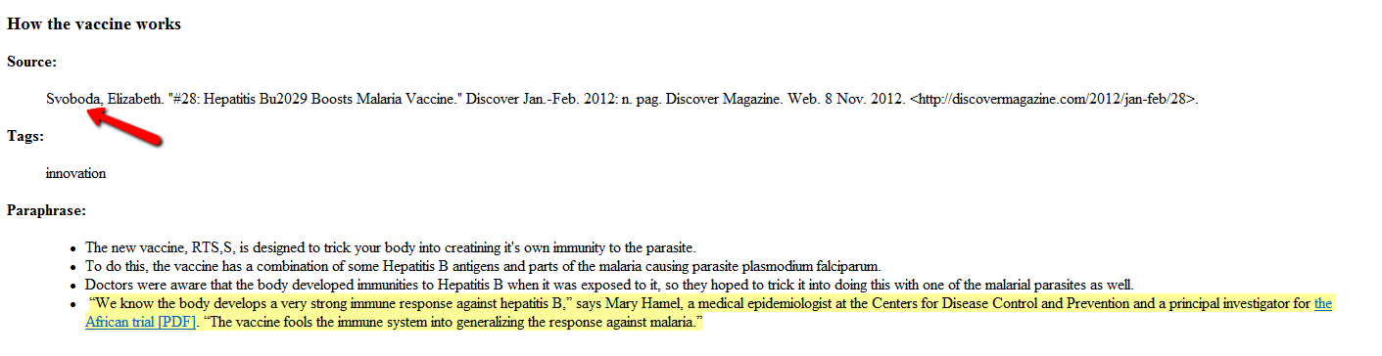
Sample: Direct Quote-
Using someone else’s words without changing them
Notecard sample:

Slide 15
Sample: Direct Quote-
Using someone else’s words without changing them
To develop the RTS,S vaccine, doctors built off of another successful vaccine. Essentially, they knew the body would develop an immunity to Hepatitis B so they created a vaccine that had both Hepatitis B antigens and parts of the malaria causing parasite plasomodium falciparum. As Dr. Hamil, a medical epidemiologist at the CDC explains, “ The vaccine fools the immune system into generalizing the response against malaria” (Svoboda).
Author’s last name period parenthesis

Slide 16
Sample Works Cited Page
Works Cited
Goldsmith, Connie. Battling Malaria: On the Front Lines against a Global Killer. Minneapolis: Twenty-First Century, 2011. Print.
"Malaria." Teen Health and Wellness. Rosen Publishing Group, Inc., 2012. Web. 15 Nov. 2012 <http://www.teenhealthandwellness.com/article/221/malaria>
"Malaria." The Gale Encyclopedia of Science. Ed. K. Lee Lerner and Brenda Wilmoth Lerner. 4th ed. Detroit: Gale, 2012. Student Resources In Context. Web. 25 Mar. 2013.
"New Hope in Malaria War As Vaccine Yields Fruit." Africa News Service 23 Nov. 2012. Student Resources In Context. Web. 25 Mar. 2013.
Svoboda, Elizabeth. "#28: Hepatitis Bu2029 Boosts Malaria Vaccine." Discover Jan.-Feb. 2012: n. pag. Discover Magazine. Web. 8 Nov. 2012. <http://discovermagazine.com/2012/jan-feb/28>.

Slide 17
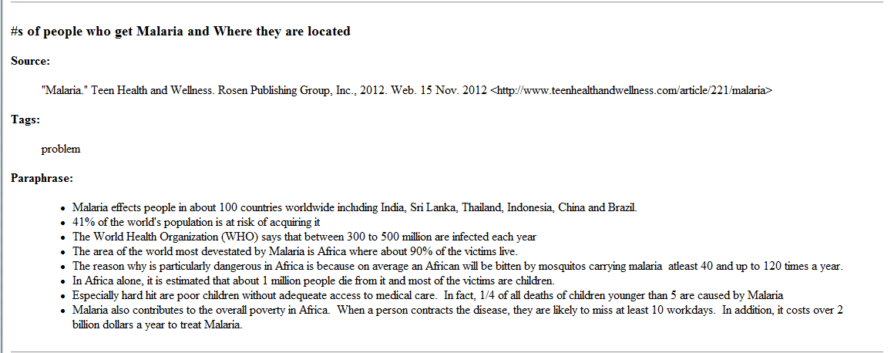
Sample: Statistic
Notecard sample:

Slide 18
Sample: Statistic
According to the World Health Organization (WHO), 41% of world’s population is at risk of getting Malaria and between 300 to 500 million people will be infected each year (“Malaria.” Teen).
Tile of Article AND first word of Database period outside of parenthesis
You need both titles because there is another article with the same title

Slide 19
Sample Works Cited Page
Works Cited
Goldsmith, Connie. Battling Malaria: On the Front Lines against a Global Killer. Minneapolis: Twenty-First Century, 2011. Print.
"Malaria." Teen Health and Wellness. Rosen Publishing Group, Inc., 2012. Web. 15 Nov. 2012 <http://www.teenhealthandwellness.com/article/221/malaria>
"Malaria." The Gale Encyclopedia of Science. Ed. K. Lee Lerner and Brenda Wilmoth Lerner. 4th ed. Detroit: Gale, 2012. Student Resources In Context. Web. 25 Mar. 2013.
"New Hope in Malaria War As Vaccine Yields Fruit." Africa News Service 23 Nov. 2012. Student Resources In Context. Web. 25 Mar. 2013.
Svoboda, Elizabeth. "#28: Hepatitis Bu2029 Boosts Malaria Vaccine." Discover Jan.-Feb. 2012: n. pag. Discover Magazine. Web. 8 Nov. 2012. <http://discovermagazine.com/2012/jan-feb/28>.

Slide 20
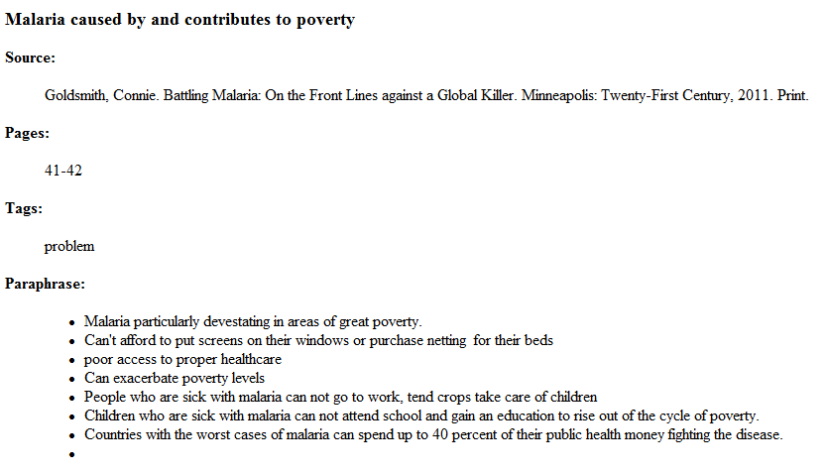
Sample- A paraphrased Opinion
Summarizing in your own words someone else’s opinion
Notecard sample:

Slide 21
Sample- A paraphrased Opinion
Summarizing in your own words someone else’s opinion
While most people would agree that malaria is a disease that affects people in poverty much more than those with adequate access to health care and simple solutions such as screens in windows and bed netting. It can also be argued that malaria can also exacerbate poverty. People who are often ill or weak from the disease can not tend their crops, go to work, attend schooling or other activities that may assist them in breaking the cycle of poverty (Goldsmith 41-42).
Author’s last name page number(s)
period

Slide 22
Sample Works Cited Page
Works Cited
Goldsmith, Connie. Battling Malaria: On the Front Lines against a Global Killer. Minneapolis: Twenty-First Century, 2011. Print.
"Malaria." Teen Health and Wellness. Rosen Publishing Group, Inc., 2012. Web. 15 Nov. 2012 <http://www.teenhealthandwellness.com/article/221/malaria>
"Malaria." The Gale Encyclopedia of Science. Ed. K. Lee Lerner and Brenda Wilmoth Lerner. 4th ed. Detroit: Gale, 2012. Student Resources In Context. Web. 25 Mar. 2013.
"New Hope in Malaria War As Vaccine Yields Fruit." Africa News Service 23 Nov. 2012. Student Resources In Context. Web. 25 Mar. 2013.
Svoboda, Elizabeth. "#28: Hepatitis Bu2029 Boosts Malaria Vaccine." Discover Jan.-Feb. 2012: n. pag. Discover Magazine. Web. 8 Nov. 2012. <http://discovermagazine.com/2012/jan-feb/28>.

Slide 23
Revisit: What it would look like in a paper?
Body of the Paper:
Scoliosis is a disorder that is defined by a curvature of the spine. About 6 to 9 million people are affected with scoliosis every year ("Scoliosis.” World). People that have scoliosis can have uneven shoulders or hips, lower back pain, or curvature of the spine. Although some forms of scoliosis seems to run in families, geneticists have not identified a particular gene linked to the disorder (Roggenbuck). Most people that have scoliosis live a normal life. But some people that have a really bad curve can have collapsed lungs and decrease the lung capacity so you are unable to breathe . Scoliosis can affect anyone at any age all around the world. However, it is five times more likely to affect girls than boys ("Scoliosis” Sick!). Scoliosis has a lot of symptoms, diagnosis, and treatment.
Works Cited:
Roggenbuck, Jennifer. "Scoliosis." The Gale Encyclopedia of Genetic Disorders. Ed. Brigham Narins. 2nd ed. Vol. 2. Detroit: Gale, 2005. 1164-1167. Opposing Viewpoints in Context. Web. 7 Nov. 2014.
"Scoliosis." Sick! Gale, 2007. Student Resources in Context. Web. 7 Nov. 2014.
Scoliosis." World of Health. Gale, 2007. Student Resources in Context. Web. 7 Nov. 2014.

Slide 24
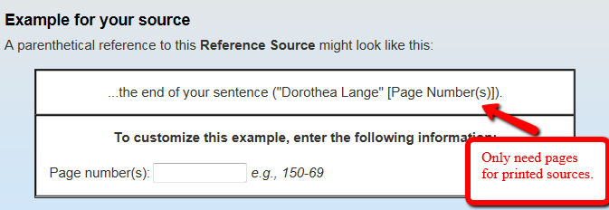
NoodleTools Can Help You with your Format
* If you used the Quick Cite option (copied and pasted your citation) the above tool will not work.

Slide 25
Review:
What do you need to Cite?
All Statistics
All Direct Quotes- When you are using someone else’s words without changing them
Any information that is Not Common Knowledge
Common knowledge is defined as information you found in more than 3 sources.
Any information that is controversial or questionable.
Opinions from scholars and other individuals you consulted.

