Slide 1

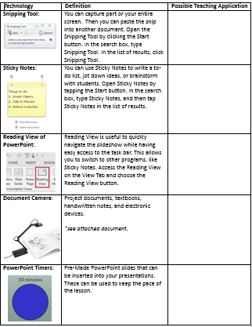
Elementary Academy
Increasing student engagement through effective use of instructional technology.

Slide 2
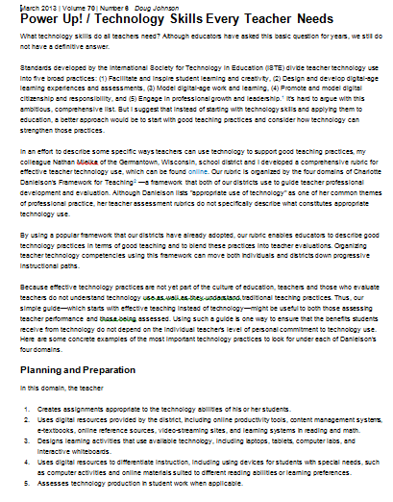
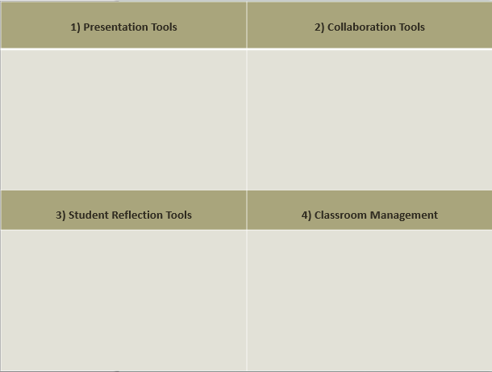

Article Reflection with Sticky Notes
What are some technologies you use or have heard of colleagues using during instruction?
PowerPoint
Notes:
Add more here..reading, writing, categ.. Type in two technologies on sticky notes
(by group)

Slide 3

Tasks
Read the article
(5 min)
List 6-8 technologies on sticky notes
(5 min)
Categorize the sticky notes as a group
(5 min)
5 minutes
10 minutes
Reading Time
Sticky Notes
15 minutes
Categorize the Sticky Notes
Notes:
Type with a keyboard on sticky notes during parts 2 and 3 in group order by passing keyboard around to each table. Each group should type two technologies onto sticky notes that are not listed by the other groups. (Model Reading View in PowerPoint with Sticky Notes.)

Slide 4
1) Presentation Tools | 2) Collaboration Tools
3) Student Reflection Tools | 4) Classroom Management

Slide 5
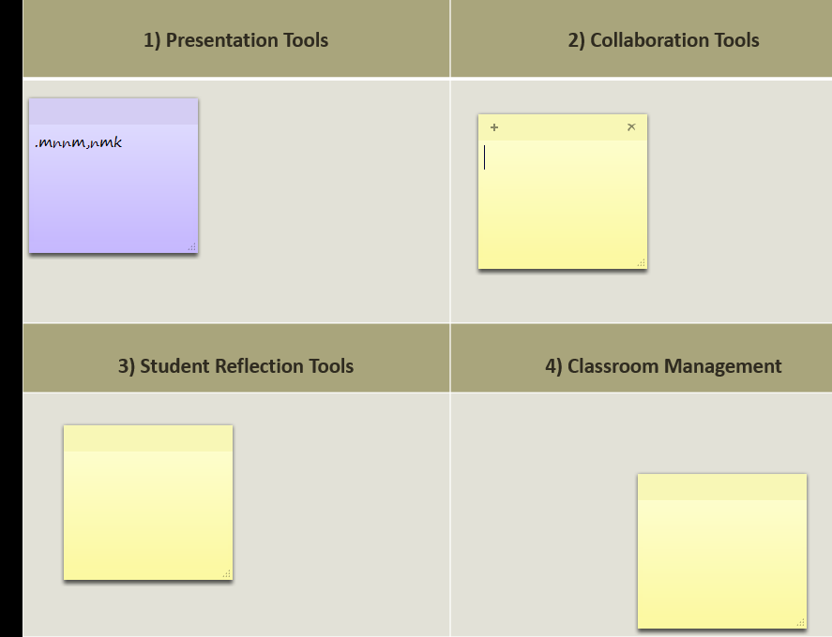
Snipping Tool
Notes:
Show how to archive the slide with Sniping Tool.

Slide 6
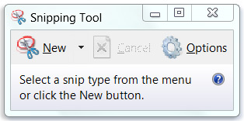
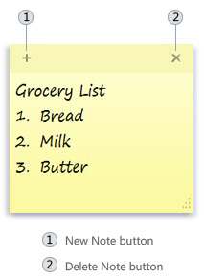
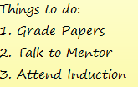
Reflect on Your Sheet
Technology Tools Used in Activity
Snipping Tool: | You can capture part or all of your screen. Then you can paste the snip into another document. Open Snipping Tool by clicking the Start button. In the search box, type Snipping Tool. In the list of results, click Snipping Tool.
Sticky Notes: | You can use Sticky Notes to write a to-do list, jot down ideas, or brainstorm with students. Open Sticky Notes by tapping the Start button . In the search box, type Sticky Notes, and then tap Sticky Notes in the list of results.
Reading View of PowerPoint: | Reading View is useful to quickly navigate the slide show while having easy access to the task bar. This allows you to switch to other programs like Sticky Notes. Access the Reading View on the View Tab and choose the Reading View button.

Slide 7
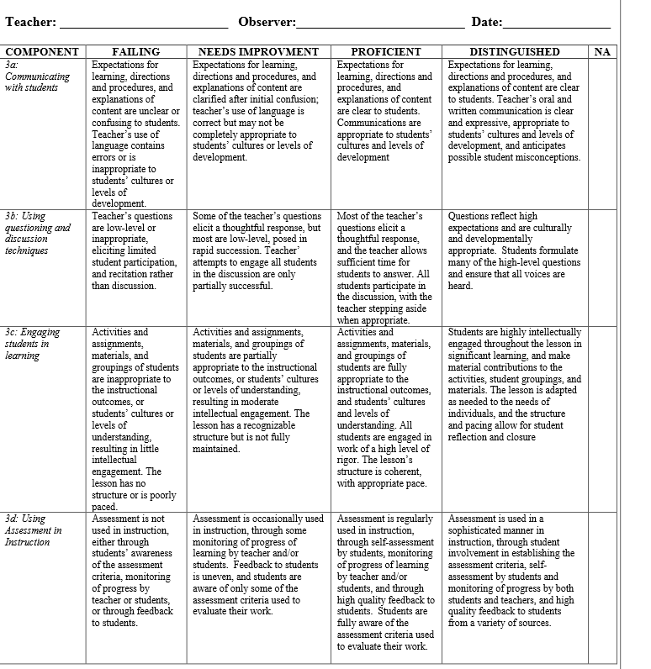
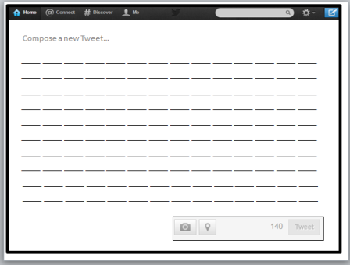
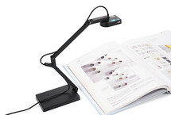
Closure Tweet
Read: The Rubric for Domains 2 and 3. Focus on the proficient and distinguished column.
Create a Tweet: As a group, tweet your goal/next step for engaging students through Educational Technology.
Note: Each group will pick a person to read the Tweet out loud to the whole group when placing it under the document camera.
Notes:
Show how to archive the slide with Sniping Tool.

Slide 8

U s e d o c u m e n t
c a m e r a t o
m a x i m i z e
i n s t r u c t I o n a l
t i m e
# 2 c

Slide 9
Closure Tweet
Read: The Rubric for Domains 2 and 3. Focus on the proficient and distinguished column.
Create a Tweet: As a group, tweet your goal/next step for engaging students through Instructional Technology
Note: Each group will pick a person to read the Tweet out loud to the whole group when placing it under the document camera.
2:00
1:59
1:58
1:57
1:56
1:55
1:54
1:53
1:52
1:51
1:50
1:49
1:48
1:47
1:46
1:45
1:44
1:43
1:42
1:41
1:40
1:39
1:38
1:37
1:36
1:35
1:34
1:33
1:32
1:31
1:30
1:29
1:28
1:27
1:26
1:25
1:24
1:23
1:22
1:21
1:20
1:19
1:18
1:17
1:16
1:15
1:14
1:13
1:12
1:11
1:10
1:09
1:08
1:07
1:06
1:05
1:04
1:03
1:02
1:01
1:00
0:59
0:58
0:57
0:56
0:55
0:54
0:53
0:52
0:51
0:50
0:49
0:48
0:47
0:46
0:45
0:44
0:43
0:42
0:41
0:40
0:39
0:38
0:37
0:36
0:35
0:34
0:33
0:32
0:31
0:30
0:29
0:28
0:27
0:26
0:25
0:24
0:23
0:22
0:21
0:20
0:19
0:18
0:17
0:16
0:15
0:14
0:13
0:12
0:11
0:10
0:09
0:08
0:07
0:06
0:05
0:04
0:03
0:02
0:01
End
2:00
5 minutes
Notes:
Share one person from each group than break.

Slide 10
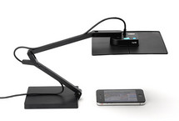
Reflect on Your Sheet
Technology Tool Used in Activity
Document Camera | Project documents, textbooks, handwritten notes, and electronic devices.
PowerPoint Timers | Pre-Made PowerPoint slides that can be inserted into your presentations.
2:00
Notes:
Show how to archive the slide with Sniping Tool.

Slide 11
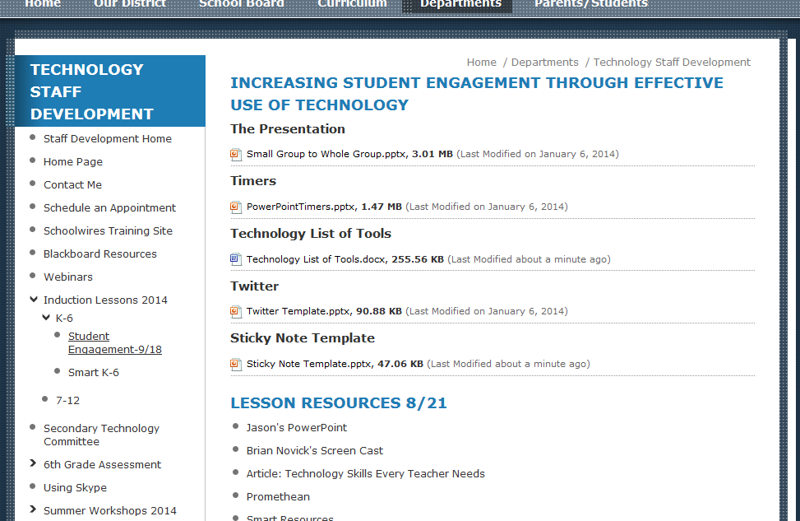

Resources: http://www.cbsd.org/jjaffe

