Slide 1
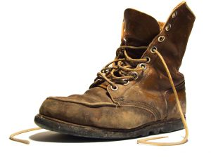
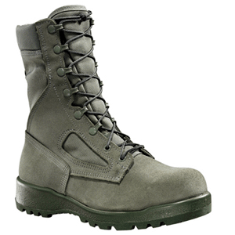
Task 1(easy): Try to remove the white background from these images.

Slide 2
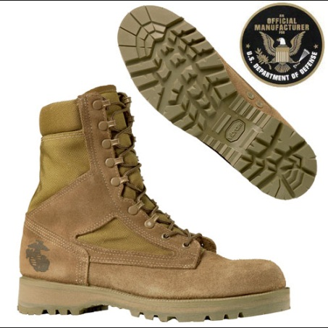
Task 2(easy): Using the Format Painter tool duplicate the style of Image 1 onto the other images.
Image 1

Slide 3
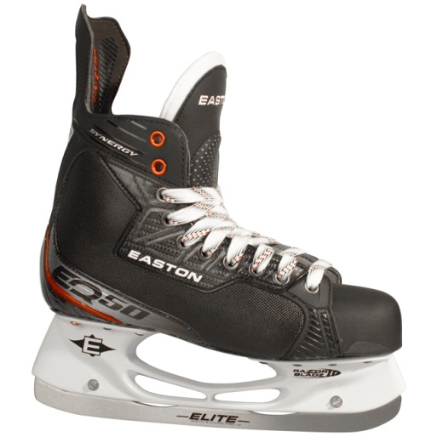
Task 3(easy): Try to duplicate Image 1 in the blue circle. You can not copy and paste.
Image 1

Slide 4
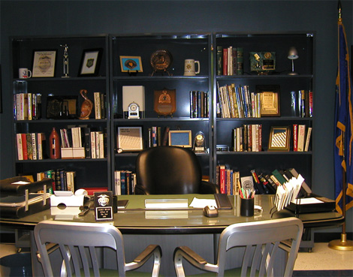
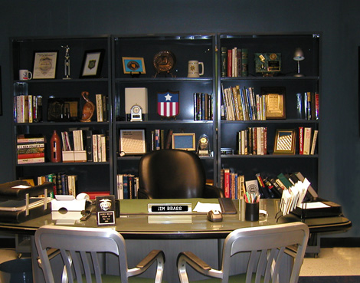
Task 4(easy): Try to draw on the images with the Pen tool.
Notes:
You can right click the mouse to see the pen features.

Slide 5
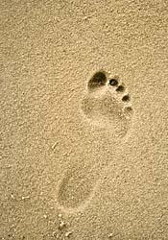
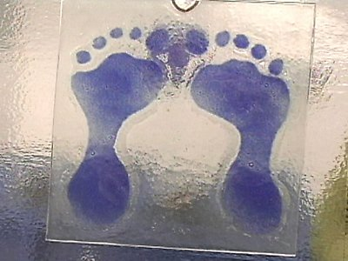
Task 5(intermediate): Try to create animated triggers with the images below. Make the images the trigger.

Slide 6
Task 6(intermediate): Change the bulleted list into a graphic organizer using SmartArt.
The following information may be obtained from footwear impressions:
Identification of Footwear
Elimination of Footwear
Participation of suspect in crime
Location of Impressions
Notes:
P 362

Slide 7
Task 7(highly advanced): Insert any video into this slide. Try to find a short clip if possible.

Slide 8
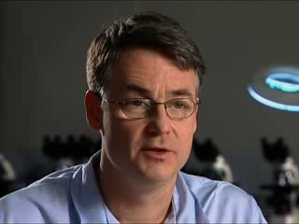
Task 8(advanced): (1) Trim this video to 30 seconds, (2) Change the first frame that is viewed using a Poster Frame.

Slide 9
Task 9 (intermediate): Try to create a timeline about any topic using the template below.
1950
1960
1970

Slide 10
1980
1990
2000

Slide 11
2010
2020
2030

Slide 12
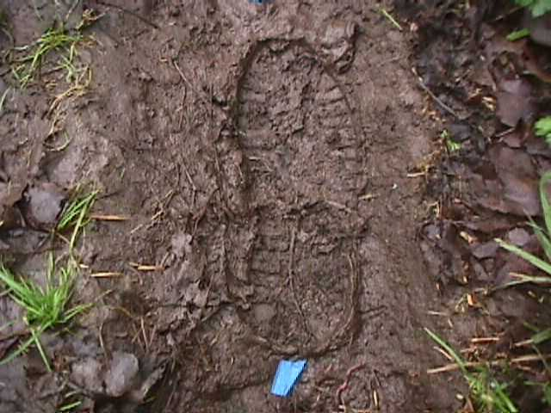

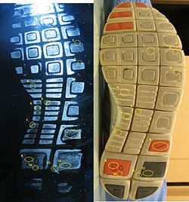

Task 10 (highly advanced): (1) Create a scrolling text, (2) Create and trim the videos to make a header, (3) Make a title, and (4) Add footsteps sound. (Click here for a silent video tutorial.)
•Welcome to Forensics • Mr. Hensel
Forensic Footwear Evidence

Slide 13
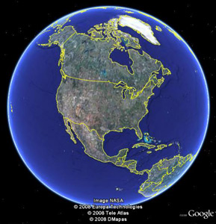
Task 11(highly advanced): Create a Google Earth screencast and insert the video into this slide.

