Slide 1
APPR 3012.d
Michelle Martoni
Assistant Superintendent

Slide 2
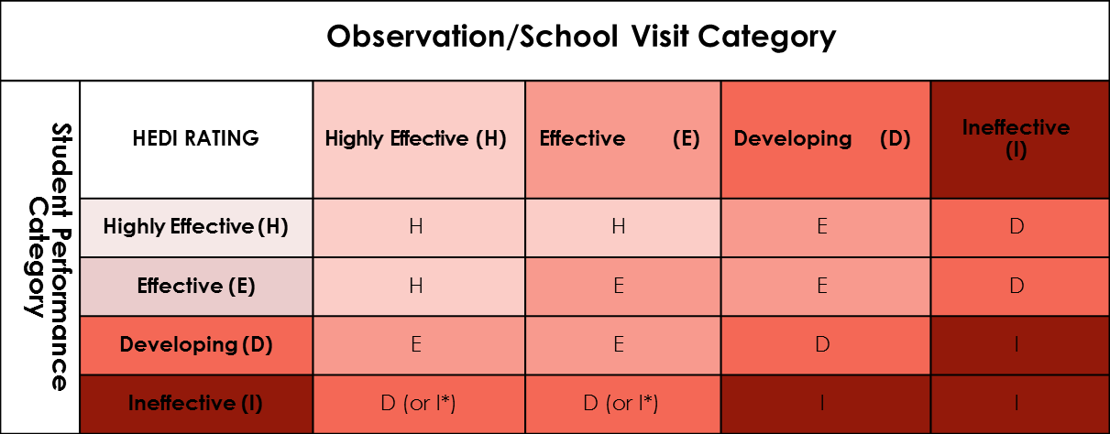
Composite Score Matrix: Two Components

Slide 3
Observation Component
1 observation by Lead Evaluator: Building Principal or designee (At least 80 percent)
At least one by outside evaluator (different BEDS number—20% Negotiable)
Peer observation (10 % Negotiable)

Slide 4
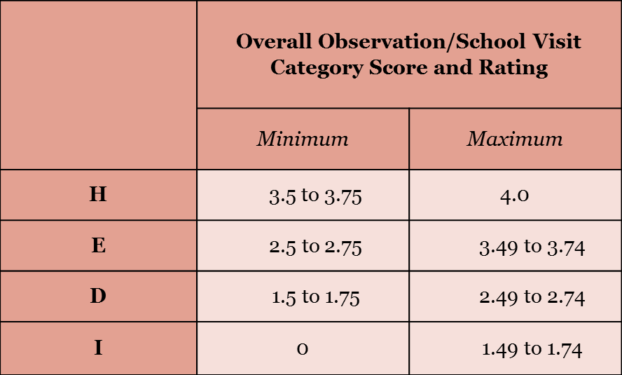
Observation Score Ranges

Slide 5
APPR Math
Teachers receive a weighted average of all observations
Any teacher who receives a 1 on both observations must receive a O for the category

Slide 6
Observation Rubric
Domains 2 and 3 (Danielson) must be evaluated over the course of the total observations

Slide 7
Student Achievement Component
State Assessment
Possible second subcomponent (Negotiable)
State assessment or state approved

Slide 8
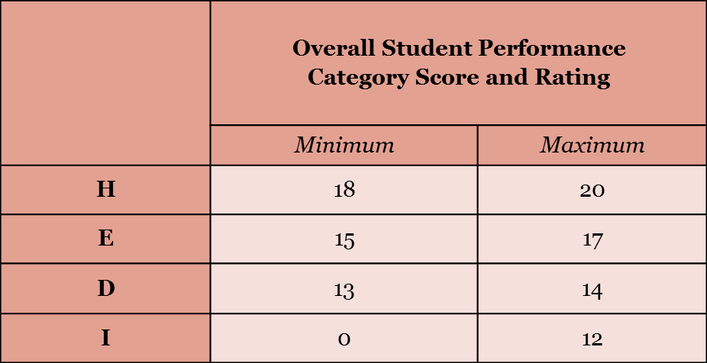
Student Performance Category: Score

Slide 9
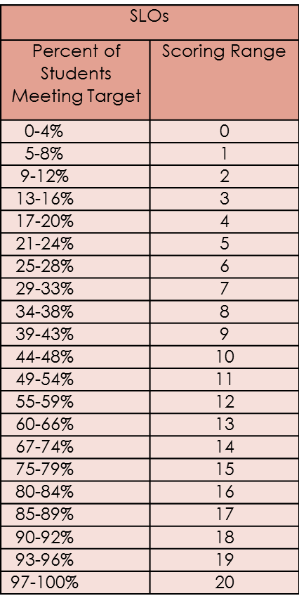
SLOs Scoring Chart

Slide 10
Appeals Process
Negotiable
The anomaly
Corrective Action

Slide 11
APPR 3012.d
Questions?

