Slide 1

5TH GRADE PARENT ORIENTATION
Welcome to our Classroom

Slide 2
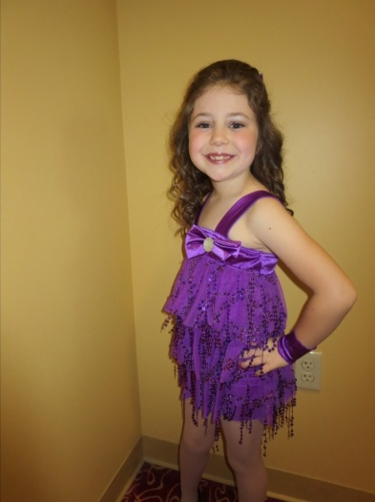
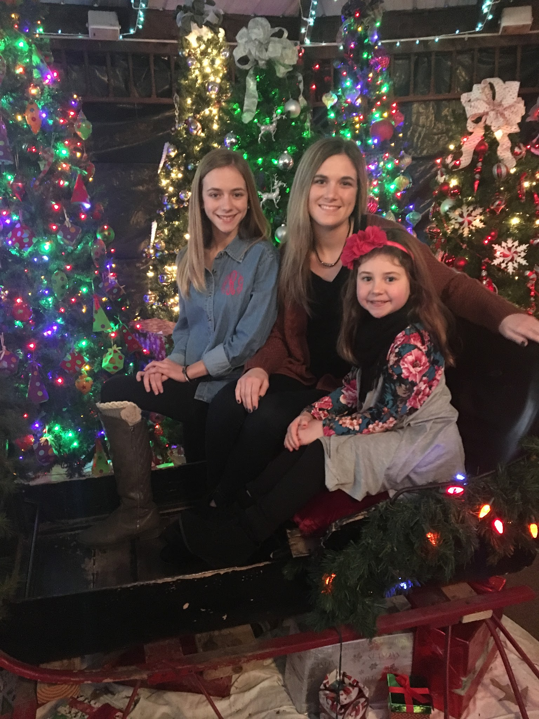
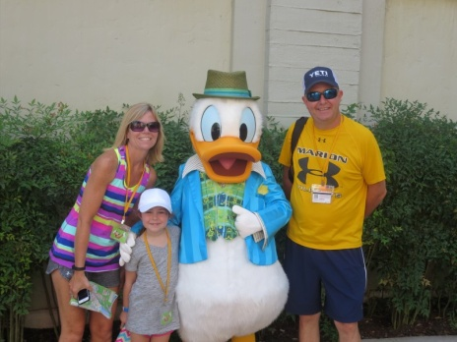
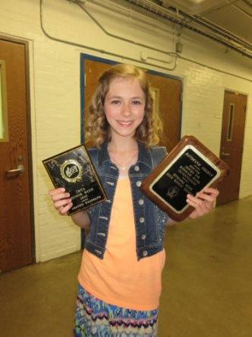
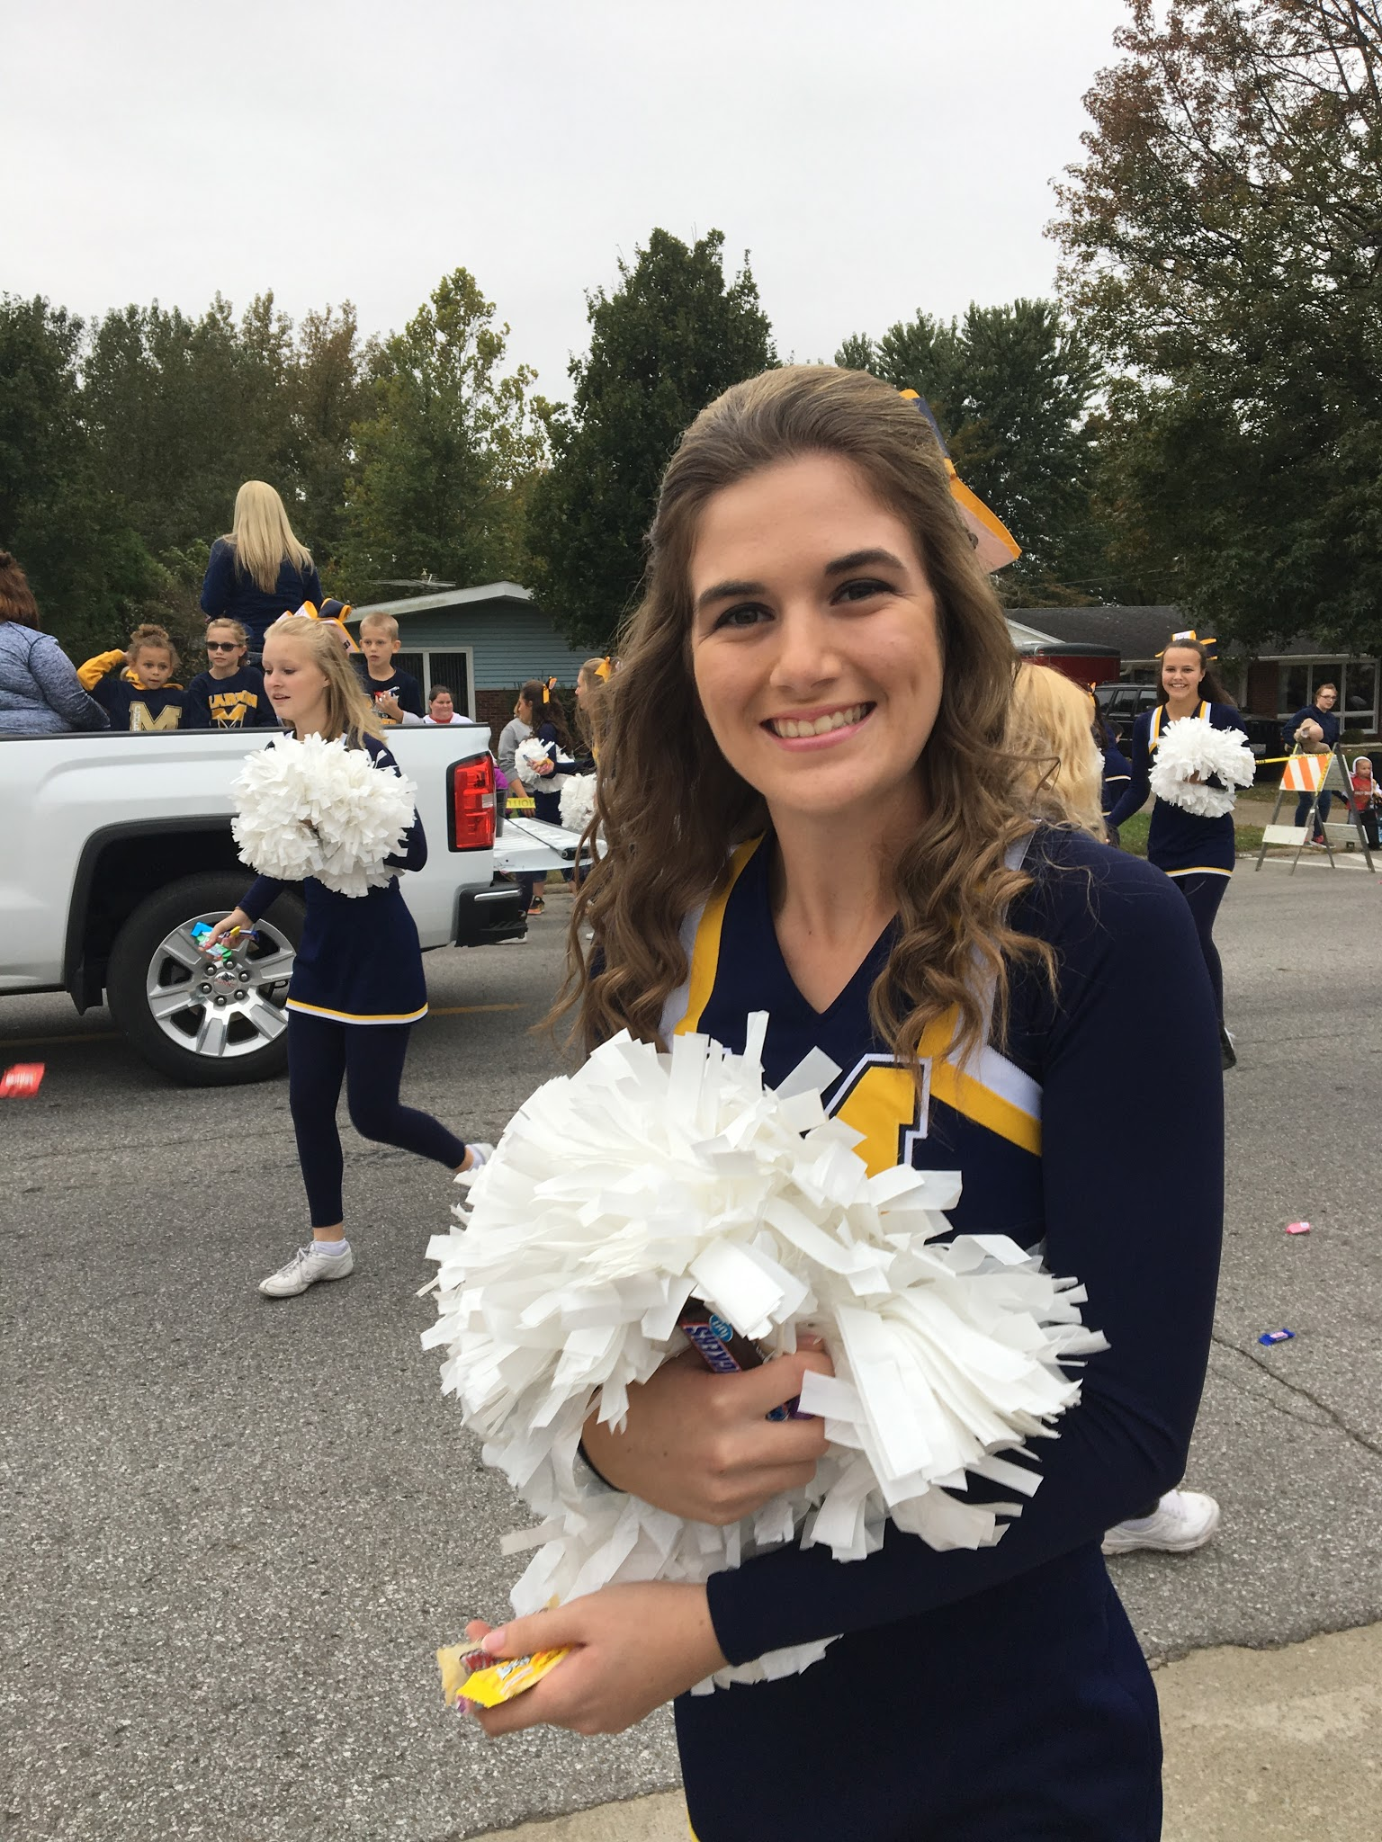
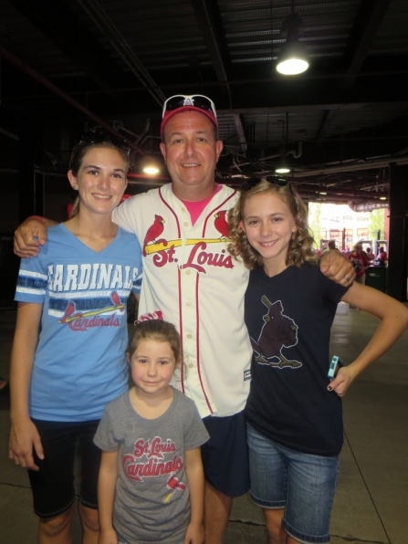
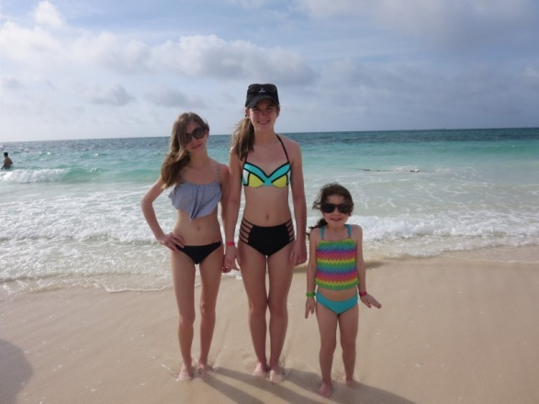
My Family and Educational Experience

Slide 3

School Safety
At least 2 emergency contact numbers *keep up to date
Doors are locked from 8:10-end of day
Sign in/ Sign out
End of day dismissal- Early Bus, Walkers/Bikes, Cars, Late Bus (if you are running late your child will wait in cafeteria- with supervision- not outside building)

Slide 4

5th grade goals:
To be more independent (exciting activities throughout year- privileges for 5th grade )
To be responsible, respectful , and safe
Honesty (we all make mistakes)
To be prepared for MJH
To be prepared for PARCC state testing
To follow the golden rule- “Treat others as you would like to be treated”.

Slide 5
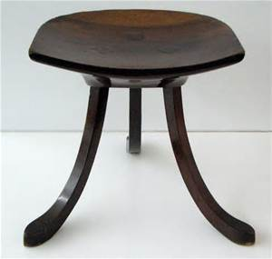
Work as a Team:
Parents, teachers, and students all work together

Slide 6
Communication:
Nothing to hide, we all want your child to succeed
E-mail newsletters every week
Various parent e-mails throughout the school year (adrandolph@marionunit2.org)
Classroom Website
Keep me updated if your e-mail changes

Slide 7
Classroom Management:
Firm, consistent
Golden Rule
PBIS- Be respectful, Be responsible, Be Safe
Management and Behavior Matrix on our classroom web page
Friday Prize- chips/drink/ sit on throne!

Slide 8
Classroom Website
Go to Marion Unit #2 .org
Select our school
Select 5th grade- Mrs. Randolph
Information included- newsletter
pictures
calendar
homework hints
spelling lists
grading scale
classroom management
classroom schedule
classroom behavior matrix

Slide 9
Homework:
Included in newsletter- at a minimum-more for responsibility- study periods during the school day
At the beginning of year, I sign each students assignment sheet
Assignments are written on board daily
I will stop signing, but check periodically
Must use break time to complete late homework
10 points deducted for late homework
Check your child’s grades on-line every week- Report Cards will be distributed after each grading period
Do not go to bed until back pack is ready for the next school day

Slide 10

Grading Scale:
Check your child’s grades every week thru Information Now (information on Marion Unit #2 website)
No name on paper- 10 points deducted
Grading Scale on our classroom Website
I will send an e-mail reminder for mid term progress and for report card times

Slide 11

Band Information:
Band parent meeting will be scheduled in September
Will keep you updated thru newsletter and e-mails
Mrs. Henshaw and Mr. Graham are the instructors
Great opportunity to meet students from other schools
Winter performance and Spring Performance

Slide 12

PARCC Testing
March /April- Language Arts & Math this year
Language Arts / Math
Common Core State Standards
More rigorous and more depth of learning- more thinking and problem solving
Focuses more on process than product
Will all be on computer- keyboarding skills

Slide 13

Accelerated Reading:
5 points per grading period
Prize at the end of the year for top
readers !!!!!!
Check classroom webpage for AR readers photograph
Grading period rewards if you earned all the points

Slide 14

Let’s have a great year!
Open communication
Best way to contact me : adrandolph@marionunit2.org
Thank you for taking time from your busy schedule to attend tonight!

