Slide 1
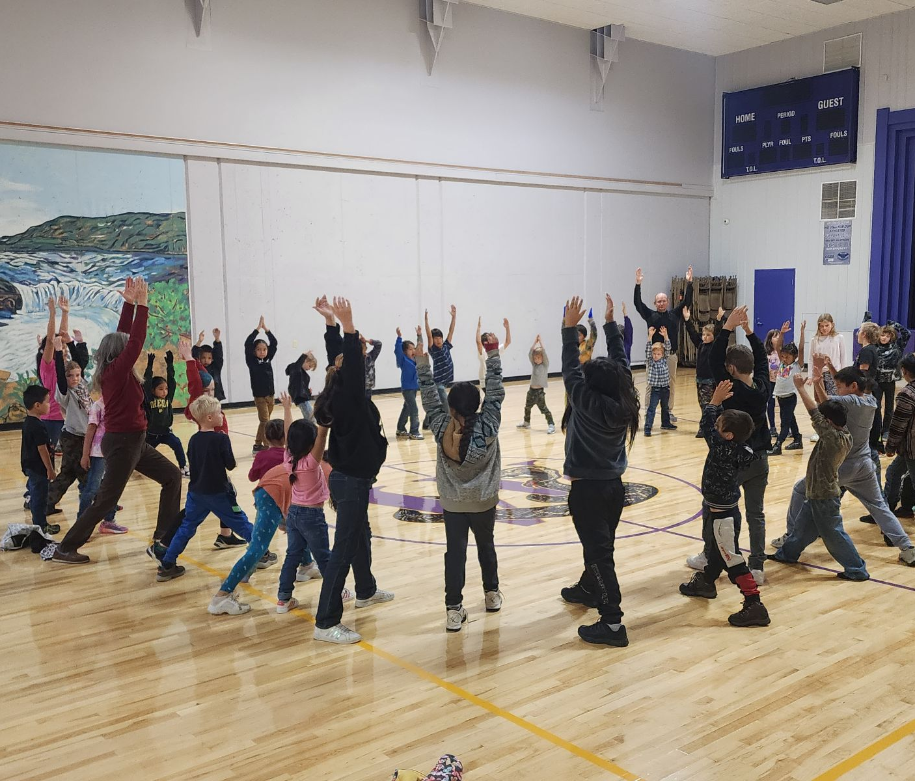
Wishram SD Levy Request
2024
Feb
13
Community Night

Slide 2

Levy Information

Slide 3
Narrative
This February, Wishram voters will decide on a four-year replacement levy funding measure. The proposed levy will fund programs in our rural school district that are outside of state-defined basic education funding. These levy enrichment funds will be invested in career & technical education, food service, school culture and climate programming & staffing, coaches and bussing for athletic programs, extra co-curricular programming and field trips. Our additional programming needs are directed to meet the needs of the whole child. With the passage of this levy, the district would receive an additional $70,292, on average, of state Levy Equalization or Matching Funding- bringing a combined amount of $145,292 to our district yearly to support our kids.
Further information is available on the district’s website at https://www.wishramschool.org/.

Slide 4
The Levy
YEAR RATE AMOUNT
2025 $1.08 $75,000
2026 $1.03 $75,000
2027 $0.98 $75,000
2028 $0.94 $75,000
Estimated Cost for Average Homeowner:
About $173 in 2025 or $14 per month, based on the median assessed local home value of $160,000.

Slide 5
Public Questions
-Q: What is an EP&O levy?
A: Levies are short-term (1-6 year) local property taxes that must be approved by the voters of a school district. An Educational Programs & Operations (EP&O) levy generates funding for educational programs and services that the state does not fund or under funds.
-Q: Is this levy a new tax?
A: The Wishram EP&O Levy on the February 13 ballot is not a new tax. It replaces an existing voter-approved levy to fund the continuation of programs and services families count on. Much like a subscription, every few years, the district asks the community to renew this local funding measure and continue to support the programs and services families expect.

Slide 6
Public Questions
-Q: Doesn’t Washington fully fund public education?
No, the state and federal governments do not fully fund public education. Although the state has invested more money in schools in recent years, it only funds part of the actual cost of education. In Wishram, the state funds 93.41% ($2,393,588) of its budget, the federal government funds 3.48% ($89,259) and local tax dollars support the rest— making up 2.93% ($75,000) of Wishram’s overall operating budget. Total ($2,562,547)
-Q: How does this levy compare to past levies?
A: The proposed levy amount per year of $75,000 is the same as previous years. Tax rates are estimated to be lower due to higher property assessments.

Slide 7
Public Questions
-Q: Does the district collect more money if home values increase?
No. The district cannot collect more than the amount approved by the voters. Increases in property values do not generate more revenue for the district.
-Q: Are tax exemptions available?
A: Some disabled and senior individuals may qualify for a tax exemption in Klickitat County. Please visit their website (https://www.klickitatcounty.org/224/Senior-Disabled-Exemption) for further information or call 509-773-3715.

Slide 8
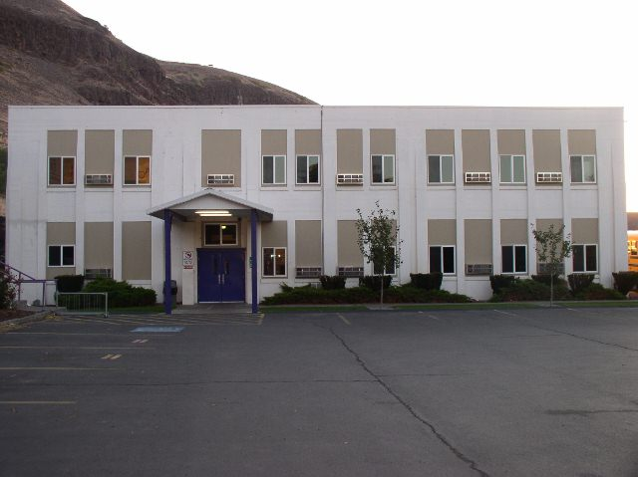
What this Levy Supports

Slide 9
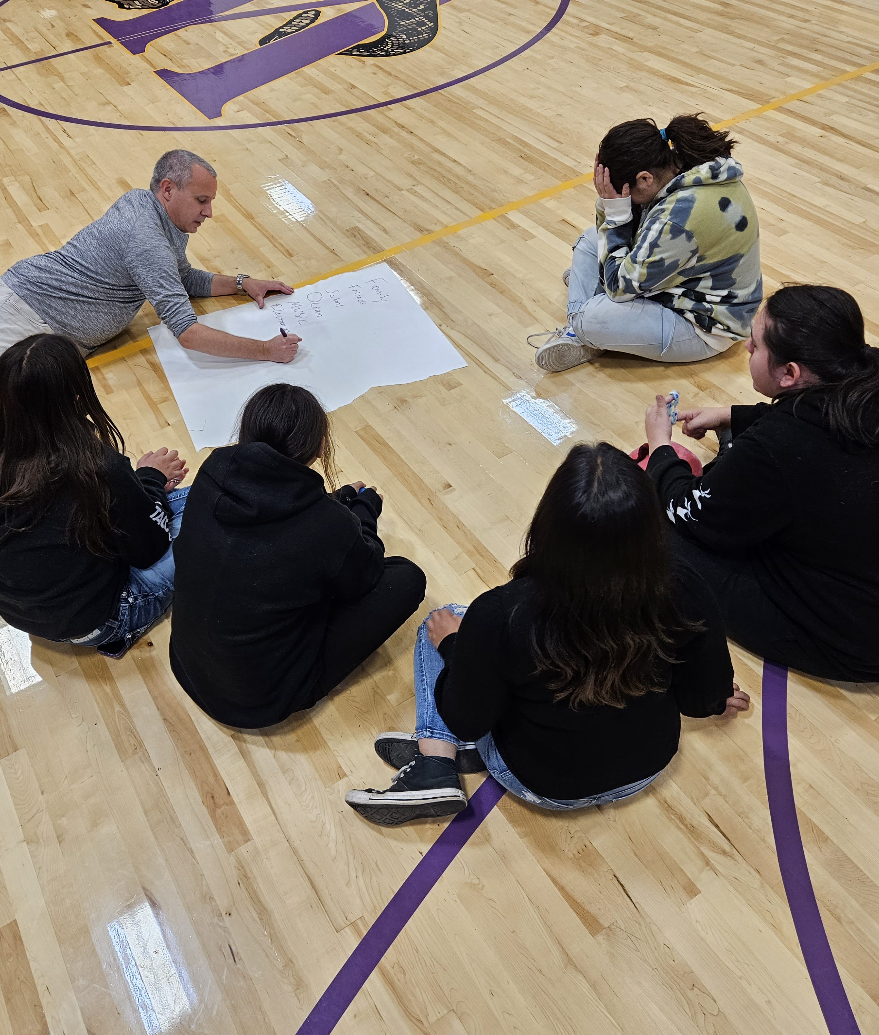
Bring Back a School Counselor
Resignation and Budget Constraints caused the loss of our counselor in 2023.
To continue providing our students with college and career readiness skills, social-emotional learning, and support.
Maintain a k-12 counselor position within the building.
Continue to enhance and expand our Positive Behavior Intervention Program.

Slide 10
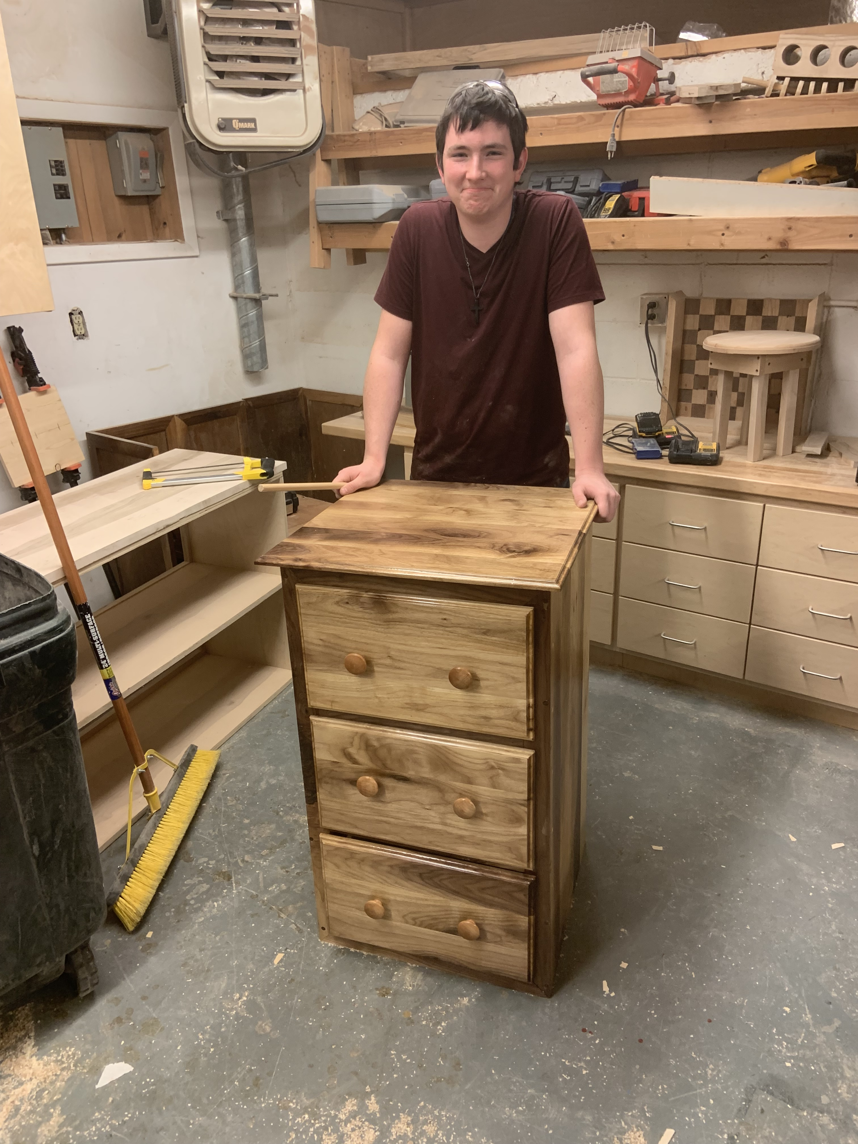
Continue CTE Programming
The hook and carrot which leads to employable skills right out of High School.
To continue course offerings in wood shop, welding, construction, and other marketable trade skills.
To provide equipment, materials, and supplies for student practice and projects.
To continue to fund and keep the CTE Teacher position.

Slide 11
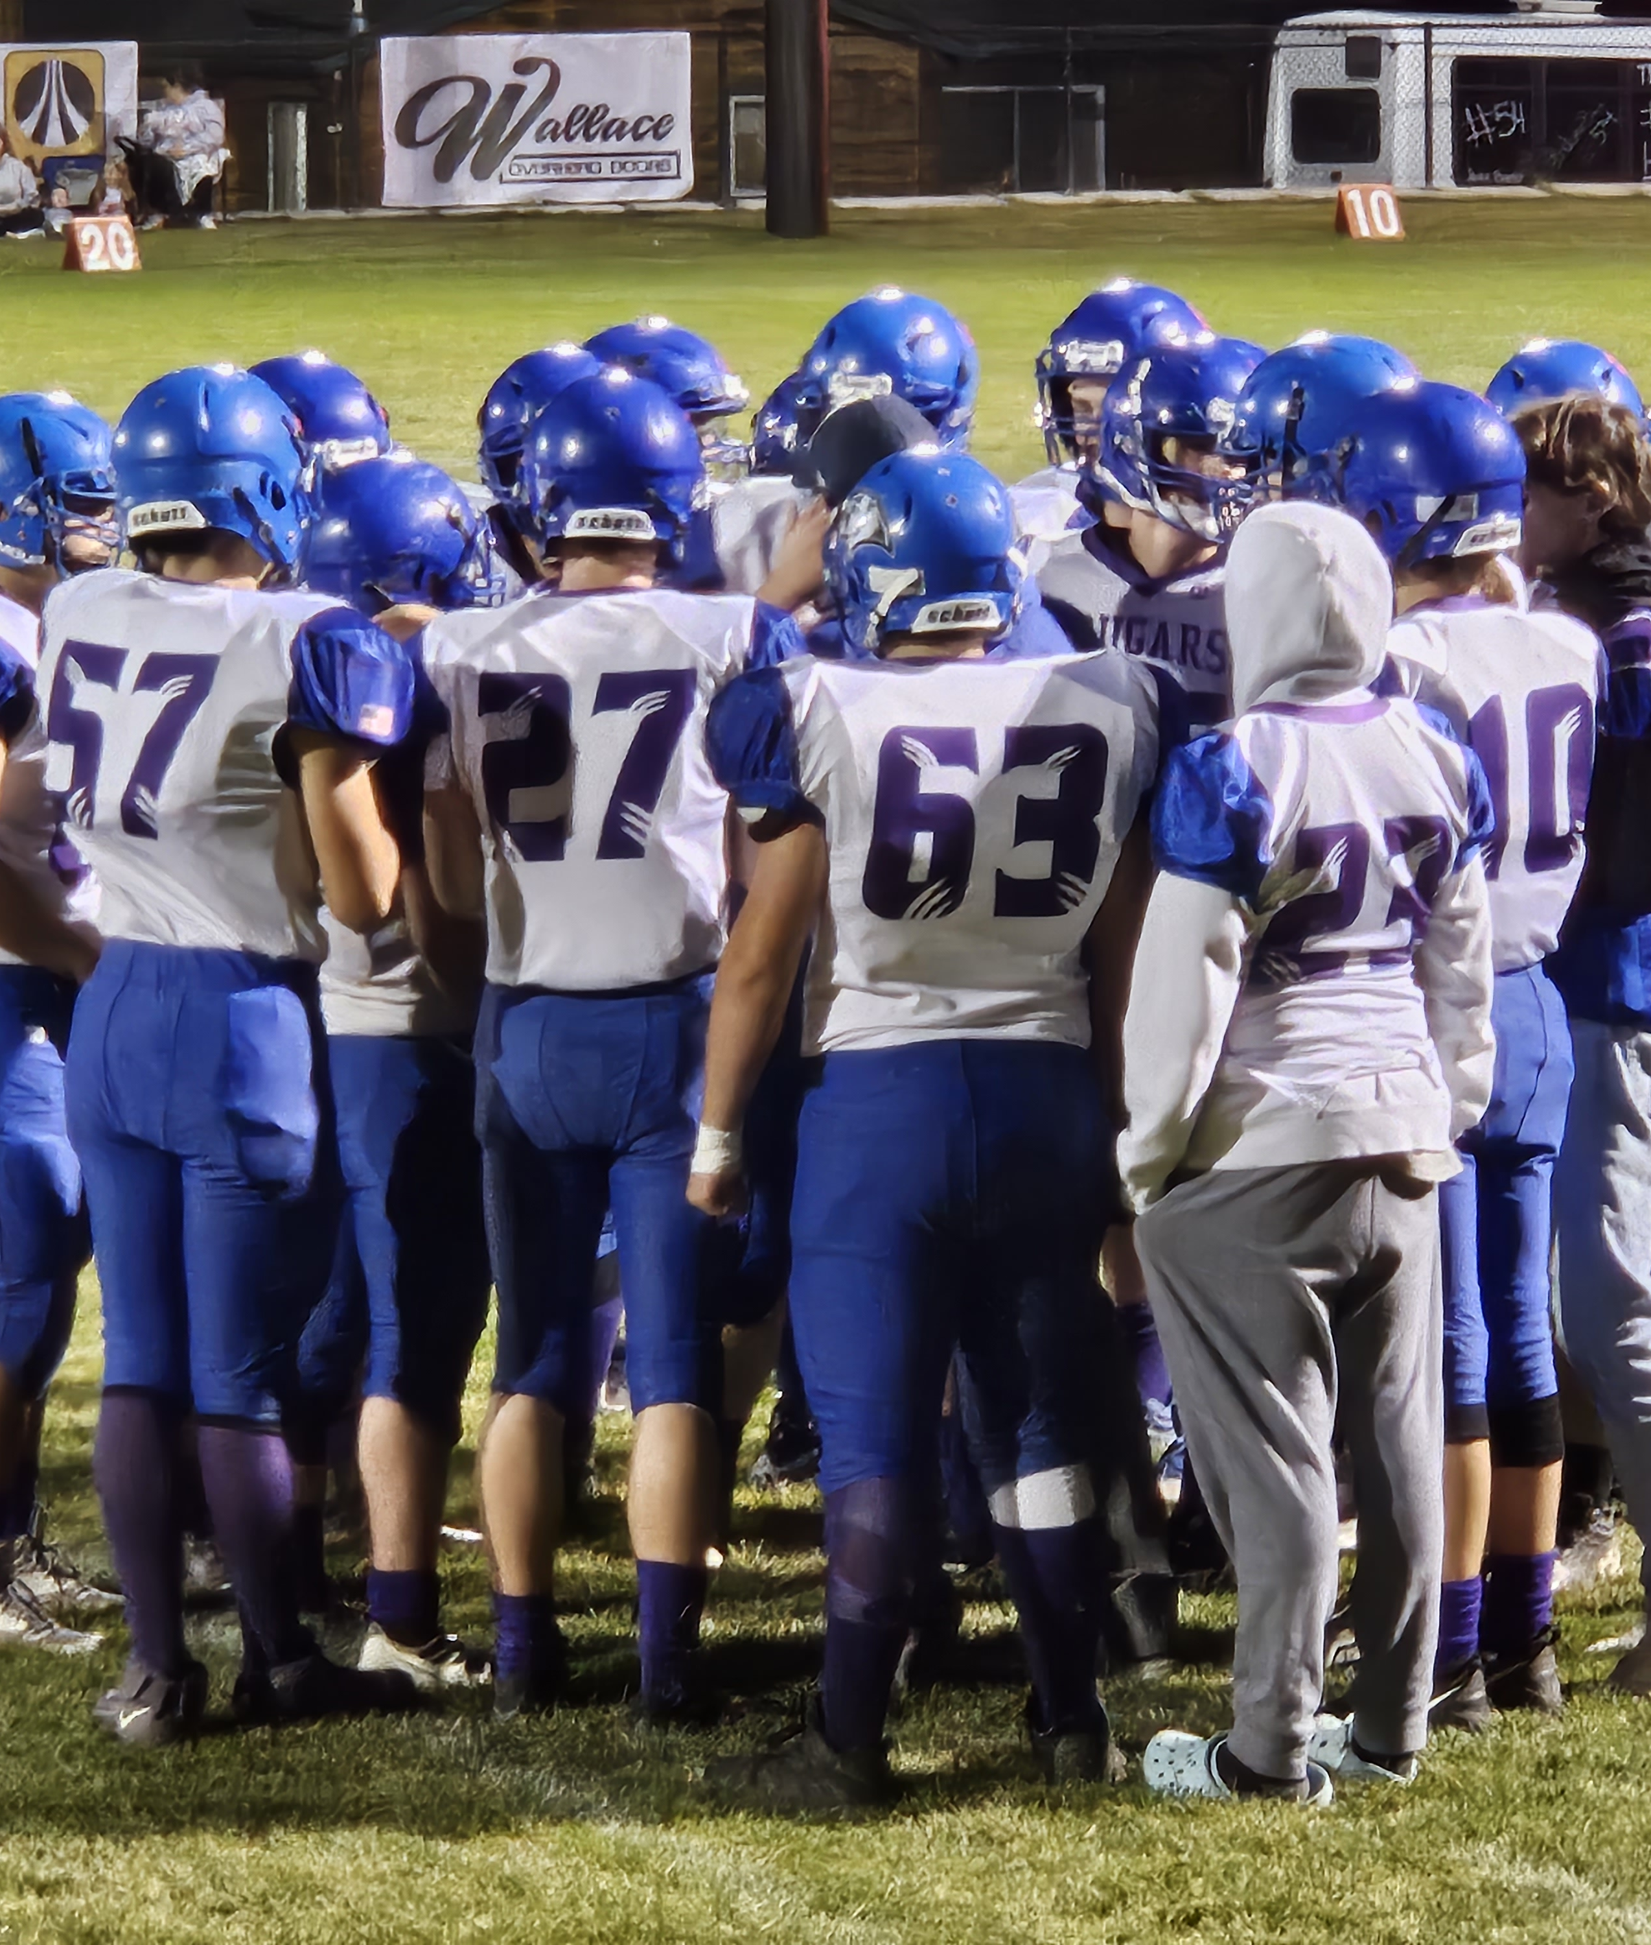
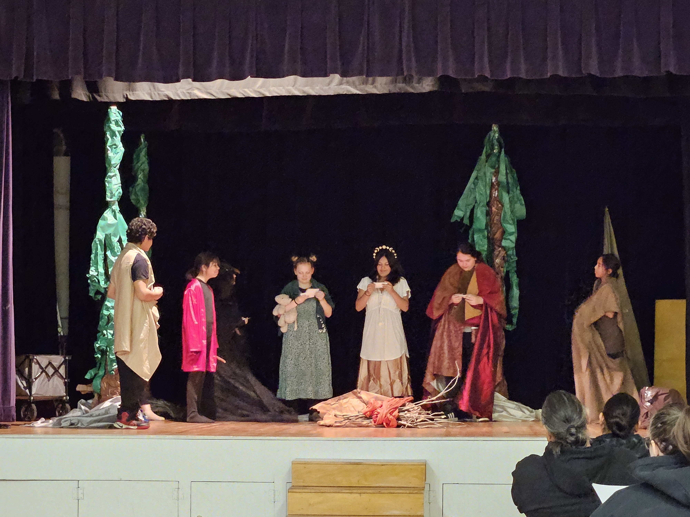
Sports and Student Activiites
Proud to be a Rattler, play as a Cougar, and embody the Wishram Community.
To continue our athletics program, which boosts school pride, teamwork, student confidence, and engagement.
To assist in covering athletic participation costs from the Lyle/Wishram Sports Combine.
To provide materials for Drama Class and Art Class.

Slide 12

Thank You!
Wishram School District

