Slide 1

Erbes Road
Student Drop-off
Stair-
well
B-1
C-1
C-2
C-3
C-4
C-5
1387-1436
B-2
Media Center Blvd.
1197-1212, 1267-1316
B-3
P-2
1317-1322, 1331-1336, 1229-1269
1275-1296, 1213-1228
B-4
D-1
D-2
D-3
D-4
Woodshop
P-1
Leopard Lane
Walkway
1337-1385, 1323-1330
Lunch Line
Renaissance Road
Los Cerritos Middle School
School Map
&
1st Floor Locker Plan
Revised 10/22/2014
Jungle Hallway

Slide 2
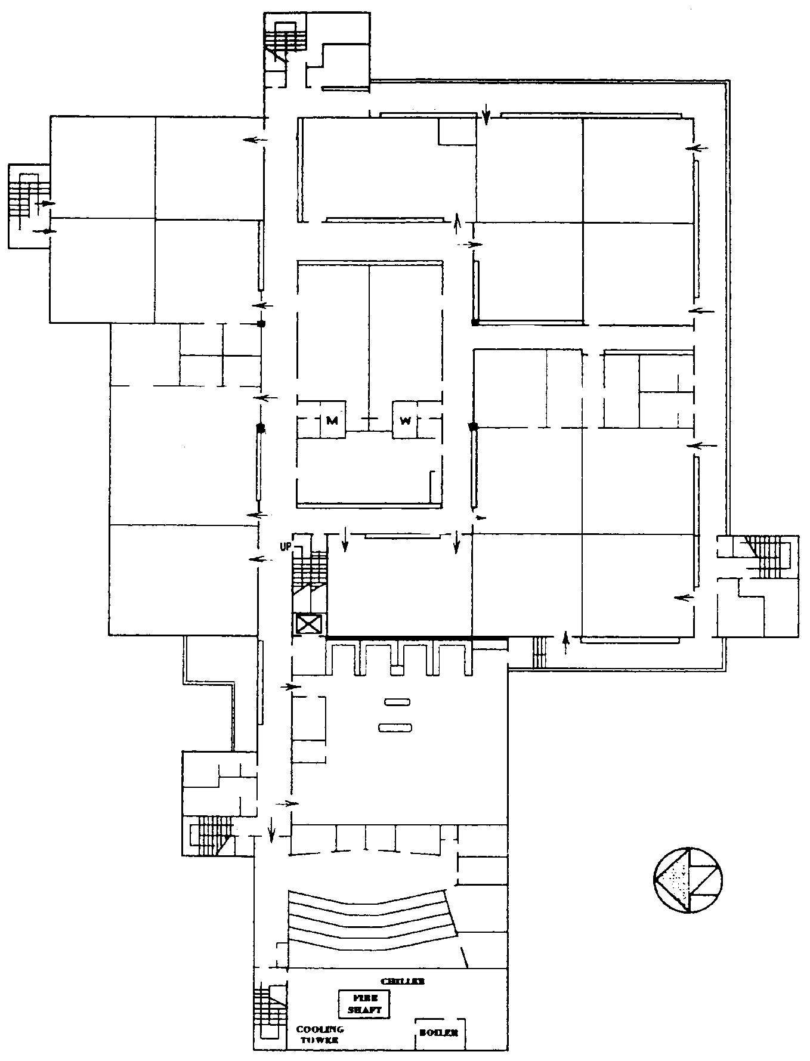
Stairwell
453-514 361-452
Room 25
805-860
Room 26
Computer Lab
Room 36
Room 35
Room 37
741 - 804
281-360
Writers Row
Room 24
861-900
1029-1112
Room 27
Room 34
701-740
Ceramics
Room
(Kiln)
Room 40
Room 39
645-700
6th Avenue
579-644
Avenida Descanso
CLU Room
Storage
Room 23
(Art)
Staff Lounge
901-940
989-1028
Room 29
Room 33
1113-1196
Calle Espanol
193-218 239-280
6th Grade
Stairwell
941-988
Room 22
Computer Lab
Room 30
Room 31
Room 32
Los Cerritos Middle School
School Map
&
2nd Floor Locker Plan
Revised 10/22/2014
515-578
139-184
Stairwell
Room 21
Room 20
(Band)

