Slide 1

Securing Funding for Students with Disabilities
Michelle Bodi
Community School District 115
Yorkville Transition Program

Slide 2


Purpose of Presentation
School District 115 finds it essential to provide Special Education Leadership, Special Education Team members and families of students with disabilities with important information and connections for future funding and planning.

Slide 3

Topic 1 PUNS
Topic 2
Topic 3
Independent Service Coordination Agencies (ISC) and Individualized Service Agent (ISSA)
Home and Community Based Funding Through Medicaid
Children’s Home Based Services
Topics
Funding Support Information
Topic 4
Topic 5
Topic 6
Adult Home Based Services
Residential Funding
Day Programming

Slide 4
Topic 7
Topic 8
Topic 9
Topics Continued
Supported Employment
Supplemental Security Income (SSI)
Supplemental Security Disability Income
(SSDI)
Topic 10
Topic 11
Medicaid
Health Benefits for Workers with Disabilities (HBWD)
Topic 12
Guardianship

Slide 5
Topics Continued
Additional Docs
Topic 13
Topic 14
Special Needs Trust
Transportation
Quick Links to Supports
ABLE Accounts

Slide 6

Independent Services Coordination Agencies
ISC agencies are responsible for informing and explaining all services and support options available to individuals with developmental disabilities and their families.

Slide 7
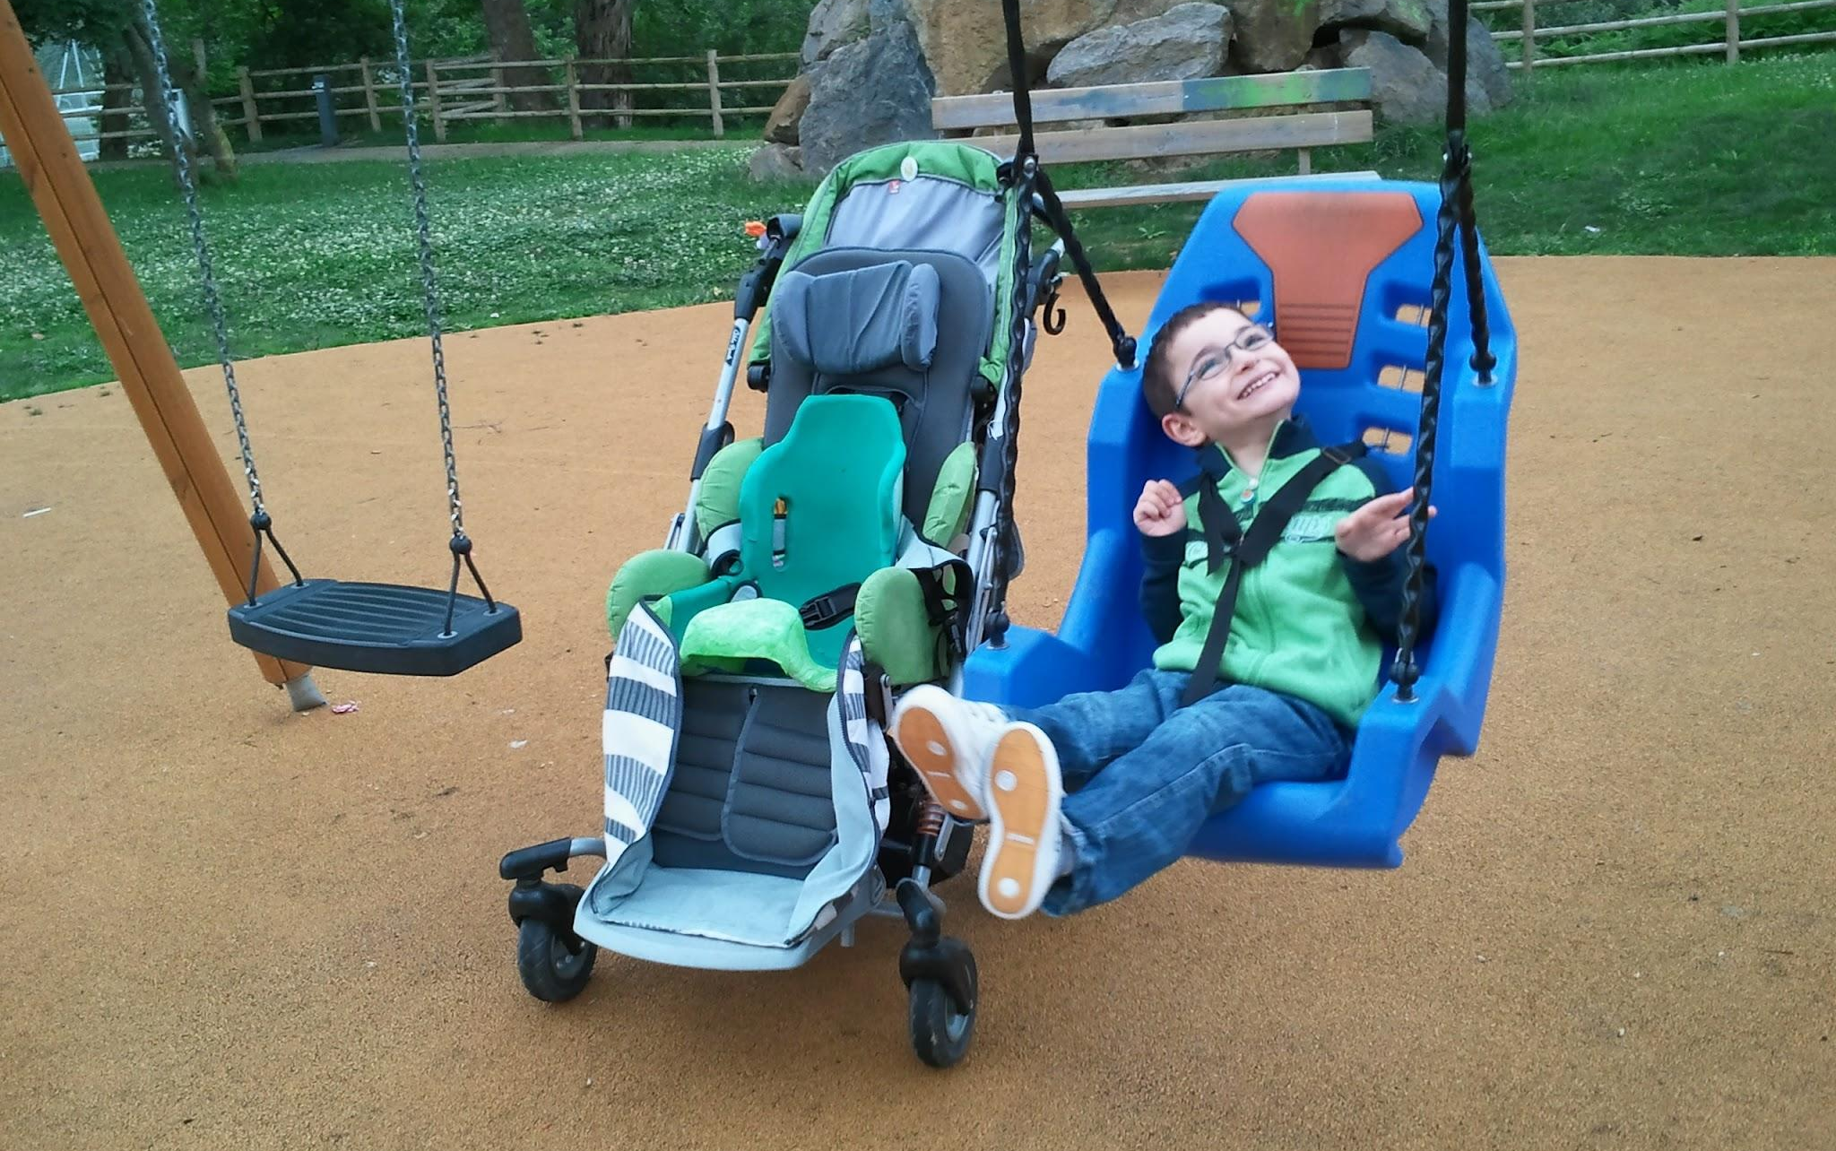

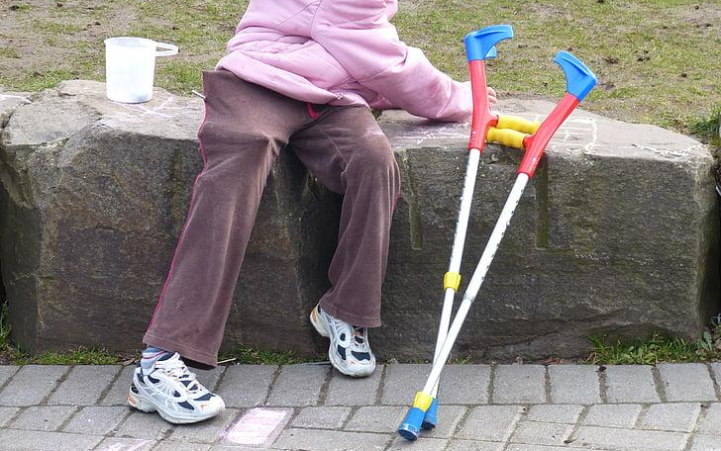



Key Takeaways About ISC
Role
How
How
Educate individuals with developmental disabilities and families of all ages by informing them of services and supports available
Determine eligibility and help families sign up with PUNS
Emergency funding is available only if individual is abused/neglected or could become homeless
Notes:
E

Slide 8
What to Expect
What families can expect to happen after contacting ISC Agency
Step 1
Step 2
Step 3
Step 4
Be Assigned and Individual Service Coordinator Agent
ISC will conduct a preaddmission screening with the individual and their family
Guardians will need to be respectful BUT Persistent (follow up)
When and if a individual applicant is pulled, individuals need to meet all criteria at this point.
Notes:
Families should call every three days to once a week for results
ISC Agents will explain what funding is available for a individual to NOT become homeless.
Final eligibility is determined having SS benefits and Medicaid, who would be the service provider if services is granted and plan for services provider if the funding is granted.

Slide 9

Important Reminders
ISC Agent Roles for Families
Explain Funding to families to prevent homelessness for individuals
Main link between families and service providers in their assigned geographic area
Will provide referrals and resources for psychological testing
  T
Families
Need to be able to describe their emergency situation once an ISC agent has been assigned
Complete PUNS questionnaire before any funding can be offered
Update PUNS annually or as emergency situations arise
Encouraged to think of the worst case scenario
  Reminders
PUNS database serves ofer 22,000 individuals
Have correct diagnosis and paperwork while in school
Labels are ok and will provide opportunities to meet criteria
Correctly certified Psychologist and licensure to accept school Psychologist reports
Notes:
School diagnosis is essential because it determines eligibility for adult services. Criteria has to be met VS Special Education that is mandated.
Intellectual disability - IQ below 70, Mental or Physical Impairments manifest before the age of 22, have substantial limitations in three major life activities.
Prior to being granted PUNS - families need to also secure SSI and Medicaid Services - Please review additional presentations and information provided.

Slide 10

Individual Support and Service Agent
Once an individual has been granted PUNS funding, an Individual Support and Service Agent (ISSA) will be assigned.

Slide 11
Role of the Individual Service & Support Advocacy
Support
Visits
File Reviews
ISSA becomes the monitoring body for all Medicaid waiver and service Programs
Conduct four annual visits with the family
File reviews to ensure services are rendered and individuals and families are satisfied
Notes:
Visits may be at the individuals home, program site, or place of resident.
State funding has allowed families have more input with providers and finding the right fit for each individual.
Ensures money follows the individuals - Goal for the individual to have support so they can use their funding and have the best available resources from the community

Slide 12

Where to Start
Kendall County Area Support
DHS Offices and Service Providers for Kendall County
Service Inc. of Illinois (Area E)
Developmental Disability Services
1919 South Highland Ave., Suite A #230
Lombard, IL 60148
Phone: (630) 425-2350
TTY: None
Fax: (630) 656-1237
Crisis after hours number: (815) 741-0800
Directions: To this Office | From this Office
Illinois Department of Human Services

Slide 13
Home and Community Based Service Funding
Now that families have funding; it is essential for families to know what they can apply for in Illinois.
Almost all adult and children funding services programs are funded under the Medicaid Waiver Program (DHS/DDD) under the Illinois Department of Human Services

Slide 14
Two Types of Home based Services for Individuals with Developmental Disabilities
Childrens’ Home Based Services (CHBS)
Adult Home Based Services (AHBS)
These waiver programs provide a monthly allotment for purchase services based on the current supplemental security income allotment
Should not be viewed as financial assistance for the family but is intended to purchase services for the individual from the providers

Slide 15
Services Can Be Purchased
Personal Support
Service facilitation
Transportation Services
Day Program
Supported Employment
Behavior Services
Occupational Therapy
Physical Therapy
Speech Therapy

Slide 16
Expectations for Receiving Services and Facilitation
Case Management Coordination
Visits
Minimum of two hours a month from a Community Agency
Agency does not have to be the same one who provides services
What Community Agency Does
Oversee monthly budget for individuals
Ensures there is an active service plan being followed
Submit monthly billing for service providers
Community Agent will conduct visits throughout the year
Difference in Waivers
The number of visits varies depending on waiver program is being accessed.

Slide 17
Individuals and Families are given a choice of which service model they would like to choose:
Family Directed
Agency Directed
Allows family to hire their own personal support worker and act as the employer of records.
Can be a family member/parent but must register with state third party agency
Agency responsible is responsible for hiring, training, overseeing their workers and are the employer of records
Agencies holds complete liability for services rendered and its workers
Notes:
Families are able to choose and request a change based on needs. They will work with their ISSA to change their service model.

Slide 18
Children Home Based Services
Children can be granted funding while at school between the ages of three and 18 years of age who have a Developmental Disability

Slide 19
Key Takeaways for CHBS
Important Age
Consider
Not all Services
Allotment is lower due to school programming coverage but Will be two times the SSI Amount granted for an individual
Due to school programming; OT/PT/Speech and personal support workers ,Day Programs are not covered
Students who have a Developmental Disability should apply for PUNS at Three
Notes:
Not all services are available under the Children’s waiver due to their daily programming provided by public school

Slide 20
Expectations for Receiving Services and Facilitation
Case Management Coordination
Visits
A Service Facilitator is required to complete six visits a year.
Perks of Enrolling in Childhood Services
Students who qualify for CHBS will automatically be transitioned into the adult system.
No wait list required
Community Agent will conduct visits throughout the year
IEP
Home Visits
School Visits

Slide 21
Adult Home Based Services
Adults can be granted funding after the age of 18 years old who have a Developmental Disability .

Slide 22
Key Takeaways About AHBS
Important Age
Consider
Services Facilitator
AHBS allotment is three times of the Social Security Amount
Required to make four visits per year
Home, Resident, Day program or IEP
Students who have a Developmental Disability should apply for PUNS at Three to access Adult funs easier
Funding is considered long term as long as individual meets medicaid waiver requirements
Notes:
Medicaid card

Slide 23

Where to Start
Operating Agency Contact Information
Division of Developmental Disabilities
Phone: (888) 337-5267
Email: DHS.DDDComments@illinois.gov
Children and Young Adult Fact Sheet
Children and Young Adult Waiver
Children and Young Adult Checklist
Children and Young Adult Residential Services Fact Sheet
Children and Young Adult Residential Services Waiver
Adults with Disabilities Waiver Fact Sheet
Adults with Disabilities Current Waiver
Checklist for Adult Waiver Services or CILA
Additional Waive Options

Slide 24
Residential Funding
Provides an overview of the types of residential supports in the community that funding can go towards.

Slide 25
Types Residential Support
24 Hours or Intermediate
CILA
ICF/DD
ICF/DD Cont
Community Integrated Living Arrangement through Department of Health and Family Services
Nursing Care on site
Funding can stay with the building
Finding a bed available
More Restrictive environment
Community Integrated Living Arrangement (CILA) through Medicaid
Less Restrictive Environments and possible less activities.
Founding is considered long term as long as individual meets medicaid/waiver requirements
Notes:
ICF/DD Through Department of Health and Family Services are typically a higher staff to patient ratio which is closer to 1 to 5 or 1 to 4

Slide 26
Additional Information on CILA Funding
Family and Intermittent Model
CILA Funding
Money follows the person
Individuals can change agency providers as desired
For an individual who chooses to stay home
They may need some supports while living at home
Capable of living mostly independent but requires supervision/assistance in some areas
Limits are up to 15 hours per week
Notes:
Families are able to choose and request a change based on needs. They will work with their ISSA to change their service model.

Slide 27
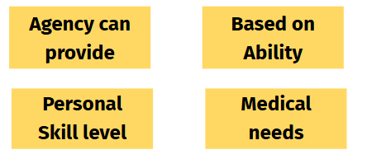
Types of Facilities under CILA
based on
Shift Staff Homes
Family Host Model
24 Hour residential that is facility based within the community
Agency supplies housing and staff
Housing 5-8 residents.
Attends Day Programs during the day and provides support for jobs
Smaller family setting
Agency screens and hires a family who can oversee 2-3 residents
Attends Day Programming and can be supporters for a job
Community Integrated Living Arrangement (CILA) Providers for Intellectual Disability Services
Notes:
Families are able to choose and request a change based on needs. They will work with their ISSA to change their service model.

Slide 28
Day Programming
Day time opportunities available through the medicaid waiver programs

Slide 29
Key Takeaways about Day Programs
Post Education System
A Day in the Life
Differences
Various Activities
Life Skills
In House Training
In House Jobs
Contract Work
Sheltered Workshops (Changes being made in IL)
Some may be strictly facility based
Some may offer community activities and experiences
Adults exiting public school will still need developmental training
Usually Mon - Fri
8:30am- 3:30pm
Notes:
ICF/DD Through Department of Health and Family Services are typically a higher staff to patient ratio which is closer to 1 to 5 or 1 to 4

Slide 30
Some Big Changes
Families should consider what is most needed for each individual
Families need to consider Transportation to and from Day Program
Transportation is no longer provided by the school system and becomes the responsibility of the individual/family receiving services
Providers of services are not responsible for transportation
If families have not received a Waiver from Medicaid - then they can inquire about private pay options.
Providers will list what payments they accept
Some families will use SSI Benefits.
Day Program Providers For Intellectual Disability Services
Notes:
Families are able to choose and request a change based on needs. They will work with their ISSA to change their service model.

Slide 31
Supported Employment
A quick dive into DHS/DRS Vocational Services

Slide 32
Key Takeaways About DHS/DRS
Accesses
While Waiting
Financial Assistance
Great opportunity who are waiting to for PUNS List and can access these services before their last semester before graduating.
DHS/DRS Funding is available for post secondary educational programs.
Will pay for college based programs that are career focused
Can seek employment services from DRS office’s last semester before receiving a HS Diploma
Individuals can not receive educational and vocational services at the same time

Slide 33
Supported Employment
SEP and other employment services are also covered by Medicaid Waiver Programs. These Services are;
Adult Home Based Services
SEP Under DD
Department of Rehabilitation Services
These programs offer for competitive and supportive employment such as;
Job placement services
Job Coaching Support
Follow up services
Based on the skills of the individual and can be more to least restrictive.
Notes:
DHS/DRS

Slide 34
Who Funds Supported Employment
Funding Through DHS/DRS is Short Term
The Department of Human Services/Division of Rehabilitation Services is an alternative funding option. (Known as DHS/DRS)
Vocational Placement
Job Coaching Services
Vocational Evaluations
DRS can pay for;
Job Training Programs
Covers Modifications
Work Gear (Shoes/Uniforms)
Job Related Programs
They also offer Home Health Services for individuals who have physical limitations
Notes:
Great opportunity who are waiting to for PUNS List and can access these services before their last semester before graduating.

Slide 35
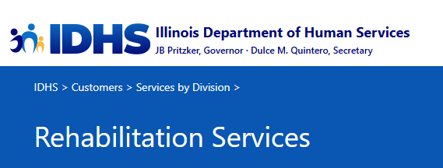
Where to Start
Rehabilitation Services
DHS's Division of Rehabilitation Services is the state's lead agency serving individuals with disabilities. DRS works in partnership with people with disabilities and their families to assist them in making informed choices to achieve full community participation through employment, education, and independent living opportunities.
How to Contact DRS
Use the online Rehabilitation Services Web Referral to refer yourself or someone else for services.
DRS staff provide services to people with disabilities in 47 local offices located in communities throughout the state. Use the DHS Office Locator and search for Rehabilitation Services to find the nearest local office or call toll-free: (877) 581-3690 (Voice, English or Español) or (866) 324-5553 (TTY).
For general questions about DRS, email DHS.DRS@illinois.gov.

Slide 36
Supplemental Security Income (SSI)
Apply for this first, individual will automatically qualify for Medicaid
Student are entitled to these services and a part of the process in securing state funding for Adult Services

Slide 37
Key Takeaways About SSI
Eligibility
Criteria
Exceptions
Specific to the Developmental Disability Population
Cognitive Impairment
Total IQ less than 70
Exceptions can be made Autism or other Medical Diagnosis with 70 or higher
Substantial limitations in three or more of the seven major life areas
Proof of disability and there is a financial need

Slide 38
SSI Additional Information
SSI Additional Information
Individual’s assets are under $2,000
  Cash
  Bonds
  Trusts
  Mutual Funds
Individual must submit banking records
Three year lookback
  Under 18 - family will provide
If denied as a child - apply when individual is 18
Most cases young adults will want to provide documentation of “fair share” of household expenses
Cautious of “renting” from family
  No longer considered a dependent
Apply online
Apply by phone with support
Name, Address, Age, Telephone, and Disability needed to apply
SSI will conduct phone interviews

Slide 39
SSI Additional Information
SSI Additional Information
Use the 1-800-772-1213 number to check on application status
Conduct phone or in person interviews
Advantages of phone interview
  If adult will not present well
In Person - adult MUST be present
  Consider wait times, bathroom situations, and other conditions that might add difficulty
Parents will be asked to give a narrative of strengths and weaknesses
Documents needed
  Official Birth Certificate
  Social Security Card
  Proof of Disability
  Social Security Questionnaire (compare to someone of same age with no disability)
Other Documents
  Psychological Evaluations
  Medical Reports
  Proof of Medications
  Doctor’s information
  School’s IEP/Eligibilities

Slide 40
Social Security Disability Insurance (SSDI)
Some adults with Developmental Disability can become eligible for Social Security Disability Income

Slide 41
Key Takeaways About SSDI
Eligibility
Criteria
How to Access
If individual has earned their own work credits (6 quarters)
If their parents are deceased, retired, or disabled
Disability requirement needs to be met along with specific criteria
Handled by the family and Social Security Office with little support from the Transition Outreach Specialist

Slide 42
SSDI Additional Information
SSDI Additional Information
Families need to be aware of how major life events could provide additional funding to individuals with Developmental Disabilities
Some individuals can receive both SSI and SSDI at the same time
The amount received from one will impact the other
There is a maximum amount an individual can receive between the two benefits each month
The total amount of receiving both will always be higher than someone only receiving one benefit
SSDI - After two years and will become automatically receive medicare
You can have both; Medicare and Medicaid

Slide 43

Where to Start
SSA.gov
Check eligibility for Social Security benefits
Our benefits are there for you when you:
Age and retire
Stop or limit work because of a disability or blindness
Lose a spouse (or a young child loses a parent)
Have difficulty paying for essentials like food, clothing, and a home
We'll tell you which ones you may be eligible for. The answers you share today help us understand what's going on in your life right now. We can't determine if you'll become eligible in the future.
Check Your Eligibility
Apply for Social Security benefits
Apply for Benefits
Aurora IL Social Security Office
Address: 1325 N Lake St, Aurora, IL 60506
Phone: (877) 274-5412

Slide 44
Medicaid
Eligibility for medicaid starts when students complete the public school system

Slide 45
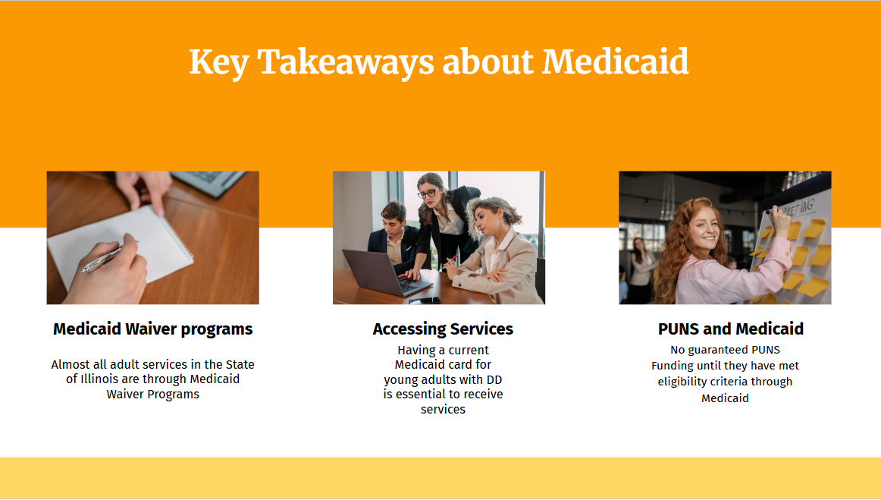

Slide 46
Medical Waiver Programs
How to Apply
Some individuals with DD become available under “All Kids Care” Program
Transitions to adult care and are eligible through medicaid. They switch from one system to the next at 19
For those who did not apply or were ineligible, they can now apply at 18 years of age
Apply online and by mail
Transition Representative Specialists can assist individuals with filling out an application.
Even with family insurance for health and private appointments, Medicaid must be up to date at all times.
*Providers are paid on time
*No Break is services for individuals and families

Slide 47
Medical Waiver Programs Reminders
Additional Documents
Families should contact their local DHS agency
Families should get comfortable with calling for updates on applications
Keep all original documents and applications
Some documents are time sensitive
Timeframe for eligibility and receive benefits 60-90 days
State or school ID Card
Social Security Card
SSI Award Letter
Bank Statements
Medical Insurance Care
30 Days of Wage Information

Slide 48
Where to Start
Medicaid Waiver Programs Through DHS
DHS Offices and Service Providers for Kendall County
Service Inc. of Illinois (Area E)
Developmental Disability Services
1919 South Highland Ave., Suite A #230
Lombard, IL 60148
Phone: (630) 425-2350
TTY: None
Fax: (630) 656-1237
Crisis after hours number: (815) 741-0800
Directions: To this Office | From this Office
Illinois’ Residential Waiver for Children and Young Adults with Developmental Disabilities
The Residential Waiver for Children and Young Adults with Developmental Disabilities provides services to children and young adults with intellectual or developmental disabilities ages 3 through 21 who are at risk of placement in an Intermediate Care Facility for Individuals with Intellectual Disability (ICF/ID).
The Illinois Department of Healthcare and Family Services (HFS) is the state Medicaid Agency (MA) and responsible for administration and oversight of this Home and Community Based Services (HCBS) waiver.
The Illinois Department of Human Services – Division of Developmental Disabilities (IDHS-DDD) is the Operating Agency (OA).
Adults with Developmental Disabilities
The Adults with Developmental Disabilities waiver provides services and individualized supports to persons 18 years of age or older with a developmental disability who are at risk of placement in an Intermediate Care Facility for persons with Intellectual or Developmental Disabilities (ICF-I/DD).
The Illinois Department of Healthcare and Family Services (HFS) is the state Medicaid Agency (MA) and responsible for administration and oversight of this Home and Community Based Services (HCBS) waiver.
The Illinois Department of Human Services – Division of Developmental Disabilities (IDHS-DDD) is the Operating Agency (OA).

Slide 49
Health Benifits for Workers with Disabilities
HBWD allows people to work and keep their benefits by paying premiums.

Slide 50
Key Takeaways About HBWD
Work Earnings
Program Supports
Purpose
Allows working individuals to have assets up to $25,000
System wants to support people with disabilities as an incentive to work
Some young adults will not qualify for Medicaid due to their work earnings

Slide 51
Where to Start
Health Benefitsa for Workers with Disabilities
What individuals will need:
Pay Stubs to document earnings
You may download an application or request an application to be E-mailed.
For more information, please call
1-800-226-0768 (TTY 1-866- 675-8440).
Illinois is part of the national movement to help people with disabilities return to work. The program called Health Benefits for Workers with Disabilities (HBWD) started providing medical benefits in January 2002.
Disability advocates have long noted that returning to work is difficult for people with disabilities. Many fear that working means losing Medicaid healthcare coverage. Often private insurance is difficult or impossible to obtain.
The goal of this program is to help people with disabilities work with full Medicaid healthcare benefits. HBWD not only encourages enrollees to work, but to increase the number of hours they are currently working. Just as the name says, the program provides health benefits for workers with disabilities. If you are an individual with a disability, between the ages of 16 and 64 and working, you may qualify for HBWD. Workers with countable income of up to $4,393 per month for a single person and $5,962 per month for a couple may qualify for the program. Unlike other Medicaid programs, HBWD allows enrollees to have up to $25,000 in assets. Depending on their income, enrollees pay a monthly premium based on their income range to receive comprehensive healthcare coverage.

Slide 52

Guardianship
At age 18, a young adult with a disability is considered a legally competent adult unless indicated otherwise

Slide 53
Key Takeaways About Guardianship
Decision Making
Who Can Be Guardian
Prove
Prior to age 18, parents need to consider if their adult will need support in decision making for themselves, financially, or medically
Must be at least 18 years old
US Citizen
No serious crimes committed
The court will want to know how he/she will provide active guardianship of the individual with a disability

Slide 54
Type of Guardianships - Not an all or Nothing
Plenary
Estate
Person
All important decisions regarding personal care and finances
Long Term
Property and finance decisions for the individual only
Long Term
Full Guardianship and all decisions that need to be made of that individual.
Long Term
Limited
Temporary
The need is specific
Court ordered and has specific limites to a person/estate/both
Short Term
Emergency situations and cannot last longer than 60 days
Short Term
Some Gaurdianships are more long term - there are also short term and limited options available

Slide 55
Guardianship Considerations
Other Types of Guardianship
It is helpful for family members to consider all possible situations.
Planing long term creates clarity when there is a change in life situations
Co-Guardianship
  Provides one of two guardians to consent prior to decisions being made
Successor Guardian
  The Individual automatically has a new guardian when the initial guardian passes away.
Testamentary Guardianship
  Named in a will through death of a parent
  Will still need to attend court to receive legal guardianship

Slide 56
No Guardian Available
State/Public Guardianship
Not all individuals will have family members who can provide guardianship
Some will have family but they may not want to pursue guardianship for an individual with a developmental disability
State Guardian
  When no family member or friend is available or interested in becoming a guardian
  Last resort
  State appointed guardian is appointed to make decisions on behalf of the individual
  Must visit the ward four times a year
  Named in a will through death of a parent
  Will still need to attend court to receive legal guardianship
Public Guardian
  Appointed to champion the rights of children and adults
  Assigned by the county to protect person/assets

Slide 57
Where to Start
Guardianship - Kendall County Court
Kendall County Court House
Address: 807 West John Street
Yorkville, IL 60560
Phone:(630) 553-4183
Email:Clerk@kendallcountyil.gov
Hours M- F: 8:00am - 4:30pm
What to expect
The application must be submitted to the County Circuit Court where the disabled person lives.
Petition forms can be picked up from the court, sent to you by mail, or downloaded from the website.
Families can “Do it yourself”
  Help Desk at County Court
  Most useful for straightforward cases with all parties in agreement
Court Fees
Physical disability certified through a health report
Notarized within three months
Hearing date will be set 30 days after petition has been filed
Court is required a summons before the hearing
All interested pirates will be served
Final decision made between 14-20 days
  Final paperwork received between three to seven days
Guardian will have come complete an annual report
Guardians in kendall County will need to complete a required training

Slide 58
Special Needs Trust
Alternative to typical Wills and Trusts for an individual with a disability t help protect funding

Slide 59
Key Takeaways About Special Needs Trusts
Prevents Limited Funding
Inheritance
Supplemental Funds
Money not set aside in a Special Needs Trust for an individual receiving funding - will automatically go to the State
Special Needs Trust are intended to supplement but not provide basic support such as food, clothing and shelter
an individual over the amount over $2,000 in assets will prevent them from almost all government assets

Slide 60
Special Needs Trust Information
Special Needs Information
Special needs Trusts can be used for
  Medical
  Dental
  Special Equipment
  Training/education
  Insurance
  Transportation
  Spending Money
  Computers/Games
  Other interests
Special Needs trust is meant to be used to enrich life
  Vacation
  Recreational
Third party
  Protects assets to allow SSI and Medicaid to remain
Families should use attorneys that are qualified and specialized to set this up correctly
Should be a standalone document that is not tied to a will
  Allows individuals to receive future gifts, estates, ect
Never too late to start!

Slide 61
Pay Back/OBRA Trust
Additional Special Needs Trust Information
Allows any money given to the individual to be put into a Special Needs Trust
Any trust money left unused will be paid back to the state upon the death of the disabled person
A Guide to Special Need Trusts
Four Different Types of Special Needs Trust
What's Aa Special Needs Trust for and How Can It Help?

Slide 62

Where to Start
Kendall Area Transit
Serving The Greater Kendall County Communities’ Public Transportation Needs
KAT will implement transit service in the Kendall County area that is reliable, flexible, and financially sustainable while satisfying the various mobility needs of the general public and individuals unable to access or operate a private automobile.
Registering for Service
In order to participate in the Kendall Area Transit program, one must become a registered rider. To find out more about how to become a registered rider contact Kendall Area Transit at 630-882-6970.
Schedule a Ride
Trips can be reserved between 4 and 14 days in advance. Priority in trip scheduling is given to individuals with disabilities and seniors based on space and availability.
Kendall Area Transit Brochure
Kendall Area Transit Brochure (Spanish)
KAT Registration Form
KAT Registration Form (Spanish)

Slide 63

Transportation
Transportation for adults who exit the public school system between 18-22 years of age.

Slide 64
Key Takeaways About Transportation
Not Provided
Vouchers
Kendall Area Transit
Day Programs may cover vouchers to cover the cost of transportation to and from their centers
Apply online
Complete Interview
Transportation can be
21 days for approval
Certified Transportation
Not 24 hours
Subscription Services
Day Programs typically do not have the capacity to provide transportation to individuals to and from

Slide 65
Where to Start
Kendall Area Transit
Serving The Greater Kendall County Communities’ Public Transportation Needs
KAT will implement transit service in the Kendall County area that is reliable, flexible, and financially sustainable while satisfying the various mobility needs of the general public and individuals unable to access or operate a private automobile.
Registering for Service
In order to participate in the Kendall Area Transit program, one must become a registered rider. To find out more about how to become a registered rider contact Kendall Area Transit at 630-882-6970.
Schedule a Ride
Trips can be reserved between 4 and 14 days in advance. Priority in trip scheduling is given to individuals with disabilities and seniors based on space and availability.
Kendall Area Transit Brochure
Kendall Area Transit Brochure (Spanish)
KAT Registration Form
KAT Registration Form (Spanish)

