Slide 1


For Teachers, Parents, Students

Slide 2






Interactive Learning
Please download Seesaw: The Learning Journal
or go to app.seesaw.me
Notes:
PD Presentation begins here.

Slide 3
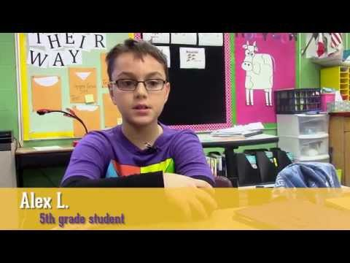
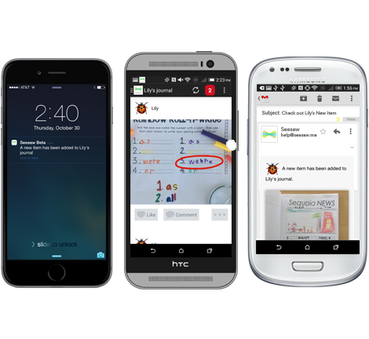
What is Seesaw?
Watch the video to see how students describe Seesaw!
A digital portfolio that collects students’ digital and physical work in one place. Everything is organized, making assessment and conferences easier!
A space that each student can own. Built-in tools make it easy for students to capture their learning, reflect, and develop new skills.
A parent communication tool that seamlessly shares what’s going on in your classroom and builds a strong school-home community.
https://www.youtube.com/watch?v=LbADgksW2L8

Slide 4
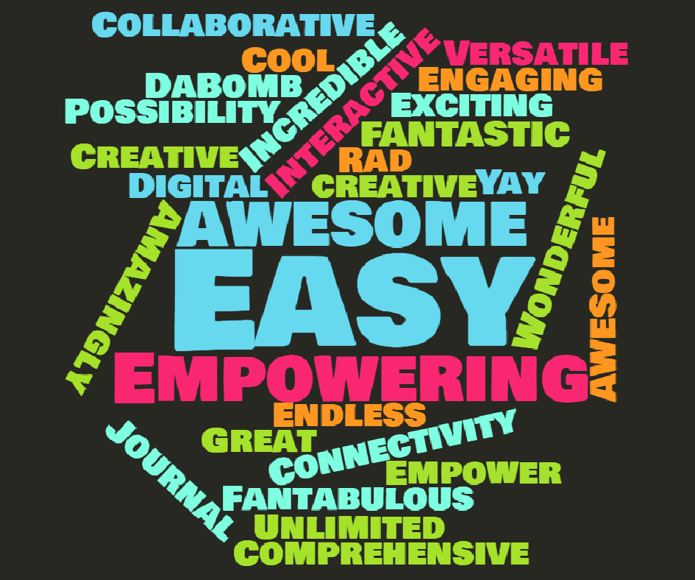
60 teachers sharing one word that describes Seesaw!

Slide 5
Why Teachers Seesaw
Empowers students to document their learning as it happens
Develops students’ writing skills, reflection skills and critical thinking skills
Develops 21st Century skills in safe, moderated environment

Slide 6
Why Teachers Seesaw
Creates a strong community around learning by involving families
Organizes and share digital creations and classroom activities
Saves time on
assessments, conferences, and newsletters

Slide 7
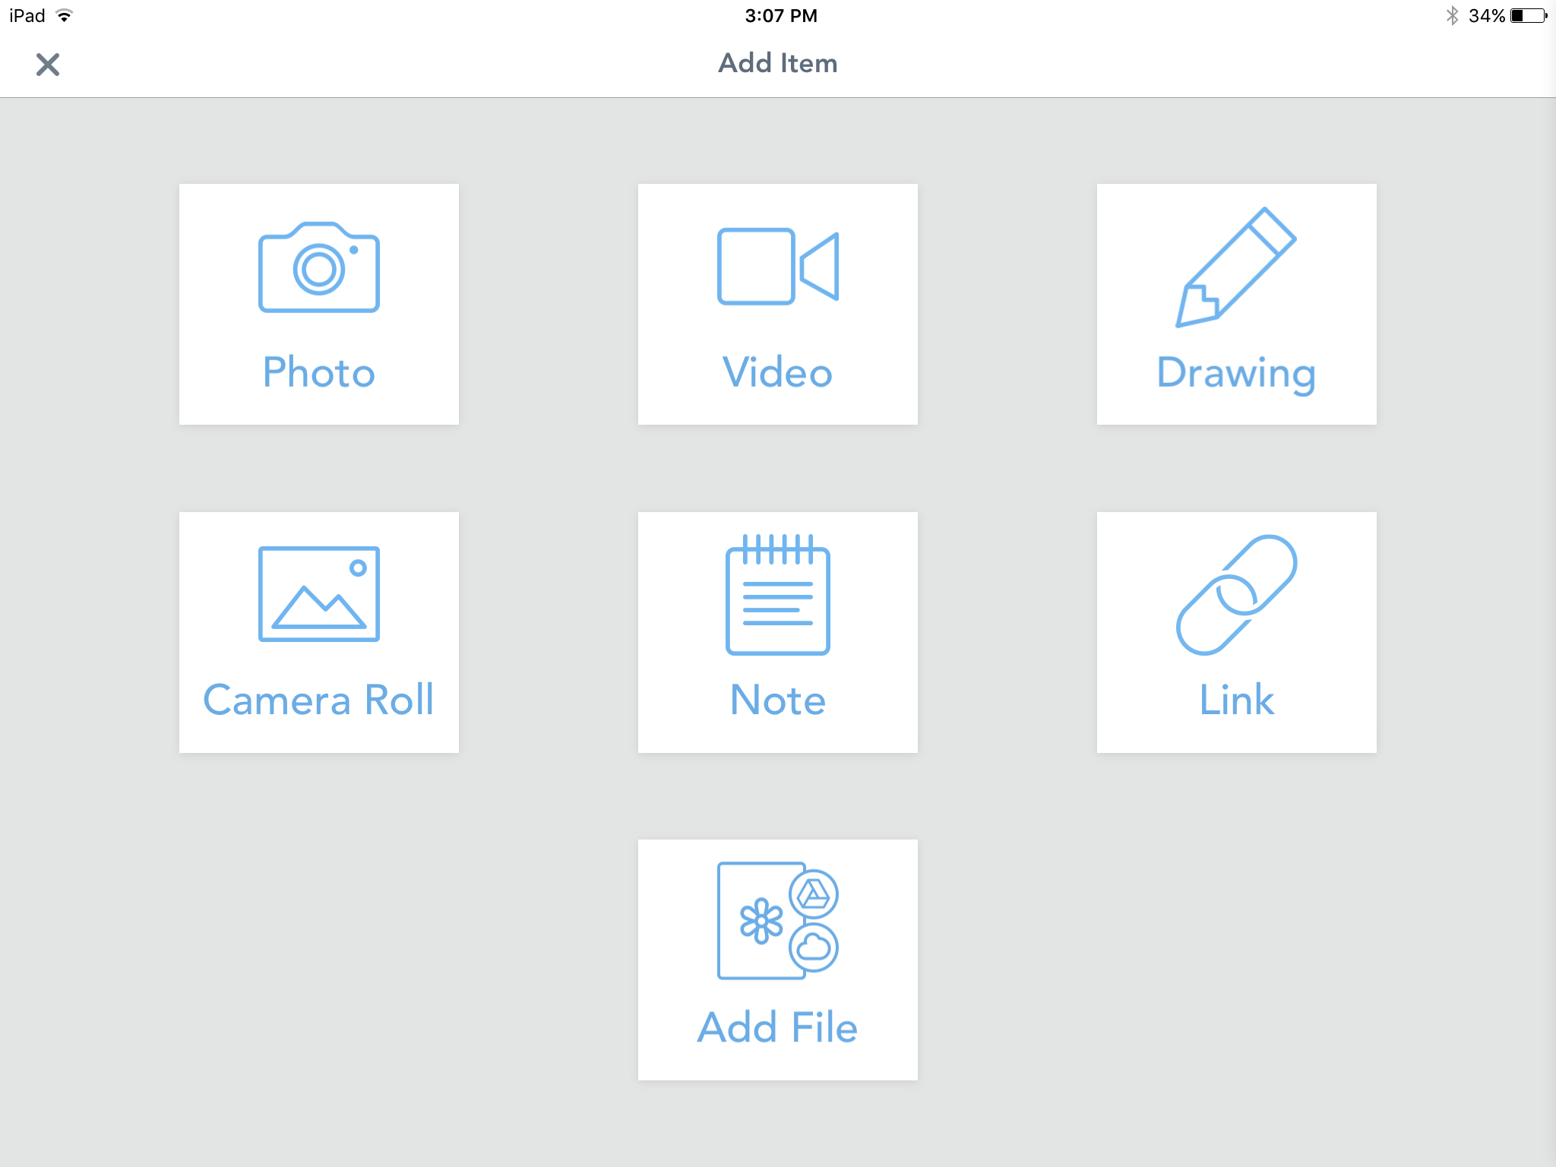
Look at all the Tools!
Camera is built-in and kid friendly
rotate record voice draw on it add caption or label

Slide 8
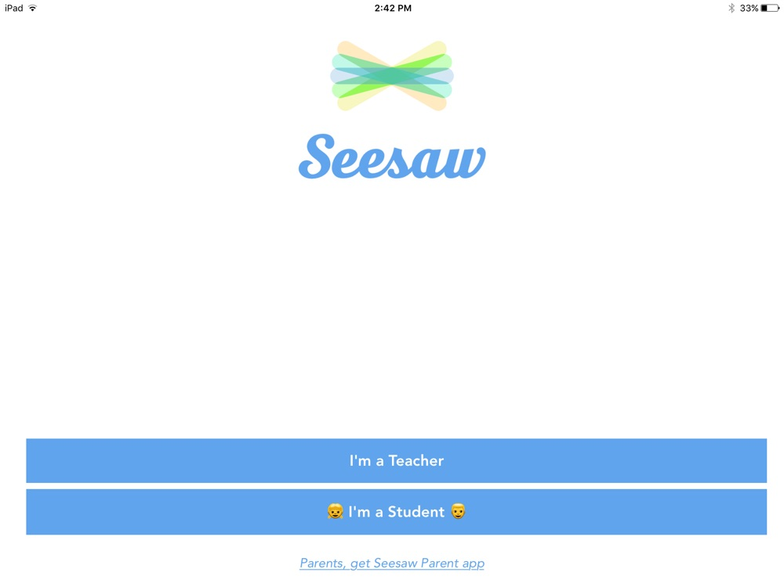
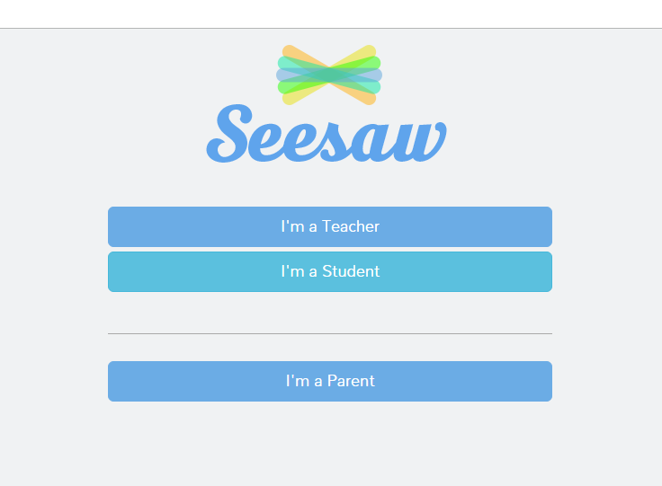
Various views depending on device
app.seesaw.me
iPad/Android/Kindle
Chromebook/Web

Slide 9
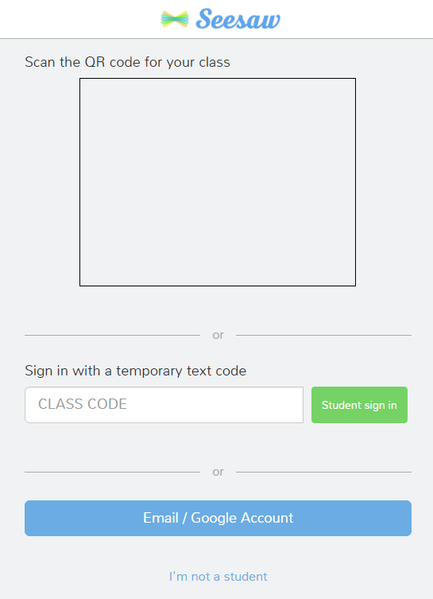
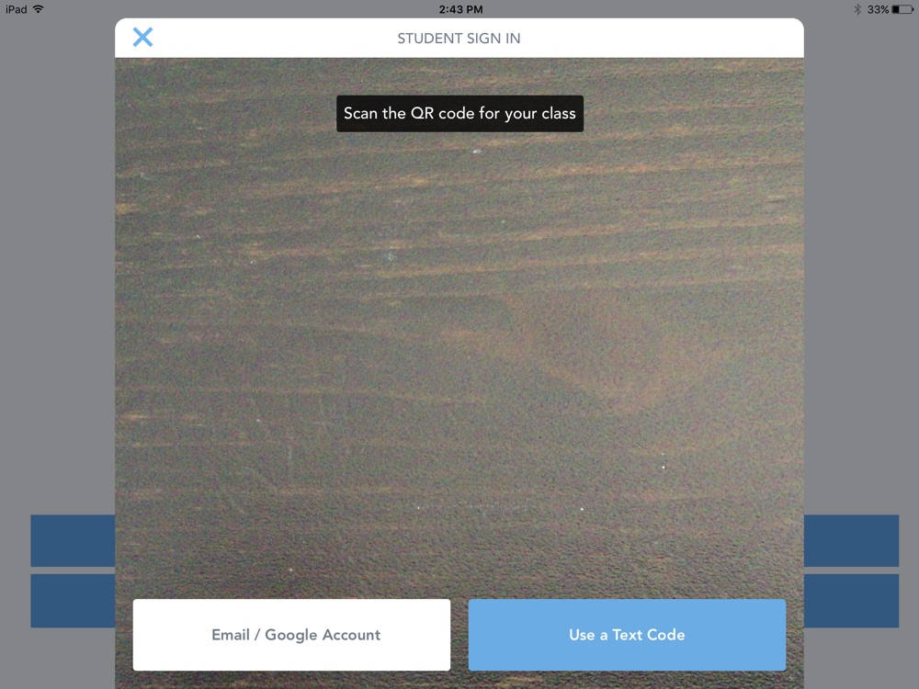
Chromebook/ Web
Scan QR code, or put in class code
iPad/Android/Kindle
built-in QR reader
pops up

Slide 10
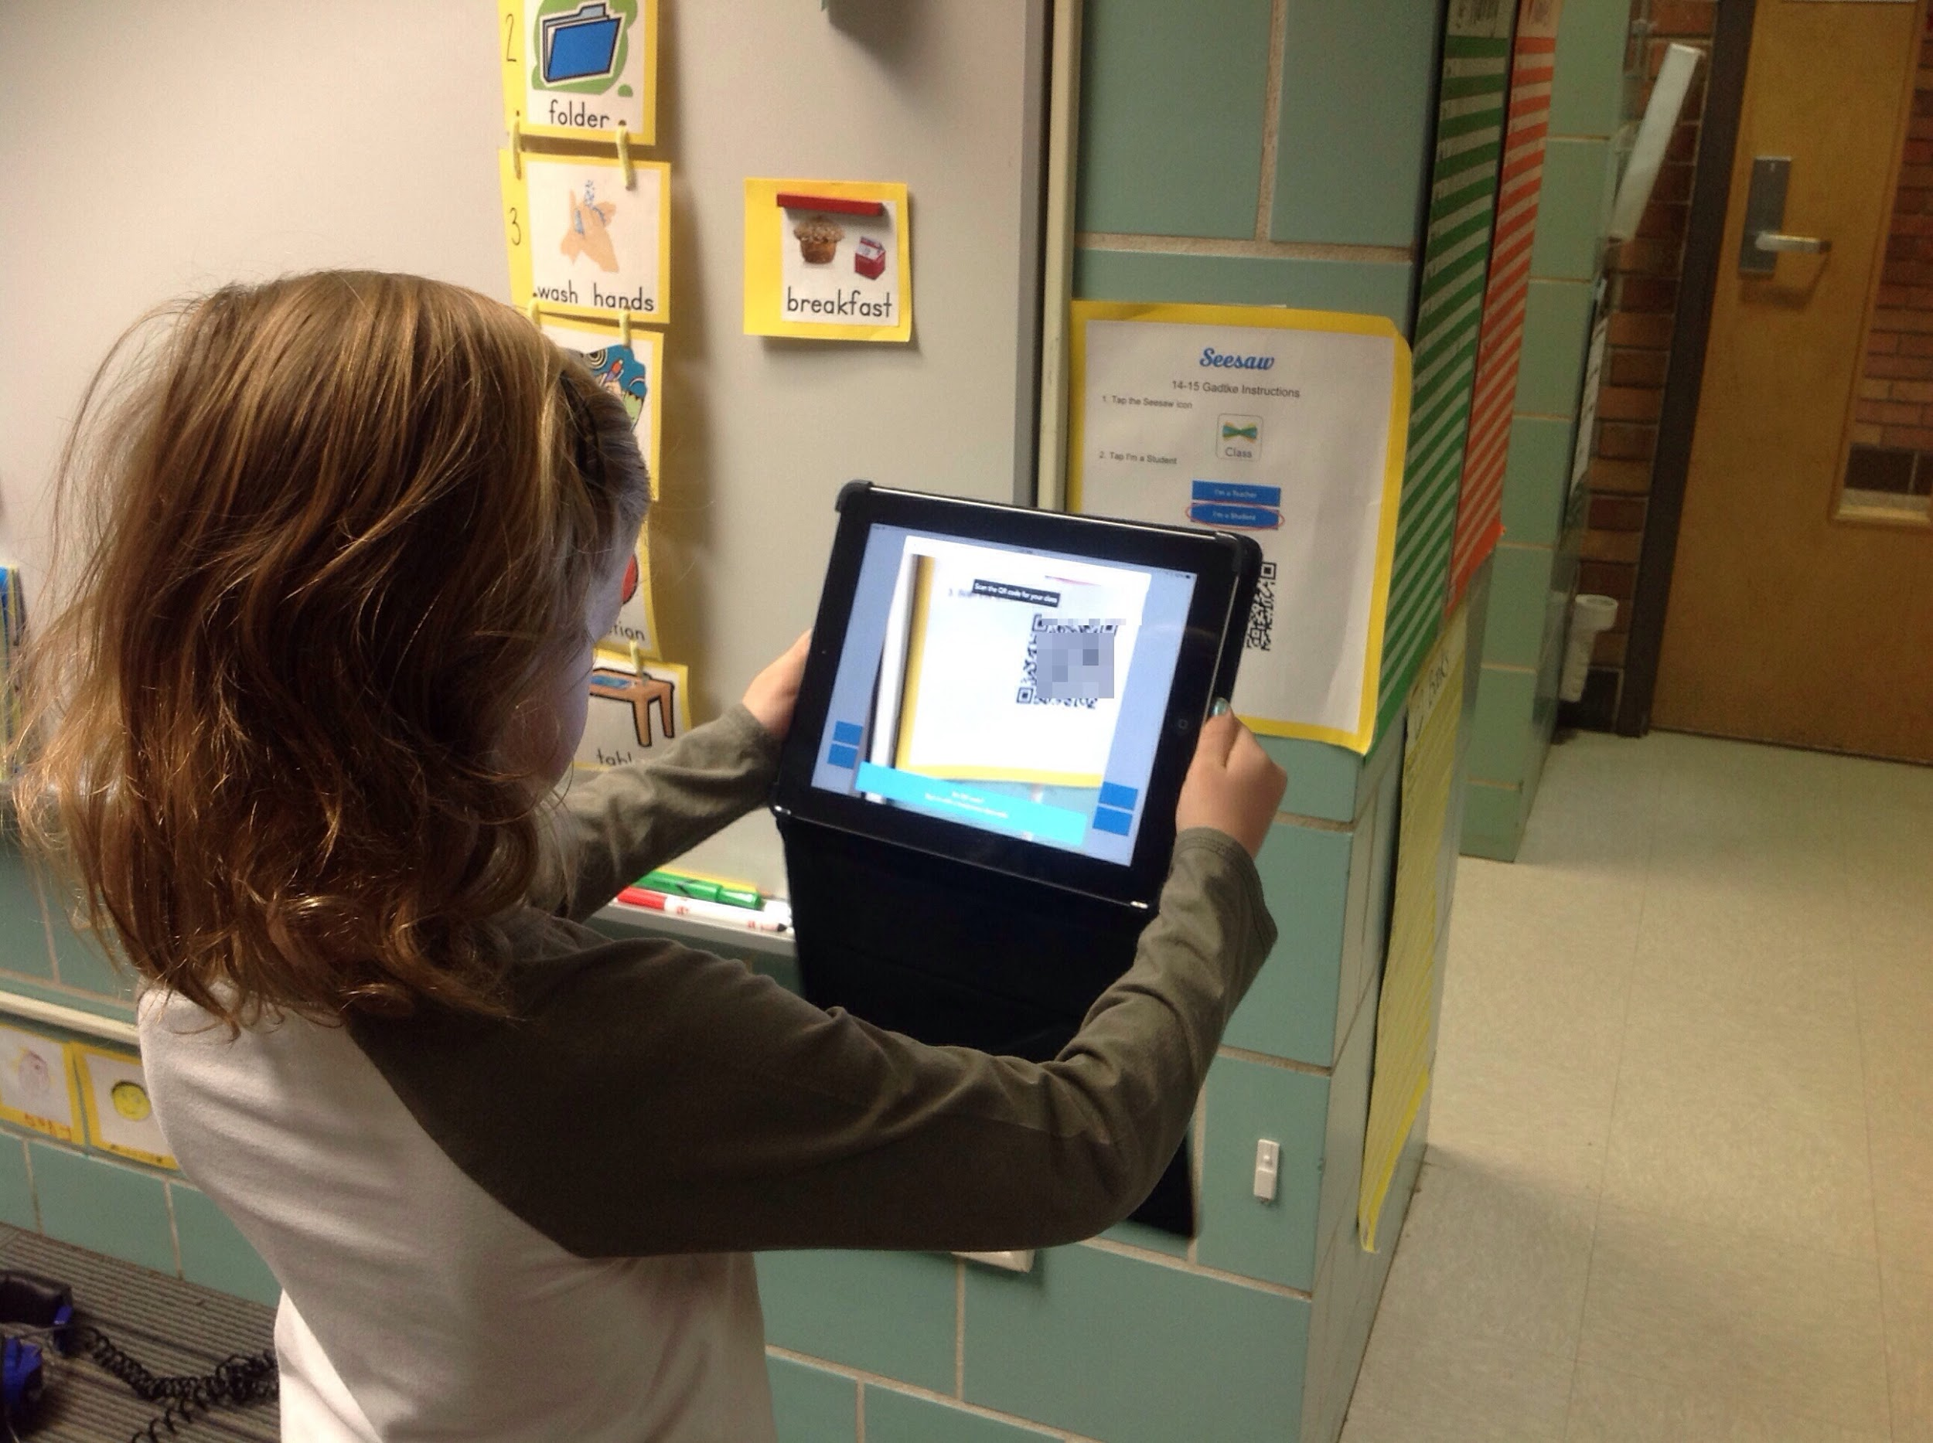
Two options for signing-in
app.seesaw.me
iPad/Android/Kindle
Chromebook/Web
Scan QR poster
or
Type class code
Stand up and scan QR poster

Slide 11
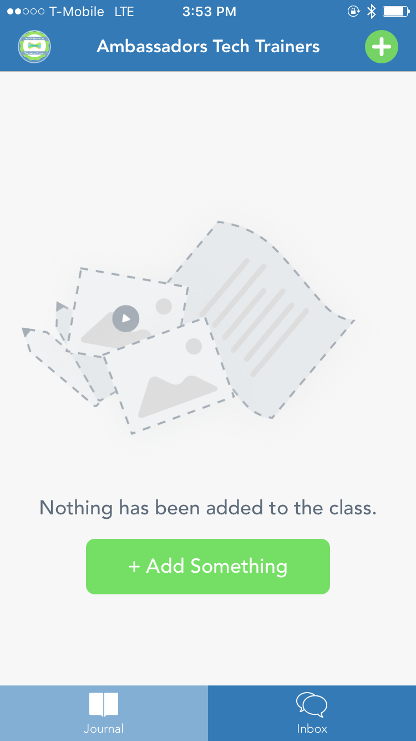
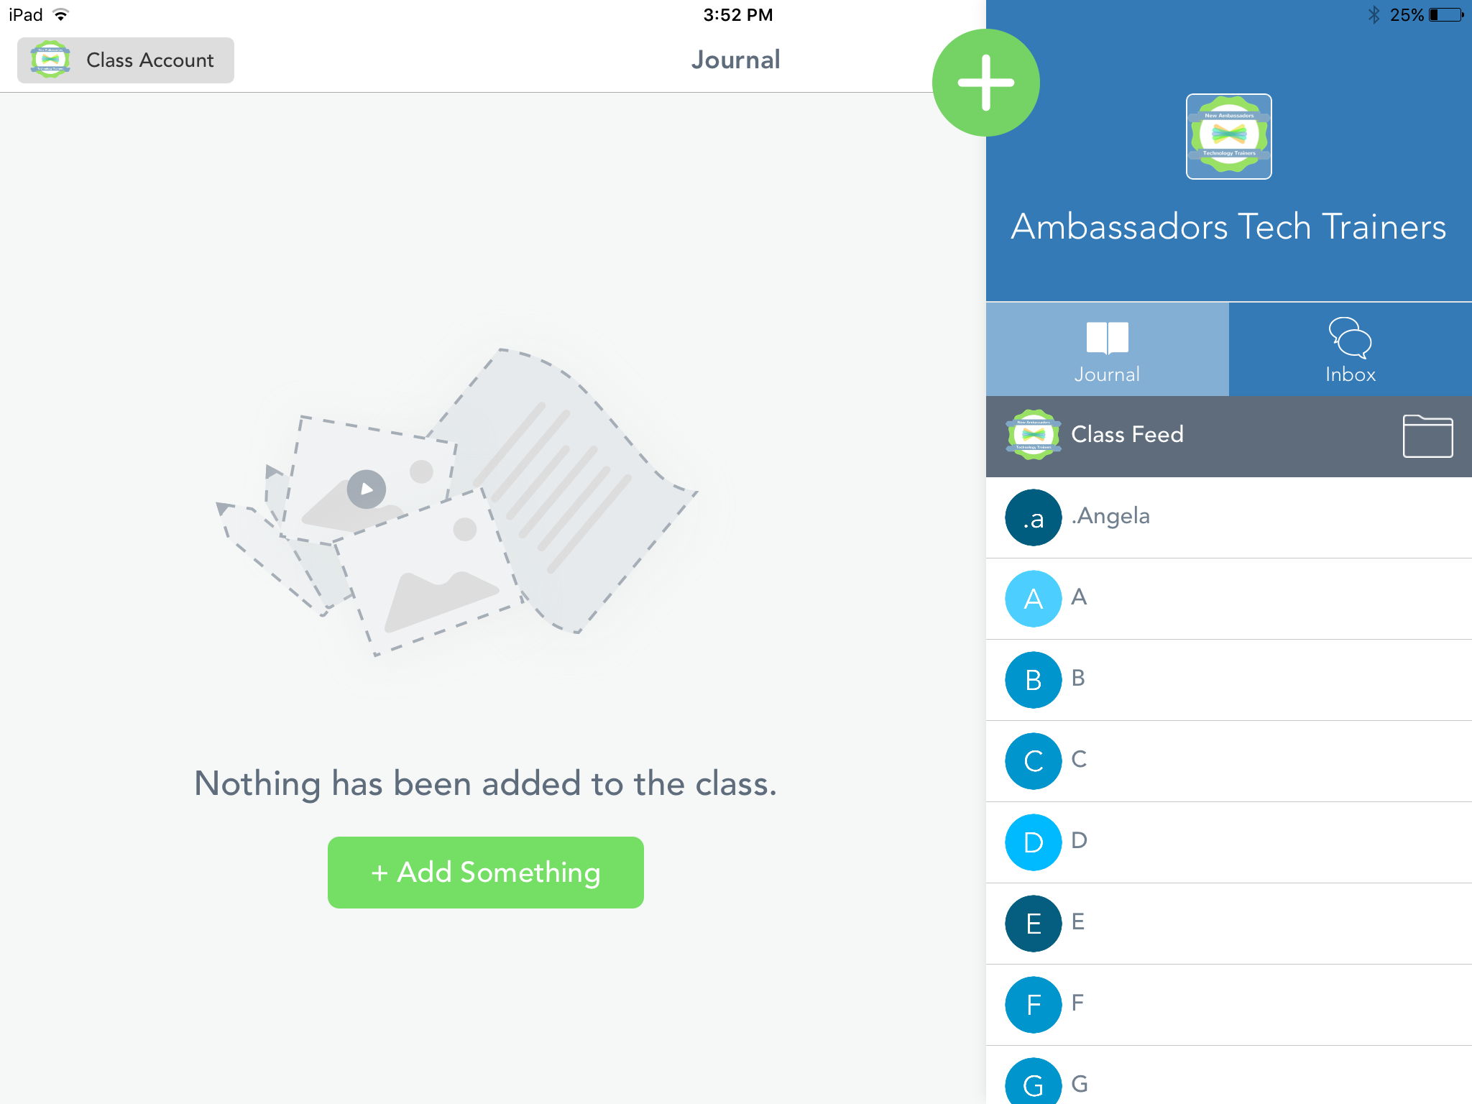
View from
mobile device
View from iOS/web
Tap the green add button

Slide 12
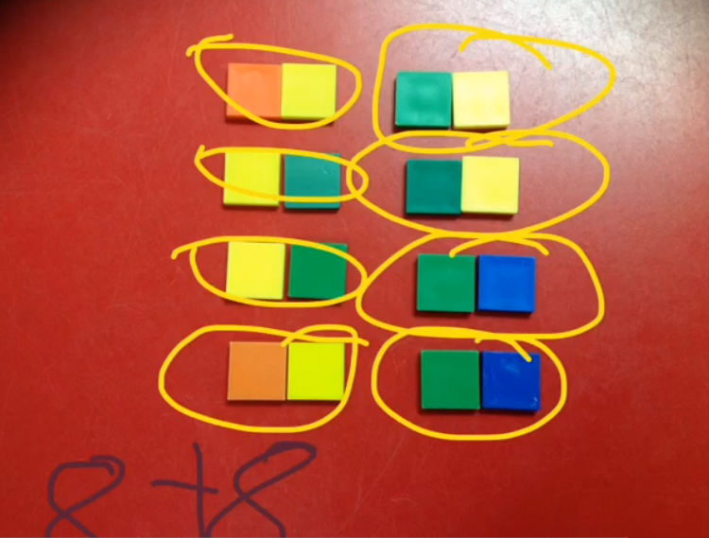
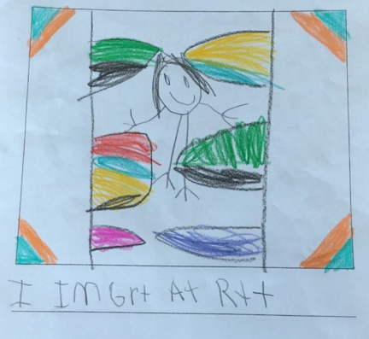
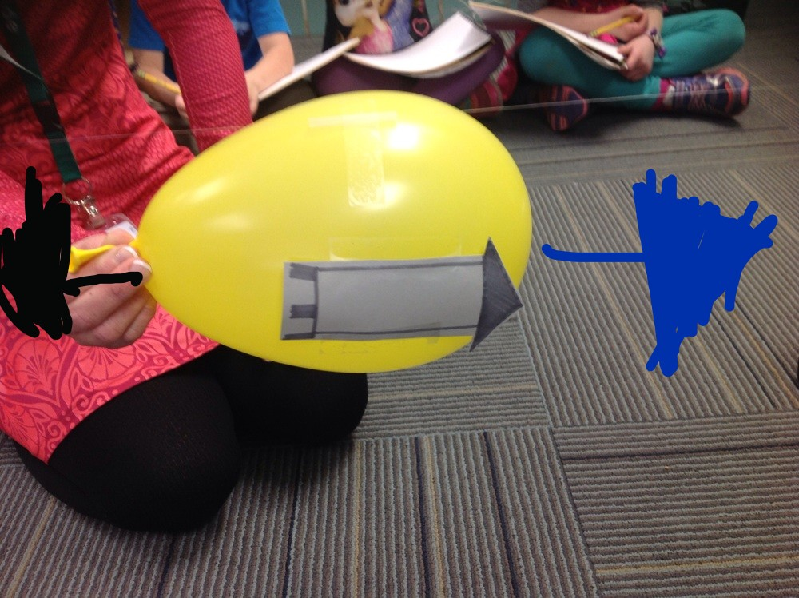
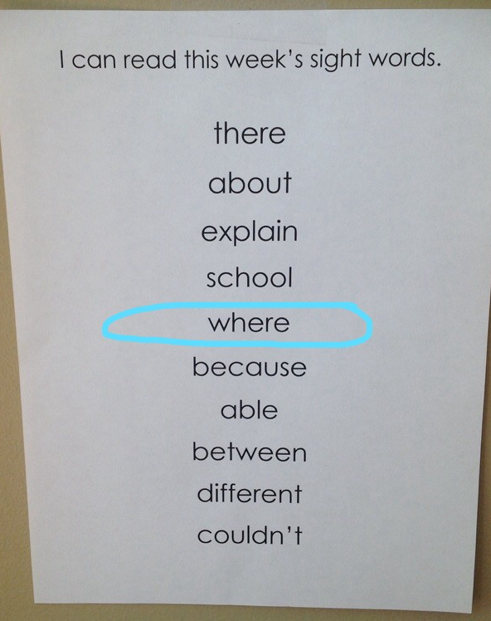
Explain a math concept
Science reflections
writer’s workshop
assessment checks

Slide 13
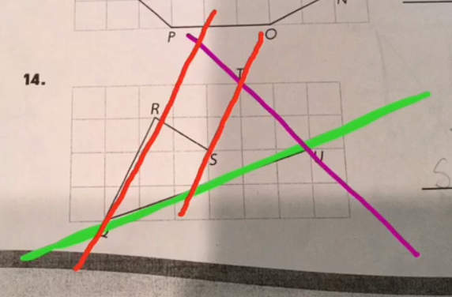
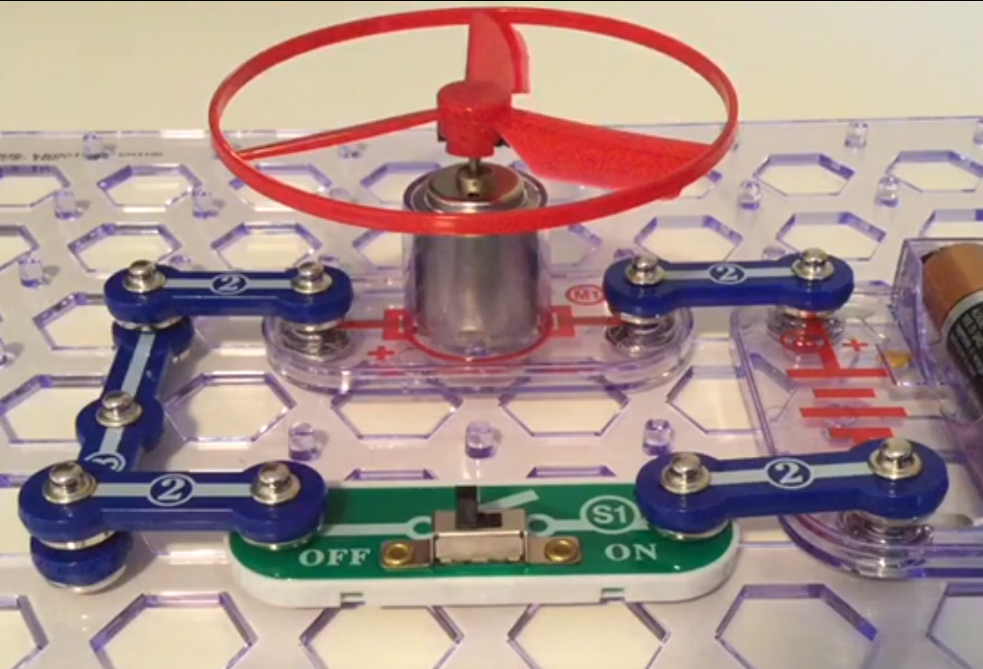
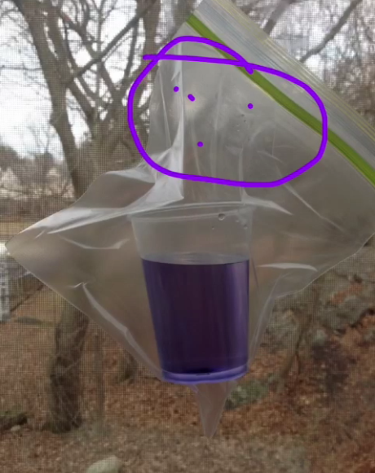
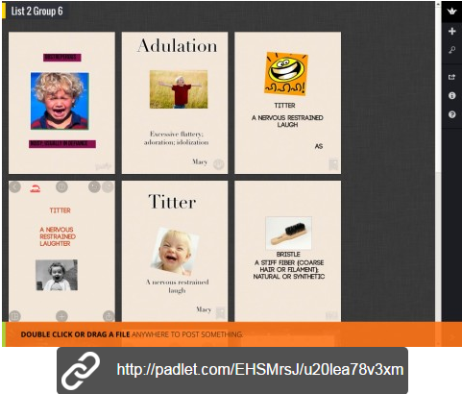
Defining parallel lines
Collaborative group predictions
Reflect, document, & plan during...
Project based learning
Makerspace
Genius Hour
High school - info pics
Padlet link saved

Slide 14

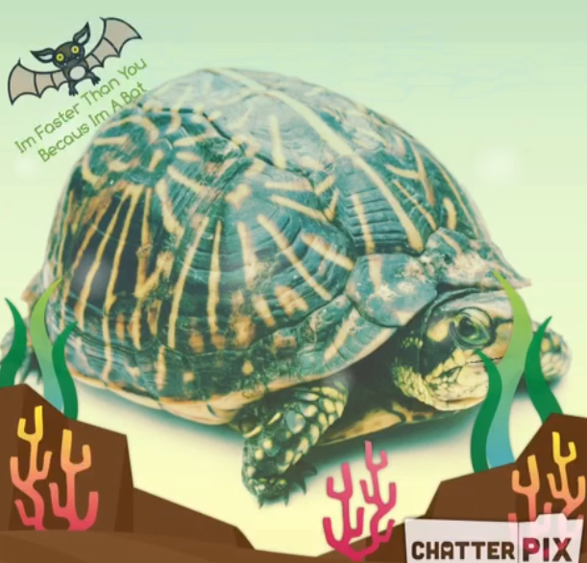
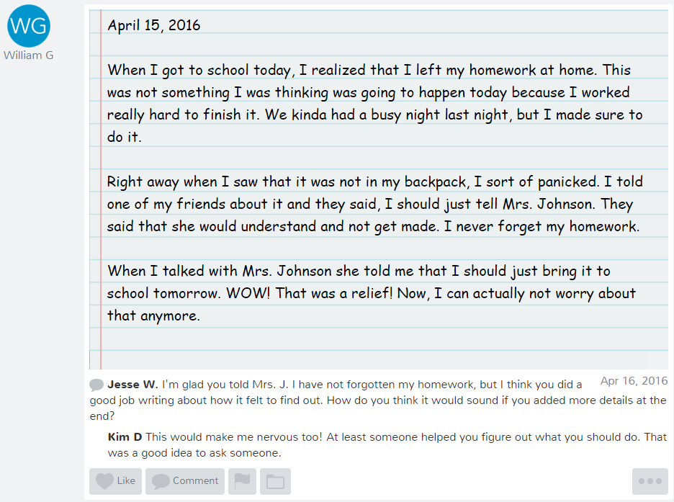
Historical characters project
Journal writing with peer feedback
ELA: synonyms

Slide 15
Interactive Learning at its Best!
app.seesaw.me
ENJOY LEARNING TOGETHER!
Notes:
PD Presentation begins here.

