Slide 1
SAMPLE
5th Grade
Lesson 2
Notes:
WELCOME & INTRODUCTION 1:30
CLASS WELCOME
Begin by welcoming students and discussing lesson and behavior expectations in whatever way is appropriate.
LESSON INTRODUCTION
Today we are doing another lesson from the MBF Child Safety Matters program.
I hope everyone remembers what we talked about in Lesson 1.
In Lesson 2, we are going to talk about bullying, cyberbullying, and digital safety.
Remember, if you have any personal stories to share related to what we are discussing, I want you to know they are very important, but because we don’t have much time for the lesson, I want you to wait and share them with your teacher or me after the lesson.
To start, I would like to see what you remember from Lesson 1.

Slide 2






Safety Check
TRUE
SAMPLE
FALSE
Notes:
SAFETY CHECK 3:00
Let’s start with a Safety Check to see what you remember from our previous lesson about abuse and the 5 Safety Rules.
During the Safety Check, I will read a statement to you and I want you to show me a thumbs up if the statement is true or a thumbs down if the statement is false.
SAFETY CHECK STATEMENTS
Only adults abuse children. (Thumbs down/False. Anyone can abuse children, even other kids.)
Your neighbor tells you about a surprise party for your parents and asks you to keep it a secret. It is okay not to tell your parents. (Thumbs up/True. Because they are not asking you to keep an unsafe secret from your parents, but asking you to keep a surprise party a secret, this is a safe secret, so it is okay not to tell your parents.)
A teenage neighbor asking to take pictures of you without your clothes on is not considered child sexual abuse. (Thumbs down/ False. Both adults and other children/teens touching or talking about private body parts, or showing or taking pictures of children without their clothes on, is child sexual abuse.)
If you are not sure about talking to a Safe Adult, you can ask a Safety Friend to help you talk to them. (Thumbs up/True)
Safety Rule #2, Spot Red Flags tells you to GET AWAY and STAY AWAY from unsafe situations. (Thumbs down/False. It tells you to be on the lookout for unsafe situations and people.)

Slide 3

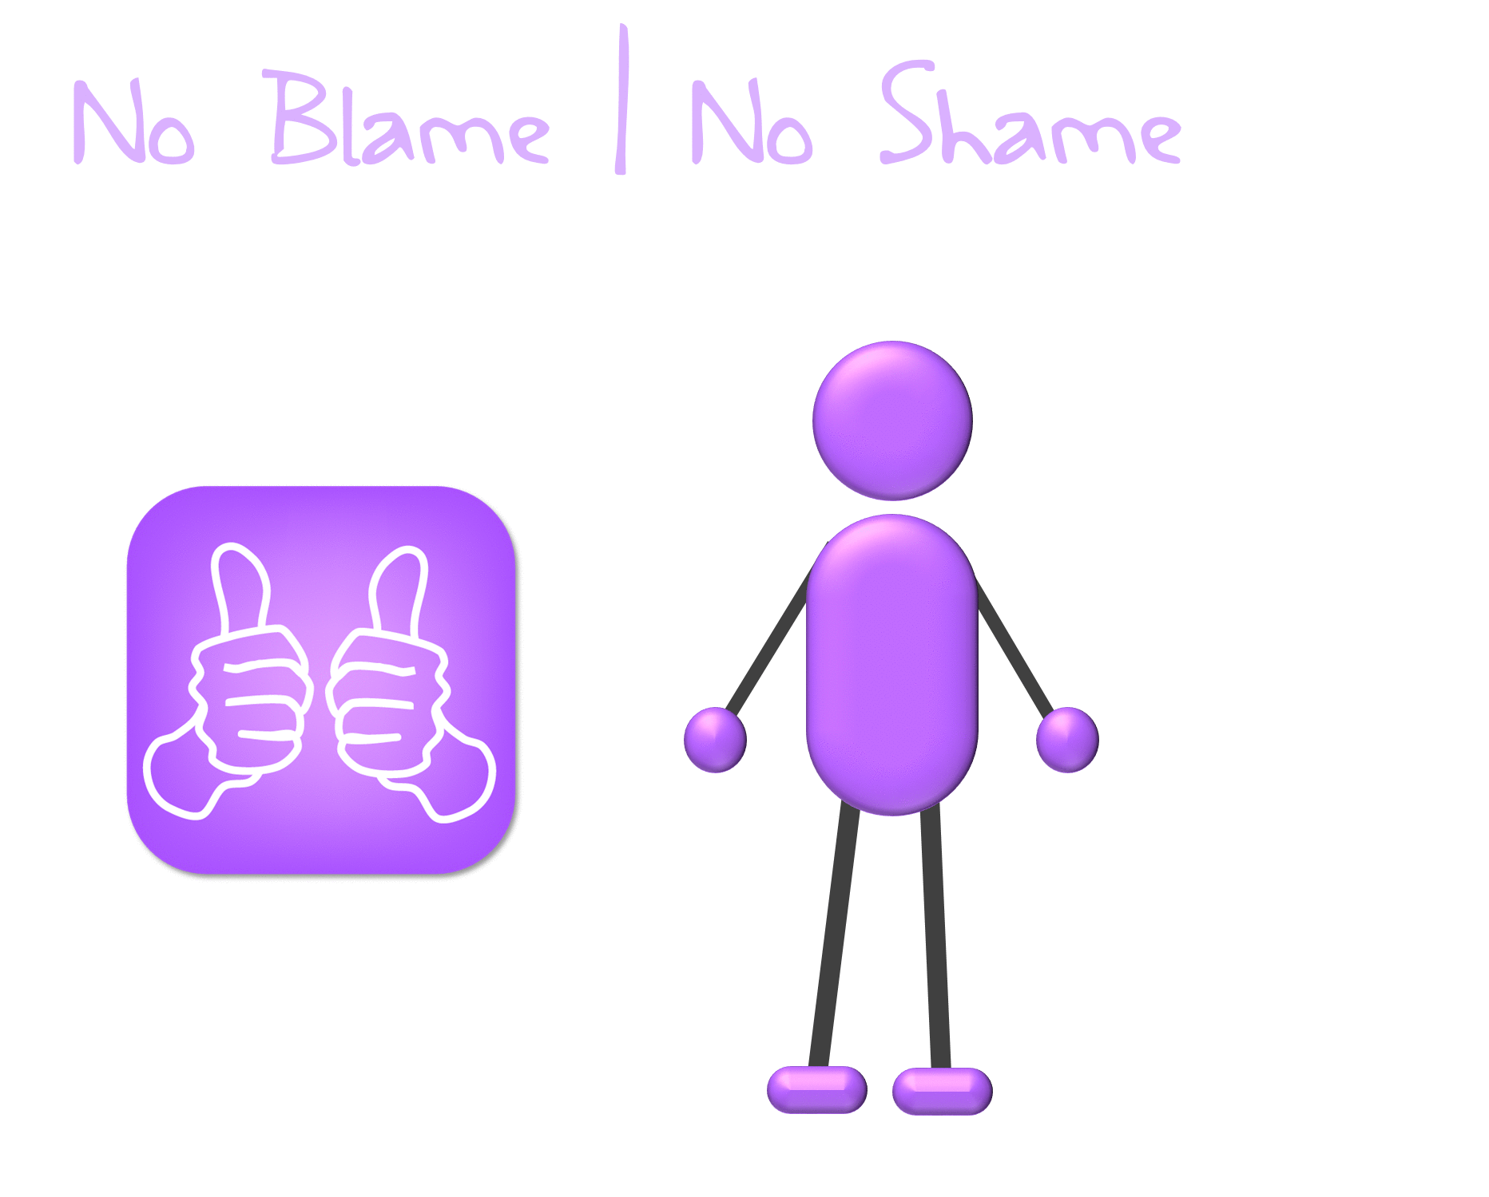

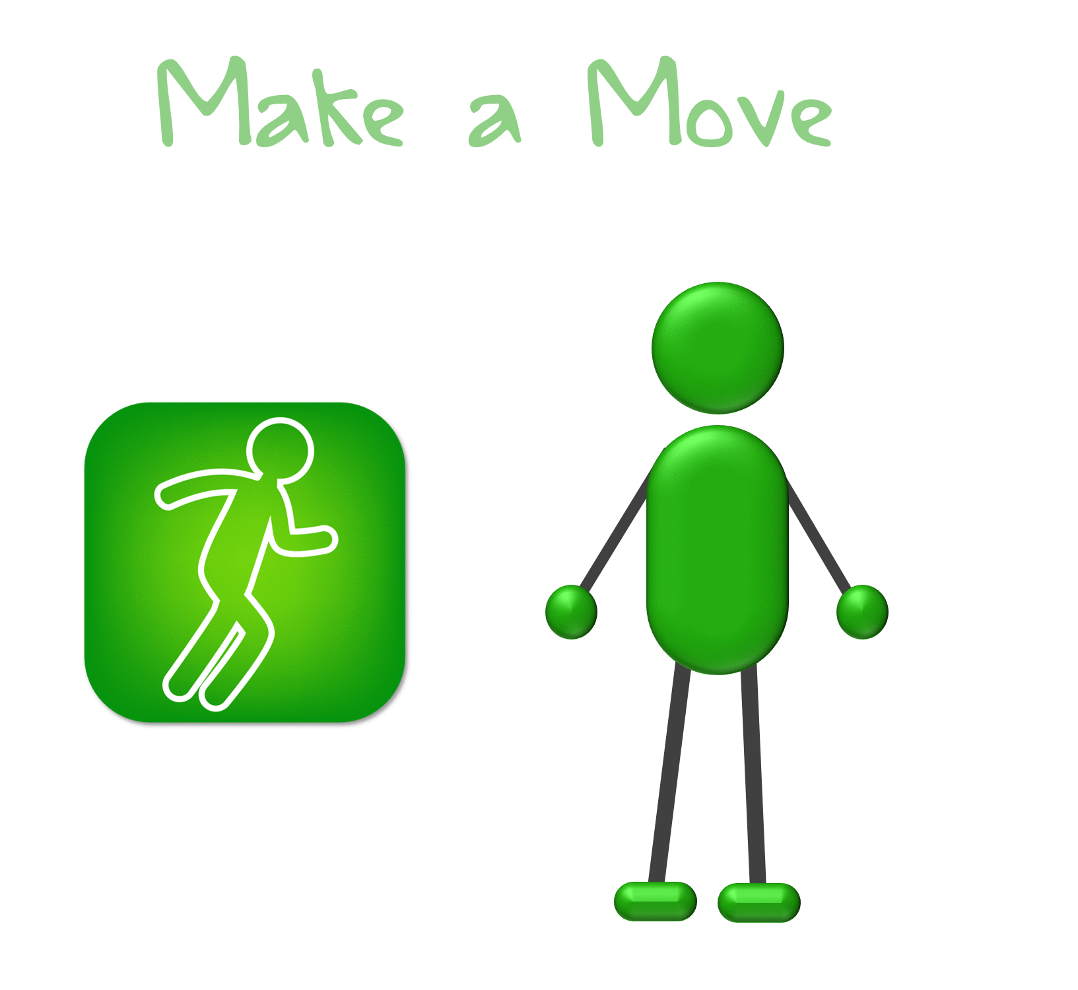




Safety Rules Review
SAMPLE
Notes:
SAFETY RULES REVIEW 2:30
ADVANCE THE SLIDE TO BEGIN AND AFTER EACH RULE TO SHOW THE NEXT RULE.
Safety Rule #4 is Talk It Up (with motion). Talking It Up means using an assertive voice to say “No” if you are in an unsafe situation, or talking to a Safe Adult.
Remember, a Safe Adult is someone you can talk to about unsafe situations, and someone you can count on to help keep you safe.
Also remember that telling is not tattling or snitching, it is reporting, which is telling a Safe Adult something for a good reason, to prevent harm or to someone help.
Tattling or snitching is done to annoy someone or get them in trouble.
If you are telling just to get someone in trouble, do not tell.
But if you are telling to get someone help, even if someone else gets in trouble, you should still tell.
You can also talk to a Safety Friend. Sometimes it is easier to talk to an adult if you have someone with you. A Safety Friend is a good friend that you trust and feel comfortable talking to. You can tell them what is happening and ask them to help you talk to a Safe Adult.
But remember, you should never tell a Safety Friend about being hurt or being unsafe INSTEAD of a Safe Adult. A Safety Friend is someone to help you talk to a Safe Adult, but you ALWAYS need to talk to a Safe Adult.
Lastly, Safety Rule #5 is No Blame | No Shame (with motion). Remember you are never at fault and you are never to blame if an adult, or another child hurts you, bullies you, or abuses you.
It is important to remember that no matter what they tell you, you have no blame in the situation. You should never feel ashamed, and remember that it’s never too late to tell, no matter what has happened or what you have been told.
Today, we are going to learn how to use these 5 Safety Rules for bullying situations and for ways to stay safe when we are using technology, like a computer, a cell phone, an iPad, or a tablet.

Slide 4





Being an Upstander
SAMPLE
Use Safety Rule #3 to Make a Move and Safety Rule #4 to Talk It Up.
Notes:
BEING AN UPSTANDER 1:30
If you have fears about standing up to a bully, there are other ways to be an Upstander.
Think about the 5 Safety Rules. You can use them to overcome those fears and do the right thing.
You can use Safety Rule #3 - Make a Move:
You can get a Safety Friend, or many friends, to help you stand up.
You can also help the bullied person STAY AWAY from the bully by being their friend. Sometimes, if the bully notices people are around their target and are being their friend, they may leave the person alone.
• You can also use Safety Rule #4 - Talk It Up:
You can use an assertive voice to tell the bully to stop and to tell them their behavior is bad.
You can also get others involved. Talk to a Safety Friend or other friends and ask them to help you stand up to the bully. A bully may not listen to you if you are alone, but they may if a group of students tells them to stop.
You can also Talk It Up to a Safe Adult about what is happening and get help to stop the bullying.
Finally, you can also use your voice and your actions to set a good example by promoting anti-bullying policies and activities in your school.

Slide 5





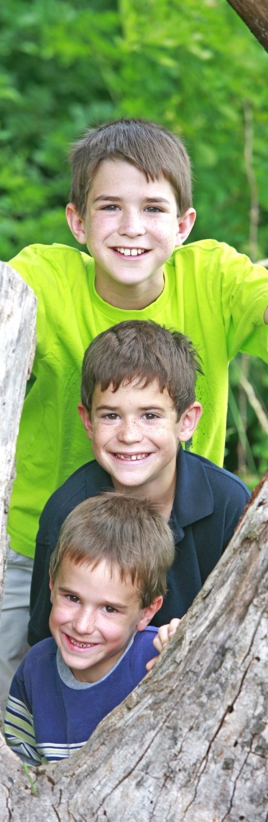
Are you a Bully?
SAMPLE
S
A
F
E
T
Y
Stop the bullying behaviors
Admit that you might be a bully and ask yourself why
Formulate a plan to change your behavior and stop bullying
Engage in the new behavior
Track your behavior and friendships
You can stop bullying; you can get help from a Safe Adult
Notes:
ARE YOU A BULLY? 2:00
We often talk about bullying and how we can help if someone is being bullied. But what if you have been a bully, or if you are bullying someone now?
If you are a bully, it is important to understand how this behavior impacts the people you bully, as well as how it impacts you.
What are some character traits of bullies? (Mean, hurtful, selfish, etc.)
You should ask yourself who you want to be. Do you want to be a bully or do you want to be a kind person?
If you are, or have been a bully in the past, I hope now you see why you need to stop. Use the word SAFETY to help you stop bullying and choose better behaviors:
Stop the bullying behaviors
Admit that you might be a bully and ask yourself why; apologize to those you’ve hurt
Formulate a plan to change your behavior and stop bullying
Engage in the new behavior
Track your behavior and friendships
You can stop bullying; you can get help from a Safe Adult

Slide 6

Safety Check
TRUE
SAMPLE
FALSE
Notes:
SAFETY CHECK 3:00
Let’s do a quick Safety Check to see if you understand bullying. Show me a thumbs up if the statement is true and a thumbs down if it is false.
SAFETY CHECK STATEMENTS
Bullying is always physical, such as shoving or hitting someone. (Thumbs down/False. Bullying can be calling someone names, or intentionally leaving someone out, such as never playing with them, or never sitting with them at lunch.)
Bullying is repeatedly harassing, threatening, or insulting another child. (Thumbs up/True)
Being a Bystander is the same thing as being an Upstander. (Thumbs down/False. Bystanders do nothing and watch people being bullied, while Upstanders stand up to bullies.)
If you do not know if a situation is bullying, it is okay to Talk It Up and tell a Safe Adult or ask a Safety Friend to help you talk to a Safe Adult. (Thumbs up/True)
Only certain people possess the positive character traits that enables them to be Upstanders. (Thumbs down/False. Everyone has some traits within them that allows them to be an Upstander.)

Slide 7



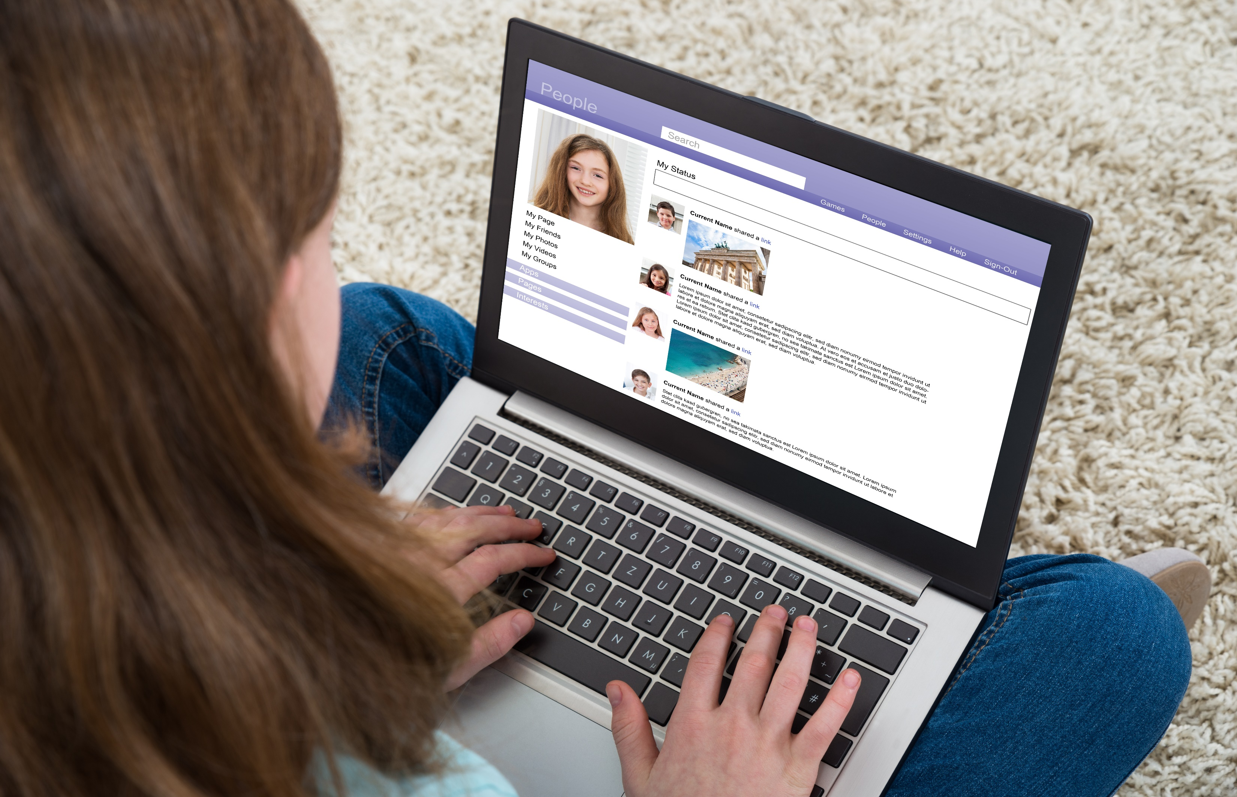
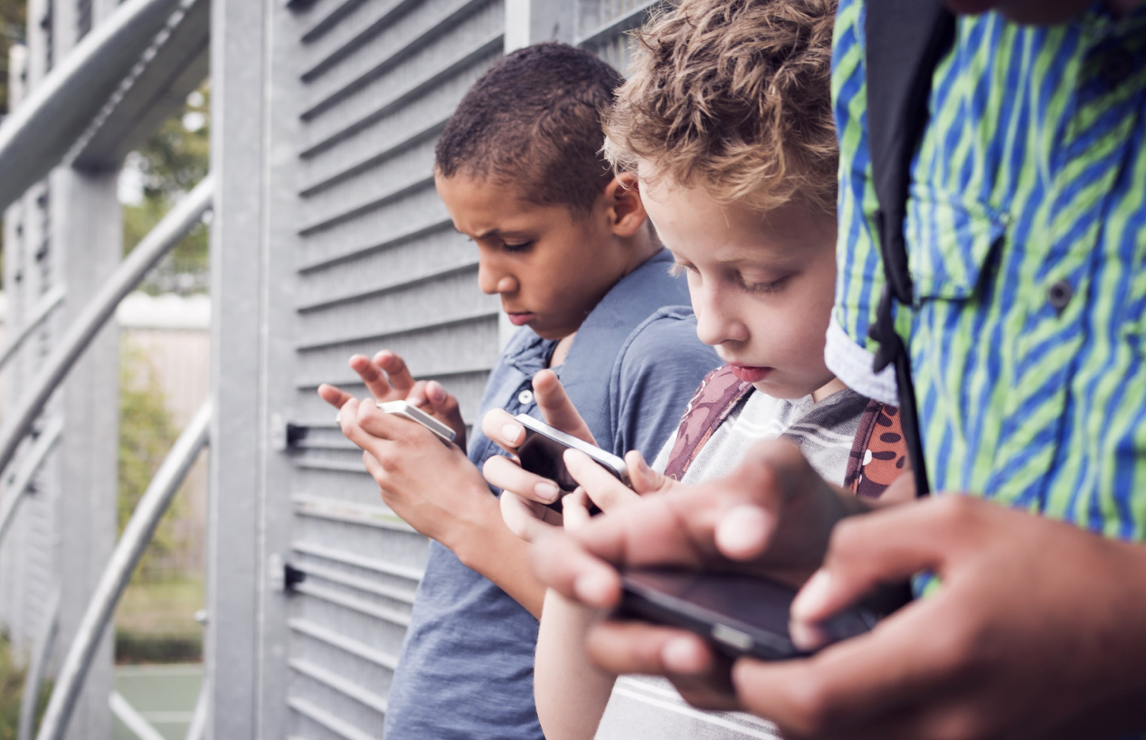
Digital Dangers
SAMPLE
Notes:
DIGITAL DANGERS 1:00
Raise your hand if you:
Use the Internet to play video games or look up information
Have or use a cell phone
Email or text
Have a Social Media account like Snapchat, Instagram, or Twitter
Technology is great, because it gives people access to virtually anything they want all over the world at any time. But there are bad things that can happen with technology too.
You need to know about all the potential digital dangers, or dangers you might encounter when you are going online or using digital devices.
There are dangers from people you know and from people you do not know when you are online.
Peers, or people that are your age or that you may go to school with, can also tease or hurt you or others online.
There is another kind of bullying I want to talk about, because bullying does not just happen in person, it can also happen online.

Slide 8
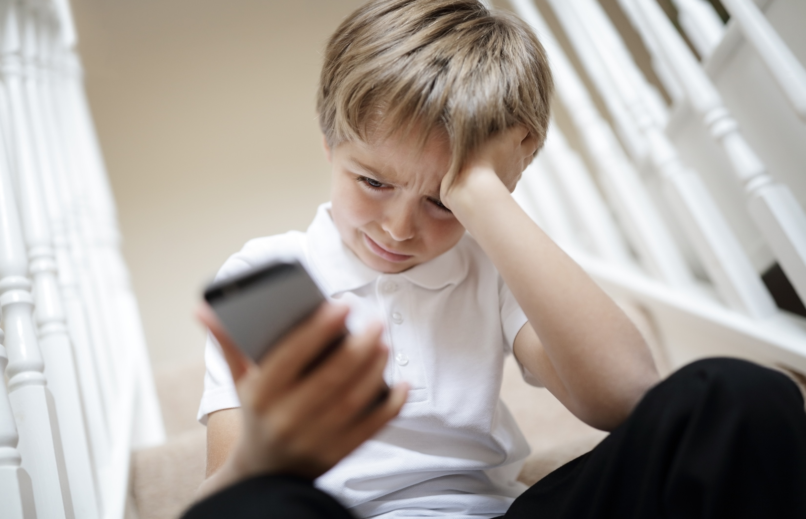

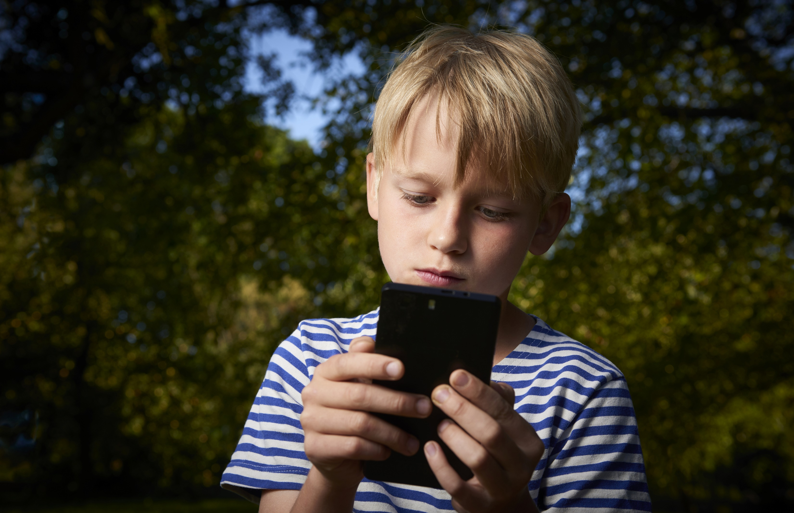

Cyberbullying
SAMPLE
Did you know 1 in 5 kids has experienced cyberbullying?
Notes:
CYBERBULLYING 1:30
Raise your hand if you have heard of cyberbullying? (Raise hands)
When someone hurts or teases others in real life, it is called bullying. When bullying occurs online – through phones, computers, games and more – it is called cyberbullying.
Cyberbullying is when someone repeatedly hurts another person with mean words or by posting mean pictures or thoughts online, or by sending them messages by email or on cell phones.
Did you know 1 in 5 children say they have experienced cyberbullying?
Here are some problems with cyberbulling:
It is hard to get away from because messages can come at all times of the day and night.
Cyberbullying impacts what happens at school, including your grades, even if the cyberbullying did not happen at school.
Just like you have learned to use the Safety Rules in unsafe situations in real life, you can use the Safety Rules in your digital life to stay safe.
For example, cyberbullying, like bullying, can be stopped by using Safety Rule #3 - Make a Move and Safety Rule #4 - Talk It Up.
You can use Safety Rule #3 - Make a Move to GET AWAY and STAY AWAY from cyberbullying.
You can also use Safety Rule #4 - Talk It Up to tell a Safe Adult and get help.
You may feel like you do not want to tell because it might:
get the person into trouble
make things worse for you with the bully
cause your parents/guardian to take your phone or computer away
get you into trouble
But telling is reporting and it’s important. Cyberbullying usually does not stop without help.

Slide 9



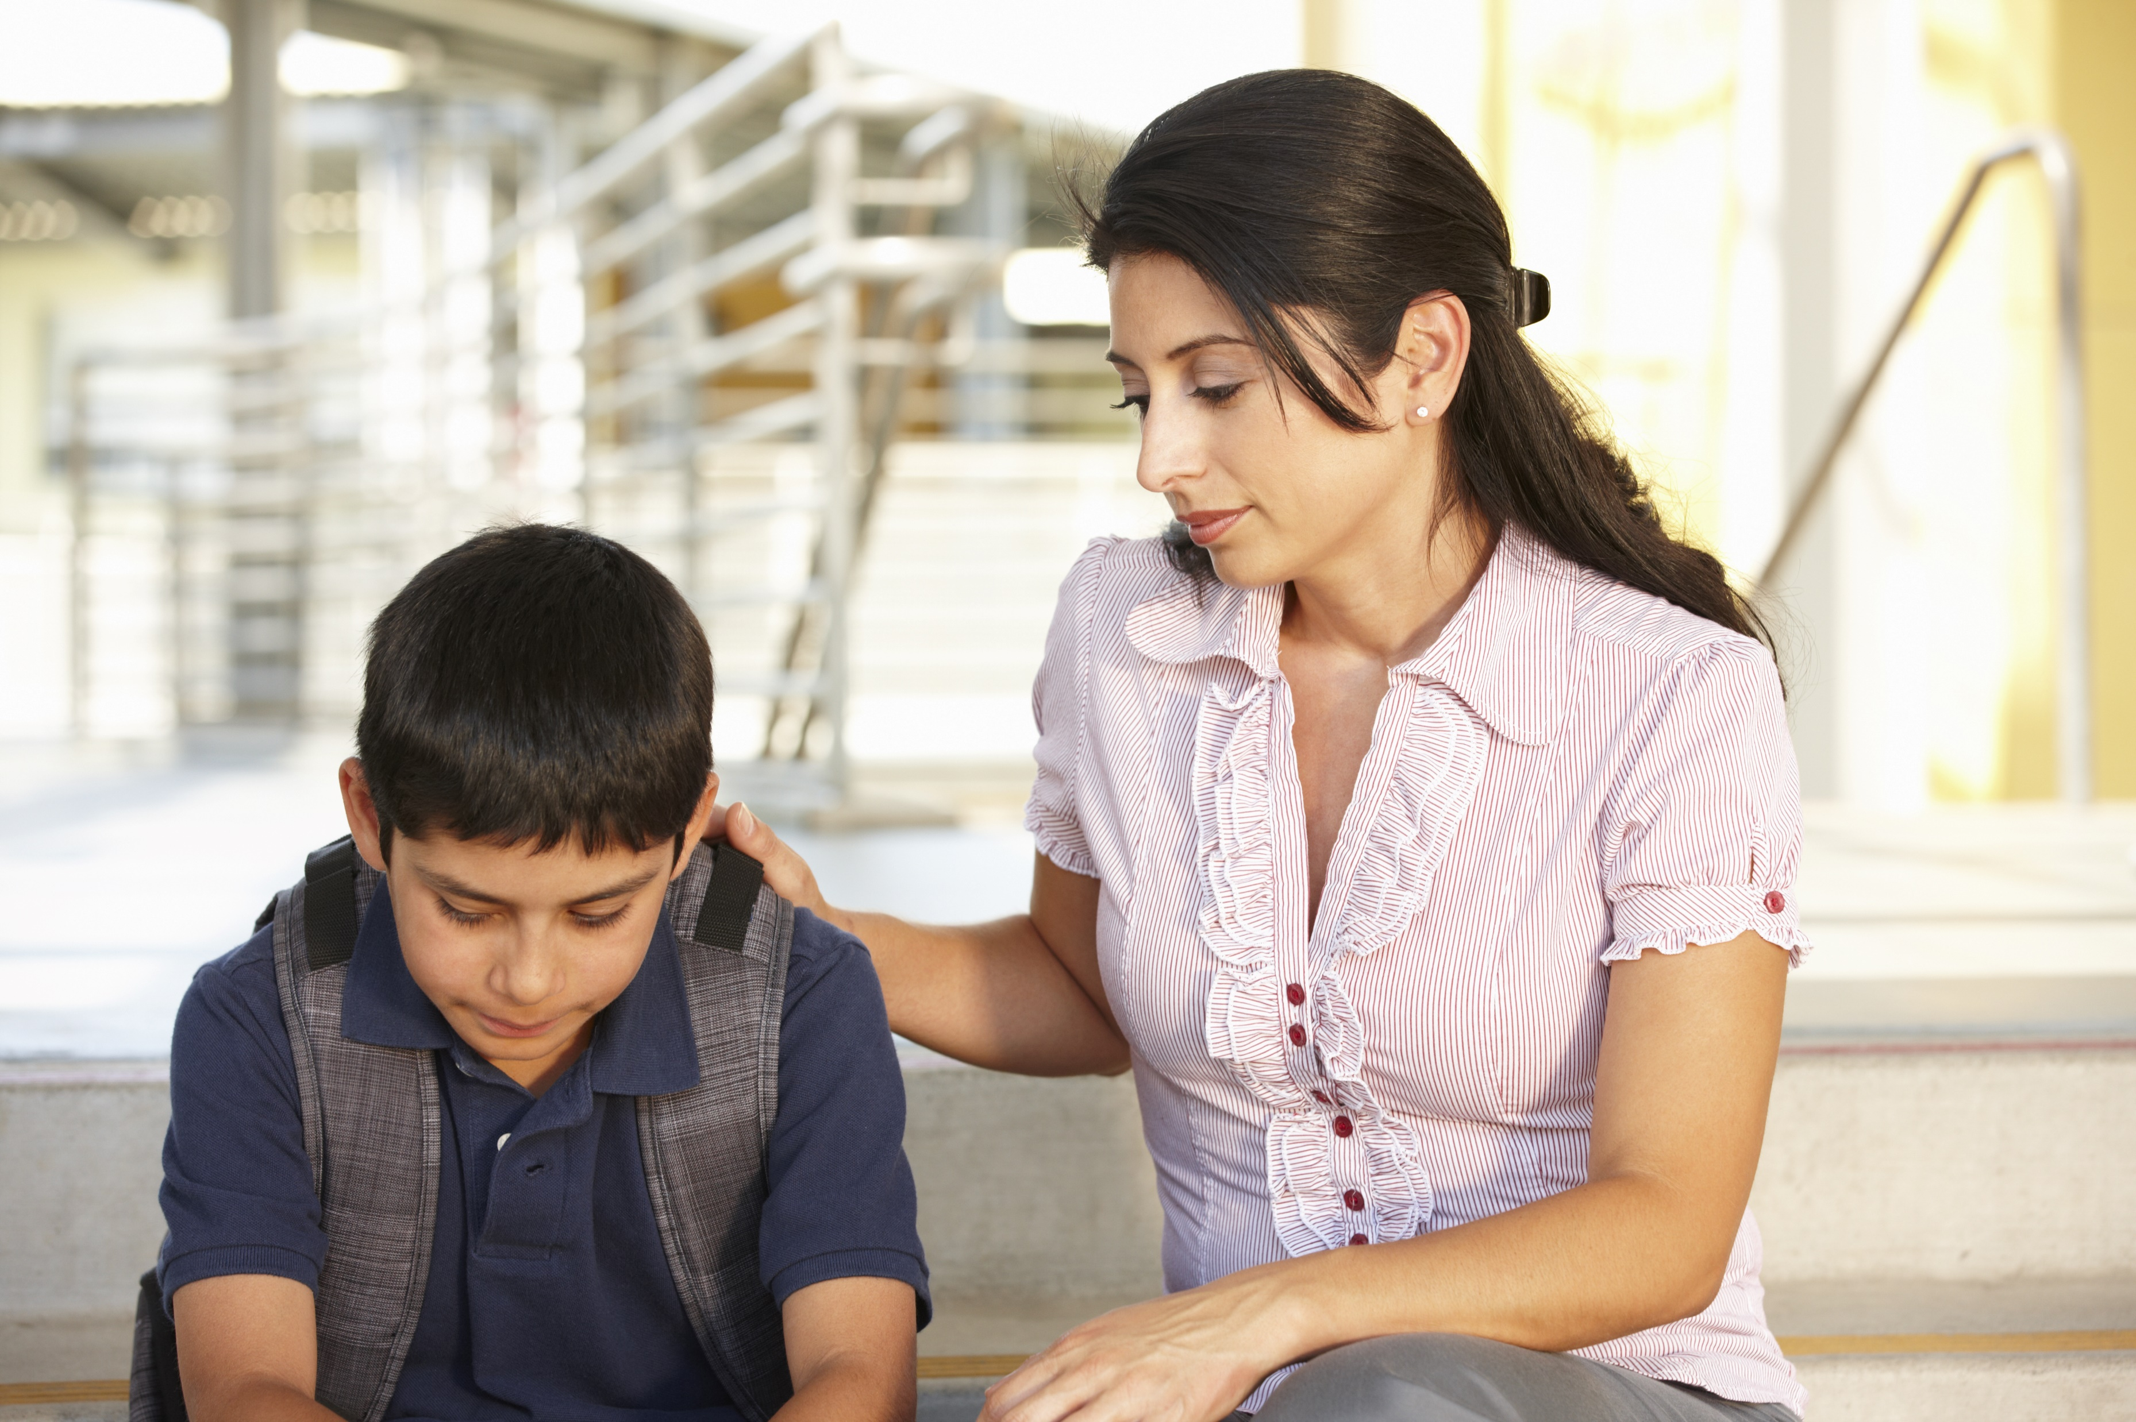

Reporting
SAMPLE
Notes:
REPORTING 1:30
If you do not speak up – cyberbullying tends to get worse, and more things get shared with more people, so it is very important to Talk It Up with a Safe Adult.
You can also talk to a Safety Friend and ask for their support. Ask them to help you talk to a Safe Adult. Sometimes it is easier to talk to an adult if you have a Safety Friend with you.
Remember, if you use Safety Rule #4 to Talk It Up, it is reporting something that is unsafe to get someone help. It is not tattling or snitching.
You can always tell your parents, or you can report it to the school, to a teacher, or a counselor.
Here is how you can report bullying or cyberbullying in your school:
__________________________________________________________________________________________________
__________________________________________________________________________________________________
__________________________________________________________________________________________________
__________________________________________________________________________________________________
Even if you think the situation is not truly bullying, it is important to tell someone about the situation before it gets worse.
***IF YOU ARE IMPLEMENTING IN TWO 30-MINUTE LESSONS, RATHER THAN THE STANDARD 55-MINUTE LESSON, STOP AFTER THIS SLIDE. TELL STUDENTS YOU WILL BE BACK SOON TO FINISH THIS LESSON. REMIND THEM TO PRACTICE THE 5 SAFETY RULES IN THE MEANTIME.***

Slide 10






Inappropriate Images
SAMPLE
Notes:
INAPPROPRIATE IMAGES 1:30
There is another digital danger that I want to share with you.
If you ever see inappropriate images online, or if an adult or another child shows you inappropriate pictures, for example, pictures of people without their clothes on (called pornography or inappropriate images), either in a magazine or on a computer or phone, you should recognize this as a Red Flag and use your Safety Rules to help you.
If someone ever shows you pictures of a child without their clothes on, or tries to take pictures of you without your clothes on, this is wrong. These kinds of pictures are called sexual abuse images.
No one should take pictures of children without their clothes on and no one should show a child pictures of others without their clothes on.
If anyone ever does these things, or sexually abuses you in any way, these are Red Flags and you should remember Safety Rule #3 to Make a Move, and GET AWAY and STAY AWAY. Try to stay away from any adult or child that touches you or talks inappropriately to you, and use Safety Rule #4 to Talk It Up to a Safe Adult to tell them why you want to STAY AWAY from that person. They can help you.
Remember Safety Rule #5, No Blame | No Shame. No matter what happens or has happened in the past, no matter what the person says, even if they say you will get into trouble, or if they say no one will believe you, or if they made you promise not to tell, it is important to remember abuse is never your fault.
You are never to blame if you are abused and you will not get into trouble if you tell.
You should not be ashamed to ask for help or to tell a Safe Adult.

Slide 11

Digital Safety
SAMPLE
How is having a cell phone a good thing?
How can having a cell phone be unsafe?
Notes:
DIGITAL SAFETY 2:00
Raise your hand if you have a cell phone. (Raise hands)
How is having a cell phone a good thing? (Calling 911 for help, calling home to check in, getting directions, finding people and locations, music, etc.)
Sometimes people use cell phones for things that are NOT good and that are unsafe, so let’s talk about how to be safe on your phone and online.
Always keep your passwords private; never share them with anyone, even friends. You may be friends today and not friends tomorrow.
Keep all pictures you send G-rated. Sometimes children your age will send text messages or pictures without their clothes on. This is called sexting and it is very unsafe.
Why is this unsafe? (Often when those types of pictures are sent to someone, they are then sent to other people, and you cannot stop it or ever take them back. Sexting is also against the law.)
You should never send a sext, never ask someone for a sext, and if you happen to get one, you should never forward or share it. If any of these situations happen to you, you should use Safety Rule #4 and Talk It Up to a Safe Adult right away.
If you are asked to send inappropriate pictures, ask yourself:
Was this my idea and is it smart?
Where will this picture end up?
Might it be forwarded or shared?
Can I get it back?
Would I want my _____ (mom/dad, grandparents, teachers, coaches) to see this?
If the answer to any of those questions is no, do not press send.
However, if you decide now, before you are ever asked, or before you ever ask anyone for inappropriate pictures, which side of the line you want to be on, then you will not have to even stop and think about it if or when you are asked.
If you decide now that you choose the safe side, then it will be easy for you to make a smart decision and say no if the situation ever arises.

Slide 12


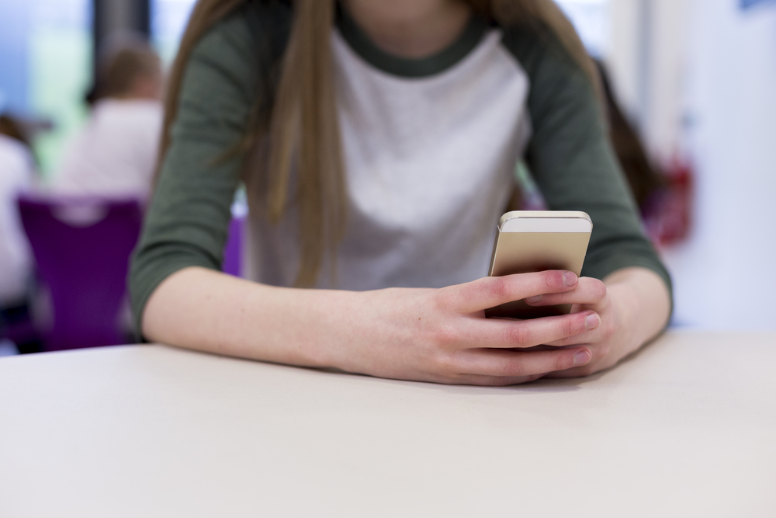

Digital Red Flags
SAMPLE
Notes:
DIGITAL RED FLAGS 2:30
Some of your parents may have set up online safety rules for you.
If not, we are going to talk about online Red Flags and Safety Rules to help in those situations.
Who remembers what a Red Flag is? (A clue that something is unsafe.)
What are some Red Flags related to the things we have discussed that may indicate something a peer, a predator, or even you might do that would be unsafe?
If you can think of a digital Red Flag, raise your hand and share with the class.
Let’s try to come up with at least 5 potential Red Flags for online behavior.
POTENTIAL RED FLAGS
Elicit responses being sure to cover the following:
Someone pretending to be someone they are not.
Adults using social media, gaming and virtual reality sites to chat with children.
Cyberbullying by peers.
Talking to them about things their parents will not talk about.
Trying to get them to meet in person.

Slide 13

Essential Review
TRUE
SAMPLE
FALSE
Notes:
ESSENTIAL REVIEW 2:30
We’re almost out of time, so let’s do a review to see what you learned today. For each statement I read, tell me if the statement is true with a thumbs up, or false with a thumbs down.
REVIEW STATEMENTS
It is not considered cyberbullying if someone sends a message with mean words on a cell phone; it is only cyberbullying if they send it on a computer. (Thumbs down/False. Both are cyberbullying.)
A Bystander is someone who stands up to bullies or helps someone being bullied. (Thumbs down/False. This is an Upstander.)
Bullying will most likely stop if everyone just ignores the bully. (Thumbs down/False. If it helps you or someone else, you should tell a Safe Adult.)
There are different ways to be an Upstander that do not necessarily involve you directly confronting a bully. (Thumbs up/ True. You can talk to a Safe Adult and ask them for help. You only want to confront a bully if you know you will be safe.)
Your digital reputation is important because people will look at your online behavior and use it to make judgments in the future about accepting you for college or jobs. (Thumbs up/True)

Slide 14



Safety Rules Review
SAMPLE
Notes:
SAFETY RULES REVIEW 1:00
Today, we learned about bullying and being safe online.
We also learned 5 Safety Rules that can help you stay safe from bullying and digital dangers.
Let’s review the Safety Rules.
Stand up and practice the rules and their motions with me and the Safety Squad.
ADVANCE THE SLIDE TO BEGIN AND AFTER EACH RULE TO SHOW THE NEXT RULE.
Safety Rule #1 is Know What’s Up
Safety Rule #2 is Spot Red Flags
Safety Rule #3 is Make a Move
Safety Rule #4 is Talk It Up
Safety Rule #5 is No Blame | No Shame

Slide 15
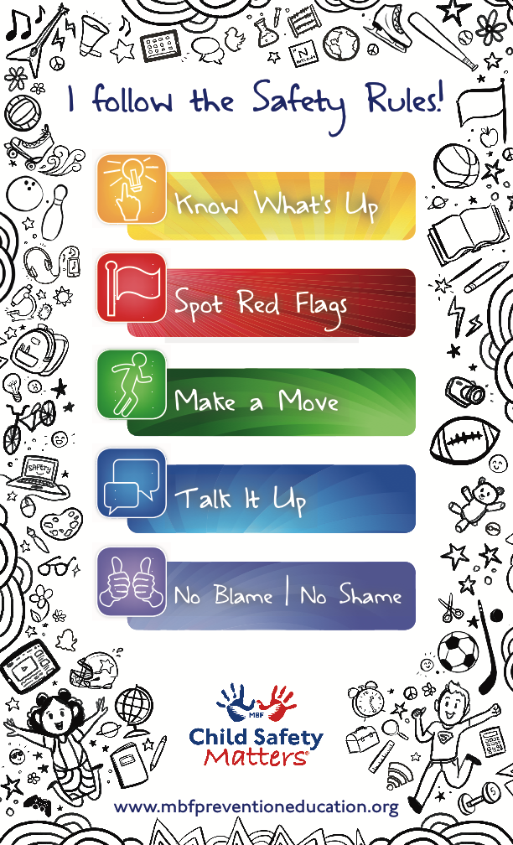
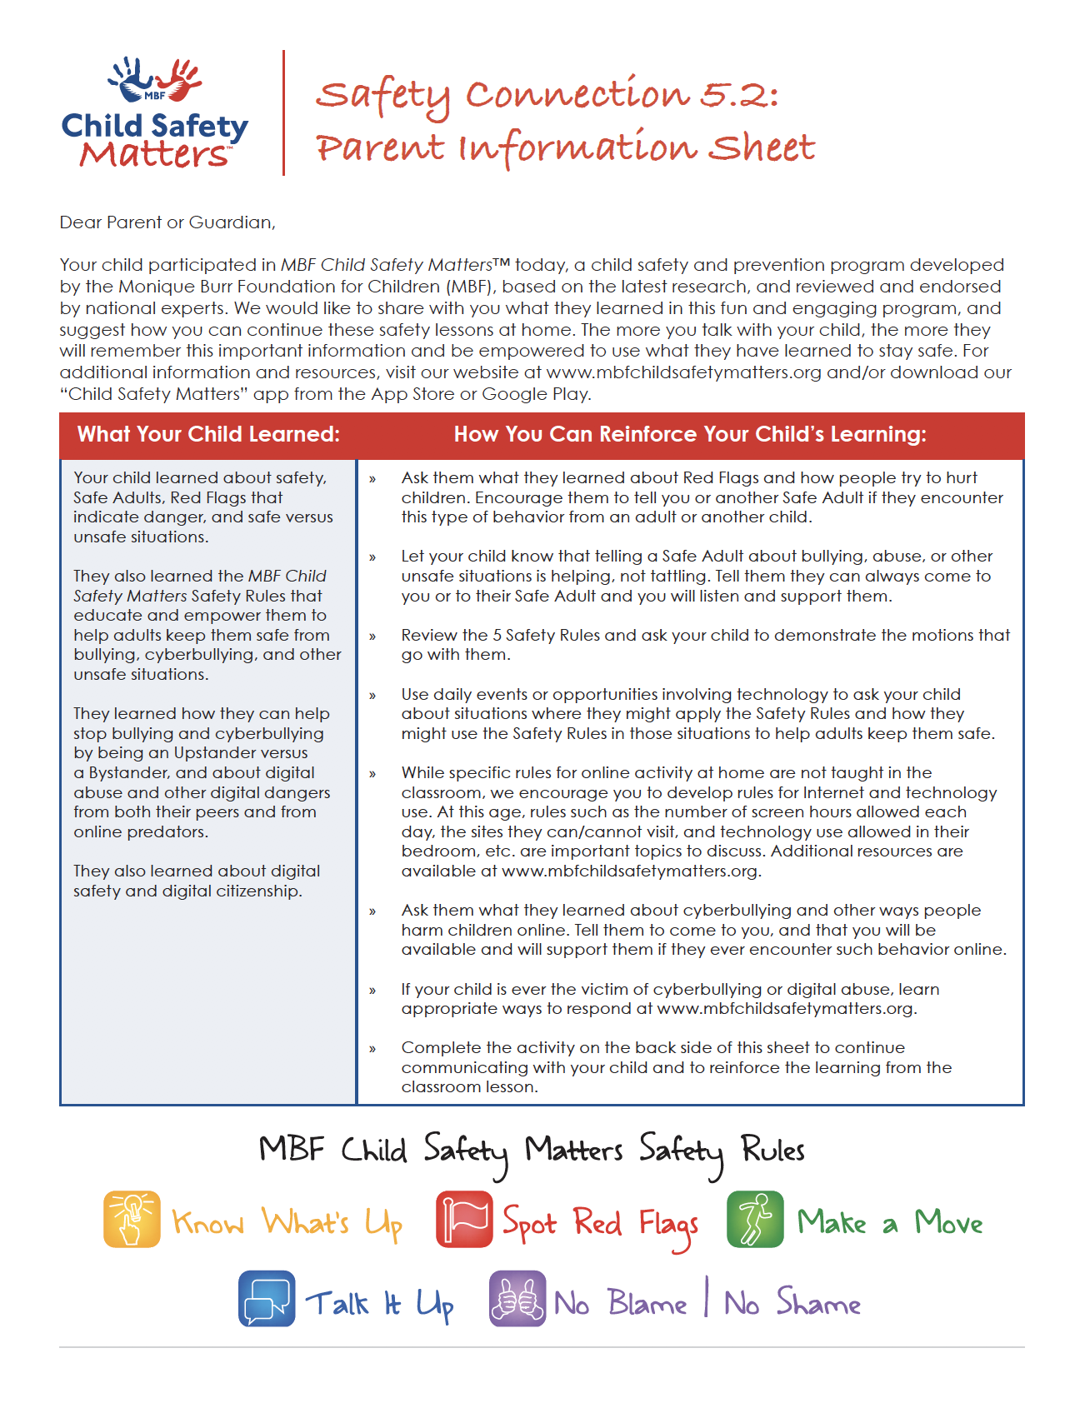
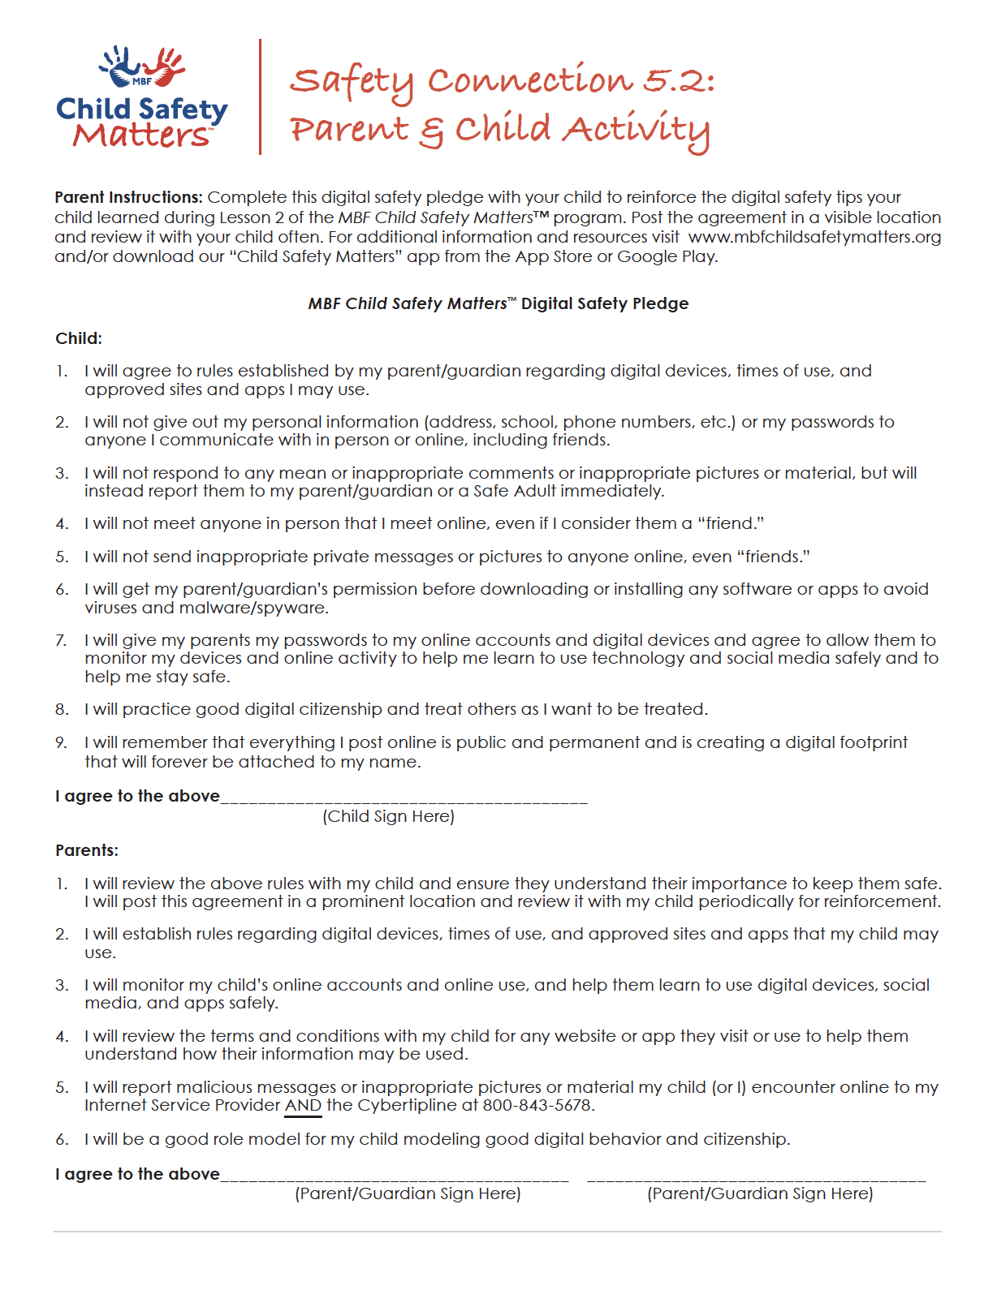
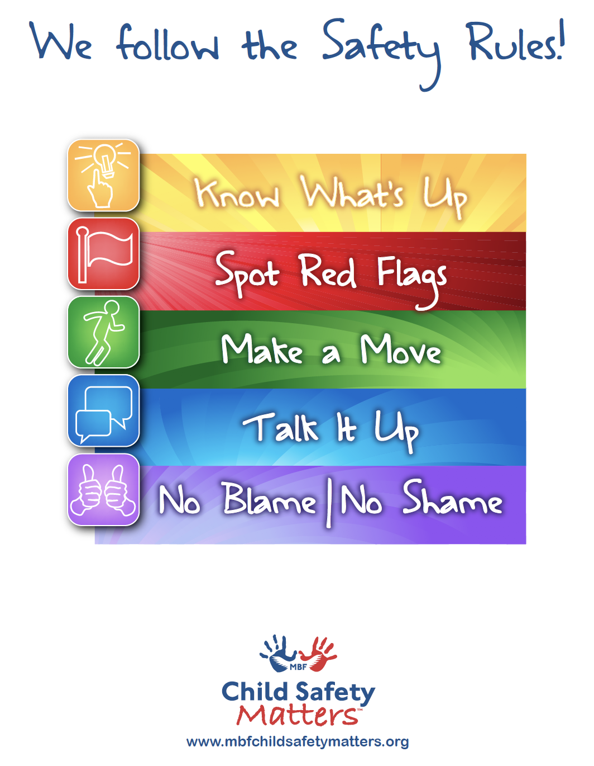
Things for You!
SAMPLE
Notes:
WRAP-UP 1:00
You learned a lot today, and I am very proud of you all. You have been a great class and I appreciate your help and participation.
To finish up today, I have a few things for you to remind you about the Safety Rules and how you can help adults keep you safe.
I have another Parent Information & Activity Sheet for you to take home and share with your parent or guardian. On the front is information for them to help keep you safe, and on the back is a fun activity. Have your parent or guardian do this activity with you so you can continue to learn your personal information and practice the Safety Rules. It is very important that your parents receive this information, so be sure you give it to them today when you get home.
You also get an MBF Child Safety Matters Coloring Poster. You can color it and then hang the poster somewhere safe in your room or house, and it will remind you to follow the Safety Rules.
And don’t forget about your Safety Rules poster for the classroom. I hope you see it every day and remember the Safety Rules.

Slide 16


SAMPLE
GREAT JOB! Every child deserves to be safe!
Notes:
CLOSE 1:00
Fantastic work today! Thank you students for your attention today, and thank you Mr./Mrs. ___________ (teacher).
I hope you all have enjoyed today’s MBF Child Safety Matters Lesson and learned a lot.
Remember to practice your Safety Rules so you do not forget them.
Does anyone have any questions before I leave?
If you think of any questions, you can ask your teacher, or you are welcome to come see me.* (*If you are a school staff member.)
Remember, every child deserves to be safe. You each deserve to be safe!

