Slide 1
Role of a School Counselor
Not your average Guidance Counselor, We are School Counselors.
“Every Child Deserves A School Counselor”

Slide 2
RCSD School Counseling Mission
To provide a comprehensive, developmentally age-appropriate and sequential school counseling program that is aligned with the New York State Learning Standards and national (ASCA) and state (NYSSCA) standards.
School Counselors address the academic, career and social-emotional development needs of students with a global perspective. School Counselors work collaboratively with families, staff, and community partners to prepare students to become effective 21st century learners, achieve success in school, and develop into contributing members of our society.

Slide 3
RCSD School Counselor Vision
Every student will acquire the academic and social-emotional skills, post- secondary preparation and career exploration to reach their fullest educational potential.

Slide 4
History
The School Counseling framework has evolved overtime from simply guidance.
We are no longer Guidance Counselors, the preferred name and title based on ASCA is School Counselor.
The title School Counselor encompasses the diversity and broad scope of the duties.

Slide 5
American School Counselor Association:
What is a Certified School Counselor?
A Certified School Counselor is a professional that:
Possesses a Master’s Degree in Counseling with a concentration in School Counseling.
Has unique theoretical and developmental training.
Has a holistic viewpoint of children to address the forever growing and changing needs of the 21st century learner.
Works collaboratively with key stakeholders to meet the academic, social -emotional, and post secondary needs.

Slide 6
The role and responsibility of a School Counselor
As defined by ASCA and NYSCCA:
Direct services: responsive services, crisis response, group, individual, appraisal, assessment, advisement, developing post- HS plans, and encourage parental involvement.
Indirect services: collaboration, consultations, referral, leadership, advocacy and teaming.
Annual student progress review: review students goals, academic, behaviors and attendance progress with grades 6-12 yearly.
Core instruction and lesson plans: Provide students with classroom instruction coupled with lesson plans that are aligned with ASCA.
Data Driven practices: Use of data to inform decisions, pre and post test/surveys.
Has a caseload of no more than 1:250 students.
Notes:
Provide chart with high versus low performing school counselors

Slide 7
Appropriate Tasks for Counselors (ASCA)
Consulting with teachers to schedule and present school counseling curriculum lessons based on developmental needs and needs identified through data
Interpreting student records
Consulting with teachers about building classroom connections, effective classroom management and the role of noncognitive factors in student success
Protecting student records and information per state and federal regulations
Consulting with the school principal to identify and resolve student issues, needs and problems
Analyzing disaggregated schoolwide and school counseling program data
Advisement and appraisal for academic planning
Orientation, coordination and academic advising for new students
Interpreting cognitive, aptitude and achievement tests
Providing counseling to students who are chronically tardy or absent
Providing counseling to students who have disciplinary problems
Providing short-term individual and small group counseling services to students
Advocating for students at individual education plan meetings, student study teams and school attendance review boards, as necessary
Analyzing grade-point averages in relationship to achievement

Slide 8
Inappropriate Tasks for Counselors (ASCA)
Building the master schedule*
Coordinating paperwork and data entry of all new students
Coordinating cognitive, aptitude and achievement testing programs
Signing excuses for students who are tardy or absent
Performing disciplinary actions or assigning discipline consequences
Coordinating schoolwide individual education plans, student study teams, response to intervention plans, MTSS and school attendance review boards
Covering classes when teachers are absent or to create teacher planning time
Maintaining student records*
Computing grade-point averages*
Supervising classrooms or common areas
Keeping clerical records
Assisting with duties in the principal’s office
Providing long-term counseling in schools to address psychological disorders
Serving as a data entry clerk

Slide 9
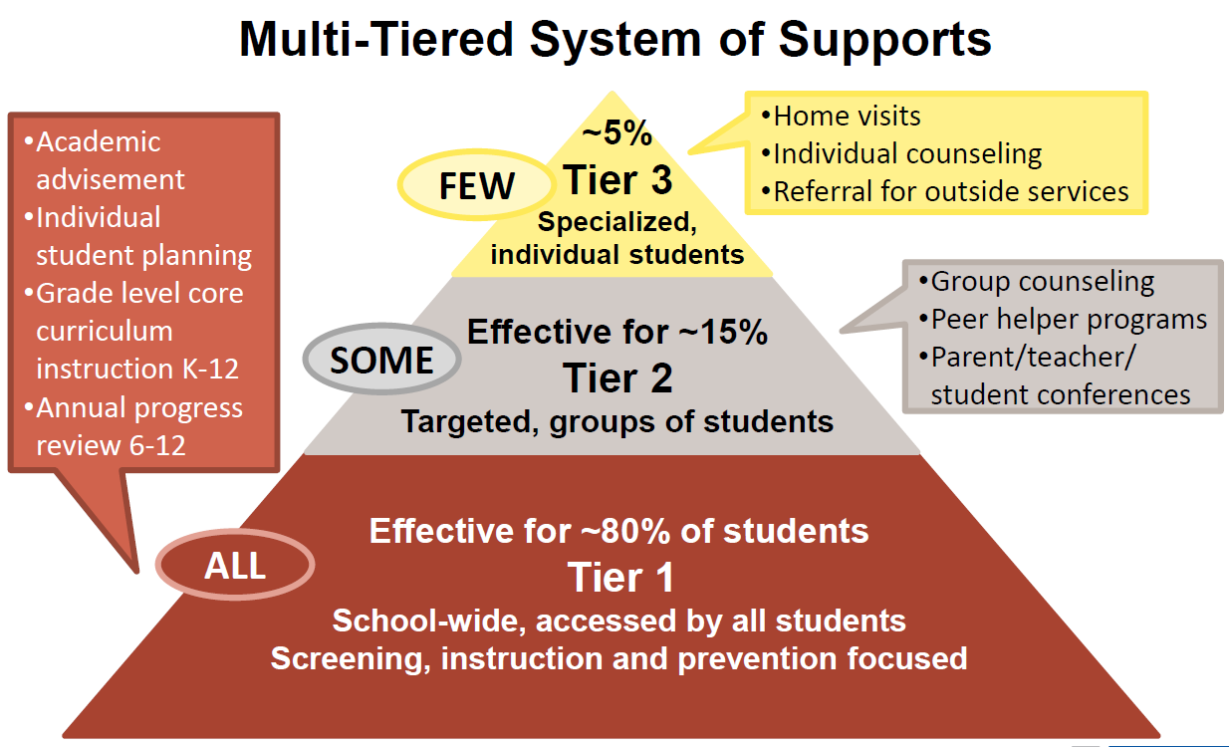
The role and responsibility of School Counselor
Notes:
To meet the vision and mission of our department, we must Focus on Tier I, 2 and 3 levels.This will help increase outcomes for students. Counselors should spend most time on on tier I activities where most students are impacted.

Slide 10
New School Counseling Regulations
The work of the school counselor is viewed as an important role for students, families, and the community at large. Evidenced by the American School Counselor Association and New York state rules and regulations that govern school counseling.
Part 100.2(j)
Notes:
Part 100(j). There must be a comprehensive school counseling program for all students in grades K - 12.
Counselors must complete an annual individual progress review for students in grades 6 -12. The review can include but not limited to academics, attendance, behavior and goal setting.
Part 80 & Part 52.21 Requirements colleges and students must uphold when pursuing a degree in School Counseling

Slide 11
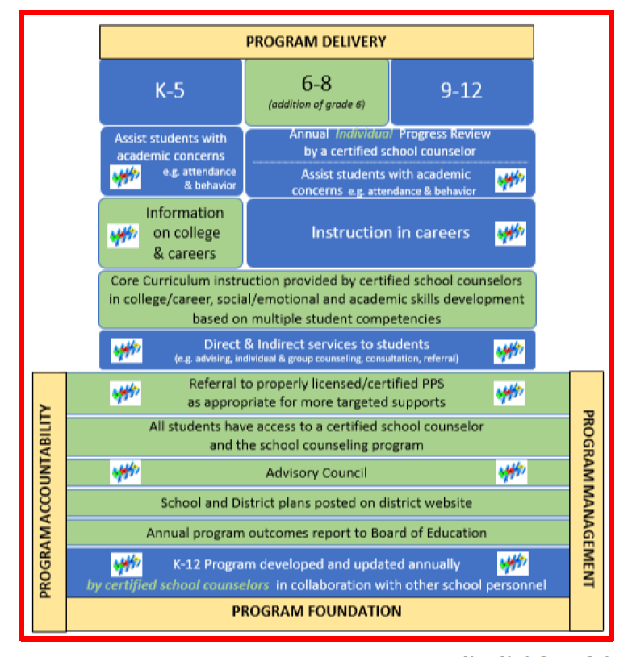
Part 100(j) - Requirements for School Counselors

Slide 12
Comprehensive School Counseling Plan
Per NYS Mandate:
Each school district must create a comprehensive school counseling plan aligned with ASCA and NYS standards. (policy adopted in July 2017).
Plans must be completed, and available on district website by September 2022.
Plans are utilized by all counselors to streamline duties and provide more consistency across the district.
Plan includes using the village approach to meet the needs of all students.
Notes:
Provide Executive Summary to colleagues

Slide 13
RCSD Comprehensive School Counseling Plan
The plan will include:
RCSD School Counseling Mission and Vision.
Role and Responsibility of a School Counselor.
A calendar of grade specific activities and duties aligned with ASCA.
*This is a living document and can be modified throughout the year to fit the needs of students.

Slide 14
Benefit of RCSD Comprehensive School Counselor Plan: Students
Prepares students for the challenges of the 21st century by acquiring knowledge and skills in academic, career and personal/social development.
Connects the educational program to future success.
Facilitates career exploration and development.
Develops decision making and problem solving.
Assists in acquiring knowledge of self and others
Enhances personal-social development.
Assist in developing effective interpersonal relationship skills.
Broadens knowledge of our changing world.
Guarantees school counseling serves to every student.
Increases the opportunity for counselor-student interaction
Encourages facilitative, cooperative peer interaction.
Fosters resiliency factors for students.

Slide 15
Benefits of RCSD Comprehensive School Counseling Plan: Parents
Prepares their children for the challenges of the 21st century through academic, career and personal/social development.
Works collaboratively and supports parents with advocating for their child’s academic, career and personal/social development.
Develops a systematic approach for their child’s long-range planning and learning.
Increases opportunities for parent/school interaction.
Enables parents to access school and community resources.
Work as partners in their child’s education.

Slide 16
Benefits of RCSD Comprehensive School Counseling Plan: Student Support Personnel
Provides School Psychologists, Social Workers and other professional student services personnel with a clearly defined role of the School Counselor.
Clarifies areas of overlapping responsibilities.
Fosters a team approach to enhance cooperation.

Slide 17
Benefits of RCSD Comprehensive School Counseling Plan: Community
Provides an increased opportunity for collaboration and participation of community members with the school program.
Creates community awareness and visibility of the school counseling program.
Connects the community to the needs of the school and the school to the needs of the community.
Enhances economic development through quality preparation of the students for the world of work.

Slide 18
Benefits of RCSD Comprehensive School Counseling Plan: Administrators
Integrates school counseling with the academic mission of the school.
Provides a program structure with specific content.
Assists administration to use school counselors effectively to enhance learning and development for all students.
Provides a means of evaluating the effectiveness of the school counseling program.
Demonstrates school counseling accountability.
Enhances community image of the school counseling program.
Notes:
Admin and counselor relationship is crucial. Working and meeting regularly as a team improved outcomes for students.

Slide 19
Benefits of RCSD Comprehensive School Counseling Plan: Teachers
Supports classroom Instruction.
Encourages positive, calendared activities and supportive working relationships.
Promotes a team effort to address developmental skills and core competencies.
Increases teacher associability to the classroom presenter and resource person.
Provides an interdisciplinary team effort to address student needs and educational goals.
Provides skill development for teachers in classroom management, teaching effectiveness, and effective education.
Provides consultant to assist teachers in their guidance and advisement role.
Positively impacts school climate and the learning community.

Slide 20
Keys to an Effective Principal-Counselor Partnership
Increased communication (Identify preferred format, begin from a place of mutual trust)
Regular meetings (Counselors provide specific questions and concerns, principals provide support avenues)
Defined roles and responsibilities (Refer to ASCA appropriate tasks, find ways to align task requests to counseling standards)
Increased counseling department awareness (Admin play important role in raising clarity and visibility)in school culture
Data use for improved communication and transparency (Counselor shares results of data collection regularly)

Slide 21
Responsibility Summary
1: Academic
Data collection
Report card meetings/celebrations
Parent meetings/workshops
Attendance committee
RTI/MTSS/Data teams
2: College/Career Readiness
Presentations with community partners
College visit field trips
Financial planning workshops
Annual individual reviews
3: Social/Emotional
Tier 1 monthly push-ins
Group counseling
Individual counseling/check-ins
Restorative practices
Mental health checks and screenings, mental health team/advisory
Referrals to community agencies
Elementary

Slide 22
Responsibility Summary
1: Academic
Data collection
Report card meetings/celebrations
Parent meetings/workshops
Attendance committee
RTI/MTSS/Data teams
2: College/Career Readiness
Presentations with community partners
College visit field trips
Financial planning workshops
Annual individual reviews
Naviance presentations and activities
Work permits*
3: Social/Emotional
Tier 1 monthly push-ins
Group counseling/mediations
Individual counseling/check-ins
Restorative practices
Mental health checks and screenings, mental health team/advisory
Referrals to community agencies
Middle

Slide 23
Responsibility Summary
1: Academic
Data collection
Report card meetings/celebrations
Parent meetings/workshops
Attendance committee
RTI/MTSS/Data teams
Scheduling changes and maintenance
Graduation plans for all students
2: College/Career Readiness
Presentations with community partners, career programming
College visit field trips
Financial aid and planning workshops
Annual individual reviews
Naviance presentations and activities
Work permits
PSAT/SAT/ACT/AP/Regents Exam Support
3: Social/Emotional
Tier 1 monthly push-ins
Group counseling/mediations
Individual counseling/check-ins
Restorative practices
Mental health checks and screenings, mental health team/advisory
Referrals to community agencies
Town Hall meetings and activities
High School

Slide 24
Questions, Comments & Suggestions
Please visit our School Counseling webpage for more information and insight.
https://www.rcsdk12.org/Domain/74

