Slide 1
September’s Frequently-Asked Questions*
*Information may not be current! Double-check when appropriate.
FAQ #1: What happens when an Intern is Uncertified?
FAQ #2: What if the “CIT Intern” already has significant teaching experience elsewhere?
FAQ #3: What’s the deal with the “New Educator Orientation Requirement?”
FAQ #4: What’s going to happen with this dramatic district reconfiguration?
FAQ #5: Show me the Money?
From CIT Mentor Forum, September 18, 2023

Slide 2
November’s Frequently-Asked Questions*
*Information may not be current! Double-check when appropriate.
FAQ #6: How do I convince my Intern to invest time in Planning & Preparation?
FAQ #7: With this new Google Drive, why can’t I just . . . ?
FAQ #8: What happens next with my reports?
FAQ #4: What’s going to happen with this dramatic district reconfiguration?
FAQ #9: How do I approach APPR Evaluation with Interns?
From CIT Mentor Forum, November 20, 2023

Slide 3
January Frequently-Asked Questions*
*Information may not be current! Double-check when appropriate.
FAQ #10: How do I advise about Transfer Days?
FAQ #11: What do I do if my Intern is struggling?
From CIT Mentor Forum, January 8, 2024

Slide 4
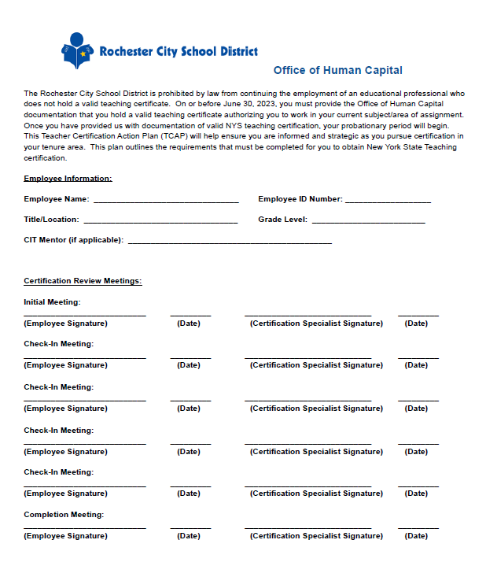
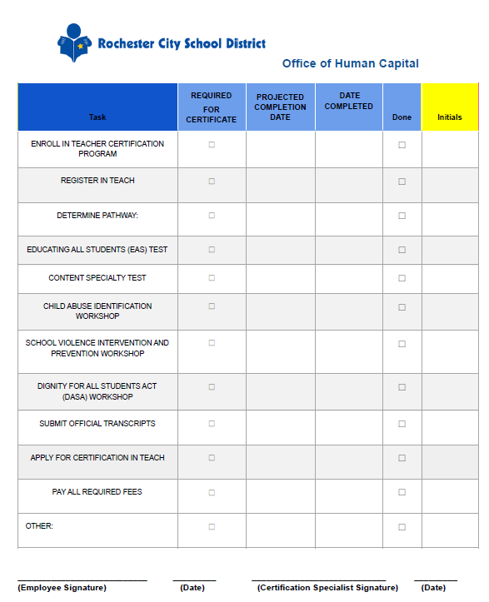
FAQ #1: What happens when an Intern is Uncertified?
Most uncertified hires have a “Teacher Certification Action Plan” or “TCAP”
Most uncertified hires are in PeopleSoft as “Contract Substitute” (code “REGS or“REGU”)
Office of Human Capital’s Director of Staff & Educator Effectiveness Kara Reidy-Vedder
Tuition Reimbursement only through
December 2023 toward “Initial Certificate.”
TR will continue to be available toward “Professional Certificate.” (Available to those with “Initial” or “Internship Certificate.”)
Info at CIT Website: www.rcsdk12.org/CIT/Certification
From CIT Mentor Forum, September 18, 2023
Notes:
Launch Poll #2

Slide 5
“CIT Intern” or “PS Uncertified?”
Certified or Almost Certified | Won’t be Certified by Sept 2024
“Intern” Support Intern Status Reports & Intern Final Report | “PS Uncertified” or “PS Per Diem” Intake Form & Semester Reports (January, June)
Comprehensive formative feedback | Address Immediate Needs Support (Time) same as Intern.
Support with completing Certification process (if needed) | Support with Certification process.
Monthly Admin Contact | Monthly Admin Contact (same as CIT Intern)
DEFAULT to CIT Intern to start
From CIT Mentor Forum, September 18, 2023

Slide 6
Other Significant Info
Teacher Evaluation
  Should be completed by Supervisor
  Important for reducing Probationary Period once certified
What happens in June?
  Goal is to support, grow, and retain promising teachers.
  TCAPs for Contract Subs revisited in June before rehiring
CIT Office will check in with mentors supporting “uncertified” folks in a few weeks to confirm status.
www.rcsdk12.org/CIT/Certification
From CIT Mentor Forum, September 18, 2023

Slide 7
FAQ #2: What if the “CIT Intern” already has significant teaching experience elsewhere?
Almost always starts as “CIT Intern,” even if experienced prior to coming to RCSD.
CIT Mentor needs to observe work with students.
If Intern has prior experience and demonstrates “effective” practice in all domains, collaborate on setting goals and providing support for continuing growth.
If first “Intern Status Report” shows Intern to be “Effective” in all domains, you may wish to reach out to CIT Director to discuss shifting level of CIT support.
From CIT Mentor Forum, September 18, 2023

Slide 8

FAQ #3: What’s the deal with the “New Educator Orientation Requirement?”
The August “New Educator Orientation” program meets a contractual requirement for all teacher hires per RTA-RCSD Contract Section 15.2 for “up to five days . . . of orientation and in-services.”
Total Attendance | 196
Incomplete (missed sessions) | 52
New Educators missed NEO | 70
(NOT to be confused with the Office of Human Capital’s “Onboarding” or monthly Friday “New Hire Sessions.”)
CIT will be sending out information about meeting the contractual requirement by the end of September.
http://www.rcsdk12.org/CIT/NTO
From CIT Mentor Forum, September 18, 2023

Slide 9
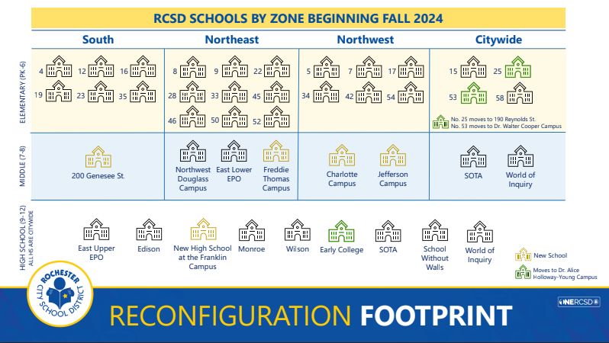
FAQ #4: What’s going to happen with this dramatic district reconfiguration?
What’s the buzz?
How to approach?
  Model Calm
  Acknowledge and validate feelings
  Avoid speculation
  Provide perspective
  Don’t lose focus on students
  Don’t dismiss your own valid emotional response.
From CIT Mentor Forum, September 18, 2023
Notes:
Launch Poll #3

Slide 10

FAQ #5: Show me the Money?
If you are activated, the CIT Mentor Stipend will typically appear in your paychecks in mid-October, with retroactive pay appearing in the subsequent paycheck.
https://www.rcsdk12.org/site/handlers/filedownload.ashx?moduleinstanceid=85257&dataid=96287&FileName=BREAKOUT%20ROOM%20TOPICS%20and%20Instructions.pdf
From CIT Mentor Forum, September 18, 2023

Slide 11

FAQ #6: How do I convince my Intern to invest time in Planning & Preparation?
Share examples, templates
The “Why”: purpose of lesson components
Co-plan, model
Third Point of Danielson rubric
Emphasize
… how planning benefits kids
… how planning allows you to be “in the moment”
… how planning allows you to focus your attention and feel successful
… how planning allows you to ‘respond’ and not ‘react’
From CIT Mentor Forum, November 20, 2023

Slide 12
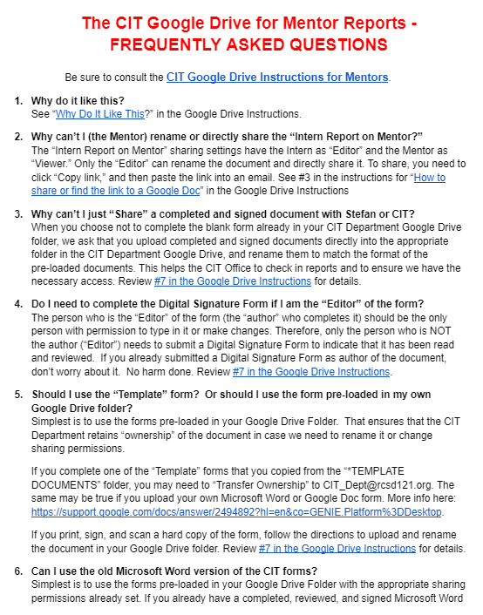
FAQ #7: With this new Google Drive, why can’t I just . . . ?
“Share” vs. “Copy link”
Organization
Document “Ownership”
Confidentiality
Tracking
https://docs.google.com/document/d/1WSb64pg9nBhPSbDLuod8K1guPY2KFhP5uryFwZnmPgM/edit
From CIT Mentor Forum, November 20, 2023

Slide 13
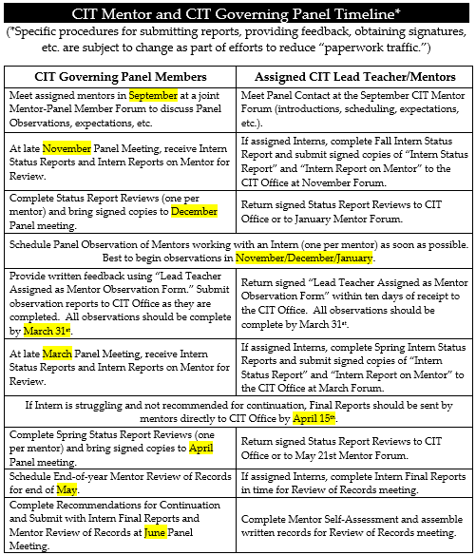
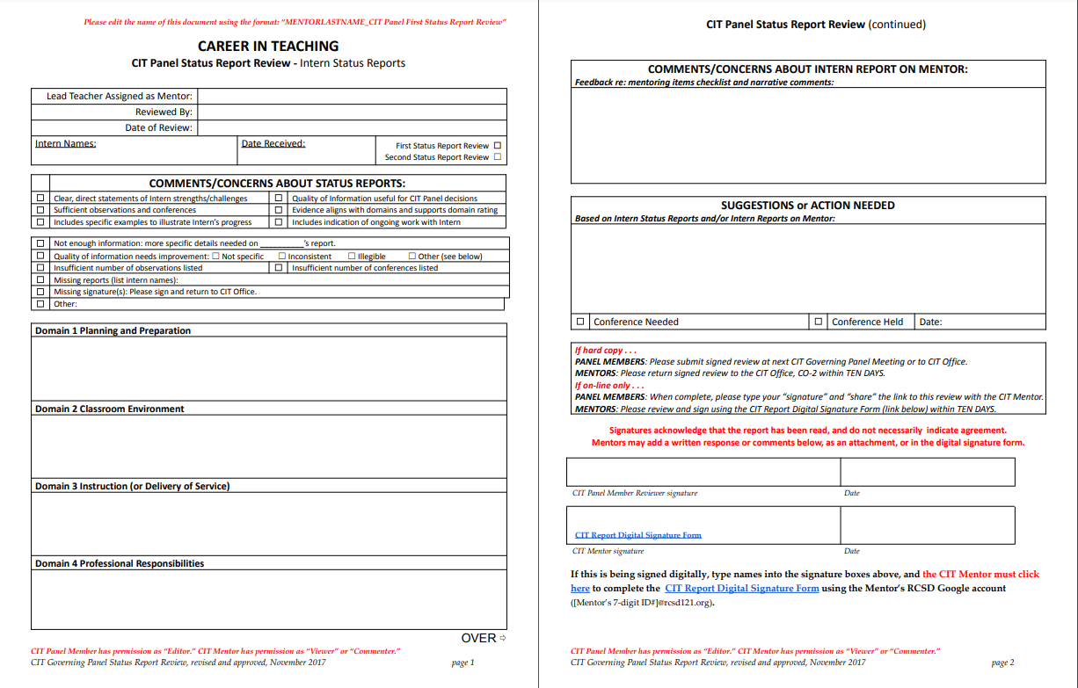
FAQ #8: What happens next with my reports?
Wendy checks them in.
CIT Governing Panel contact reviews them and provides feedback.
They became the springboard and/or reference point for ongoing Mentor work.
From CIT Mentor Forum, November 20, 2023

Slide 14
FAQ #9: How do I approach APPR Evaluation with Interns?
Whenever possible, ease their anxiety.
Frame suggestions as ways to help them do their best work for students (not “because your admin will be looking for . . .”).
Frame it as “Feedback” (not “Pass/Fail” or “getting dinged” for doing something wrong).
Drain some of the mystery.
Provide perspective: verbal feedback, facial expressions, body language vs. what ends up in writing.
Remind them that if something is unfair, there is a clear process by which to address it
From CIT Mentor Forum, November 20, 2023

Slide 15
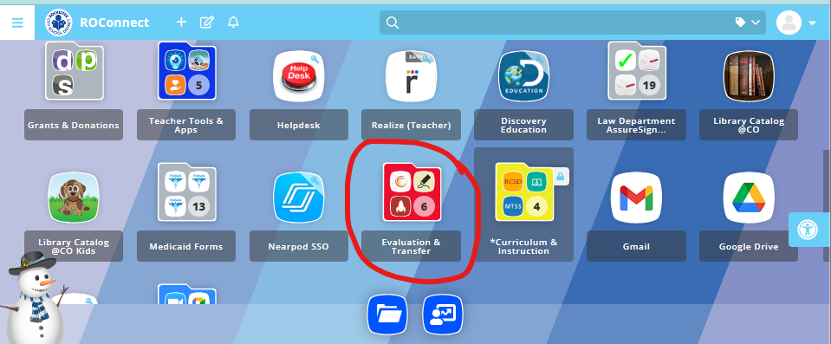
FAQ #10: How do I advise about Transfer Days?
If in school that is closing: Participate in Transfer Process!
If teacher is not yet NYS certified:
Can’t participate in ‘Voluntary Transfer’
If certified by ‘Transfer Days’ in May/June, their position will not be listed as a “vacancy,” and they can participate in later rounds.
Remind Interns who participate in the transfer process to alert building supervisors (great opportunity for discussion about next year).

Slide 16

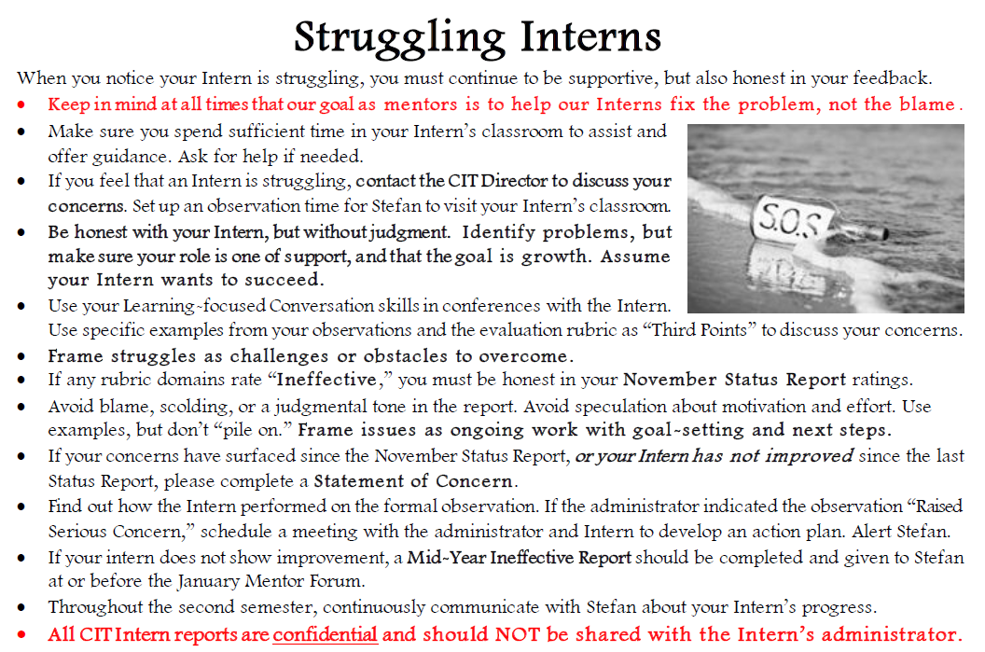
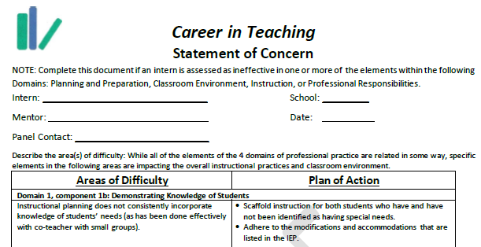
FAQ #11: What do I do if my Intern is struggling?
Mentor Handbook, pp. 33-35
Call the CIT Office!
Document in your Mentor Log
When needed, know your boundaries, and check that the Intern has external supports
If “Ineffective” ratings are not showing improvement, consider “Statement of Concern.”

