Slide 1
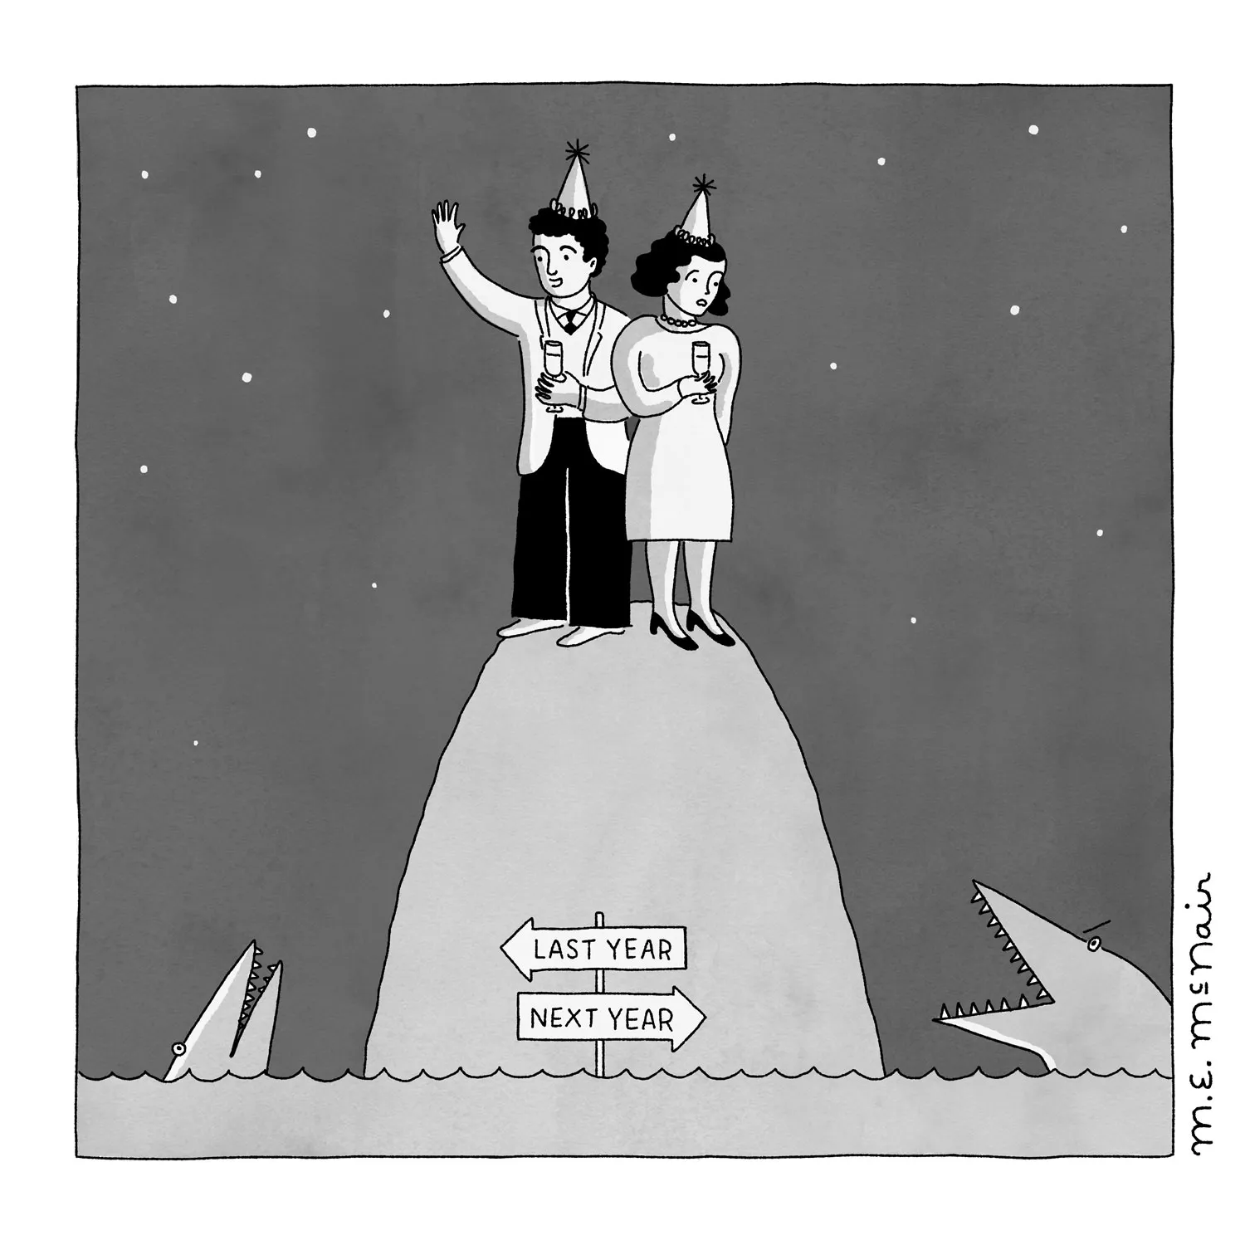

Happy New Year CIT Mentor Forum, January 8, 2024
Share in “Chat:”
What is the most important message for the teacher/service provider you are supporting to hear in the new year?
We will share the responses (with names removed) after today’s meeting.
Tech issues with Microsoft Teams? Please email Anna.Leone-Tobar@rcsdk12.org .
This Photo by Unknown Author is licensed under CC BY-SA
Notes:
Start Music at 3:49 pm

Slide 2
Happy New Year CIT Mentor Forum, January 8, 2024
Share in “Chat:”
What is the most important message for the teacher/service provider you are supporting to hear in the new year?
We will share the responses (with names removed) after today’s meeting.
Today’s AGENDA:
New Year Message to your CIT Interns
CIT Reminders & Announcements
Supporting through “Rejuvenation” Phase
FAQs: Transfers, Struggling Interns
Status of Status Reports
Problem-Solving Support from Each Other
Check Out & Survey Time
Tech issues with Microsoft Teams? Please email Anna.Leone-Tobar@rcsdk12.org .
This Photo by Unknown Author is licensed under CC BY-SA

Slide 3

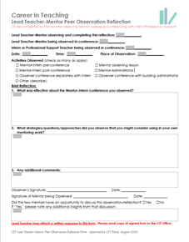
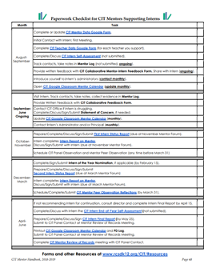
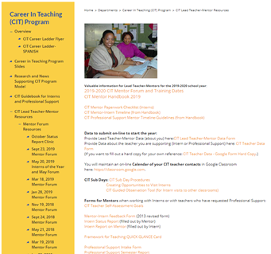
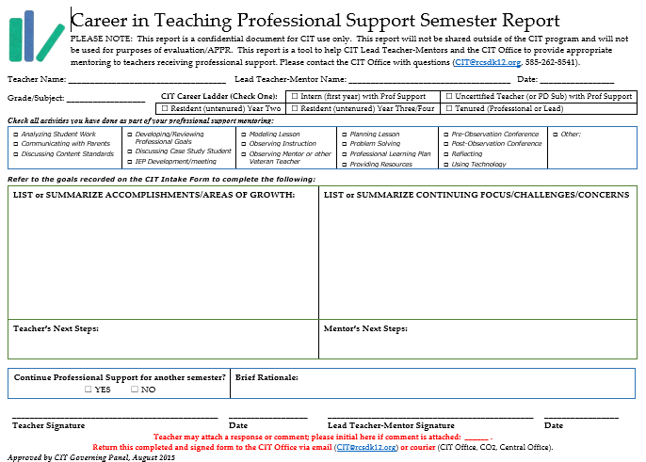
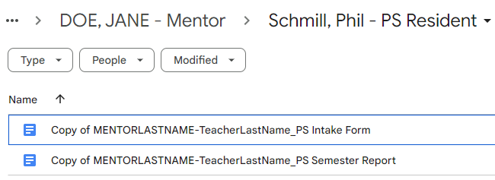
New Year - New (& Old) CIT Stuff To Do
If activated, remember to . . .
Update your Google Classroom Calendar
Arrange your Mentor Peer Observation
Schedule your CIT Panel Observation
If Interns, remember to . . .
Make your Monthly Administrator Contact
Review Transfer Day Process with Intern
If Professional Support . . .
Start preparing your
Professional Support Semester Report
www.rcsdk12.org/CIT/Resources

Slide 4
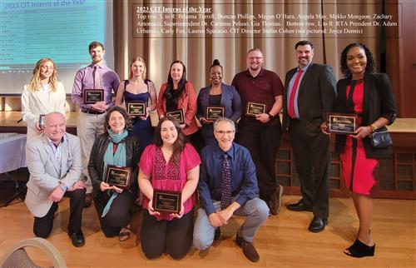

CIT Interns of the Year
DEADLINE for Nominations: February 16th
To recognize the most OUTSTANDING new teachers and service providers.
Please be selective (from 259 Interns!)
What distinguishes this nominee as an outstanding intern?
Form must be signed by both Mentor AND Supervising Administrator
https://www.rcsdk12.org/CIT/Interns

Slide 5

Seeking Qualified Applicants to become CIT Mentors!
Candidates must have 7 years of successful classroom teaching experience and/or direct student contact (at least 5 in the RCSD).
Selection as a CIT Lead Teacher-Mentor does not guarantee an active assignment.
Selection as a CIT Lead Teacher-Mentor does not usually include release time from classroom responsibilities.
If activated, CIT Lead Teacher-Mentors are compensated by stipend.
The CIT Governing Panel uses a selective process as per contract (since 2015-2019, 63.% of applicants were selected).
www.rcsdk12.org/CIT/Application

Slide 6
CIT Mentor Reapplications
If your Lead Teacher-Mentor two-year term expires in June 2024 you will receive notice in January that you must reapply to continue as a mentor for 2024-2026. You will receive an email message with a link to an on-line CIT Lead Teacher-Mentor Reapplication Google form that must be completed by [Deadline TBA].
The Reapplication process has been delayed. Stay tuned for more information soon!
When answering Reapplication prompts, give yourself some time to reflect and to answer questions thoughtfully and thoroughly using concrete examples of from your work as a Mentor so the CIT Panel will have sufficient evidence to evaluate your reapplication;
If you do not finish all the questions in one sitting, you can return to the form and make changes up until the due date; you can do this by submitting the form, and then using the link in the email confirmation that you will receive to return and edit your responses;
If you have not been activated, or your actual experience does not provide a relevant example for a reapplication question, you will be asked to indicate that in your answer and describe how you might approach the scenario or issue;
CIT will contact your current RTA Rep and Principal directly for a reference; you do not need to ask them to submit confidential reference forms as in the past; and
It would be helpful to let CIT know if you are not planning to reapply (so we won’t bug you with reminders).
The CIT Governing Panel will rate your written reapplication responses based on your clear analysis of your mentoring practice with fully developed, relevant and specific examples. In February, the CIT Governing Panel will review reapplications, mentor performance, paperwork, attendance, references, and evaluations and will either (1) renew you for another two-year term, (2) invite you for a reapplication interview, or (3) decline to renew your position for another term.
Email stefan.cohen@rcsdk12.org with questions.

Slide 7

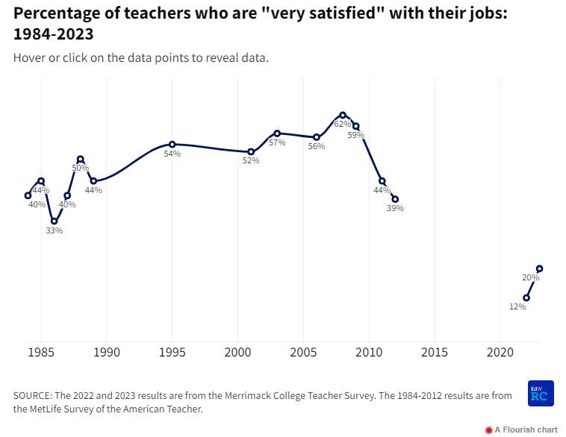
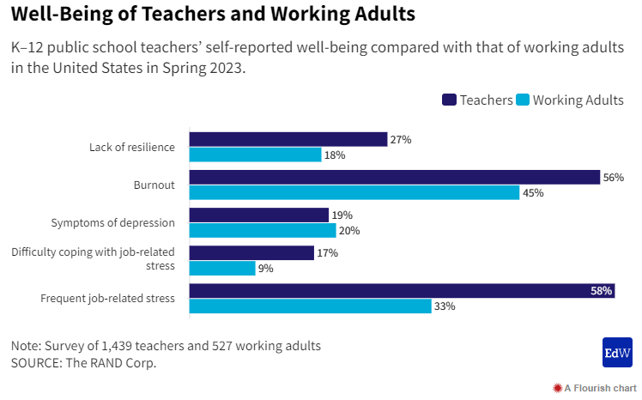
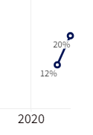
Some National Trends
Teacher job satisfaction improves from last year.
Teachers are still more stressed than other working adults
https://www.edweek.org/teaching-learning/the-teaching-profession-in-2023-in-charts/2023/12

Slide 8
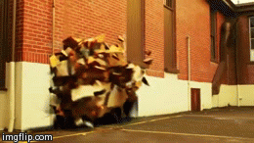
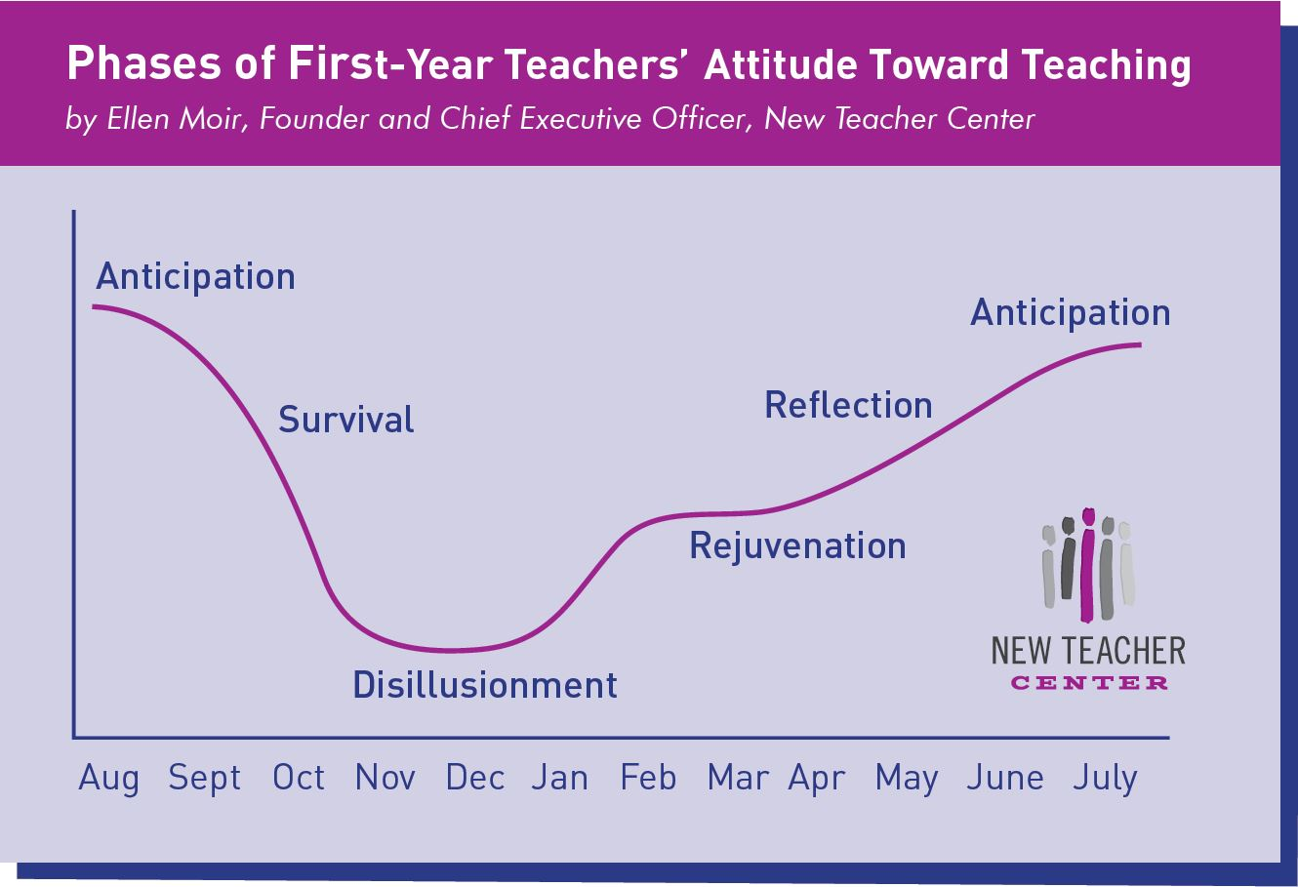
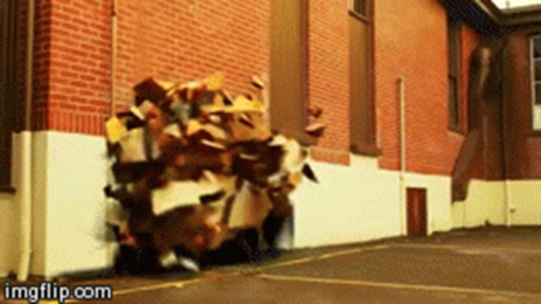
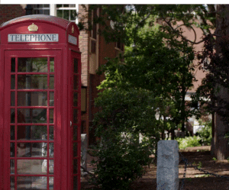


New Year . . . New Hopes for “Rejuvenation”

Slide 9

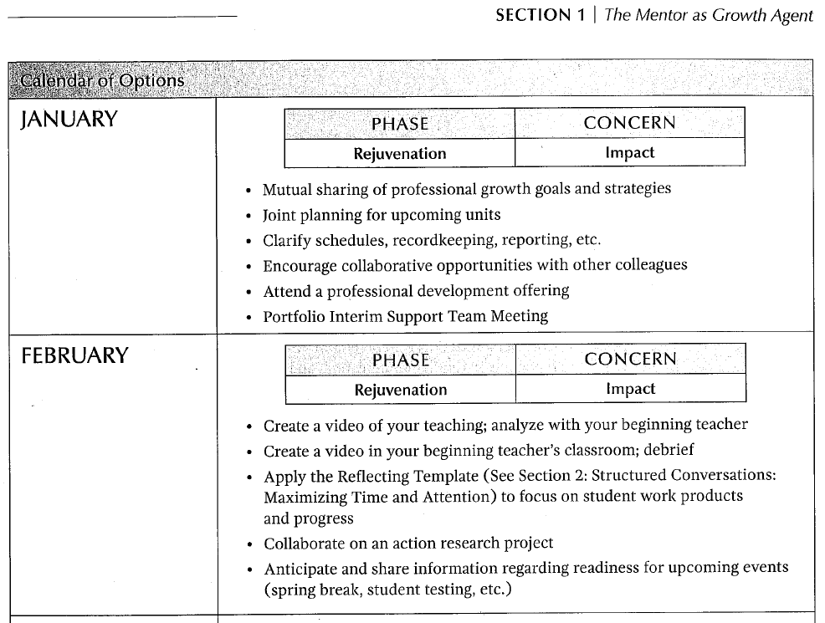
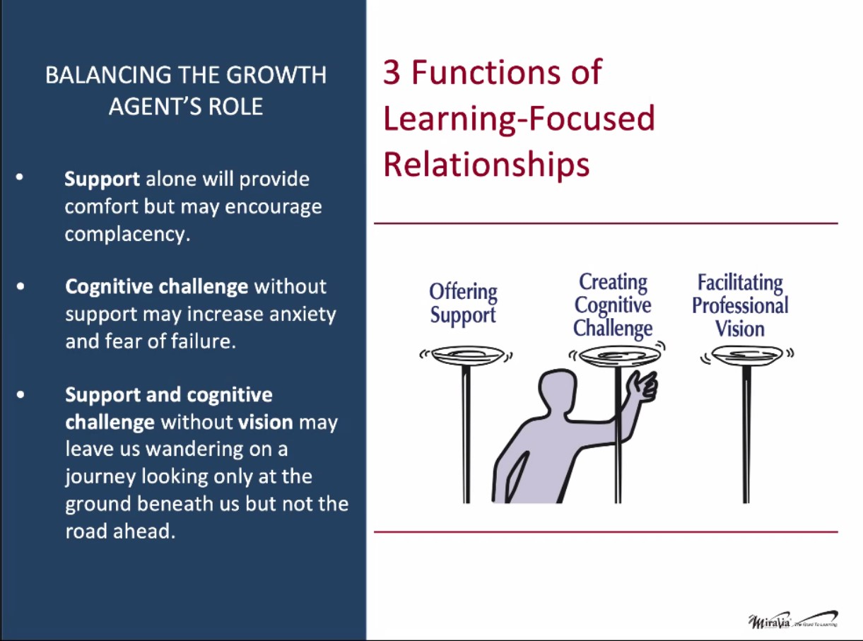
Mentoring Matters (Lipton, Wellman)
Top of page 15
Notes:
Share items from page 11,

Slide 10
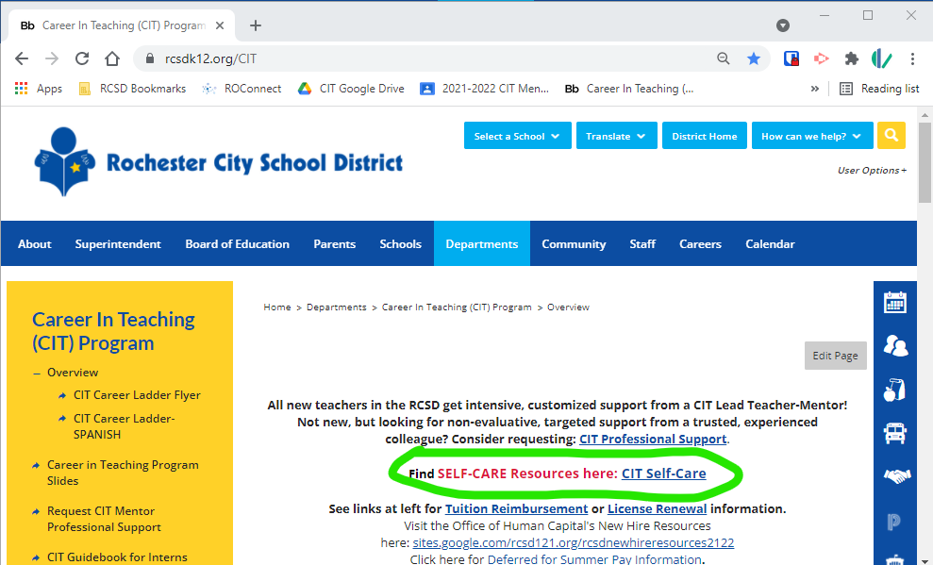


Taking Care of Ourselves
NY Times: The Learning Network
Pieces of Advice From Educators on How to Survive This Challenging Time: Taking Care of Yourself
Set boundaries around work
Do things you enjoy
Connect with your educator community
Step back and think about the big picture
https://www.nytimes.com/2021/12/14/learning/48-pieces-of-advice-from-educators-on-how-to-survive-this-challenging-time.html#link-5943fe1n
From 2020-2021, SUGGESTIONS INCLUDED . . .
Talk openly about mental health issues,
including your own.
Learn to spot early signs of
mental health struggles.
Create ongoing systems of support.
Build a culture of check-ins.
Notes:
CIT Self-care Resources: https://docs.google.com/document/d/143hLUS31ct8EnW-thtUqkTpbJ66GqEvs4taWkzMnMW4

Slide 11

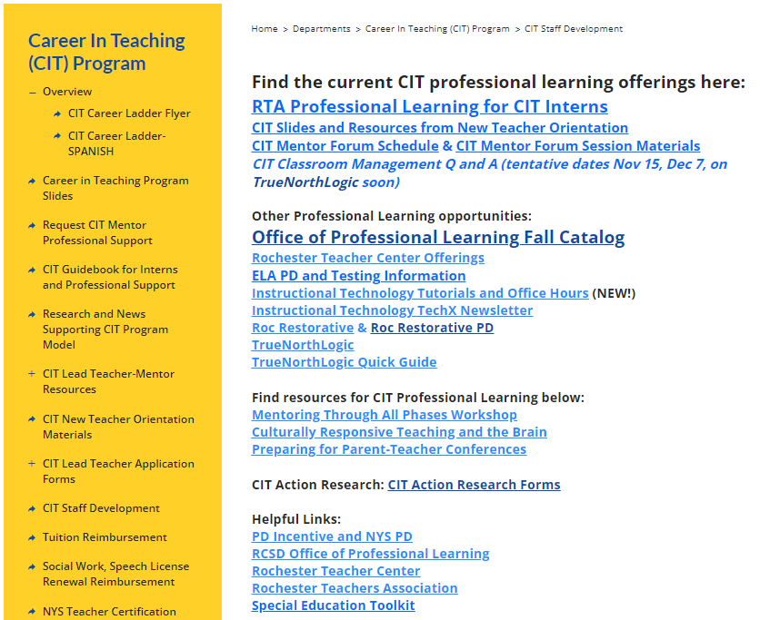
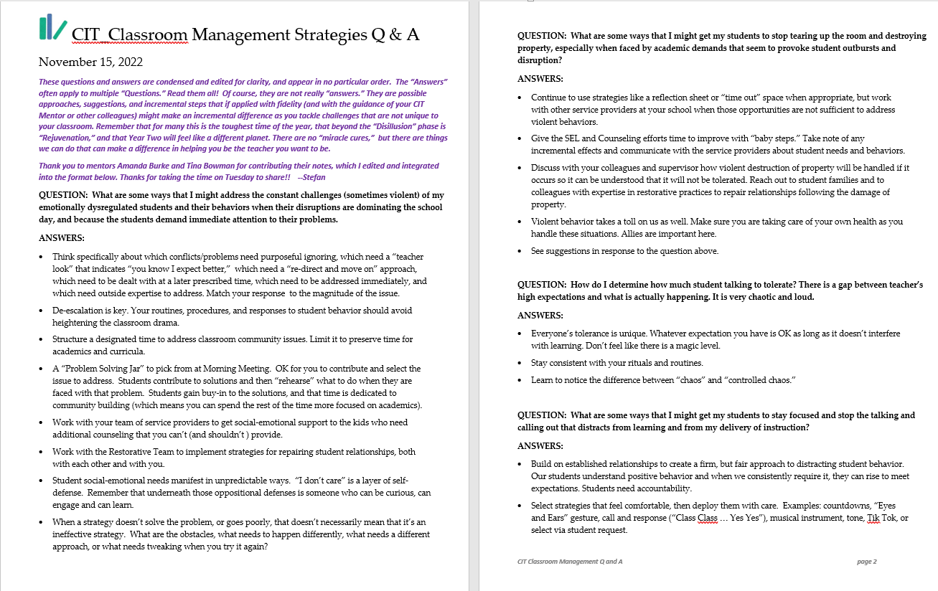
Professional Learning
www.rcsdk12.org/CIT/StaffDevelopment
Rochester Teacher Academy
Rochester Teacher Center
https://rcsdk12.truenorthlogic.com

Slide 12
September’s Frequently Asked Questions*
*Information may not be current! Double-check when appropriate.
FAQ #1: What happens when an Intern is Uncertified?
FAQ #2: What if the “CIT Intern” already has significant teaching experience elsewhere?
FAQ #3: What’s the deal with the “New Educator Orientation Requirement?”
FAQ #4: What’s going to happen with this dramatic district reconfiguration?
FAQ #5: Show me the Money?
https://www.rcsdk12.org/Page/58854

Slide 13
November’s Frequently Asked Questions *
*Information may not be current! Double-check when appropriate.
FAQ #6: How do I convince my Intern to invest time in Planning & Preparation?
FAQ #7: With this new Google Drive, why can’t I just . . . ?
FAQ #8: What happens next with my reports?
FAQ #9: How do I approach APPR Evaluation
with Interns?
https://www.rcsdk12.org/Page/58854

Slide 14
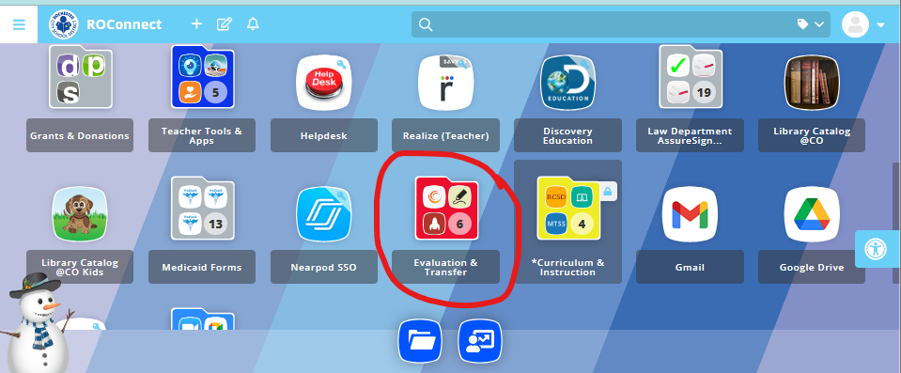
FAQ #10: How do I advise about Transfer Days?
If in school that is closing: Participate in Transfer Process!
If teacher is not yet NYS certified:
Can’t participate in ‘Voluntary Transfer’
If certified by ‘Transfer Days’ in May/June, their position will not be listed as a “vacancy,” and they can participate in later rounds.
Remind Interns who participate in the transfer process to alert building supervisors (great opportunity for discussion about next year).

Slide 15

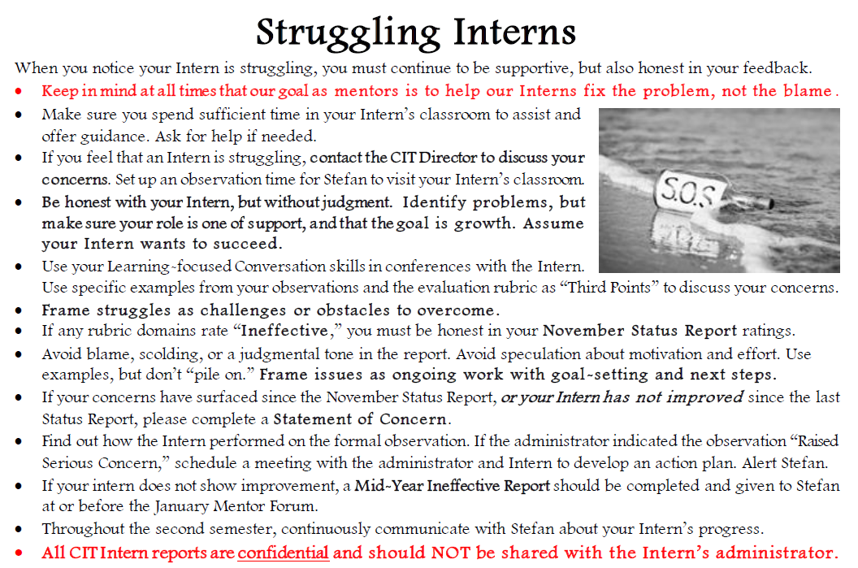
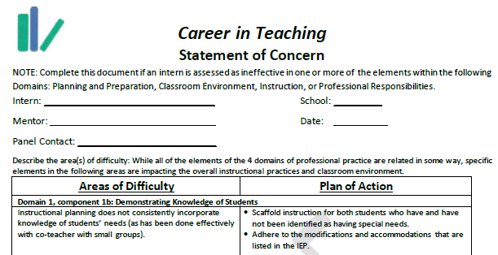
FAQ #11: What do I do if my Intern is struggling?
Mentor Handbook, pp. 33-35
Call the CIT Office!
Document in your Mentor Log
When needed, know your boundaries, and check that the Intern has external supports
If “Ineffective” ratings are not showing improvement, consider “Statement of Concern.”

Slide 16
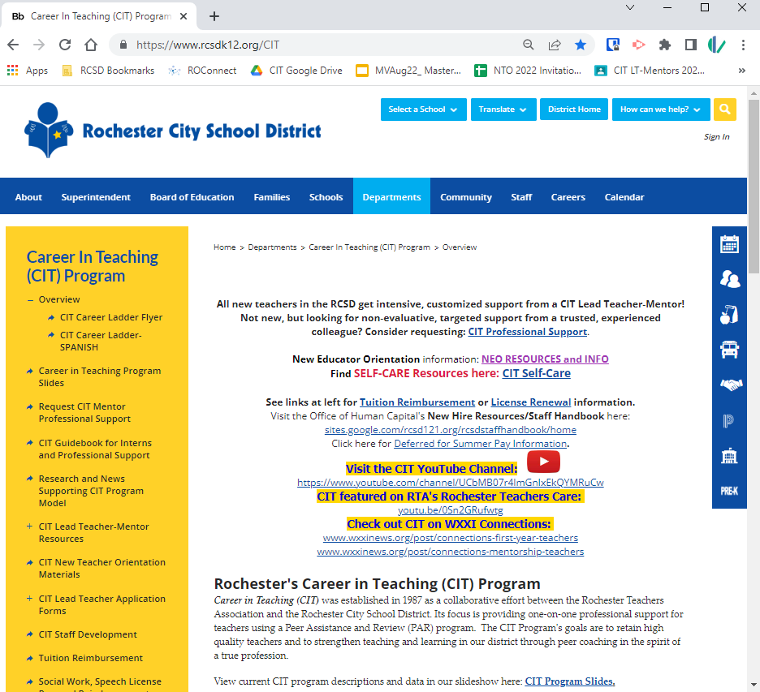
So when you have questions . . .
Start with the CIT Website: www.rcsdk12.org/CIT.
Tuition Reimbursement
APPR Evaluation Process Info
Teacher Evaluation Guide
Staff Development
(PD Recommendations)
Intern & Prof Support Guidebook
Links for Teacher Certification
Links for PD Incentive and NYS PD Requirements
Self-care Resources

Slide 17



Calendars, Forms, and More
@ www.rcsdk12.org/CIT/Resources

Slide 18


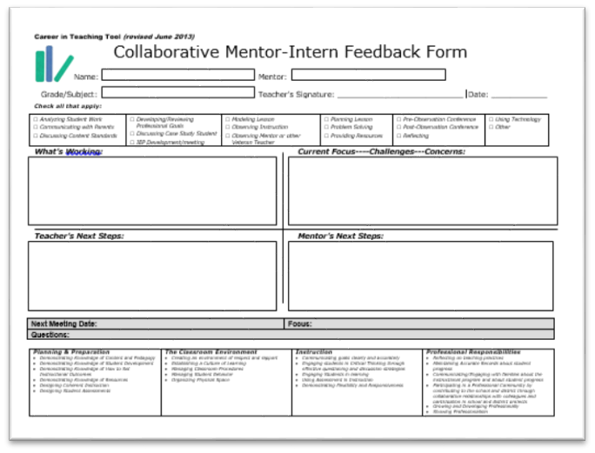
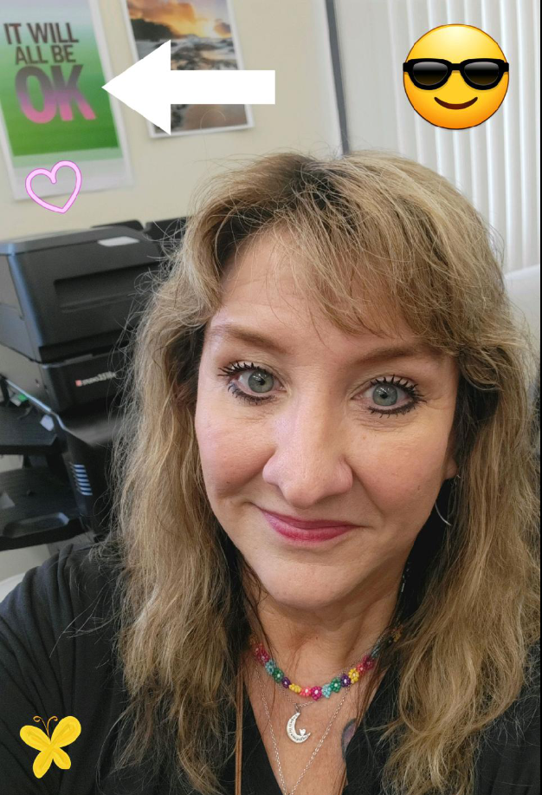

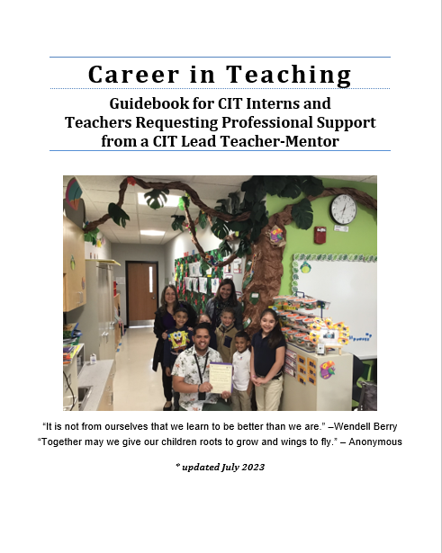
At the CIT Office . . .
Ready to help!
Wendy.Underhill@rcsdk12.org
585-262-8518
These forms are available in modified versions for
Counselors, Librarians, Psychologists, Social Workers, and Speech Language Therapists.

Slide 19
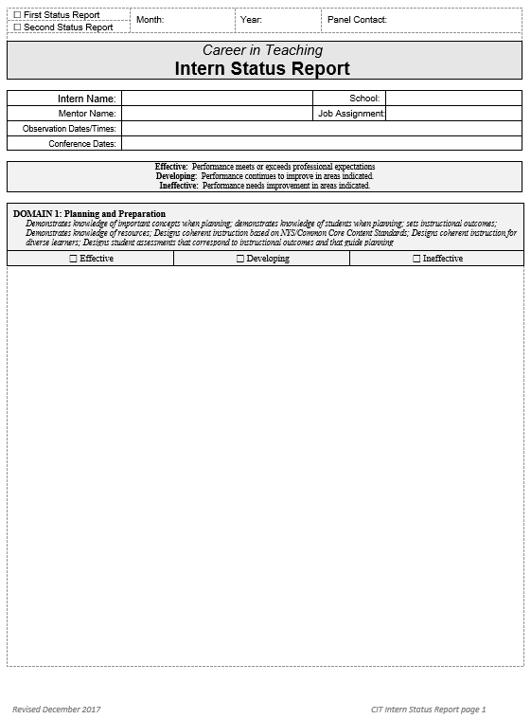
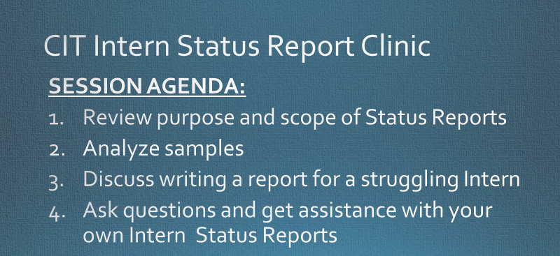
The Status of Intern Status Reports
Find all materials here: https://www.rcsdk12.org/Page/50046
Notes:
Consistent feedback that this is one of the most challenging parts of the Mentoring role.

Slide 20
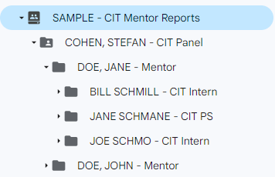
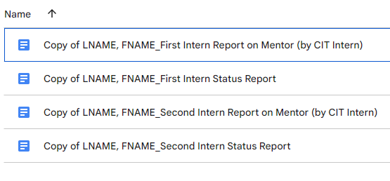
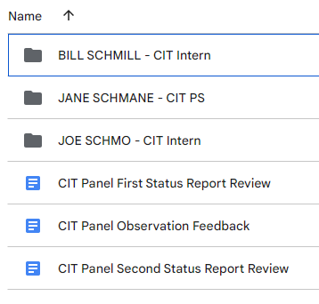
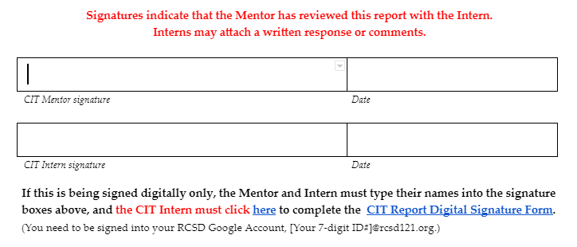
CIT Intern Status Reports in CIT Department Google Drive
CIT Google Drive for Mentor Reports – INSTRUCTIONS for CIT Mentors
Notes:
Poll?

Slide 21
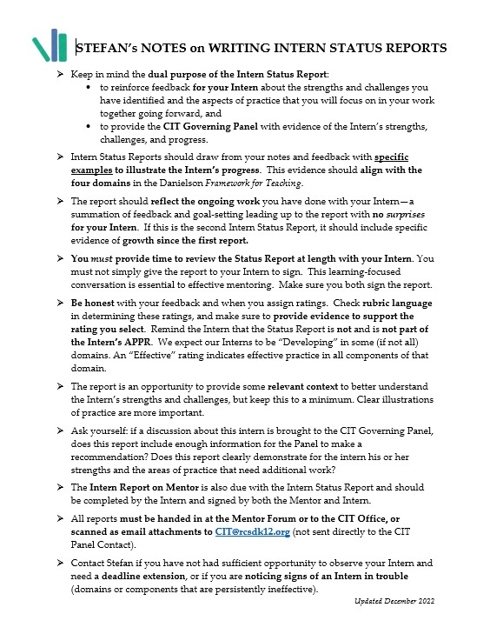
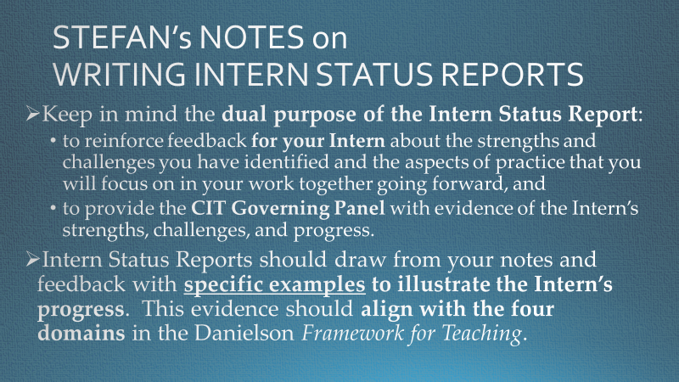
Purpose
Find all materials here: https://www.rcsdk12.org/Page/50046

Slide 22
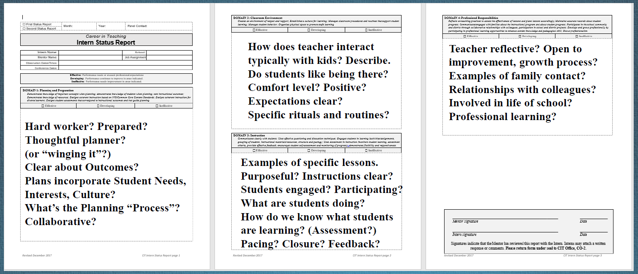
Domain-based Evidence
Find all materials here: https://www.rcsdk12.org/Page/50046

Slide 23

Sample Analysis
On your own:
Read over a relevant sample (or two or more).
What are some of the characteristics in these samples that make them valuable (for Interns and for the CIT Panel)?
We will come back and discuss in Breakout Rooms (based on grade-level, content area, specialized service).
https://drive.google.com/drive/folders/11KkS6BanVm7wMiwWxrcc-vAB_cFi_4-R
Please remember to respect the confidentiality of the Interns and Mentors whose reports are today’s samples.
Notes:
https://drive.google.com/drive/folders/11KkS6BanVm7wMiwWxrcc-vAB_cFi_4-R?usp=sharing
What are some of the characteristics in these samples that make them valuable (for Interns and for the CIT Panel)?

Slide 24
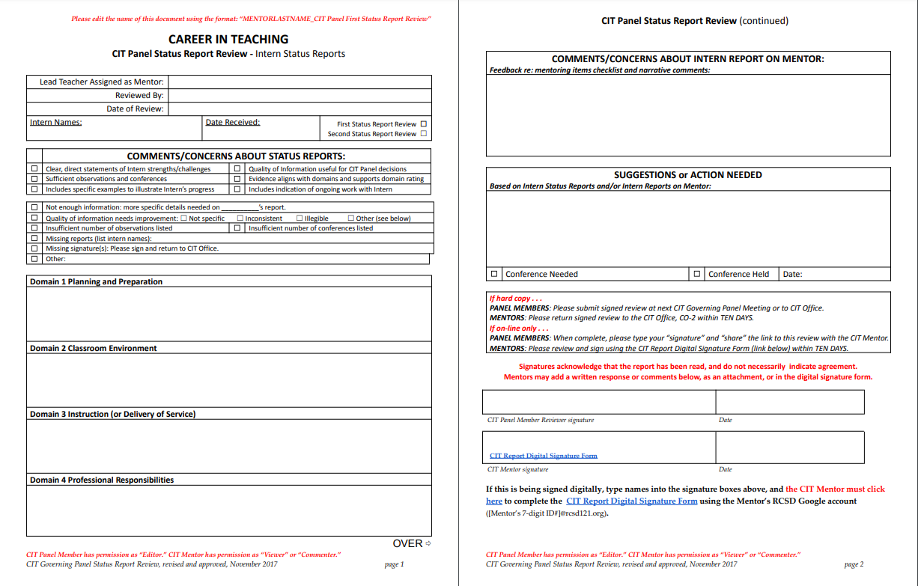
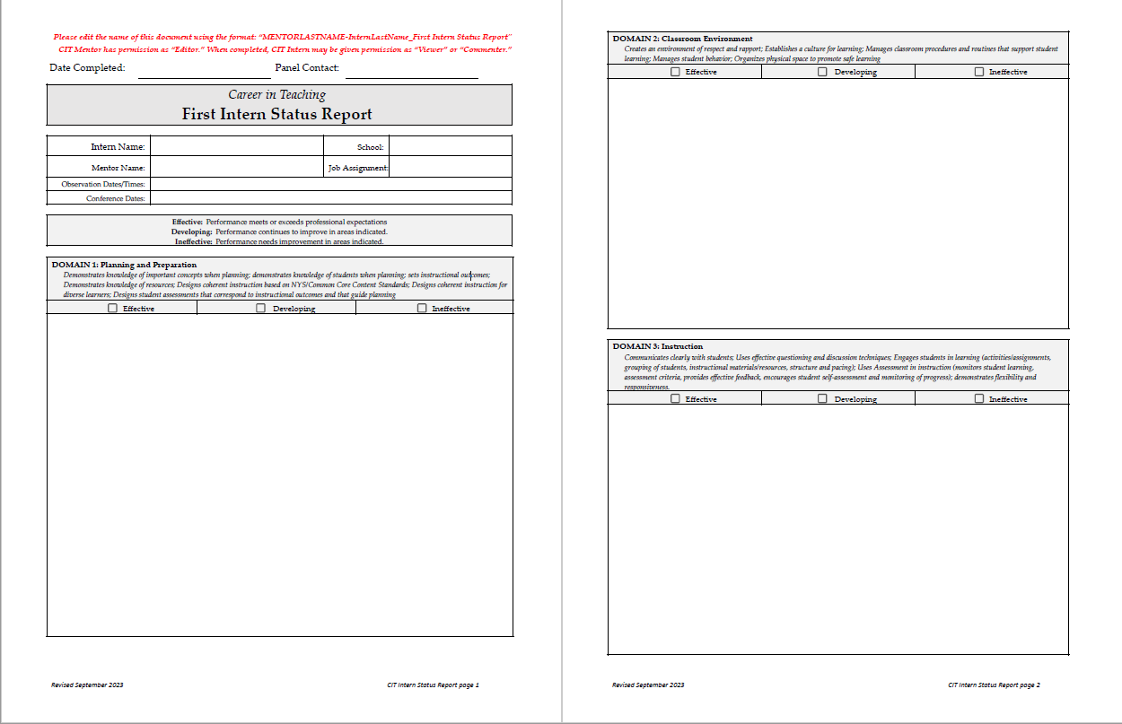
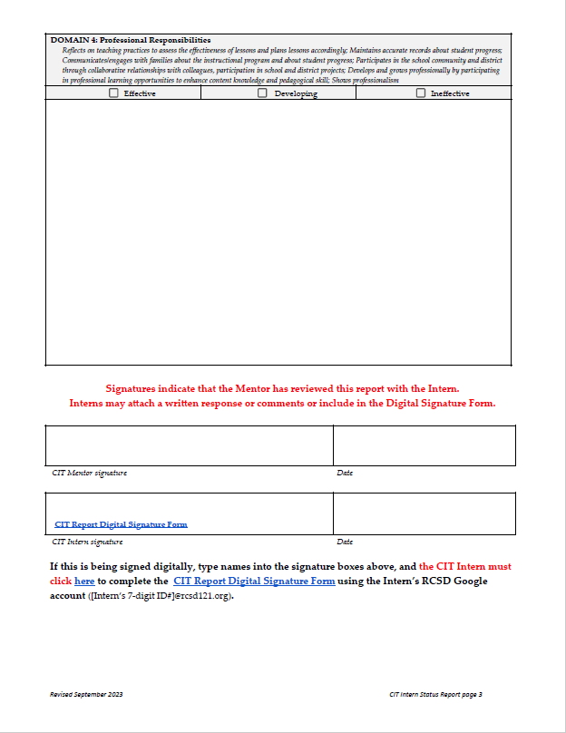
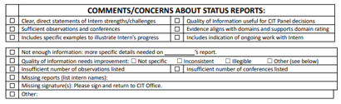
Current Feedback

Slide 25


Breakout Room Status Report Discussion
Please . . .
Take one minute to get re-acquainted. Then …
  Share your insights about the the characteristics in these samples that make them valuable.
  Discuss what kind of feedback on your Intern Status Reports be most helpful to you
  Share any suggestions, tips, or tricks for producing high quality, valuable Intern Status Reports.
Try sharing on the collaborative Microsoft Teams Whiteboard.
Be sure to give everyone an opportunity to speak and to listen.
Only share what you feel comfortable sharing, you always have the option to pass.
Please respect the privacy of the others in your Breakout Room.
You are welcome to leave the Breakout Room to return to the main room at any time.
Notes:
https://rcsdk12-my.sharepoint.com/:wb:/g/personal/1266650_rcsdk12_org/EfrT2KvaKTxJsSmg91AfR8MBat7dQFWsJvz7EKnpTYjbsg?e=4V0ZM7

Slide 26
Feedback
Possible CIT INTERN STATUS REPORT Checklist for Mentors and CIT Panel:
☐ Is the Status Report useful for your Intern?
☐ Does it pertain specifically to your Intern’s practice (Intern-centered)?
☐ Are their sufficient examples from enough rubric components to comprehensively assess the Intern’s practice?
☐ Is your praise specific enough to reinforce positive practice?
(What does that good practice look like?)
☐ Have you already discussed the issues captured in the Status Report (no surprises)?
☐ Does the evidence align with the Danielson rubric domains and with the descriptors for Effective, Developing, or Ineffective practice?
☐ Have you supported your comments (and ratings) with clear examples to illustrate?
☐ Have you described how students are interacting with the teacher or with each other?
☐ Have you described what students are doing during lessons or in groups? Examples of participation and engagement?
☐ Have you included the negative stuff? Did you include strategies for improvement & growth?
☐ Is it clear what you are working on with your Intern going forward?
What else belongs on this checklist?
https://docs.google.com/document/d/1KEzmnSDKxSC7R-LvfaP9n8JsIXXGgN3N/edit
Notes:
https://docs.google.com/document/d/1KEzmnSDKxSC7R-LvfaP9n8JsIXXGgN3N/edit?usp=sharing&ouid=106959346899243899716&rtpof=true&sd=true

Slide 27

Breakout Room Topics or (even better!) Discuss One of Your Own
Creating Opportunities to Visit my Intern with Students
My Intern Fears “Getting Caught” Falling Behind or not Teaching Grade Level Curriculum
Intern is Effective. What now?
Mediating my Intern’s Relationships with Colleagues
Handling my Intern’s Work Ethic (It’s not strong.)
How to Ask Questions to Deepen Thinking & Encourage Intern Independence
My Intern is not Connecting with Students/Not Planning Sufficiently/Not Consistently Following Through . . .
My Intern is Getting Bad Advice from School Colleagues
Need Clear Roles for Co-teachers or for Support Staff
It is Never my Intern’s Fault (according to my Intern)
Addressing my Intern about Cultural Bias or Favoritism
Intern’s Challenges are due to School Environment or School Leadership
Notes:
https://www.rcsdk12.org/site/handlers/filedownload.ashx?moduleinstanceid=85464&dataid=97571&FileName=Breakout%20Rooms%20and%20Instructions%201.8.2024.docx

Slide 28

Breakout Room Problem Solving
Please . . .
Take one minute to make brief introductions.
Poll each Mentor in the Breakout room about a
topic/challenge they most want to address (relevant to Mentoring and to the Mentors in that Breakout Room).
Be sure to give everyone an opportunity to speak and to listen.
Only share what you feel comfortable sharing, you always have the option to pass.
Please respect the privacy of the others in your Breakout Room.
You are welcome to leave the Breakout Room to return to the main room at any time.
Notes:
https://www.rcsdk12.org/site/handlers/filedownload.ashx?moduleinstanceid=85464&dataid=97571&FileName=Breakout%20Rooms%20and%20Instructions%201.8.2024.docx

Slide 29


Brief Discussion Debrief
How was the discussion process for you?
Did you gain some helpful ideas?
Any themes emerge? Any surprises?
Please “raise your hand”
or drop your comments into the ‘Chat’.
(We can share comments with the group after the Forum.)
You will be invited to share reactions and insights in the Survey after the session.
Notes:
Paste in Chat:
How was the discussion process for you? Did you find common issues? Consensus? Any surprises?

Slide 30

Affinity Groups, RCSD Leadership Competency, & You!
Look for opportunities to ensure teacher leader input on these district initiatives:
Steering Committee for Affinity Group Initiative
RCSD Affinity Groups are safe spaces for educators of historically marginalized groups to come together in order to:
  make connections to those with similar lived experiences, mutual concerns, and a common purpose.
  build a sense of camaraderie and a system of support through fellowship and networking.
  provide RCSD leadership with ideas and recommendations for changes in practices, procedures, and policies that negatively impact diversity and inclusion efforts.
  support RCSD efforts to recruit, develop, support, and retain the most effective and diverse staff.
RCSD School Leader Evaluation Project
Look for a Form asking for your input on the 10
‘competencies’ and 30 ‘indicators’ to be used for
evaluating building administrators. What should be
looked for when evaluating folks based on these standards? https://www.npbea.org/psel/

Slide 31

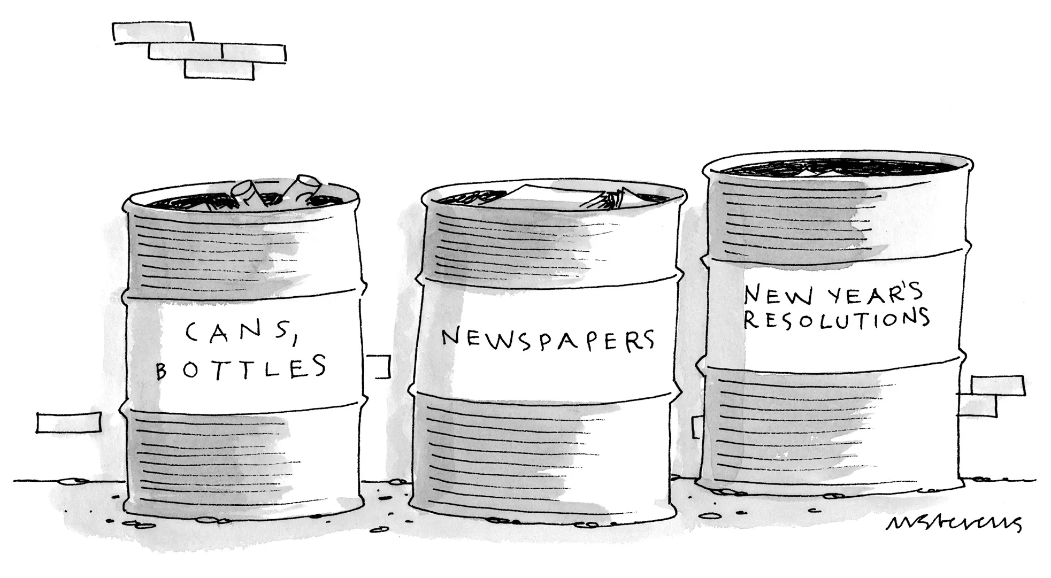
Thanks for starting another year with CIT!
Please complete the Program Evaluation Survey after today’s Forum. Your input is needed to help us plan future sessions.
Find slides and session materials at the CIT Website Mentor Forum Resources page: https://www.rcsdk12.org/Page/58855
This Photo by Unknown Author is licensed under CC BY-SA

