Slide 1
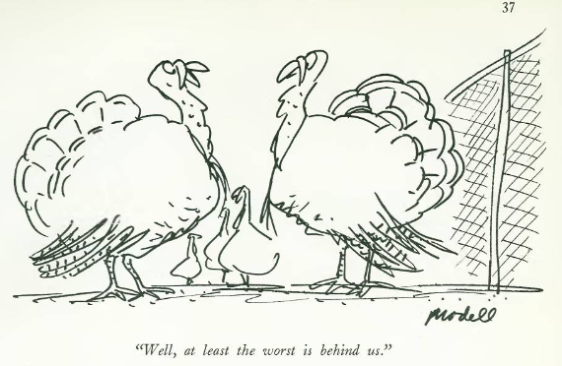
Giving Thanks for our CIT Mentor Forum
November 20, 2023
Your Intern will be grateful to know . . .
You’ve had a very tough day in your classroom or with students. In one sentence (not a run-on), what do you say to yourself and/or do to get beyond it and back into a positive frame of mind for the next day?
Type your one sentence into the Chat.
Tech issues during this Microsoft Teams meeting?
Please email Anna.Leone-Tobar@rcsdk12.org .
Notes:
Launch Poll #1

Slide 2
Giving Thanks for our CIT Mentor Forum
November 20, 2023
TODAY’S AGENDA:
Interns will be Grateful for Your Advice
Supporting Each Other: Breakout Room Discussions & Prolem-Solving
Frequently Asked Questions
Fun with the CIT Dept Google Drive
How’d we do? How can we do it better? Insights from 2023 CIT Program Evaluation Survey with Goal-Setting
FSA Enrollment, PD, Facing the Future, & How to Evaluate Administrators
Survey says . . . Cranberry Sauce!
Your Intern will be grateful to know . . .
You’ve had a very tough day in your classroom or with students. In one sentence (not a run-on), what do you say to yourself and/or do to get beyond it and back into a positive frame of mind for the next day?
Type your one sentence into the Chat.
Tech issues during this Microsoft Teams meeting?
Please email Anna.Leone-Tobar@rcsdk12.org .
Notes:
Launch Poll #1

Slide 3
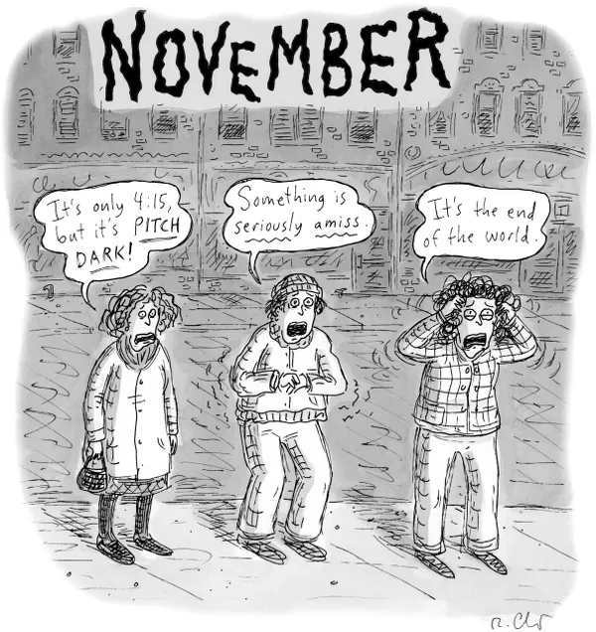
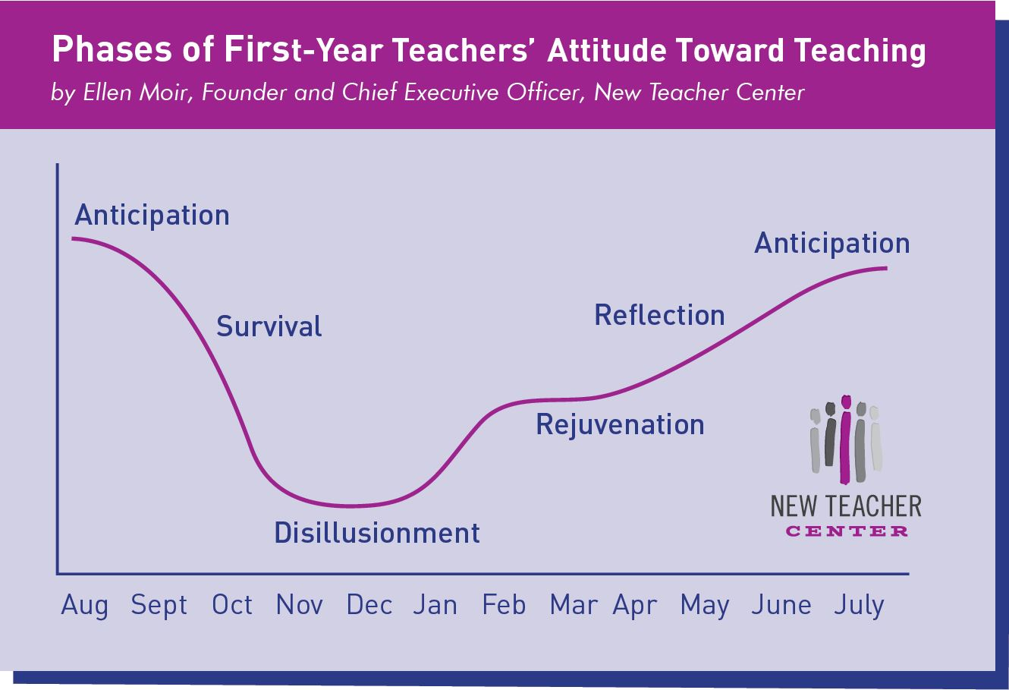
‘Tis the Season for Thanksgiving & Disillusionment

Slide 4

How to Shake the ‘October Blues’ and Rediscover the Joy in Teaching
Teachers share their tips for getting through a rough patch
By Madeline Will — October 03, 2022 6 min read
Keep some perspective and know that you’re not alone.
Take some time during the weekends to think strategically about one thing that can make a difference the following week.
Make sure you’re getting enough sleep.
Shake up your routine.
Set boundaries, stick to them.
Focus on the joy of learning.
Collaborate with your colleagues.
Embrace humor.
‘Remember your why’
https://www.edweek.org/teaching-learning/how-to-shake-the-october-blues-and-rediscover-the-joy-in-teaching/2022/10
Notes:
Importance of remaining positive

Slide 5
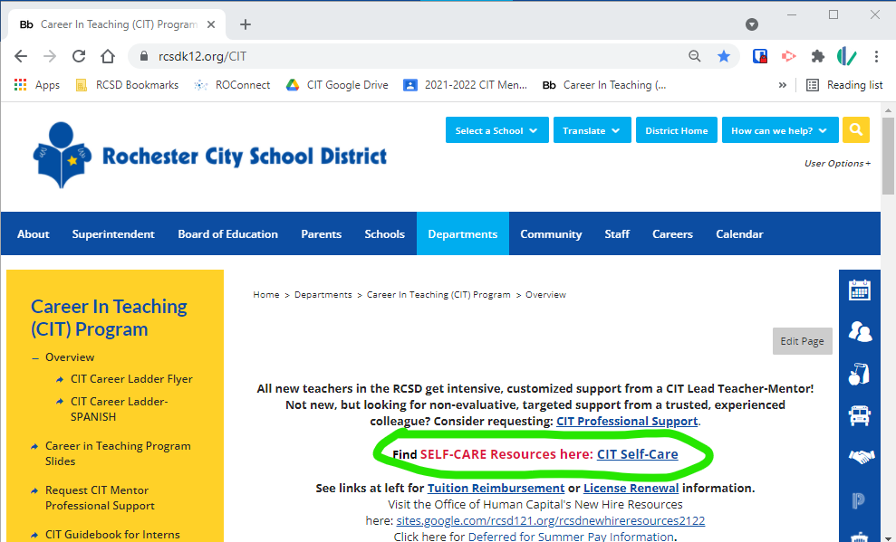


Taking Care of Ourselves
NY Times: The Learning Network
Pieces of Advice From Educators on How to Survive This Challenging Time: Taking Care of Yourself
Set boundaries around work
Do things you enjoy
Connect with your educator community
Step back and think about the big picture
https://www.nytimes.com/2021/12/14/learning/48-pieces-of-advice-from-educators-on-how-to-survive-this-challenging-time.html#link-5943fe1n
From 2020-2021, SUGGESTIONS INCLUDED . . .
Talk openly about mental health issues,
including your own.
Learn to spot early signs of
mental health struggles.
Create ongoing systems of support.
Build a culture of check-ins.
Notes:
CIT Self-care Resources: https://docs.google.com/document/d/143hLUS31ct8EnW-thtUqkTpbJ66GqEvs4taWkzMnMW4

Slide 6
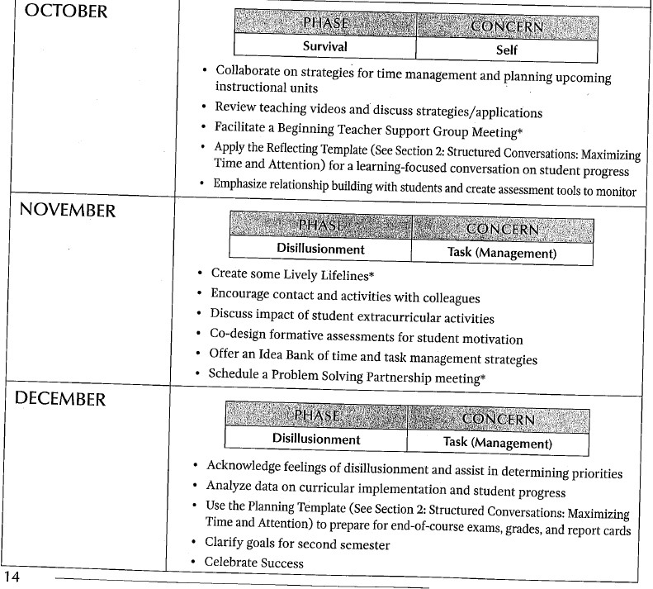

Mentoring Matters p. 14
(Lipton, Wellman)

Slide 7
Today’s Breakout Rooms by grade-level/subject/special area

Slide 8

From September 18, 2023 CIT Mentor Forum Evaluation survey

Slide 9

Getting the Most out of Our Discussion
“What did you feel were the strengths of this Mentor Forum session?”
“Having time in small groups with new mentors to pick each others' brains . . . .”
“Talking to other mentors and having time to discuss our experiences and challenges.”
“Ability to talk with brand new mentors and experienced mentors.”
”Sharing expertise and voicing concerns in a confidential, collegial manner.”
“I liked the break out rooms where we could speak to other mentors.”
“The time that we were able to talk with other mentors in breakout room sessions.”
“. . . always nice to meet with other mentors to make myself feel ‘normal’ with things.”
“Break out discussions are always great.”
”Break-out rooms are always great to hear other's experiences.”
“Break Out rooms to have time to discuss how things are going, it is always helpful to get tips from other mentors.”
“Having breakout rooms to meet with other mentors and ask specific questions.”
“I do really appreciate time to interact with other mentors just sharing our experiences this year or in the past.”

Slide 10
Getting the Most out of Our Discussion
“What might help you get the most out of our Mentor Forums?”
“More time in breakout rooms.
Needed more time to share and ask and answer questions.”
“More breakout room time.”
“More time to problem solve struggles we may be experiencing with our interns”
“More time to talk to other mentors”
“Less time in break out rooms. It's painful.”
“Breakout rooms are good but the time frame seems too long.”
“When we were in breakout rooms with 2 other mentors, it was too long. We were struggling to find things to talk about after following the given prompts.”
“Groups were very quiet and non-responsive”

Slide 11
Getting the Most out of Our Discussion
“In the breakout rooms when we were sharing advice: Could we add a norm that we shouldn’t critique the value of that person's advice. I shared . . . [and another mentor] . . . criticized my advice and said it wasn't that important. LOL. I have thick skin, but it certainly doesn't make me
want to share out anymore.
I was a bit dejected that night.”

Slide 12

What helps create a Safe, Productive, Effective
Breakout Room Conversation
Ground rules and expectations
Maintain focus on the task at hand
Approach as a postive opportunity to address real challenges: if not yours, someone else’s.
“I-statements” and avoiding assumptions.
Attending fully, listening actively, pausing.
Reflect on your own tendencies in small group discussion.

Slide 13
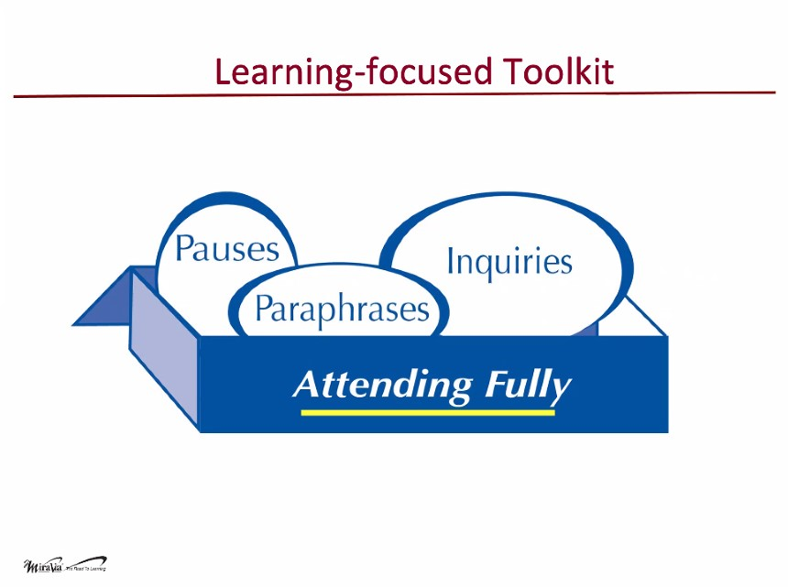
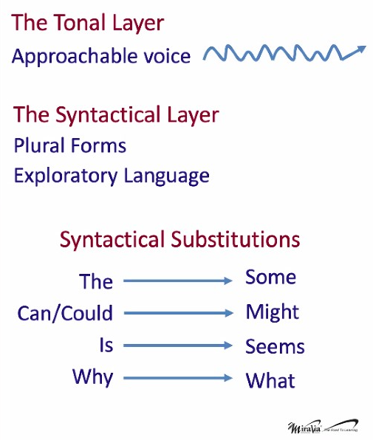
Use your Learning-Focused Toolkit
Attending Fully
Pausing
Paraphrasing
Invitational Inquiries
Page 59, 68

Slide 14

Breakout Room Problem Solving
Please . . .
Take one minute to make brief introductions.
Poll each Mentor in the Breakout room about a
topic/challenge they most want to address (from the list or one that is relevant to Mentoring and to the Mentors in that Breakout Room).
Be sure to give everyone an opportunity to speak and to listen.
Only share what you feel comfortable sharing, you always have the option to pass.
Please respect the privacy of the others in your Breakout Room.
You are welcome to leave the Breakout Room to return to the main room at any time.
Notes:
https://www.rcsdk12.org/site/handlers/filedownload.ashx?moduleinstanceid=85257&dataid=96287&FileName=BREAKOUT%20ROOM%20TOPICS%20and%20Instructions.pdf

Slide 15

Breakout Room Topics
My Own Mentor Confidence & Morale
How to Find Enough Time to Meet for Observations & Debriefing – Difficulty with Scheduling/Teaching at Same Time as Intern
Questioning to Deepen Thinking & Independence
Getting Intern to Respond & Be Respectful of My Time (“Is My Mentee Ghosting Me?”)
Supporting with Classroom Management when not in the same building
Intern is experienced & doing great. What to work on?
Co-teaching, working with other adults.
How to get Intern to overcome ‘fixed beliefs’ about students in order to build relationships.
Conversation strategies for Intern resistant to try things to improve and/or accepts chaotic conditions.
How to address physical fights that are beyond the Intern’s control
Notes:
https://www.rcsdk12.org/site/handlers/filedownload.ashx?moduleinstanceid=85257&dataid=96287&FileName=BREAKOUT%20ROOM%20TOPICS%20and%20Instructions.pdf

Slide 16


Brief Discussion Debrief
How was the discussion process for you?
Did you gain some helpful ideas?
Any themes emerge? Any surprises?
Please “raise your hand”
or drop your comments into the ‘Chat’.
(We can share comments with the group after the Forum.)
You will be invited to share reactions and insights in the Survey after the session.
Notes:
Paste in Chat:
How was the discussion process for you? Did you find common issues? Consensus? Any surprises?

Slide 17
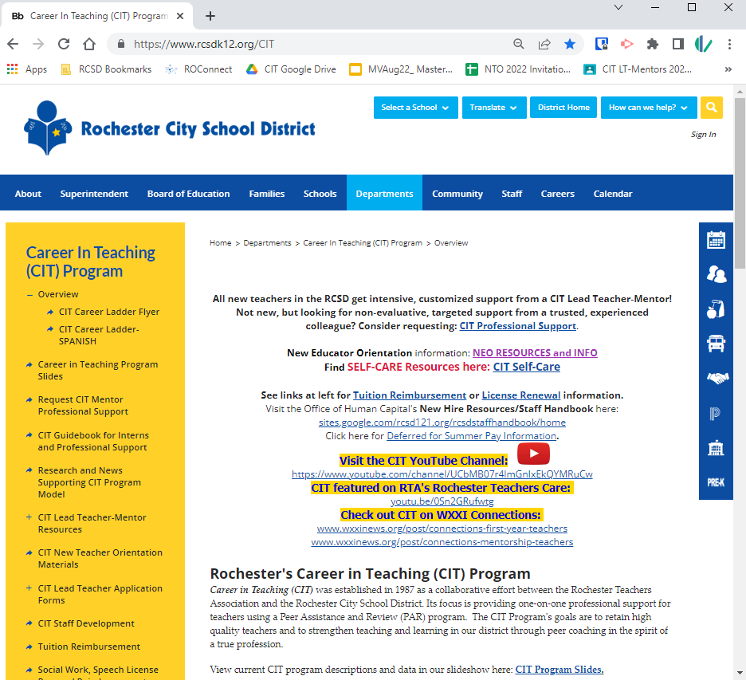
So when you have questions . . .
Start with the CIT Website: www.rcsdk12.org/CIT.
Tuition Reimbursement
APPR Evaluation Process Info
Teacher Evaluation Guide
Staff Development
(PD Recommendations)
Intern & Prof Support Guidebook
Links for Teacher Certification
Links for PD Incentive and NYS PD Requirements
Self-care Resources

Slide 18



Calendars, Forms, and More
@ www.rcsdk12.org/CIT/Resources

Slide 19


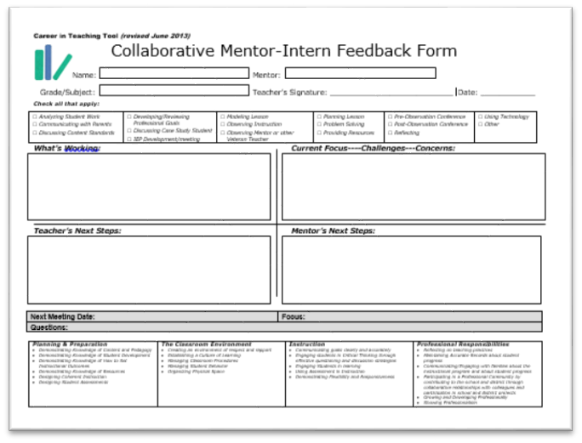
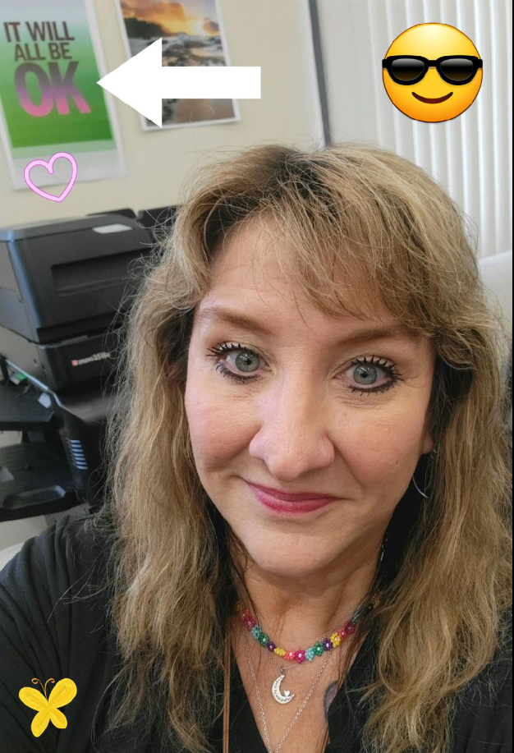

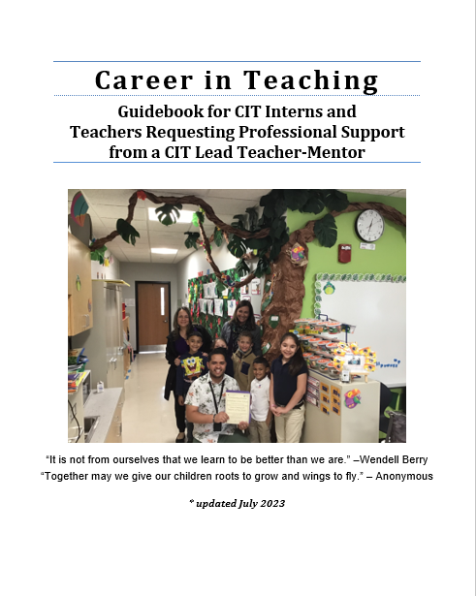
At the CIT Office . . .
Ready to help!
These forms are available in modified versions for
Counselors, Librarians, Psychologists, Social Workers, and Speech Language Therapists.

Slide 20
September’s Frequently Asked Questions
FAQ #1: What happens when an Intern is Uncertified?
FAQ #2: What if the “CIT Intern” already has significant teaching experience elsewhere?
FAQ #3: What’s the deal with the “New Educator Orientation Requirement?”
FAQ #4: What’s going to happen with this dramatic district reconfiguration?
FAQ #5: Show me the Money?

Slide 21
FAQ #6: How do I convince my Intern to invest time in Planning & Preparation?
Share examples, templates
The “Why”: purpose of lesson components
Co-plan, model
Third Point of Danielson rubric
Emphasize
… how planning benefits kids
… how planning allows you to be “in the moment”
… how planning allows you to focus your attention and feel successful
… how planning allows you to ‘respond’ and not ‘react’

Slide 22
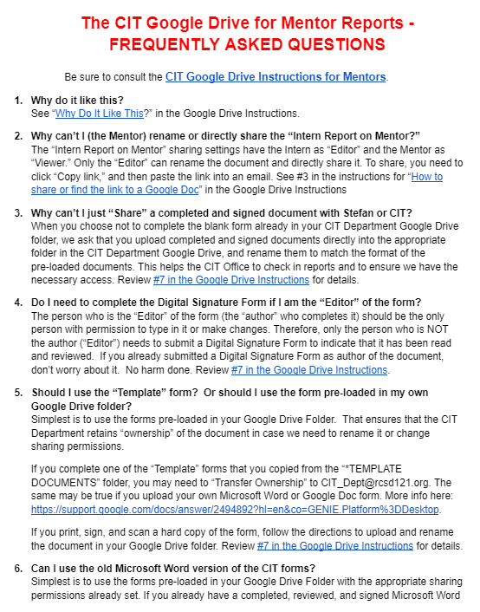
FAQ #7: With this new Google Drive, why can’t I just . . . ?
“Share” vs. “Copy link”
Organization
Document “Ownership”
Confidentiality
Tracking
https://docs.google.com/document/d/1WSb64pg9nBhPSbDLuod8K1guPY2KFhP5uryFwZnmPgM/edit

Slide 23
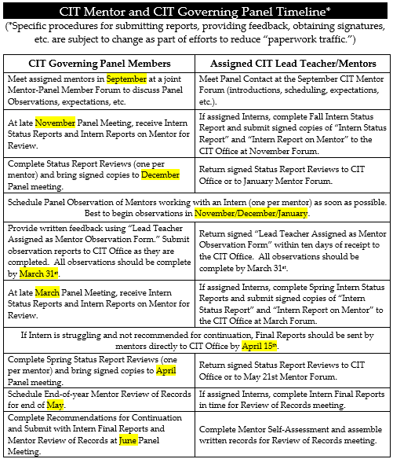
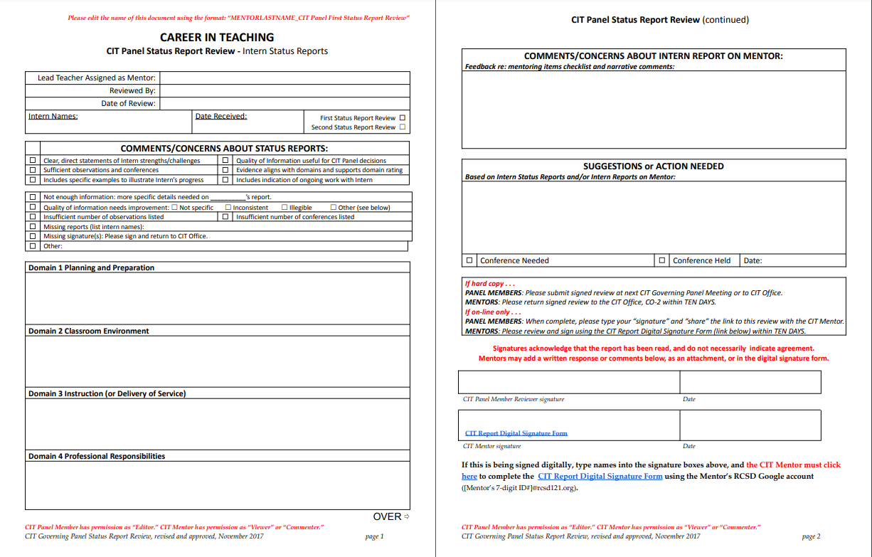
FAQ #8: What happens next with my reports?
Wendy checks them in.
CIT Governing Panel contact reviews them and provides feedback.
They became the springboard and/or reference point for ongoing Mentor work.

Slide 24
FAQ #9: How do I approach APPR Evaluation with Interns?
Whenever possible, ease their anxiety.
Frame suggestions as ways to help them do their best work for students (not “because your admin will be looking for . . .”).
Frame it as “Feedback” (not “Pass/Fail” or “getting dinged” for doing something wrong).
Drain some of the mystery.
Provide perspective: verbal feedback, facial expressions, body language vs. what ends up in writing.
Remind them that if something is unfair, there is a clear process by which to address it

Slide 25
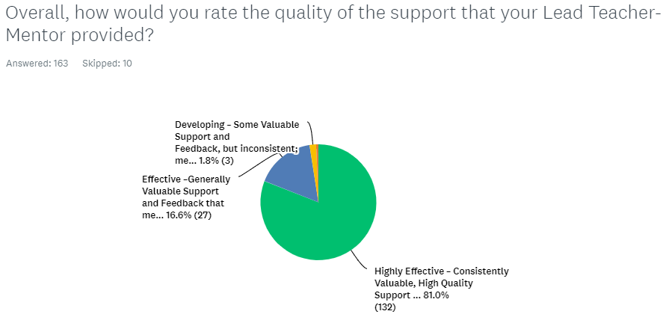
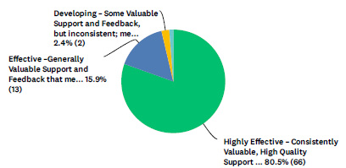
2023 CIT Program Evaluation Survey
Compare to 2022

Slide 26
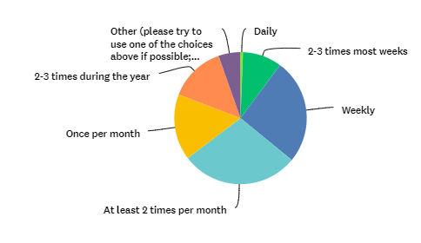
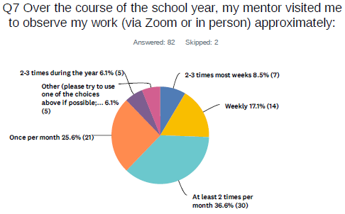
2023 CIT Program Evaluation Survey
Over the course of the school year, my mentor visited me to observe my work (via Zoom or in person) approximately:
OBSERVATIONS
Compare to 2022

Slide 27
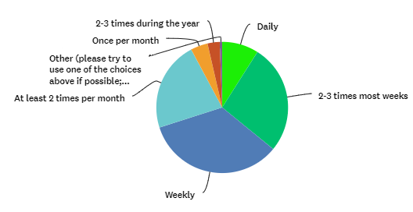
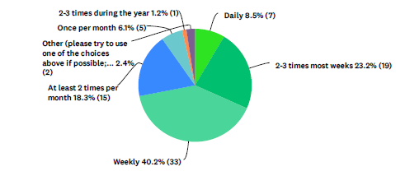
2023 CIT Program Evaluation Survey
My mentor was in contact with me approximately (include classroom/office visits, Zoom visits, phone calls, emails, texts, meetings outside of classroom)
CONTACT
Compare to 2022

Slide 28
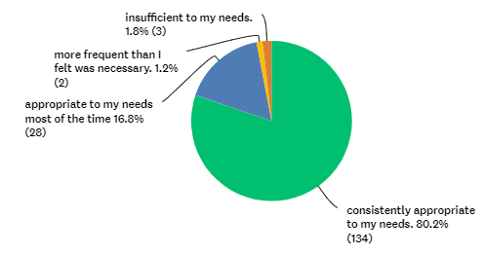
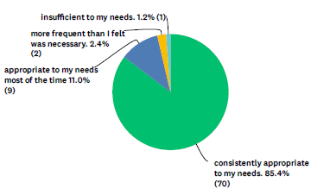
2023 CIT Program Evaluation Survey
The frequency of contact with my mentor was
FREQUENCY of CONTACT
Compare to 2022

Slide 29
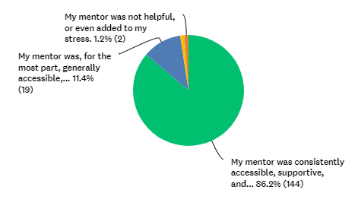
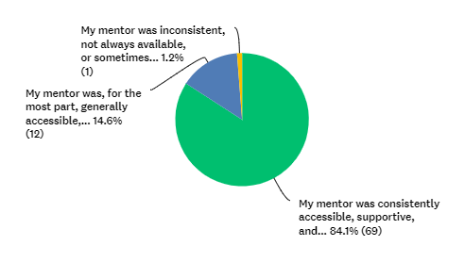
2023 CIT Program Evaluation Survey
Which of the following best describes your relationship with your assigned Lead Teacher-Mentor?
RELATIONSHIP with MENTOR
Compare to 2022

Slide 30
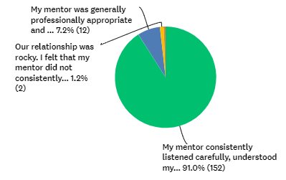
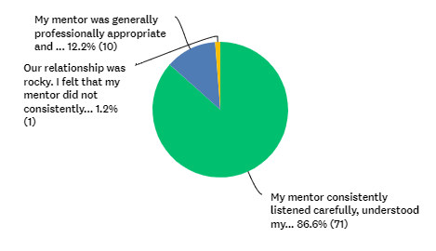
2023 CIT Program Evaluation Survey
Which of the following best describes your interactions with your assigned Lead Teacher-Mentor?
INTERACTIONS with MENTOR
Compare to 2022

Slide 31
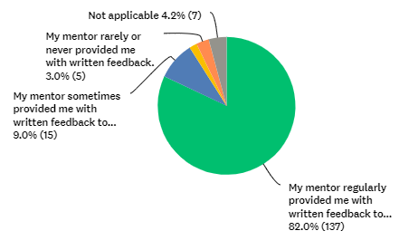
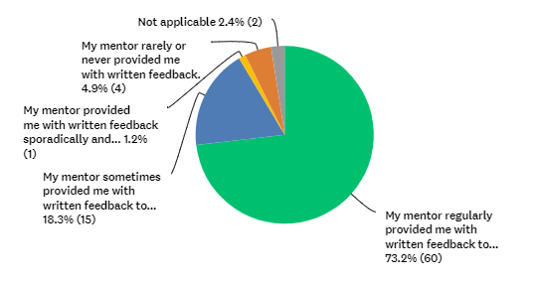
2023 CIT Program Evaluation Survey
Which of the following describes your use of written feedback?
WRITTEN FEEDBACK
Compare to 2022

Slide 32

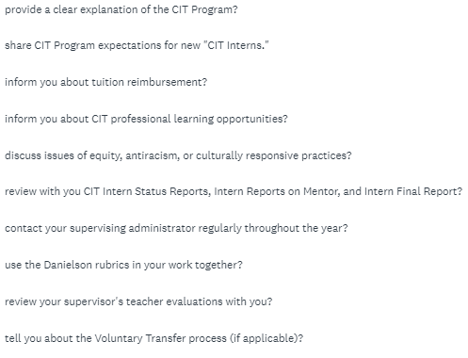
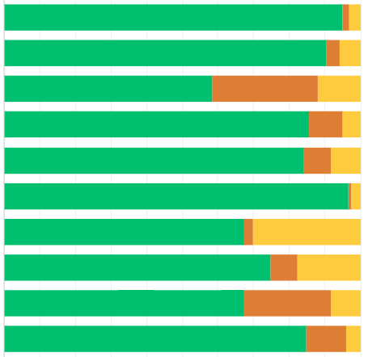
2023 CIT Program Evaluation Survey
Did your Mentor . . .

Slide 33
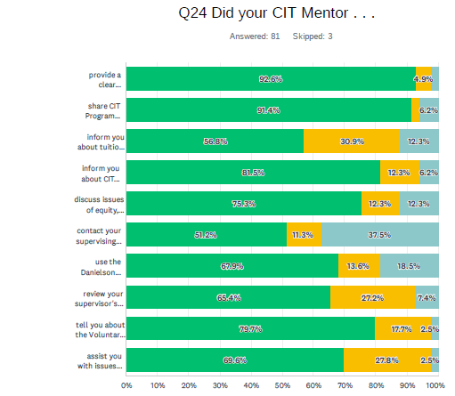
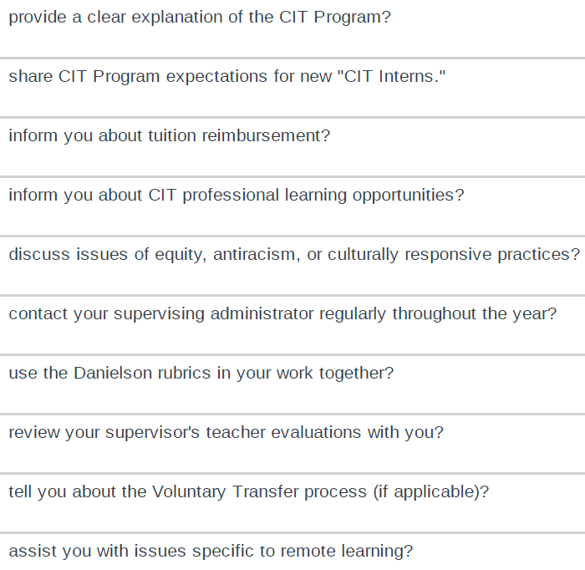
2022 CIT Program Evaluation Survey

Slide 34
Review the Comments in the CIT Program Evaluation Survey:
2023_CIT_Intern_Program_Evaluation Survey
Pages of comments to review | Survey Questions | Start here if your last name begins with . . .
PAGES 1-12 | Frequency & Quality of Contacts; Additional Comments | A through D
PAGES 13-19 PAGES 20-24 | Overall Quality of Support; How CIT Mentor Helped You Most What Could Be Improved-CIT? | E through L
PAGES 25-29 PAGES 30-35 | What Helped you Most Besides Mentor What Could Be Improved-District? | L through P
PAGES 36-42 PAGES 43-44 PAGES 45-65 | Considered resigning? Reasons Did your Mentor . . . ? Planning; Environment; Instruction; Prof Resp; Cult Resp Practices | R through Z
What confirmed, challenged, or extended your thinking about our Mentoring work? What surprised you? What questions were raised? Add your comments on the following slides
Find Link here and in Chat for CIT Program Evaluation Survey Analysis PADLET

Slide 35
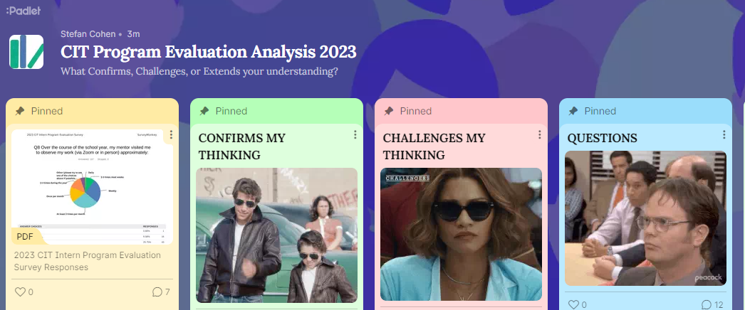
15 Minutes to add insights to the Padlet
ON YOUR OWN. https://rcsdk12.padlet.org/1266650/cit-program-evaluation-analysis-2023-cjzf1n390ya5qx9p
Notes:
https://rcsdk12.padlet.org/1266650/cit-program-evaluation-analysis-2023-cjzf1n390ya5qx9p

Slide 36
10 Minutes to share insights and set goals in BREAKOUT ROOMS
In your Breakout Rooms (randomly assigned)
Based on reviewing Survey Responses:
Discuss any significant Confirming, Challenging, or Extending insights that you would like to share.
Set and Share a Personal Goal for your Mentoring Practice.
Suggest any Program Goals for the CIT Program.

Slide 37
Brief Discussion Debrief
How was the discussion process for you?
Did you gain some helpful ideas?
Any themes emerge? Any surprises?
Please “raise your hand”
or drop your comments into the ‘Chat’.
(We can share comments with the group after the Forum.)
You will be invited to share reactions and insights in the Survey after the session.
Notes:
Paste in Chat:
How was the discussion process for you? Did you find common issues? Consensus? Any surprises?

Slide 38
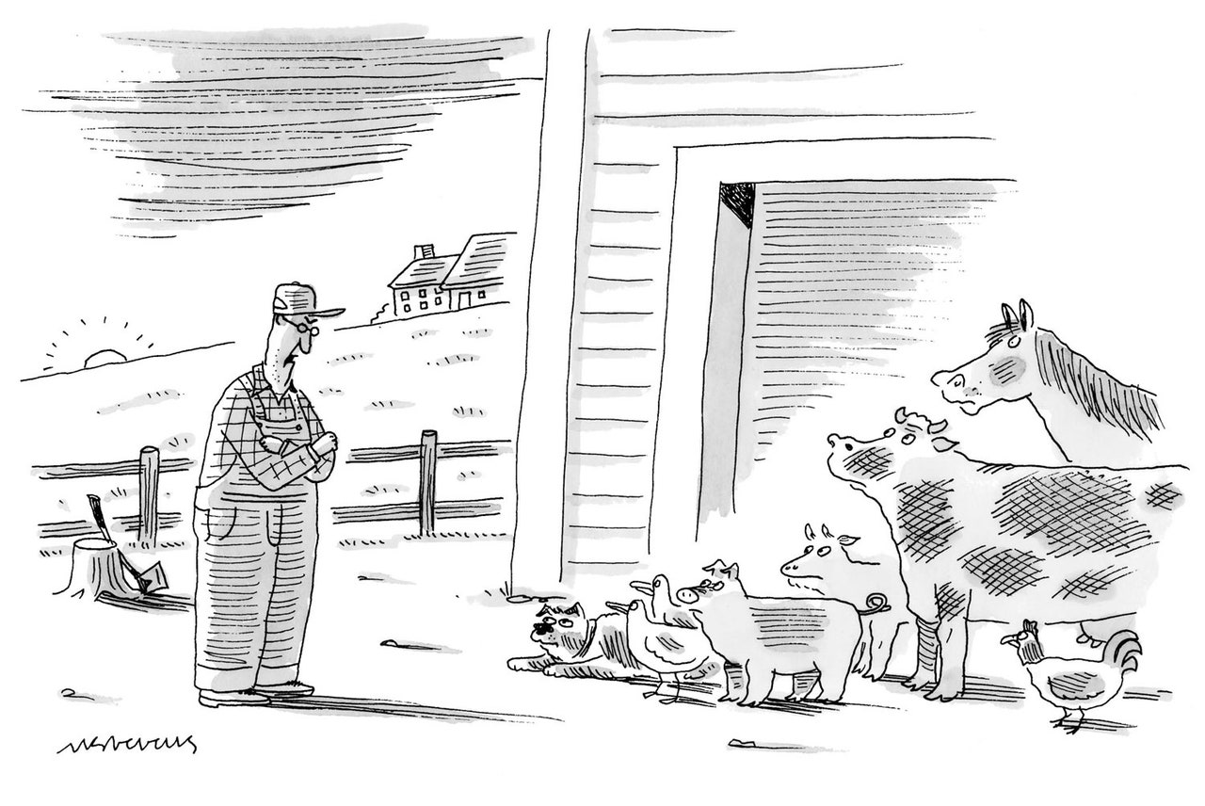

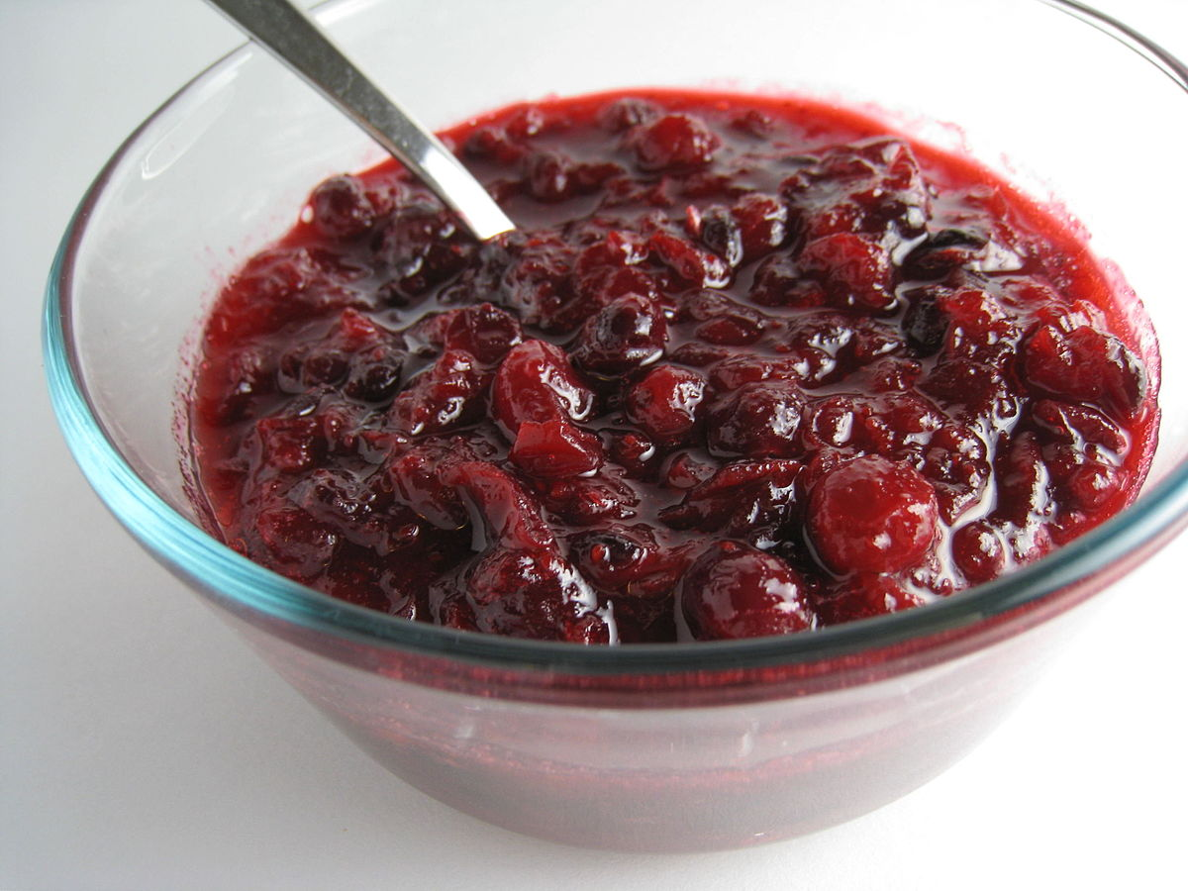
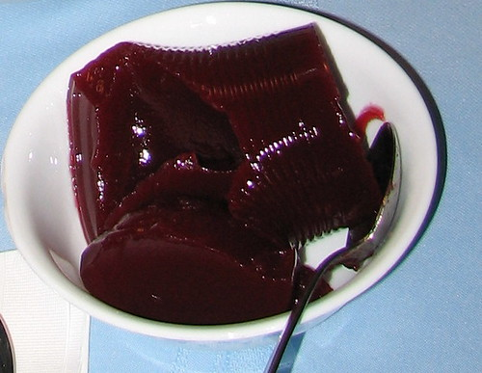
Some other relevant CIT Stuff
Make sure Interns know about the Flexible Spending Account enrollment deadline of November 30th.
Relevant PD from RTA Rochester Teaching Academy (taught by fellow CIT Mentors!):
  Teacher-Student relationships
  Restorative Practices
  Managing Student Anxiety
  Creative Classroom Strategies
  Writing Quality IEPs
www.rcsdk12.org/CIT/StaffDevelopment
Reconfiguration Anxieties: Avoid Speculation!
Provide Input for RCSD School Leader Evaluation Project (comment on Administrator “Competency Indicators”). Stay Tuned!
or

