Slide 1
8th Grade Parent Night
February 13, 2024

Slide 2

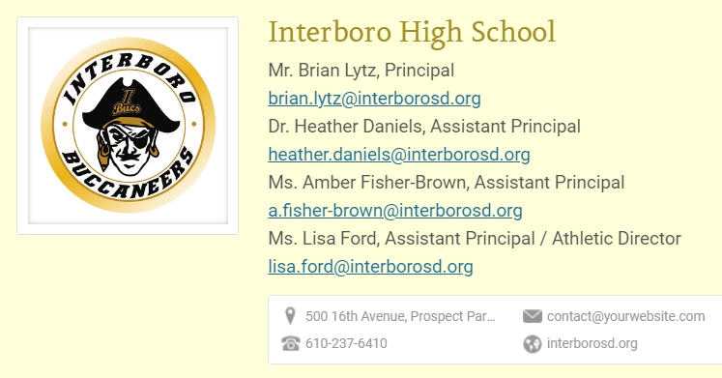
High School
Administration

Slide 3
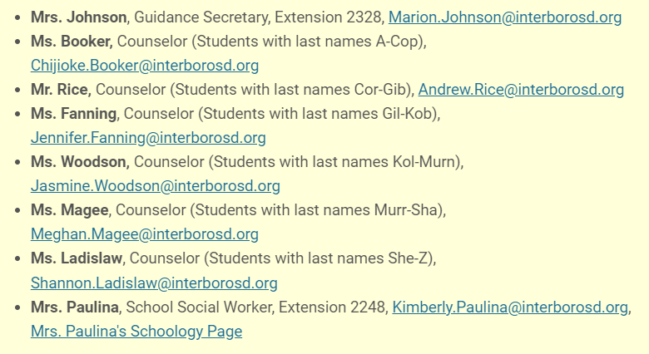
GUIDANCE COUNSELORS

Slide 4
GUIDANCE COUNSELORS
The counseling department can help you with:
  Course Scheduling
  Graduation Planning
  PSATs, SATs, ACTs, and ASVAB
  Monitoring Academic Progress
  Problem solving and communication skills
  Individual and Group Counseling
  Study Skills and Time Management
  College and Career Counseling
  College Visits

Slide 5

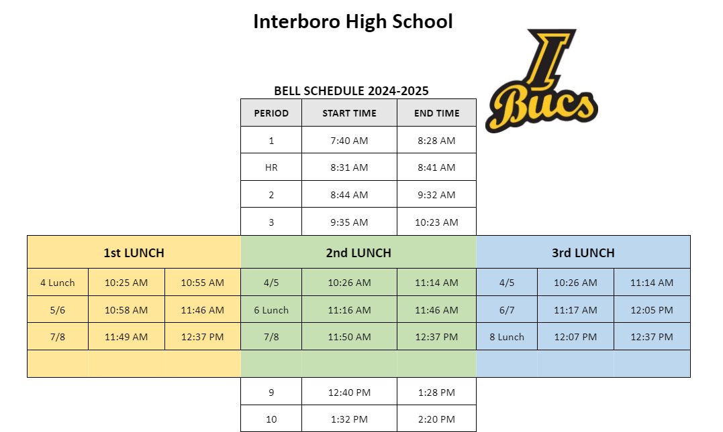
Bell Schedule

Slide 6
How your grade is calculated
Your Marking Period course grade calculation:
  60% Assessment
  40% Assignments
Your Final Grade calculation:
  20% each Marking Period
  10% Midterm
  10% Final Exam

Slide 7
How can I be successful?
Ask Questions
Check Schoology & eSchool
Get Help If You Need It
Stay Organized
Participate in the BUCS Program
Get Involved!

Slide 8


Slide 9
GRADUATION REQUIREMENTS
English Social Studies Science Mathematics Health PE Electives Total: | Required 4 4 3 3 .5 1.0 7.5 23 | Recommended 4 4 4 4 .5 1.0 8.5 27
The Clock Starts Now!

Slide 10

WHAT ARE THE KEYSTONES exams?
The Keystone Exams are administered in 3 areas:
  Algebra I
  Biology
  English Literature
The Keystone Examinations are designed to be an “end of course” examination. When a student completes a Keystone related course (Algebra I, Biology, English 10) he/she will take the Keystone Exam.

