Slide 1
Citizens’ Bond Oversight Committee Training
Roles and Responsibilities

Slide 2
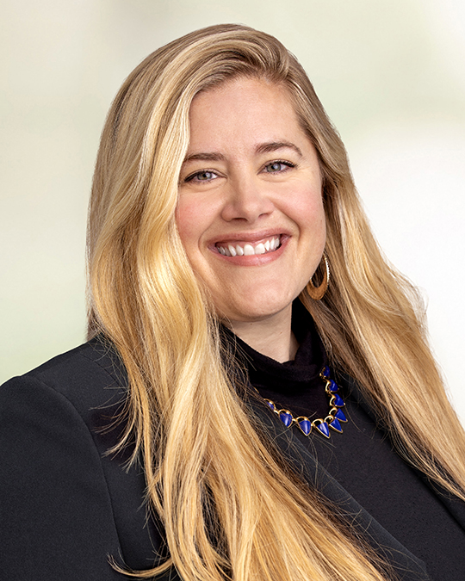
Presenter
Jennifer Bradlee
Of Counsel
jennifer.bradlee@bbklaw.com
916-551-2836
Jennifer Bradlee is an attorney in the Public Finance Group and serves as bond counsel, disclosure counsel and underwriter’s counsel on a variety of transactions throughout the State of California.

Slide 3
Agenda
Proposition 39 and Measure “O”
The Project List
Purpose of the Committee
Committee Members
Committee Responsibilities
District Support

Slide 4
Proposition 39
School District Bonds

Slide 5

Proposition 39: The Smaller Classes, Safer Schools, and Financial Accountability Act (2000)
History
Requirement for Citizens’ Oversight Committee

Slide 6
Measure “O”
Proposition 39 Bond Measure
Approval of the Voters
Citizens’ Oversight Committee

Slide 7
The Project List

Slide 8

Approved Projects
The Bond Measure
Contract with the voters
What it is and what it is not

Slide 9
Purpose of the Committee

Slide 10

Purpose
To INFORM the public
To ADVISE the public
To REVIEW AND REPORT expenditures

Slide 11
Committee Members

Slide 12

Committee Members
The California Education Code requires that citizens’ bond oversight committees have at least seven members from categories as described therein.
The Education Code further states that committee members serve for a minimum term of two years, without compensation, and for no more than three consecutive terms.

Slide 13

Who Cannot Be a Committee Member?
Certain individuals are prohibited from serving as a member of a citizens’ bond oversight committee

Slide 14
Committee Roles and Responsibilities

Slide 15
Responsibilities
The purposes of the citizens’ bond oversight committee is to inform the public concerning the expenditures of bond proceeds.
There are certain activities that the committee must do pursuant to the statutory authority.
  Actively review and report on the proper expenditure of taxpayers’ money for school construction.
  Advise the public as to whether a school district is in compliance with the requirements of paragraph (3) of subdivision (b) of Section 1 of Article XIIIA of the California Constitution
  Ensure that the bond proceeds are expended only for purposes described in the California Constitution and ensure that no funds are used for any teacher or administrative salaries or other operating expenses.

Slide 16
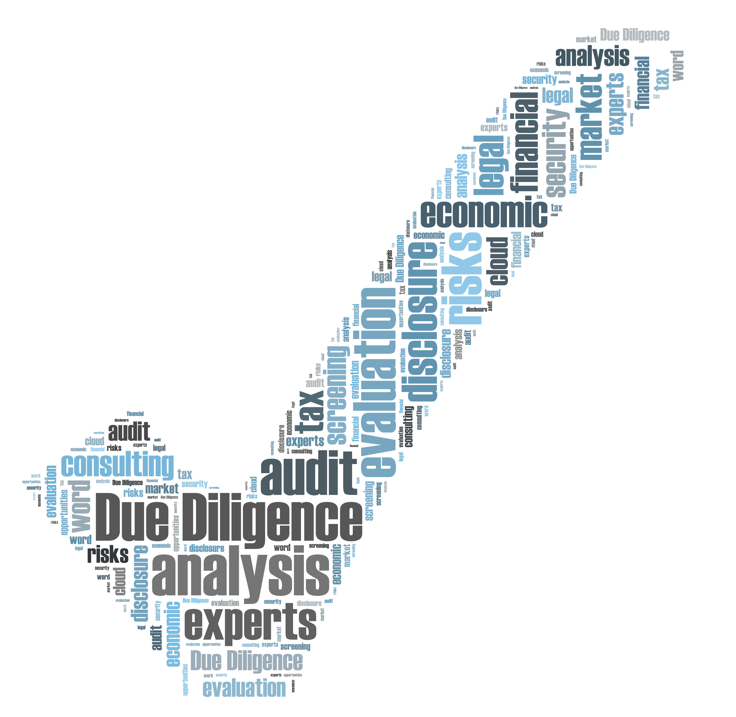
Activities
Receive
Review
Inspect
Report

Slide 17
District Assistance

Slide 18

District Support
The governing body of a school district must provide a committee with any necessary technical and administrative assistance

Slide 19
Jennifer Bradlee
Questions?
Jennifer.bradlee@bbklaw.com | ext. 3136

