Slide 1
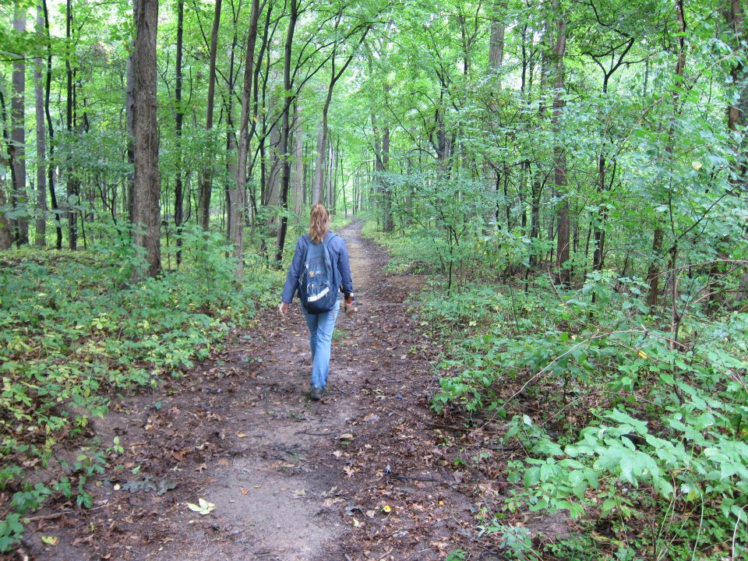
What do I study and why does it matter?
Phenology: when plants and animals do really important life events
Why are plants important?

Slide 2
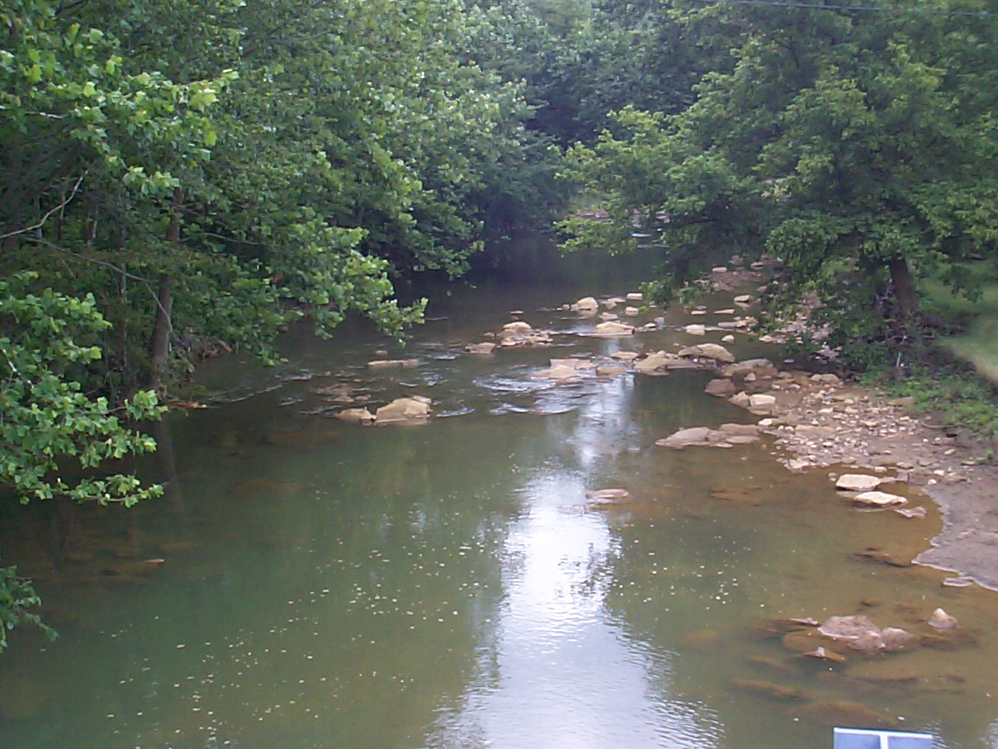
What other reasons are plants important?
Make oxygen
Take up carbon dioxide
Make food (sugars)
Add water to the air

Slide 3

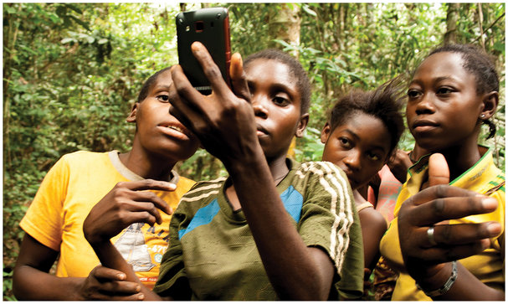
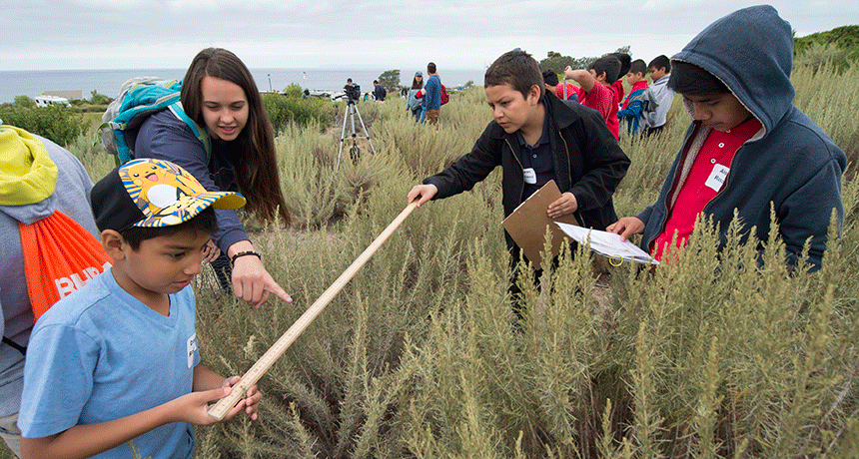
We need your help!

Slide 4
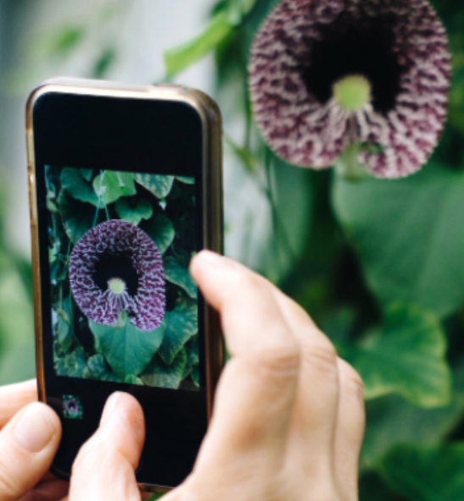
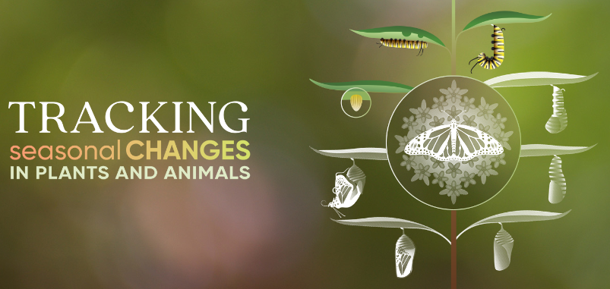
Help scientists like me fight global warming!
https://budburst.org/why-participate
https://www.usanpn.org/nn/become-observer

Slide 5
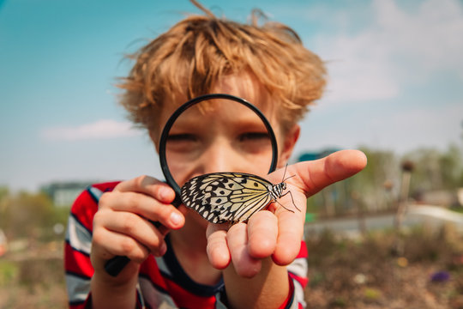
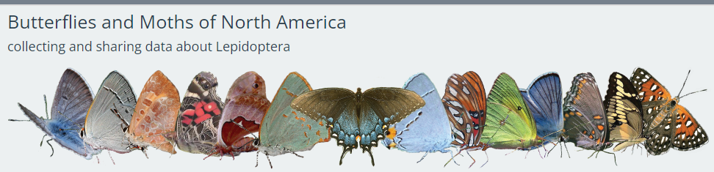
Take pictures of butterflies!
https://www.butterfliesandmoths.org/get-involved

Slide 6
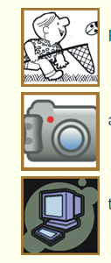
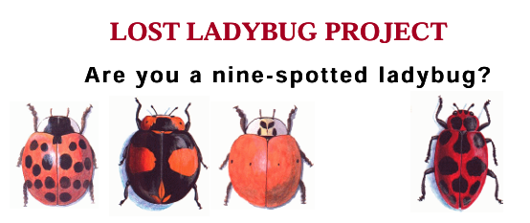
Look for ladybugs!
1. Find ‘em
2. Take a picture
3. Submit it!
http://www.lostladybug.org/participate.php

Slide 7
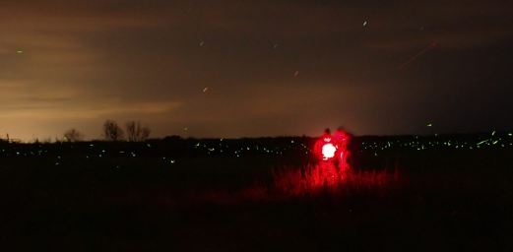
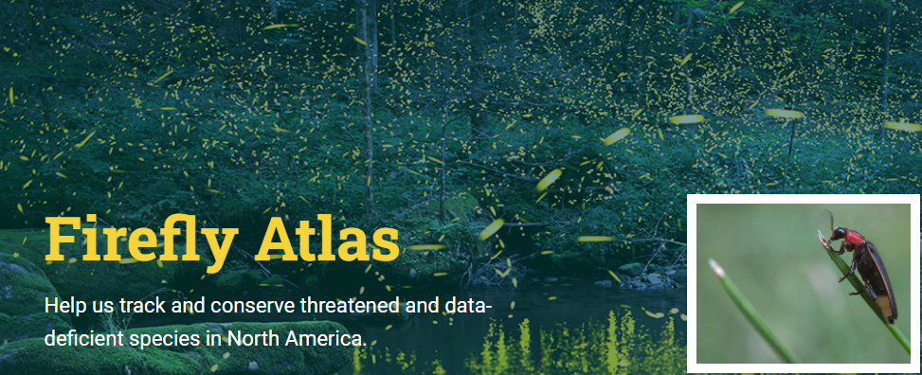
Look for Lightning Bugs!
https://www.fireflyatlas.org/get-involved/how-to-participate

Slide 8
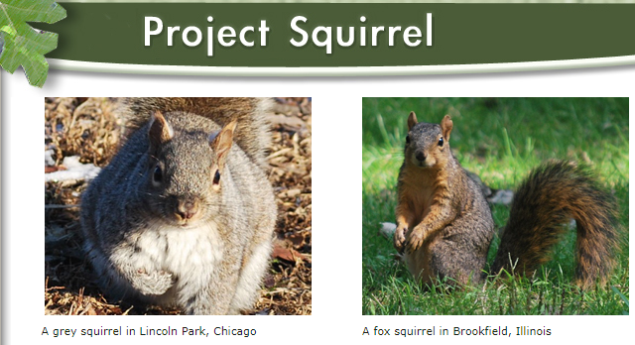

Squirrel!
https://projectsquirrel.org/index.shtml

Slide 9
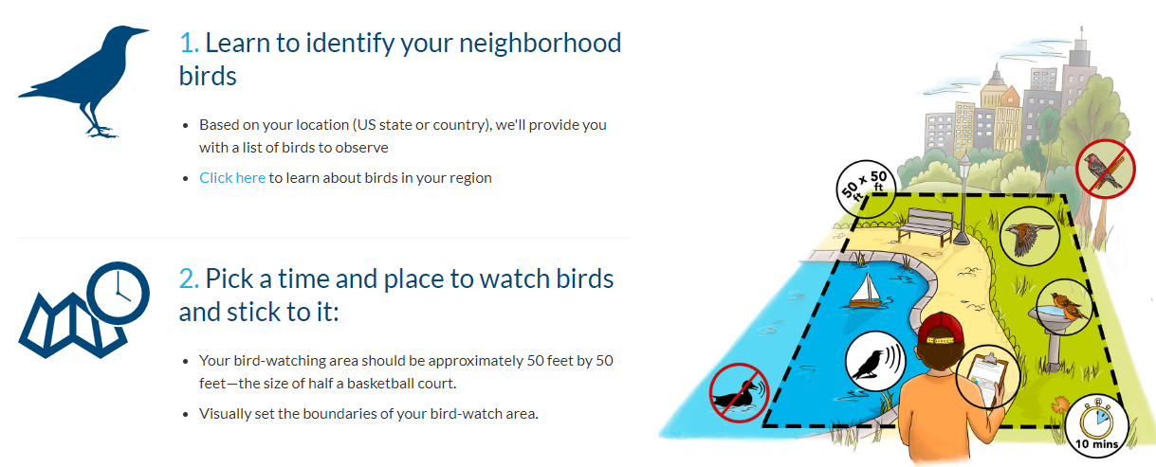
City birds!
https://data.celebrateurbanbirds.org/cub/instructions

Slide 10
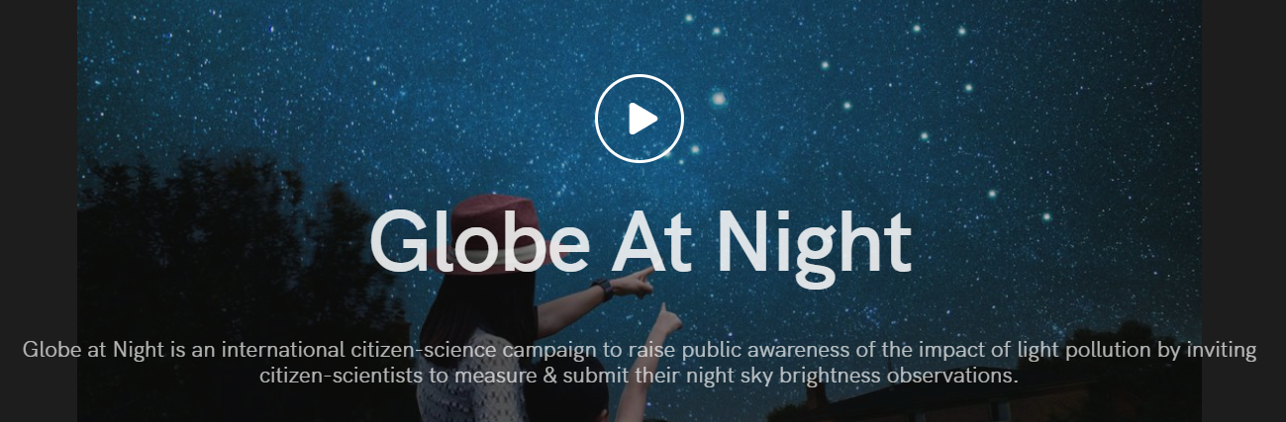
Look at the stars!
https://globeatnight.org/

