Slide 1

The Arc of Monmouth
Mike Garra
mgarra@arcofmonmouth.org
For people with intellectual and developmental disabilities

Slide 2

Introduction
Understanding the adult system of services
Two ways to receive services in DDD:
  Supports Program
  Community Care Waiver (CCW)
For people with intellectual and developmental disabilities

Slide 3
Where Do I Start?
Determination of Eligibility by DDD
    age18+ for determination
  age 21+ for services
  Medicaid Eligibility
  Living in unlicensed setting
    (with family or on own)
For people with intellectual and developmental disabilities

Slide 4
Next Steps: NJ CAT
Complete the NJ Comprehensive Assessment Tool (NJ CAT)
    Scored in areas of: Self-care, Behavioral, Medical
  Results determine individual’s Tier
    A, B, C, D, E – with or without Acuity
  Tier determines individual’s Budget
    DDD will notify you of the tier
For people with intellectual and developmental disabilities

Slide 5
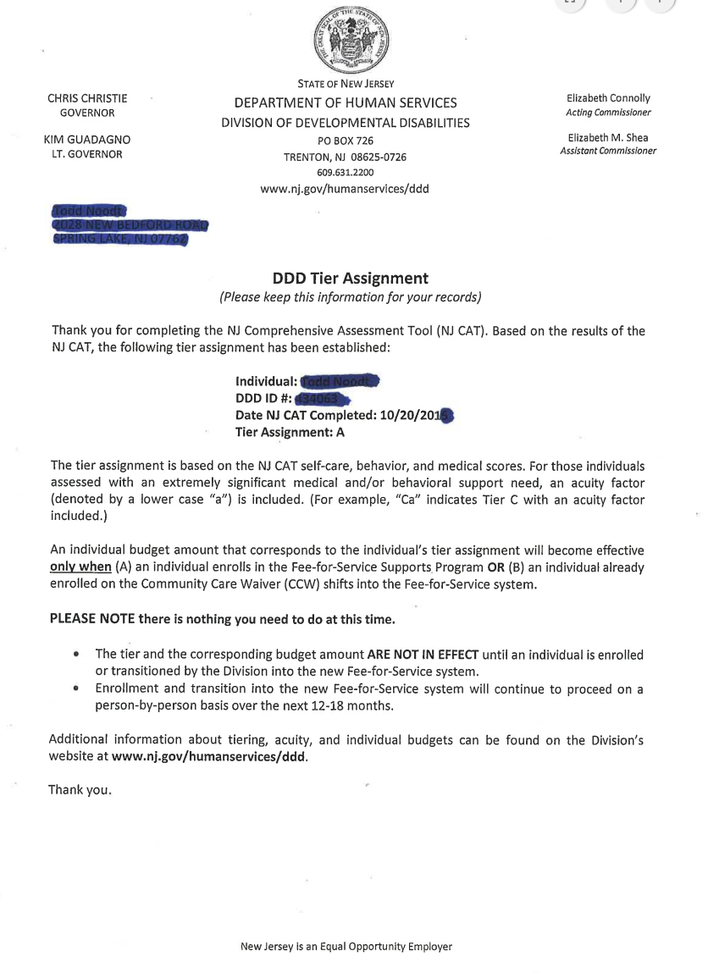
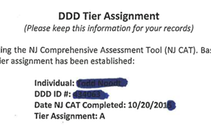
Sample Letter: DDD Tier Assignment
For people with intellectual and developmental disabilities

Slide 6
Tier Budgets (set by DDD)
Tier | Employment/Day | Individual/Family Supports | Supported Employment | Total Individual Budget
A | $14,000 | $5,000 | Available as needed | $19,000
Aa | $20,000 | $5,000 | Available as needed | $25,000
B | $18,000 | $10,000 | Available as needed | $28,000
Ba | $26,000 | $10,000 | Available as needed | $36,000
C | $22,000 | $10,000 | Available as needed | $32,000
Ca | $32,000 | $10,000 | Available as needed | $42,000
D | $33,000 | $15,000 | Available as needed | $48,000
Da | $47,000 | $15,000 | Available as needed | $62,000
E | $43,000 | $15,000 | Available as needed | $58,000
Ea | $63,000 | $15,000 | Available as needed | $78,000
For people with intellectual and developmental disabilities

Slide 7
Next Steps: Selecting a Support Coordinator
Select a Support Coordination Agency (SCA)
  If the individual does not select, one will be assigned
DDD will assign SCA
Support Coordinator (SC) will call to set up an intake
Takes 30 days to develop the NJ Individual Service Plan (ISP)
For people with intellectual and developmental disabilities

Slide 8
What Does a Support Coordinator Do?
Identifies the person’s support needs/preferences
  Develops NJ Person Centered Planning Tool
  Develops NJ Individual Service Plan (ISP)
Locates options for desired services based on funds available in the individual’s budget
Monitors the supports and services the person receives
Responds to emergencies and other service-related needs
For people with intellectual and developmental disabilities

Slide 9
What Are Your Responsibilities?
Be Ready With Information:
  Family’s Contact Info/Email
  Individual’s Medicaid Card Number
  HMO Case Manager’s Contact Info
Go to NJ Division of Vocational Rehabilitation Services (DVRS)
  An employment Goal MUST be in the ISP
For people with intellectual and developmental disabilities

Slide 10
Will the Individual Enroll in the
Supports Program?
What is it?
  Medicaid Waiver
Examples of Types of Services Available:
Assistive Technology
Behavioral Supports
Community-based Supports
Community Inclusion
Day Habilitation
Goods & Services
Prevocational Training
Respite
Supported Employment – Individual
Supported Employment – Small Group
Transportation
Vehicle Modifications
For people with intellectual and developmental disabilities

Slide 11
A Note about “Goods & Services”
Requires Special Permission
Must be delivered by an Approved Provider
Paid by “Fiscal Intermediary”
For people with intellectual and developmental disabilities

Slide 12
The Arc of Monmouth is Ready:
Support Program Services
Behavioral Supports
Behavioral Assessment
Implementation of Plan
Career Planning
Community-Based Assessments (Job Sampling)
Job Preference Inventories
Community-Based Supports
1-to-1 support staff to attend event, class, etc.
1-to-1 support staff assistance with daily living activities
Development of Behavioral Plan
Training/Supervision of Paid Caregivers
Periodic Reassessment
Identification of Career Options/Job Matches
Community Inclusion Services
Small group recreational activities (events, shopping, bowling)
Small group outings (festivals, museums, theater events, sporting events
For people with intellectual and developmental disabilities

Slide 13
The Arc of Monmouth is Ready:
Support Program Services
Day Habilitation
Day Programs (e.g. Achievement Centers)
Natural Supports Training
Training on:
Hoyer lift
ambulation/transfer techniques
diet/eating techniques
diabetes management
Prevocational Training
Job Clubs
Utilizing the One Stop and other related services
Classroom style programs/training/ experiences
Volunteer experiences
includes transportation
use of AT device
implementing behavior plan
For people with intellectual and developmental disabilities

Slide 14
The Arc of Monmouth is Ready:
Support Program Services
Supported Employment – Individual Support
Training and systematic instruction
Job Coaching
Benefit Support
Job Development
Travel Training
Training on integrating into the workplace
Job Site Analysis
Supported Employment – Small Group Support
Mobile crews
Group placements
Social enterprises in which employees are making commensurate wages
On-site job training
Job development
Job site analysis
Transportation
Train/Bus fare
Taxi/Car Service fare
Individual provider fee
Transportation provider fees
For people with intellectual and developmental disabilities

