Slide 1

SORA
(The Student Reading App) Tutorials

Slide 2
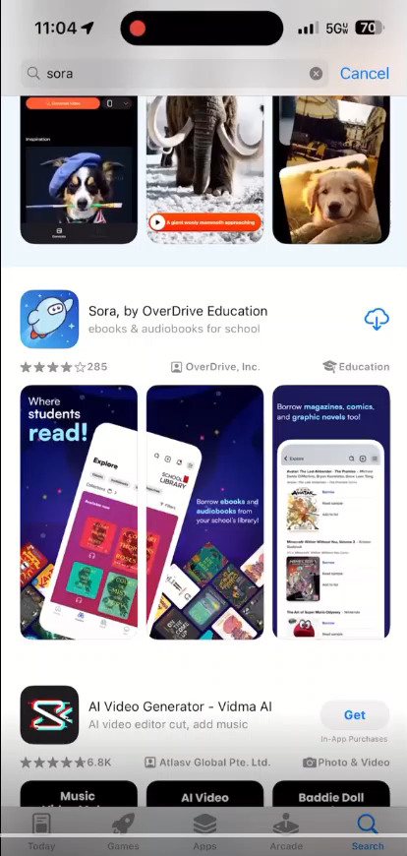
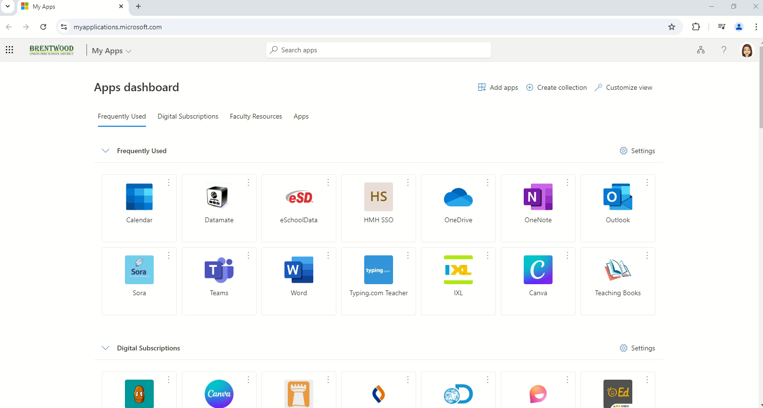
Accessing Sora
Phone/Tablet App
MyApps

Slide 3
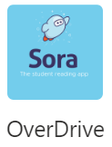
eBooks and Audiobook Access
Sora is a program run through Overdrive. Overdrive is the database that most libraries offer their patrons eBooks, audiobooks, and more. Brentwood students can access SORA by clicking the “Overdrive” link on MyApps.

Slide 4
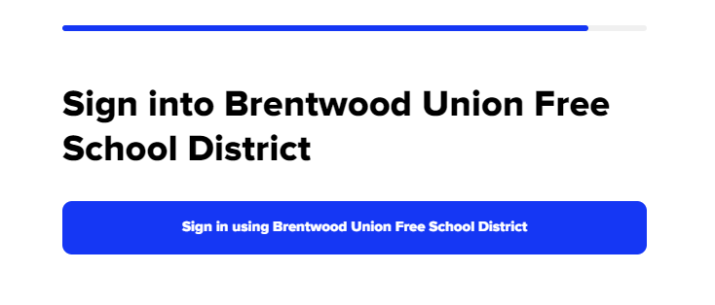

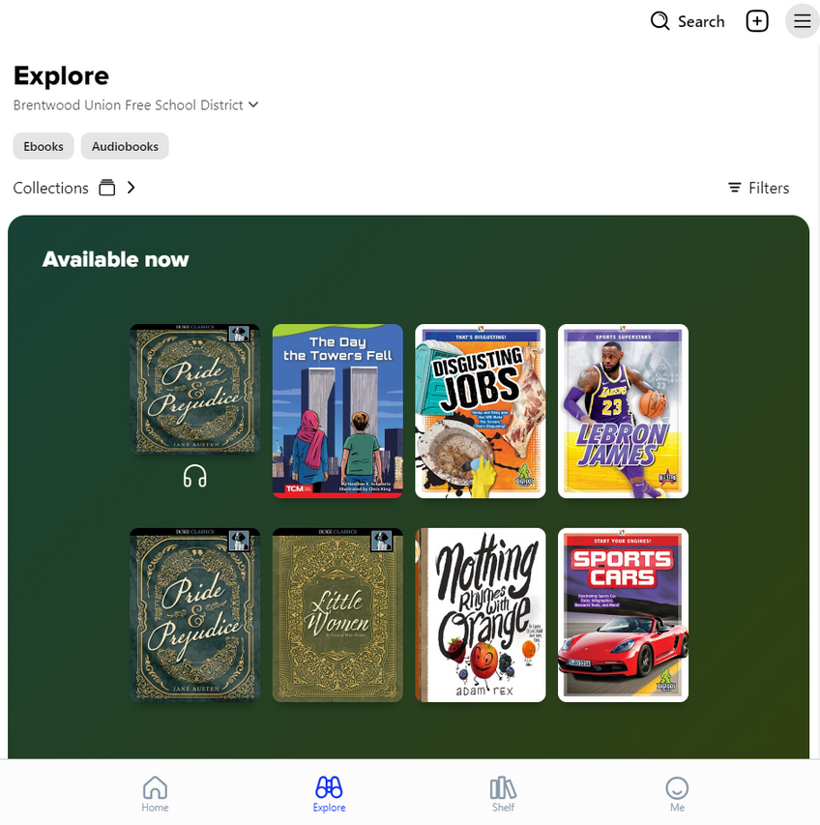

How do I get to the site?
Once you’ve clicked the Overdrive icon in “My Apps”, you can sign in using Brentwood UFSD.
Once you’ve signed in, it will bring you to the explore page. From this page, you can click the three lines in the corner (circled in blue) to access your account settings.
You can also click “Filters” (circled in red) to set what types of books come up for you based on reading level, topic, language, etc.

Slide 5
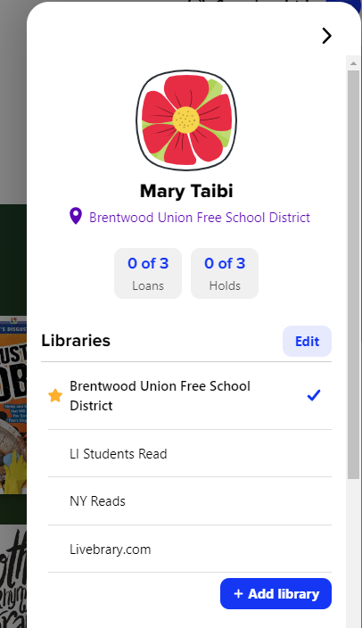
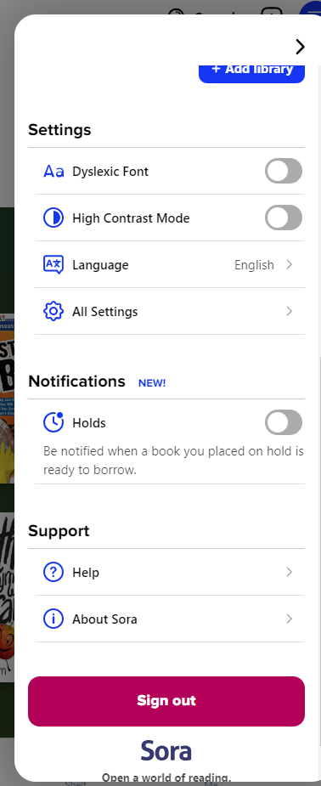

Settings
Your account will have you name and a place for you to choose your profile picture. The list of libraries you can borrow books from will be listed below your name. All the libraries shown on this picture are free to join.
In settings, you can also change the text is presented, your preferred language, and set up notifications.

Slide 6
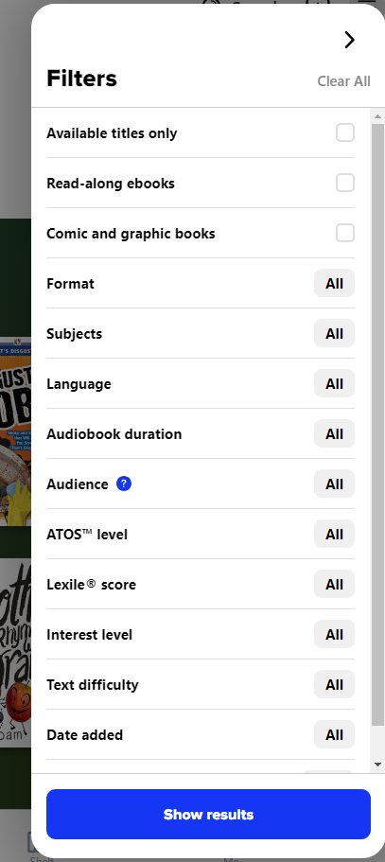
Sora will offer you many different filter options.
You can find books in different languages, change the language setting of the app, choose a book based on reading level, topic, or age.
Filters
in
“Explore”

Slide 7
Tutorial Videos
and Additional Features

Slide 8
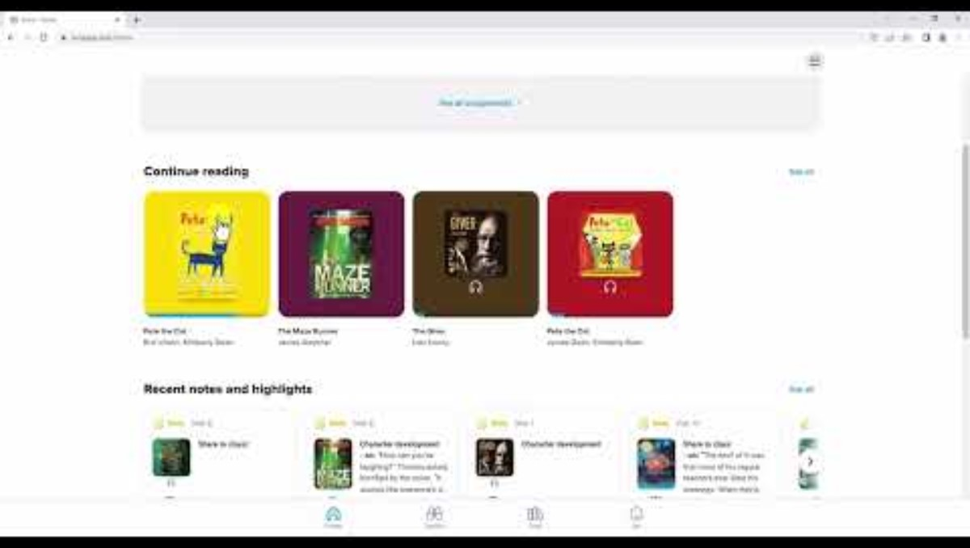
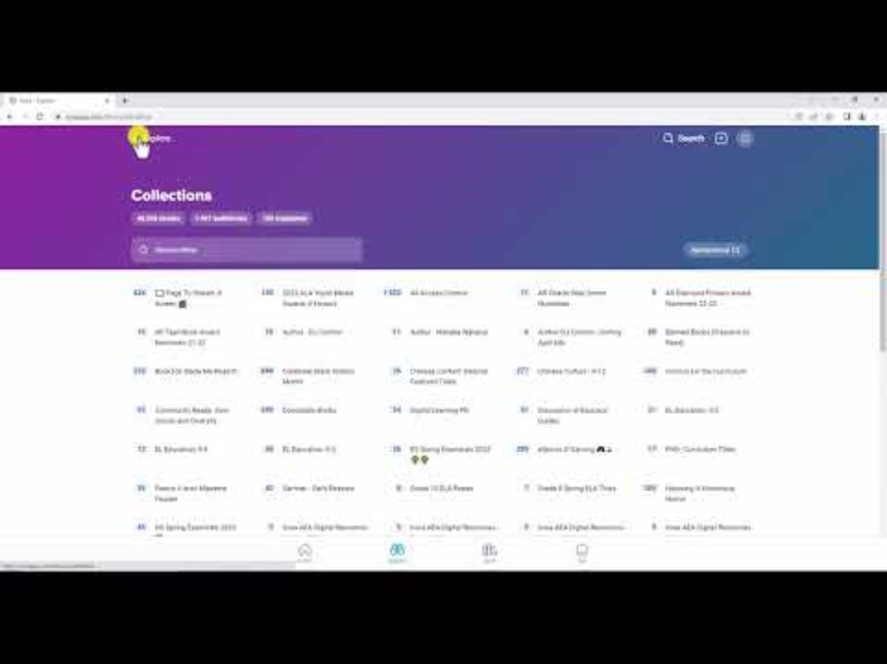
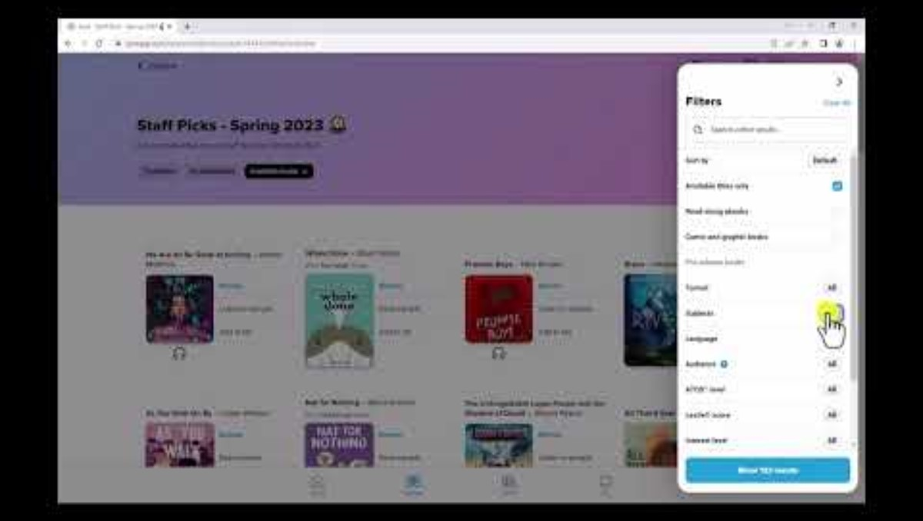
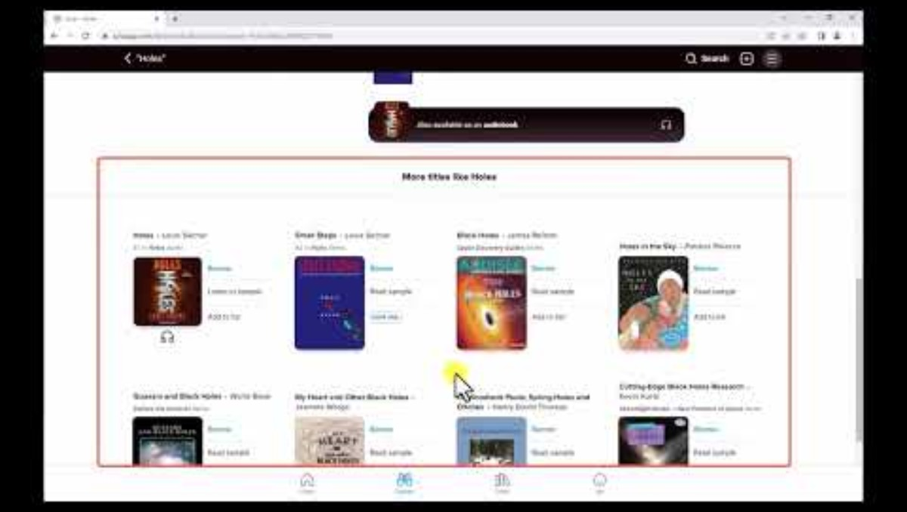
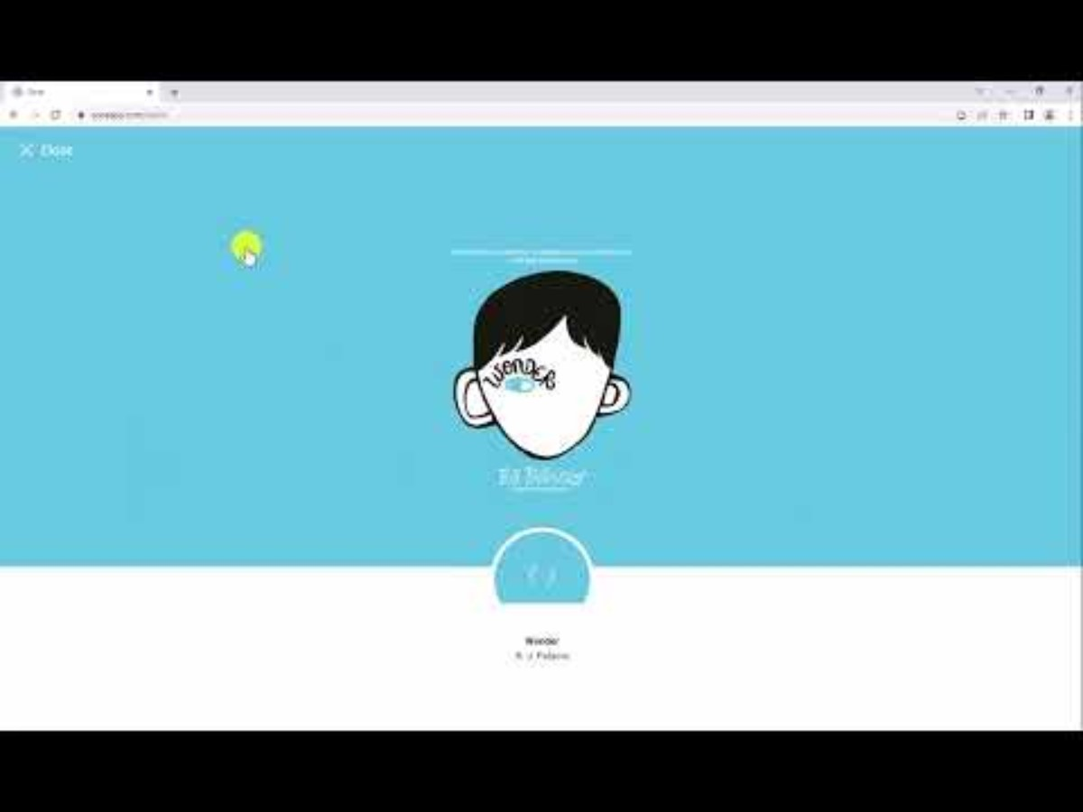
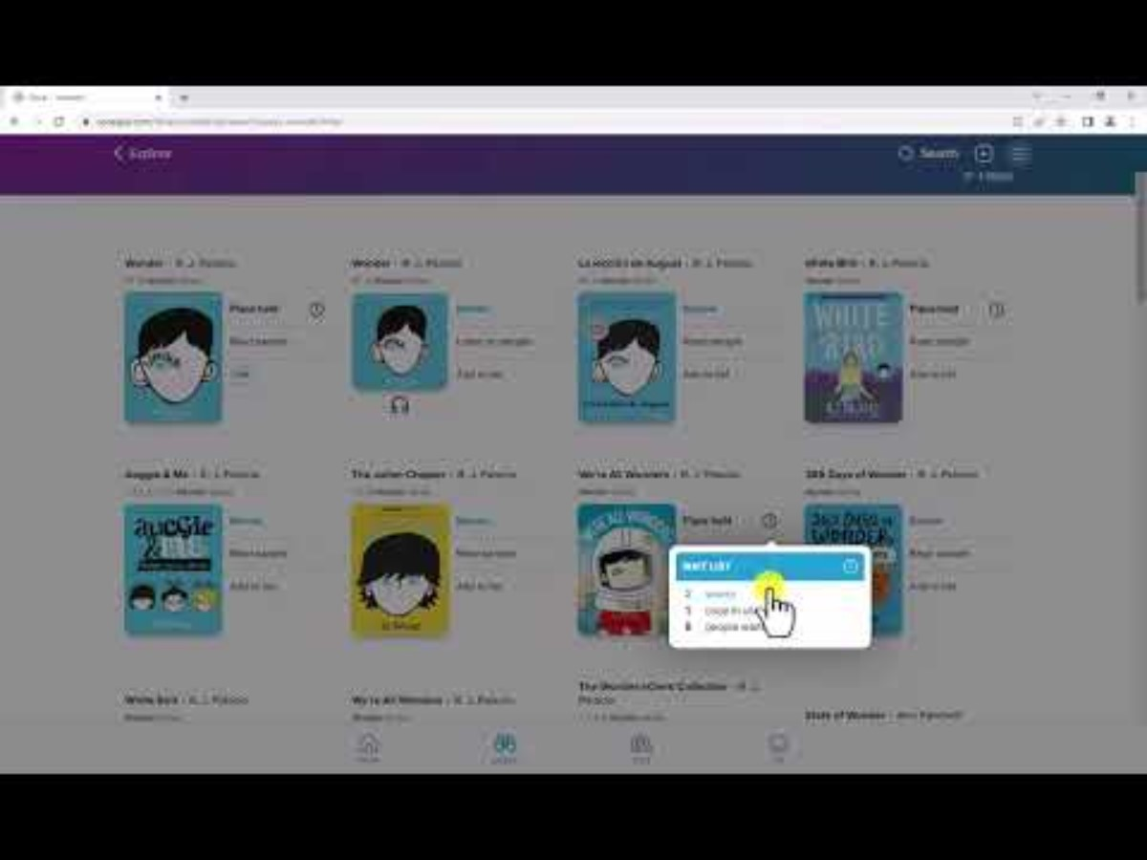
Accessing Books
Navigation
Browse Collections and Search for Books
Sort and Filter Books
See Book Details
Borrow a Book
Place a Hold

Slide 9
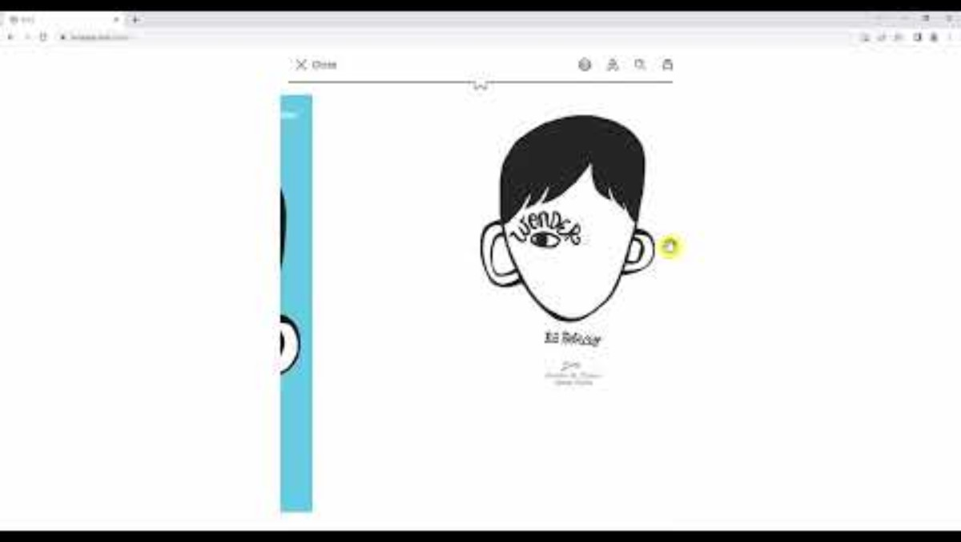
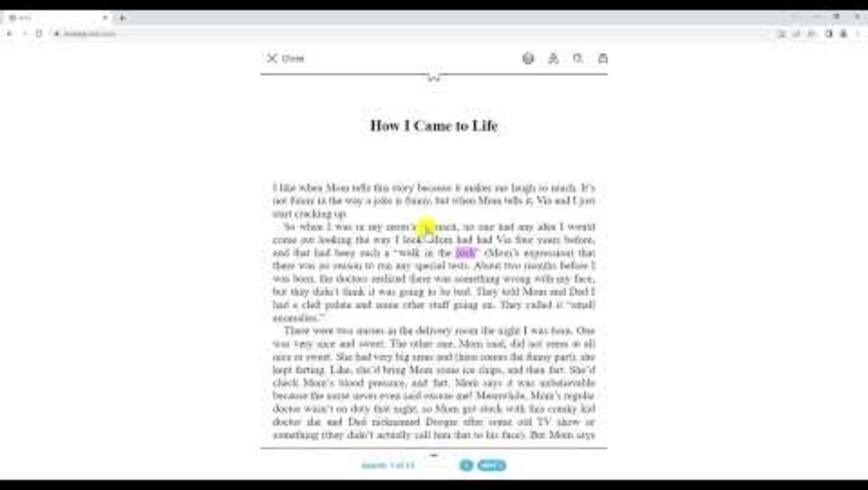
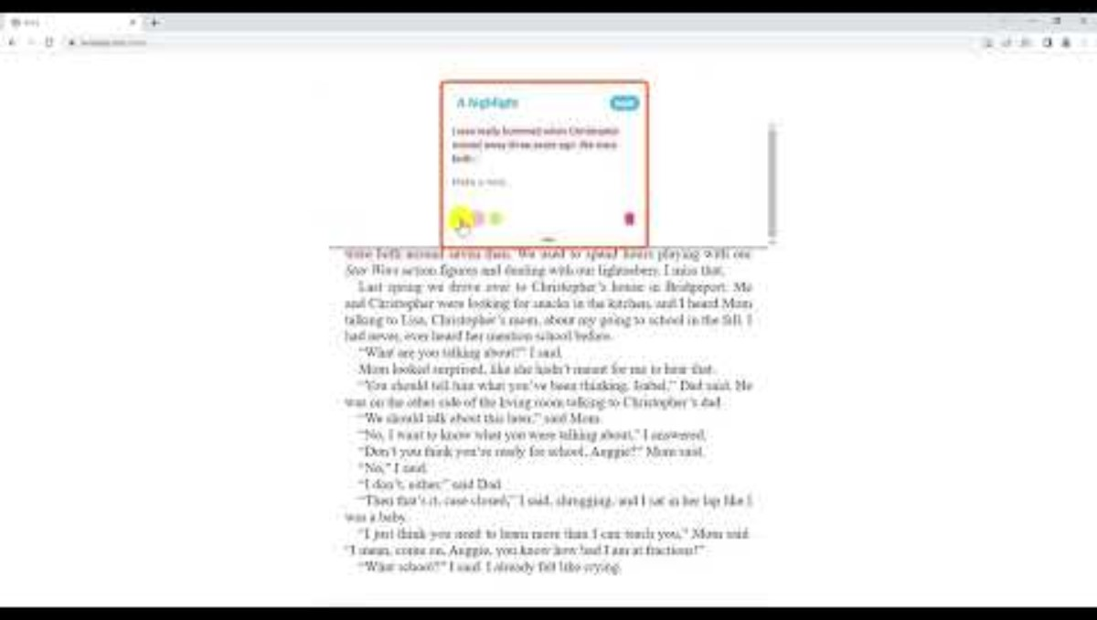
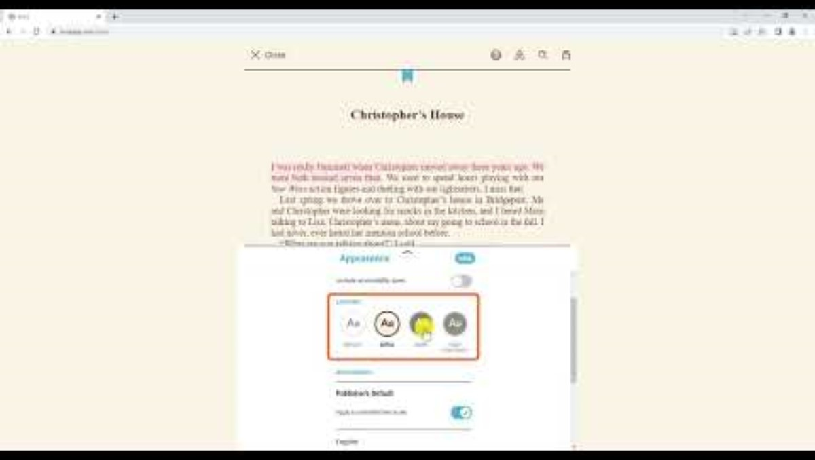
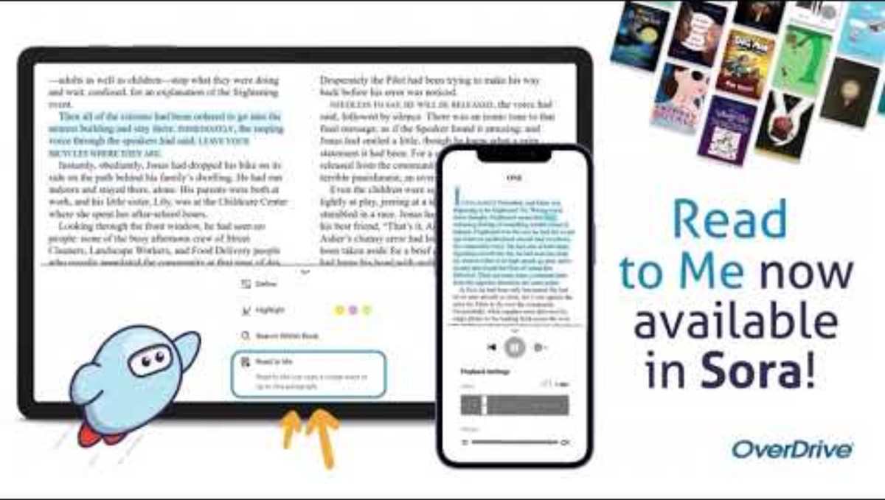
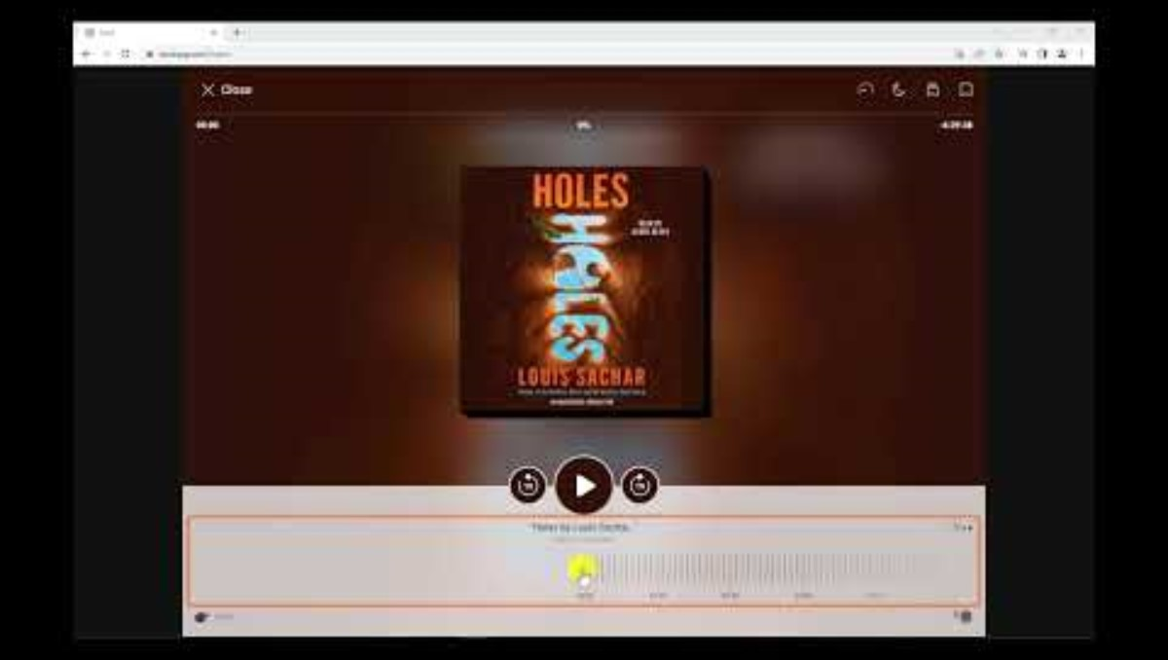
Reading and Listening
Begin Reading
Navigate an eBook
Define, Bookmark, Highlight, and Annotate
Customize Settings
“Read to Me” Feature
Audiobook

