Slide 1
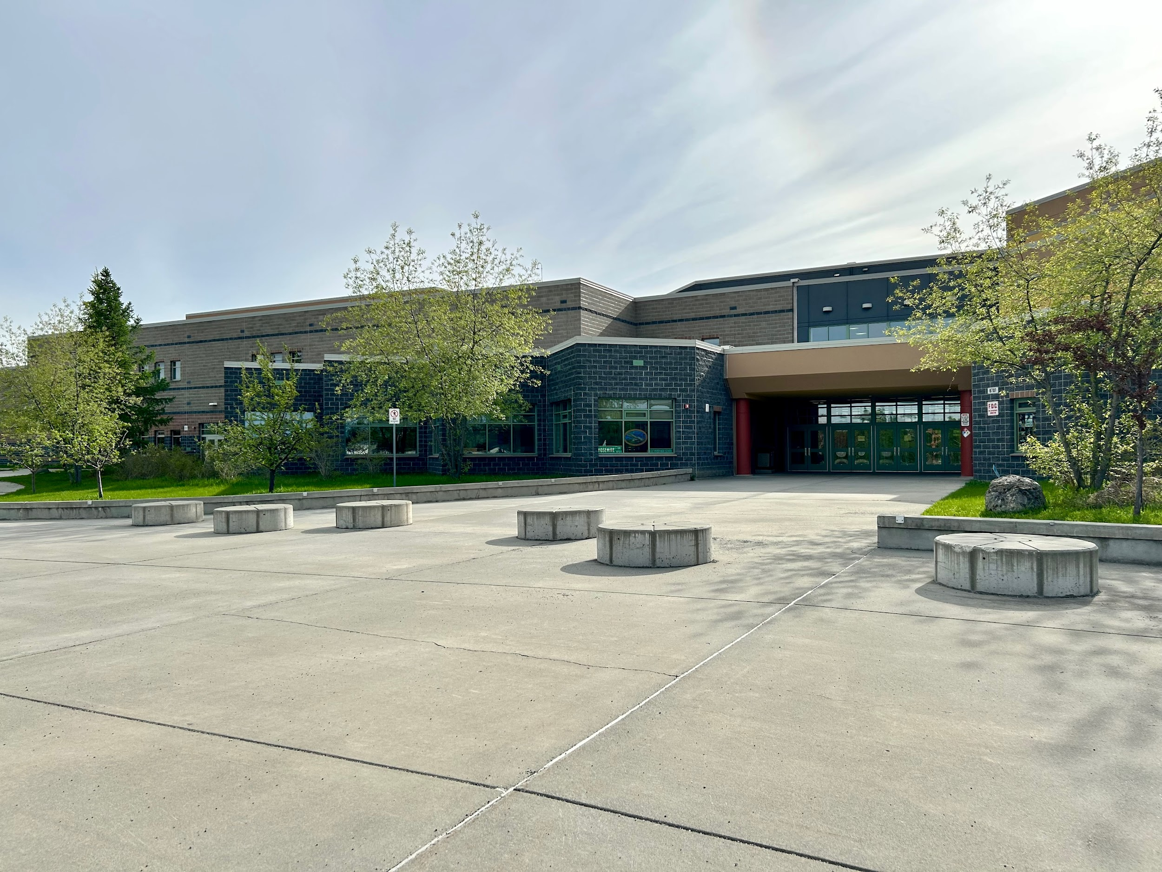
Welcome Freshmen!
Things you want to know but may not want to ask ;0)

Slide 2
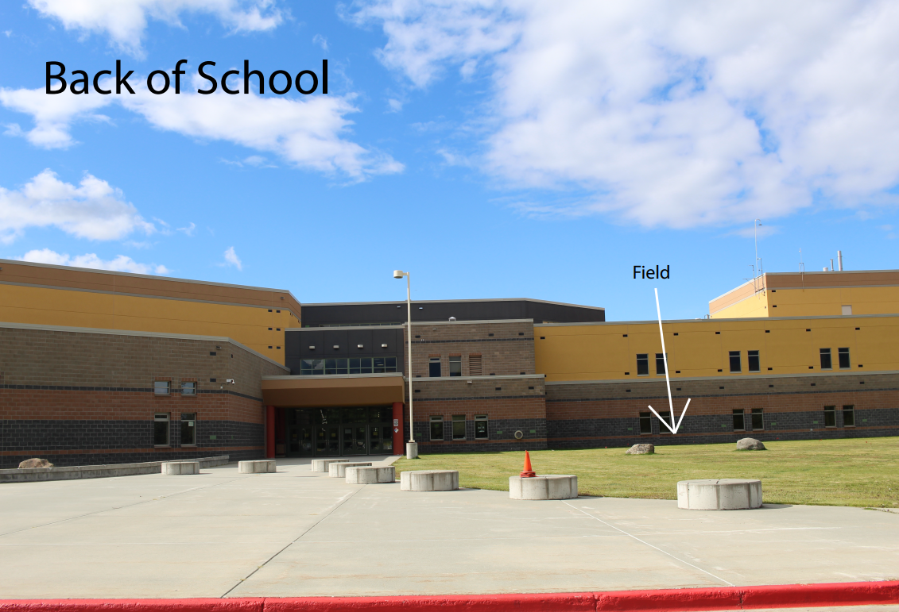
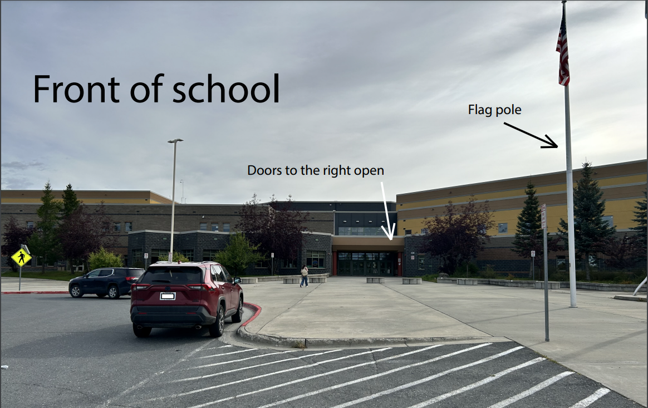
Finding your way around:
Bus drop-offs are in the back of the school; parent drop-offs are in the front of the school. Student parking is only in the front parking lot.

Slide 3
Where is my classroom?
All classrooms with a 100 in the number (A102, F105, H114…) are on the first floor of the school. Classrooms with a 200 in the number are on the second floor.
Our classroom numbers do not all follow a sequence. If you’re trying to find a particular class, it’s helpful if you know the name of the teacher.
There are maps in the front office and posted in the hallways if you need one.

Slide 4
What are the commons?
The main commons is located between the two main entrances to the school. It is the “common” area that connects the two.
The green commons is downstairs (think green grass on ground level) and the purple commons is upstairs. These are areas where lockers are located, but classes use them for group exercises, too.

Slide 5
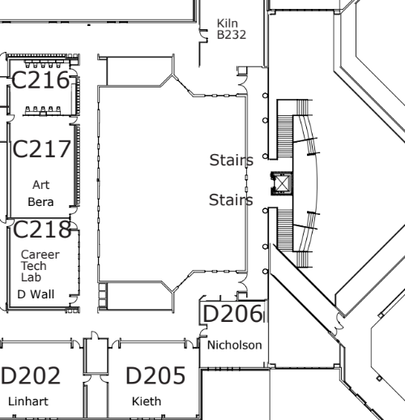
Where is the art classroom?
The art classroom is down the hallway that overlooks the library on the second floor.
C217
Art
Looking
Into the
library
Commons
Go either way

Slide 6
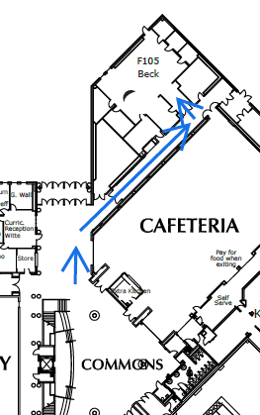
Where is the choir room?
F105
Choir
The choir room is down the hallway
that is across from the curriculum
office on the first floor.

Slide 7
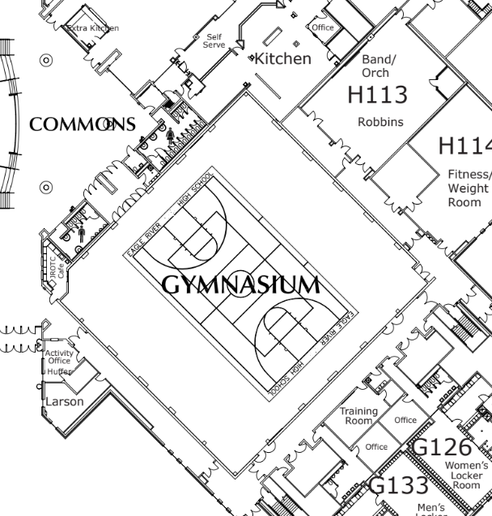
Where is the band room?
H113
Band
The band room is down the hallway that is next to the gym (follow it all the way around the gym to the end).

Slide 8
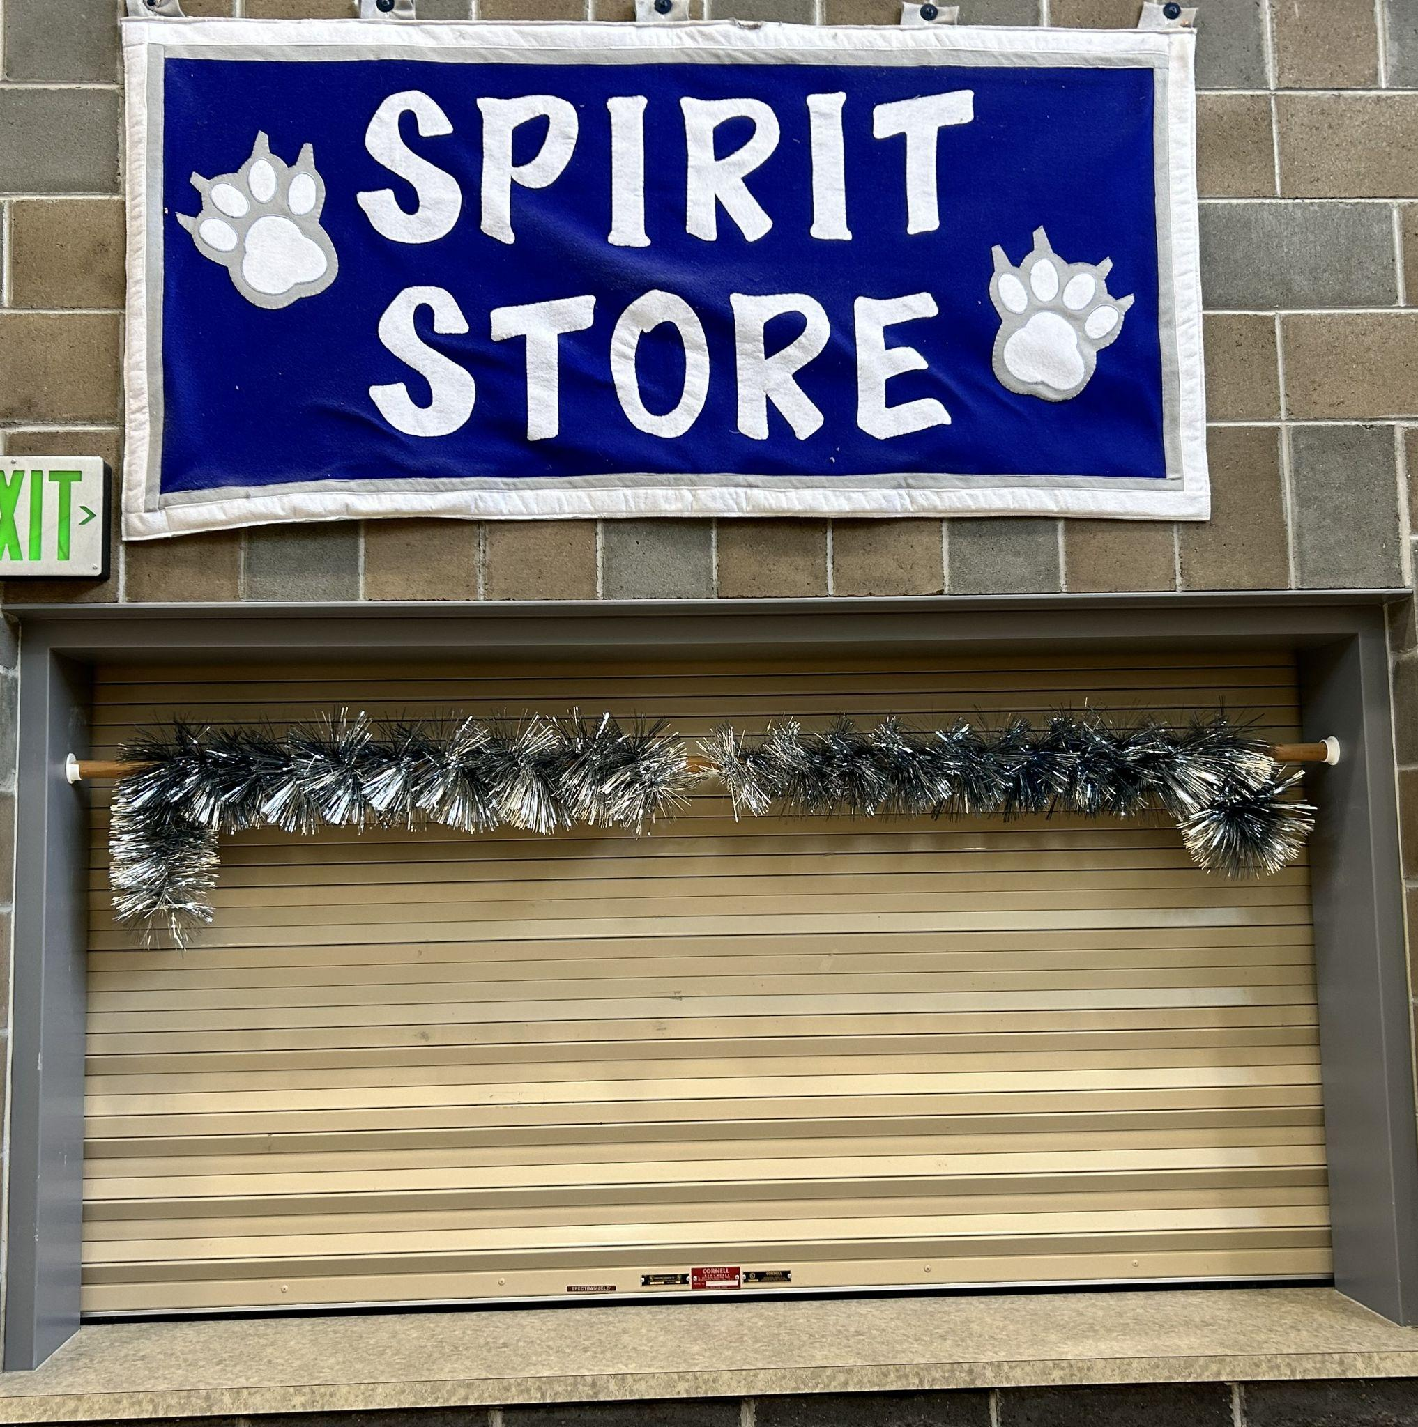
What is the Spirit Store?
The Spirit Store is where you can buy Eagle River High School-branded clothing and gear. (You’ll need some for gym class.) It is typically open on Thursdays during lunchtime. Cash, checks and credit cards are accepted.
We have “Spirit Day” every Friday. You’re encouraged to dress in our school colors or spirit wear. (Some teachers even hand out candy if you do!)

Slide 9
Where can I exchange my Chromebook or get a new Chromebook?
If you have an existing Chromebook that no longer functions properly (but has not been obviously abused), bring it to the library or the tech office located beside the library to exchange it.
Never had a Chromebook before and need one? Head to the same places and they’ll get you one.
Need a charger? Same place! :)

Slide 10
How do I login to Q/Student Connect?
What is it, anyway?
You’ll frequently hear your teachers refer to Q or Student Connect. They’re the same thing. You will use your student ID as your username to login and your default password will be the first letter of your name (capitalized) and then your student ID number (ex: A1234567). If you want, you can reset your password to something you like better in the “My Account” tab once you’re logged in.
Q/Student Connect is a useful resource that allows you to see your assignments and grades. You can also find out where your locker is, the combination to your locker, who your counselor is, and what your schedule looks like for the semester.

Slide 11
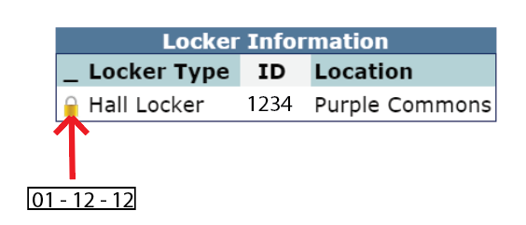
All About your locker:
How do I find my locker? When you login to Q/Student Connect (this doesn’t work in Parent Connect), click on the Enrollment tab in the side menu. You’ll see a box like this:
The ID tells you what locker you have. Click on the yellow lock symbol to reveal your locker combination.
How do I unlock my locker? Watch this video, it will help a lot. Also, it’s okay to ask for help. We’ve all been there.
Do I actually have to use my locker? ERHS has a “no backpacks/bags in class” policy, so you’ll want to leave that stuff in your locker.

Slide 12
What is my school email address?
You don’t have one. If the school asks you for an email address, they mean your personal email address. Your ASD login (lastname.firstname@asdk12) is not an email address.

Slide 13
The odd stuff:
Can I chew gum? Yes, you’re in high school. We assume you’re mature enough to know how to keep it out of your hair and where to throw it away properly. Please do so.
Where can I eat lunch? Students aren’t required to eat in the cafeteria. Grab a buddy and form a lunch group in a classroom or visit one of the clubs that meets during lunch and get involved in something you’re interested in.

Slide 14
The odd stuff:
Can I do band/choir and play sports? Yup. Sure can.
How do I sign up for sports? The easiest answer is to visit our website. Many sports start before school does, so pay close attention to the dates. You can join a sport after it has already begun, however, you might not be able to count it toward a PE waiver.
Should I join a sport? Absolutely! Joining a sport or club is an excellent way to start making friends. Don’t be intimidated if you don’t already know someone, or if you’re not the next Olympic gold medalist. We have activities for everyone at every ability.

Slide 15
The odd stuff:
Are phones allowed in the classrooms? During class time, phones (earbuds, smartwatches…etc.) have to be put away and out of sight. You can use them during passing.

Slide 16
The odd stuff:
What do I do if I need to leave school early? Your parent has to call our attendance line or use their Q/Parent Connect to let us know what time you need to leave. You will be sent a blue pass with the time you’re scheduled to leave. You can just leave once it’s that time. Just sign out at the main office on your way out, your parent doesn’t need to come inside.
What if I’m going on vacation? If you’ll be out of school for more than five days, you have to fill out a prearranged absence form. This form requires you to meet with each of your teachers before you leave, so it’s best to do it at least a week before you go.

Slide 17
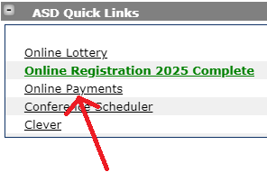
The odd stuff:
I signed up for a class that has a fee, where can I pay it? Class fees and activity fees can be paid through Q/Parent Connect. This is also where your parent can add money to your cafeteria account, or buy an activity sticker (which is a great deal if you want to go to the games)!

Slide 18
The odd stuff:
I have another question, who can I ask? Call our main office, 907-742-2700, we would love to hear from you!

