Slide 1

Class of 2026:
Academic Planning Meetings
Murrieta Mesa High School
Notes:
Presentation for:
What is financial aid
SAT and ACT
A-G Requirements
CCGI
Parchment Official Transcripts
Resume
CSU Direct

Slide 2
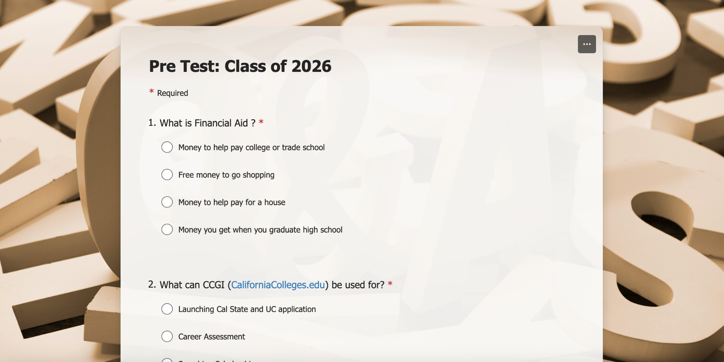
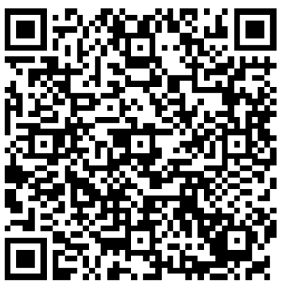
Survey Time!

Slide 3
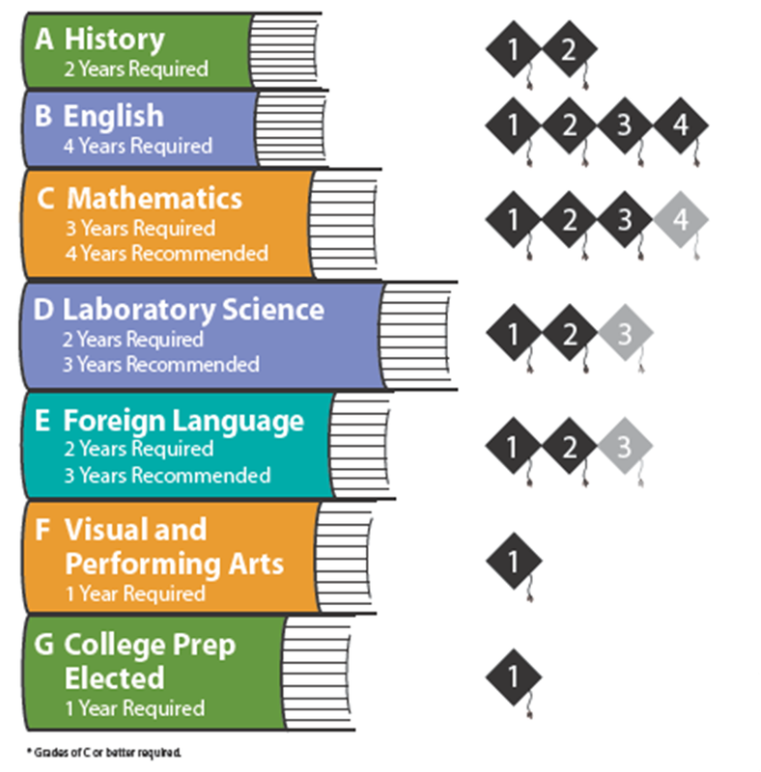
A-G Requirements

Slide 4
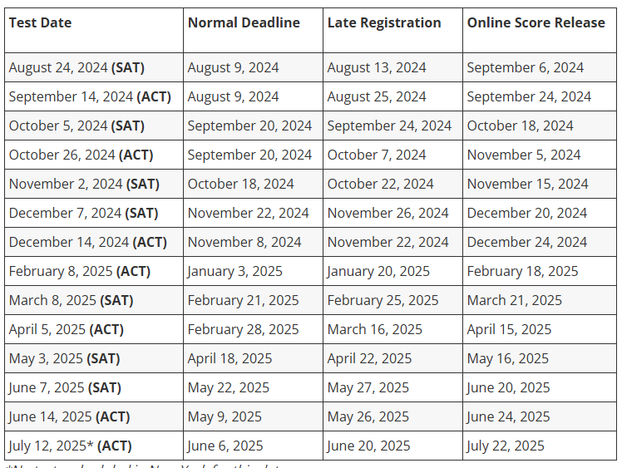
Who needs to take the SAT and ACT?
The Scholastic Assessment Test (SAT) and American College Testing (ACT), are both standardized tests used for some college admissions in the US.
They are designed to measure a student readiness for college-level work.
Cost: $68
Fee waiver for students who qualify for free/reduced lunch program

Slide 5
What is CSU Direct?
Benefits:
Eligibility:
California State University (CSU) Direct Admission Program is a pilot program that automatically admits eligible high school seniors to participate in CSU campuses.
Students can receive a coupon code for free applications to the participating universities.
Students receive official acceptance letters from the universities.
Students must be graduating seniors.
Students must have completed their A-G Requirements.
Students must have a GPA of 2.5 or higher by the end of their junior year.

Slide 6
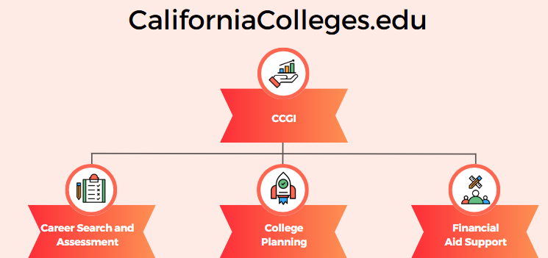

What is California Colleges?
The CCGI website helps guide you to discover your interest and values
Find careers, colleges, or specific trainings to reach your goals.
You can learn how to find money to pay for college.
Launch college and financial aid applications directly from the website.
You can monitor all of your progress in just one place!

Slide 7
What is Parchment?
Create an account using your Personal Email
This is a fast, secure way to send and track your transcripts. Parchment is the recommended & most efficient option complete with tracking and email notification.
There is a $4.40 service charge for official transcript and no charge for unofficial transcripts.
Orders are typically processed within a 48 hour period if received M-F (before 1pm on Friday.

Slide 8
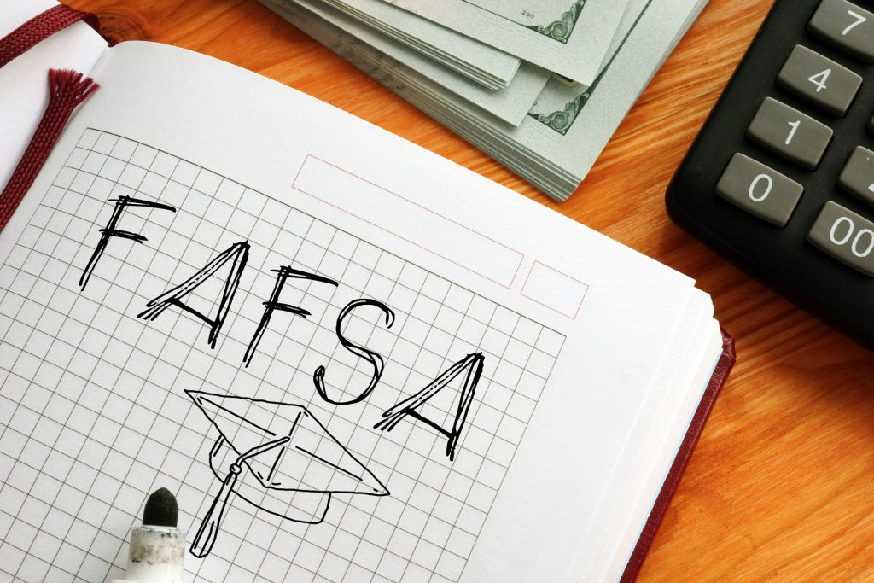
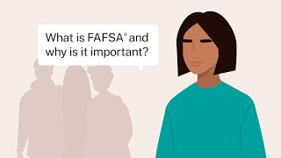
What is Financial Aid?

Slide 9
It’s time to work on your Resume!
What to include in your resume:
A resume is valuable because it helps showcase your skills, experiences, and achievements for potential employment.
A resume can help students stand out in their college applications.
Education, including your GPA
Job history, including paid employment and volunteer work
Clubs, sports, activities, and leadership roles
Achievements, awards, and honors
Special courses or areas of interest
Additional skills or training

Slide 10
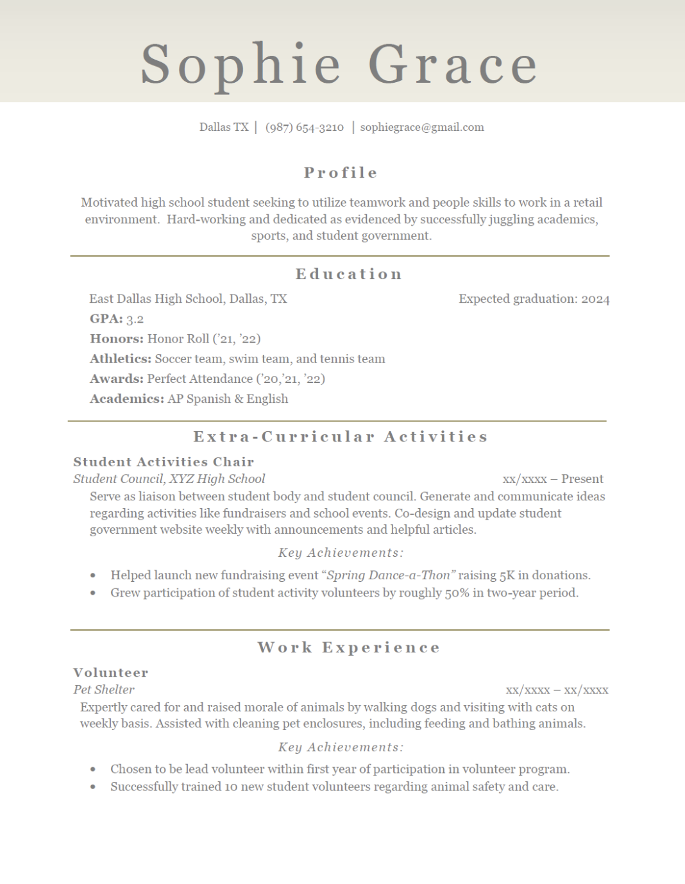

Resume Example
Canva
Google Docs Resume Templates
Microsoft
MyPerfectResume
Indeed

Slide 11





Extra Tools & Resources

Slide 12
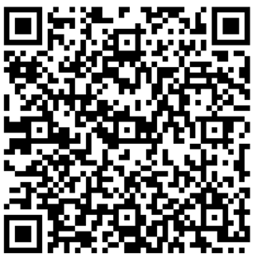
Survey Time!

Slide 13
Is your academic plan up to date?
GO TO SCHOOL WEBSITE
Click on STUDENTS
Click on Learning Links
Click
on AERIES

Slide 14
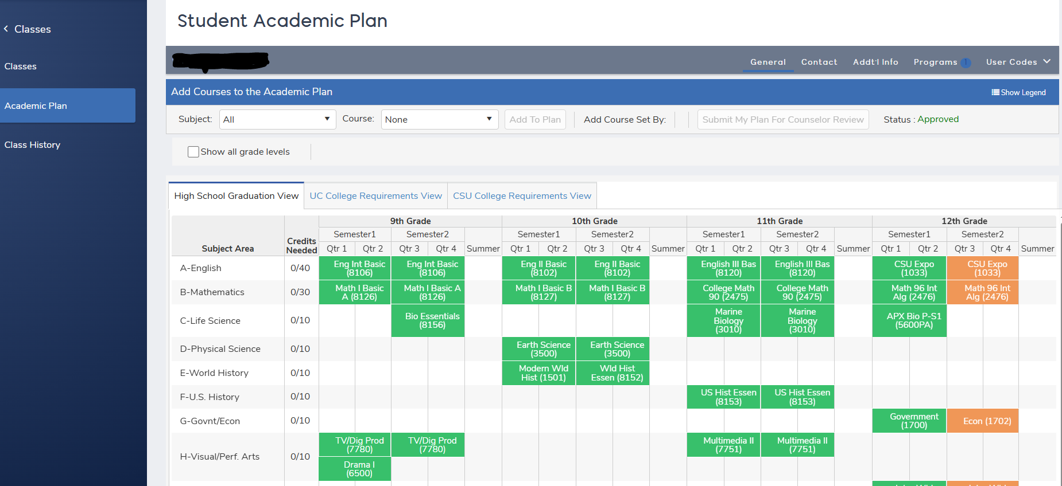
Academic Plans
Green=Classes Completed
Orange=Classes in progress
Blue =Classes planned for future

Slide 15
Graduation requirements
You should have at least 7 classes in your academic plan (this includes early release and TA (forms can be picked up from student services)
Core classes you need senior year (English and Gov/ Econ)
You may also need to make up any D’s or F’s earned for graduation or A-G requirements.
Additional graduation requirements
-Junior reflective task
-Senior culminating Project
-40 hours of community service

Slide 16
Counselor 1:1’s
Counselors will be calling you out to meeting with you from February 10th - February 18th
Things counselors will review:
Your transcript and Grad status/A-G
Your academic plan for next year
Summer school info
College and career prep
If you are not called out within this time frame please reach out to your counselor to request a meeting.
Reminder:
These meetings are for YOU. Come with questions and please be open so that we can help support your goals.

Slide 17
Thank you for your time!

